Slide 1
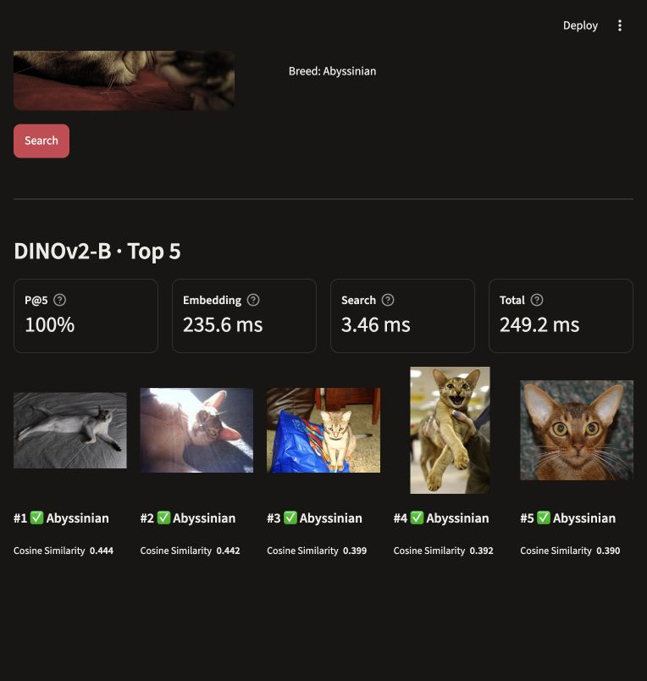
Visual similarity
search
A query photograph becomes a ranked list of similar pets. We compare DINO and DINOv2 with supervised DeiT using the same image gallery.
Research question: How do these representations differ in retrieval quality and embedding speed?
The interface lets us compare model outputs for the same photograph.

Slide 2
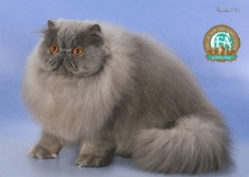
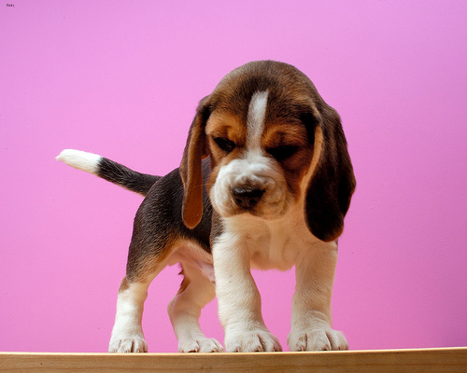
Dataset
Oxford-IIIT Pet contains 7,349 photographs of cats and dogs across 37 breeds. Changes in pose, background and lighting make same-breed retrieval a useful visual search task.
Partition | Images
Gallery | 1,840
Validation queries | 1,840
Official test queries | 3,669
Split: We divide the official trainval set equally into gallery and validation queries, stratified by breed with seed 42. The official test set stays separate for final evaluation.
Preprocessing: We convert images to RGB, resize the shorter side to 256 pixels and center-crop to 224 × 224. All models use the same ImageNet normalization.
Persian
Beagle
Dataset: robots.ox.ac.uk/~vgg/data/pets/

Slide 3
Evaluation
Relevance: An image is relevant when its breed matches the query. Breed labels approximate visual similarity.
Quality metric | What it measures
Precision@5 and @10 | The fraction of returned images that match the query breed.
Recall@5 and @10 | The fraction of all relevant gallery images retrieved.
Hit@5 | Whether the top five include at least one same-breed image.
Speed metric | Timed operation
Gallery build (s) | Extracting embeddings for the full gallery.
Preprocessing (ms) | Preparing one query image for the encoder.
Query embedding (ms) | Encoding one query image as a vector.
Search (ms) | Finding the five closest gallery vectors.
Quality scores average over queries within each split. Runtime summaries report component medians.

Slide 4
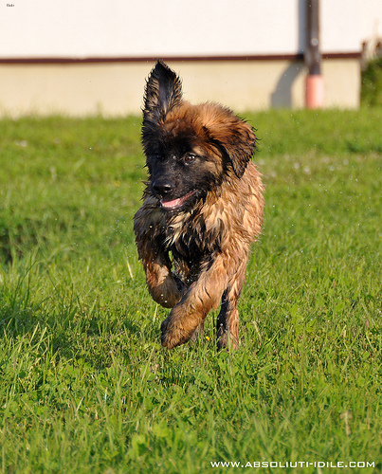
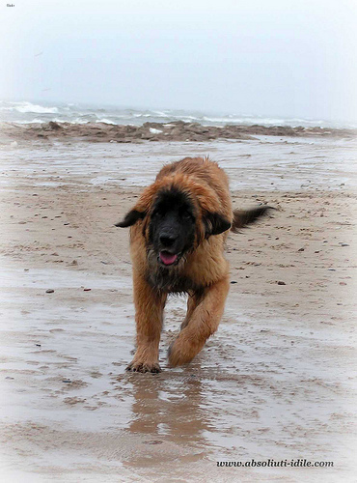
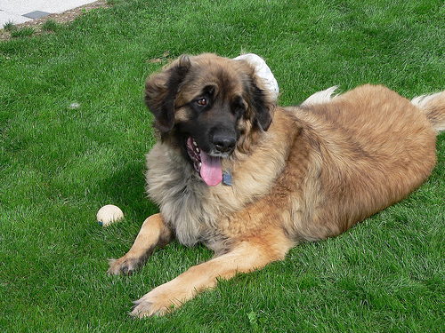
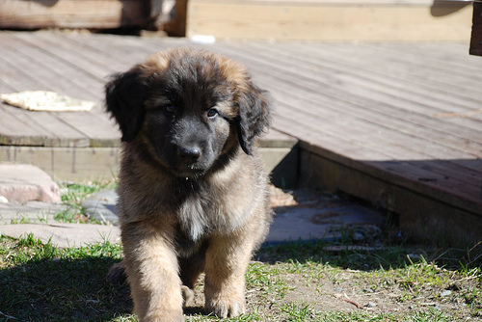
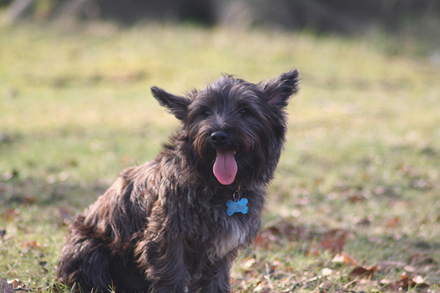
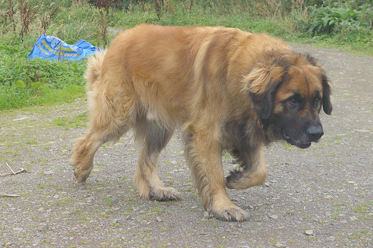
Retrieval pipeline
Each encoder turns the photograph into a normalized vector. We rank the gallery by cosine similarity and return its closest images.
Image
transform
Frozen
encoder
Unit
vector
Cosine
similarity
Query image
Top-5 results
Pretraining | Models | Feature size
Self-supervised | DINO-S and DINOv2-B | 384 / 768
Supervised | DeiT-S and DeiT-B | 384 / 768
All encoders are frozen and share the same preprocessing. Breed labels enter evaluation only.

Slide 5
Retrieval quality
DINOv2 retrieves the highest share of same-breed images. Supervised DeiT-S also outperforms the original DINO, so self-supervision alone does not determine quality.

Slide 6
Speed
Model | Gallery build (s)
DINO-S | 8.14
DeiT-S | 7.83
DINOv2-B | 28.16
DeiT-B | 20.62
Per query: Preprocessing takes about 5.6 ms and cosine search takes 0.22–0.25 ms. Most model-dependent latency comes from computing the embedding.
Timing setup: Tesla T4, 200 identical queries, batch size one and three repeats. We report component medians. Gallery embeddings are built offline and reused.

Slide 7
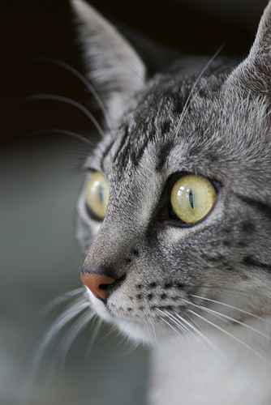
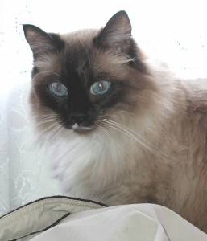
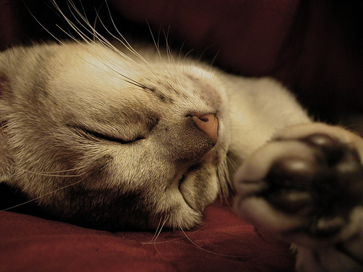
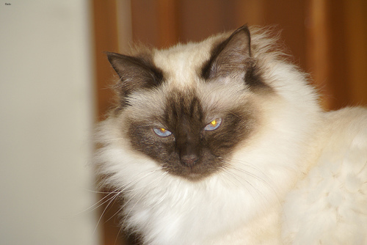
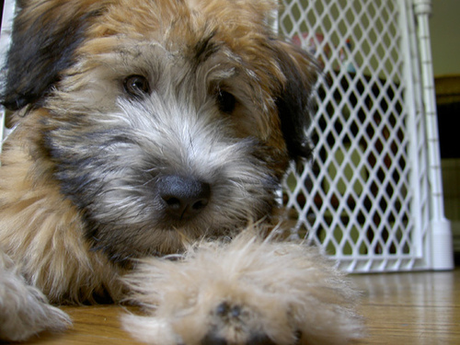
Representative failures
DINO-S
DINOv2-B
DeiT-B
Query
Abyssinian
Retrieved
Egyptian Mau
Query
Siamese
Retrieved
Birman
Query
Leonberger
Retrieved
Wheaten Terrier
Possible cause: The sleeping pose may hide breed-specific cues.
Possible cause: Similar facial markings may drive the match.
Possible cause: Coat texture may outweigh breed-specific shape.

Slide 8
Conclusions
What the comparison shows: DINOv2-B gives the best retrieval quality, but supervised DeiT-S also achieves higher Precision@5 than DINO-S. Self-supervised pretraining therefore does not guarantee the best result for every encoder.
What this means for the system: We would choose DINOv2-B when matching quality matters most. DeiT-S is a useful faster alternative when query embedding latency is more restrictive. The final choice should reflect the application’s quality and response-time requirements.

Slide 9
Limitations
Breed labels approximate visual similarity: Pets from different breeds can still look similar, so the metrics do not capture every useful visual match.
The comparison does not isolate supervision: Encoder architectures and pretraining datasets differ. We compare complete pretrained models and cannot attribute the quality gap to self-supervision alone.
Speed depends on the measurement setup: Our timings describe the Tesla T4 benchmark and its fixed gallery. Component medians do not represent measured end-to-end demo latency.

Slide 10
Team contributions
Member | Contribution
Azamat | Implemented data loading, preprocessing and the shared split. Evaluated DINO-S and supervised DeiT-S in the first notebook.
Karim | Evaluated DINOv2-B and supervised DeiT-B in the second notebook. Exported their metrics and embedding artifacts.
Aslan | Combined results from all four encoders, verified the comparison and analyzed representative failures for the final figures.
Danil | Defined the evaluation protocol, integrated the repository and built the interactive demo. Prepared the final report and presentation.
Code and reproduction instructions: github.com/kite121/Visual_retrieval_system

Slide 11
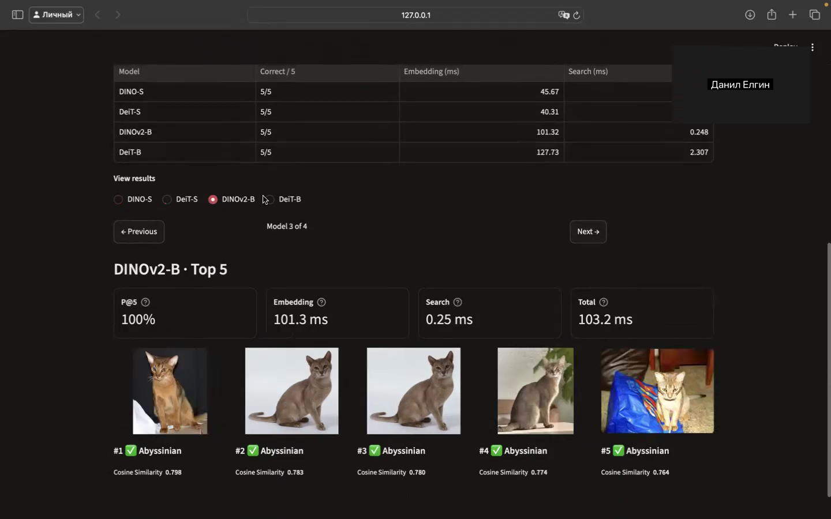
System demonstration

Slide 12
Thank you for your attention
Q&A
We welcome your questions.

Slide 13
Full quality metrics
Model | P@5 | P@10 | R@5 | R@10 | Hit@5
DINO-S | 84.16 | 81.56 | 8.47 | 16.41 | 97.47
DeiT-S | 86.65 | 85.27 | 8.72 | 17.16 | 96.92
DINOv2-B | 90.64 | 88.81 | 9.12 | 17.87 | 98.20
DeiT-B | 87.52 | 86.04 | 8.80 | 17.31 | 96.78
Precision measures the relevant share of retrieved images. Recall measures coverage of the relevant gallery. Hit records whether any relevant neighbor appears.
All values are percentages averaged over official test queries.

Slide 14
Runtime measurements
Model | Gallery build (s) | Preprocess (ms) | Embedding (ms) | Search (ms)
DINO-S | 8.14 | 5.60 | 6.25 | 0.224
DeiT-S | 7.83 | 5.58 | 5.10 | 0.226
DINOv2-B | 28.16 | 5.64 | 18.64 | 0.252
DeiT-B | 20.62 | 5.66 | 12.47 | 0.253
Protocol: We rebuild gallery embeddings in three fresh repeats and time the same 200 test queries on Tesla T4. Gallery batch size is 64, and queries use batch size one.
Interpretation: Query values aggregate per-repeat medians. Component medians cannot be added to obtain measured end-to-end latency.

