Slide 1
Final Project
Wacky Wavy Inflatable Arm Flailing Tube Men (WWIAFTM)
Members: Max Eshleman, Taylan Dillion, Zheng Li,
Corey Tokunaga-Reichert

Slide 2
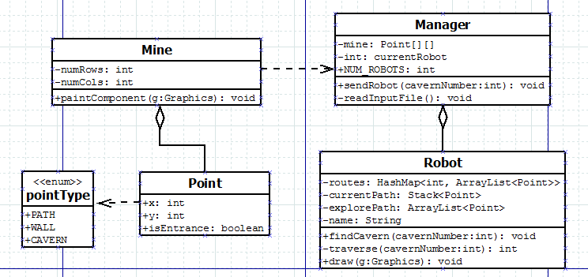
UML

Slide 3
Design
Route finding is random.
Recursive function deletes unnecessary points from the path.
Robots can speed up and slow down depending on how impatient the user is.
Different mines can be read in if desired.
List of found caverns displayed for each robot.
Store path to any cavern encountered.

Slide 4
Lessons Learned
Memory addressing issues with known paths.
Careful with Thread.sleep() when repaint() is involved.
The order of the lines of code that generate the GUI can cause problems. (required minimize/resize for Swing components to appear).
Sometimes it is acceptable to hard-code certain things (in this example, it was the four robots and their names/colors) because software can become too agile and result in a lot of “overhead”.

