Slide 1
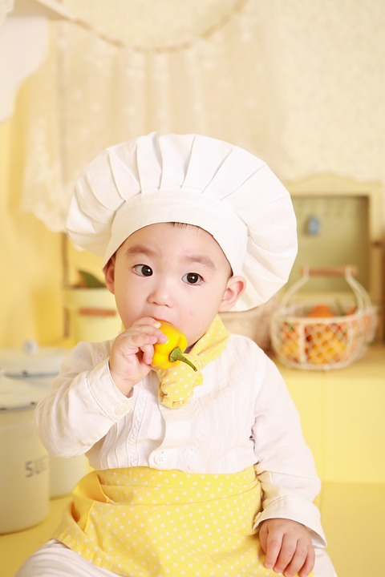
Food around Asia
Matrix
Kite
William
Lucy
Phoo Pwint

Slide 2
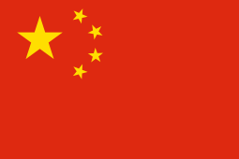
Chinese Food

Slide 3
Competitive Landscape

Slide 4
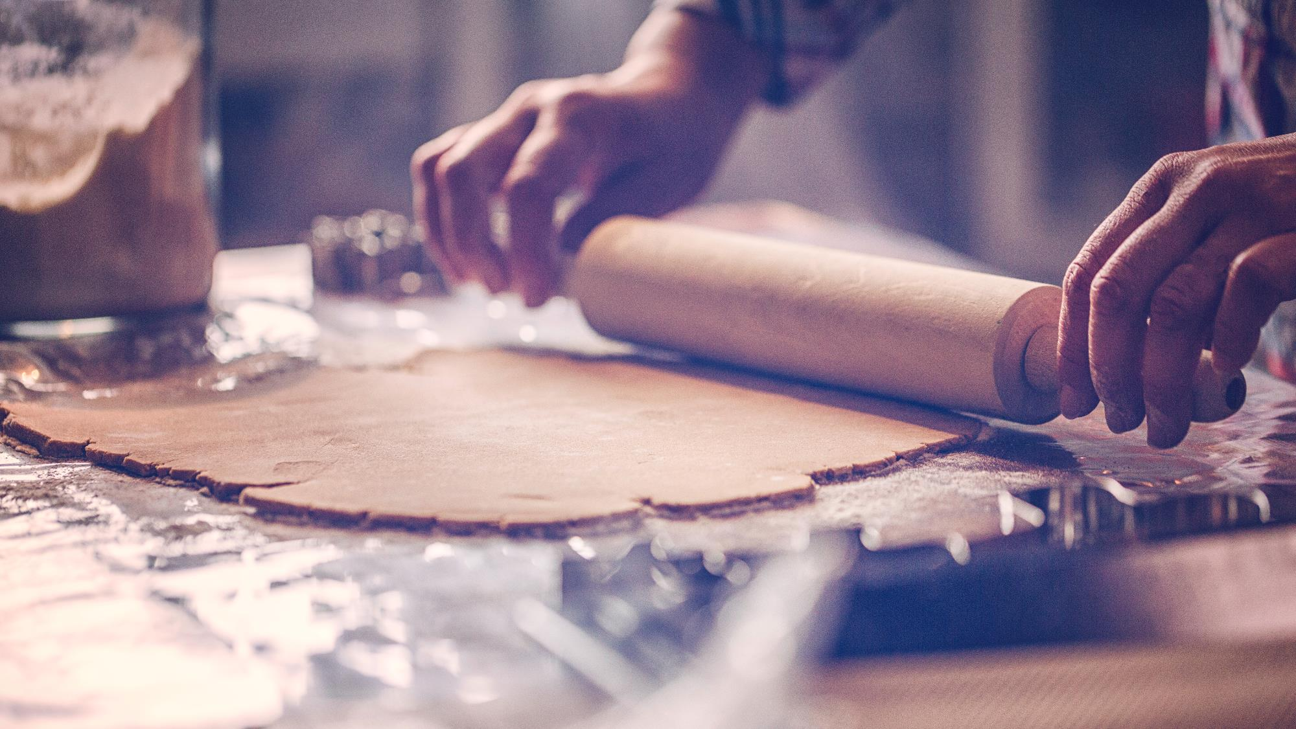

Key to Success
Better Sales
Quicker Responses
Better Customers
Better Service
More Products

Slide 5


Thank You
Email somesone@example.com

