Slide 1
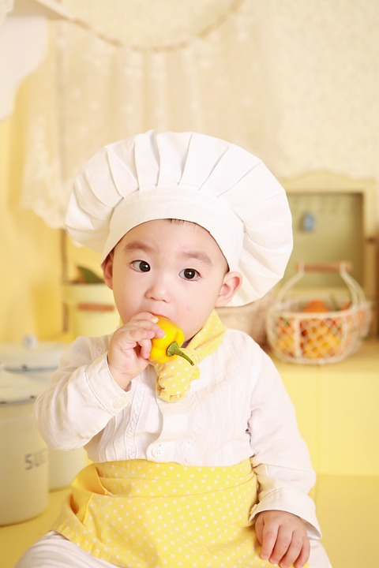
Food around Asia
Matrix
Kite
William
Lucy
Phoo Pwint

Slide 2
CHINESE FOOD

Slide 3
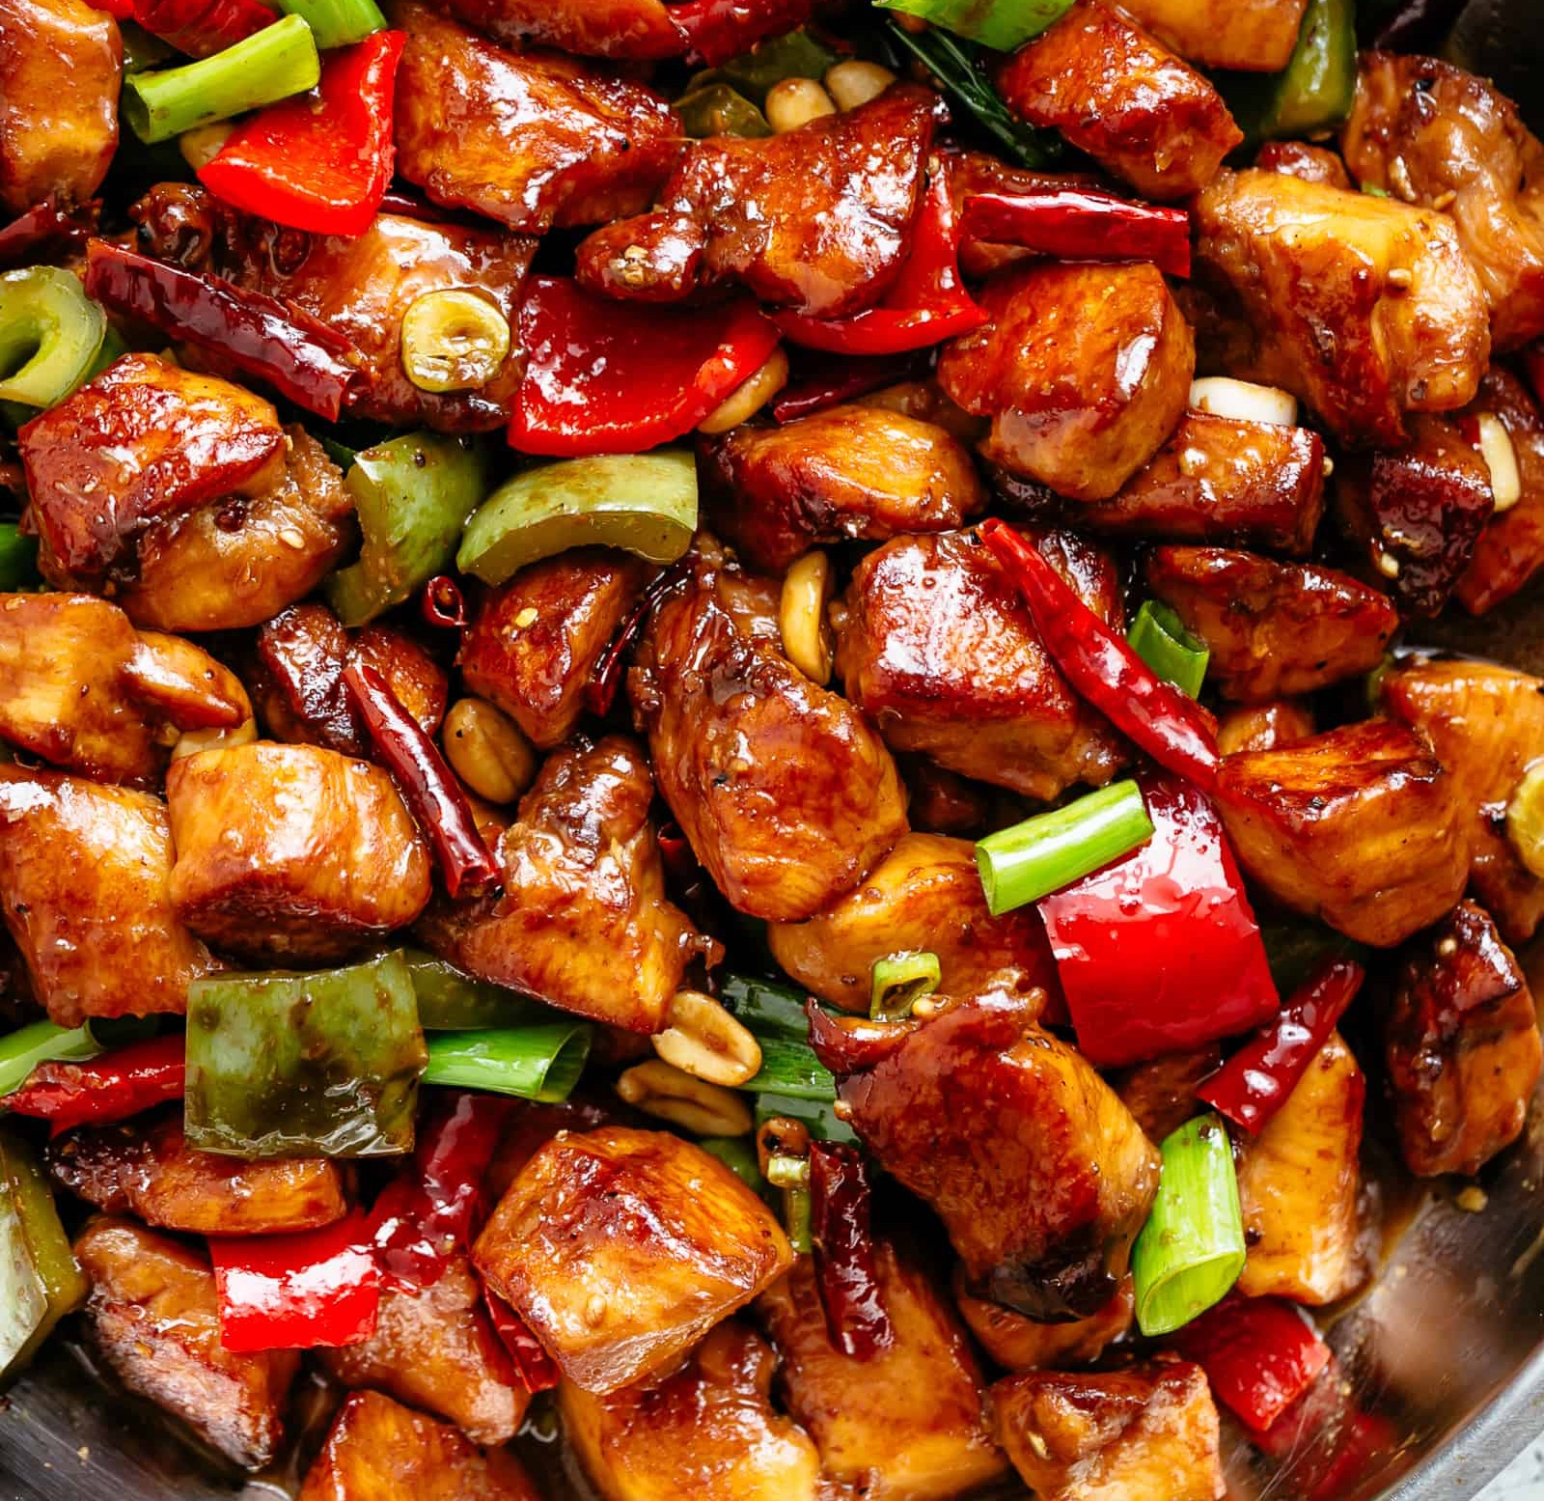
Kite
Kite
Kite
Kite
Kite
Kite dog
Kite god Kite kek
Kite LoL
Kite Kite

Slide 4

Kung Pao Chicken
Originated: named after Ding Baozhen, governor of Sichuan Province. His title was Gongbao.

Slide 5

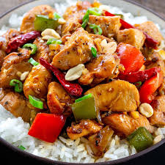
Kung Pao
Chicken
Ingredient
It is made with stir-fried chicken mixed with Sichuan pepper corns, peanuts, chili and bell peppers.
Named after DingBaozhen, governor of Sichuan Province. His title was Gongbao.

Slide 6
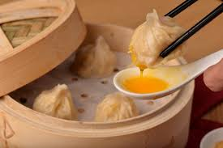
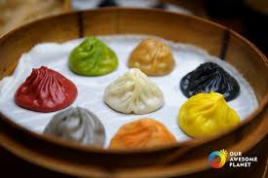
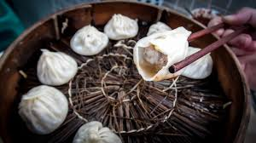
XIAO LONG BAO
Ingredient:
Steamed bun with meat fillings and spicy soup.
Eat with ginger sauces.
Feel the burning and explosion flavor.
It is a type of Chinese steamed bun from Jangnan region

Slide 7
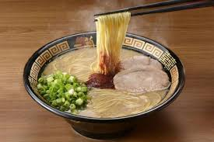
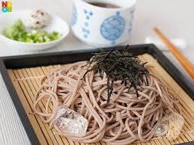
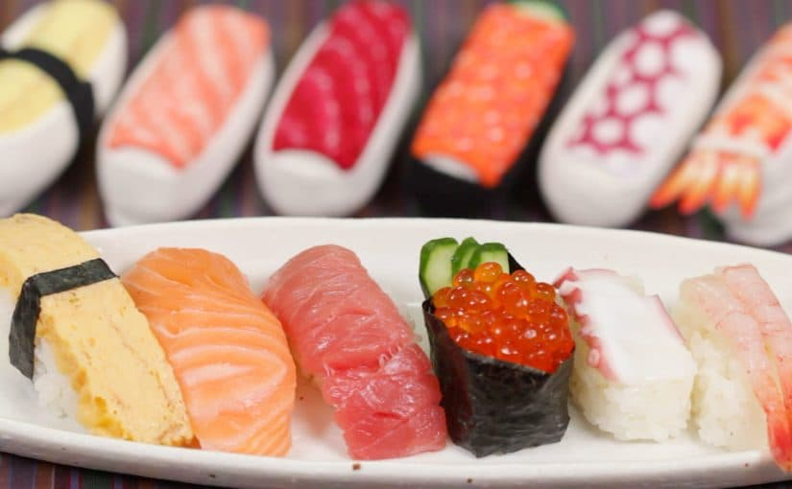
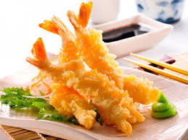
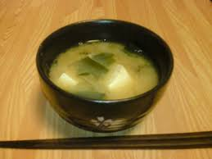
JAPANESE FOOD

Slide 8
Ramen
Ingredients
Ramen means “pulled noodles”.
Originated in the early 1900s.

Slide 9
SUSHI

Slide 10
Miso soup
Ingredients

