Slide 1
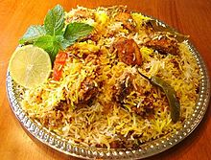
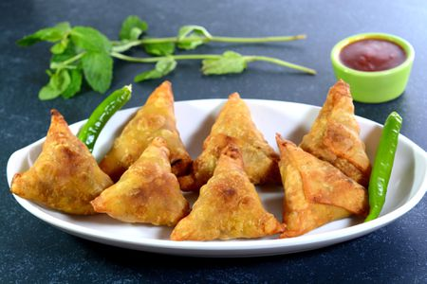
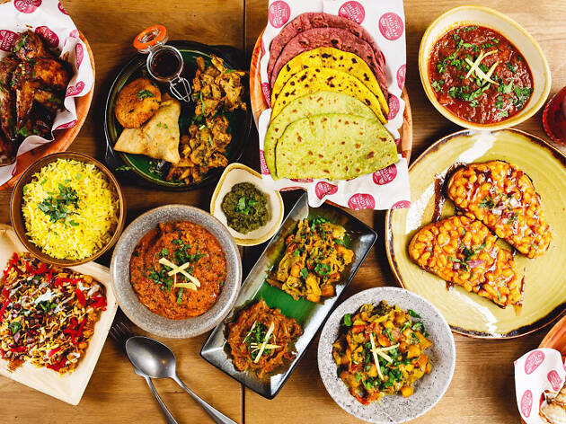
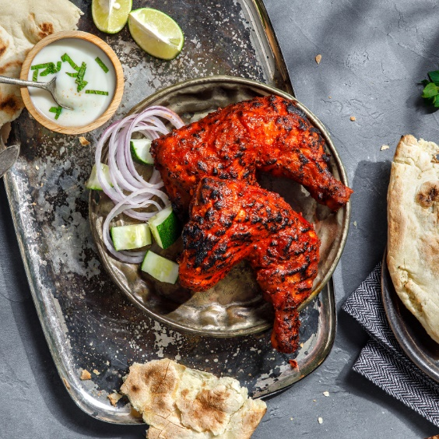
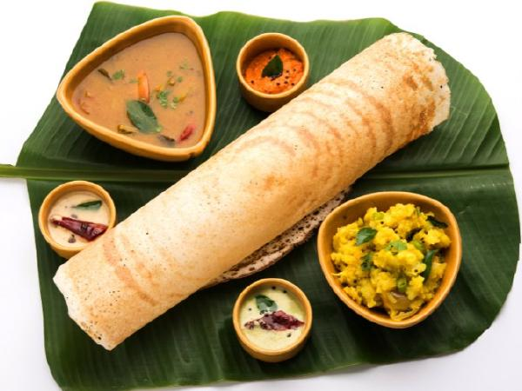
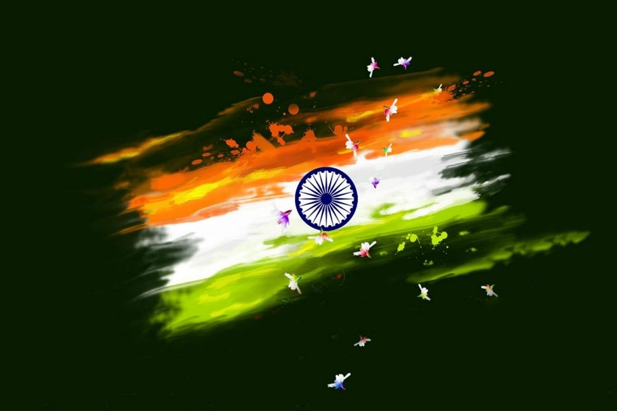
Indian Food

Slide 2

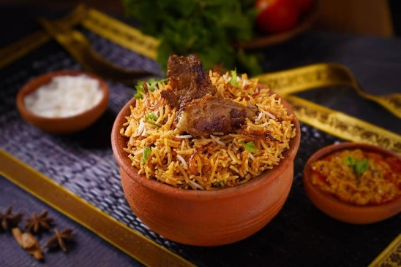
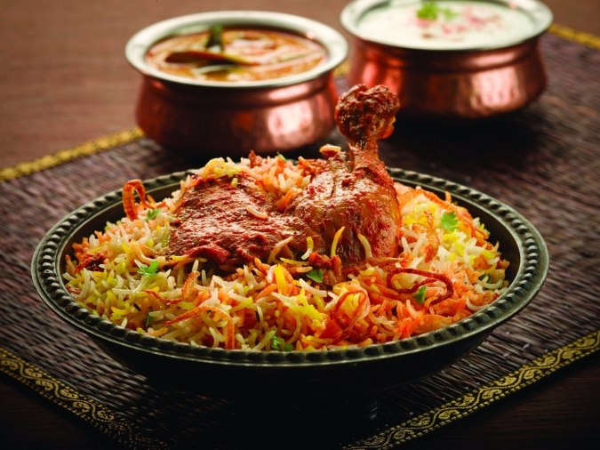
Biryani
-is a mixed rice dish with its origins among the Muslims of the Indian subcontinent.
Ingredients
It is made with Indian spices, rice, meat (chicken, goat, beef, lamb, prawn, or fish), vegetables or eggs.

Slide 3
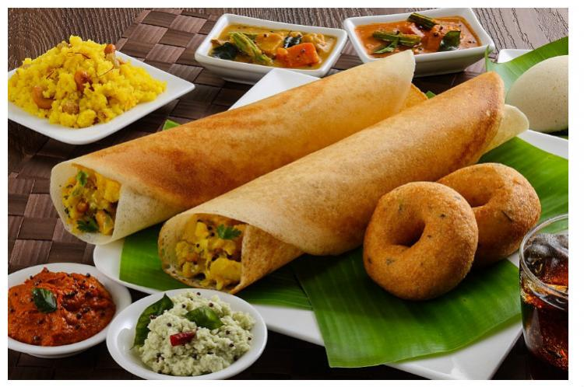
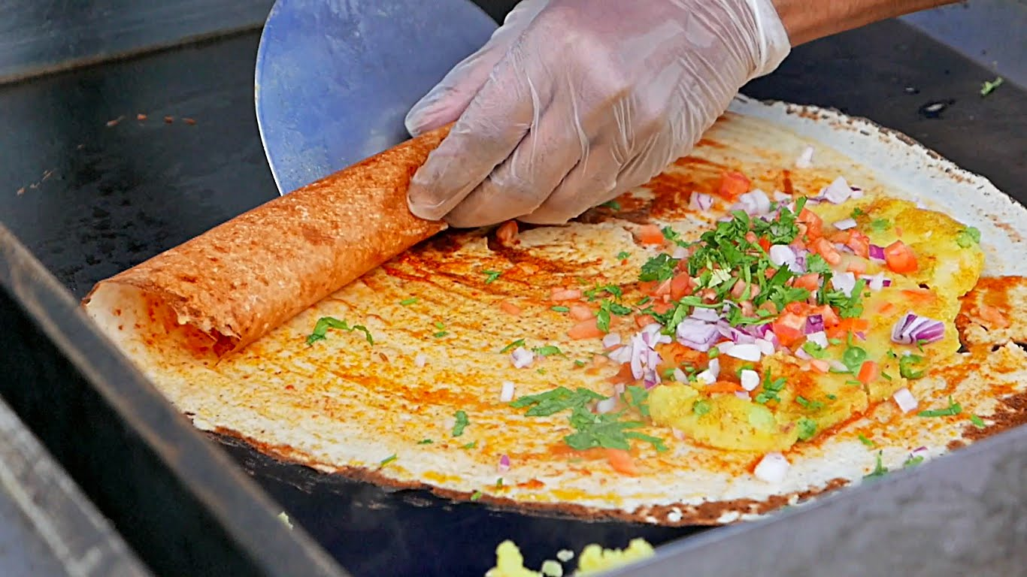
Dosa
-is a cooked flat thin layered rice batter,
originating from the Indian subcontinent, made from a fermented batter.
Its main ingredients are rice and black gram ground together in a fine, smooth batter with a dash of salt.

Slide 4
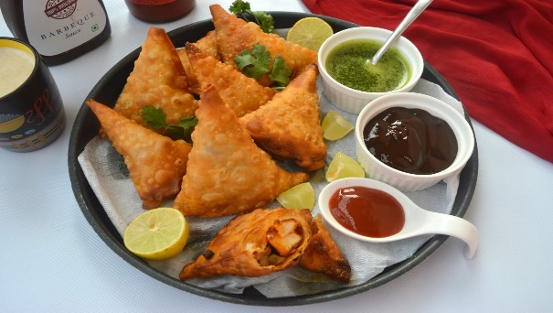
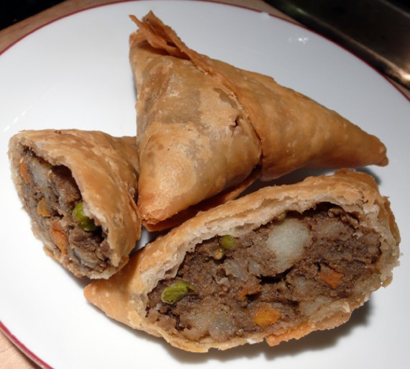
Samosa
is a fried or baked dish with a savory filling and may take different forms, including triangular, cone….
Ingredients
It is filled with spiced potatoes, onions, peas, meat, or lentils.

