Slide 2
DevDay Exchange London · 1 Nov 2026
Keith So
Resona: a two-minute check-in on the phone you already carry.

Slide 3
CASE 01 · HOOK
Resona 01 / 05
THE NUMBER YOU CANNOT SIT WITH
A WEEKDAY, SAMPLED
The average UK knowledge worker now spends
SLEEP 8h
SITTING 9.5h
MOVE 2.5h
OTHER 4h
9.5
ONS UK Time Use Survey · 2022-23 40% SITTING
HOURS PER DAY
sitting at a desk.
CARDIOVASCULAR
TYPE 2 DIABETES
ALL-CAUSE MORTALITY
+147% RISK
+112% RISK
+40%
More than they sleep.
AT 8+ HRS/DAY
Wilmot et al, Diabetologia, 2012
meta-analysis, 794,577 people
Ekelund et al, The Lancet, 2016
SEDENTARY · CARDIOVASCULAR · METABOLIC · RESPIRATORY
01 / 05

Slide 4
CASE 02 · PROBLEM
Resona 02 / 05
THE MARKET IS MOVING. THE TOOLS ARE NOT.
By supporting the improvement of employees’ health and wellness directly, businesses are able to be more productive, less absent, and longer-tenured. The economics are settled. The delivery is not.
CASE A DEMAND VALIDATED
CASE B SUPPLY BROKEN
Hedgeweek · July 2025
Healthcare Innovation · Fitbit corporate study
Citadel hires its first
Chief Medical Officer.
The wearable gap.
£1,000 saved, then abandoned.
Ken Griffin appoints Dr David Stark (ex-Morgan Stanley, Harvard-trained pediatric neurologist) to drive peak performance across the firm. A signal the $5.7 trillion hedge fund industry treats employee health as alpha.
Enrolled employees saved an average £1,000 per year in healthcare costs but 40% dropped off by month three. Fitbit corporate sales have declined every year since 2018. The demand is there. The hardware is not the answer.
First-ever CMO on Wall Street · July 2025
Global corporate wellness market: $53 bn · mostly unloved
No daily, private, hardware-free check-in for a whole team. Until now.
Citadel · July 2025 · Fitbit corporate · Healthcare Innovation study
02 / 05

Slide 5
CASE 03 · SOLUTION
Resona 03 / 05
THREE SIGNALS · ONE PHONE · TWO MINUTES
Resona. Every phone is an instrument.
01
02
03
LIVE
LIVE
LIVE
Breath.
Motion.
Heart.
Microphone
Motion sensor
Front camera
How long and how steadily you can blow, measured from the sound of a six-second breath.
Stillness from a 10-second hold. Walking cadence from ten steps.
Experimental pulse estimate from 30 seconds of face video. Shows coaching instead of a number when the signal is weak.
6s blow · processed on the phone
Phone accelerometer · processed on the phone
Face detection keeps the estimate on your skin, not the background
Raw audio, video and motion stay on the phone. Readings are experimental, not a medical assessment.
Module 01 · Breath ▸ Module 02 · Motion ▸ Module 03 · Heart
03 / 05

Slide 6
CASE 04 · BUILT TODAY WITH CODEX
Resona 04 / 05
WHAT CODEX BUILT WITH US TODAY
One working journey, honest by design.
01
02
03
TODAY
TODAY
BEFORE
Reports.
Honesty pass.
Credited.
Codex model + strict schema
Codex audit
Existing Resona prototype
After each capture the app sends only derived numbers to gpt-5.3-codex. A strict JSON schema means it can only pick a tip from fixed, non-medical options. It cannot write a diagnosis.
Codex read every screen and removed claims the readings cannot support: spirometry numbers, GP advice, screening labels.
Breath and motion signal processing from an unfinished April prototype; the pulse experiment from June. Today's work is on branch feat/devday-reset.
Consent switch before recording · raw data stays on device
Copy matches what the signal can actually show
github.com/kitfunso/resona
8 commits today, 11:42 to 14:45 · 69 files changed on branch feat/devday-reset
Capture ▸ Consent ▸ Codex report
04 / 05

Slide 7
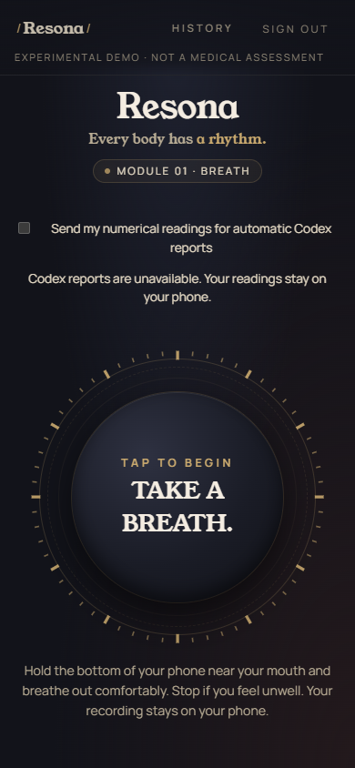
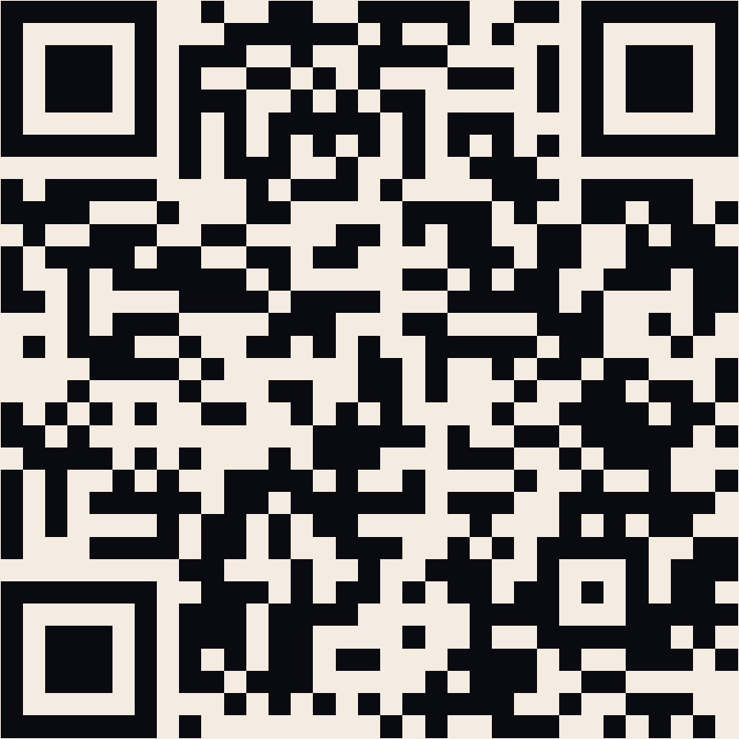
CASE 05 · LIVE DEMO
Resona 05 / 05
● LIVE DEMO
Blow. Walk. Read the report.
01
Open Resona on your phone and start as a guest.
02
Choose whether readings are sent for a report.
03
Blow into the bottom of the phone for six seconds.
04
Walk ten steps, then read your report.
No wearable. Two minutes. Your data stays yours.
resona-devday-original-2026.pages.dev
Reports picked by a Codex model · no audio leaves your phone
05 / 05

