Slide 1
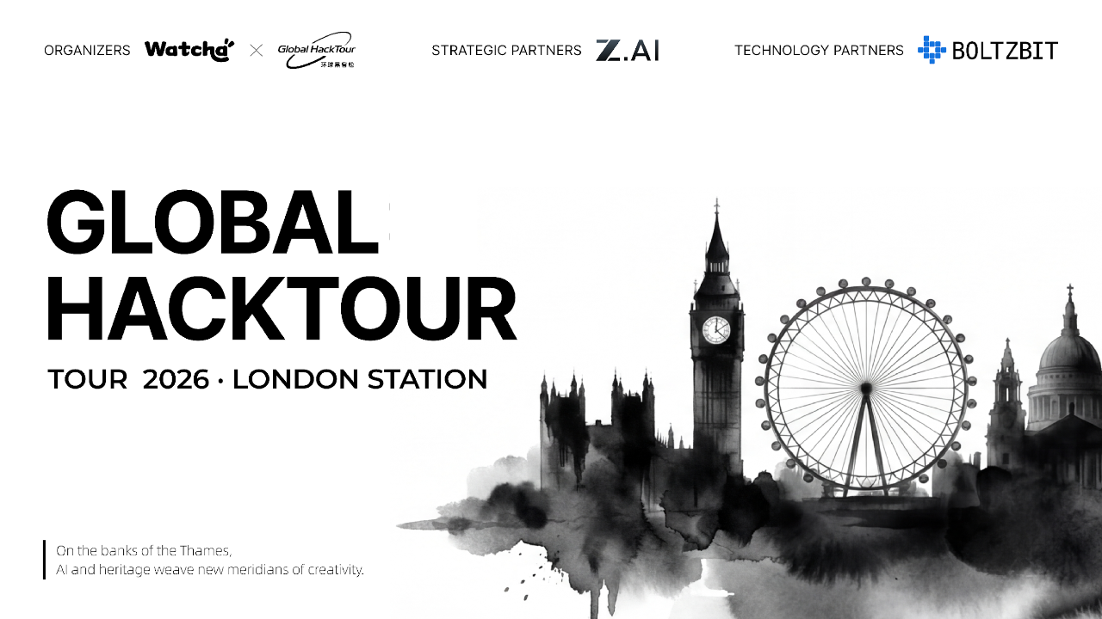

Slide 2

20 + Team Solomid
Keith So
Resona - A phone-based, two-minute wellness check-in for teams at work.

Slide 3
CASE 01 · HOOK
Resona 01 / 04
THE NUMBER YOU CANNOT SIT WITH
A WEEKDAY, SAMPLED
The average UK knowledge worker now spends
SLEEP 8h
SITTING 9.5h
MOVE 2.5h
OTHER 4h
9.5
ONS UK Time Use Survey · 2022-23 40% SITTING
HOURS PER DAY
sitting at a desk.
CARDIOVASCULAR
TYPE 2 DIABETES
ALL-CAUSE MORTALITY
+147% RISK
+112% RISK
+40%
More than they sleep.
AT 8+ HRS/DAY
Wilmot et al, Diabetologia, 2012
meta-analysis, 794,577 people
Ekelund et al, The Lancet, 2016
SEDENTARY · CARDIOVASCULAR · METABOLIC · RESPIRATORY
01 / 05

Slide 4
CASE 02 · PROBLEM
Resona 02 / 04
THE MARKET IS MOVING. THE TOOLS ARE NOT.
By supporting the improvement of employees’ health and wellness directly, businesses are able to be more productive, less absent, and longer-tenured. The economics are settled. The delivery is not.
CASE A DEMAND VALIDATED
CASE B SUPPLY BROKEN
Hedgeweek · July 2025
Healthcare Innovation · Fitbit corporate study
Citadel hires its first
Chief Medical Officer.
The wearable gap.
£1,000 saved, then abandoned.
Ken Griffin appoints Dr David Stark (ex-Morgan Stanley, Harvard-trained pediatric neurologist) to drive peak performance across the firm. A signal the $5.7 trillion hedge fund industry treats employee health as alpha.
Enrolled employees saved an average £1,000 per year in healthcare costs but 40% dropped off by month three. Fitbit corporate sales have declined every year since 2018. The demand is there. The hardware is not the answer.
First-ever CMO on Wall Street · July 2025
Global corporate wellness market: $53 bn · mostly unloved
No daily, private, hardware-free check-in for a whole team. Until now.
Citadel · July 2025 · Fitbit corporate · Healthcare Innovation study
02 / 05

Slide 5
CASE 03 · SOLUTION
Resona 03 / 04
THREE SIGNALS · ONE PHONE · TWO MINUTES
Resona. Every phone is an instrument.
01
02
03
LIVE
LIVE
Q3
Breath.
Motion.
Heart.
Microphone · Acoustic spirometry
IMU · DeviceMotion API
Front camera · rPPG
FEV1, FVC, PEF. Forced exhalation analysed from turbulent flow noise. Normalised to Hankinson NHANES III predicted values, ATS/ERS 2019 quality flags.
Tremor from 10s stillness. Gait cadence and stride variability from 10-step walk. Standing-up streaks over time.
Resting heart rate and HRV from 30s face video. Sub-pixel colour oscillations, bandpass 0.7 to 4 Hz.
60 Hz accelerometer · FFT bands
MediaPipe ROI · Q3 2026
Goel et al., SpiroSmart, UbiComp 2012 · 6s blow · 48 kHz PCM · on-device
All processing on-device. No audio, no video, no GPS leaves the phone.
Module 01 · Breath ▸ Module 02 · Motion ▸ Module 03 · Heart
03 / 04

Slide 6
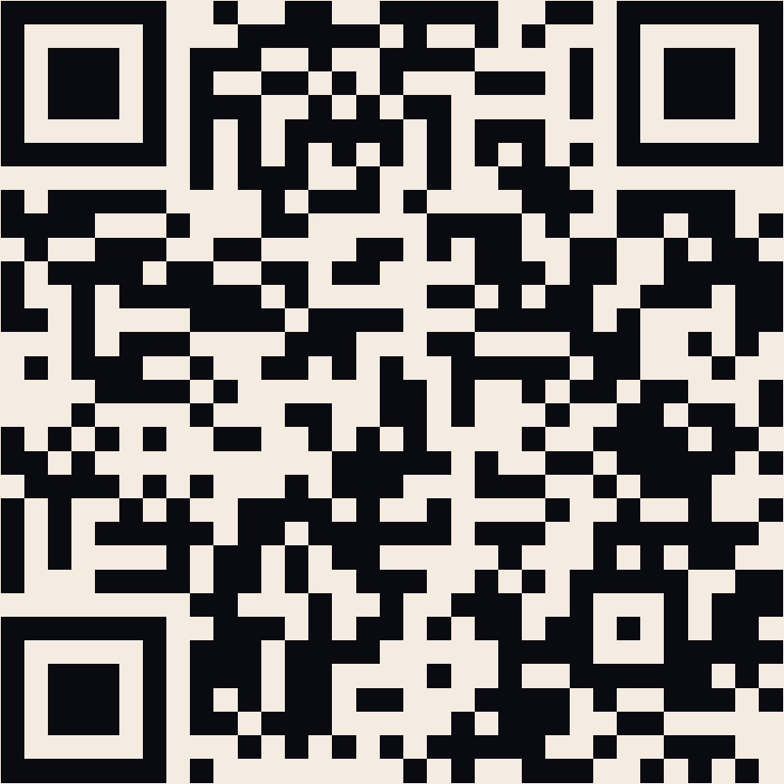
CASE 04 · LIVE DEMO
Resona 04 / 04
● LIVE DEMO
Scan. Blow. Fill the bar.
01
Scan the code with your phone camera. You land on an onboarding form.
02
Enter a team code.
03
Blow into the bottom of your phone for six seconds.
04
See your analysis, your numbers, and your team on the board.
Fill the bar together. Top team takes the board.
mocha-cleat-chastity.ngrok-free.dev
GP letter written live by GLM 5.1 · no audio leaves your phone
04 / 04

