Slide 1
CS3343 Software Engineering Practice
Members
WONG, Chung Man (53145233)
KONG, Tsz Kit (53143798)
Ho, Wai Kit (53144248)
SO, Chun Hei (53144525)
LAU, Kam Yu (53144179)
YIU, Yiu Yeung (53144144)

Slide 2
Project Background
Topic: Airline Ticket Ordering System
Implementation:
To purchase the airline ticket
Extension functions
Path finding for different routes of the flights
Flyer miles calculation
Additional baggage fees calculation
Credit card discount for different airline company

Slide 3
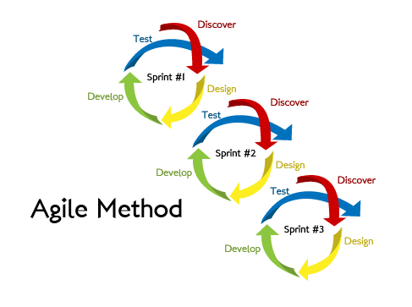
Agile Development Methodologies
The key of agile software development methodology
“iteration” and “incremental”
Deliver few functions only in one sprint
Increase the communication with our client
Continuously improvement and faster response

Slide 4
Scrum
Daily stand up meeting
What we did yesterday
What we need to do today
Any blockers that you face
Sprint planning meeting
Sprint goal
Sprint backlog (Few product backlog)
Sprint Retrospective meeting
Review the last sprint
Take action items for any blockers
Sprint duration: 1 week

Slide 5
Team and Roles
Roles | Name
Project Manager, Development Team | SO, Chun Hei
Assistant Manager, Project Planning, Development Team | WONG, Chung Man
Scrum Master, Development Team | HO, Wai Kit
Configuration Manager, Development Team | YIU, Yiu Yeung
Development Team | KONG, Tsz Kit
Development Team | LAU, Kam Yu

Slide 6
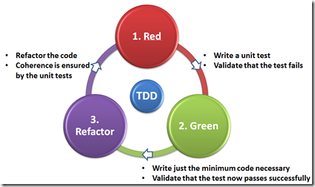
Test Driven Approach
Write the test before coding
Fit the functions only
Make sure all the tests can be passed no matter any tests and codes added
Reduce the risk in the early stage

Slide 7
Pair Programming
One will be code writer, another one to be the observer
Switch the role frequently
Increase the communication chance to share the common problems and experience
Learning with each other
Reduce bugs and increase the quality

Slide 8
Development Tools
Eclipse
Integrated development environment with many plugins
GitHub
A distributed version control system and source code management system
JUnit
A framework to write repeatable tests
Mockito
A framework to mock components in test phase

Slide 9
Configuration Management Approach
Git
Provided by GitHub ( a third-party system who provides Git’s services )
Git User Account
Basic Flow of Commit and Retrieve
Review Before Committing
Further Functions of Git and GitHub

Slide 10
System Workflow
Input date for flight, location of departure and destination
Select the available route.
Select the airline company for flight and input no. of tickets.
Calculate total amount
Input credit card info.
Input baggage-related info.
Order Confirmation
END

Slide 11
Project Demonstration
Please enjoy!

Slide 12
Bug Report
Title: Baggage Fee Calculation Error Caused by Baggage Extra Fee
Description: Incorrect baggage fee when take more than one baggage.
Vendor: Team 18 | Product: Airline Ticket Purchasing System | Versions: 1.09
Severity: Critical |  | Update: 1/10/2014
Status: Outstanding |  | Assigned to: Nelson Wong Chung Man
Problem: The baggage fee calculator outputs an incorrect fee $400 which includes extra baggage fee when it is in following situations: Free baggage allowance is based on unit Piece. 1 baggage and 1 sporting equipment is free for transfer. Extra fee $1000 must be paid for each extra baggage. Extra fee $400 must be paid if average baggage weight is 30 – 40 KG. Total baggage is 2 including a sporting equipment. Total weight of 2 baggage is 40 KG and average weight is 20 KG. The formula should be as the following: ($1000 fee x 2 baggage) - ($1000 free baggage + $1000 free sporting equipment transfer) + $0 exceed average weight fee = $0 According to the formula, we can see that the calculator incorrectly fulfill the condition of point 4. Thus, the final result is $400 incorrectly.
Updated by Nelson Wong Chung Man on 12/10/2014
After Nelson checking, it is caused by the total baggage weight have not divided by amount of baggage. Thus, the fee is abnormally high and the weight cannot be shared by a group. Now, the incorrect formula already fixed and passed testing.
Title & Brief Description
Location of the Bugs
Severity
Responsibility
Specific & Reproducible
Actual & Expected Results
Update

Slide 13
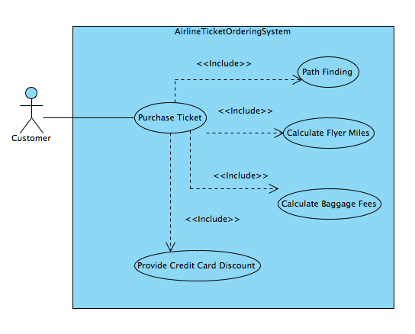
Use Case

Slide 14
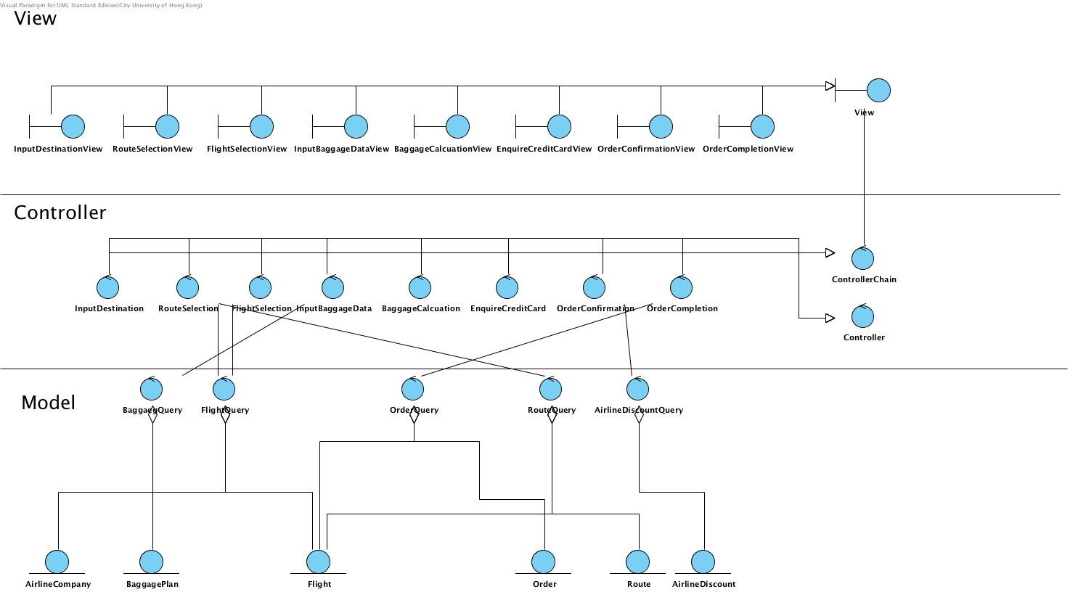

MVC

Slide 15
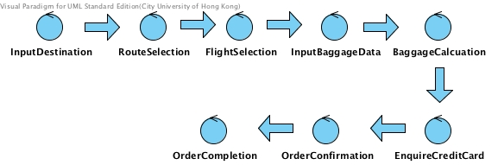
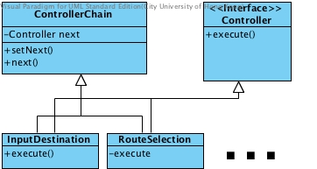
Chain Pattern

Slide 16
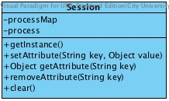
Singleton Pattern

Slide 17
MVC

Slide 18

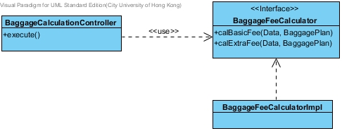
Refactoring
Have a set of test cases
Find code smells and make sure that passed all test cases (Debug if fail)
Do refactoring and the test cases should be still passed
Before:
Depend on Calculator Directly
Many Duplicate Codes
After:
Dependency Inversion Principle
Reduce Duplication

Slide 19
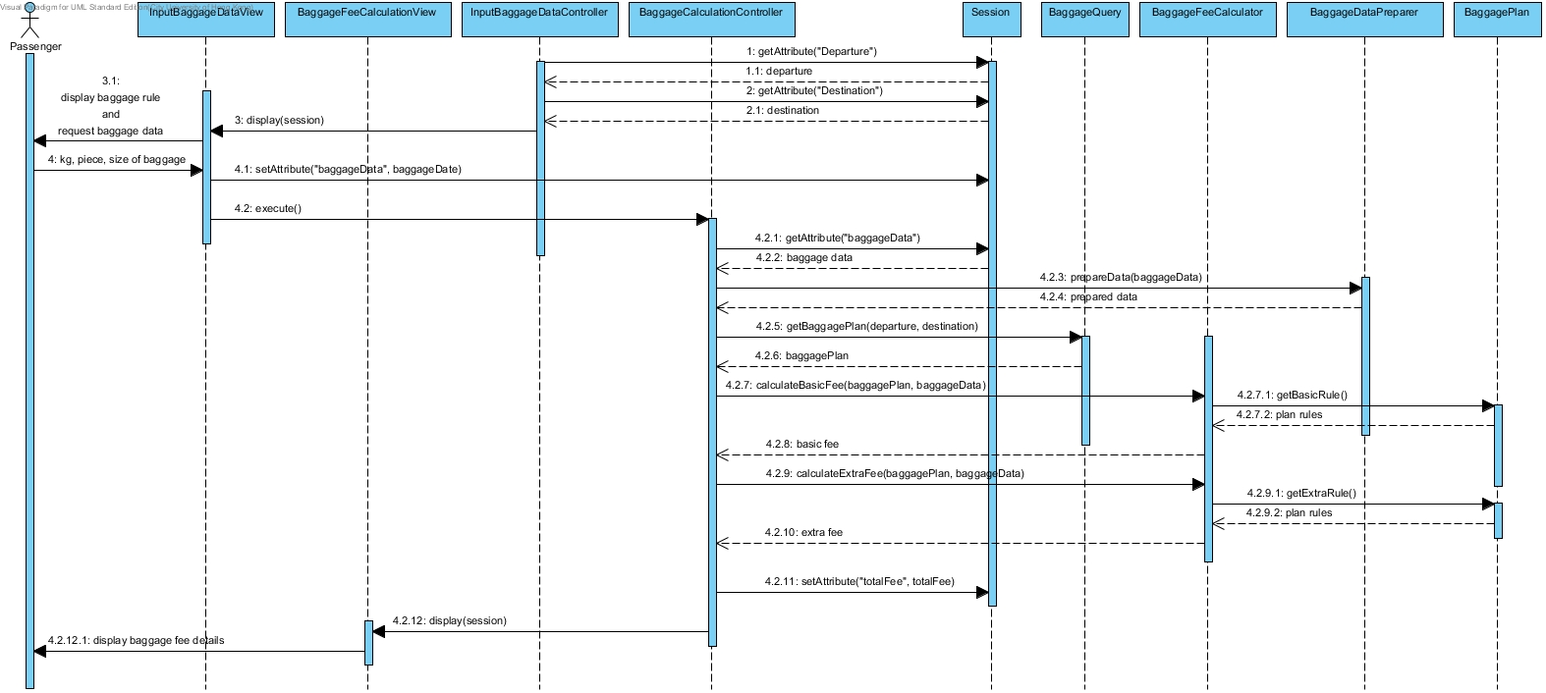
Sequence diagram - Baggage Calculator

Slide 20
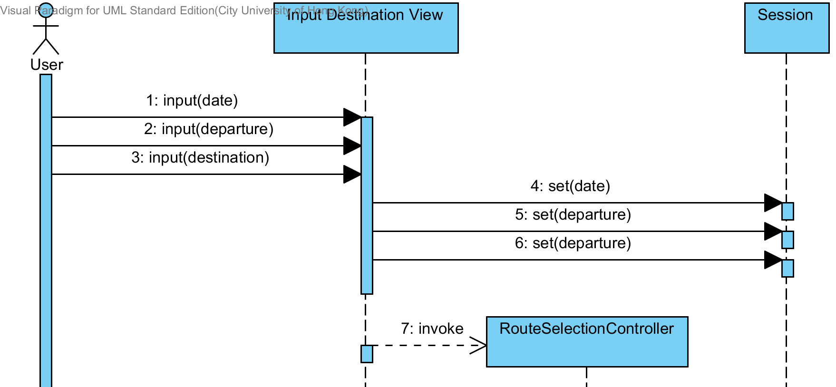
Sequence diagram – Enter Destination

Slide 21
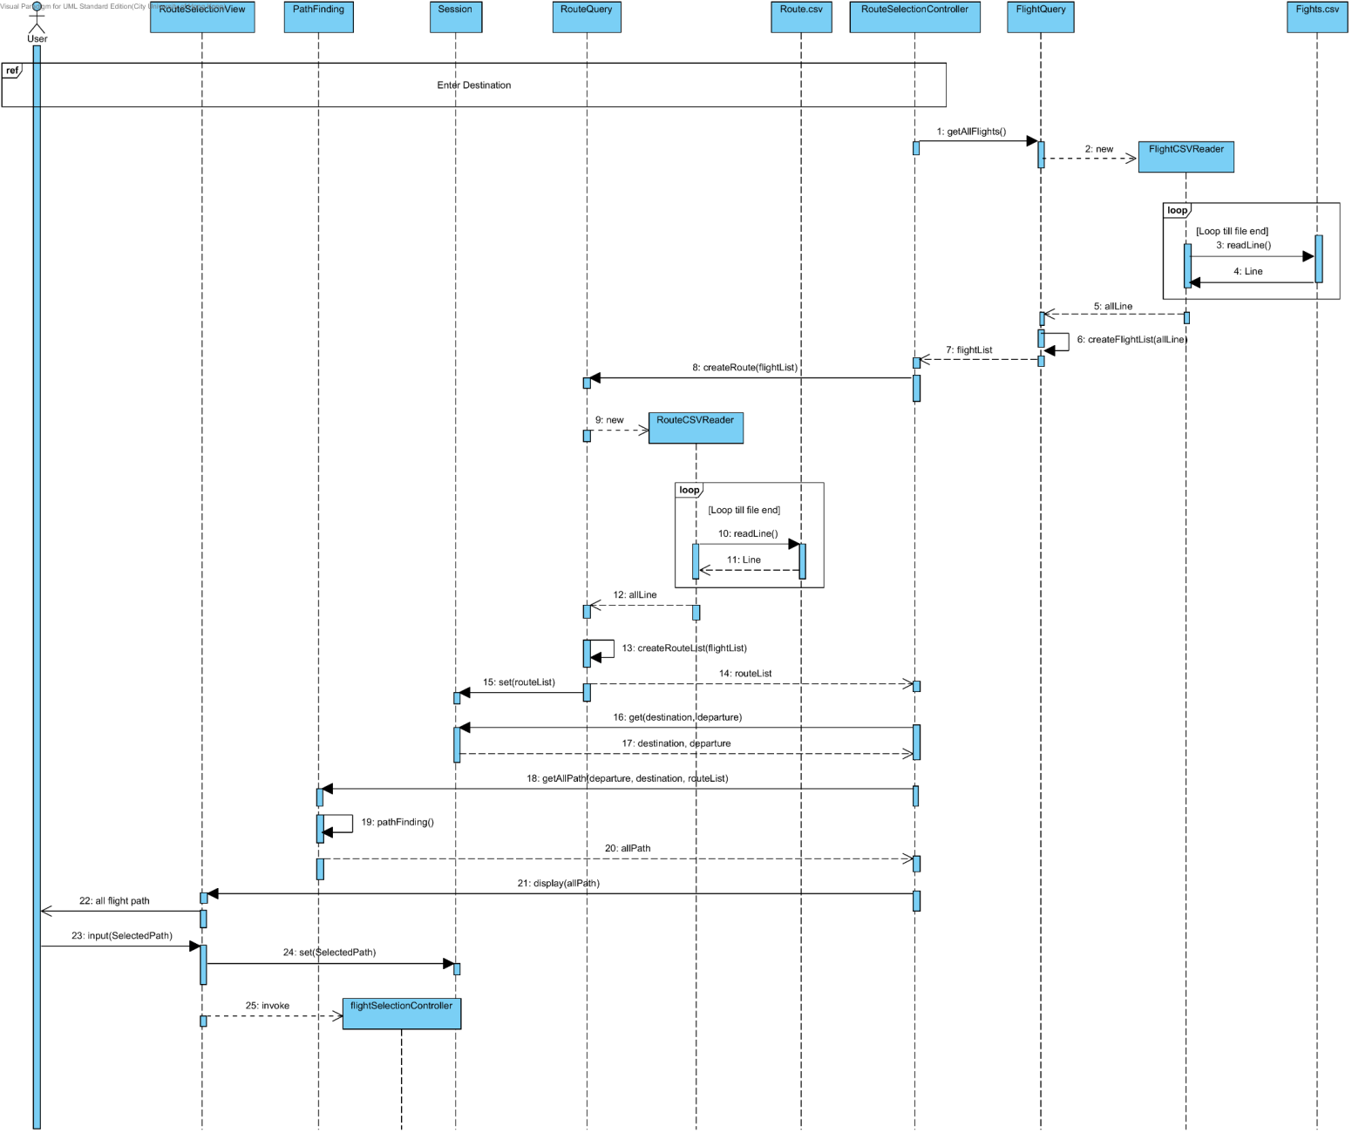
Sequence diagram – Route Selection

