Slide 1
Patterns Without Source:
A Meta-Analysis of PWS Cup 2025
Hinata Kikuchi · Hajime Ono · Kazuhiro Minami
Research Organization of Information and Systems · Chuo University · The Institute of Statistical Mathematics · Kanazawa University
Notes:
Good afternoon.
I am Hinata Kikuchi from the ROIS and Chuo University.
This is joint work with Hajime Ono and Kazuhiro Minami.
Today, I want to ask a very simple question:
How much can we learn when we do not know exactly how the method worked?
20secs.
Let me start with a real story.

Slide 2
Netflix Prize shows the tension in data disclosure
🎬
2006
Netflix Prize
👤
Re-identification
risk shown
⏸
Prize 2
suspended
⭐ ⭐ ⭐
Anonymized
movie ratings
🔗
Linked with
IMDb ratings
Detailed disclosure helps research — but disclosure itself can create privacy and organizational risks.
What can researchers do when those details are simply not available?
Source: Narayanan & Shmatikov (2006/2008); FTC closing letter to Netflix (2010).
Notes:
In 2006, Netflix launched the Netflix Prize.
To improve its recommendation system, Netflix released movie-rating data from about half a million subscribers.
Names and direct identifiers were removed.
But researchers later showed that some anonymous records could be linked back to individuals using only a small amount of public information — for example, movie ratings on IMDb.
This became more than an academic result.
When Netflix later planned a second competition with richer data, the U.S. Federal Trade Commission raised concerns about re-identification.
Netflix eventually suspended the second Prize.
So there is a real tension here.
Detailed disclosure helps research. But disclosure itself can also create privacy and organizational risks.
45secs.
And that leaves researchers with a practical problem.
What can we do when those details are simply not available?

Slide 3
寓話
最初にフックとして、寓話で、
「私たちは多くの場合に、詳細なデータを取得できない」という話をします。
匿名化手法および攻撃の文脈で、「実際に攻撃によって特定された、という事例を研究し、その研究成果を報告したところ、その匿名化手法を実施した企業の評判が下がり、大問題になってしまった研究者の話」をします。

Slide 4
Fiction → real problem
そのあと、「実際にはこんな事例は起きていないが、企業も研究者も、このようなリスクを考えて、重要な事例でも、匿名化・攻撃のアルゴリズムそのものが公開されることは稀だ」とつなげます。
「こんな状況でも、研究者としてはやはり重要な知見を得たいですよね？私たちはそれが実現可能なのか、PWSCUP2025という状況を使って検証してみました。」
とつなげます。

Slide 5
Big Problem
Big Problemとして、
「詳細なアルゴリズムやソースコードが得られず、手法の大まかな類型と結果しか観測できないとき、それでもそこから意味のある知見を引き出せるのか。 」を置く。

Slide 6
We often see outcomes, not implementations
What we often observe
What remains hidden
Outcomes
✓
Method family
✓
Parameters
?
Source code
?
Can outcomes + type-level descriptions
still generate meaningful knowledge?
Not enough for definitive causal claims — but perhaps enough to discover patterns and formulate testable hypotheses.
Notes:
In many real settings, this is exactly what we face.
We can observe what happened.
We may know the broad type of anonymization or attack that was used.
But we do not know the exact parameters.
We do not see the full implementation.
And we often do not have the source code.
So our question is:
Can we still extract meaningful knowledge when we only have outcomes and type-level descriptions?
Obviously, that information is not enough for a controlled causal study.
But perhaps it is enough to discover patterns — and to formulate useful hypotheses.
50secs.
To explore this question, we found a useful test case: PWS Cup 2025.

Slide 7
Why PWS Cup?
コードがなく、発表として曖昧な形でしか情報が得られないが、high-levelな手法の説明および結果としてのスコアは得られる中間的な状況にあたり、分析に向いていると考えたと説明します。

Slide 8
Minimum PWS Cup mechanics
そして、実際にPWSCUP2026の説明を簡単にします。
この時の説明の内容は
「PWSCUPは日本で10年間行われている匿名化・攻撃手法コンペであり、各チームは防御役・攻撃役の両方を担う」
「PWSCUP2025では、表彰式当日、各チームは自身が利用した戦略のポスター発表および10分間の発表プレゼンが行われた」
「今回は、医療データがテーマであり、匿名化データとともに、それを利用して作成された機械学習モデルの提出が定められていた」
「防御側では、データの有用性とメンバーシップ推定への抵抗性が採点され、攻撃側では、メンバーシップ推定の成功率が採点された」
とします。

Slide 9
Why PWS Cup?
PWS Cup 2025
Defender
Comparable Scores
Utility (of C and D)
Anonymity (of C and D)
Attack Effect (of Attacker)
Attacker
Process
Anonymized data
C
Hidden sample
B
Attack
Membership inference
Which rows were in B?
XGBoost model
D
Train
Like the real world:
implementation mostly hidden
Final showcase
posters + short talks
provide type-level descriptions
Unlike the real world:
common evaluation framework
Notes:
PWS Cup is an anonymization and attack competition held annually in Japan since 2015.
And every team plays both roles: defender and attacker.
In 2025, the challenge used synthetic health records.
As a defender, each team received a hidden sample and submitted two things:
an anonymized dataset, and an XGBoost model for stroke-risk prediction.
Then every team attacked every other team.
The attack was membership inference:
Which patients in the population were actually included in the hidden sample?
So at the end, we have comparable outcomes for utility, anonymization, and attack performance.
But for our question, there is one more important feature.
At the final showcase, every team presented what it had done — through posters and short talks.
So we could observe the type of strategy.
But code release was optional.
Only two of the twenty-four teams released code.
That makes PWS Cup an unusual middle ground.
The implementation is mostly hidden, like in the real world.
But the outcomes are measured under the same framework.
So we asked: can we learn anything from that?

Slide 10
Turn vague presentations into testable questions
24 teams
registered
20 strategies
reconstructed
Categorical
features
Two empirical
questions
Coding Examples:
Questions:
Defender
H1
Were generation/reconstruction designs associated with better utility and anonymization?
Did the team perturb the provided sample directly, or build a new dataset from elsewhere?
Did it use synthetic generation/noise/ optimization techniques?
H2
Did disclosure risk depend on the combination of defender and attacker strategies?
Attacker
Did it use the released model, or train its models for own membership attack?
Notes:
So we reconstructed the missing information by hand.
We attended the final showcase and documented each team's anonymization, model-training, and attack strategy from posters, presentations, and follow-up discussions.
We obtained usable descriptions for twenty teams.
Then we converted those descriptions into categorical features.
For example:
Did the team perturb the provided sample directly, or build a new dataset from elsewhere?
Did it use synthetic generation?
Noise?
Optimization techniques?
And on the attack side, did it use the released model, or train its models for own membership attack?
To avoid building results around one unusual team, we only kept features used by at least four teams.
Then we used these coarse descriptions to ask two questions.
First: were generation- and reconstruction-based designs associated with better utility and anonymization?
Second: did disclosure risk depend on the combination of the defender's strategy and the attacker's strategy?
With only twenty teams, we deliberately kept the analysis small:
effect sizes, sparse regression models, and for the attack analysis, the 361 attacker–victim pairs.
And despite the very coarse information, the first pattern was surprisingly clear.

Slide 11
Reconstruction
Defender
Attacker
20 teams
19 teams
Base
B (13) → elsewhere (7)
Attack target
anonymized data only (15) → also the released model (4)
Synthesis
no (9) → yes (11)
Attacker-trained model
no (13) → yes (6)
Noise
no (14) → yes (6)
Optimization
no (14) → yes (6)
Non-default distance
no (11) → yes (8)
Row swapping
no (10) → yes (10)
→ marks the contrast direction: every effect size and every IRR is reported for the right-hand category.
Ex. Team 18 — overall rank 1
Ex. Team 8 — best attack score
elsewhere · synthesis yes · noise no · optimization yes · swapping no
anonymized data only · attacker-trained model yes · non-default distance no
Inferred Synthea's parameters with a generative model, built a pseudo-population, then picked its best 10,000 rows by simulated annealing.
A Gaussian LiRA combined with a distance attack on covariance-augmented data.

Slide 12
Key opportunity
「ここで、そのような粗い情報からも学ぶことが可能なのか？ということが我々が知りたいことだ」、と進める
コードがなく、発表として曖昧な形でしか情報が得られないが、high-levelな手法の説明および結果としてのスコアは得られる中間的な状況にあたり、PWSCUPは適切な検証の場である。

Slide 13
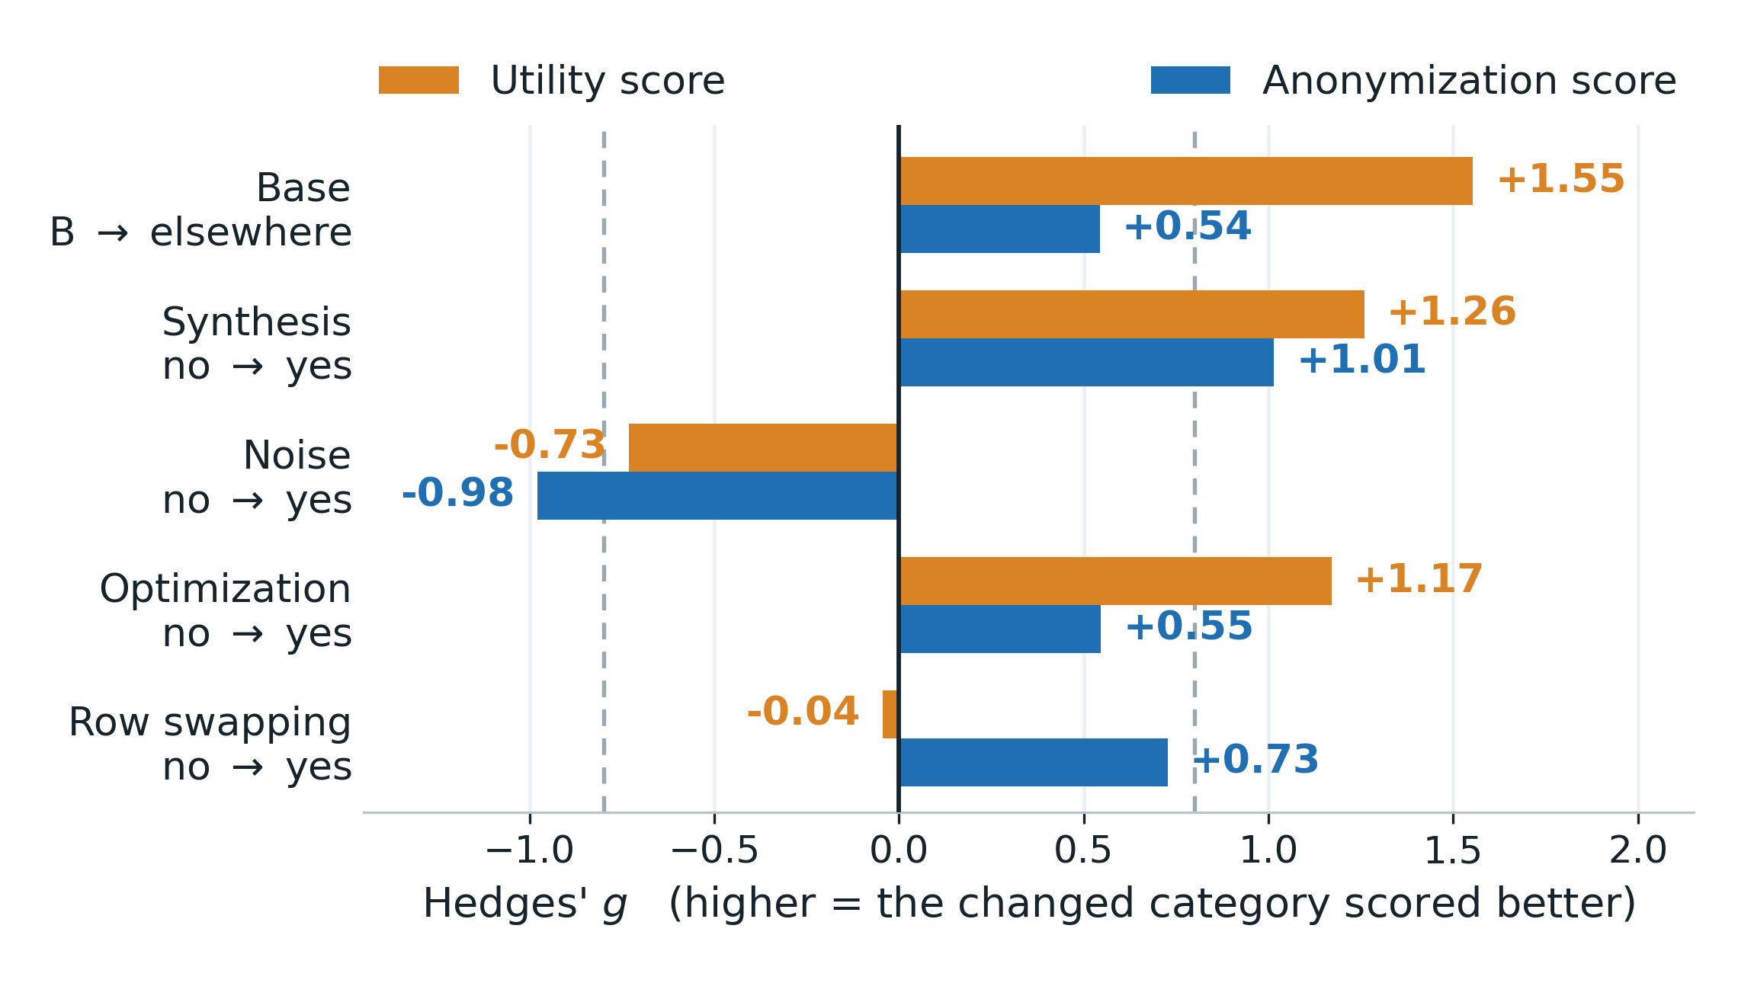
H1: Were generation/reconstruction designs associated with better utility and anonymization?
Main pattern
Synthesis moved utility and anonymization strongly in the same direction.
Base: B → elsewhere
utility +1.55
Synthesis
utility +1.26 · anon. +1.01
Explicit noise went the opposite way
Yes. - Some designs affected both scores in this contest.
Notes:
Here is the first result.
Orange is utility.
Blue is anonymization.
Positive values mean that the strategy on the right performed better.
The largest utility difference is at the top.
Teams that did not simply transform the provided sample, but instead reconstructed data from elsewhere, had substantially higher utility.
The effect size was 1.55.
Now look at synthesis.
Synthetic designs were associated with higher utility — 1.26 — and higher anonymization — 1.01.
That is the interesting part.
In this competition, synthesis was the one design choice that moved both outcomes strongly in the same direction.
Explicit noise went in the opposite direction.
Row swapping barely changed utility, but was positively associated with anonymization.
But there is an obvious objection.
Maybe these defenses only looked strong because they happened to face the wrong kind of attacker.

Slide 14
PWSCUP overview
全チームが何をしたか、を説明していたことを例示を踏まえて説明する
攻撃側の手法の例示(トップなど)
防御側の手法の例示(トップなど)
各チームの分析で利用した属性の意味を説明する
  Baseは「匿名化データを何のレコードを土台に作ったか」、Synthesisは「新しいレコードを生成したか」

Slide 15
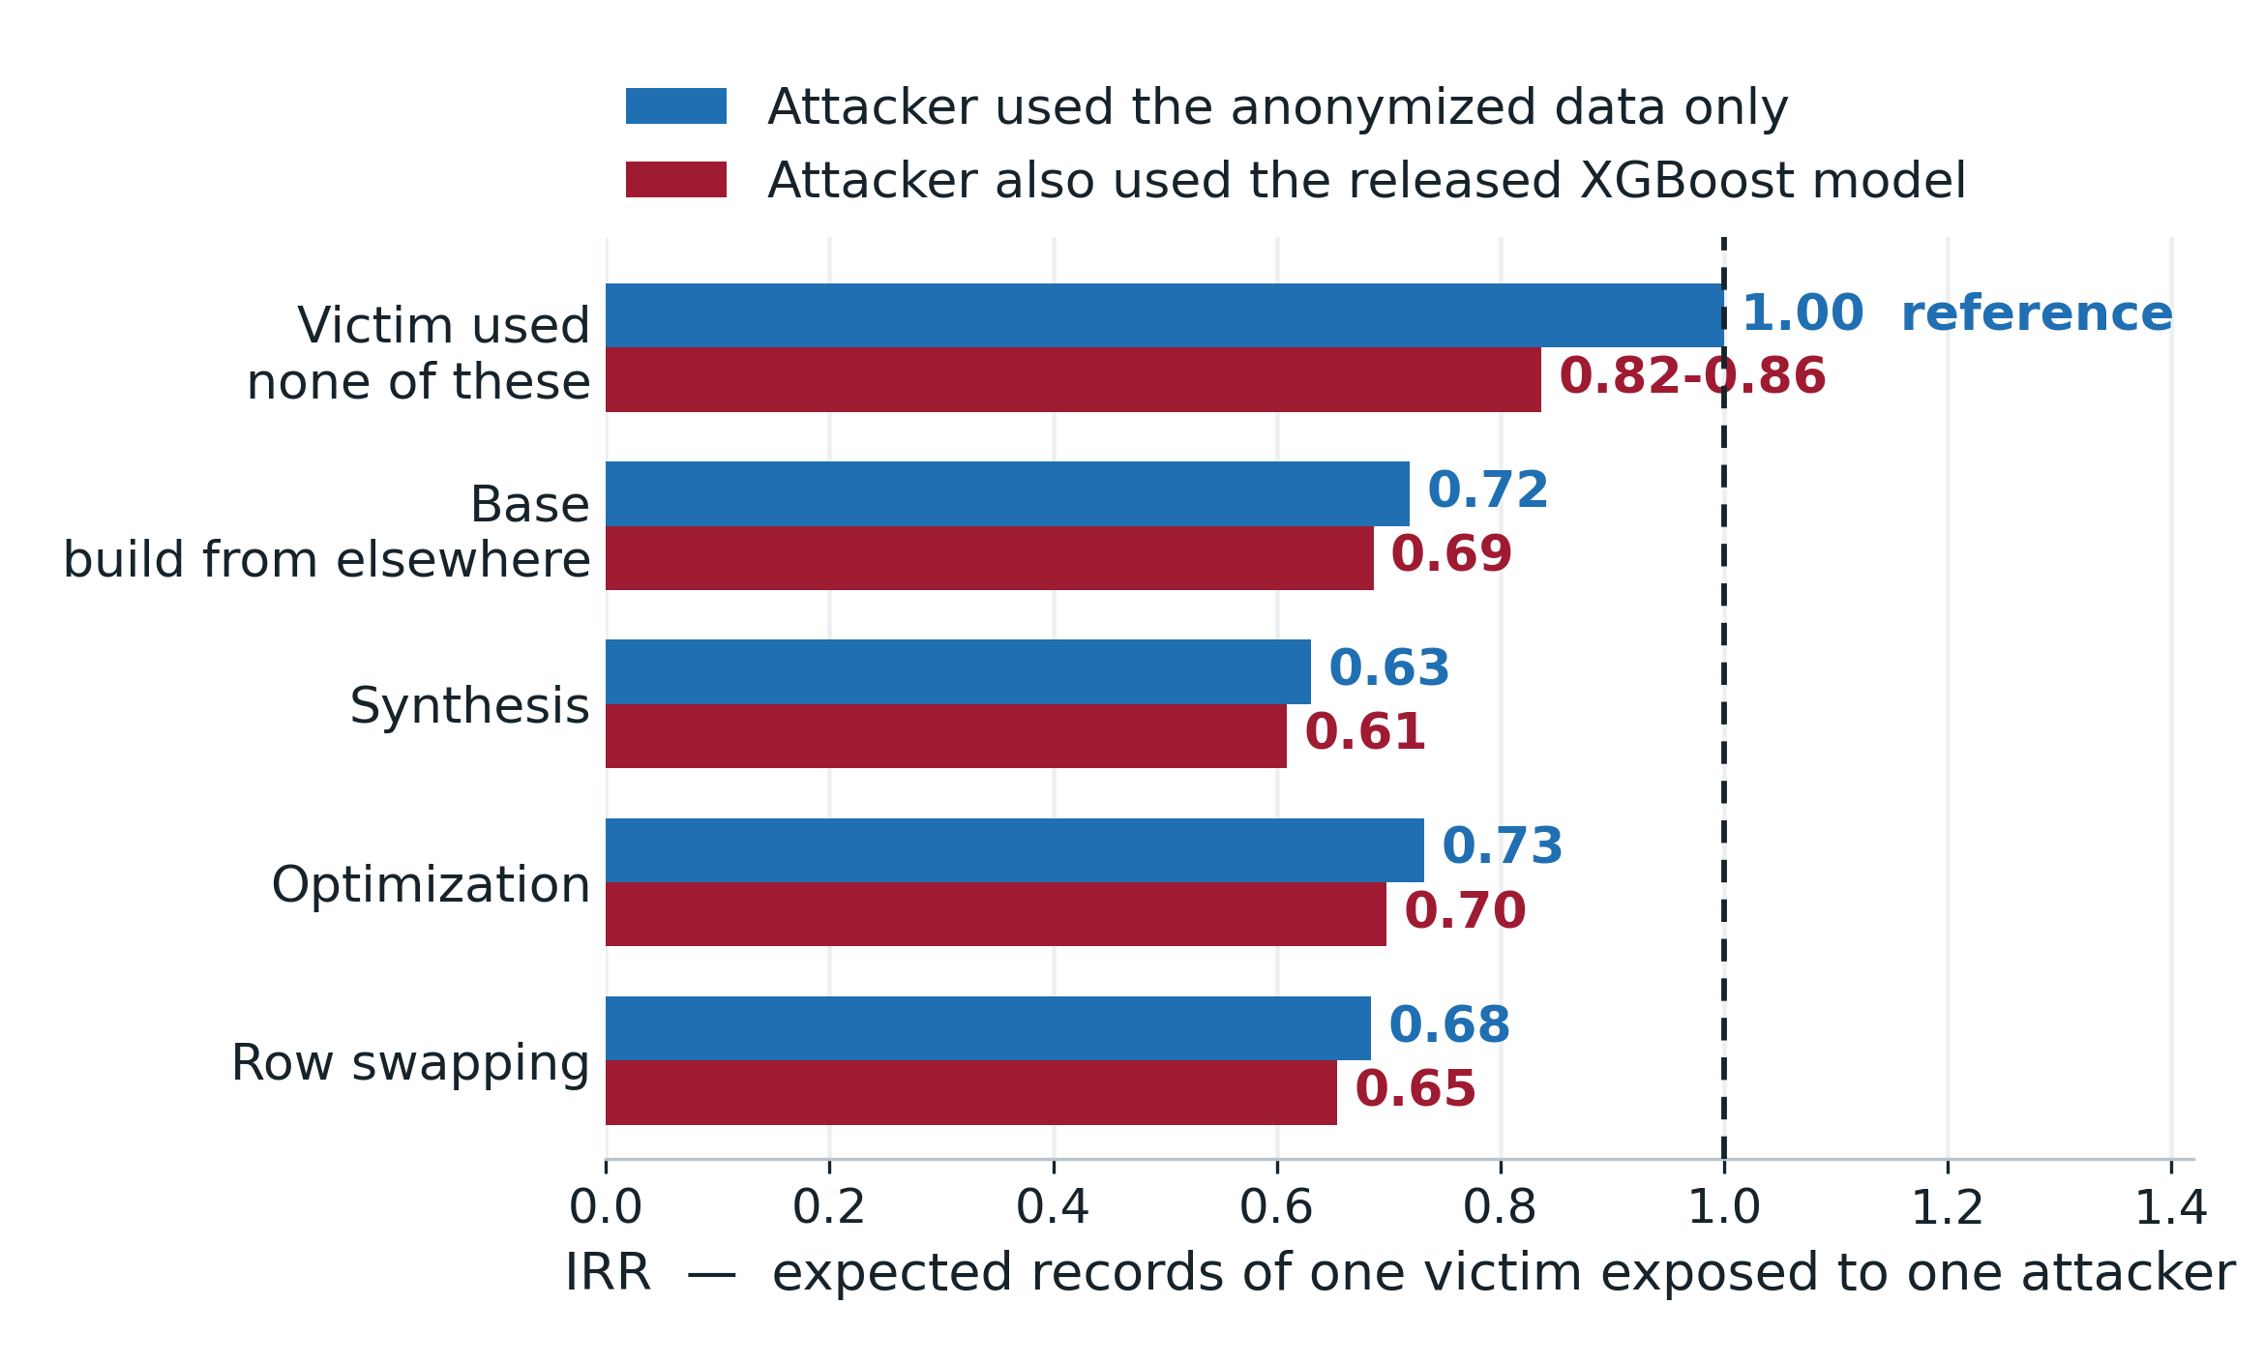
H2: Did disclosure risk depend on the combination of defender and attacker strategies?
IRR below 1 = fewer exposed records
Victim-side choices
IRR 0.63–0.73
≈ 27–37% lower exposure
Using the released model
worsened attacker’s performance but changed little once the victim used these designs
Partly yes. – disclosure risk partly relied on it in this contest.
Notes:
So for H2, we stopped looking at one score per team.
We analyzed all 361 ordered attacker–victim pairs directly.
The outcome is how many of one victim's records one attacker exposed.
An incidence rate ratio below one means fewer exposed records.
Start with the victim side.
Each of these four anonymization choices is associated with lower exposure.
The IRRs are around 0.63 to 0.73.
So, in these models, expected exposure is roughly 27 to 37 percent lower.
Now look at the attacker.
Attackers that also used the released XGBoost model actually performed slightly worse against victims using none of these designs.
That surprised us.
And once the victim used one of these stronger anonymization designs, adding the released model changed very little.
So the exact pairing does matter.
But the much larger pattern comes from the victim's anonymization choice.
These results look interesting.
But before asking how general they are, we need to be very clear about what this study can and cannot tell us.

Slide 16
仮説1の図と得られた示唆

Slide 17
Exploratory patterns, not universal laws
What this cannot support
What it still gives us
20 teams, observed not assigned
→ associations, not causal effects
Within PWS Cup 2025, these are the patterns the data show
Coded from presentations
→ method family, not parameters
Type-level descriptions were enough to produce specific, quantified hypotheses
One contest, one synthetic population, one scoring rule
→ not universal
The same coding idea can apply wherever approaches are reported at this level of detail
You do not need the code to start asking the right questions.
Notes:
There are three important limitations.
First, twenty teams — and the strategies were observed, not randomly assigned.
So these are associations, not causal effects.
Second, our coding captures the family of the method, not its parameters or implementation.
And third, this is one contest, with one synthetic population and one scoring system.
So I am not claiming that synthetic data is universally better, or that these attack results generalize to every setting.
These are exploratory patterns from PWS Cup 2025.
But remember the question we started with.
We deliberately began with incomplete information.
And even at that resolution, we were able to move from vague descriptions to specific, quantitative hypotheses.
And I think that is the more general lesson from this study.

Slide 18
仮説2の図と得られた示唆

Slide 19
Incomplete information does not mean no information
Full disclosure is valuable.
But when it is unrealistic, structured type-level reporting still has value.
No report
Vague poster
Structured questionnaire
Full code
Controlled study
Feasibility
Rigor
One ask for future competitions
If full source-code release is unrealistic, require every team to answer a short structured questionnaire about its strategy.
We may not have the source — but we can still start finding the patterns.
Notes:
Let me return to where I started.
Full disclosure is extremely valuable for research.
But as the Netflix case illustrates, disclosure can also create real privacy and organizational risks.
So in practice, we will sometimes have to study systems without seeing every implementation detail.
Our PWS Cup case suggests that this does not mean we have to give up.
Type-level descriptions were not enough for definitive conclusions.
But they were enough to identify patterns, quantify them, and formulate questions that can now be tested more rigorously.
And this suggests a very simple next step.
Requiring every participant to release complete source code may not always be realistic.
But asking every team to complete a short, structured questionnaire about its strategy is much easier.
Then the next analysis can begin with structured evidence, rather than reconstructing it afterwards.
We may not have the source — but we can still start finding the patterns.
Thank you.

Slide 20
THANK YOU
Patterns Without Source:
A Meta-Analysis of PWS Cup 2025
Questions?
Reconstructed data, codebook and analysis code
github.com/kiti1924/PWSCUP2025_REVIEW_PUB
Competition materials and full results
iwsec.org/pws/2025/cup25.html
Contact
kikuchih@ism.ac.jp
Supported by JST K Program, Grant Number JPMJKP24U5, Japan.

Slide 21
BACKUP
Slides for questions
Patterns Without Source · PSD 2026, Cadiz
12
Notes:
Divider - do not show unless a question needs it.
(JP) B1 結果表 / B2 特徴量ツリー / B3 AICc回帰 / B4 チーム別コーディング / B5 全dyadicモデル / B6 Groundhog Day 対比

Slide 22
Backup: PWS Cup 2025 main results
Team | Utility | Pen. | Anon. | Total | Rank | Attack
1 | 91.89 | 13 | 70.47 | 162.36 | 8 | 113.81
2 | 91.92 | 14 | 72.86 | 164.78 | 6 | 105.43
3 | 75.93 | 20 | 65.73 | 141.66 | 17 | 105.81
4 | 77.98 | 10 | 78.60 | 156.58 | 11 | 101.47
5 | 91.64 | 19 | 66.75 | 158.39 | 10 | 107.74
6 | 91.25 | 11 | 78.31 | 169.56 | 4 | 109.17
7 | 74.09 | 17 | 71.91 | 146.00 | 16 | 103.93
8 | 91.18 | 10 | 78.63 | 169.81 | 3 | 121.13
9 | 81.04 | 13 | 74.30 | 155.34 | 12 | 106.84
10 | 91.93 | 14 | 72.21 | 164.14 | 7 | 13.79
11 | 84.54 | 14 | 69.32 | 153.86 | 13 | 104.06
12 | 78.21 | 15 | 73.90 | 152.11 | 14 | 106.60
Team | Utility | Pen. | Anon. | Total | Rank | Attack
13 | 90.84 | 13 | 76.50 | 167.34 | 5 | 106.93
14 | 77.36 | 20 | 24.64 | 102.00 | 22 | 101.22
15 | 67.99 | 17 | 67.81 | 135.80 | 19 | 106.09
16 | 81.75 | 12 | 77.28 | 159.03 | 9 | 107.59
17 | 75.40 | 19 | 30.44 | 105.84 | 21 | 102.79
18 | 91.55 | 10 | 79.28 | 170.83 | 1 | 108.39
19 | 70.95 | 12 | 75.11 | 146.06 | 15 | 101.50
20 | 94.67 | 11 | 75.57 | 170.24 | 2 | 99.99
22 | 84.41 | 20 | 47.69 | 132.10 | 20 | 102.83
23 | 66.36 | 12 | 70.29 | 136.65 | 18 | 100.63
24 | 69.59 | 20 | 0.00 | 69.59 | 23 | 104.46
Team 21 withdrew. Team 10 submitted no attack. Final score = 0.1 x preliminary round + 0.9 x main round. The anonymization score already has the penalty subtracted.
Patterns Without Source · PSD 2026, Cadiz
13
Notes:
Team 18 won overall; team 8 was the strongest attacker (121.13); teams 14, 17, 22 and 24 were the vulnerable ones.

Slide 23
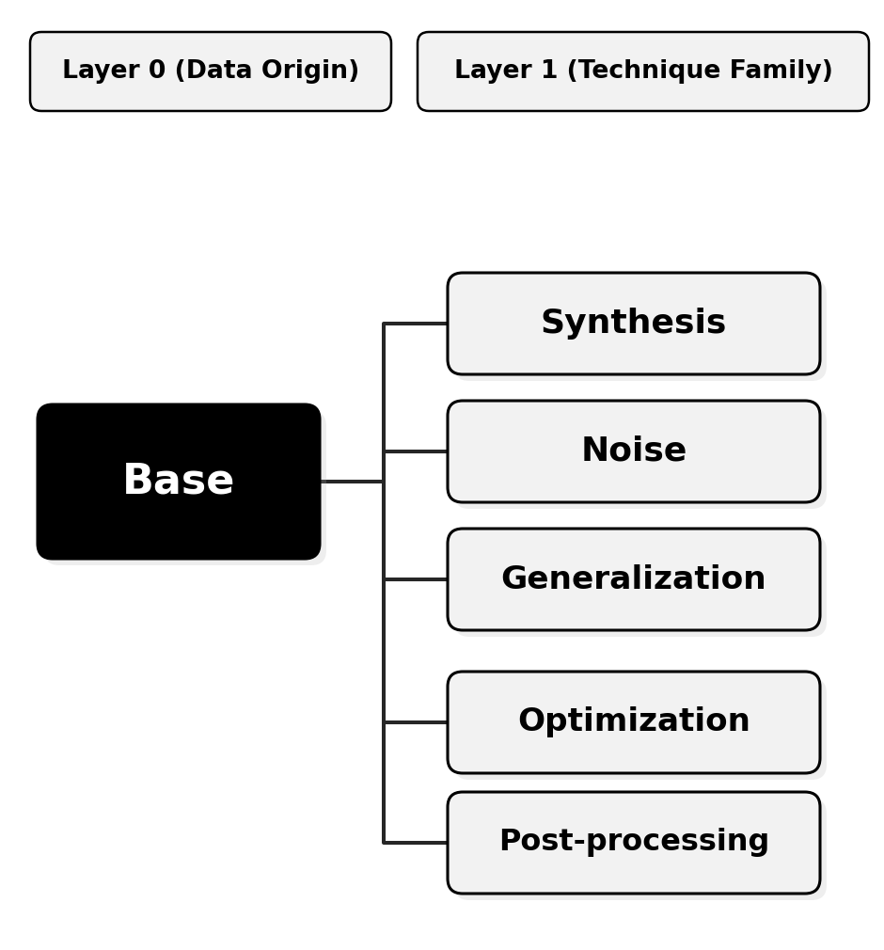
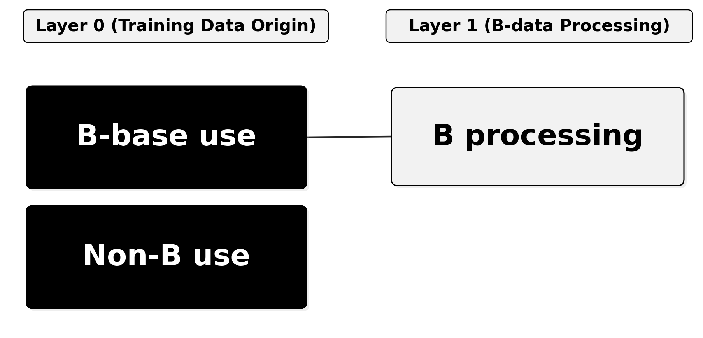
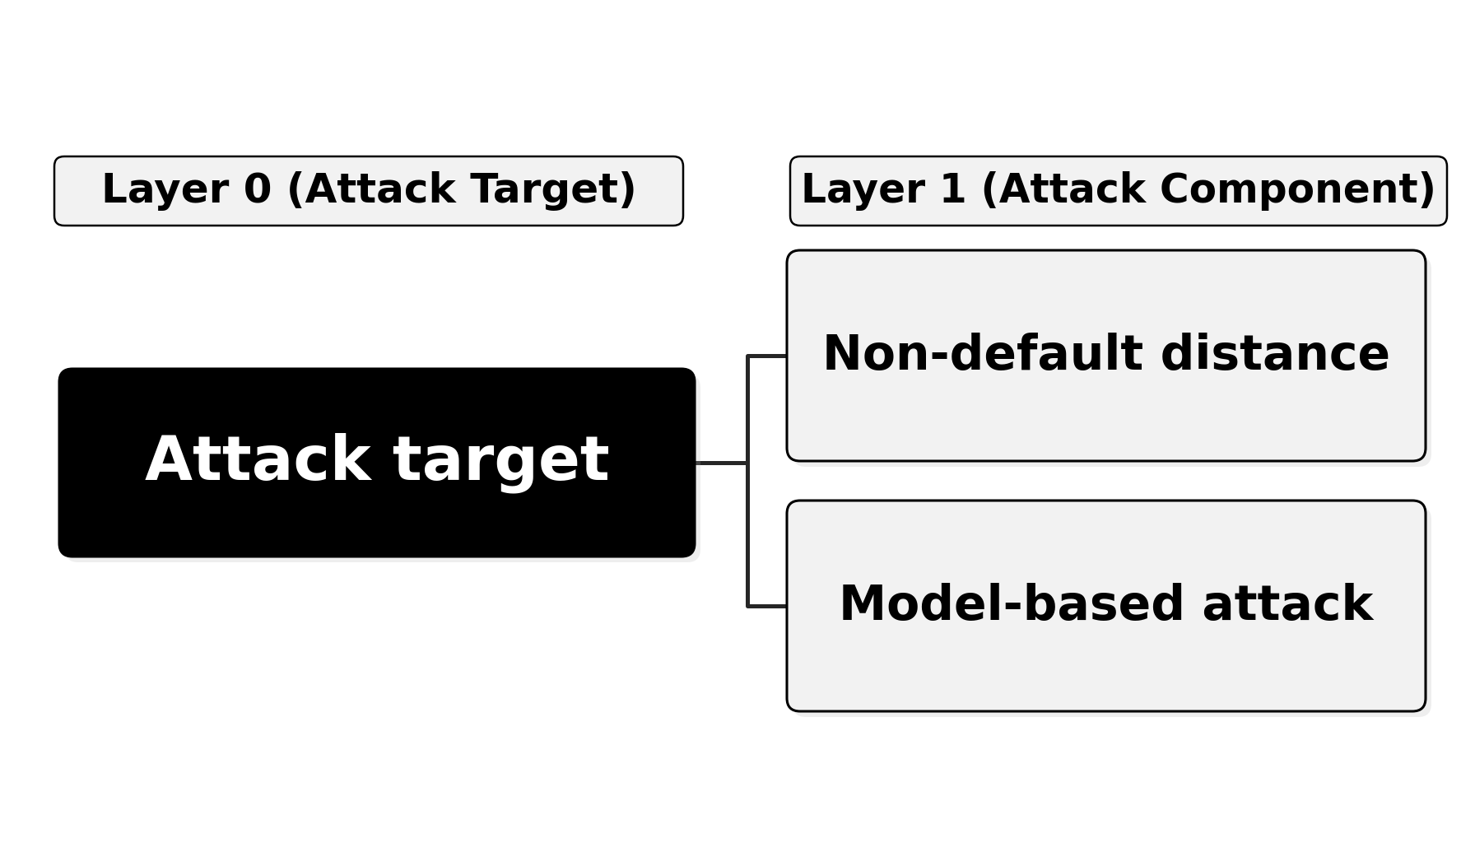
Backup: the full feature taxonomies
Anonymization
Training models
Features are hierarchical: a Layer 1 feature refines its Layer 0 parent. Only features present in at least four teams were kept.
Attacks
Patterns Without Source · PSD 2026, Cadiz
14
Notes:
Backup for 'how exactly did you code the approaches'.

Slide 24
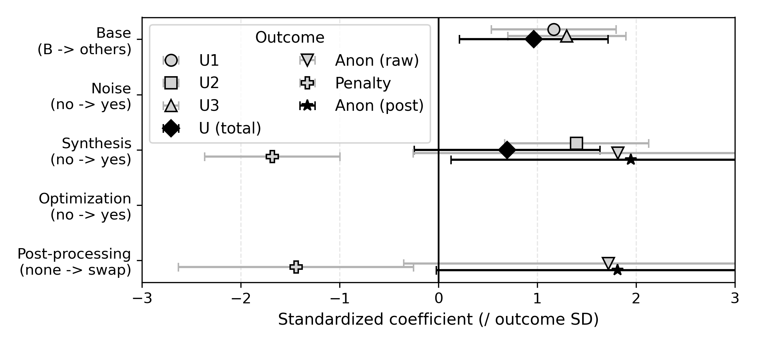
Backup: the AICc-selected regressions agree with the effect sizes
Two things worth saying
Optimization had g = 1.17 but was never retained.
Four of the six teams that optimized also built from elsewhere, and optimization went with synthetic designs. Once Base or Synthesis is in the model, AICc no longer pays for it — exactly the confounding the search is there to catch.
The anonymization models keep an interaction.
Synthesis x swapping, R2 between 0.47 and 0.69. Swapping raises the base anonymization score by about 32 points for non-synthetic designs, and leaves synthetic ones essentially unchanged.
Standardized OLS coefficients, 95% CI. A missing point means the feature was not retained for that outcome.
Patterns Without Source · PSD 2026, Cadiz
15
Notes:
Backup for 'did the multivariate analysis agree' and 'why did optimization drop out'.

Slide 25
Backup: team-level coding
Team | Base | Synth | Noise | Optim | Swap
1 | others | Y | N | N | none
2 | B | Y | N | N | none
3 | B | N | N | N | swap
5 | others | Y | N | Y | swap
6 | B | N | Y | N | swap
8 | others | Y | N | Y | swap
9 | B | N | Y | N | swap
10 | others | Y | N | Y | none
11 | others | N | Y | Y | swap
12 | B | Y | N | N | none
13 | B | Y | N | Y | none
15 | B | N | Y | N | none
16 | B | Y | N | N | swap
17 | B | N | Y | N | none
18 | others | Y | N | Y | none
19 | B | Y | N | N | swap
20 | others | Y | N | N | swap
22 | B | N | N | N | none
23 | B | N | N | N | swap
24 | B | N | Y | N | none
Team | Attack target | Non-default dist. | Attacker-trained
1 | anon | Y | N
2 | anon | N | Y
3 | anon | N | N
5 | anon | Y | N
6 | anon | N | Y
8 | anon | N | Y
9 | anon | N | N
10 | -- | -- | --
11 | both | N | N
12 | anon | N | Y
13 | anon | Y | Y
15 | both | Y | Y
16 | anon | Y | N
17 | anon | N | N
18 | anon | Y | N
19 | anon | N | N
20 | both | N | N
22 | anon | N | N
23 | anon | Y | N
24 | both | Y | N
Team 21 withdrew; teams 4, 7, 14 and 21 could not be coded. Team 10 submitted no attack.
Patterns Without Source · PSD 2026, Cadiz
16
Notes:
Backup for 'which team did what'. Same table is in the paper's appendix and in the public repository.

Slide 26
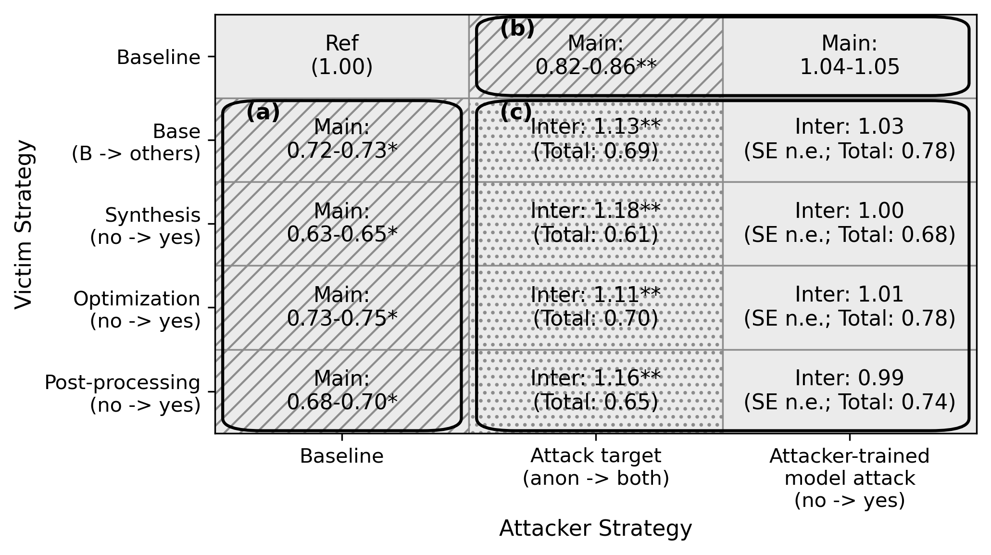
Backup: the full dyadic model, all eight specifications
How to read the cells
Main
The main-effect IRR, as a range across the four specifications that share that variable.
Inter
The interaction coefficient itself — not an effect you can read on its own.
Total
victim x attacker x interaction — the expected exposure when both are present. These are the numbers plotted on the H2-1 slide.
SE n.e.
The two-way clustered standard error was not estimable, so no inferential claim is made — this is why H2-2 is reported as a null result rather than a small effect.
The version printed in the paper. Areas (a) victim main effects, (b) attacker main effects, (c) interactions.
Patterns Without Source · PSD 2026, Cadiz
17
Notes:
Backup for anyone who wants the coefficient decomposition behind the H2-1 chart, or the H2-2 specifications.

Slide 27
Backup: how this sits against the synthetic-data literature
The tension
Other likely questions
Stadler et al. (2022) conclude that synthetic data does not give a better privacy-utility trade-off than traditional row-level sanitization.
Here, synthesis was associated with higher scores on both axes at once.
The two are not directly comparable. We compare across teams and whole design families, not parameters within one algorithm. Varying a parameter inside one method would still trace the classic trade-off curve.
Differential privacy? Several teams tried DP synthesizers and abandoned them - utility was too low under this scoring rule. Only two used explicit Laplace noise.
Why negative binomial? The exposed-record counts are heavily over-dispersed relative to Poisson.
Why did using the released model hurt attackers? We can only speculate: the model carries little membership signal here, and the effort spent on it did not go into the distance matching that worked.
Patterns Without Source · PSD 2026, Cadiz
18
Notes:
The Groundhog Day question is the one this audience is most likely to ask.

