Slide 1
PSD 2026 · CADIZ, SPAIN · SESSION: SYNTHETIC DATA I
Patterns Without Source
A Meta-Analysis of PWS Cup 2025
Hinata Kikuchi · Hajime Ono · Kazuhiro Minami
Research Organization of Information and Systems · Chuo University · The Institute of Statistical Mathematics · Kanazawa University
30 September 2026, 16:15 · Short presentation · Paper in USB proceedings
Patterns Without Source · PSD 2026, Cadiz
1
Notes:
[0:00-0:25 | 25 sec]
Good afternoon. I am Hinata Kikuchi from the Institute of Statistical Mathematics. This is joint work with Hajime Ono and Kazuhiro Minami.
In ten minutes I want to convince you of one thing: you can learn something from a competition even when you only ever see what type of method each team used.
---
(JP) 25秒。名乗り＋一文のフック。原稿を読まず聴衆を見る。ここで速度を決める。

Slide 2
We usually learn the type of method, never the detail
In PWS Cup 2025
And outside the contest
Every team presents its approach at the final showcase, so the family of method is public
Parameters, implementation and stopping rules are not — and only 2 of 24 teams released code
Breach reports, news coverage and vendor statements name the type of anonymization and the type of attack
The detail behind them is almost never published
?
How far can type-level descriptions alone take us?
PWS Cup 2025 gives us 24 teams' outcomes, and a type-level description of how each of them got there.
Patterns Without Source · PSD 2026, Cadiz
2
Notes:
[0:25-1:25 | 60 sec]
Red-teaming is now the accepted way to check whether anonymization really protects people, and competitions are where that happens in public. But notice what a competition actually leaves behind.
In PWS Cup 2025, every team presented its approach at the final showcase. So the family of method is public - you know a team used a copula, or added noise, or matched records by distance. What is not public is the detail: the parameters, the implementation, where they stopped tuning. Two of the twenty-four teams released code.
And that is not a defect peculiar to this contest. It is the normal situation. A breach report, a news story, a vendor statement - they tell you what kind of anonymization was in place and what kind of attack was run. The detail almost never appears.
So the question is: how far can type-level descriptions alone take us?
---
(JP) 60秒。ここが talk 全体の入口。「コードが無い」ではなく「詳細が無く類型だけがある」という状況を、PSD 参加者自身が日常的に直面する問題として置く。

Slide 3
PWS Cup 2025: every team is both defender and attacker
1
Anonymization phase
2
Attack phase
A population
Every team receives A, C and D of every other team.
100,000 rows · Synthea health data · 18 variables
anonymize
C anonymized data
submitted
Which 10,000 rows of A
were in that team's B?
B hidden sample
10,000 rows drawn from A — never published
D XGBoost stroke model
Membership inference — one guess set per victim, 24 teams attacking each other.
train
submitted
Utility score from C and D, up to 100 Anonymization score = (10,000 − best attacker's correct guesses) / 100, minus a penalty
Patterns Without Source · PSD 2026, Cadiz
3
Notes:
[1:25-2:35 | 70 sec]
PWS Cup is a Japanese anonymization contest, run every year since 2015, and every team plays both roles.
Follow the letters, because I will use them for the rest of the talk. The organizer generates a population A - a hundred thousand Synthea health records. From A it draws a sample B of ten thousand rows and gives it to one team. B is never published. The team turns B into anonymized data C, and trains an XGBoost stroke-risk model D on it. C and D are what it submits.
Then everyone attacks everyone. Each team receives the A, the C and the D of every other team, and has to say which rows of A were in that team's hidden B. That is a membership inference attack.
Utility is scored from C and D, out of a hundred. Your anonymization score is what your best attacker could not do to you, minus a penalty if the same record was found by many attackers.
---
(JP) 70秒。図の A→B→C,D を指でなぞる。A⊃B の包含関係が伝われば残りは速い。

Slide 4
We recovered each team's approach by hand, at the showcase
24
teams registered
20
approaches we could reconstruct
2
teams that released code
1
Attend the showcase
2
Write the approaches down
3
Code them as categories
Posters, spotlight talks and follow-up discussions - the only public record of each team's approach.
Anonymization, model training and attack, documented team by team.
Keep a feature only if at least four teams used it, so no effect rests on one or two teams.
What we recovered is the family of each team's method — not its parameters, and not its code.
Patterns Without Source · PSD 2026, Cadiz
4
Notes:
[2:35-3:25 | 50 sec]
So we went and recovered it. We attended the final showcase and documented, team by team, how they anonymized, how they trained their model, and how they attacked - from the posters, the spotlight talks, and conversations in the room.
That gave us usable summaries for twenty of the twenty-four teams. We encoded each approach as categorical features, and kept a feature only if at least four teams used it, so nothing we report rests on one or two idiosyncratic teams.
To be clear about the resolution: what we recovered is the family of each method. Not its parameters, and not its code.
---
(JP) 50秒。「精度＝類型レベル」であることを事実として言い切る。謝罪口調にしない。

Slide 5
Eight categorical features — and what the two winners chose
Defender
Attacker
20 teams
19 teams
Base
B (13) → elsewhere (7)
Attack target
anonymized data only (15) → also the released model (4)
Synthesis
no (9) → yes (11)
Attacker-trained model
no (13) → yes (6)
Noise
no (14) → yes (6)
Optimization
no (14) → yes (6)
Non-default distance
no (11) → yes (8)
Row swapping
no (10) → yes (10)
→ marks the contrast direction: every effect size and every IRR is reported for the right-hand category.
Ex. Team 18 — overall rank 1
Ex. Team 8 — best attack score
elsewhere · synthesis yes · noise no · optimization yes · swapping no
anonymized data only · attacker-trained model yes · non-default distance no
Inferred Synthea's parameters with a generative model, built a pseudo-population, then picked its best 10,000 rows by simulated annealing.
A Gaussian LiRA combined with a distance attack on covariance-augmented data.
Patterns Without Source · PSD 2026, Cadiz
5
Notes:
[3:25-4:15 | 50 sec]
These are the features that survived, with the split across their two values, and the arrow tells you which direction I will report: every number later is for the right-hand category.
Five on the defender side. The one that matters most is Base: did the team start from the sample B it was given, or build its dataset from somewhere else. Then synthesis, explicit noise, an optimization loop, and row swapping afterwards. Three on the attacker side: did the attack also use the released model D, did the attacker train its own membership model, did it go beyond plain Manhattan distance.
The two boxes at the bottom make it concrete. Team 18 won overall: it did not use B at all - it inferred Synthea's parameters with a generative model, built its own pseudo-population, and picked the best ten thousand rows by simulated annealing. Team 8 was the strongest attacker: a Gaussian LiRA combined with a distance attack on covariance-augmented data.
---
(JP) 50秒。表は読み上げない。矢印の意味を一度だけ言い、Ex の2チームを具体例として語る。

Slide 6
Three questions — and how we test them with n = 20
H1
H2-1
H2-2
Do generation- and reconstruction-based designs beat direct perturbation — on utility and on anonymization?
Does an anonymization design become vulnerable when the attacker also uses the released XGBoost model?
Does it become vulnerable when the attacker trains its own membership model on the anonymized data — LiRA, RMIA?
Effect sizes
Regression model search
Dyadic model
Hedges' g across the 20 teams, corrected for the small sample. |g| above 0.8 is a large effect.
A large univariate effect can come from a feature's correlation with another coded feature. The AICc search checks whether it survives with the others in the model.
Negative binomial over all 361 ordered victim-attacker pairs, so the pairing itself is in the model. Errors clustered by attacker and by victim.
Patterns Without Source · PSD 2026, Cadiz
6
Notes:
[4:15-5:15 | 60 sec]
Three questions came out of the showcase. H1 is the oldest argument in this room: does building a fresh dataset actually beat perturbing the real one? Then two separate attack questions, and they are genuinely different. H2-1: does a design become vulnerable when the attacker also exploits the released XGBoost model - external information the defender handed over? H2-2: does it become vulnerable when the attacker instead trains its own membership model on the anonymized data, LiRA or RMIA style?
Twenty teams, so the method has to suit that. We lead with effect sizes. Then a regression model search - and the reason is specific: with features this correlated, a large univariate effect can simply be another feature showing through, so the AICc search asks whether it survives when the others are in the model. And for the attack questions we keep the pairing: a dyadic model over all 361 ordered pairs, with errors clustered by attacker and by victim.
---
(JP) 60秒。H2 を 2 つに割ったことを明確に。回帰探索の目的＝交絡・相関の確認、と一言で言う。

Slide 7
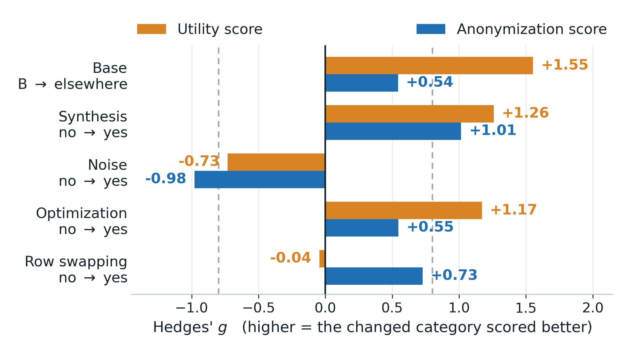
H1: reconstructing beat perturbing — on both scores
Base (B → elsewhere)
utility +1.55
Synthesis
utility +1.26 · anon. +1.01
Explicit noise
utility -0.73 · anon. -0.98
Row swapping
utility -0.04 · anon. +0.73
The AICc search keeps Base for the statistics and Kruskal-Wallis parts, Synthesis for logistic regression.
Synthesis is the one choice that moved both scores at once.
Hedges' g across 20 teams. Dashed lines mark |g| = 0.8, the conventional threshold for a large effect.
Patterns Without Source · PSD 2026, Cadiz
7
Notes:
[5:15-6:35 | 80 sec]
Here is H1. Orange is the utility score, blue is the anonymization score; the dashed lines are the conventional threshold for a large effect.
The strongest single effect is Base. Teams that did not start from the sample they were given, but rebuilt a dataset from elsewhere, scored higher on every utility component - g of one point five five. Synthesis is next, and this is the interesting one: large for utility at plus one point two six, and large for anonymization too at plus one point zero one. Adding explicit noise went the other way on both. Row swapping did nothing for utility but helped anonymization.
The AICc search agrees, and it adds one thing the effect sizes hide: swapping helps most on top of a non-synthetic design - about thirty-two points of anonymization score there, and essentially nothing for designs that were already synthetic.
So the highest scores in this contest did not come from carefully perturbing the real sample. They came from rebuilding a fresh one that reproduced the target statistics. And note: synthesis moved both scores in the same direction.
---
(JP) 80秒。最初の10秒で色の対応(橙=有用性/青=匿名性)を言う。Groundhog Day との緊張関係はここでは触れず、質疑で出させる (backup B5)。

Slide 8
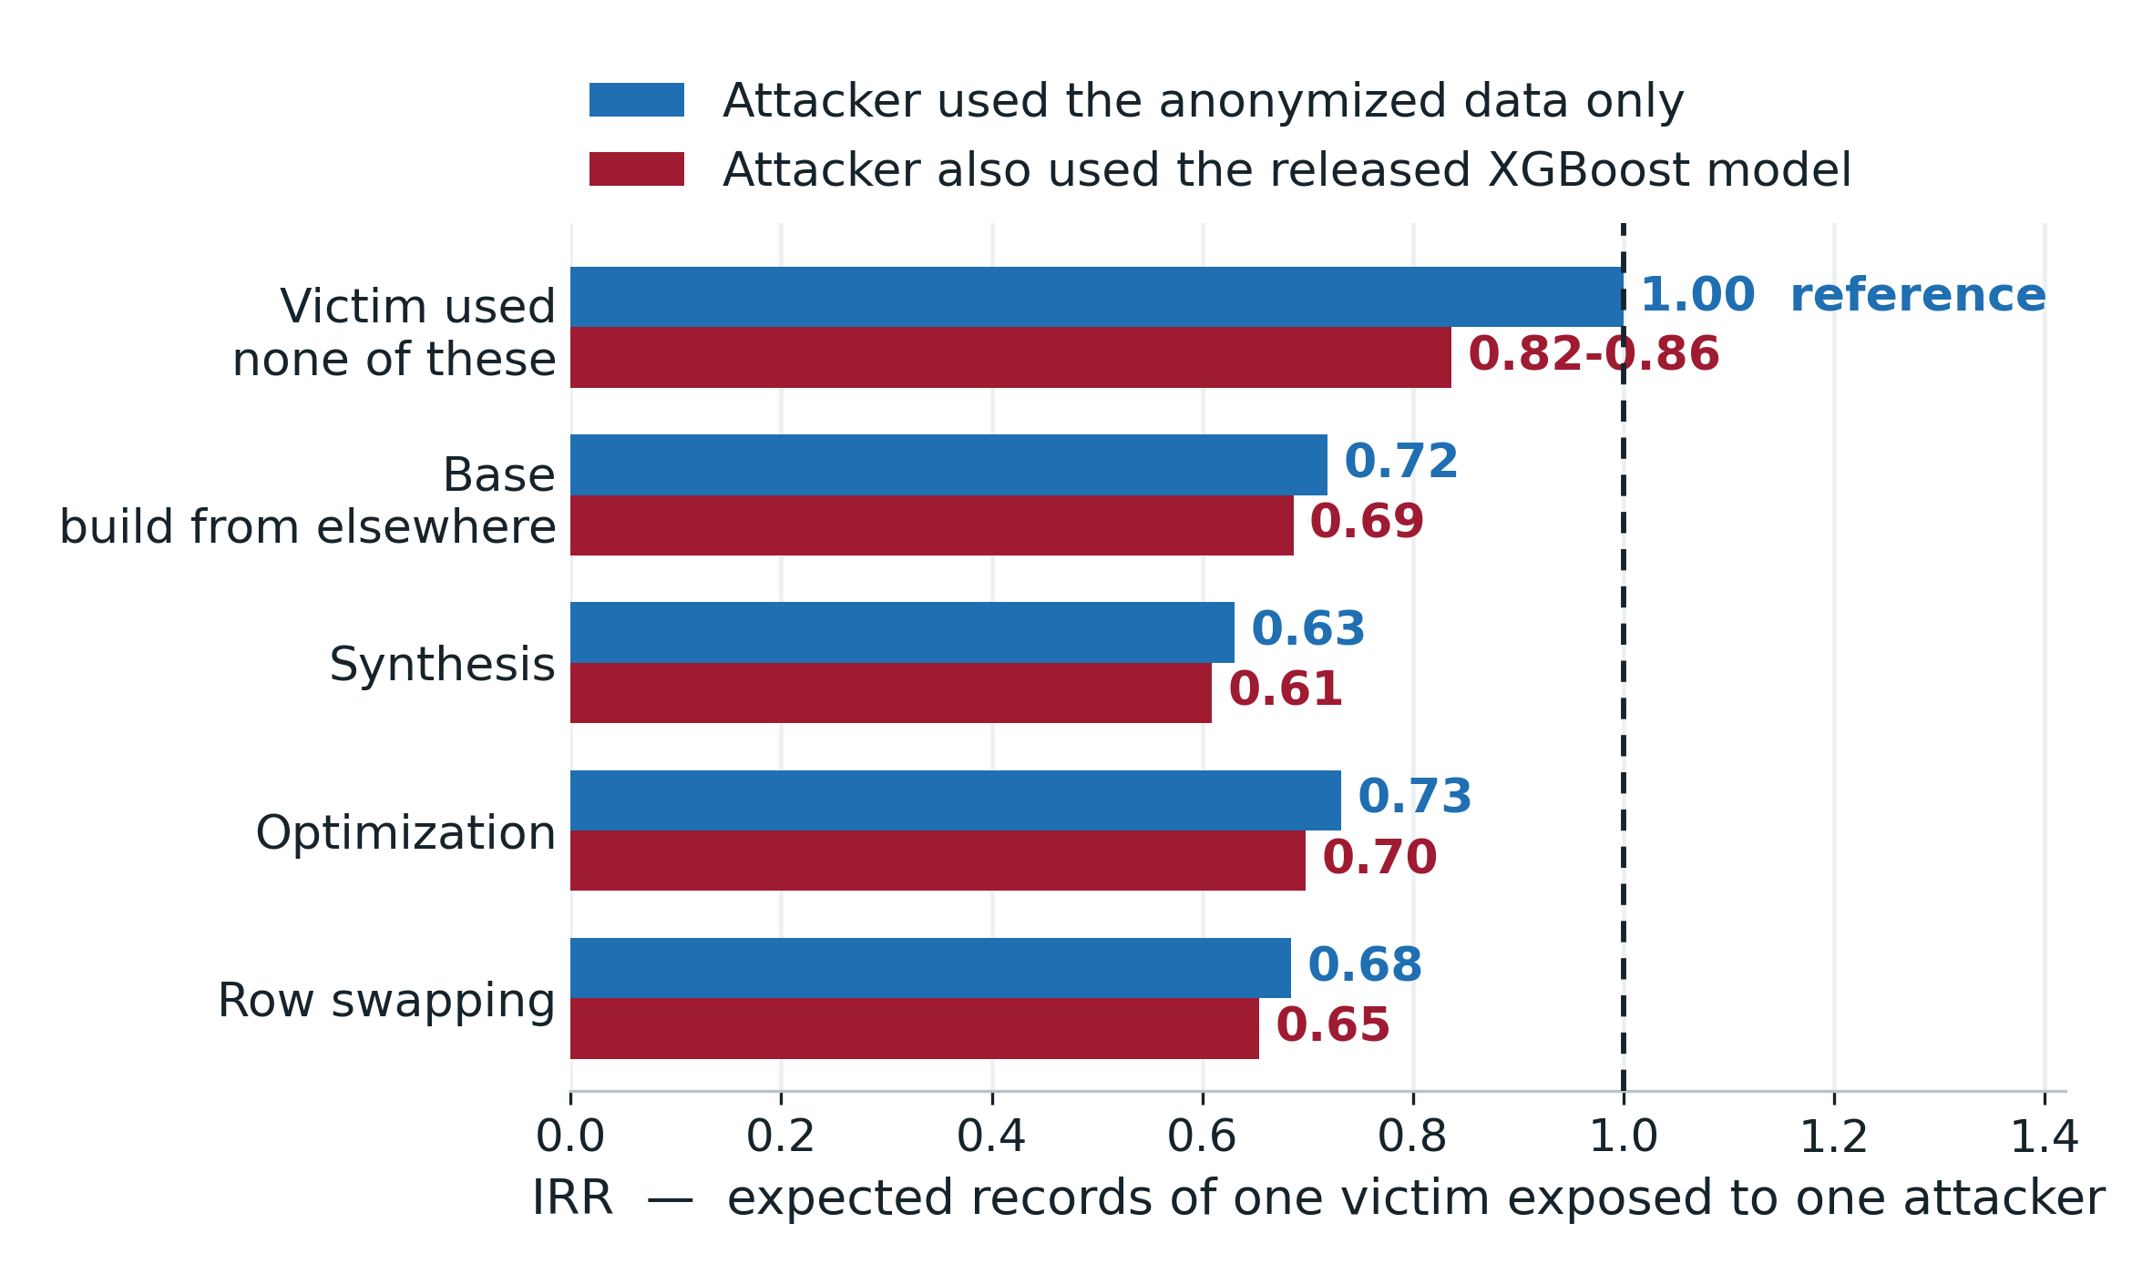
H2-1: the released model cost attackers, and only against weak targets
H2-1 partly yes
Every design cut exposure on its own: IRR 0.63-0.73, all p < 0.05
Attackers who also used the released model landed 14-18% fewer hits — against victims using none of these designs
Against victims that used them, the model bought nothing: 0.72 → 0.69, 0.63 → 0.61
H2-2 no
Attacker-trained membership models — LiRA, RMIA, classifiers — showed no effect: IRR 1.04-1.06, p = 0.31-0.59, and no estimable interaction with any design. No design was specifically vulnerable to them.
IRR = expected number of one victim's records exposed to one attacker; 1.00 = no design and no model use. Negative binomial, 361 ordered pairs, errors clustered by attacker and by victim.
Patterns Without Source · PSD 2026, Cadiz
8
Notes:
[6:35-8:05 | 90 sec]
Now the two attack questions. The chart is H2-1. Every bar is an incidence rate ratio: the expected number of one victim's records that one attacker found, with one meaning no design and no model use. Blue is an attacker working from the anonymized data alone, red is an attacker that also used the released XGBoost model.
Read the top row first. Against a victim that used none of these designs, the attacker who reached for the released model did worse, not better - fourteen to eighteen percent fewer hits. That surprised us.
Now the four rows below. Each design on its own cuts exposure to roughly 0.63 to 0.73, all significant. And look at the red bars there: 0.72 down to 0.69, 0.63 down to 0.61. Against a victim that used the design, using the model bought the attacker essentially nothing. So the pairing does matter, but only in that one direction: the model channel is worth something to the attacker only where the anonymization was weak to begin with.
H2-2 is quicker, and it is a null result. Attackers who trained their own membership model on the anonymized data - LiRA, RMIA, classifiers - show an IRR of about 1.04, p between 0.31 and 0.59. The interactions were not estimable. We found no evidence that any design was specifically vulnerable to them.
---
(JP) 90秒。上段(防御なし)→下段(防御あり)の順で読ませる。赤棒が下段でほぼ動かない点が要。H2-2 は図にせず、右下の黒カードを指して10秒で言い切る。

Slide 9
What this can and cannot support
The constraints
What it still gives us
20 teams, observed and not assigned — these are associations between design choices and scores, not causal effects
Coded from presentations: the family of each method, not its parameters
One contest, one Synthea population, one scoring rule
Within PWS Cup 2025, these are the patterns the data show
Type-level descriptions, with almost no code, were enough to produce specific and quantified hypotheses
The same coding applies to any contest that reports approaches at that level of detail
You do not need the code to start asking the right questions.
Patterns Without Source · PSD 2026, Cadiz
9
Notes:
[8:05-8:50 | 45 sec]
Let me be straight about the scope. Twenty teams, observed and not assigned - so associations, not causal effects. The coding is at the level of the method family, not its parameters. And it is one contest, one Synthea population, one scoring rule.
But within PWS Cup 2025, these are the patterns the data show. And the part I would like you to take away is this: type-level descriptions, with almost no code anywhere, were still enough to produce specific, quantified hypotheses. The same coding applies to any contest - or any setting - that reports approaches at that level of detail. You do not need the code to start asking the right questions.
---
(JP) 45秒。制約は事実として速く。右カードが本題 - PWS Cup を知らない聴衆に「あなたの状況でも使える」と渡す。

Slide 10
A short questionnaire would make the next contest analyzable
What we found
One ask for organizers
H1
Generation- and reconstruction-based designs scored higher on utility and on anonymization alike.
H2-1
Exploiting the released model cost the attacker — and bought nothing once the victim used one of these designs.
H2-2
Attacker-trained membership models showed no effect against any design.
Requiring source code is not always possible — industrial and privacy constraints are real, and this contest shows what happens: two teams out of twenty-four.
But a short questionnaire, answered by every team, costs almost nothing — and might already yield useful insight of the kind shown on the left.
Then the next analysis can start from what teams reported, instead of what we had to reconstruct.
Patterns Without Source · PSD 2026, Cadiz
10
Notes:
[8:50-9:40 | 50 sec]
To close. Three findings. H1: generation- and reconstruction-based designs scored higher on both. H2-1: exploiting the released model cost the attacker, and bought nothing once the victim used one of these designs. H2-2: attacker-trained membership models showed no effect against any design.
And one ask. Requiring source code is not always possible - industrial and privacy constraints are real, and this contest shows what that looks like: two teams out of twenty-four. But a short questionnaire, answered by every team, costs almost nothing, and might already yield insight of the kind you see on the left. Then the next analysis can start from what teams reported, instead of what we had to reconstruct.
---
(JP) 50秒。右カードが会場(組織委員・NSI関係者)への唯一の要求。控えめな言い方のまま、最後の一行で締める。

Slide 11
THANK YOU
Questions?
Patterns Without Source: A Meta-Analysis of PWS Cup 2025
Reconstructed data, codebook and analysis code
github.com/kiti1924/PWSCUP2025_REVIEW_PUB
Competition materials and full results
iwsec.org/pws/2025/cup25.html
Contact
kikuchih@ism.ac.jp
Supported by JST K Program, Grant Number JPMJKP24U5, Japan.
Patterns Without Source · PSD 2026, Cadiz
11
Notes:
[9:40-10:00 | 20 sec]
Everything is on GitHub - the reconstructed feature table, the codebook and the analysis code - so every coding decision is inspectable, and you can disagree with any of them. Thank you.
---
(JP) 20秒。ここで止める。質疑5分は発表の半分 - backup を使い切るつもりで。

Slide 12
BACKUP
Slides for questions
Patterns Without Source · PSD 2026, Cadiz
12
Notes:
Divider - do not show unless a question needs it.
(JP) B1 結果表 / B2 特徴量ツリー / B3 AICc回帰 / B4 チーム別コーディング / B5 全dyadicモデル / B6 Groundhog Day 対比

Slide 13
Backup: PWS Cup 2025 main results
Team | Utility | Pen. | Anon. | Total | Rank | Attack
1 | 91.89 | 13 | 70.47 | 162.36 | 8 | 113.81
2 | 91.92 | 14 | 72.86 | 164.78 | 6 | 105.43
3 | 75.93 | 20 | 65.73 | 141.66 | 17 | 105.81
4 | 77.98 | 10 | 78.60 | 156.58 | 11 | 101.47
5 | 91.64 | 19 | 66.75 | 158.39 | 10 | 107.74
6 | 91.25 | 11 | 78.31 | 169.56 | 4 | 109.17
7 | 74.09 | 17 | 71.91 | 146.00 | 16 | 103.93
8 | 91.18 | 10 | 78.63 | 169.81 | 3 | 121.13
9 | 81.04 | 13 | 74.30 | 155.34 | 12 | 106.84
10 | 91.93 | 14 | 72.21 | 164.14 | 7 | 13.79
11 | 84.54 | 14 | 69.32 | 153.86 | 13 | 104.06
12 | 78.21 | 15 | 73.90 | 152.11 | 14 | 106.60
Team | Utility | Pen. | Anon. | Total | Rank | Attack
13 | 90.84 | 13 | 76.50 | 167.34 | 5 | 106.93
14 | 77.36 | 20 | 24.64 | 102.00 | 22 | 101.22
15 | 67.99 | 17 | 67.81 | 135.80 | 19 | 106.09
16 | 81.75 | 12 | 77.28 | 159.03 | 9 | 107.59
17 | 75.40 | 19 | 30.44 | 105.84 | 21 | 102.79
18 | 91.55 | 10 | 79.28 | 170.83 | 1 | 108.39
19 | 70.95 | 12 | 75.11 | 146.06 | 15 | 101.50
20 | 94.67 | 11 | 75.57 | 170.24 | 2 | 99.99
22 | 84.41 | 20 | 47.69 | 132.10 | 20 | 102.83
23 | 66.36 | 12 | 70.29 | 136.65 | 18 | 100.63
24 | 69.59 | 20 | 0.00 | 69.59 | 23 | 104.46
Team 21 withdrew. Team 10 submitted no attack. Final score = 0.1 x preliminary round + 0.9 x main round. The anonymization score already has the penalty subtracted.
Patterns Without Source · PSD 2026, Cadiz
13
Notes:
Team 18 won overall; team 8 was the strongest attacker (121.13); teams 14, 17, 22 and 24 were the vulnerable ones.

Slide 14
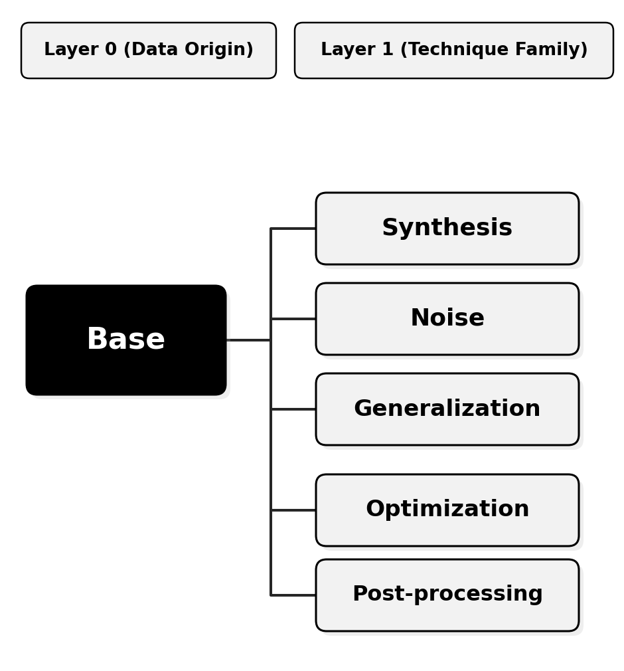
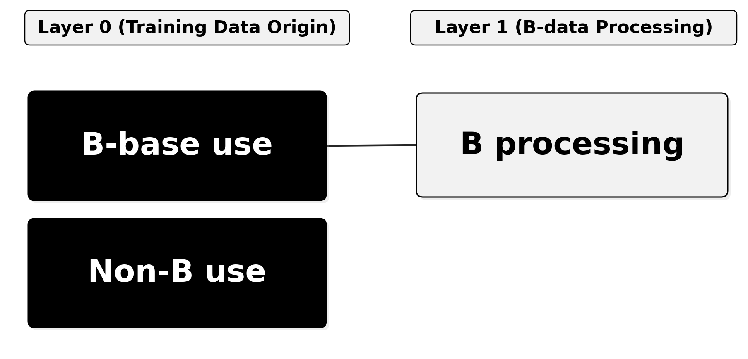
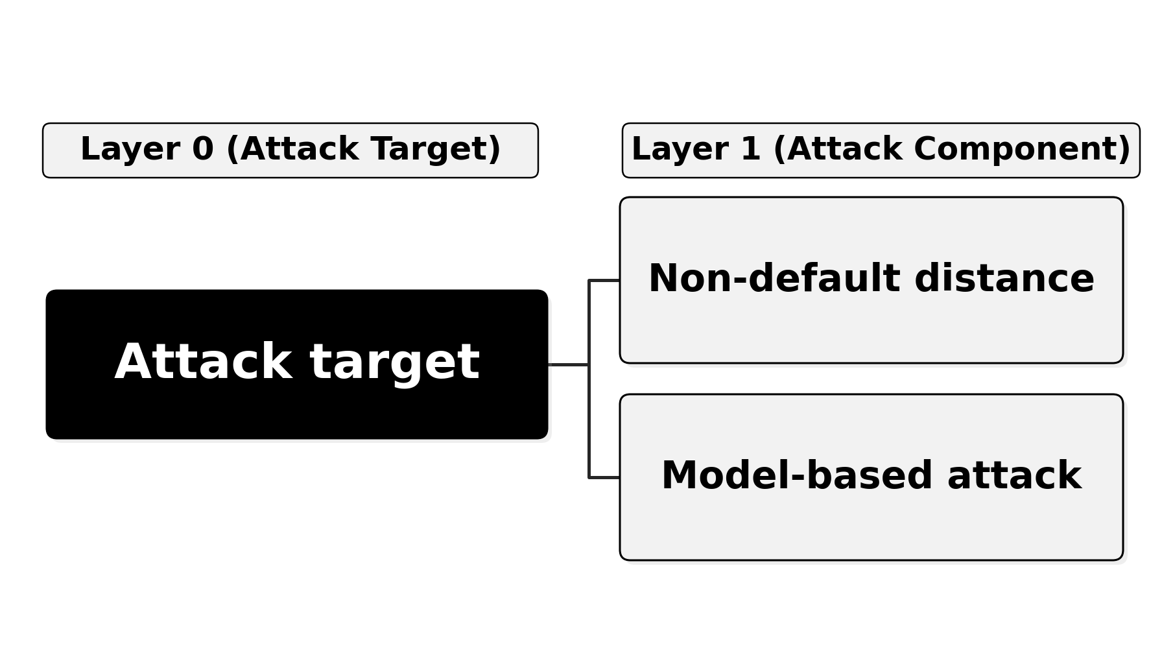
Backup: the full feature taxonomies
Anonymization
Training models
Features are hierarchical: a Layer 1 feature refines its Layer 0 parent. Only features present in at least four teams were kept.
Attacks
Patterns Without Source · PSD 2026, Cadiz
14
Notes:
Backup for 'how exactly did you code the approaches'.

Slide 15
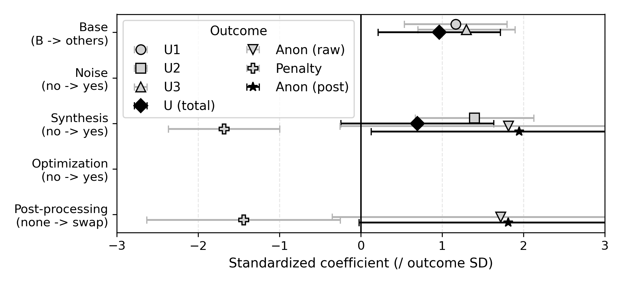
Backup: the AICc-selected regressions agree with the effect sizes
Two things worth saying
Optimization had g = 1.17 but was never retained.
Four of the six teams that optimized also built from elsewhere, and optimization went with synthetic designs. Once Base or Synthesis is in the model, AICc no longer pays for it — exactly the confounding the search is there to catch.
The anonymization models keep an interaction.
Synthesis x swapping, R2 between 0.47 and 0.69. Swapping raises the base anonymization score by about 32 points for non-synthetic designs, and leaves synthetic ones essentially unchanged.
Standardized OLS coefficients, 95% CI. A missing point means the feature was not retained for that outcome.
Patterns Without Source · PSD 2026, Cadiz
15
Notes:
Backup for 'did the multivariate analysis agree' and 'why did optimization drop out'.

Slide 16
Backup: team-level coding
Team | Base | Synth | Noise | Optim | Swap
1 | others | Y | N | N | none
2 | B | Y | N | N | none
3 | B | N | N | N | swap
5 | others | Y | N | Y | swap
6 | B | N | Y | N | swap
8 | others | Y | N | Y | swap
9 | B | N | Y | N | swap
10 | others | Y | N | Y | none
11 | others | N | Y | Y | swap
12 | B | Y | N | N | none
13 | B | Y | N | Y | none
15 | B | N | Y | N | none
16 | B | Y | N | N | swap
17 | B | N | Y | N | none
18 | others | Y | N | Y | none
19 | B | Y | N | N | swap
20 | others | Y | N | N | swap
22 | B | N | N | N | none
23 | B | N | N | N | swap
24 | B | N | Y | N | none
Team | Attack target | Non-default dist. | Attacker-trained
1 | anon | Y | N
2 | anon | N | Y
3 | anon | N | N
5 | anon | Y | N
6 | anon | N | Y
8 | anon | N | Y
9 | anon | N | N
10 | -- | -- | --
11 | both | N | N
12 | anon | N | Y
13 | anon | Y | Y
15 | both | Y | Y
16 | anon | Y | N
17 | anon | N | N
18 | anon | Y | N
19 | anon | N | N
20 | both | N | N
22 | anon | N | N
23 | anon | Y | N
24 | both | Y | N
Team 21 withdrew; teams 4, 7, 14 and 21 could not be coded. Team 10 submitted no attack.
Patterns Without Source · PSD 2026, Cadiz
16
Notes:
Backup for 'which team did what'. Same table is in the paper's appendix and in the public repository.

Slide 17
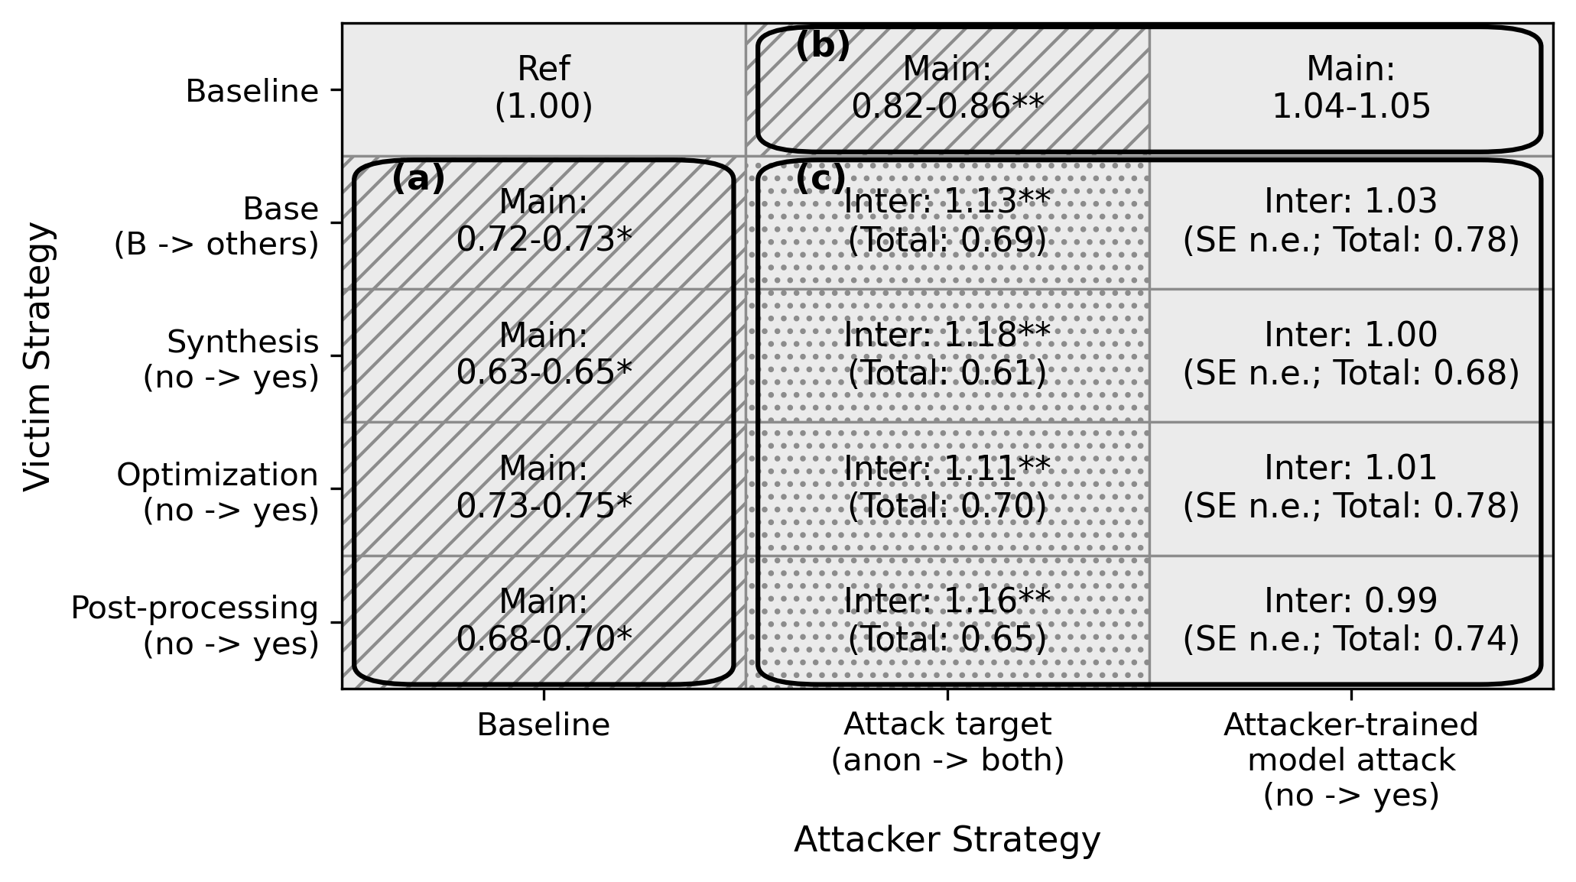
Backup: the full dyadic model, all eight specifications
How to read the cells
Main
The main-effect IRR, as a range across the four specifications that share that variable.
Inter
The interaction coefficient itself — not an effect you can read on its own.
Total
victim x attacker x interaction — the expected exposure when both are present. These are the numbers plotted on the H2-1 slide.
SE n.e.
The two-way clustered standard error was not estimable, so no inferential claim is made — this is why H2-2 is reported as a null result rather than a small effect.
The version printed in the paper. Areas (a) victim main effects, (b) attacker main effects, (c) interactions.
Patterns Without Source · PSD 2026, Cadiz
17
Notes:
Backup for anyone who wants the coefficient decomposition behind the H2-1 chart, or the H2-2 specifications.

Slide 18
Backup: how this sits against the synthetic-data literature
The tension
Other likely questions
Stadler et al. (2022) conclude that synthetic data does not give a better privacy-utility trade-off than traditional row-level sanitization.
Here, synthesis was associated with higher scores on both axes at once.
The two are not directly comparable. We compare across teams and whole design families, not parameters within one algorithm. Varying a parameter inside one method would still trace the classic trade-off curve.
Differential privacy? Several teams tried DP synthesizers and abandoned them - utility was too low under this scoring rule. Only two used explicit Laplace noise.
Why negative binomial? The exposed-record counts are heavily over-dispersed relative to Poisson.
Why did using the released model hurt attackers? We can only speculate: the model carries little membership signal here, and the effort spent on it did not go into the distance matching that worked.
Patterns Without Source · PSD 2026, Cadiz
18
Notes:
The Groundhog Day question is the one this audience is most likely to ask.

