Slide 1
Patterns Without Source
A Meta-Analysis of PWS Cup 2025
We see the outcome.
How much can we learn about the method?
Hinata Kikuchi · Hajime Ono · Kazuhiro Minami
The Institute of Statistical Mathematics | PSD 2026
01
Notes:
目安：30秒
問いを置いたら一拍おき、実話へ進む。所属・共著者は画面を読み切らず簡潔に。
English speaking cue
Good afternoon. I am Hinata Kikuchi from the Institute of Statistical Mathematics. This is joint work with Hajime Ono and Kazuhiro Minami. Today, I want to ask one question: how much can we learn when we can see the outcome, but not exactly how the method worked? Let me start with a real story.
Sources
PWSCUP2025_REVIEW_PUB/paper/main.tex

Slide 2
Netflix Prize: disclosure and privacy
2006
2006–2008
2009–2010
Ratings released
External linkage
Prize 2 suspended
About 500,000 users
Direct identifiers removed
Public IMDb ratings
Some users re-identified
Richer dataset planned
FTC raised privacy concerns
Data disclosure enables research and can create privacy risks
Narayanan & Shmatikov (2006–2008); FTC closing letter (12 March 2010)
02
Notes:
目安：60秒
時系列を左から右へ。Netflixはデータ公開の事例であり、コード非公開の原因を実証する例ではない。
English speaking cue
In 2006, Netflix launched the Netflix Prize. To improve recommendations, it released movie ratings from about half a million subscribers, with direct identifiers removed. Narayanan and Shmatikov showed that some records could be linked to individuals using public information, such as ratings on IMDb. Netflix later planned a second competition with richer data. The Federal Trade Commission raised concerns about re-identification, and Netflix subsequently suspended those plans. This illustrates a tension: data disclosure helps research, but can also create privacy risks. Our study concerns a different information gap: limited access to implementation details. What can researchers learn when those details are unavailable?
Sources
https://arxiv.org/abs/cs/0610105
https://www.ftc.gov/sites/default/files/documents/closing_letters/netflix-inc./100312netflixletter.pdf

Slide 3
The information gap
Observable
Often unavailable
Outcomes
Method families
Parameters
Implementation / source code
Can we still identify meaningful patterns?
03
Notes:
目安：45秒
観測できるものと欠けているものを対比し、因果ではなく仮説形成へ目的を限定する。
English speaking cue
We can observe what happened. We may also know the broad family of anonymization or attack that was used. But we may not know the parameters, see the full implementation, or have the source code. Can we still extract meaningful knowledge from outcomes and type-level descriptions? This information alone cannot establish causal effects. But it may reveal patterns and help formulate useful hypotheses. To explore that possibility, we studied PWS Cup 2025.
Sources
PWSCUP2025_REVIEW_PUB/paper/main.tex

Slide 4
Why PWS Cup 2025?
DEFEND
RELEASE
ATTACK
Hidden sample of
synthetic health records
Anonymized data
+ stroke-risk model
Infer who belonged
to the hidden sample
2 / 24
Strategies described in posters and talks
teams released code
Outcomes measured under a common framework
04
Notes:
目安：75秒
ルール説明を約半分、共通評価とコード公開2チームという研究上の利点を残り半分に配分。
English speaking cue
PWS Cup is an anonymization and attack competition held in Japan since 2015. The 2025 challenge used synthetic health records. As defenders, teams received a hidden sample and released an anonymized dataset and an XGBoost model for stroke-risk prediction. As attackers, they tried to infer which population records belonged to another team's hidden sample. This gives us utility scores, anonymization scores, and pairwise attack outcomes under a common evaluation framework. There is also a useful information gap. Posters and short talks described the strategies, but code release was optional. Only two of the twenty-four teams released code. So the implementations were mostly unavailable, while the outcomes were comparable. That combination makes this competition a useful case for our question.
Sources
PWSCUP2025_REVIEW_PUB/paper/main.tex

Slide 5
From presentations to testable questions
24 teams → 20 reconstructed
Categorical features: base, synthesis, noise, optimization, attack strategy
H1 · 20 teams
H2 · 361 ordered pairs
Design choices and
utility / anonymization
Defender–attacker combinations
and exposed-record counts
Features retained when present in at least four teams
05
Notes:
目安：65秒
24から20への絞り込みと、H1はチーム単位、H2は対戦ペア単位という違いを説明。
English speaking cue
We reconstructed strategy descriptions from posters and short presentations. Twenty teams provided enough information to code categorical features. These included whether a team used the supplied sample as its base, used synthesis, added noise, or applied optimization. Attack features included use of the released model and training an attacker's own scoring model. We retained features present in at least four teams. We then asked two questions. H1: were generation- and reconstruction-based designs associated with better utility and anonymization? H2: did disclosure depend on the combination of defender and attacker strategies? For H1, we used effect sizes and sparse regressions across twenty teams. For H2, we analyzed 361 ordered attacker–victim pairs.
Sources
PWSCUP2025_REVIEW_PUB/paper/main.tex
PWSCUP2025_REVIEW_PUB/Final_0521.csv

Slide 6
H1: generation and reconstruction
Synthesis was associated with higher scores on both outcomes
Hedges’ g; n = 20. Positive favors the second category. Anonymization: post-penalty score.
06
Notes:
目安：85秒
橙＝有用性、青＝匿名化。BaseとSynthesisを主図とし、他3特徴の数値は質疑用へ。
English speaking cue
Here is the first result. Orange is utility, and blue is anonymization. The effect size is Hedges' g. Positive values favor the second category in each comparison. Start with the base: teams using an alternative to directly transforming the provided sample had higher utility, with an effect size of 1.55. Now look at synthesis. It was associated with higher utility, at 1.26, and higher anonymization, at 1.01. In the remaining comparisons, explicit noise was negatively associated with both outcomes. Swapping had almost no utility difference, but a positive anonymization association. Sparse regressions selected by AICc retained parts of the same pattern. These models are an exploratory check, not independent confirmation. With only twenty teams and correlated design choices, we interpret these as associations within this contest. The next question is whether those patterns depend on the attack strategy.
Sources
PWSCUP2025_REVIEW_PUB/paper/main.tex
PWSCUP2025_REVIEW_PUB/Final_0521.csv

Slide 7
H2: defender–attacker combinations
Victim main effects: IRR 0.63–0.75 across model specifications
When the attacker also uses the released model
Victim feature | Interaction IRR | Combined IRR
Alternative base | 1.13 | 0.69
Synthesis | 1.18 | 0.61
Optimization | 1.11 | 0.70
Swapping | 1.16 | 0.65
Combined IRRs < 1: the estimated victim-side advantage persists
Each row has its own reference. Attacker-trained-model interactions: clustered SE not estimable.
07
Notes:
目安：90秒
IRRの分母は各モデル固有の基準。全特徴がない共通集団ではない。攻撃者学習モデルとの交互作用は推論不能。
English speaking cue
For H2, we analyzed the number of records exposed in each of 361 ordered attacker–victim pairs. An incidence rate ratio, or IRR, below one means fewer expected exposed records relative to that model's reference. Across the models, the four victim-side features had IRRs from 0.63 to 0.75: about 25 to 37 percent lower expected exposure. The table focuses on attackers that also used the released model. Their interactions with victim features were above one. But the combined effects, including both main effects and the interaction, remained below one, from 0.61 to 0.70. So the pairing mattered, while the estimated victim-side advantage persisted. Each row has its own model-specific reference; these are not comparisons with one common group lacking all four features. For attacker-trained scoring models, the clustered standard errors of the interactions could not be estimated. We therefore cannot conclude that those interactions are absent. Overall, H2 receives partial support.
Sources
PWSCUP2025_REVIEW_PUB/paper/main.tex

Slide 8
What this evidence can support
Limits
Contribution
20 teams, observed strategies
Method families, not implementations
One competition and evaluation setting
Specific, quantitative
hypotheses for future tests
Causal effects and general privacy
guarantees remain unestablished.
08
Notes:
目安：50秒
一つのsynthetic populationとは言わず、一つの競技・データ生成・評価設定とする。
English speaking cue
These results have clear limits. We observed twenty teams; their strategies were not randomly assigned. Our categories describe method families, rather than exact parameters or implementations. And all results come from one competition, with its particular data-generation and scoring framework. We therefore cannot claim that synthetic data is universally better, or that these defenses are safe against every attack. What we have are exploratory patterns from PWS Cup 2025. But remember our starting question. Even with incomplete information, we moved from broad descriptions to specific, quantitative hypotheses that future studies can test.
Sources
PWSCUP2025_REVIEW_PUB/paper/main.tex

Slide 9
Incomplete information
does not mean
no information
The next competition
Collect strategy information
with a common questionnaire
09
Notes:
目安：55秒
Netflixの公開データの問題と、本研究の実装情報の不足を区別したまま回収。共通質問票は今後の提案。
English speaking cue
Let me return to the opening story. The Netflix case illustrates why data disclosure needs care. Our PWS Cup study addresses a different practical problem: learning when implementation details are limited. Type-level descriptions did not give us definitive conclusions. But they let us identify patterns, quantify them, and formulate questions for more rigorous testing. A practical next step is to collect strategy information systematically. A short, structured questionnaire could record each team's design choices and the evidence behind them. The next analysis could then begin with structured information, rather than reconstructing it afterwards. We may not have the source, but we can still start finding the patterns. Thank you.
Sources
PWSCUP2025_REVIEW_PUB/paper/main.tex
https://www.ftc.gov/sites/default/files/documents/closing_letters/netflix-inc./100312netflixletter.pdf

Slide 10
Questions
Patterns Without Source
A Meta-Analysis of PWS Cup 2025
Data and analysis code
github.com/kiti1924/PWSCUP2025_REVIEW_20260716
10
Notes:
I would be happy to take your questions.
質疑5分。非表示補足：11 H1全効果量、12 H2全結果、13 競技詳細、14 標本と対戦ペア、15 Netflix出典。
Data and analysis code: https://github.com/kiti1924/PWSCUP2025_REVIEW_20260716

Slide 11
Q&A: H1 effect sizes
Feature contrast | Utility g | Anonymization g
Base: B to others | 1.55 | 0.54
Synthesis: no to yes | 1.26 | 1.01
Noise: no to yes | −0.73 | −0.98
Optimization: no to yes | 1.17 | 0.55
Swapping: no to yes | −0.04 | 0.73
Positive values favor the second category
Hedges’ g, n = 20. Anonymization uses Anon_all, including penalties.
11
Notes:
目安：0秒
すべて観測的な比較。ノイズの因果効果や差分プライバシー一般の評価ではない。
English speaking cue
Optimization overlaps with other choices and was not retained in the selected regressions. These are point estimates, not confidence intervals.
Sources
PWSCUP2025_REVIEW_PUB/paper/main.tex; PWSCUP2025_REVIEW_PUB/Final_0521.csv

Slide 12
Q&A: H2 main and interaction effects
Victim feature | Main IRR | Attack target Interaction / total | Trained scorer Interaction / total
Reference | 1.00 | Main: 0.82–0.86** | Main: 1.04–1.05
Base: B to others | 0.72–0.73* | 1.13** / 0.69 | 1.03 / 0.78 SE n.e.
Synthesis | 0.63–0.65* | 1.18** / 0.61 | 1.00 / 0.68 SE n.e.
Optimization | 0.73–0.75* | 1.11** / 0.70 | 1.01 / 0.78 SE n.e.
Swapping | 0.68–0.70* | 1.16** / 0.65 | 0.99 / 0.74 SE n.e.
Ranges span model specifications, not confidence intervals. * p < 0.05, ** p < 0.01.
SE n.e.: the two-way clustered standard error for the interaction was not estimable.
12
Notes:
目安：0秒
各行・各組合せは別モデル。totalはexp(βvictim + βattacker + βinteraction)。SE推定不能を非有意と呼ばない。
English speaking cue
Eight dyadic negative binomial specifications, with two-way clustering by attacker and victim. Each specification has its own joint reference.
Sources
PWSCUP2025_REVIEW_PUB/paper/main.tex; paper/figs/H2/h2_heat_twoway_bw.png

Slide 13
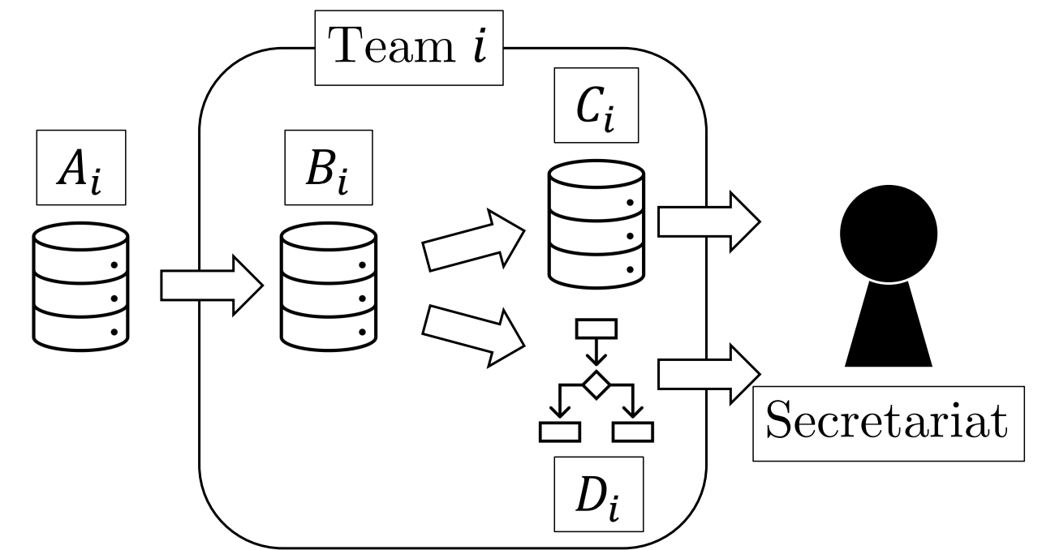
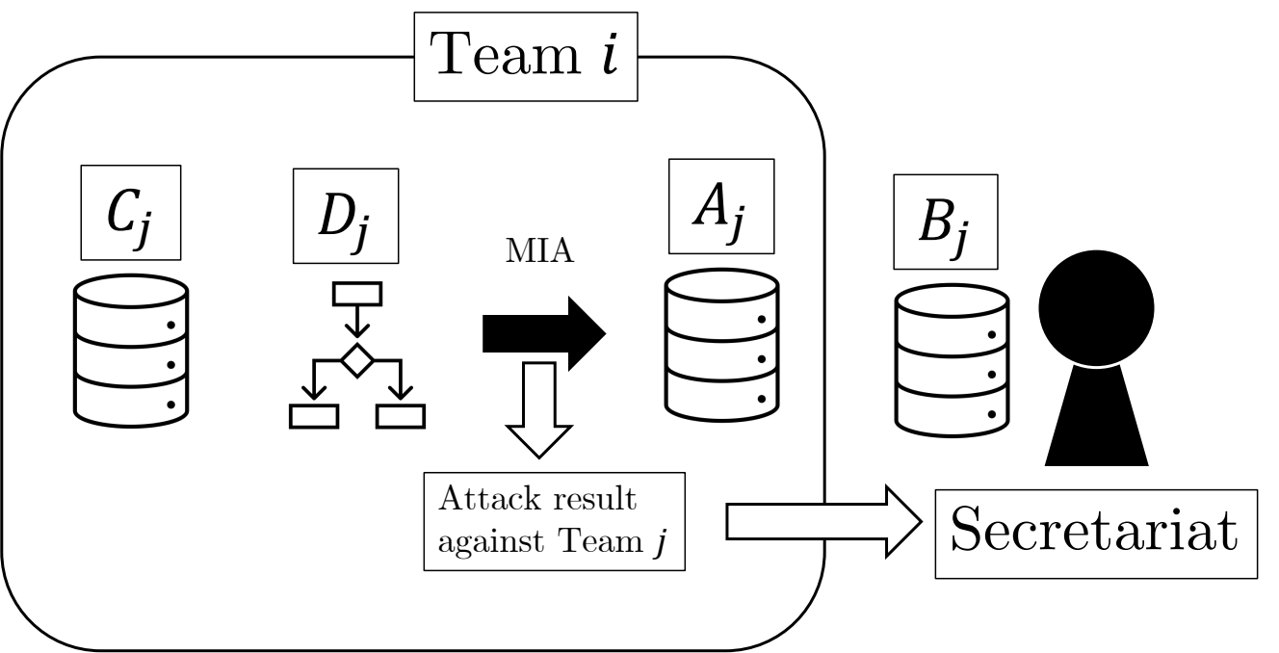
Q&A: the defense and attack phases
Defense
Attack
Release anonymized data C
and stroke-risk model D
Infer which population records
belong to hidden sample B
Population: 100,000 records. Hidden sample: 10,000. Synthetic health data, 18 variables.
13
Notes:
目安：0秒
各チームの母集団と標本。モデルDが必ずCで学習されたとは限らない。
English speaking cue
The model may be trained using the provided sample or generated data; the diagram does not impose training exclusively on C.
Sources
PWSCUP2025_REVIEW_PUB/paper/main.tex; paper/figs/system_models/ano_phase.pdf; paper/figs/system_models/att_phase.pdf

Slide 14
Q&A: why 20 teams and 361 pairs?
24 registered → 20 coded defenders
19 coded attackers
20 × 19 − 19 self-pairs = 361
Team 10 submitted no attack. Team 21 withdrew.
The pair observations are not independent; uncertainty is clustered by both teams.
14
Notes:
目安：0秒
20チームのうちTeam10は防御のみ。対応する攻撃者は19なので自己対戦19を除く。361は独立した361チームではない。
English speaking cue
We used twenty coded defenders and nineteen coded attackers, excluding self-pairs. Dependence across victims and attackers is addressed with two-way clustered standard errors, subject to the estimability limitations shown on slide 12.
Sources
PWSCUP2025_REVIEW_PUB/paper/main.tex; PWSCUP2025_REVIEW_PUB/Final_0521.csv

Slide 15
Q&A: the Netflix evidence and its scope
Narayanan & Shmatikov
Public auxiliary information enabled identification of some Netflix records.
How To Break Anonymity of the Netflix Prize Dataset (2006 / 2007)
FTC closing letter · 12 March 2010
The FTC raised concerns about the planned richer dataset.
After discussions, Netflix notified the FTC that Prize 2 would be suspended.
A data-disclosure case; it does not establish why PWS teams withheld source code.
15
Notes:
目安：0秒
研究が単独で中止を引き起こしたとは主張しない。Netflixはデータ公開、本研究は実装情報の不足という別の対象。
English speaking cue
The historical sequence motivates careful disclosure. The inference that limited implementation information remains worth studying is our framing, not a causal conclusion from the Netflix case.
Sources
https://arxiv.org/abs/cs/0610105
https://www.ftc.gov/sites/default/files/documents/closing_letters/netflix-inc./100312netflixletter.pdf

