Slide 1
Development of a Web Service for Creating and Managing an Interactive Digital Portfolio and Resume
Melnik Ekaterina Lyudmila Lyadova - supervisor
Notes:
Good morning (afternoon, evening), everyone. My name is Ekaterina Melnik, and today I am going to present my project: Development of a Web Service for Creating and Managing an Interactive Digital Portfolio and Resume.

Slide 2


The Modern Challenge of Professional Self-Presentation
Notes:
Today's job market, especially in tech and creative fields, is highly competitive. Professionals showcase their work across many platforms—GitHub, Behance, LinkedIn and through PDF resumes. This creates a fragmented digital identity. Employers struggle to get a complete, compelling picture of a candidate's skills and experience.

Slide 3





The Gap in Current Solutions
Category | Key Limitation
Professional Networks | No deep project visualization
Design Portfolios | Niche audience, no resume
Resume Builders | Static format, weak project display
Code Repositories | Code-focused, no visual portfolio or career analytics
Notes:
Existing tools address the problem only partially. Each category has fundamental limitations that prevent it from being a complete solution.

Slide 4
Comparison of Existing Solutions
Platform / Feature | Interactive Skill Visualization | Rich Project Showcase | Customizable Resume Templates | PDF Export | Public Profile Link | Data-Driven Skill Analysis
About.me | ✕ | ✕ | ✕ | ✕ | ✓ | ✕
CakeResume / Kickresume | ! (Basic) | ! (Limited) | ✓ | ✓ | ✓ | ✕
Behance / Dribbble | ✕ | ✓ (For design) | ✕ | ✕ | ✓ | ✕
LinkedIn | ! (Simple list) | ! (Text-based) | ! (Limited) | ! (Basic) | ✓ | ! (Very basic)
GitHub Pages | ✕ | ✓ (Code-focused) | ✕ | ✕ | ✓ | ✕
My Project PortfolioPro | ✓ (Charts, graphs) | ✓ (Full media support) | ✓ (Fully customizable) | ✓ (Smart, styled) | ✓ (With privacy control) | ✓ (Core innovation)
Notes:
Here is a detailed comparison of specific platforms that confirms the fragmentation. As we can see, the market is filled with good, but specialized tools. Some are great for simple links but lack depth. Others create beautiful resumes but offer poor project visualization. Design platforms are fantastic for creatives, but not universal. And no current solution connects your self-presentation with actionable, data-driven insights from the job market.

Slide 5

An All-in-One Interactive Portfolio
Key Features
Interactive Constructor – drag & drop + visual skill charts
Smart PDF Export – one-click polished resume
Public Profile – shareable link, full design control
Analytics Module – data-driven career insights (e.g., "Add React for +65% matches")
Notes:
My solution is to integrate best-in-class features into a single, cohesive platform, eliminating the need for users to fragment their professional identity across multiple tools.
Crucially, it adds a layer of intelligence: a data-driven recommendation system. This system analyzes user skills, offering advice to close skill gaps and increase career opportunities.
Thus, the final product is not just a presentation tool, but a functional builder that helps users not just show their skills but also understand their market value and identify clear paths for professional development.

Slide 6




Limitations
Niche audience – devs, designers
External API – relies on HH.ru
Self-reported data – not verified
Notes:
Regretfully, there are some limitations and here let's outline them.
First, the service is designed for the digital sector. It's not the best fit for another fields like law or accounting.
Second, a key feature—the smart skill analysis—relies on external job market data. This makes it dependent on the availability of those APIs.
Third, it's important to note that the platform displays user-provided information (projects or skill). So the system cannot independently verify the accuracy of this information.

Slide 7
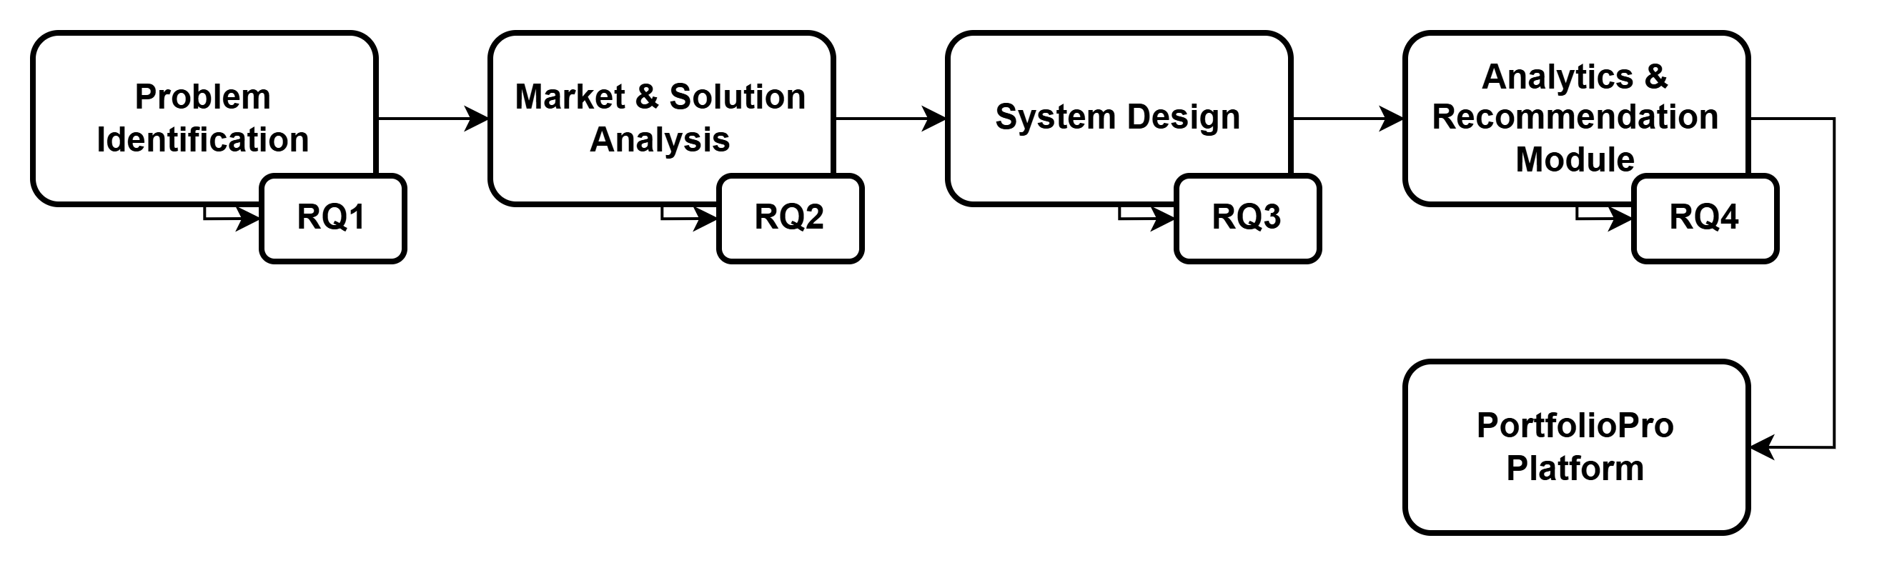
Research Questions
Notes:
This sequence illustrates the logical foundation of the research questions. Each question directly informs a key stage in the development of portfolio service.

Slide 8

Research Questions
RQ1: How does the design of skill visualization (charts, graphs) in a digital portfolio influence an employer's perception of a candidate?
RQ2: What design approaches in existing platforms successfully combine user-friendly creation tools with employer-oriented utility?
RQ3: What methods and approaches are most suitable for developing an all-in-one portfolio tool that combines key features from existing solutions?
RQ4: What methods and data allow for analysis of a user's skills and provide personalized recommendations for career growth?
Notes:
Four research questions guide this study, covering visualization, design, architecture, and analytics.

Slide 9

RQ1: Visualization & Perception
Memorability
Visual embellishments increase memorability of charts. (Bateman et al., 2010)
Structured self-presentation boosts perceived credibility. (Toma & Hancock, 2011)
Accuracy
High memorability does not guarantee correct interpretation; embellishments may distort meaning (Borkin et al., 2013)
Risk: Over-stylized visuals can prioritize aesthetics over accurate communication.
Key Insight : Skill visualizations must balance engaging design with clear and interpretable information.
Notes:
Research on data visualization shows that visual elements like colors and icons make skill charts more memorable. But memorability doesn’t always mean accuracy—overly decorative visuals can distort the actual information. At the same time, structured self‑presentation increases perceived credibility. So the key is balance: skill visualizations need to be engaging but still clear and accurate.

Slide 10

RQ2: Dual-Audience Design
Creator Perspective (Usability)
Usability guidelines show that simple forms reduce errors and increase efficiency. (Bargas-Avila et al., 2011)
Trust in the platform (transparency and reliability) encourages adoption by both users and employer (Gefen et al., 2008)
Employer Perspective (Evaluative Depth)
The structure of information affects assessment quality; oversimplification may reduce evaluation depth. (Langer et al., 2018)
Key Insight : The system must be intuitive for creators while providing structured, trustworthy signals for employers.
Notes:
A portfolio platform serves two audiences. For creators, usability is critical: simple, well‑structured forms reduce errors and make the process efficient. For employers, the presentation must provide enough depth to allow proper evaluation. Oversimplification can actually hurt assessment quality. And trust matters too—both sides need to feel the platform is reliable. So the design must be intuitive for creators while giving employers the structured information they need.

Slide 11



RQ3: System Architecture
Agile Development
Agile = flexibility, iterative delivery, adaptability to change. (Petersen & Wohlin, 2010)
Data‑Intensive Architecture
Modular, scalable architecture needed for integrating user data + external APIs. (Chen et al., 2012)
Key Insight : Combine agile process with solid, modular backend to ensure both flexibility and robustness.
Notes:
Building this system combines two technical approaches. Agile development gives us flexibility and allows iterative delivery. But because the platform handles user data and external APIs, it also needs a modular, scalable architecture that can grow and stay stable. Agile methods support the development process, while a robust backend ensures long‑term reliability—both are essential.

Slide 12

RQ4: Predictive Analytics
Descriptive (Static Analysis)
Big data from job vacancies reveals patterns in labor market demand. (Frank et al., 2019)
Skills function as economic signals valued by the labor market. (Deming, 2017)
Predictive (Actionable Insights)
Predictive analytics estimates future trends and skill gaps. (Shmueli & Koppius, 2011)
Goal: Convert labor-market data into personalized skill recommendations.
Key Insight : Analyze vacancy data (HH.ru) to identify high-demand skills and compare them with user profiles to generate targeted recommendations.
Notes:
Job vacancy data reveals patterns in labor market demand—what skills are most needed. Skills themselves act as economic signals. Descriptive analytics simply summarizes the current market. But predictive analytics goes further: it estimates future trends and identifies skill gaps. The goal is to apply predictive logic, comparing the user’s skills with evolving market demand to give personalized, forward‑looking recommendations.

Slide 13
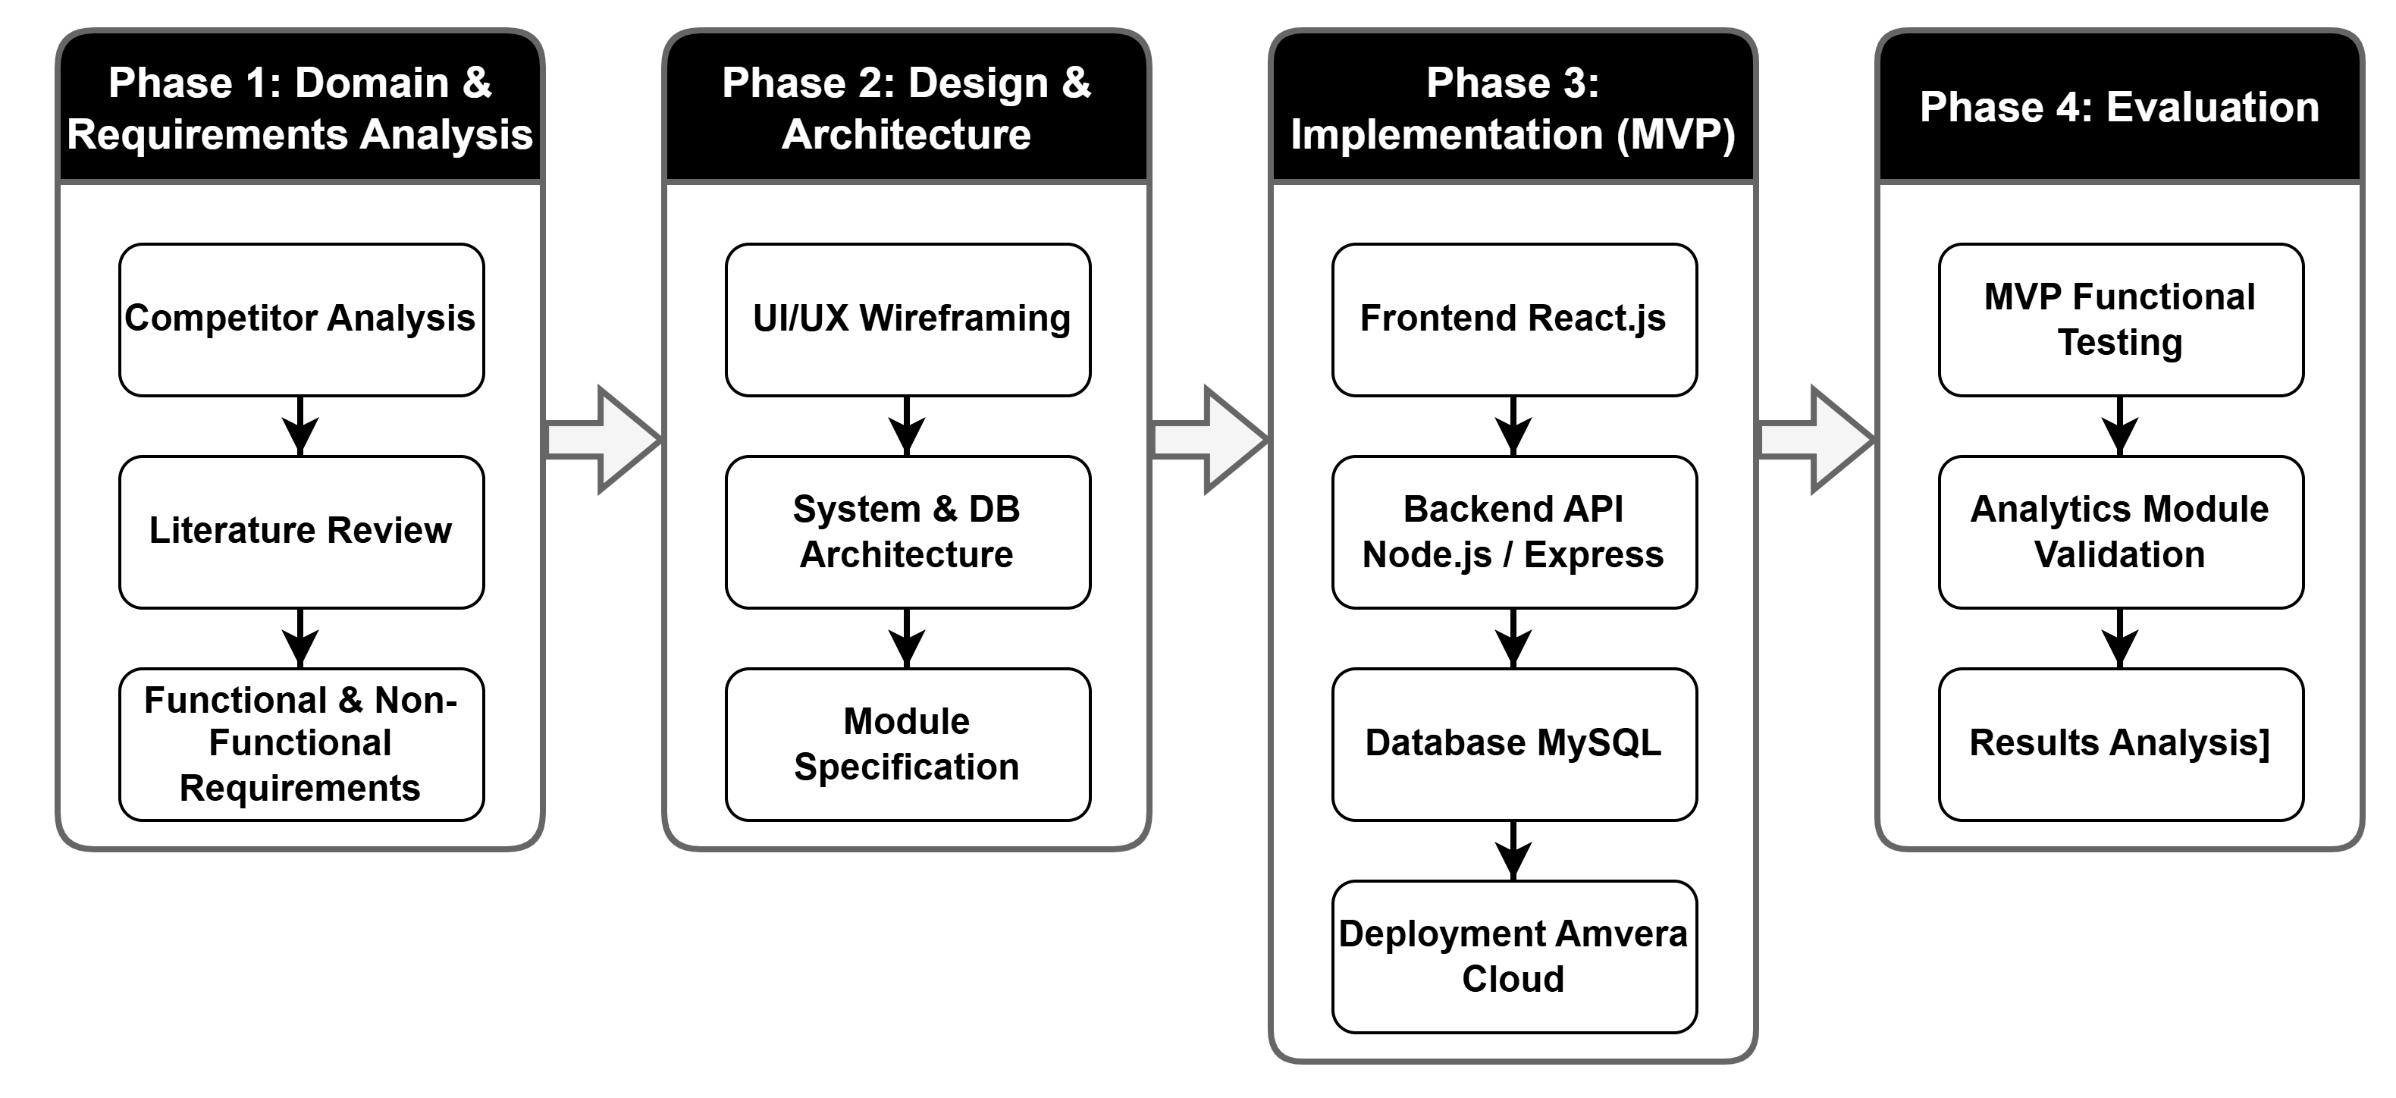
Methods
Notes:
The methodology follows four phases: domain analysis, design, implementation, and evaluation. The implementation uses React, Node.js, MySQL, and cloud deployment with HH.ru API integration. The final phase tests functionality and analytics performance.

Slide 14
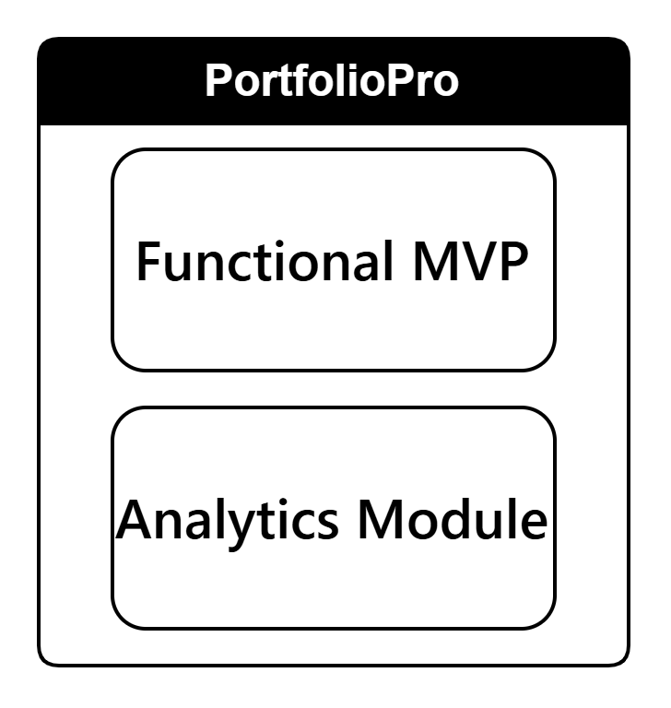
Anticipated Results
A working platform with user authentication, interactive portfolio constructor, and one‑click PDF resume generation.
Integration with HH.ru API for real‑time skill‑gap analysis and personalized career recommendations.
Notes:
Two results are anticipated: a functional MVP and an analytics module that provides data‑driven career recommendations.

Slide 15
References
Bateman, S., et al. (2010). Useful junk? The effects of visual embellishment on comprehension and memorability of charts. Proceedings of the SIGCHI Conference on Human Factors in Computing Systems, pp. 2573–2582. URL: https://doi.org/10.1145/1753326.1753716
Bargas-Avila, J. A., et al. (2011). Simple but crucial user interfaces in the World Wide Web: Introducing 20 guidelines for usable web form design. Journal of Usability Studies, Vol. 7(1), pp. 1–28.
Borkin, M. A., et al. (2013). What makes a visualization memorable? IEEE Transactions on Visualization and Computer Graphics, Vol. 19(12), pp. 2306–2315. URL: https://doi.org/10.1109/TVCG.2013.234
Caers, R., Castelyns, V. (2011). LinkedIn and Facebook in Belgium: The influences and biases of social network sites in recruitment and selection procedures. Social Science Computer Review, Vol. 29(4), pp. 437–448. URL: https://doi.org/10.1177/0894439310386567
Chen, H., Chiang, R. H. L., Storey, V. C. (2012). Business intelligence and analytics: From big data to big impact. MIS Quarterly, Vol. 36(4), pp. 1165–1188.
Deming, D. J. (2017). The growing importance of social skills in the labor market. Quarterly Journal of Economics, Vol. 132(4), pp. 1593–1640. URL: https://doi.org/10.1093/qje/qjx022
Frank, M. R., et al. (2019). Toward understanding the impact of artificial intelligence on labor. Proceedings of the National Academy of Sciences, Vol. 116(14), pp. 6531–6539. URL: https://doi.org/10.1073/pnas.1900949116
Gefen, D., Benbasat, I., Pavlou, P. A. (2008). A research agenda for trust in online environments. Journal of Management Information Systems, Vol. 24(4), pp. 275–286.
Langer, M., König, C. J., Fitili, A. (2018). Information presentation in online recruitment systems and its effects on assessment outcomes. International Journal of Selection and Assessment, Vol. 26(4), pp. 353–365.
Petersen, K., Wohlin, C. (2010). The effect of moving from a plan-driven to an agile development approach. Empirical Software Engineering, Vol. 15(6), pp. 654–693. URL: https://doi.org/10.1007/s10664-010-9136-6
Rivera, L. A. (2015). Hiring as cultural matching: The case of elite professional service firms. American Sociological Review, Vol. 80(5), pp. 999–1022.
Shmueli, G., Koppius, O. R. (2011). Predictive analytics in information systems research. MIS Quarterly, Vol. 35(3), pp. 553–572.
Toma, C. L., Hancock, J. T. (2011). A new twist on love’s labor: Self-presentation in online dating profiles. Communication Research, Vol. 38(3), pp. 326–349. URL: https://doi.org/10.1177/0093650210386104
Notes:
The research is grounded in established literature from visualization, usability, software engineering, and labor economics. And this concludes the presentation.

