Slide 1
Scala Workshop
Levon Ter-Isahakyan
11/19/16

Slide 2
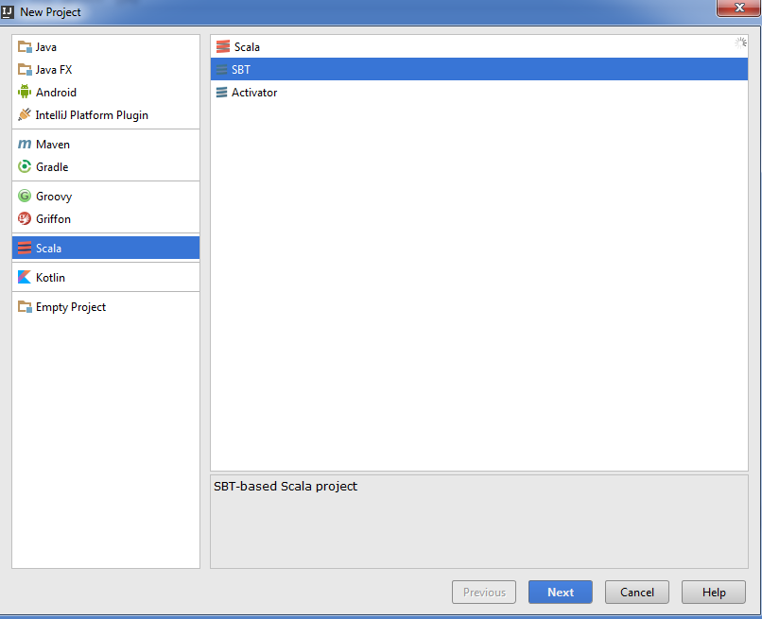
New SBT Project

Slide 3
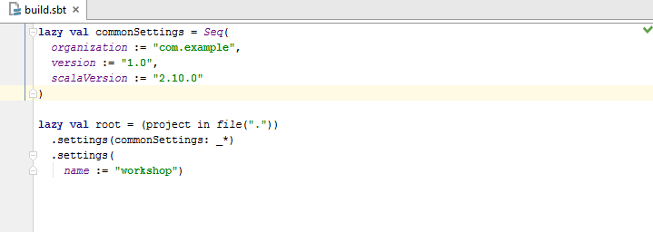
Basic Build.sbt

Slide 4
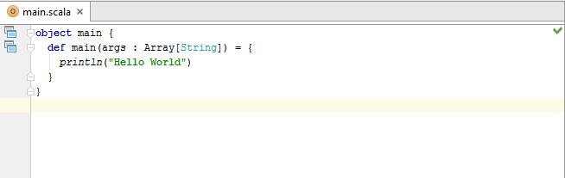
Hello World

Slide 5
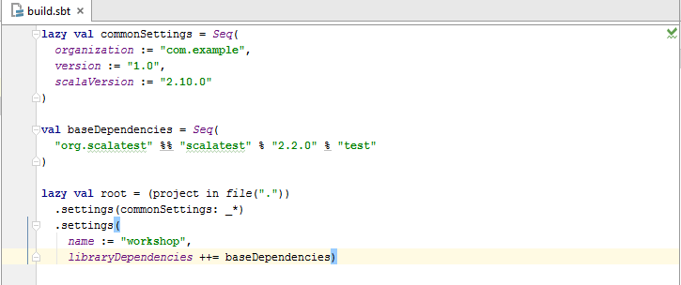
Dependencies

Slide 6
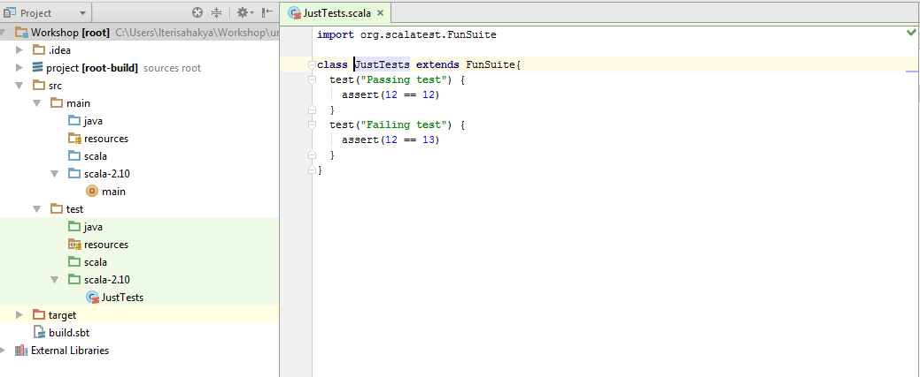
Basic ScalaTests

Slide 7


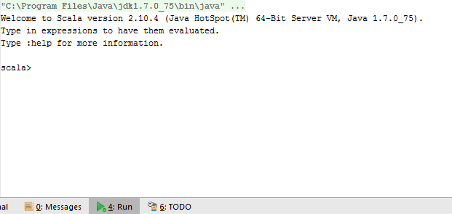
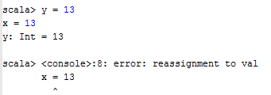
Scala Console
Var and Val
Cannot reassign val
Avoid using var

Slide 8





Type Inference
Method Invocation
Omitting parenthesis
More complex Example
One parameter
Multiple parameters
Method chaining

Slide 9
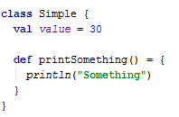
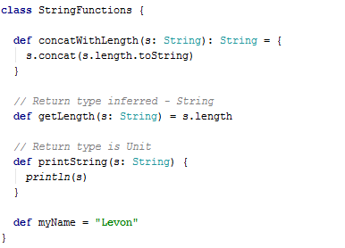


Classes
Method Definitions
Class Parameters – Hidden members
Class Parameters – Public members

Slide 10


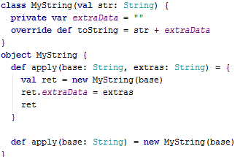

Classes Continued
Companion Objects
Object with same name as class or trait
Defined in same source file as associated class or trait
Has access rights to class or traits
Can access private methods and fields
Extending classes
Case classes
Apply method

Slide 11

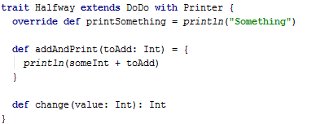




Traits
Traits extending traits
Extending multiple traits
And then….?

Slide 12
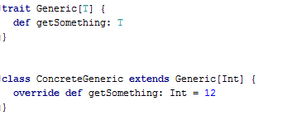


Parametrized Classes and Traits

Slide 13
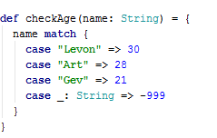
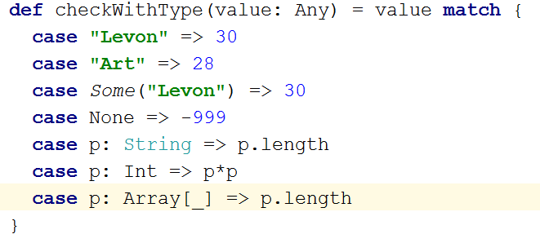
Match and Case
Extracting type
Try for yourself
Try for yourself

Slide 14
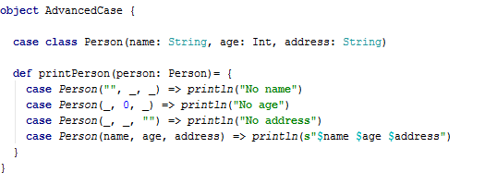
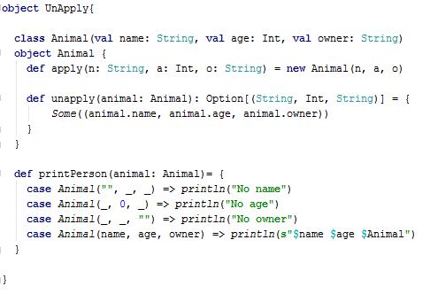
Pattern matching
Apply and Unapply
Try for yourself

Slide 15
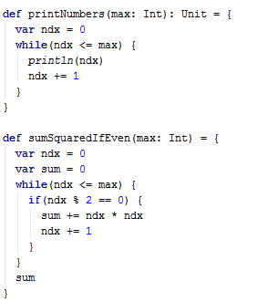

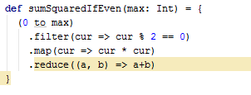
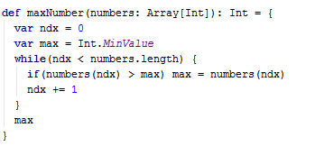

Looping
Think Functional

Slide 16
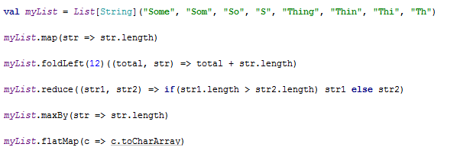

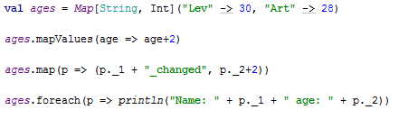

Map, Reduce, Fold
Try for yourself
Given: String of words separated by space find:
The longest word
The most common word
The most common letter
Create a map from letter to a set of words it appear in

Slide 17
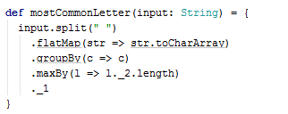

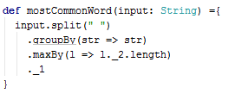
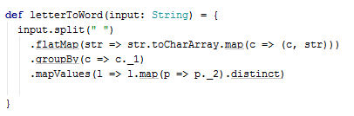
Solutions
Given: String of words separated by space find:
The longest word
The most common word
The most common letter
Create a map from letter to a set of words it appear in

Slide 18
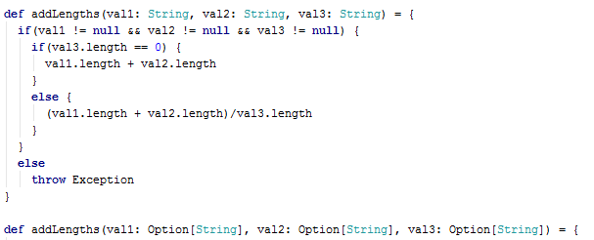


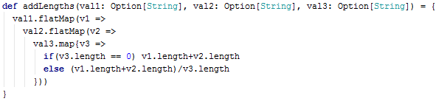

Option instead of NULL
Try for yourself

Slide 19


Case Study – Queue the scala way
What is the scala way of defining a generic queue?
Why is this better?

Slide 20
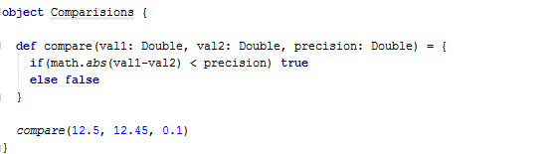

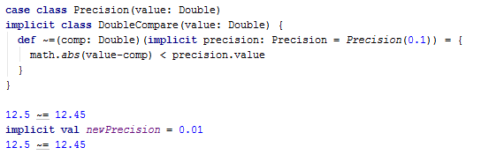


Advanced Concepts
Can we make this look nicer?
Configurable precision and look nice?
Can we make this look nicer?
What about precision?
Try for yourself

Slide 21
Questions?

Slide 22
The END

