Slide 1
Agoda Release Manager Bot
By Joel Dickson
And Tomz

Slide 2
The challenge?
We have over 100 developers working on a single Repository
This repository has a build that needs to pass to merge in your Pull Request to master
12k C# Unit tests
2k Shallow Selenium UI Tests (Running on Mocked Data)
150 end to end Selenium integration tests
2k JavaScript tests
Sonarqube static code analysis
Codecov Coverage requriement
Only a single developer can merge at one time
because after he merges the next developer needs to rerun the build with the previous developers change to make sure that the merged code hasn’t affected his code
The results was a manually managed “queue” that the developers came up with

Slide 3
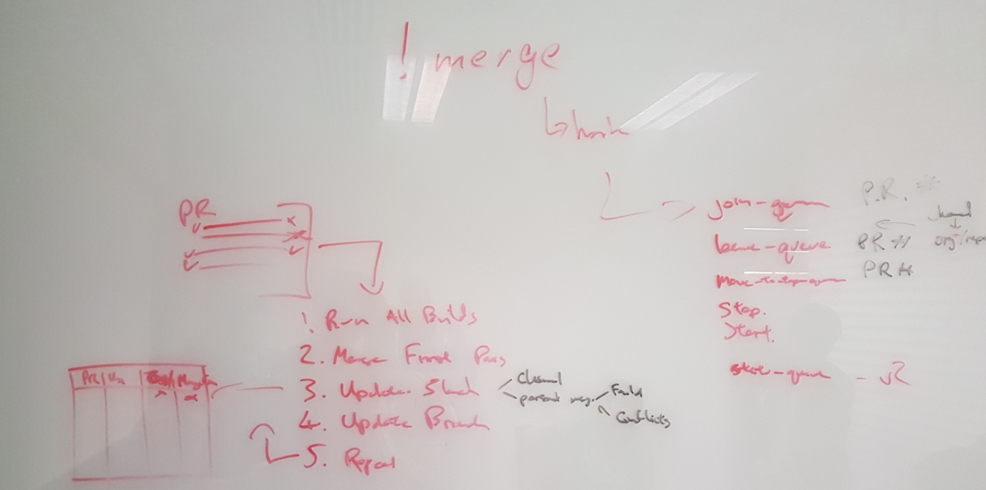
Some Background
In Process automation - Empirical process control is key
Decisions are made based on observation and experimentation rather than on detailed upfront planning
The developers doing the development are the best ones to do their own automation
We observed an existing manual process the developers had, then engaged with them and automated it

Slide 4
What did we observe?
We observed the developers where using slack to communicate about who could merge in next, and had formed a manual queue process in a channel for the repo
Developers would
indicate they were ready to merge
Be placed in a list that was pinned to the channel
The person at the top of the list would then wait for their build to pass, merge their pull request
Remove themselves form the list
The next developer would do the same
The process worked, it was slow, but it worked
Main issue with the manual system were
Someone in the top of the queue has a failed build for some reason and takes hours to fix, holding up the queue
The next in the queue (after someone has merged) might be away from their desk, so this would hold up the queue
Manual process made things laborious for developers

Slide 5
What did we Build?
We decided to mimic the developers interaction with slack using a bot
And fix the issues they were having with the manual process at the same time

Slide 6
What did we build?
Slack bot is a dot net core app
We converted the Slack NET API to NET core and it is available on github.com/agoda-com
Using octokit.net to connect to GitHub and TeamCity’s REST API
We monitored the slack channel for commands form the developers in the channel then make calls to GitHub and teamcity to orchestrate the manual tasks the developers where doing

Slide 7
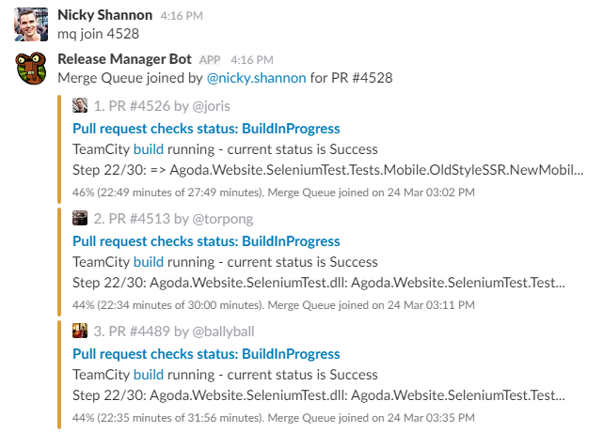
How does it work?
Merge Queue function of the Release Manager Bot
We called it the “Release Manager Bot” because we have plans for future use with it
Command line drive
mq join
mq leave
mq list
mq help
mq start/stop

Slide 8
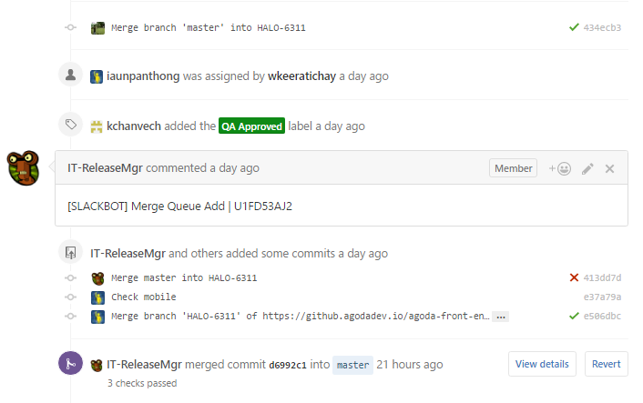
How does it work?
Data storage? Queue persistence?
State transitions are stored on pull request comments
An in memory object is created and then modified on each transition as well as the state change being stored
On app start up Comments are read from all open pull requests and replayed to rebuild the object

Slide 9
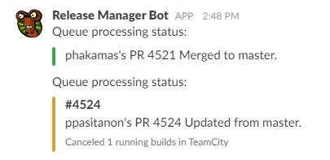
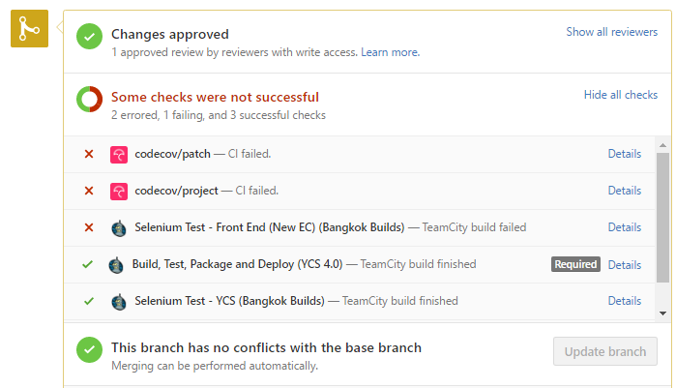
How does it work?
Bot polls the repo every 10 seconds for the commit status of the pull request
If one of the Pull Requests in the Queue has a passing commit statuses it will merge it
Then it will update the top 4 in the queue to rerun
This was done in the event the first person in the queue has an issue
Using the commit status allows us to add additional checks in future

Slide 10
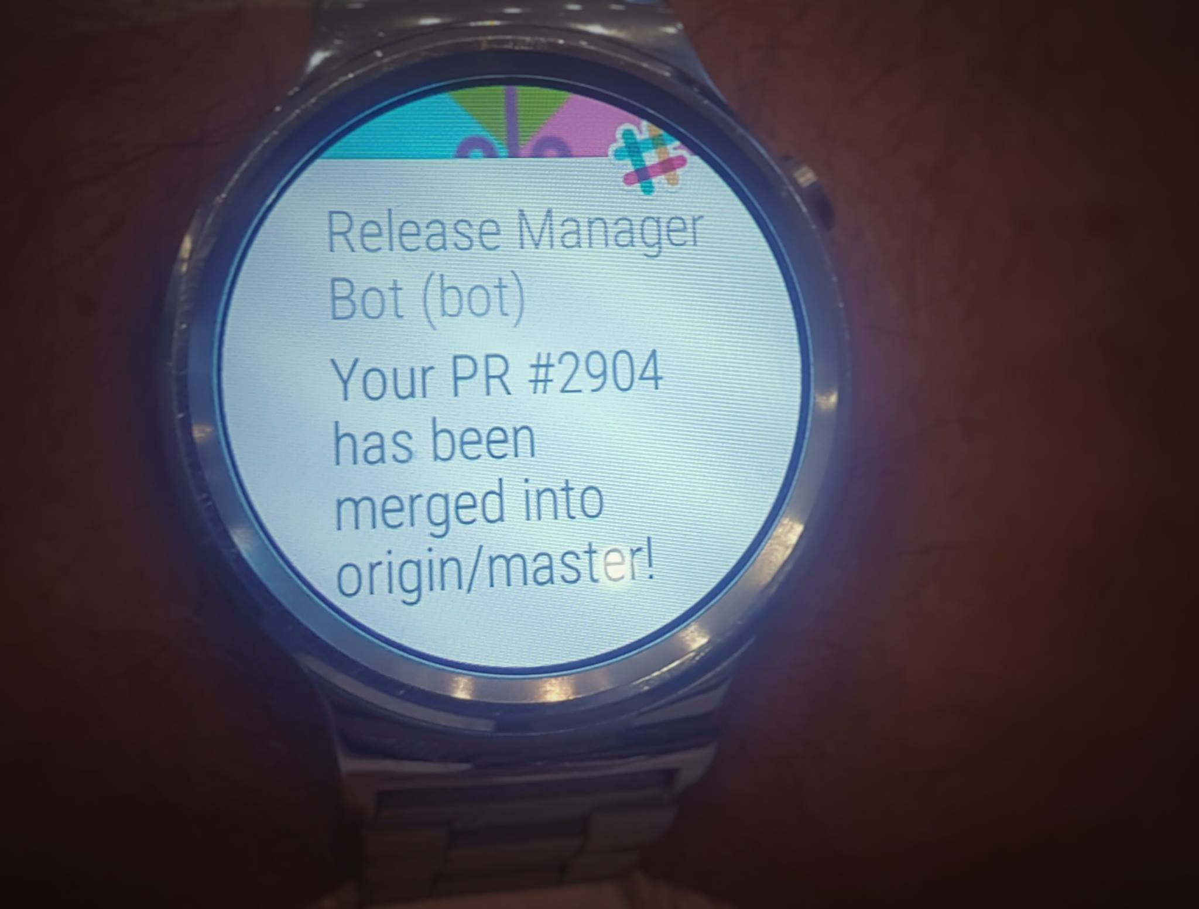
How does it work?
Runs 24 hours a day
In some case developers will leave the office and they will get a PM later in the evening on slack when their Pull Request Is merged
We have made close to 40 merges to master in a 24 hour period using the bot running all day and night…

Slide 11
Criticisms
Feedback
I think the merge bot is wrong, I think we built a great automation tool that has almost nothing about being a bot. Instead of posting a message to the bot, we could have just made a “special” comment in github (“READY TO MERGE”)
Usage of bots carries with it certain security risks, and I would make sure you take action such as 2FA on slack before using Bots

Slide 12
How do the developers feel?

