Slide 1
Lets Do CI/CD
By Joel Dickson
Development Manager, Agoda

Slide 2
Overview
Create Build definitions in TeamCity
C# net core 1.1 MVC/Web API Project
Typescript/Webpack
Unit Test NUnit and Mocha
Output Packages for Deployment
Update GitHub Pull Request status
Create deployments in Octopus
Deploy to Cluster (C# backend)
Deploy to CDN (React SPA)
Send an Alert to Slack
Source:

Slide 3
Things you will need
A Web Browser
WIFI password for agoda_visitor
agoda.com
TeamCity Server Address
http://teamcity01.southeastasia.cloudapp.azure.com
Octopus Server Address
http://octopus01.southeastasia.cloudapp.azure.com

Slide 4
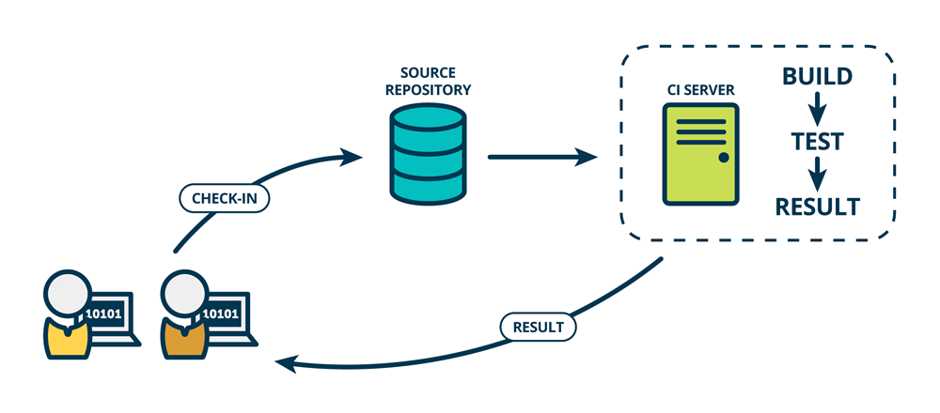
CI 10k feet overview
Continuous Integration (CI) is a development practice that requires developers to integrate code into a shared repository several times a day. Each check-in is then verified by an automated build, allowing teams to detect problems early.

Slide 5
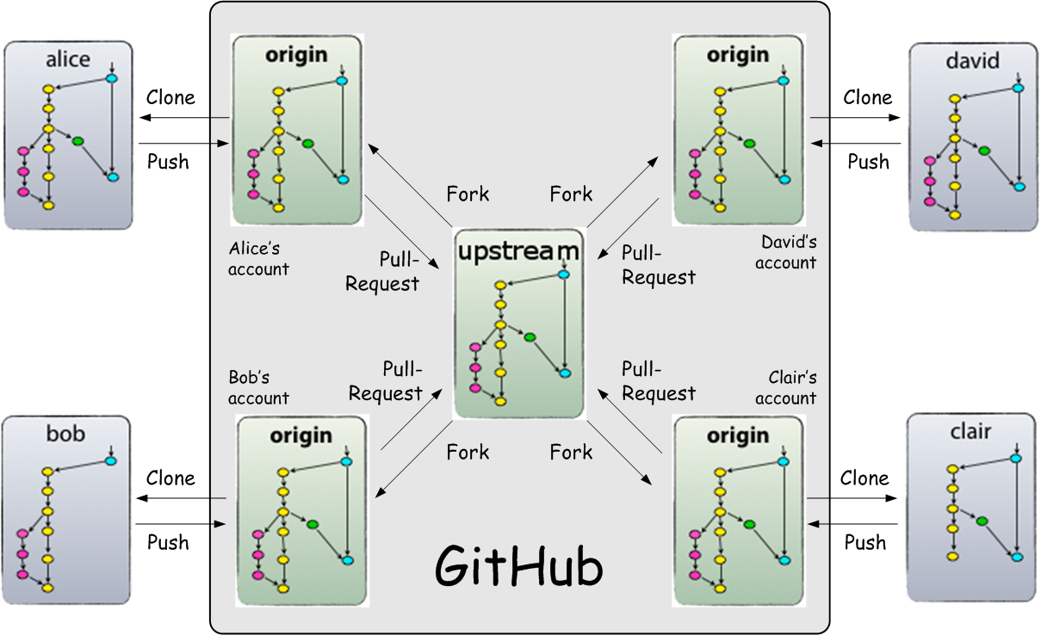
GitHub Forking
A fork is not a branch
A fork allows you to copy a repo for your own purposes
This allows for people disconnected from a development team to propose changes to something they don’t own OR use an existing product to start a new project in a different direction
Forks allow for collaboration without intruding on ownership

Slide 6
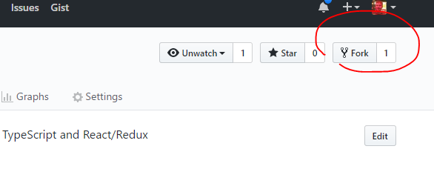
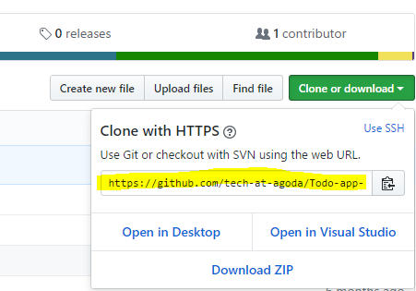
Setup Repo
Fork repo from https://github.com/tech-at-agoda/Todo-app-sample
Copy the repo’s git https address AFTER you fork it so you can use it in TeamCity
Clone on your local (optional)

Slide 7

TeamCity basic Architecture
TeamCity has a Server/Client Architecture with the Build Agents that run the jobs
TeamCity Requires a database, can be MS SQL, MySQL, Postgress or Oracle. And has built in HFSDB for testing/demo installs
Agent runs on JVM so can run on Windows, Linux, Mac, etc.
Agents are grouped into pools in teamcity for segregation based on Capabilities, geolocation, etc.

Slide 8
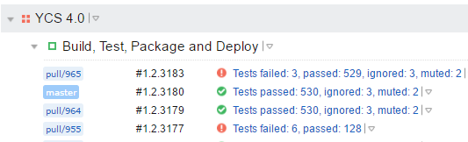



Naming Conventions for TeamCity
Create a Sub-Project with you Application name
Create Build Definitions with the “Action” that takes place
Why?
There are project level settings that you will want to change between applications
TeamCity is Designed to scale at the build definition level
Unlike other build systems that run tasks on an agent in parallel, TeamCity parallelizes over multiple agents, using different build definitions
Most Definitions start out with all-in-one (Build, Test, Package, Deploy, etc), but when you want to branch out this becomes easy, you can just create new build defs with the steps, and the naming convention scales nicely as you do.

Slide 9
Create your Build in TeamCity
Demo (Create Project and Build Def)
Clone Repo to your local (optional)
Demo (Look at project layout in GitHub or Local)

Slide 10
Project Layout
ToDo csproj
C# WebAPI Backend
Deployment Target Cluster
ToDo.Tests csproj
Nunit test project for C#
ToDoCDN csproj
Typescript React App
Tests are included with react components
Deployment Target CDN

Slide 11
Why we love (hate) CDNs
CDN are great for distributing static files close to your users, and can even cache dynamic files if you are so inclined
What wrong with them though?
Traditional CDN technology updates take time to populate, where as new file population is almost instant.
Many CDNs allow forcing updates, but limit the amount of times you can do this
What do we do about this? Always INSERT, never UPDATE
This works inherently better for js and css content as it will ensure that browser cache is updated

Slide 12
Webpack plugins to deal with this
Chunk Hash feature of webpack
Adds the content dependent hash to the filename or path
Content dependent is important because if the content doesn’t change you don’t want users re-downloading the file on updates, extremely important if you are doing CD or Frequent live deployments
https://webpack.js.org/guides/caching/
Commons Chunk plugin
Bundles 3rd party content separately, important as your libraries usually don’t change as often as your code, so it prevent re-downloading
https://webpack.js.org/plugins/commons-chunk-plugin/
Asset webpack plugin
Outputs a file you can using in your dynamic project to know the location of the assets
https://github.com/kossnocorp/assets-webpack-plugin

Slide 13
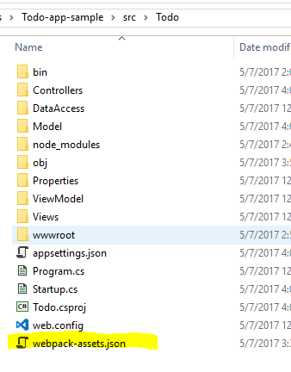

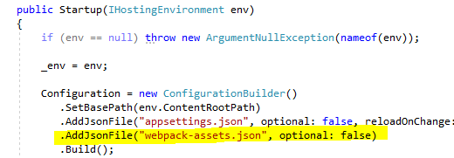
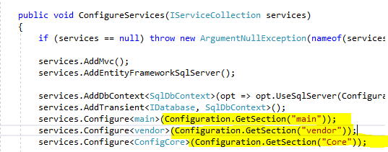
Making Webpack and Dot Net work
Webpack is configured to out the assets json file that contains the assets file names/paths
We such this out of our the files using the net core AppSettings and throw it in the view page of the razor view

Slide 14
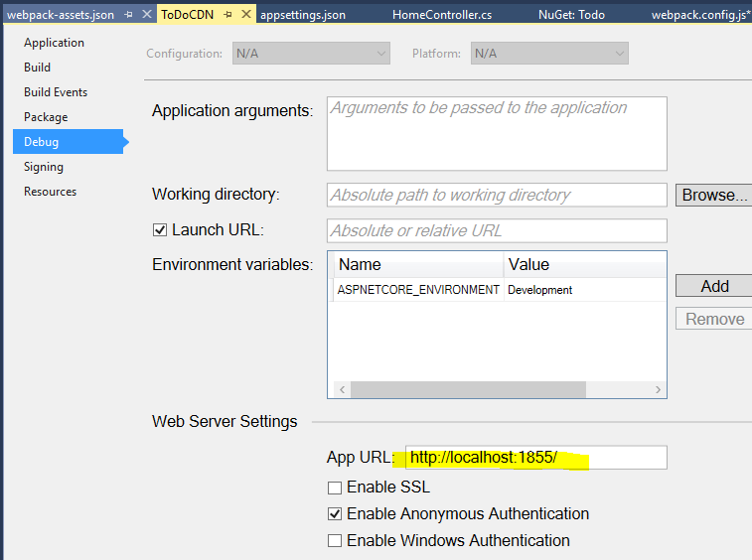
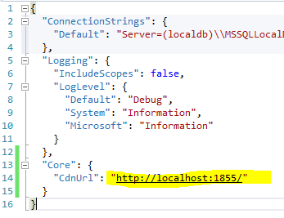
Debug on your local like it’s a CDN
The two projects will launch a website each on your local
You can also use the webpack web server for the CDN project for better debugging

Slide 15
Lets Create the Client Side Build Steps
Demo

Slide 16
Why is my NPM install Step taking so long?
TeamCity plus nodejs OOTB don’t play well
TeamCity clears the node_modules folder
Work around is to manually backup and restore this folder
https://beerandserversdontmix.com/2016/06/04/teamcity-and-avoiding-redownloading-of-npm-packages/

Slide 17
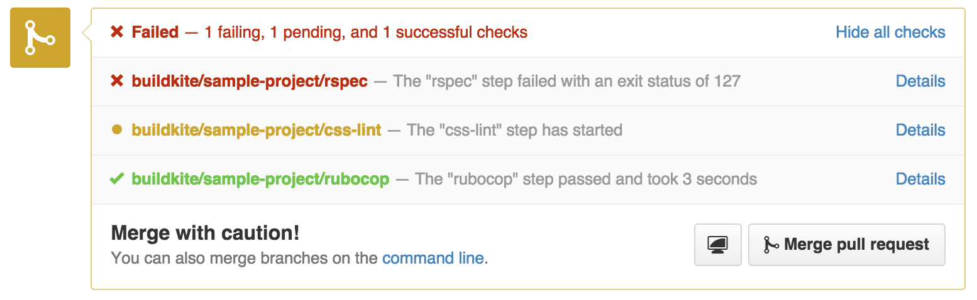
Commit Status Publishing
Systems run builds (or other quality checks) on commits, they post back to Git systems (Github, GitLab, Bitbucket, etc) the success or failure status
Allows verification of Quality before merging to master

Slide 18
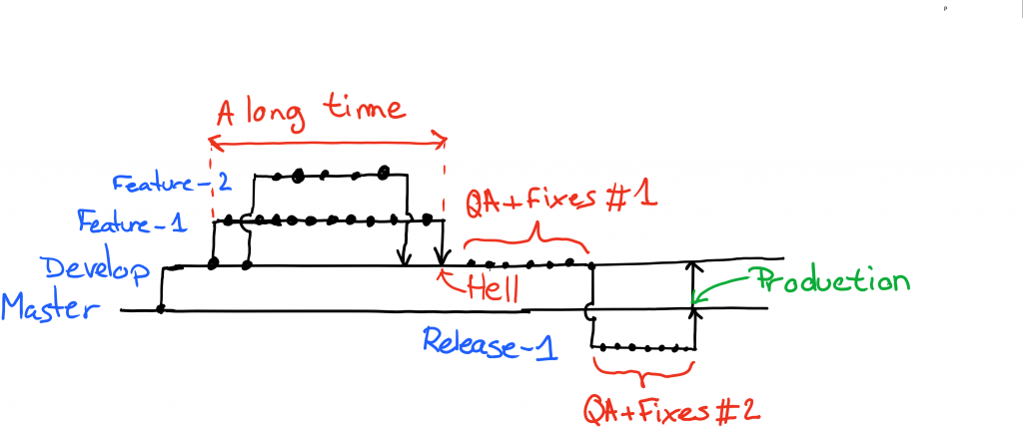
Git Flow
Got Flow was one of the first Branching systems widely adopted in Git. It was good for long release cycles (1-3 months or more).
For CD Systems it adds additional complexity that is not required

Slide 19
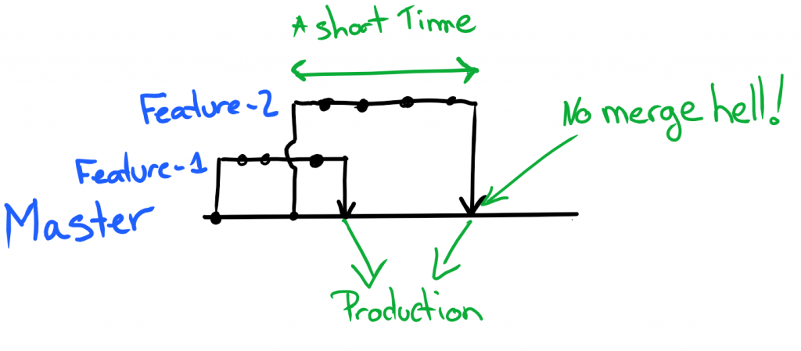
GitHub Flow
GitHub flow is a system designed for CD systems.
Simplifies the branching strategy with a focus on short lived branches, moving fast and fixing fast
Ref: https://blogs.technet.microsoft.com/devops/2016/06/21/a-git-workflow-for-continuous-delivery/

Slide 20
Pull Request Demo
Demo (Make a pull request in GitHub)

Slide 21
Octopus Deploy Architecture
Octopus Includes package management, Configuration management, and manages the life cycle through the deployment pipeline (e.g. Dev to QA to Prod)
Package management support for nuget, docker, or just plain ZIP files is support.

Slide 22
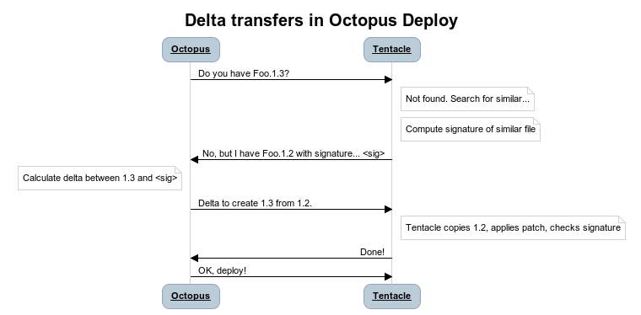
Delta Transfers in Octopus Deploy
100% C# implementation of remote delta compression based on the rsync algorithm
Octodiff is on GitHub and is licensed under the Apache license. It has three different commands - creating a signature, creating a delta, and applying a delta (patch).

Slide 23
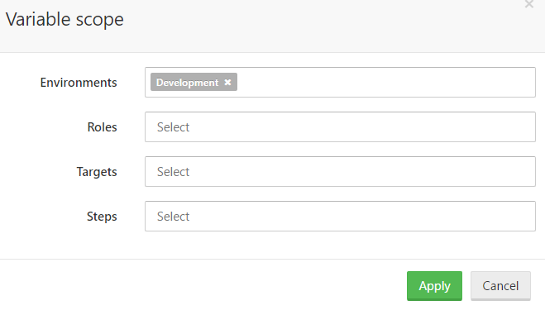
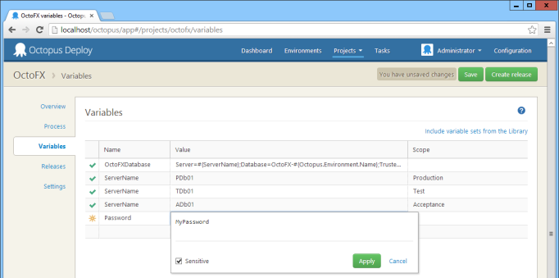
Dev -> QA -> Prod
Scope and variables in octopus

Slide 24
CD to CDN, why we don’t need Dev and QA CDN
Chunk hash and link from versioned app in dev/qa etc.
We don’t need different CDN for Dev QA etc because our C# App simply links to the relevant hashed version
Storage is cheap

Slide 25
AWS S3 and CloudFront
Why CDN (Content Delivery Network)?
Allows you to put your static content closer to your users
If you have a geographically disperse user base CDN are essential
CDNs like Cloudflare, CloudFront, Azure and Akamai have hundreds of endpoints around the world
S3 is an easy step into the CDN world, its an object store that AWS allows you to easily publish to it’s CloudFront CDN

Slide 26
Adding Deployment Steps to your Build Definition
Demo (Deploy)

Slide 27
Octopus Release Versioning
There is a Difference between package and release version
Variables and process changes are versioned and change between release
This is a good thing, it means that future changes aren’t retroactively applied to your history, so Version 1.1 will deploy the same why it did before when you are making updates to 2.4 for example

Slide 28
Deploying with Octopus to Production
Demo (Adding the tentacle to Production)

