Slide 1

Big Data for everyone

Slide 2
Big Data
What is it?
Raw data from which different insights and views can be extracted
How to process it?
Using distributed computing , more machines faster processing
Why do we care?
It allows us to go back to the historical data and get a different insight which we would have missed otherwise

Slide 3
Objective
Introducing Hadoop ecosystem from high level
Understand the inter-working and inter-dependence of fundamental Hadoop systems
Mapping current understanding of legacy systems to Hadoop
Building solutions on Hadoop

Slide 4
Challenges of distributed computing
Reliability
Bandwidth limitation
Consistency
Complexity of system

Slide 5
How Hadoop overcomes the challenges
Move computation to the data
Transparent file system to build any application on top of it
Its Parallel not concurrent to keep things simple

Slide 6
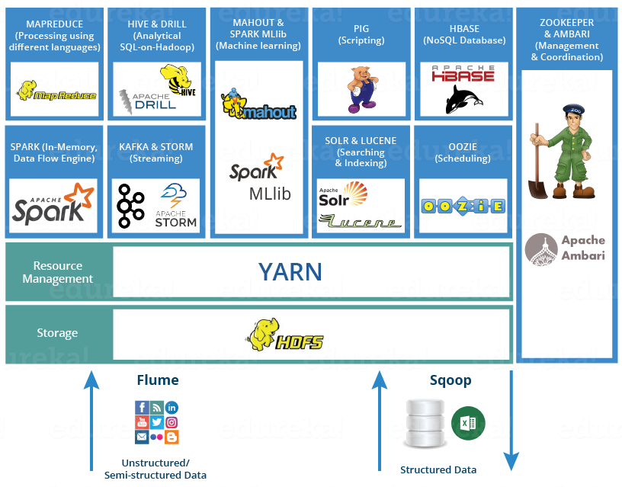
Hadoop
Modern day general purpose distributed computing framework

Slide 7
Fundamental Systems of Hadoop
The file system : HDFS
The resource manager: Yarn
The coordination Engine : Zookeeper
Processing engine of your choice : Spark

Slide 8
HDFS
Distributed file system
Blocks are the building blocks
Files are broken down in blocks and stored
Redundant and available: multiple copies of each block
WORM: Write once read multiple times

Slide 9
HDFS: Components
Block: Fundamental storage unit
DataNode : stores blocks
NameNode: Stores metadata
The block addresses that make up a file
The location of blocks and their copies

Slide 10

HDFS

Slide 11
YARN
Cluster resource manager
Dynamic resource allocation
Multi-tenant
Locality aware

Slide 12
YARN:
Container: Basic resource unit
Flexible size
Resource Manager
Scheduler: container
Applications Manager: assigns containers to the
Node manager
Node level resource management

Slide 13
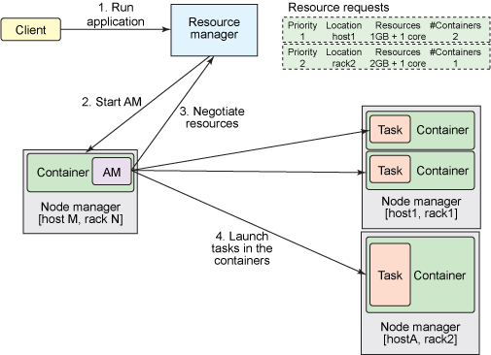
YARN: Architecture

Slide 14
Hive: Data warehouse system
Use SQL to query data
Common interface to various data storage formats
Shared meta data structures

Slide 15
Spark: In memory processing engine
General purpose in-memory processing framework
Lazy evaluation
RDD at the core of processing (newer versions have changed a lot of things)
Build SQL, graph processing, ML on same framework
Support for Hadoop

Slide 16
Hands on
Loading data to HDFS
Create Hive tables
Trying out different queries
Spark-shell
Building spark application

