Slide 1
Nutmeg
github.com/kitizz/nutmeg
Christopher Ham
Notes:
Core points:
Fast, responsive
Fast data update rate
Multiplatform, multilingual
Template figure layouts
Parameter, GUI updates

Slide 2
The Project
Overview
Goals
Non Goals
Features + Examples

Slide 3
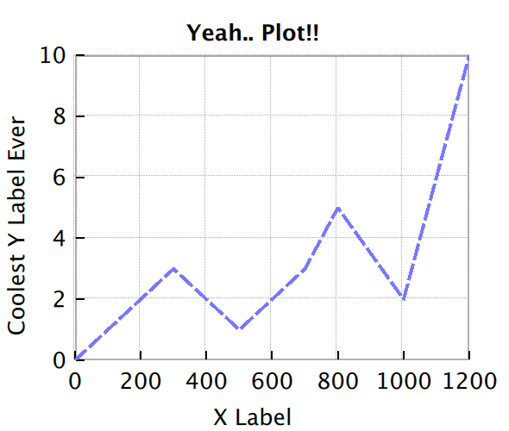
Overview
Multi-platform
Multi-lingual
Standalone core
Connects with multiple clients
Tabbed Figures
Experiment1.py
Optimiser.py
Accelerometer.cpp
Cluster/CrunchData.py

Slide 4
Goals
Designed for playing with data

Slide 5
Goals
Designed for playing with data
GUI: Fast and Responsive
GUI: Stays out of the way
Data updates are fast
Run on multiple platforms
Clients: Desktop
Core: Desktop + Mobile

Slide 6
Non Goals
Replace existing tools for publishing
Matlab
GNU Plot
Matplotlib
Output to PDFs, Images
For now

Slide 7
Features
Full multitouch + mouse navigation
Data point inspection
Figure layout using QML
Bind plot data to parameters

