Slide 1
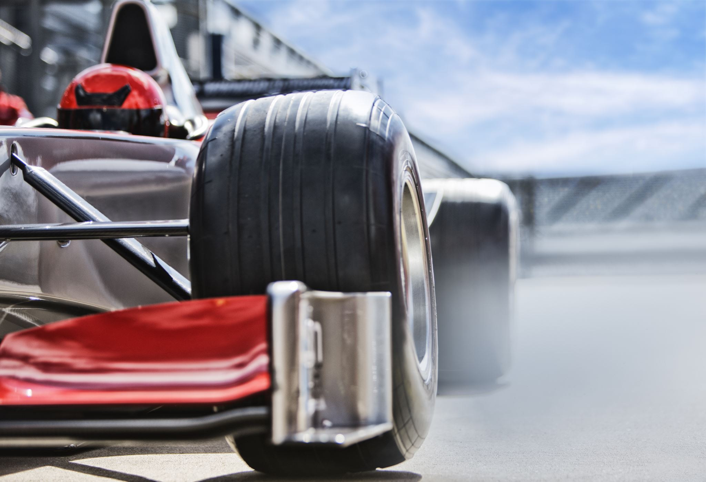
Racing Insights
Analyzing the Formula 1 2013 Season with Neo4j

Slide 2
Introduction – Group Member
Kevin
Wenhao Fang (Simon)
A tech enthusiast,
Specializing in backend development and cloud computing
Django, AWS, Oracle

Slide 3
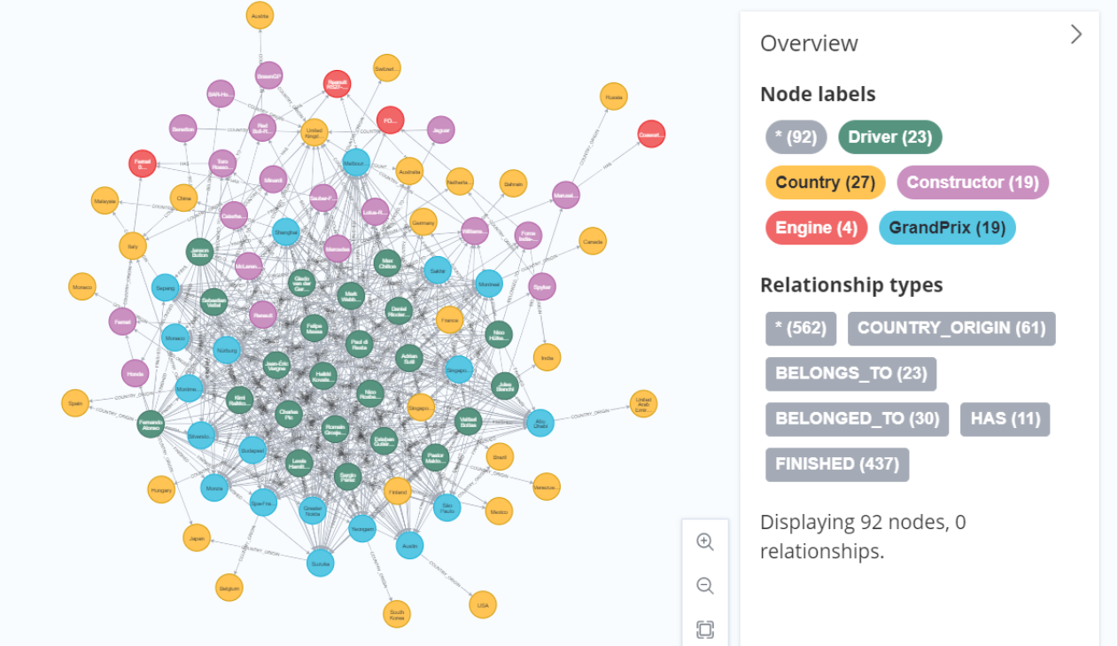
Introduction – Dataset
Formula 1 2013 Season
URL:
https://portal.graphgist.org/graph_gists/formula-1-2013-season/source

Slide 4
Quetsions
Which engine is the best?
Top 5 drivers who has the most retirement?
Categorize constructors into 3 tiers.
Make link prediction between driver and constructor.
Categorize drivers using python.

Slide 5
Quetsions-1 Which engine is the best?

Slide 6
Quetsions-2

Slide 7
Quetsions-3: Categorize constructors
Cypher
GDS Library
Steps:
Sum total points per constructor
Create graph
k-mean clustering
Neo4j Demo

Slide 8
Quetsions-4: link prediction between driver and constructor.
Cypher
GDS Library
link prediction:
(d:Driver)-[r:BELONGS_TO]->(c:Constructor)
Steps:
Create graph
Create pipline
Node embeddings
Add Features
Split train-test
Add and train model
Predict

Slide 9
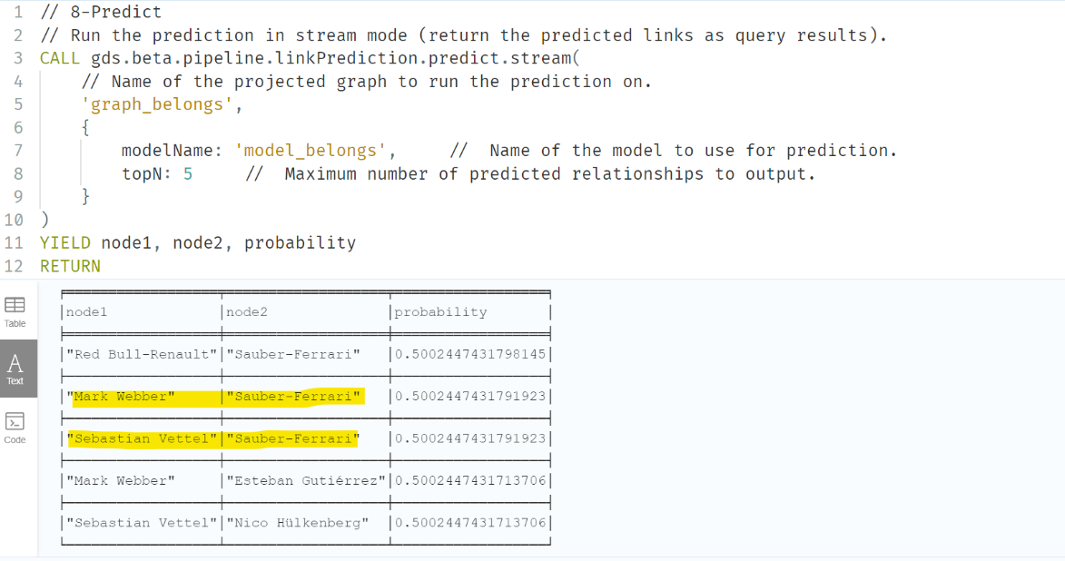
Quetsions-4: link prediction between driver and constructor.
Neo4j Demo (Heterogeneous nodes link prediction)

Slide 10
Quetsions-5: Categorize Drivers
Python, (neo4j+graphdatascience)
Steps:
Install packages
Establish Connection
Define cypher script
Run script and return data
Jupyter Note Demo

Slide 11
Reference
Node embeddings - Neo4j Graph Data Science
K-Means Clustering - Neo4j Graph Data Science
Link prediction pipelines - Neo4j Graph Data Science

