Slide 1
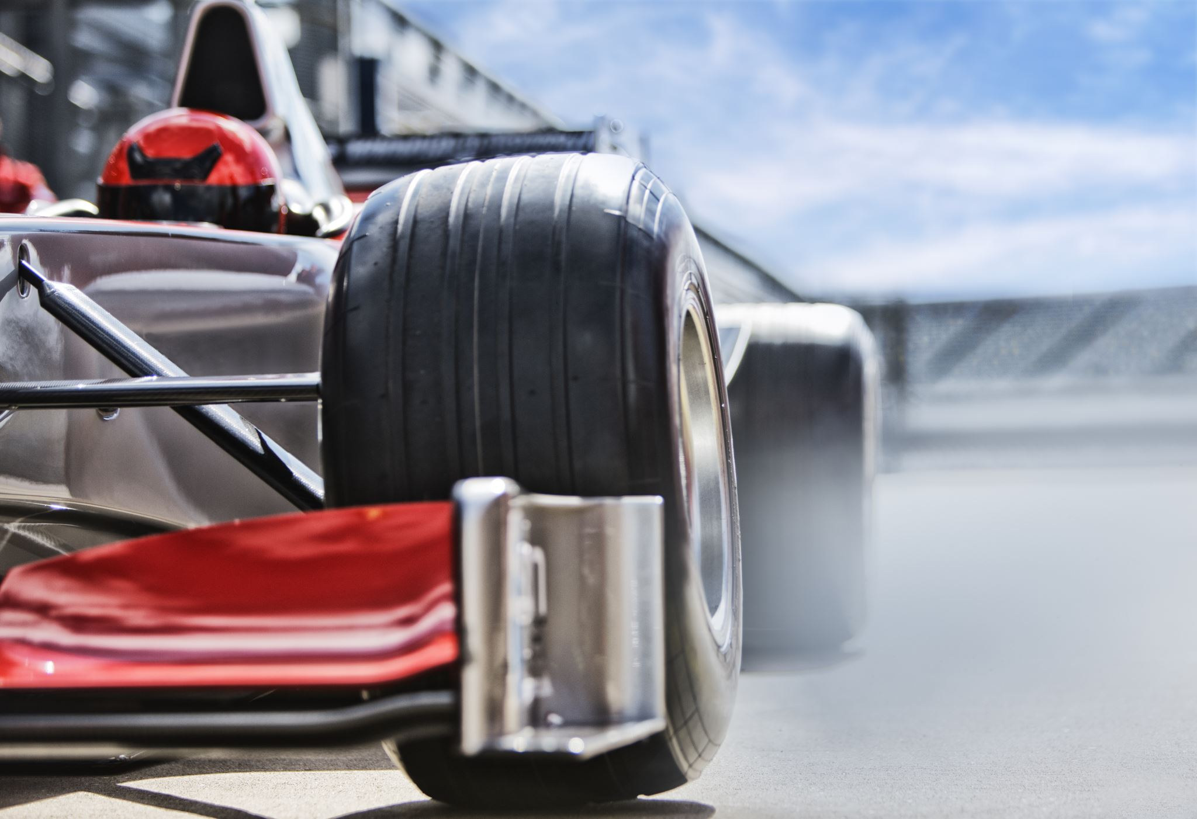
Racing Insights
Analyzing the Formula 1 2013 Season with Neo4j

Slide 2
Introduction – Group Member
Tsz Kit Cheung (Kevin)
A F1 fan
Wenhao Fang (Simon)
A tech enthusiast,
Specializing in backend development and cloud computing
Django, AWS, Oracle

Slide 3
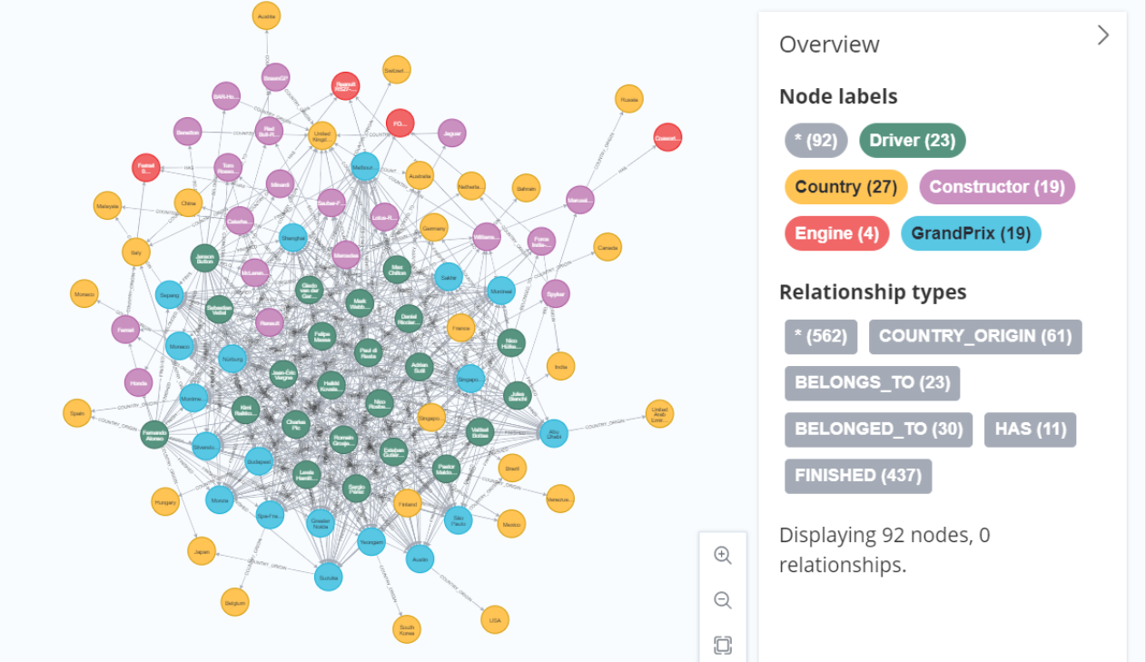
Introduction – Dataset
Formula 1 2013 Season
URL:
https://portal.graphgist.org/graph_gists/formula-1-2013-season/source

Slide 4
Introduction – Dataset
Nodes: (Drivers, Country, Constructors, Engine, Grand Prix)
23 Drivers, 27 Countries, 19 constructors (include previous constructors), 4 engines and 19 Grand Prix
Relationships:
Constructors -> Engine (has), Constructors -> Country (Country Origin)
Drivers->Country (Country Origin), Drivers-->Constructor (Belongs to),
Drivers--> Grand Prix (Finished)
Grand Prix->Country (Country Origin)
Our objective: To summarize the performance of drivers and
Constructors in the season

Slide 5
Questions
Which engine is the best?
Top 5 drivers who has the most retirement?
Categorize constructors into 3 tiers.
Make link prediction between driver and constructor.
Categorize drivers using python.

Slide 6
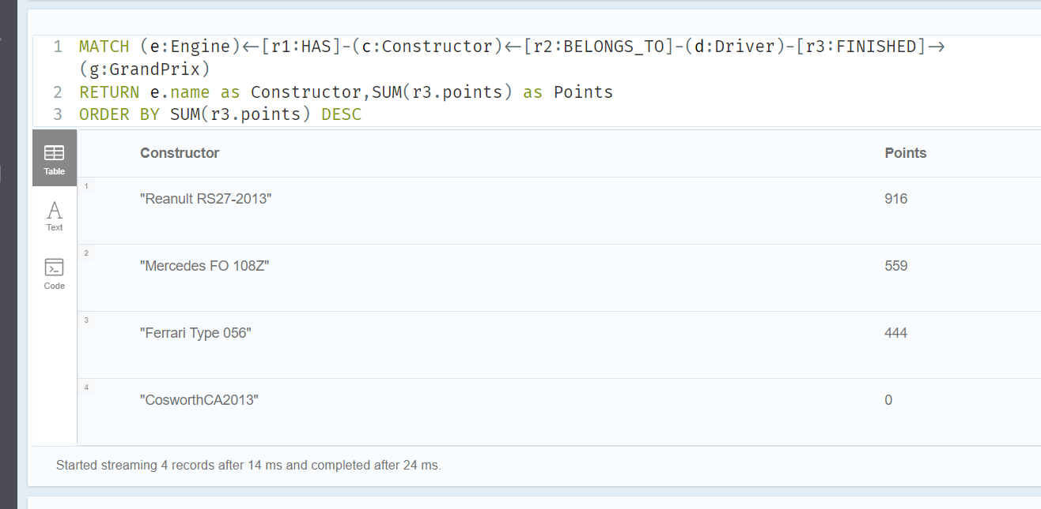
Quetsions-1 Which engine is the best?
Used cypher query, Renault RS27-2013 is the best engine

Slide 7
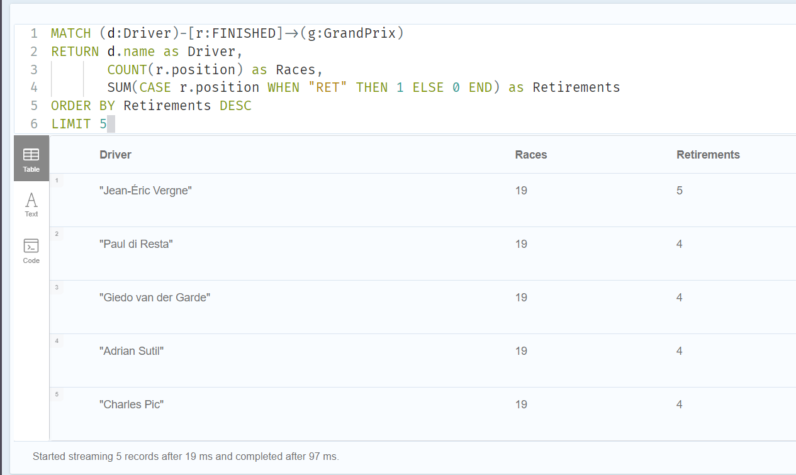
Quetsions-2 Top 5 drivers who has the most retirement?

Slide 8
Quetsions-3: Categorize constructors
Cypher
GDS Library
Steps:
Sum total points per constructor
Create graph
k-mean clustering
Neo4j Demo

Slide 9
Quetsions-4: link prediction between driver and constructor.
Cypher
GDS Library
link prediction:
(d:Driver)-[r:BELONGS_TO]->(c:Constructor)
Steps:
Create graph
Create pipline
Node embeddings
Add Features
Split train-test
Add and train model
Predict

Slide 10
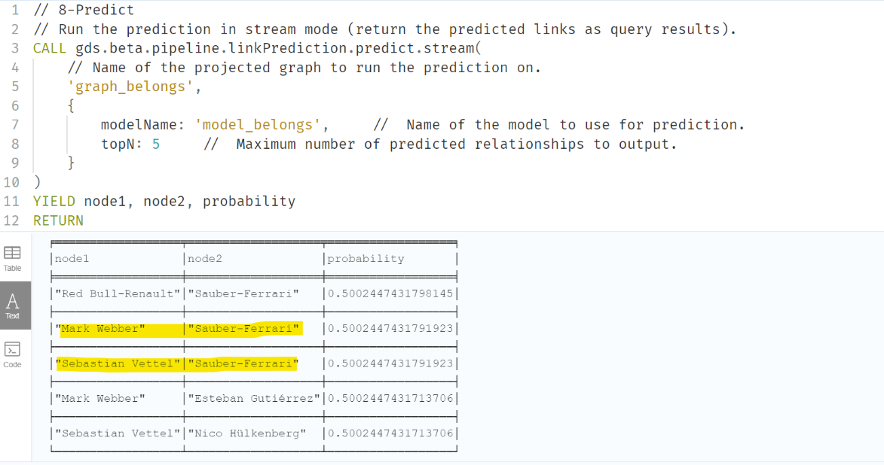
Quetsions-4: link prediction between driver and constructor.
Neo4j Demo (Heterogeneous nodes link prediction)

Slide 11
Quetsions-5: Categorize Drivers
Python, (neo4j+graphdatascience)
Steps:
Install packages
Establish Connection
Define cypher script
Run script and return data
Jupyter Note Demo

Slide 12
Reference
Node embeddings - Neo4j Graph Data Science
K-Means Clustering - Neo4j Graph Data Science
Link prediction pipelines - Neo4j Graph Data Science

