Slide 1
ITC 5201 Database Programming using Java
Assignment #4
Notes:
Ass04 Group03, created by Wenhao Fang

Slide 2
1-Demonstration
Testing Data
UI + Functionalities
IsExist
View
Clear
Insert
Update
Validation
Connection Failure
Input over size
Empty ID

Slide 3
2-Design
Database Connection
Problem
Solution
MVC
Github
Protocol
Source code Interpretation

Slide 4
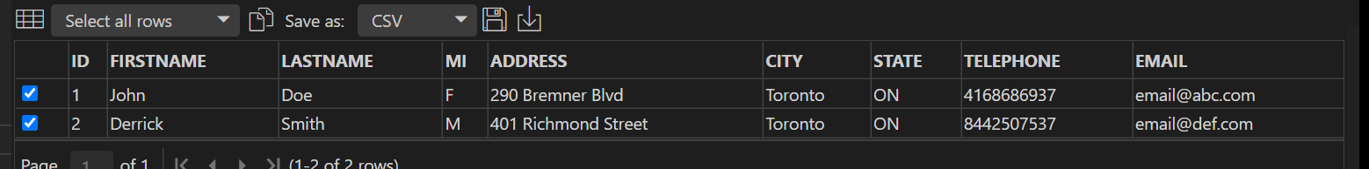
1-Demonstration
1.Testing Data
See SQL code in java_staff.sql

Slide 5
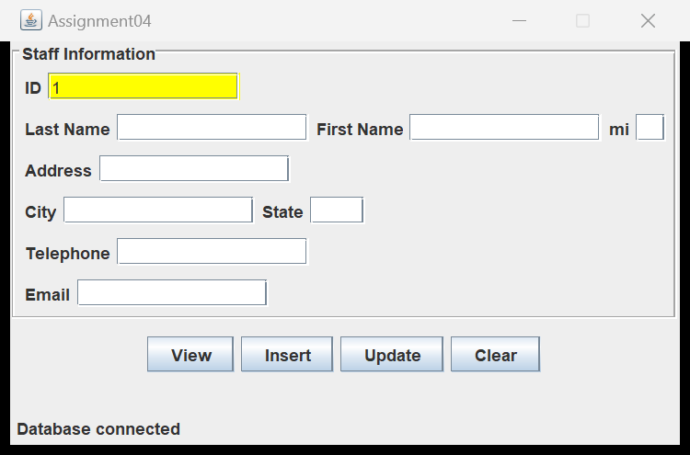
1-Demonstration
UI + Functionalities
IsExist:Yellow

Slide 6
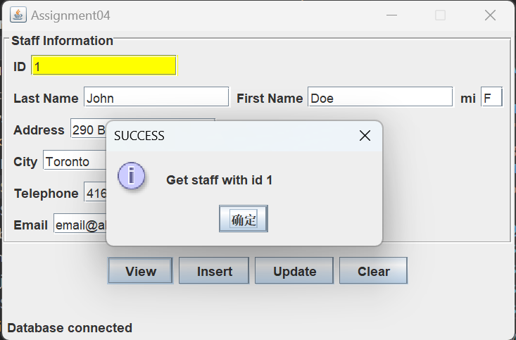
1-Demonstration
UI + Functionalities
View: Exist

Slide 7
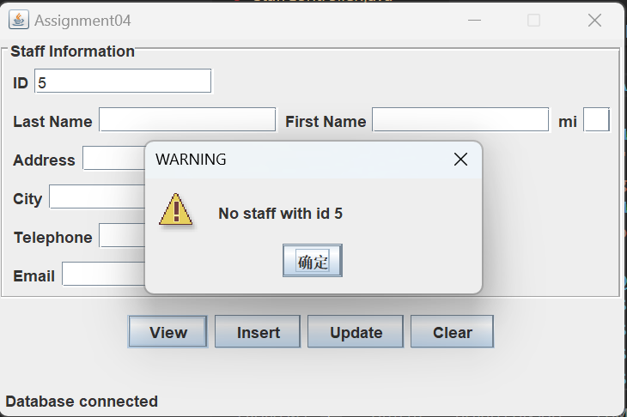
1-Demonstration
UI + Functionalities
View: Not-exist

Slide 8
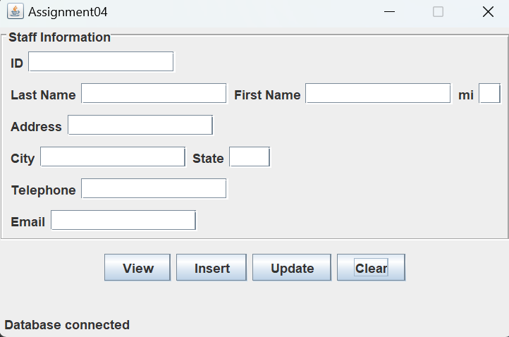
1-Demonstration
UI + Functionalities
Clear

Slide 9
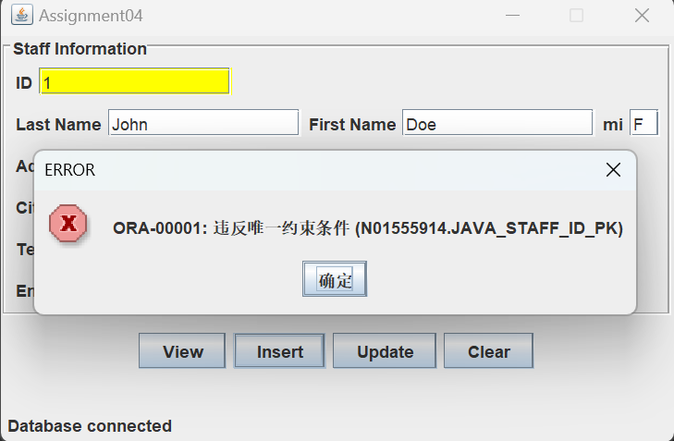
1-Demonstration
UI + Functionalities
Insert: Repeated

Slide 10
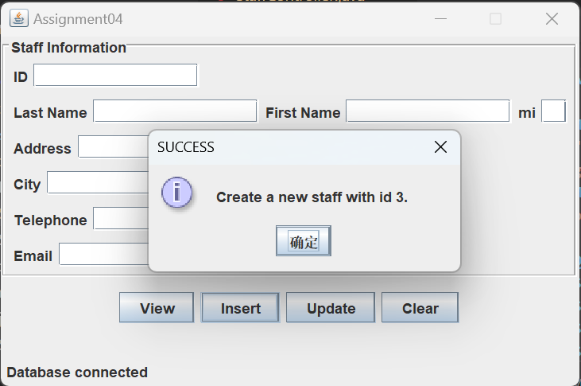
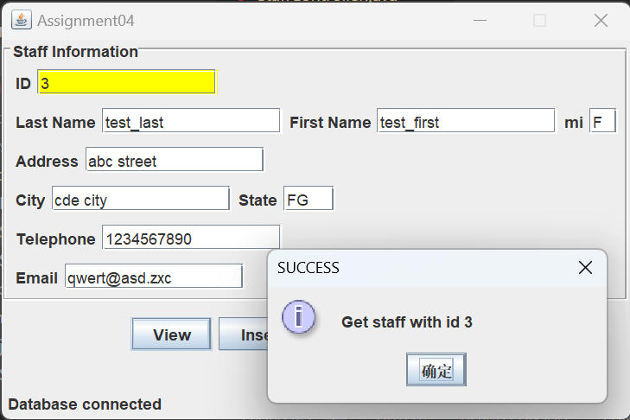
1-Demonstration
UI + Functionalities
Insert + View

Slide 11
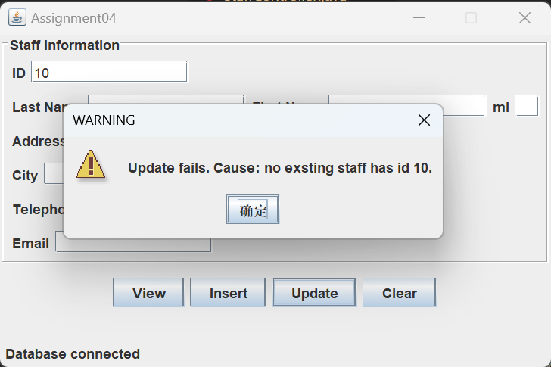
1-Demonstration
UI + Functionalities
Update: Non-exist

Slide 12
1-Demonstration
UI + Functionalities
View: retrieve old data
Update: input new data
View: retrieve new data

Slide 13
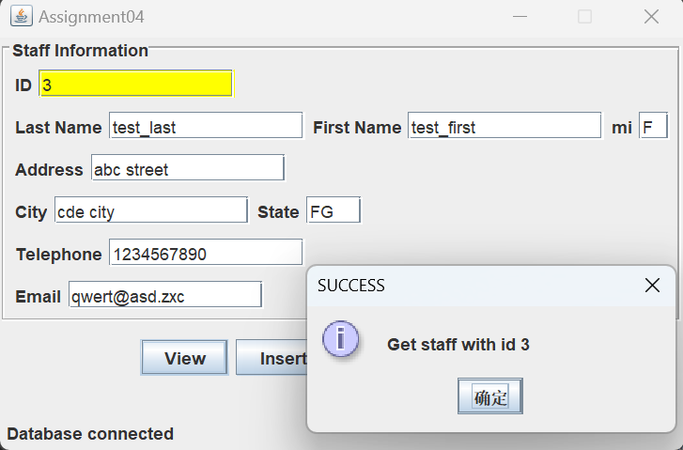

Slide 14
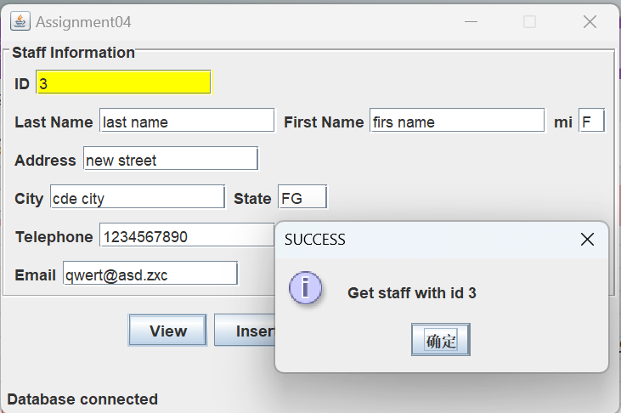

Slide 15
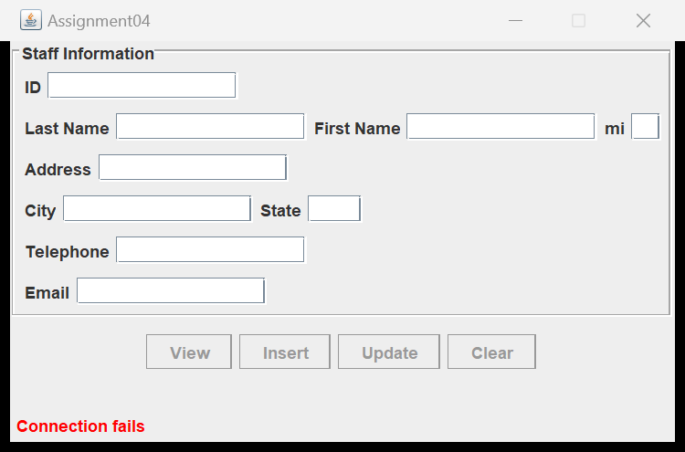
1-Demonstration
Validation
Connection Failure

Slide 16
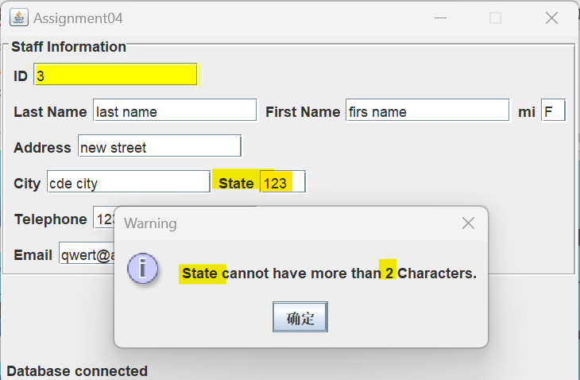
1-Demonstration
Validation
Input over size

Slide 17
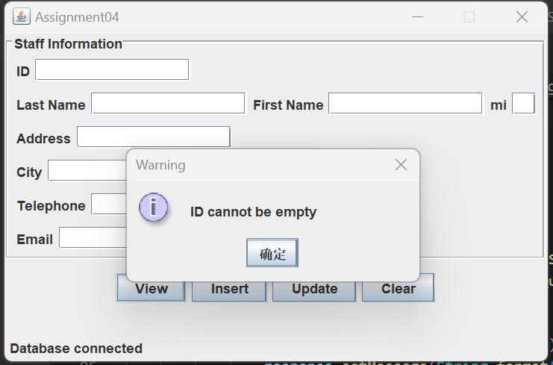
1-Demonstration
Validation
Empty ID

Slide 18
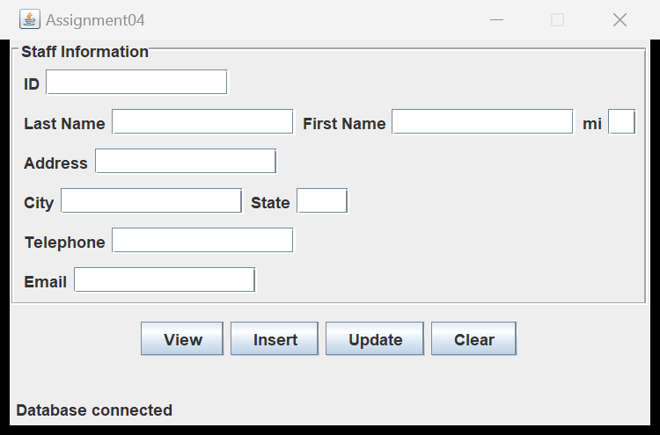
2-Design
UI
ActionListener

Slide 19
2-Design
Database Connection
Oracle -> Class Name -> URL
Build connection:
try-with-resources Statement

Slide 20
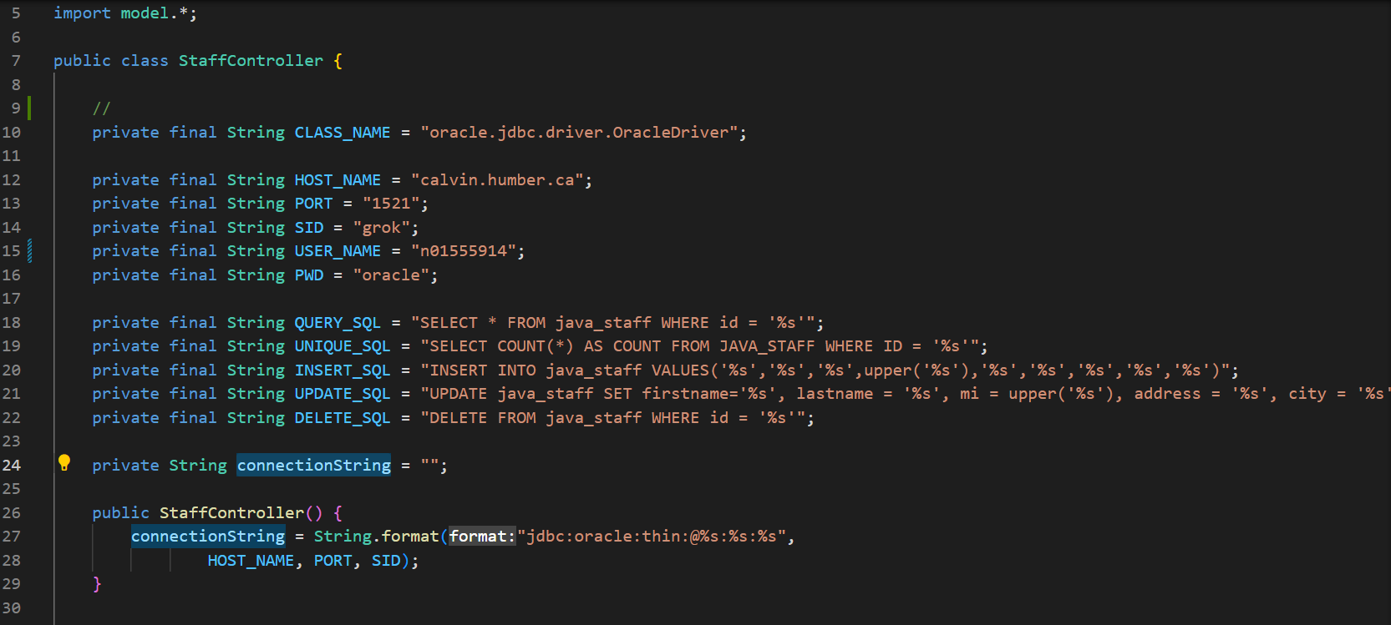

Slide 21
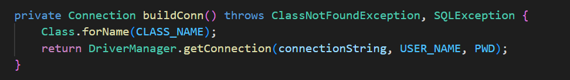

Slide 22
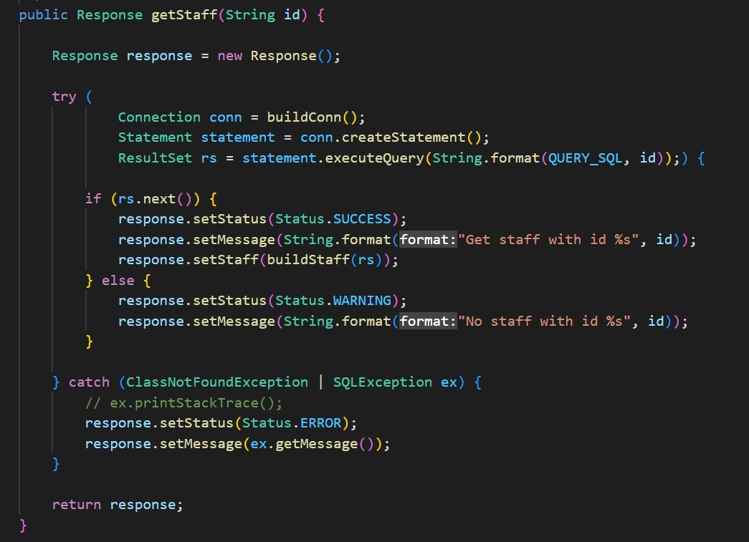

Slide 23
2-Design
Problem:
Coupling:
Interaction among programmers working in a group leads to low productivity.
Files Iteration
Files conflicts of each development iteration cost debut time.

Slide 24
2-Design
Solution
MVC Architecture(Coupling:)
Programmer take each part based on a protocol, lowering the potential coupling and then improving productivity
Github:
All documents are uniform

Slide 25
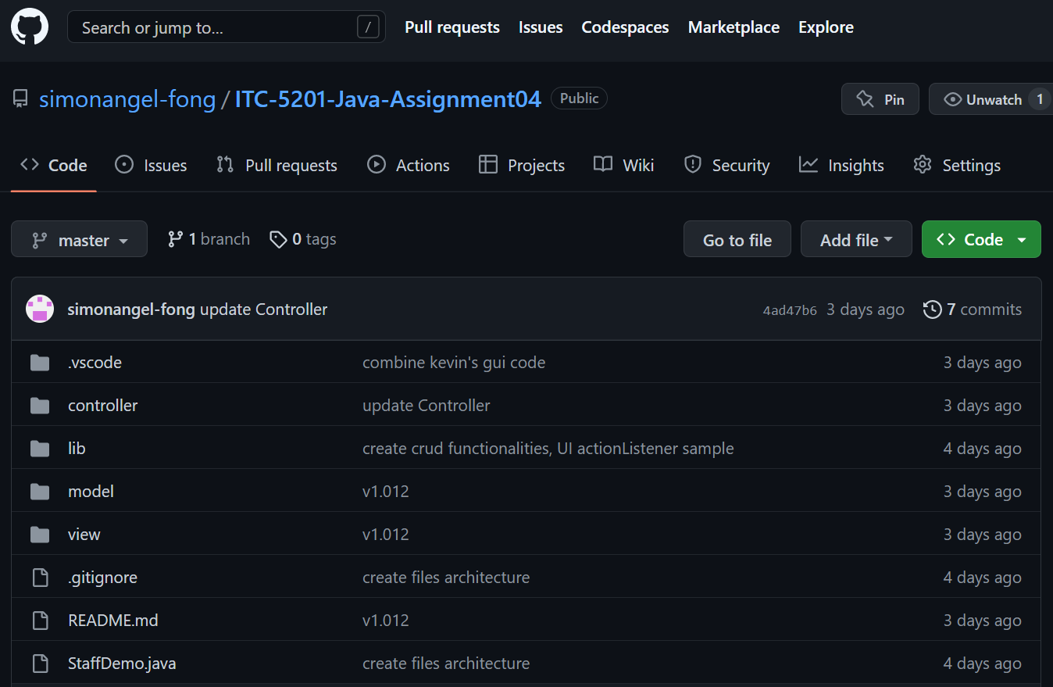
Welcome to visit our github
https://github.com/simonangel-fong/ITC-5201-Java-Assignment04

Slide 26
2-Design: MVC
Model
Model: Staff
Defined by table
Shared across UI and Controller
The data transfer between UI and Controller
View: UI
Controller

Slide 27
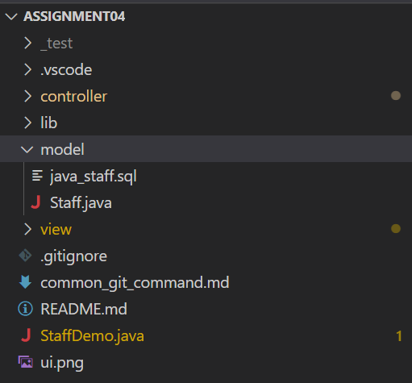
File

Slide 28
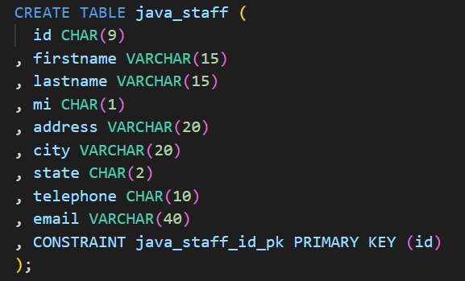
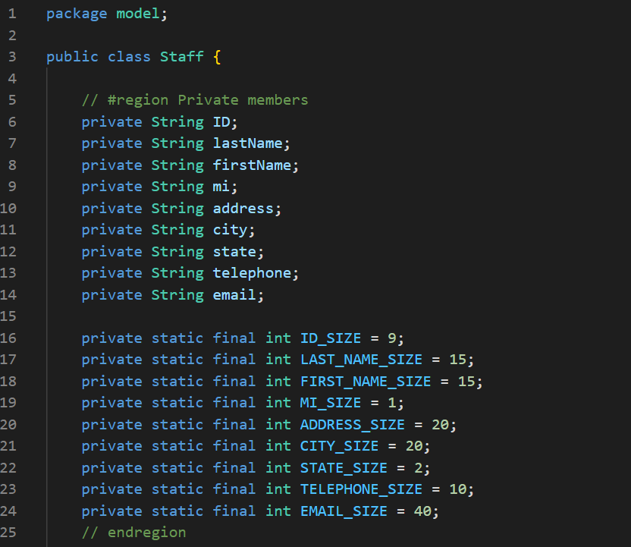
Model and TABLE

Slide 29
2-Design: MVC
Model
View: UI
Interface used by end user
Call methods defined in Controller and display feedback
StaffUI.java
View: UI
Controller

Slide 30
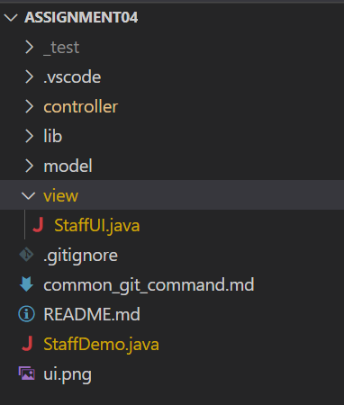
File

Slide 31
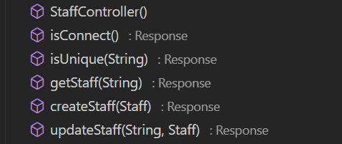
2-Design: MVC
Model
View: UI
Controller
Controller
Provide key functionalities
Control access to database
Return a response object when called by UI

Slide 32
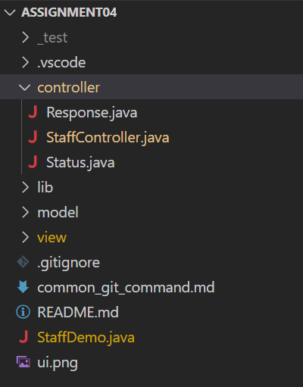
File

Slide 33
2-Design: Protocol
A protocol (Response) will be followed during development.
UI
Controller
Database
getStatf()
executeQuery()
Response
ResultSet
Status.Seccess
Data:Staff
Status.Error
Exception
Message

Slide 34
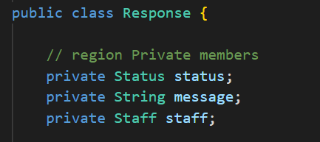
Component of response
Response:
Status: Success, Warning, Error
Message
Staff

Slide 35
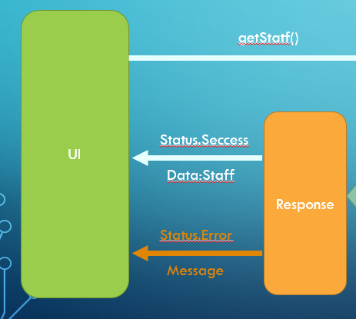
Protocol: Advantages
Font end: Easy to bind data
1.check status
2.1 If success, then bind data + get message
2.2 if warning, then get warning message
2.3 if erro, then get error message
3.show message box

Slide 36
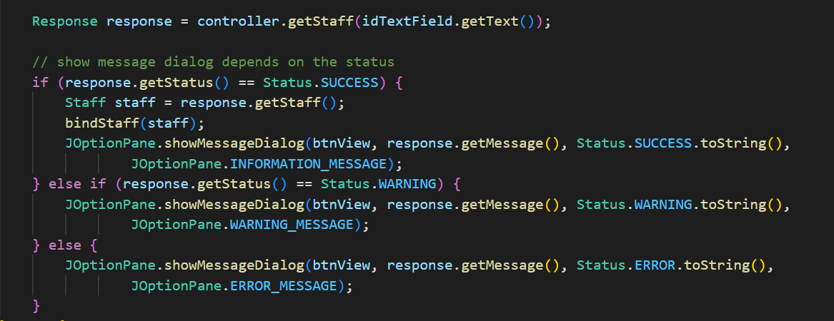

Slide 37
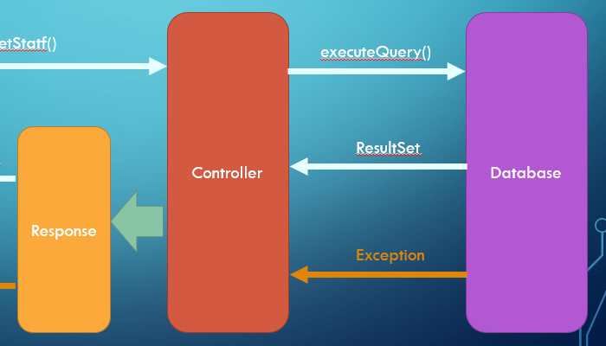
Protocol: Advantages
Back end
Connect database
CRUD SQL
Return Response object

Slide 38
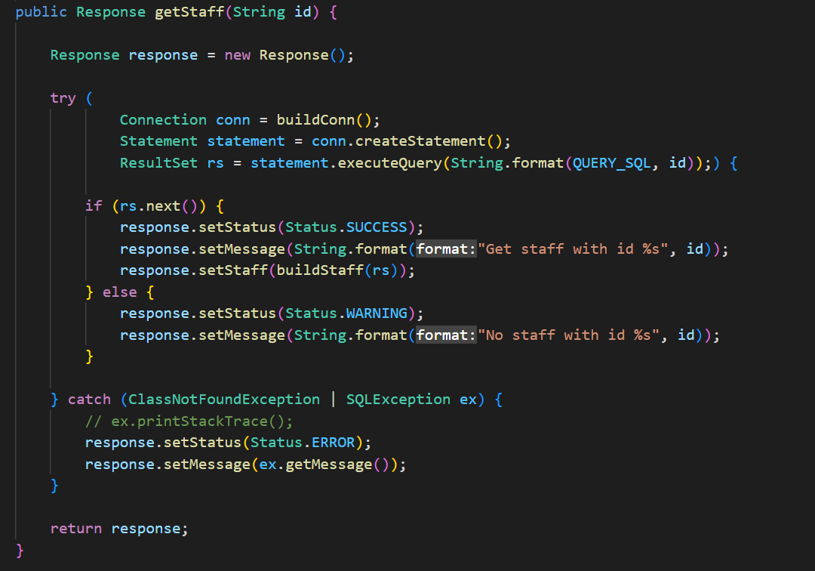
Protocol: Advantages

Slide 39
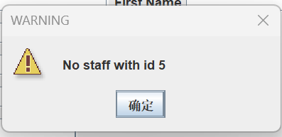
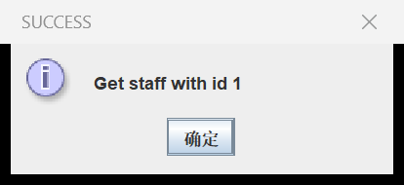
Protocol: Advantages
Efficiency
Decouple potential interaction between font end and back end.
Improve development productivity
UI User friendly
End user always get required message

Slide 40
Thank you
Group3
Ansh Bhardwaj
Tsz Kit Cheung
Wenhao Fang

