Slide 1
ITC 5201 Database Programming using Java
Assignment #4
Notes:
Ass04 Group03, created by Wenhao Fang

Slide 2
1-Demonstration
Testing Data
UI + Functionalities
IsExist
View
Clear
Insert
Update
Validation
Connection Failure
Input over size
Empty ID

Slide 3
2-Design
Database Connection
Problem
Solution
MVC
Github
Protocol
Source code Interpretation

Slide 4
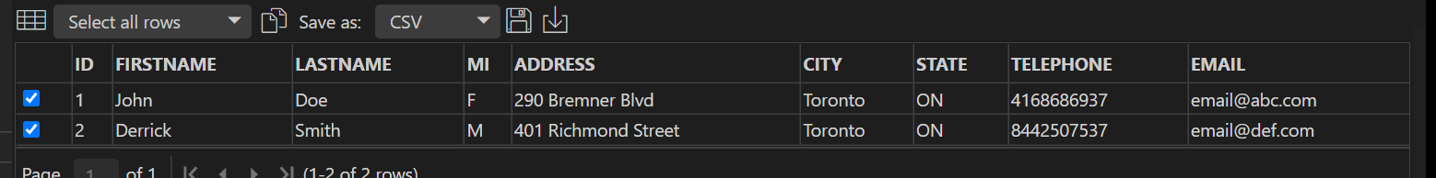
1-Demonstration
1.Testing Data
See SQL code in java_staff.sql

Slide 5
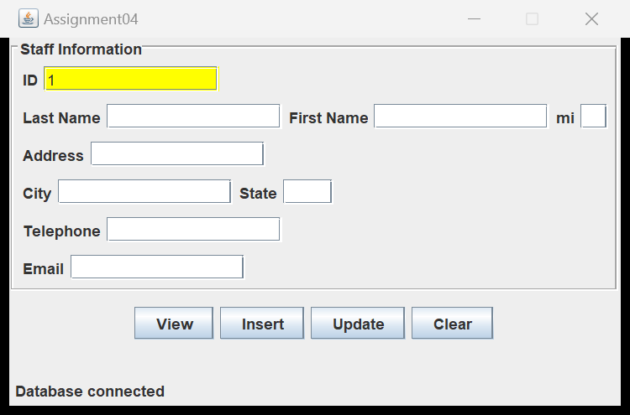
1-Demonstration
UI + Functionalities
IsExist:Yellow

Slide 6
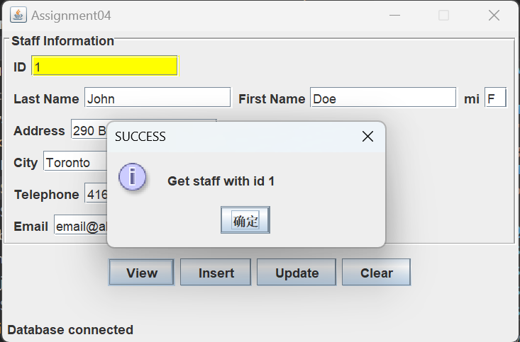
1-Demonstration
UI + Functionalities
View: Exist

Slide 7
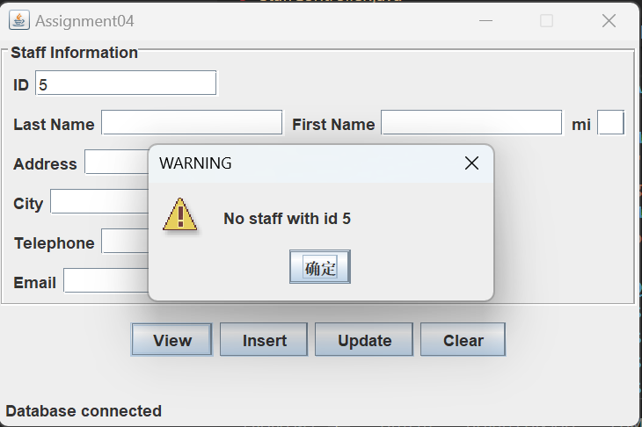
1-Demonstration
UI + Functionalities
View: Not-exist

Slide 8
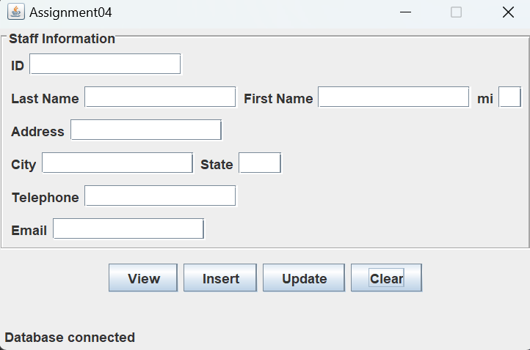
1-Demonstration
UI + Functionalities
Clear

Slide 9
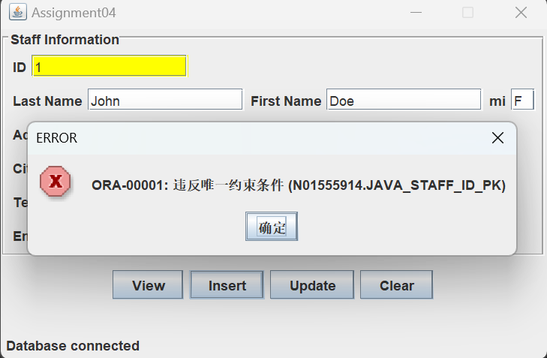
1-Demonstration
UI + Functionalities
Insert: Repeated

Slide 10
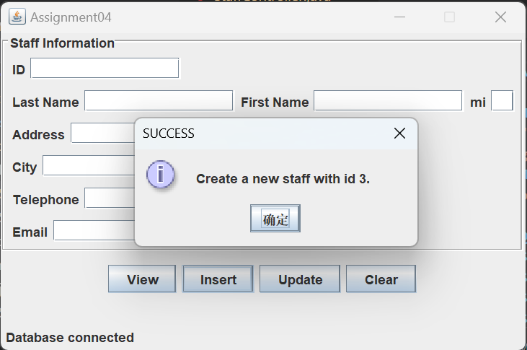
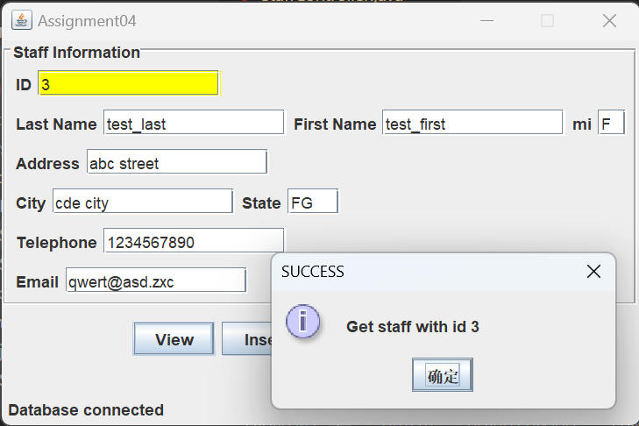
1-Demonstration
UI + Functionalities
Insert + View

Slide 11
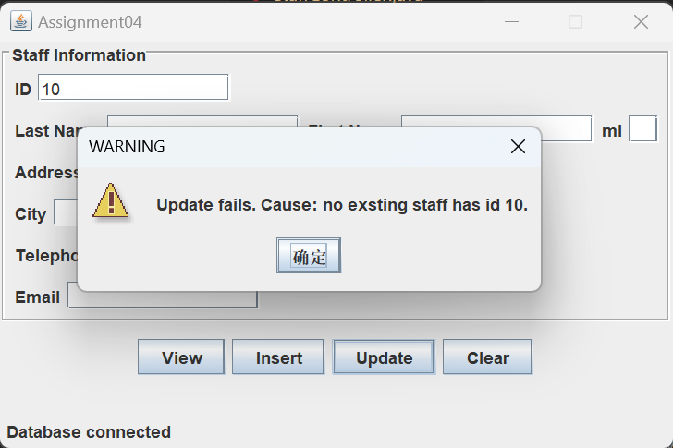
1-Demonstration
UI + Functionalities
Update: Non-exist

Slide 12
1-Demonstration
UI + Functionalities
View: retrieve old data
Update: input new data
View: retrieve new data

Slide 13
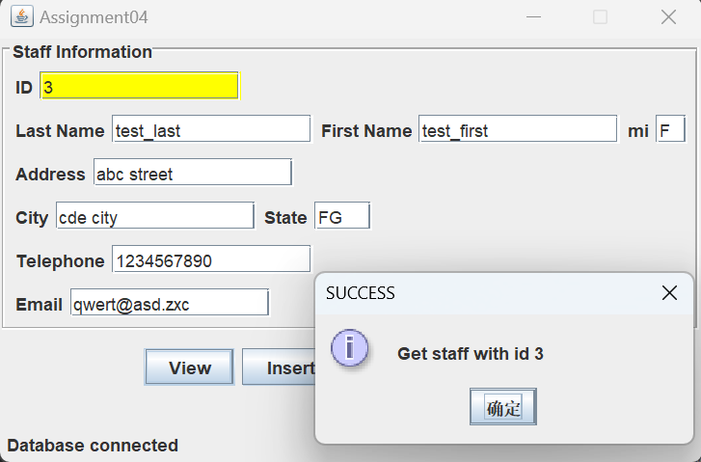

Slide 14
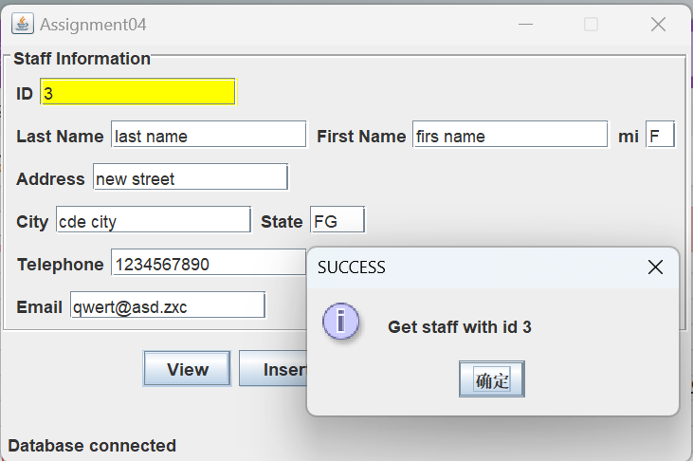

Slide 15
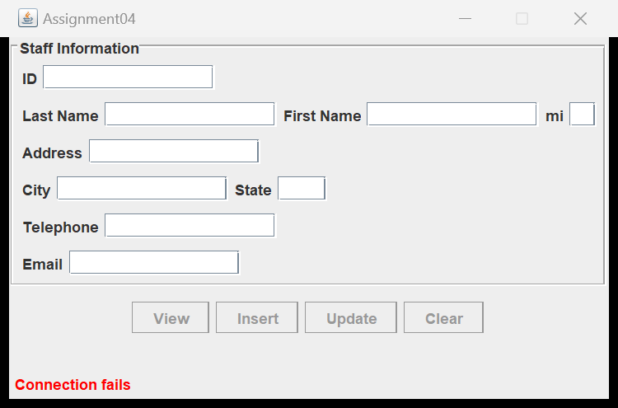
1-Demonstration
Validation
Connection Failure

Slide 16
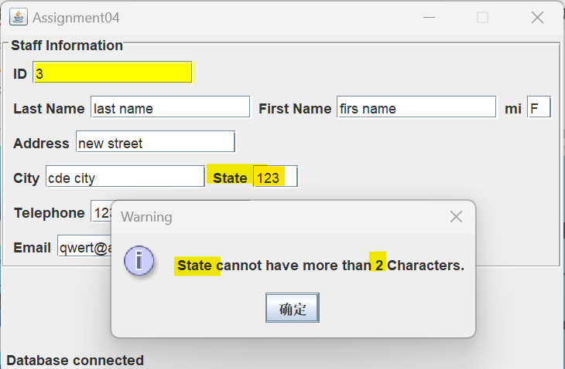
1-Demonstration
Validation
Input over size

Slide 17
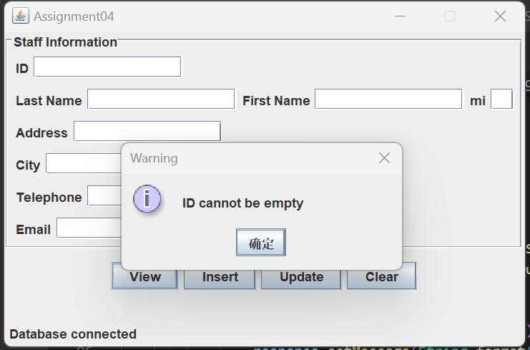
1-Demonstration
Validation
Empty ID

Slide 18
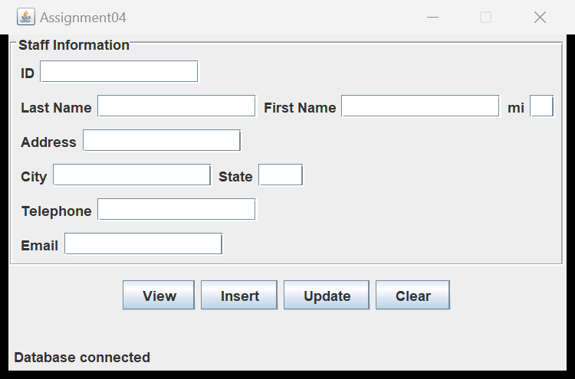
2-Design
UI
ActionListener

Slide 19
2-Design
Database Connection
Oracle -> Class Name -> URL
Build connection:
try-with-resources Statement

Slide 20
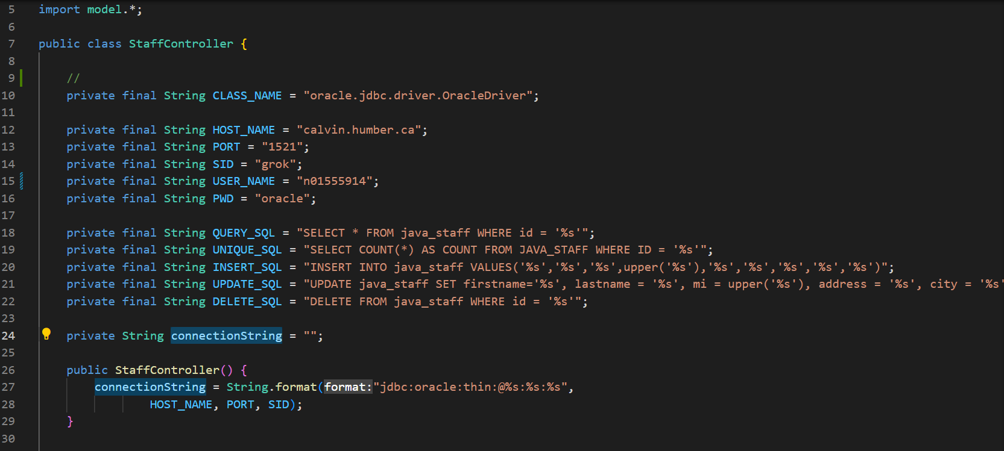

Slide 21
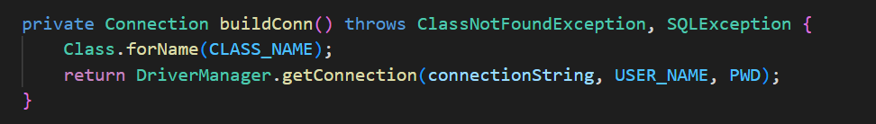

Slide 22
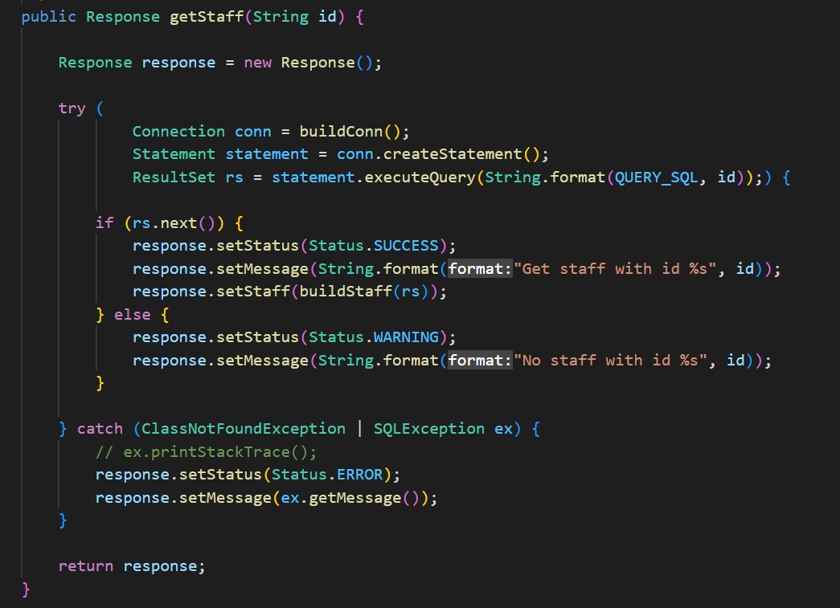

Slide 23
2-Design
Problem:
Coupling:
Interaction among programmers working in a group leads to low productivity.
Files Iteration
Files conflicts of each development iteration cost debug time.

Slide 24
2-Design
Solution
MVC Architecture(Coupling:)
Programmer take each part based on a protocol, lowering the potential coupling and then improving productivity
Github:
All documents are uniform

Slide 25
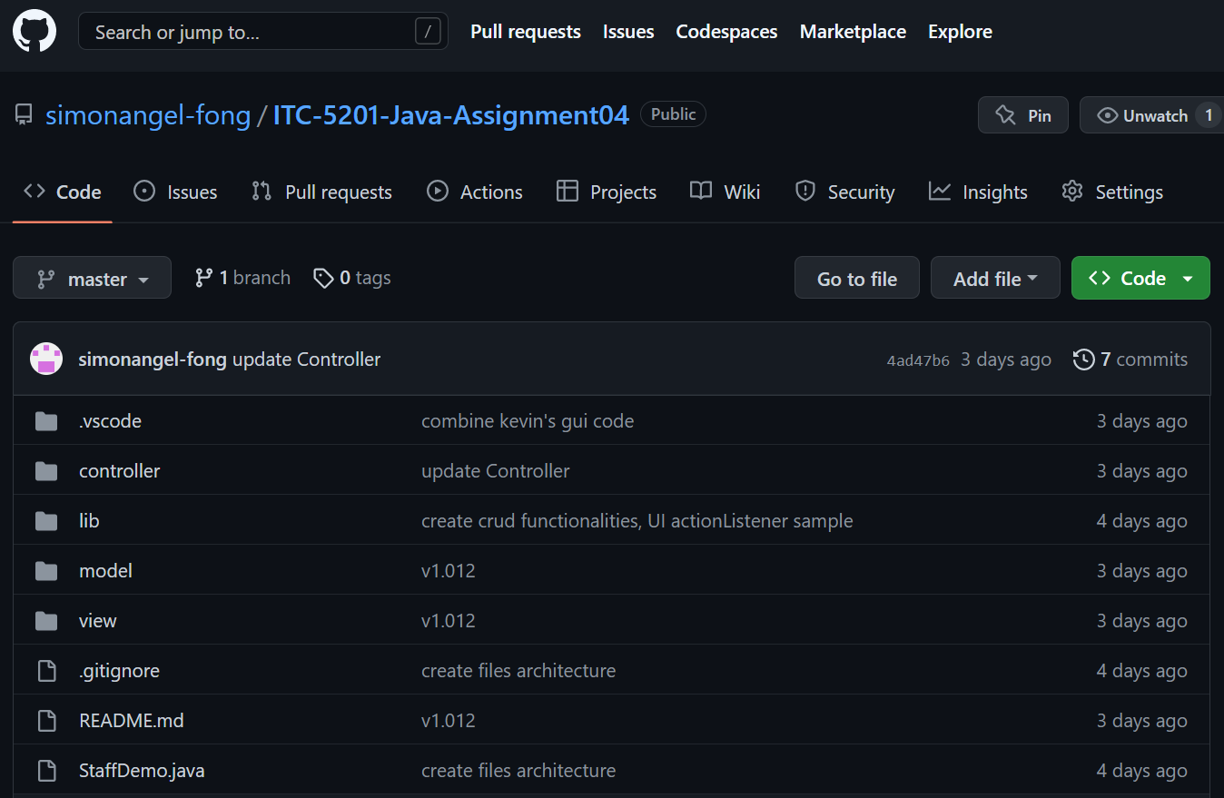
Welcome to visit our github
https://github.com/simonangel-fong/ITC-5201-Java-Assignment04

Slide 26
2-Design: MVC
Model
Model: Staff
Defined by table
Shared across UI and Controller
The data transfer between UI and Controller
View: UI
Controller

Slide 27
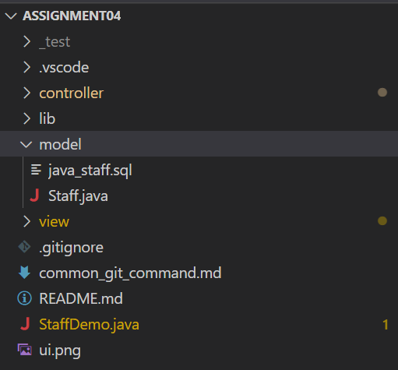
File

Slide 28
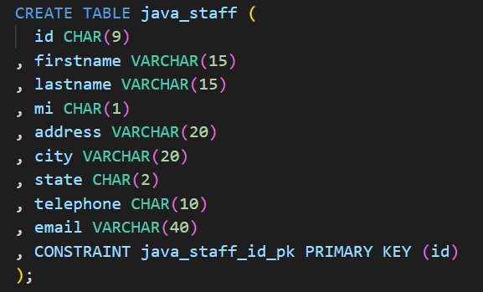
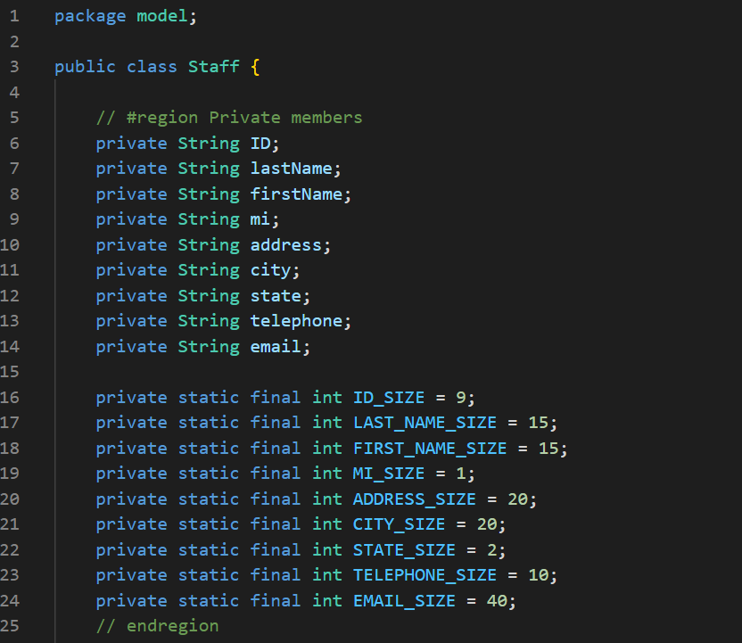
Model and TABLE

Slide 29
2-Design: MVC
Model
View: UI
Interface used by end user
Call methods defined in Controller and display feedback
StaffUI.java
View: UI
Controller

Slide 30
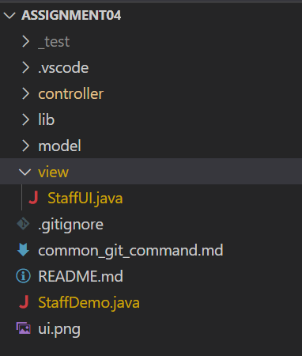
File

Slide 31
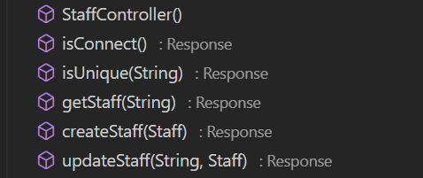
2-Design: MVC
Model
View: UI
Controller
Controller
Provide key functionalities
Control access to database
Return a response object when called by UI

Slide 32
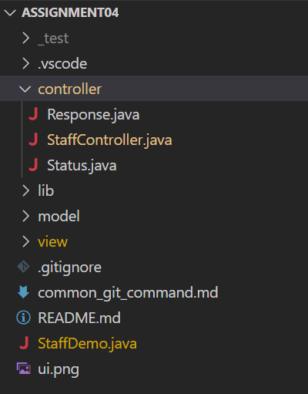
File

Slide 33
2-Design: Protocol
A protocol (Response) will be followed during development.
UI
Controller
Database
getStatf()
executeQuery()
Response
ResultSet
Status.Seccess
Data:Staff
Status.Error
Exception
Message

Slide 34
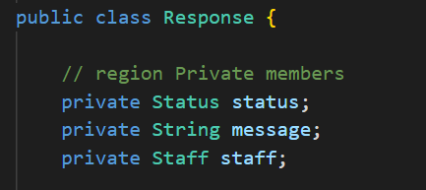
Component of response
Response:
Status: Success, Warning, Error
Message
Staff

Slide 35
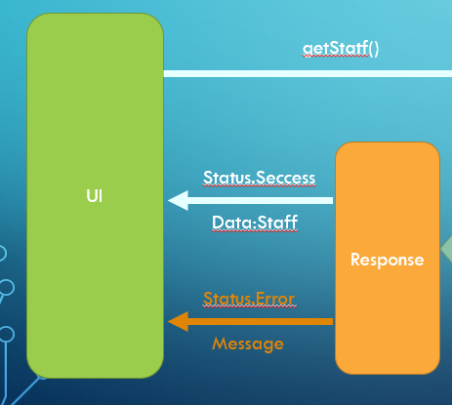
Protocol: Advantages
Font end: Easy to bind data
1.check status
2.1 If success, then bind data + get message
2.2 if warning, then get warning message
2.3 if erro, then get error message
3.show message box

Slide 36
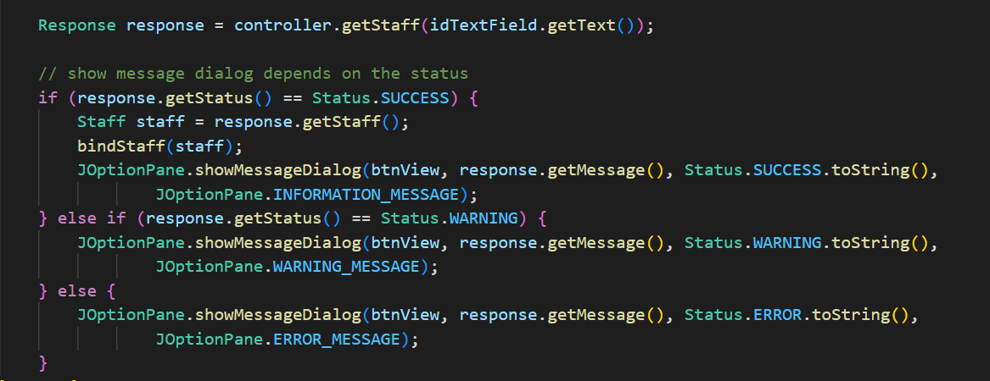

Slide 37
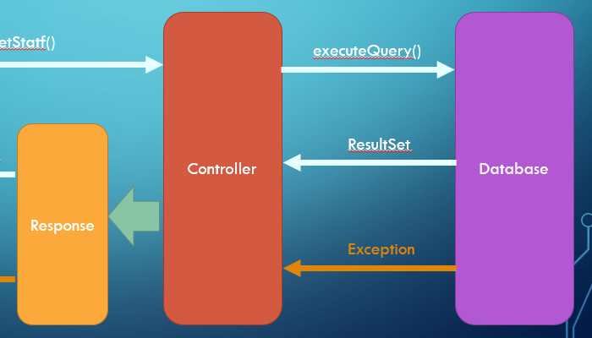
Protocol: Advantages
Back end
Connect database
CRUD SQL
Return Response object

Slide 38
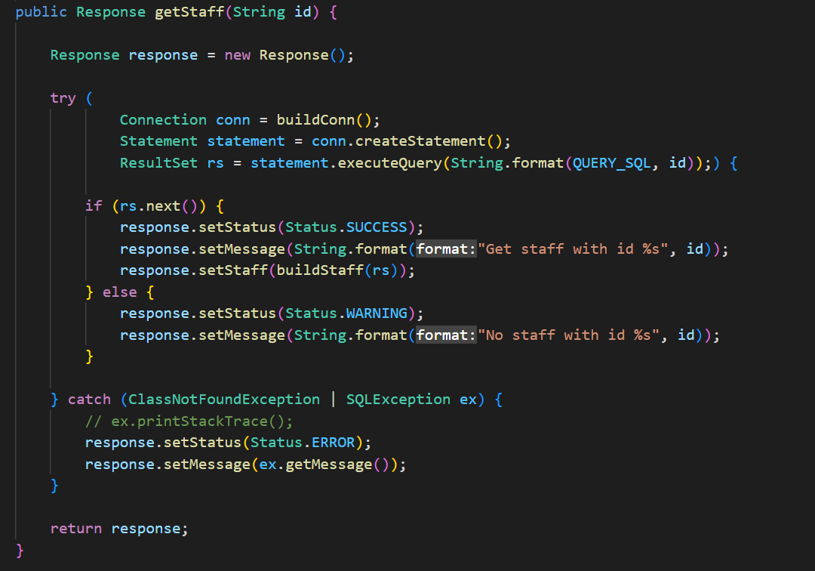
Protocol: Advantages

Slide 39
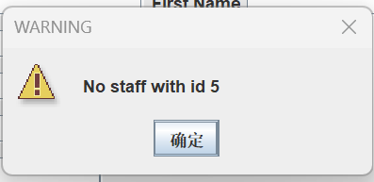
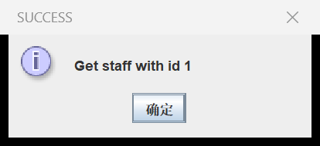
Protocol: Advantages
Efficiency
Decouple potential interaction between font end and back end.
Improve development productivity
UI User friendly
End user always get required message

Slide 40

self-evaluation
Is your database created correctly? ____________
Can you create the UI? ____________
Can you connect to the database? ______
Is the View button implemented correctly? _______________
Is the Insert button implemented correctly? ________
Is the Update button implemented correctly? ________
Is the Clear button implemented correctly? ________
Notes:
Picture url: https://www.thefirsthomebuyersclub.co.nz/home-loan-pre-approval/

Slide 41
Thank you
Group3
Ansh Bhardwaj
Tsz Kit Cheung
Wenhao Fang

