Slide 1
styles-components

Slide 2
What ?
Why ?

Slide 3
Setup
npm i styled-components --save

Slide 4
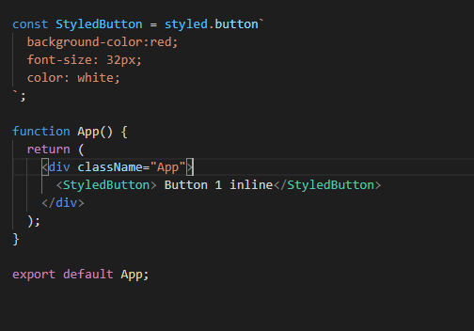
How ? Create first styled compoment

Slide 5
How ? How many ways
Two ways
Create a file
Create styled component inside the component itself

Slide 6
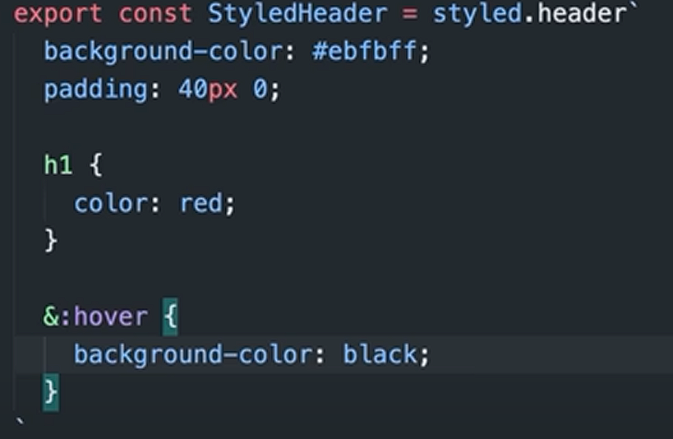
How ? Hover

Slide 7
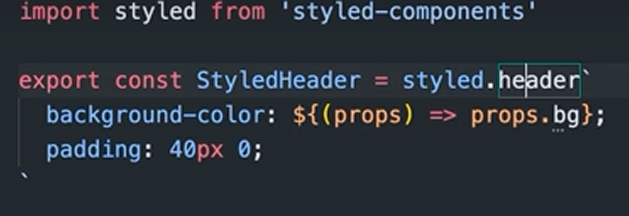
How ? Props

Slide 8
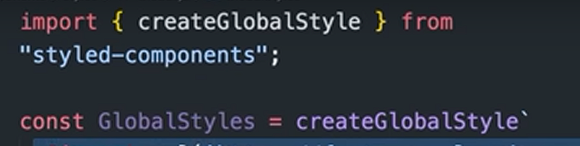
How ? Global

