Slide 1
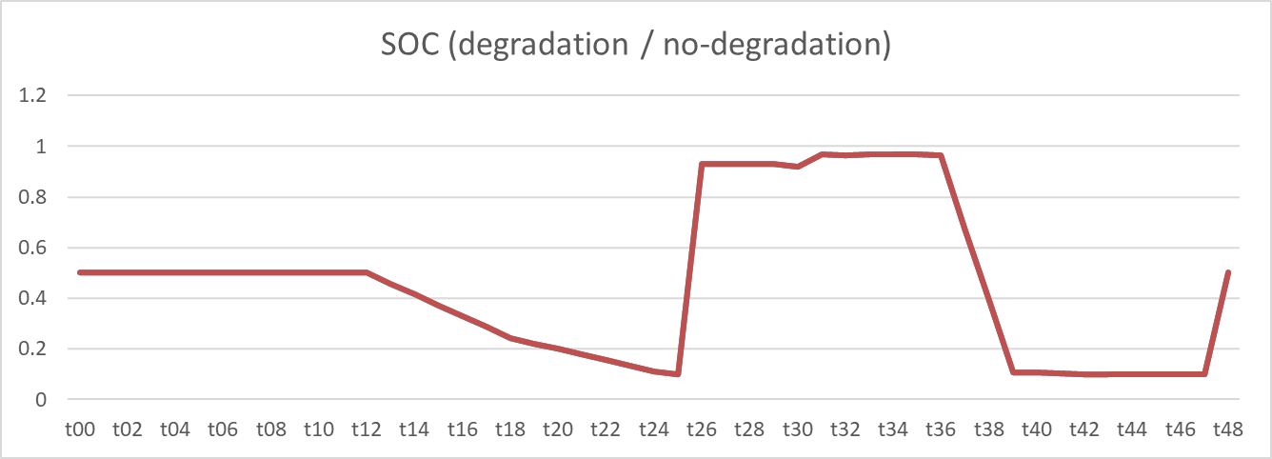
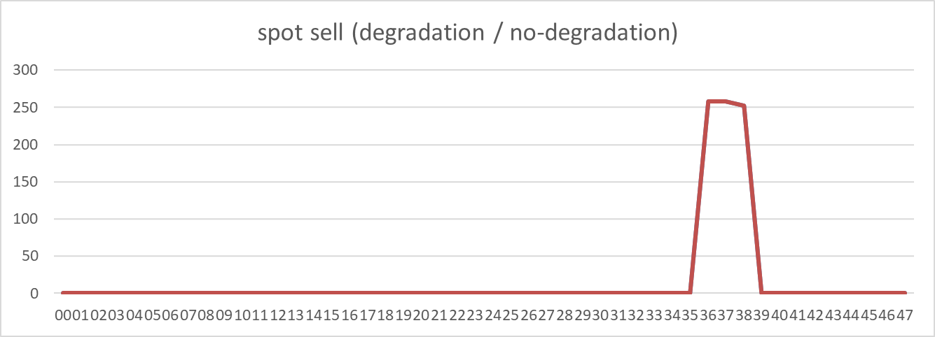
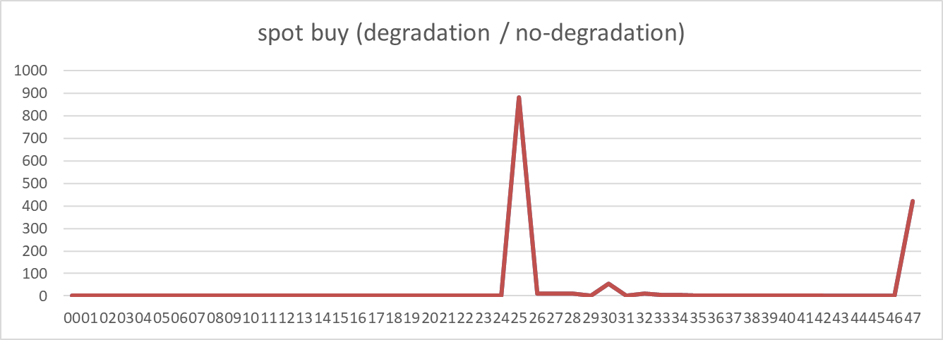
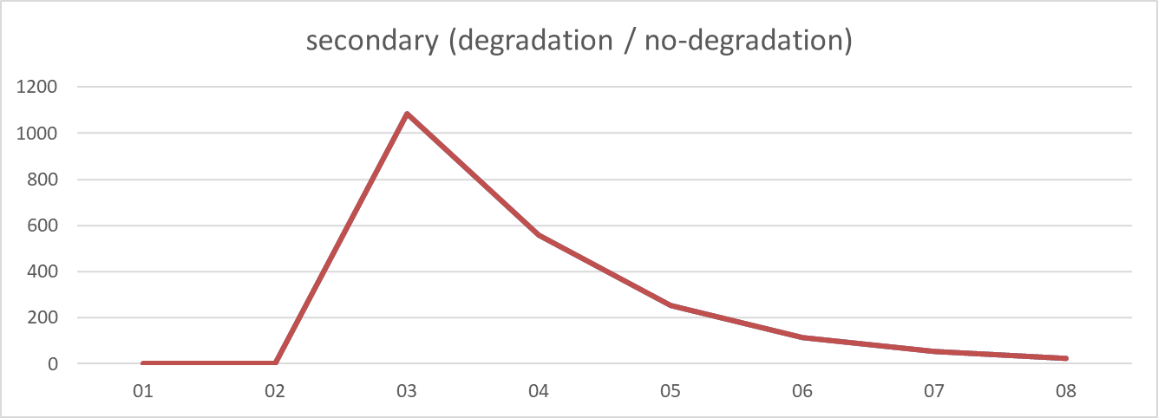
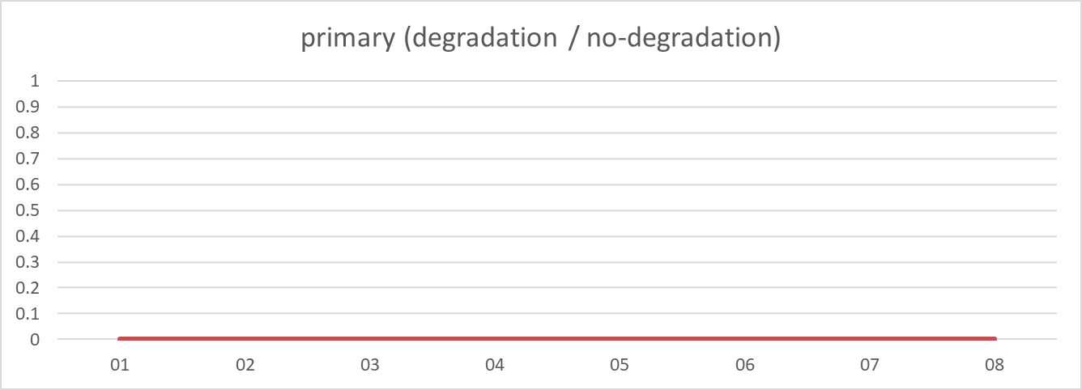
2024-04-30
2024-04-30
SOC: almost same (avg diff 0.000, sum diff 0.00) | Spot buy: almost same (avg diff 0.000, sum diff 0.00) | Spot sell: almost same (avg diff 0.000, sum diff 0.00) | Primary: almost same (avg diff 0.000, sum diff 0.00)

Slide 2
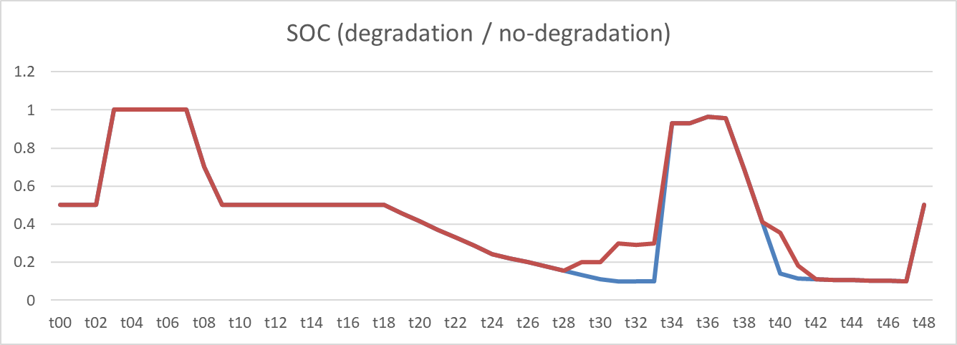
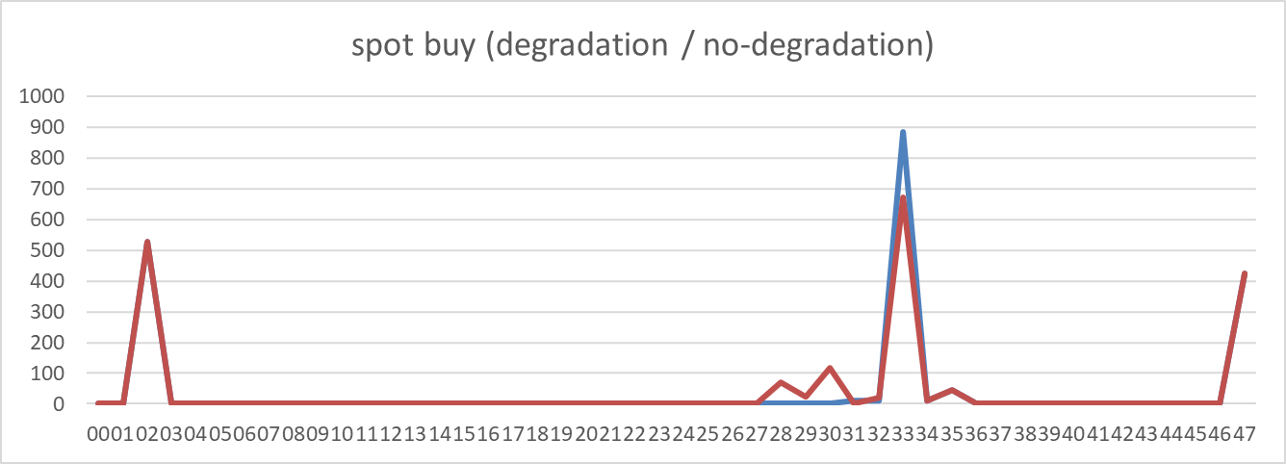
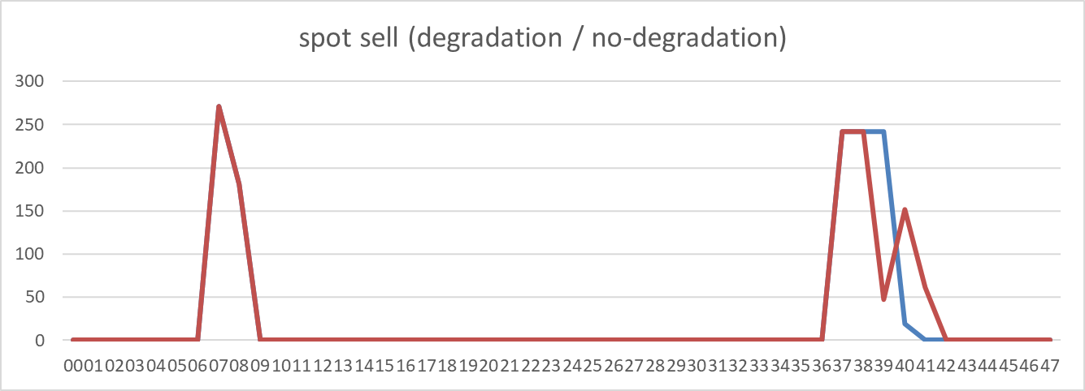
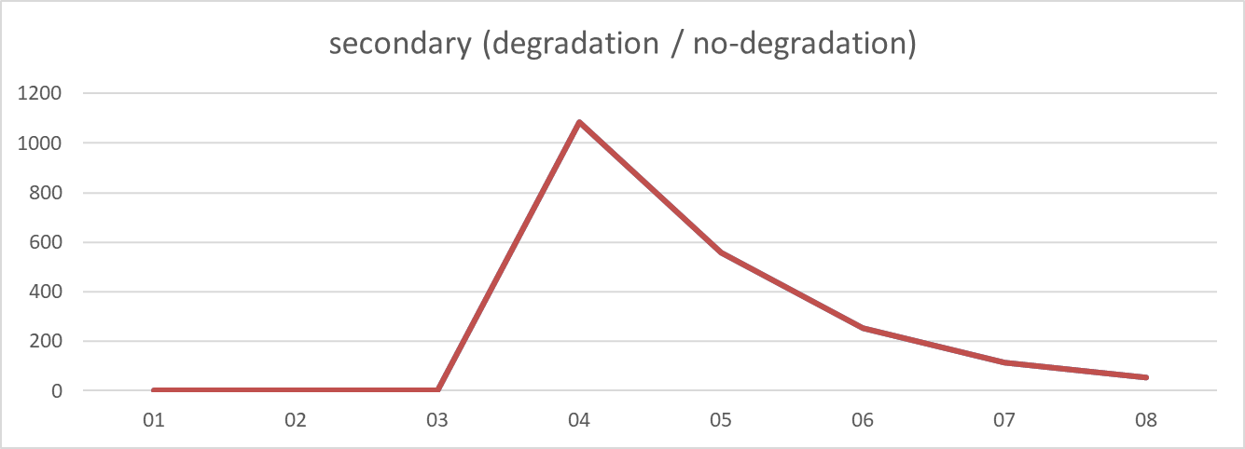
2024-05-03
2024-05-03
SOC: non-degraded case is higher (avg diff -0.021, sum diff -1.03) | Spot buy: almost same (avg diff 0.000, sum diff 0.00) | Spot sell: almost same (avg diff 0.000, sum diff 0.00) | Primary: almost same (avg diff 0.000, sum diff 0.00)

Slide 3
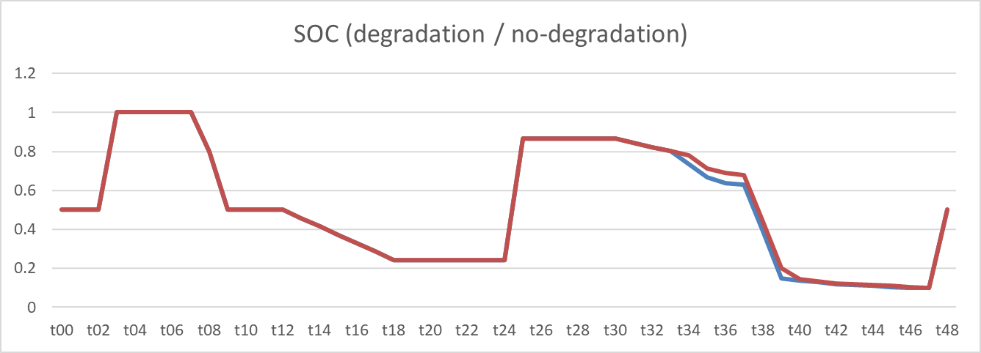
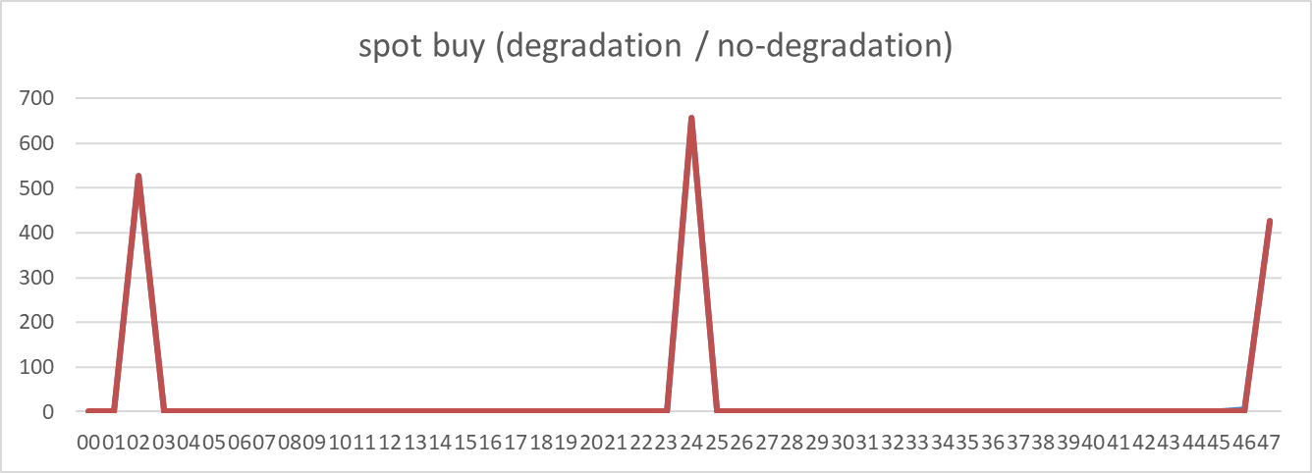
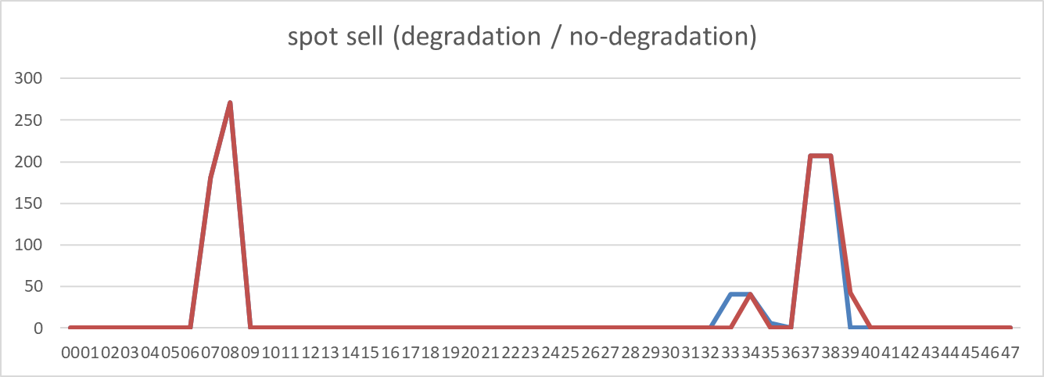
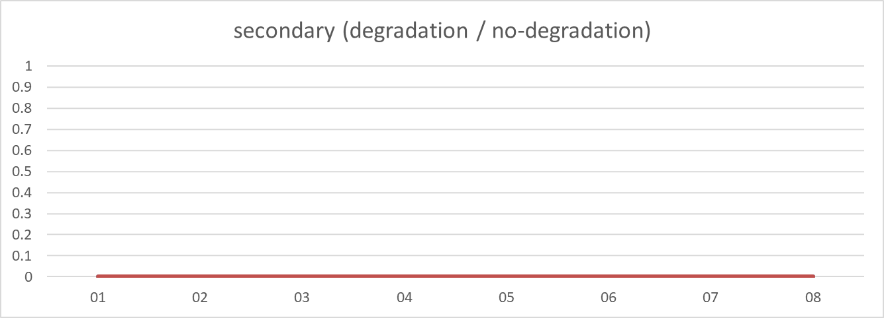
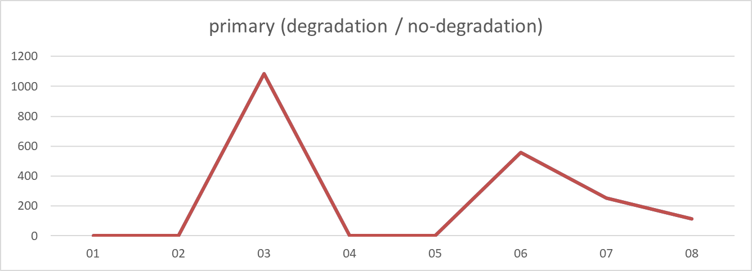
2024-05-06
2024-05-06
SOC: non-degraded case is higher (avg diff -0.007, sum diff -0.33) | Spot buy: degraded case is higher (avg diff 0.100, sum diff 4.82) | Spot sell: degraded case is higher (avg diff 0.086, sum diff 4.13) | Primary: almost same (avg diff 0.000, sum diff 0.00)

Slide 4
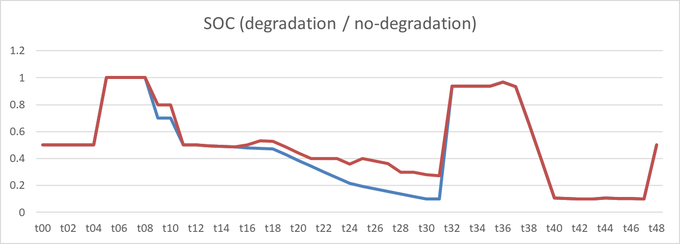
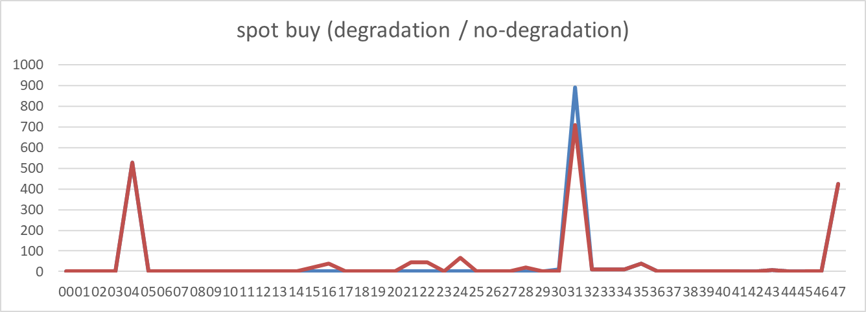
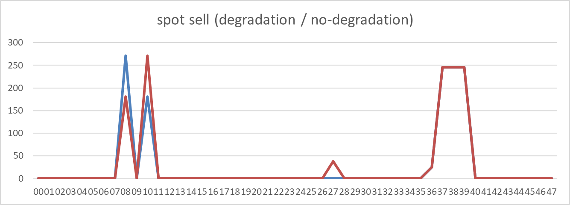
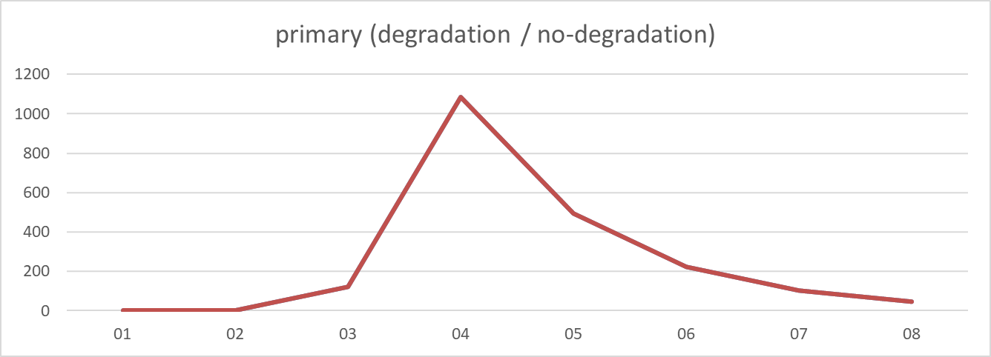
2024-05-10
2024-05-10
SOC: non-degraded case is higher (avg diff -0.045, sum diff -2.20) | Spot buy: non-degraded case is higher (avg diff -0.912, sum diff -43.77) | Spot sell: non-degraded case is higher (avg diff -0.782, sum diff -37.53) | Primary: almost same (avg diff 0.000, sum diff 0.00)

Slide 5
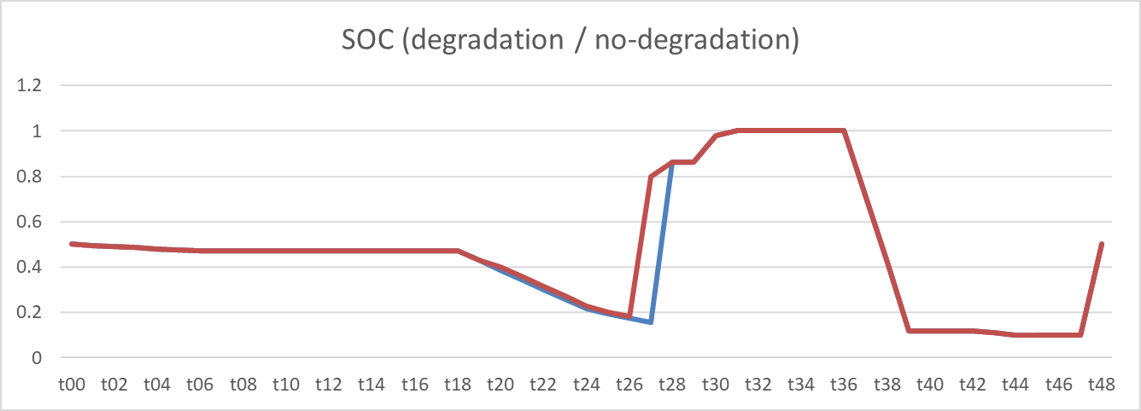
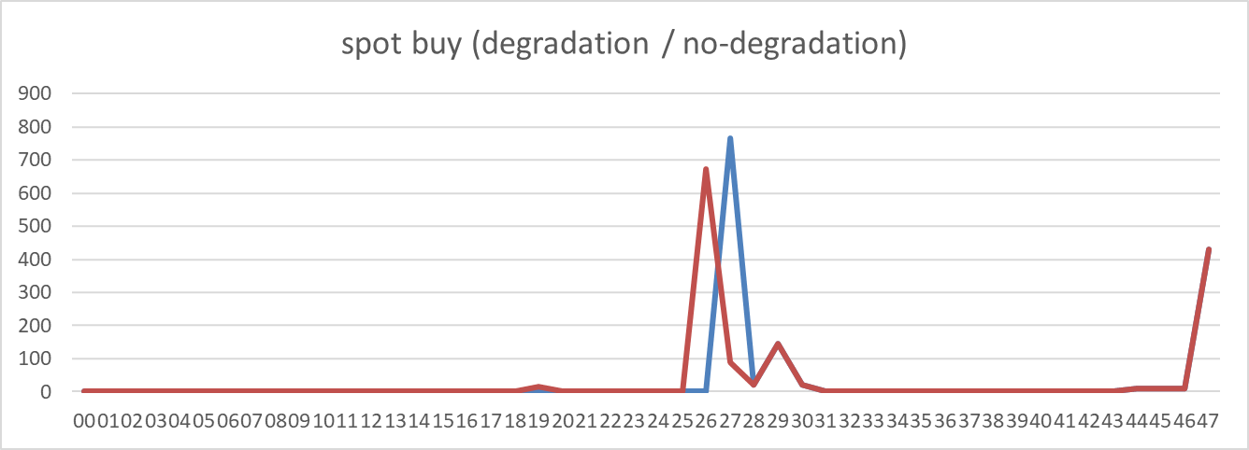
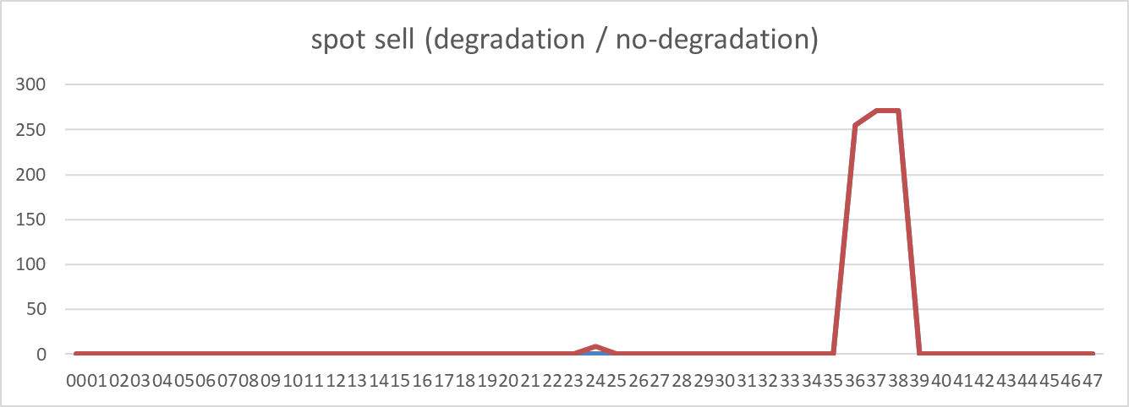
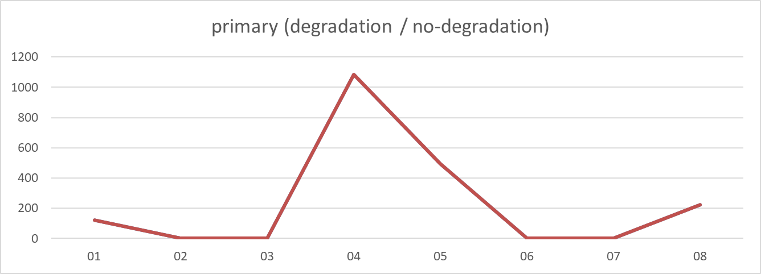
2024-06-05
2024-06-05
SOC: non-degraded case is higher (avg diff -0.015, sum diff -0.73) | Spot buy: non-degraded case is higher (avg diff -0.206, sum diff -9.87) | Spot sell: non-degraded case is higher (avg diff -0.176, sum diff -8.46) | Primary: almost same (avg diff 0.000, sum diff 0.00)

Slide 6
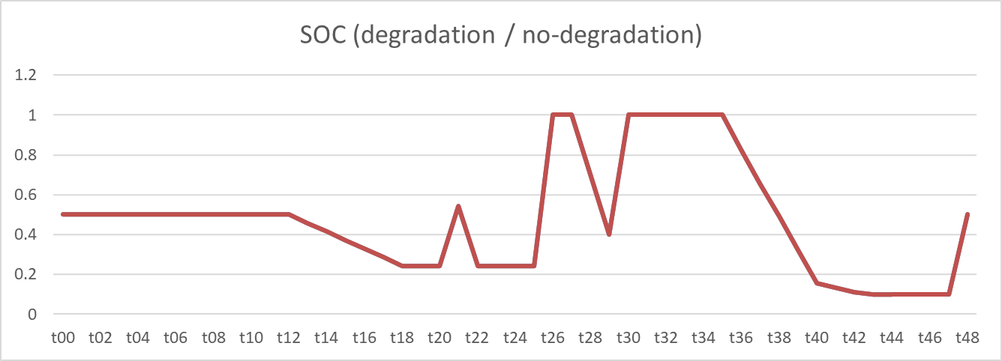
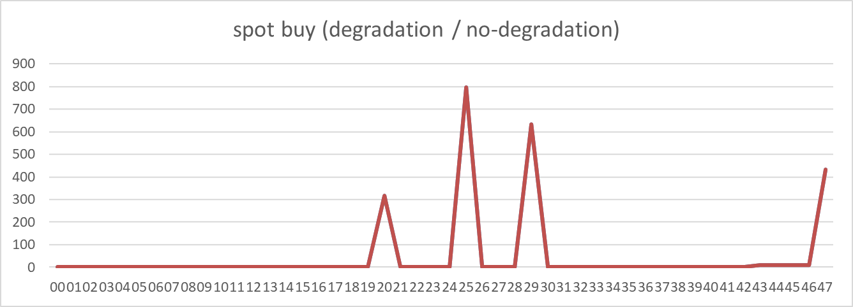
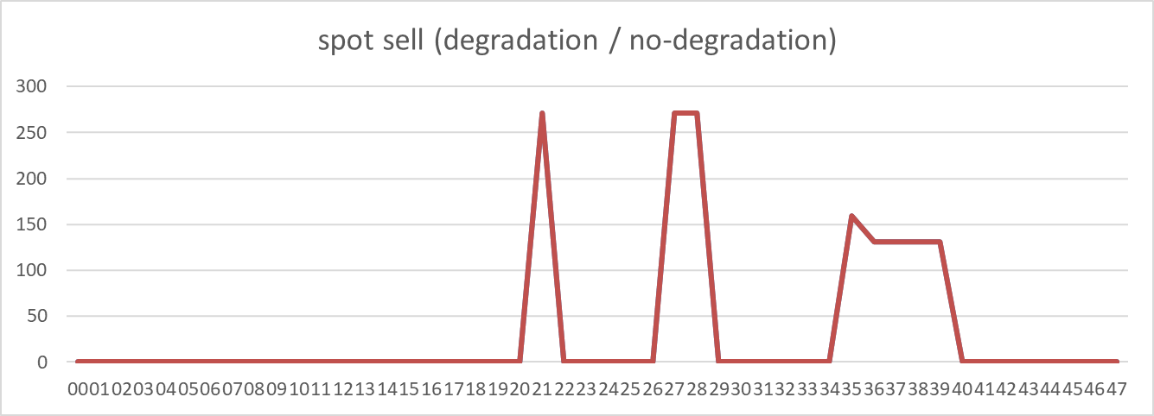
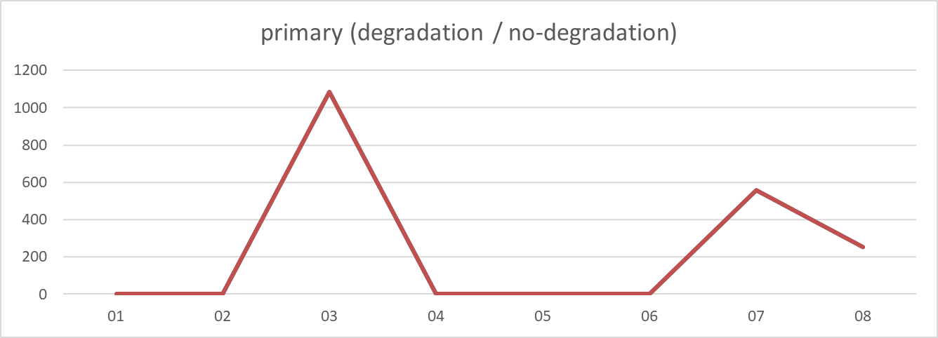
2024-06-11
2024-06-11
SOC: almost same (avg diff 0.000, sum diff 0.00) | Spot buy: almost same (avg diff 0.000, sum diff 0.00) | Spot sell: almost same (avg diff 0.000, sum diff 0.00) | Primary: almost same (avg diff 0.000, sum diff 0.00)

Slide 7
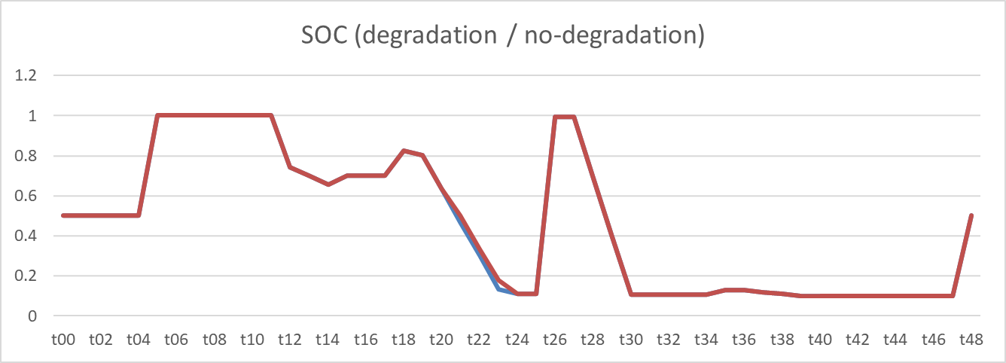
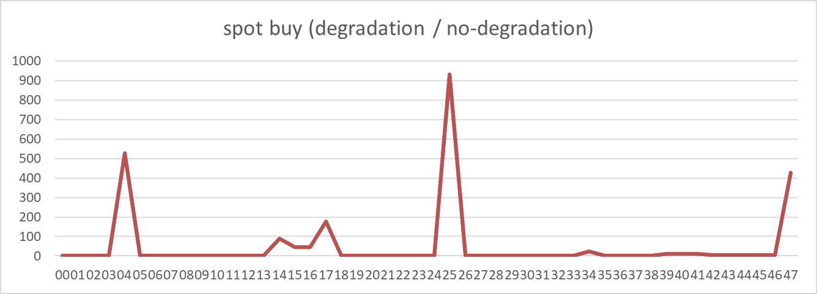
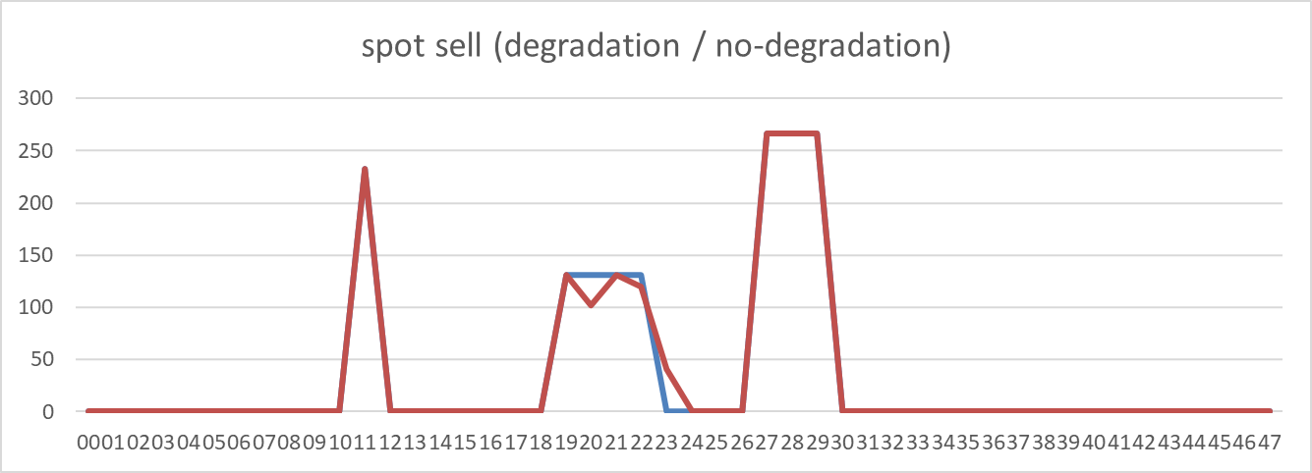
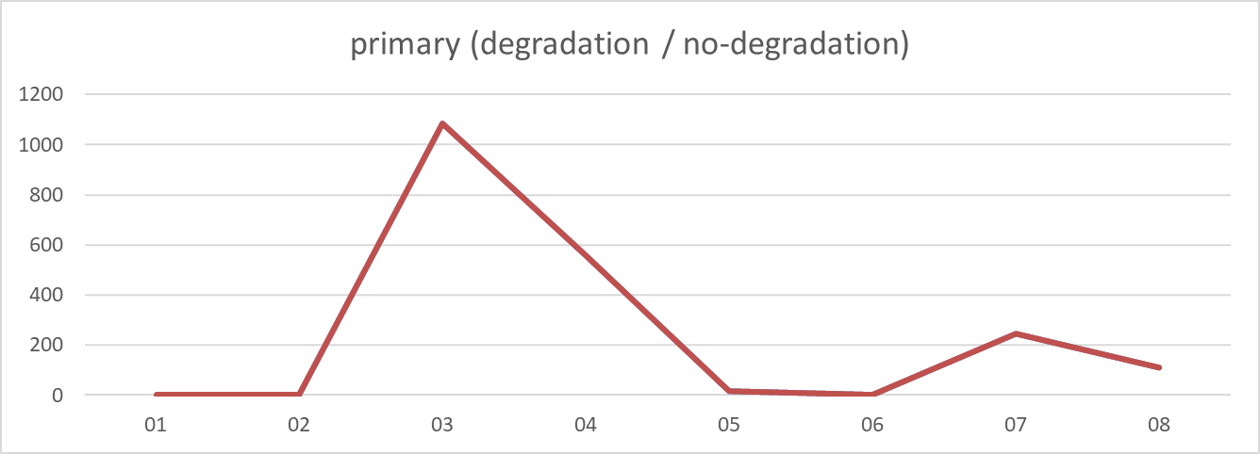
2024-07-01
2024-07-01
SOC: non-degraded case is higher (avg diff -0.002, sum diff -0.11) | Spot buy: almost same (avg diff 0.000, sum diff 0.00) | Spot sell: almost same (avg diff 0.000, sum diff 0.00) | Primary: almost same (avg diff 0.000, sum diff 0.00)

Slide 8
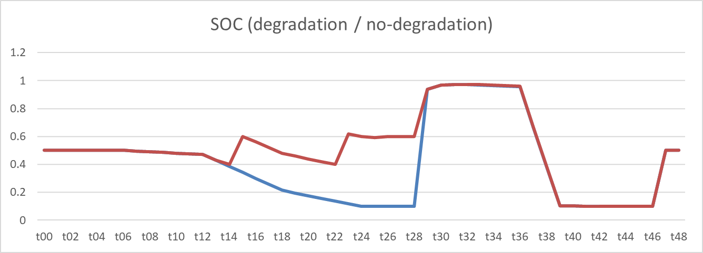
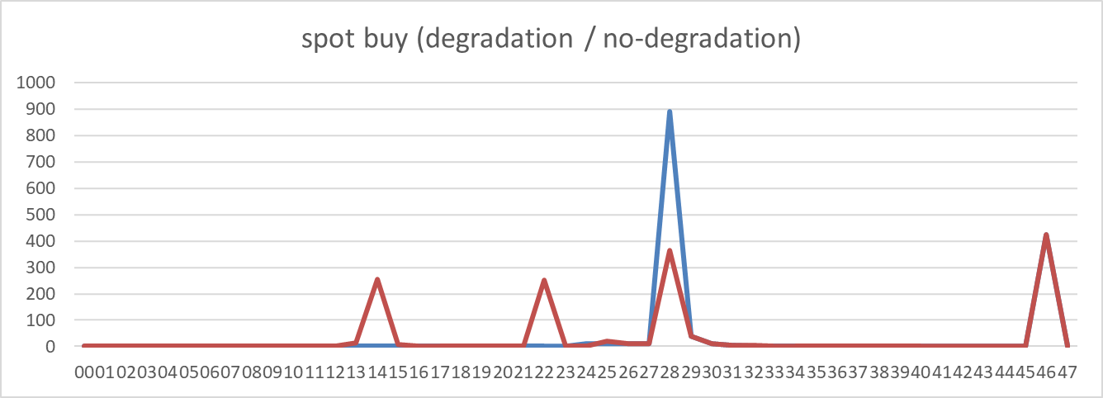

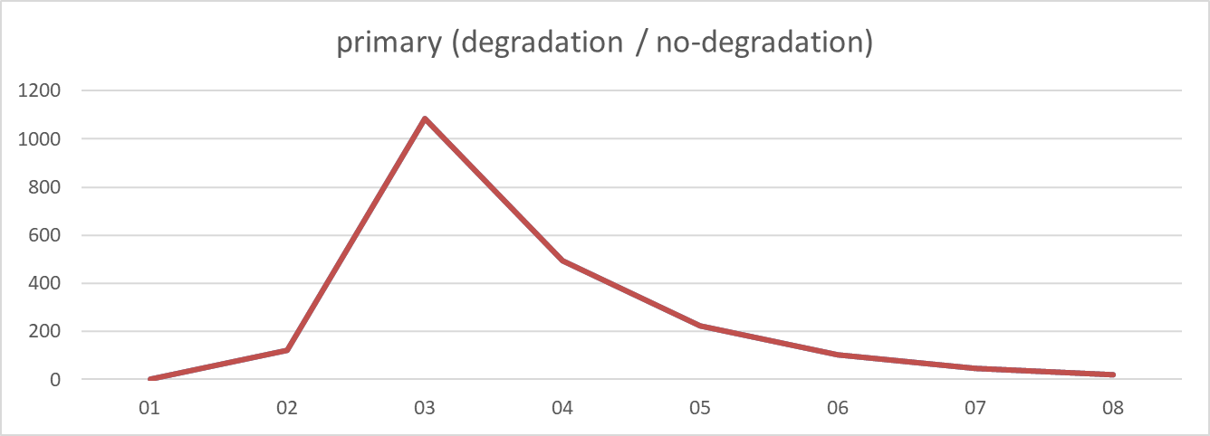
2024-08-06
2024-08-06
SOC: non-degraded case is higher (avg diff -0.105, sum diff -5.13) | Spot buy: non-degraded case is higher (avg diff -0.088, sum diff -4.25) | Spot sell: non-degraded case is higher (avg diff -0.076, sum diff -3.64) | Primary: almost same (avg diff 0.000, sum diff 0.00)

Slide 9
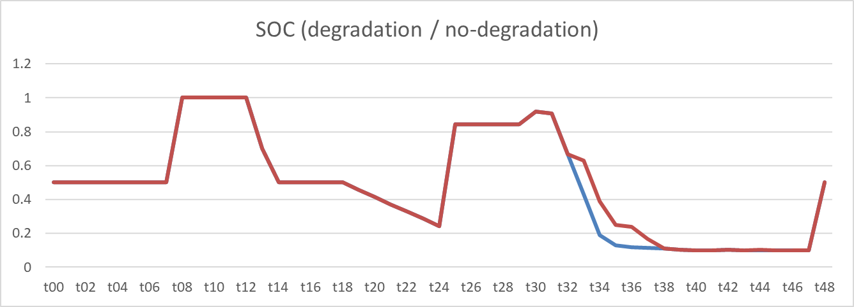
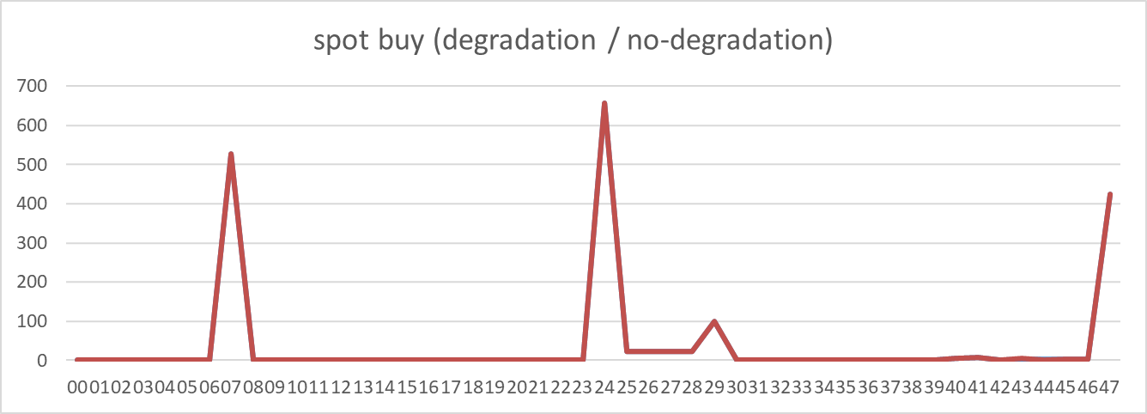
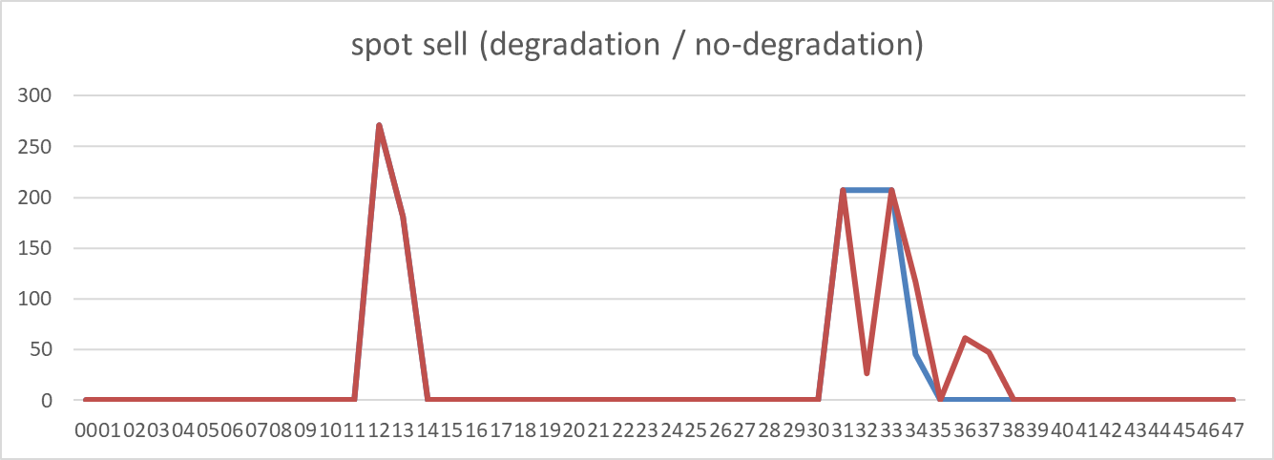
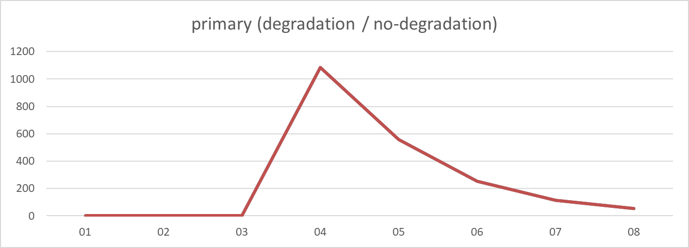
2024-10-22
2024-10-22
SOC: non-degraded case is higher (avg diff -0.014, sum diff -0.70) | Spot buy: almost same (avg diff 0.000, sum diff 0.00) | Spot sell: almost same (avg diff 0.000, sum diff 0.00) | Primary: almost same (avg diff 0.000, sum diff 0.00)

Slide 10
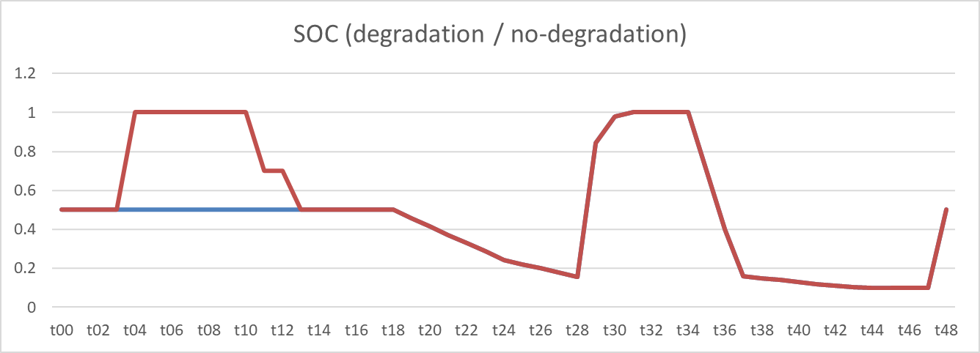
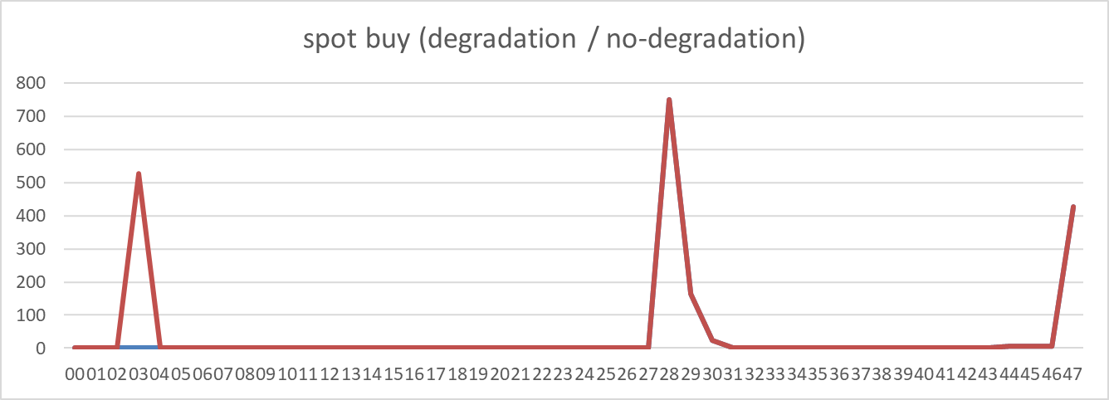
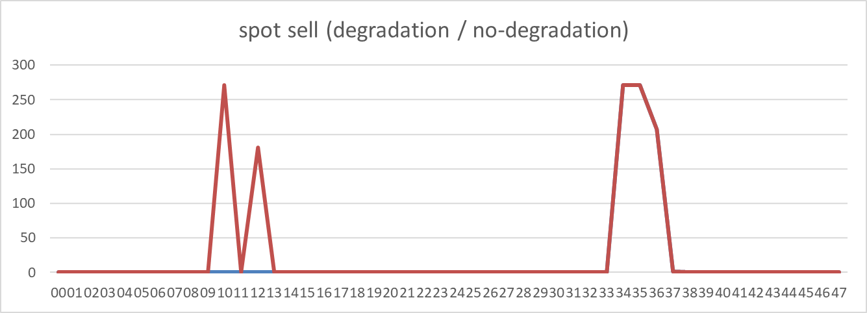
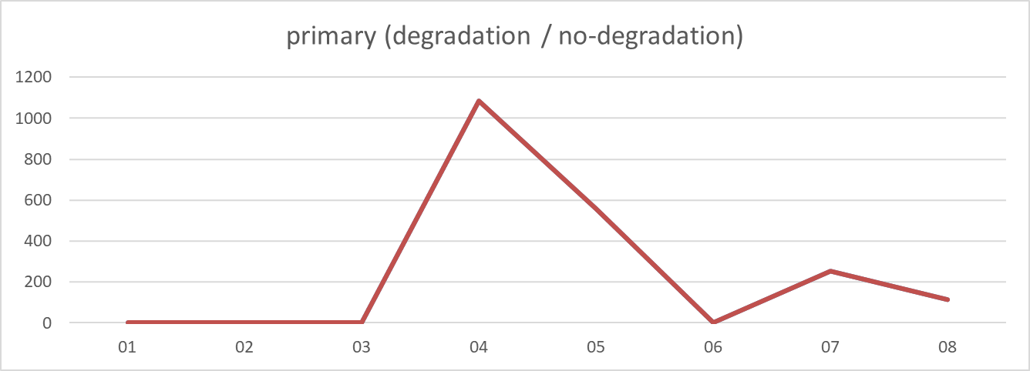
2024-12-04
2024-12-04
SOC: non-degraded case is higher (avg diff -0.080, sum diff -3.90) | Spot buy: non-degraded case is higher (avg diff -10.965, sum diff -526.32) | Spot sell: non-degraded case is higher (avg diff -9.401, sum diff -451.25) | Primary: almost same (avg diff 0.000, sum diff 0.00)

Slide 11
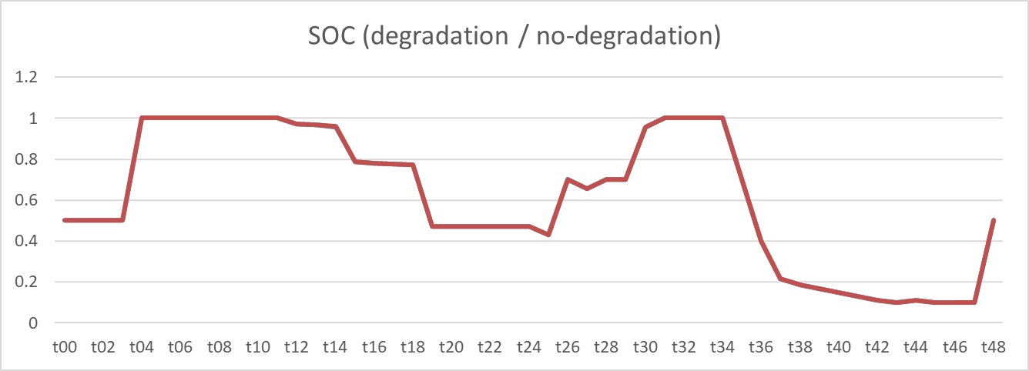
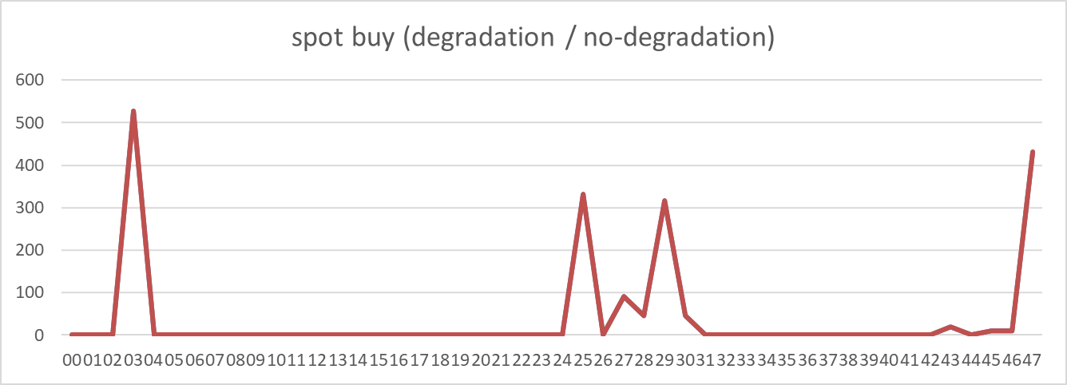
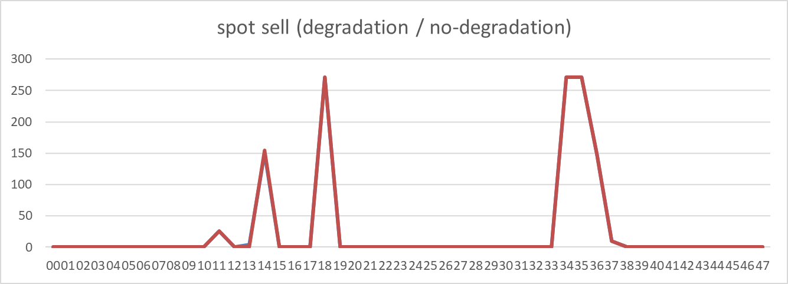
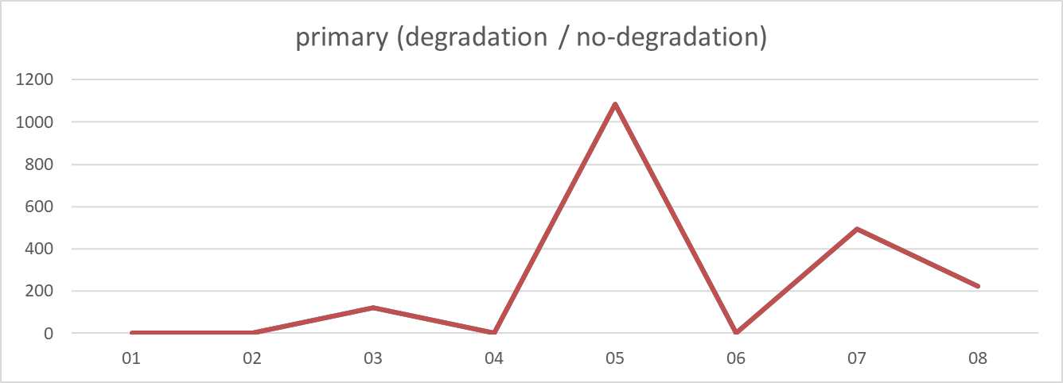
2025-01-30
2025-01-30
SOC: non-degraded case is higher (avg diff 0.000, sum diff 0.00) | Spot buy: almost same (avg diff 0.000, sum diff 0.00) | Spot sell: almost same (avg diff 0.000, sum diff 0.00) | Primary: almost same (avg diff 0.000, sum diff 0.00)

Slide 12
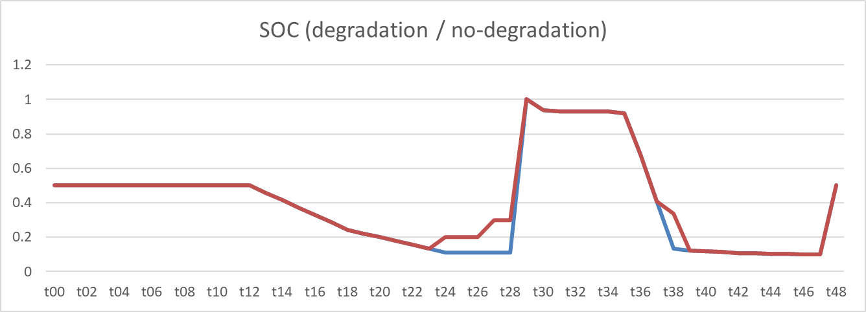
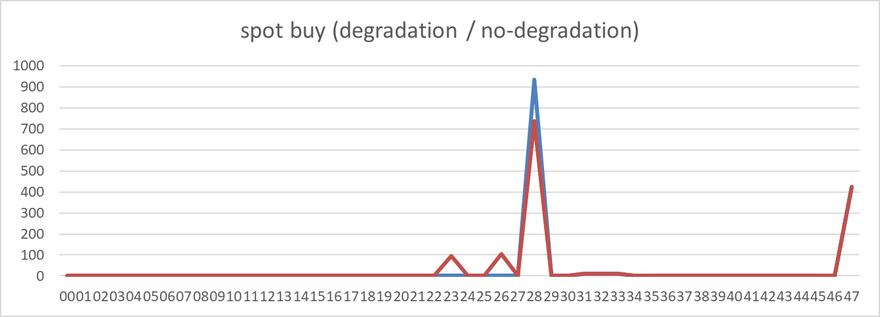
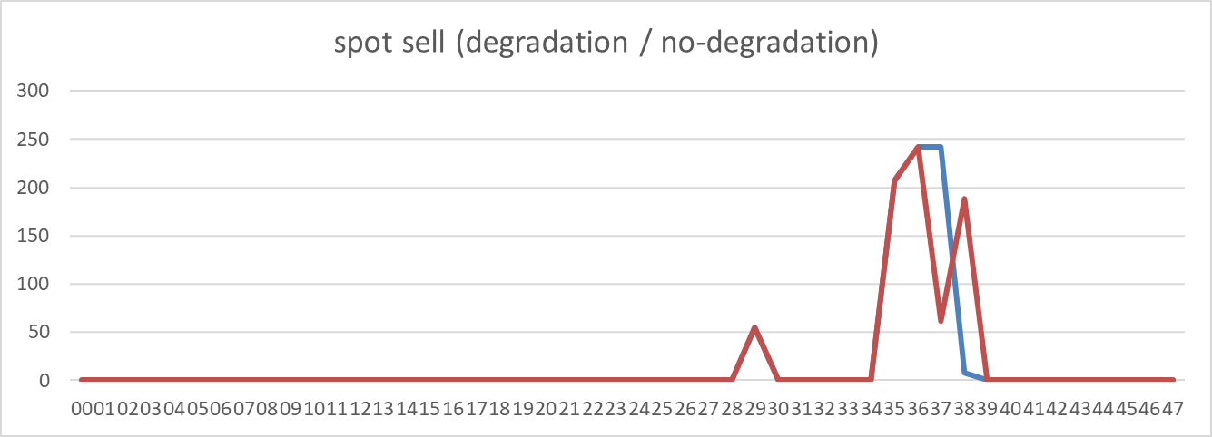
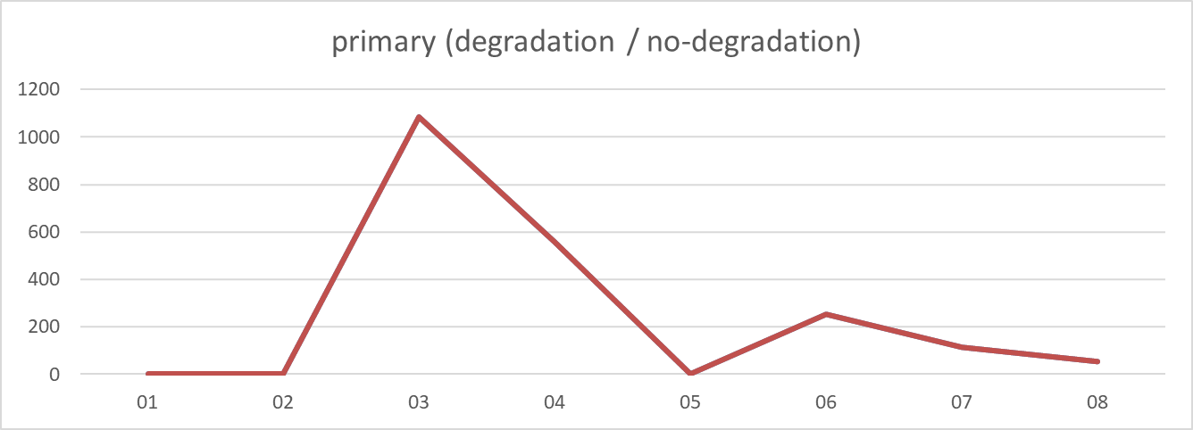
2025-02-11
2025-02-11
SOC: non-degraded case is higher (avg diff -0.017, sum diff -0.85) | Spot buy: almost same (avg diff 0.000, sum diff 0.00) | Spot sell: almost same (avg diff 0.000, sum diff 0.00) | Primary: almost same (avg diff 0.000, sum diff 0.00)

Slide 13
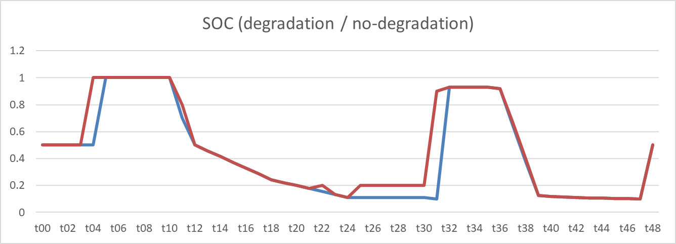


2025-03-25
2025-03-25
SOC: non-degraded case is higher (avg diff -0.041, sum diff -2.02) | Spot buy: non-degraded case is higher (avg diff -0.989, sum diff -47.47) | Spot sell: non-degraded case is higher (avg diff -0.848, sum diff -40.70) | Primary: almost same (avg diff 0.000, sum diff 0.00)

Slide 14
2024-04-30
2024-04-30
SOC: almost same (avg diff 0.000, sum diff 0.00) | Spot buy: almost same (avg diff 0.000, sum diff 0.00) | Spot sell: almost same (avg diff 0.000, sum diff 0.00) | Primary: almost same (avg diff 0.000, sum diff 0.00)

Slide 15
2024-05-03
2024-05-03
SOC: non-degraded case is higher (avg diff -0.021, sum diff -1.03) | Spot buy: almost same (avg diff 0.000, sum diff 0.00) | Spot sell: almost same (avg diff 0.000, sum diff 0.00) | Primary: almost same (avg diff 0.000, sum diff 0.00)

Slide 16
2024-05-06
2024-05-06
SOC: non-degraded case is higher (avg diff -0.007, sum diff -0.33) | Spot buy: degraded case is higher (avg diff 0.100, sum diff 4.82) | Spot sell: degraded case is higher (avg diff 0.086, sum diff 4.13) | Primary: almost same (avg diff 0.000, sum diff 0.00)

Slide 17
2024-05-10
2024-05-10
SOC: non-degraded case is higher (avg diff -0.045, sum diff -2.20) | Spot buy: non-degraded case is higher (avg diff -0.912, sum diff -43.77) | Spot sell: non-degraded case is higher (avg diff -0.782, sum diff -37.53) | Primary: almost same (avg diff 0.000, sum diff 0.00)

Slide 18
2024-06-05
2024-06-05
SOC: non-degraded case is higher (avg diff -0.015, sum diff -0.73) | Spot buy: non-degraded case is higher (avg diff -0.206, sum diff -9.87) | Spot sell: non-degraded case is higher (avg diff -0.176, sum diff -8.46) | Primary: almost same (avg diff 0.000, sum diff 0.00)

Slide 19
2024-06-11
2024-06-11
SOC: almost same (avg diff 0.000, sum diff 0.00) | Spot buy: almost same (avg diff 0.000, sum diff 0.00) | Spot sell: almost same (avg diff 0.000, sum diff 0.00) | Primary: almost same (avg diff 0.000, sum diff 0.00)

Slide 20
2024-07-01
2024-07-01
SOC: non-degraded case is higher (avg diff -0.002, sum diff -0.11) | Spot buy: almost same (avg diff 0.000, sum diff 0.00) | Spot sell: almost same (avg diff 0.000, sum diff 0.00) | Primary: almost same (avg diff 0.000, sum diff 0.00)

Slide 21
2024-08-06
2024-08-06
SOC: non-degraded case is higher (avg diff -0.105, sum diff -5.13) | Spot buy: non-degraded case is higher (avg diff -0.088, sum diff -4.25) | Spot sell: non-degraded case is higher (avg diff -0.076, sum diff -3.64) | Primary: almost same (avg diff 0.000, sum diff 0.00)

Slide 22
2024-10-22
2024-10-22
SOC: non-degraded case is higher (avg diff -0.014, sum diff -0.70) | Spot buy: almost same (avg diff 0.000, sum diff 0.00) | Spot sell: almost same (avg diff 0.000, sum diff 0.00) | Primary: almost same (avg diff 0.000, sum diff 0.00)

Slide 23
2024-12-04
2024-12-04
SOC: non-degraded case is higher (avg diff -0.080, sum diff -3.90) | Spot buy: non-degraded case is higher (avg diff -10.965, sum diff -526.32) | Spot sell: non-degraded case is higher (avg diff -9.401, sum diff -451.25) | Primary: almost same (avg diff 0.000, sum diff 0.00)

Slide 24
2025-01-30
2025-01-30
SOC: non-degraded case is higher (avg diff 0.000, sum diff 0.00) | Spot buy: almost same (avg diff 0.000, sum diff 0.00) | Spot sell: almost same (avg diff 0.000, sum diff 0.00) | Primary: almost same (avg diff 0.000, sum diff 0.00)

Slide 25
2025-02-11
2025-02-11
SOC: non-degraded case is higher (avg diff -0.017, sum diff -0.85) | Spot buy: almost same (avg diff 0.000, sum diff 0.00) | Spot sell: almost same (avg diff 0.000, sum diff 0.00) | Primary: almost same (avg diff 0.000, sum diff 0.00)

Slide 26
2025-03-25
2025-03-25
SOC: non-degraded case is higher (avg diff -0.041, sum diff -2.02) | Spot buy: non-degraded case is higher (avg diff -0.989, sum diff -47.47) | Spot sell: non-degraded case is higher (avg diff -0.848, sum diff -40.70) | Primary: almost same (avg diff 0.000, sum diff 0.00)

Slide 27
debug

Slide 28













spot_summary_2024 (1)_soc
spot_summary_2024 (1)_soc
Could not extract metrics to generate a short insight.

Slide 29
spot_summary_2024 (1)_soc
spot_summary_2024 (1) Cluster 0
Could not extract metrics to generate a short insight.

Slide 30
spot_summary_2024 (1)_soc
spot_summary_2024 (1) Cluster 1
Could not extract metrics to generate a short insight.

Slide 31
spot_summary_2024 (1)_soc
spot_summary_2024 (1) Cluster 2
Could not extract metrics to generate a short insight.

Slide 32
spot_summary_2024 (1)_soc
spot_summary_2024 (1) Cluster 3
Could not extract metrics to generate a short insight.

Slide 33
spot_summary_2024 (1)_soc
spot_summary_2024 (1) Cluster 4
Could not extract metrics to generate a short insight.

Slide 34
spot_summary_2024 (1)_soc
spot_summary_2024 (1) Cluster 5
Could not extract metrics to generate a short insight.

Slide 35
spot_summary_2024 (1)_soc
spot_summary_2024 (1) Cluster 6
Could not extract metrics to generate a short insight.

Slide 36
spot_summary_2024 (1)_soc
spot_summary_2024 (1) Cluster 7
Could not extract metrics to generate a short insight.

Slide 37
spot_summary_2024 (1)_soc
spot_summary_2024 (1) Cluster 8
Could not extract metrics to generate a short insight.

Slide 38
spot_summary_2024 (1)_soc
spot_summary_2024 (1) Cluster 9
Could not extract metrics to generate a short insight.

Slide 39
spot_summary_2024 (1)_soc
spot_summary_2024 (1) Cluster 10
Could not extract metrics to generate a short insight.

Slide 40
spot_summary_2024 (1)_soc
spot_summary_2024 (1) Cluster 11
Could not extract metrics to generate a short insight.

Slide 41
spot_summary_2024 (1)_soc
spot_summary_2024 (1) Cluster 12
Could not extract metrics to generate a short insight.

Slide 42

spot_summary_2024 (1)_soc
spot_summary_2024 (1) Cluster 0
SOC: almost same (avg diff 0.000, sum diff 0.00)

