Slide 1
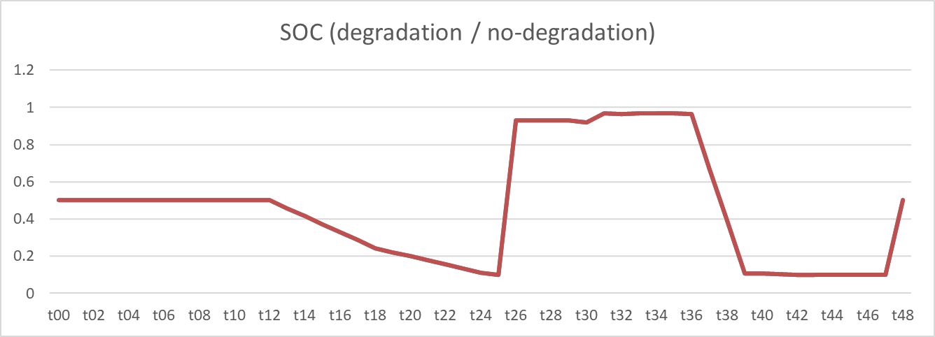
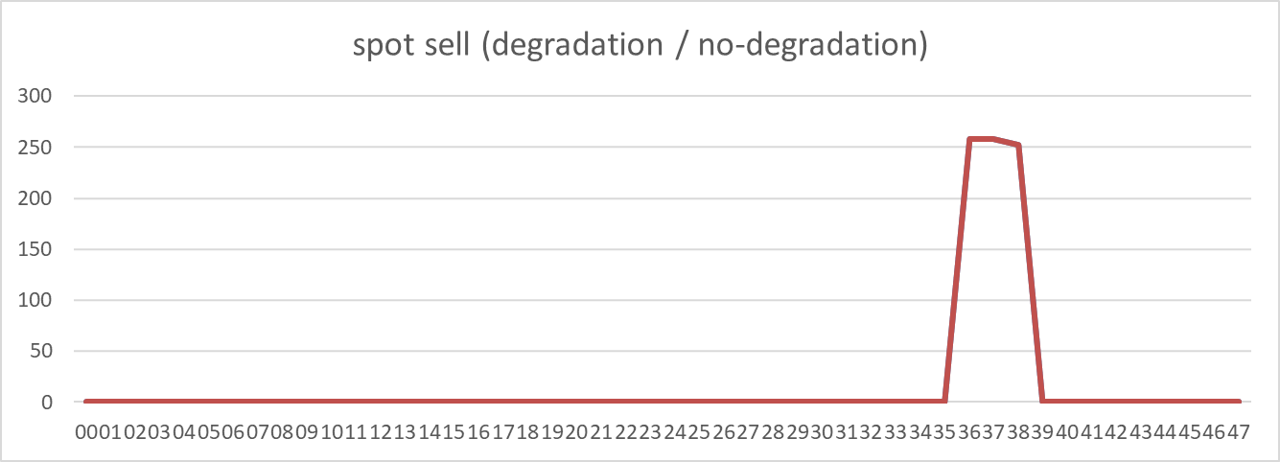
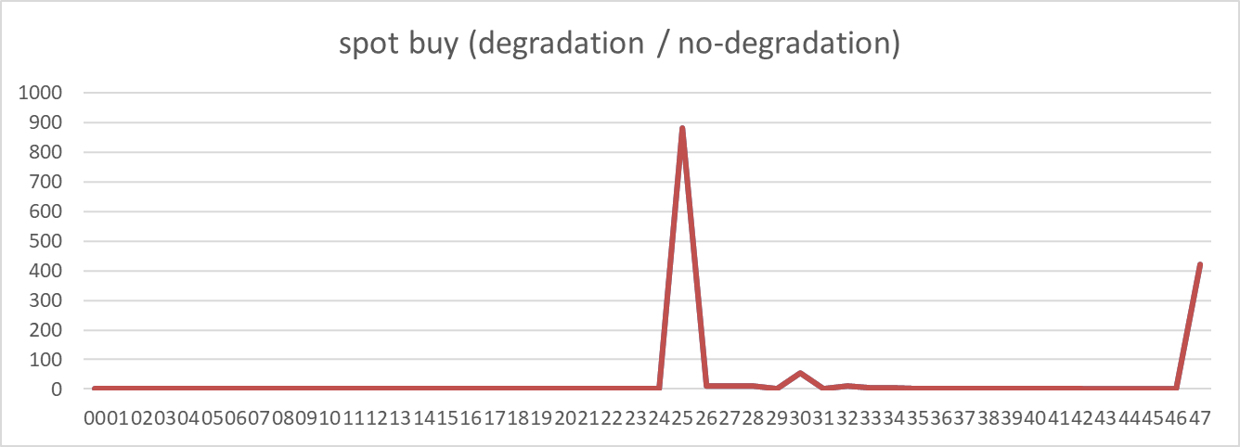
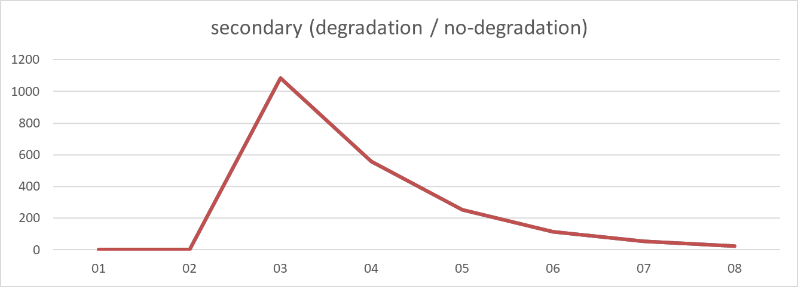
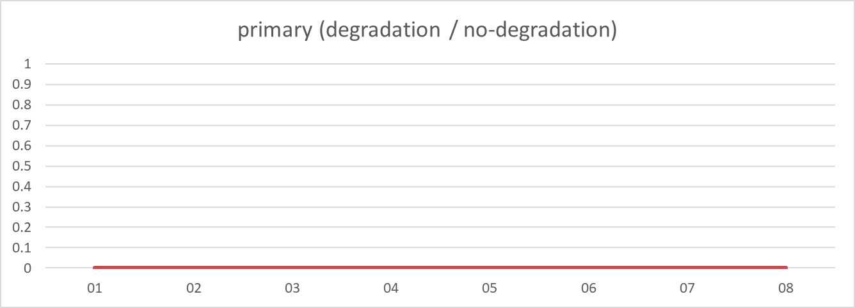
2024-04-30
2024-04-30
SOC: almost same (avg diff 0.000, sum diff 0.00) | Spot buy: almost same (avg diff 0.000, sum diff 0.00) | Spot sell: almost same (avg diff 0.000, sum diff 0.00) | Primary: almost same (avg diff 0.000, sum diff 0.00)

Slide 2
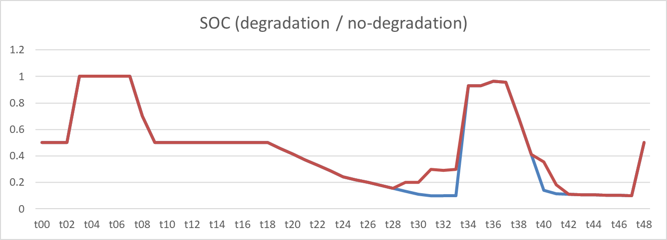
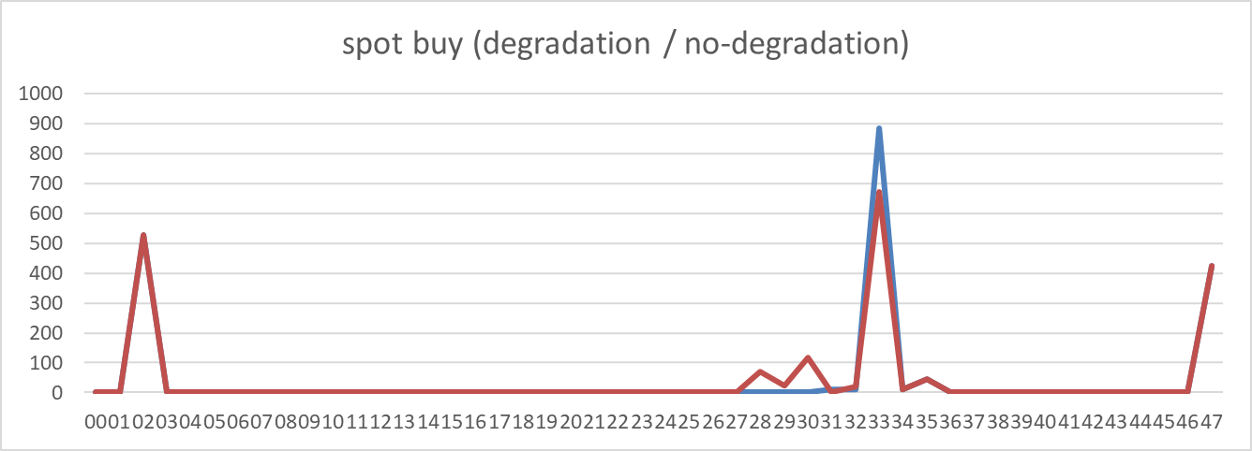
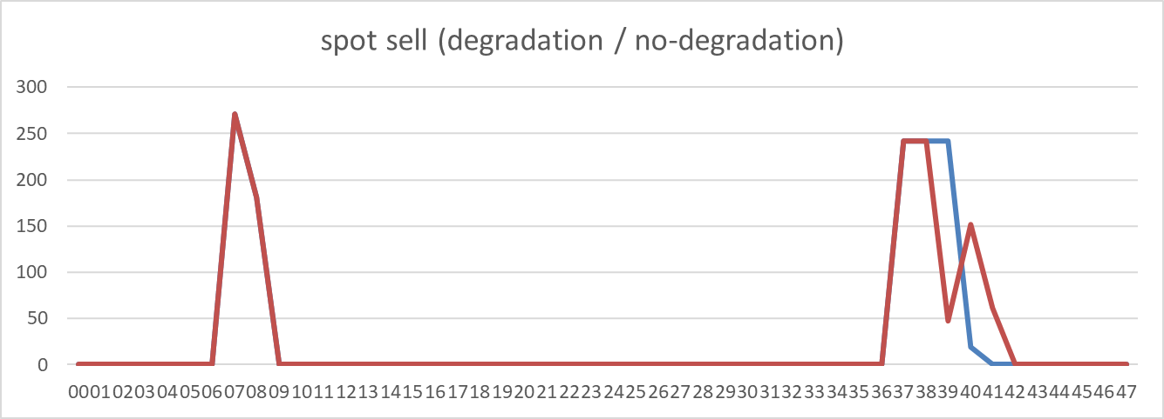
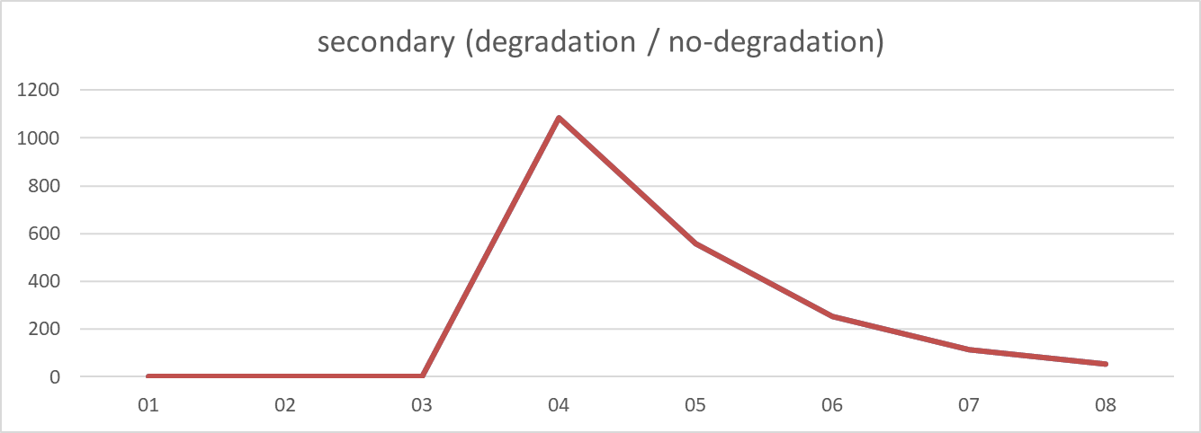
2024-05-03
2024-05-03
SOC: non-degraded case is higher (avg diff -0.021, sum diff -1.03) | Spot buy: almost same (avg diff 0.000, sum diff 0.00) | Spot sell: almost same (avg diff 0.000, sum diff 0.00) | Primary: almost same (avg diff 0.000, sum diff 0.00)

Slide 3
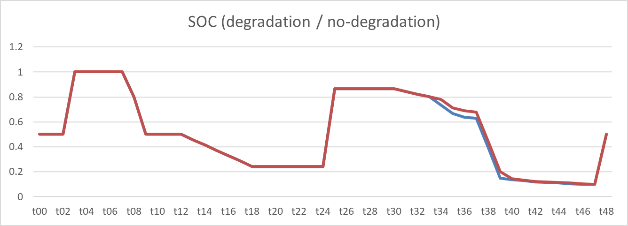
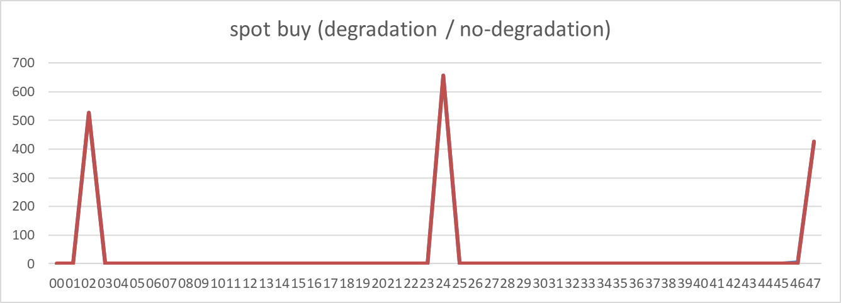
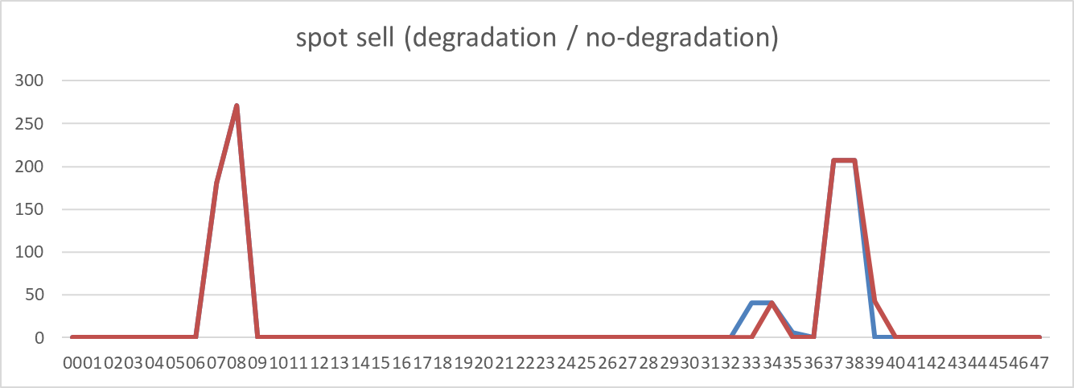
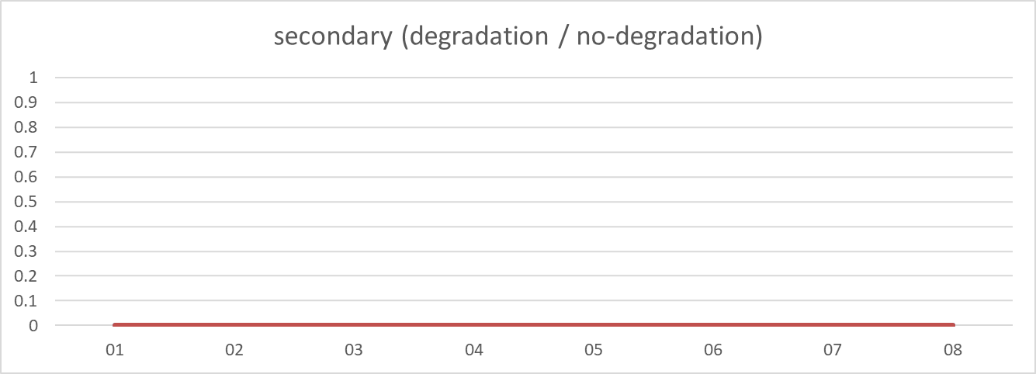
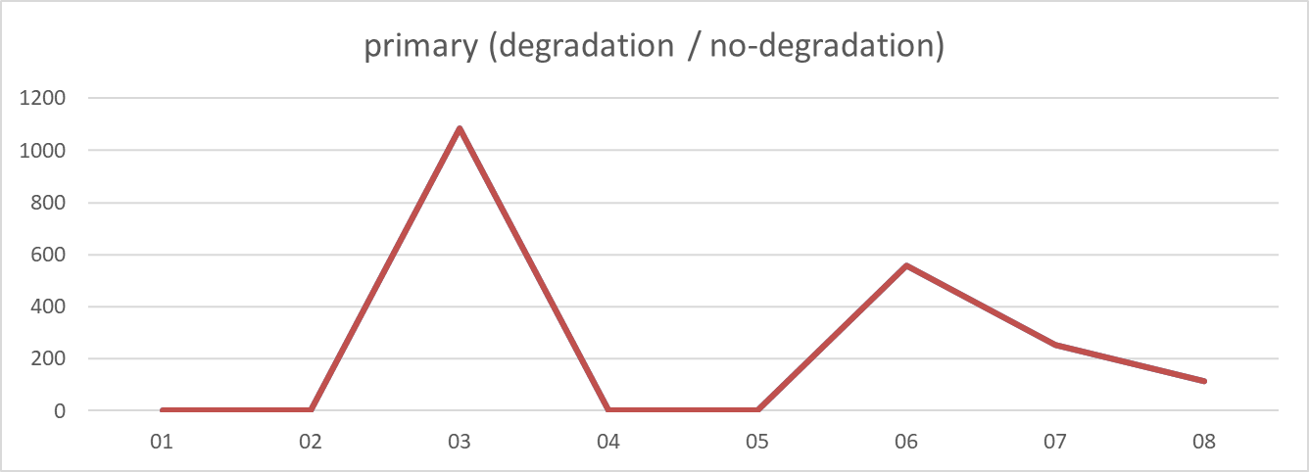
2024-05-06
2024-05-06
SOC: non-degraded case is higher (avg diff -0.007, sum diff -0.33) | Spot buy: degraded case is higher (avg diff 0.100, sum diff 4.82) | Spot sell: degraded case is higher (avg diff 0.086, sum diff 4.13) | Primary: almost same (avg diff 0.000, sum diff 0.00)

Slide 4
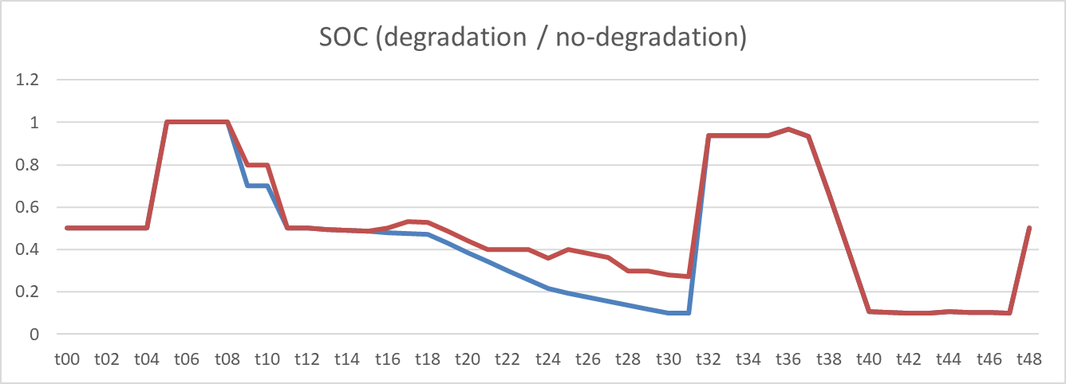
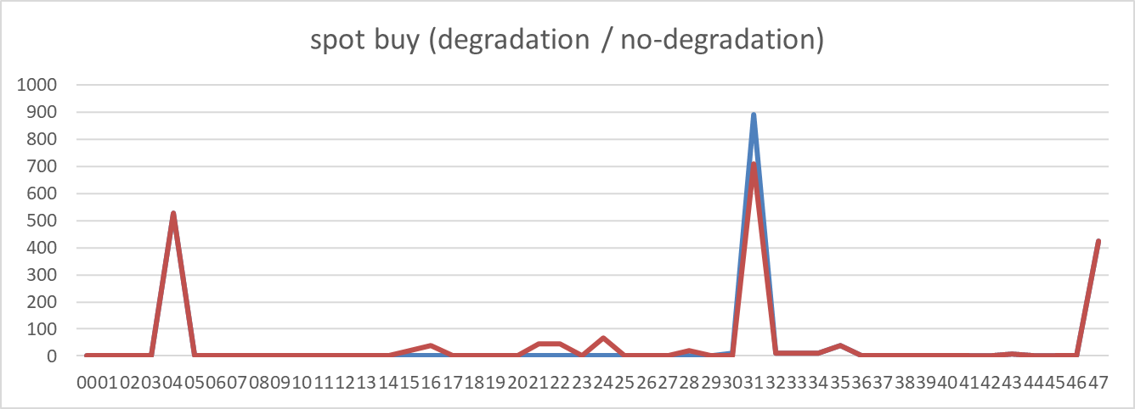
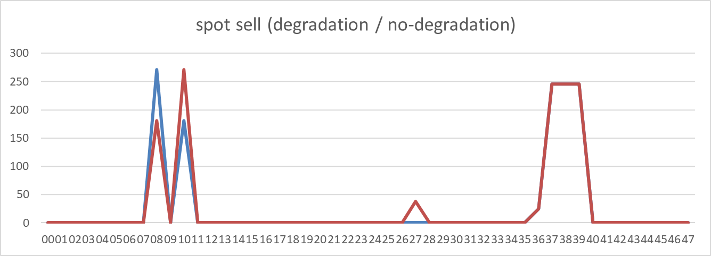
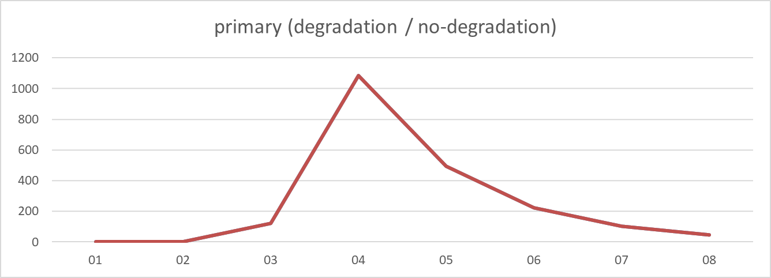
2024-05-10
2024-05-10
SOC: non-degraded case is higher (avg diff -0.045, sum diff -2.20) | Spot buy: non-degraded case is higher (avg diff -0.912, sum diff -43.77) | Spot sell: non-degraded case is higher (avg diff -0.782, sum diff -37.53) | Primary: almost same (avg diff 0.000, sum diff 0.00)

Slide 5
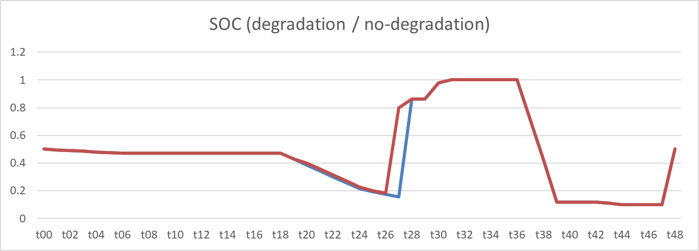
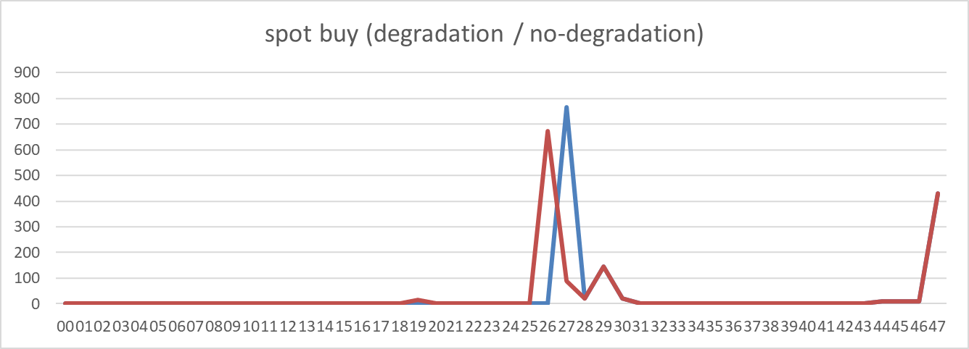
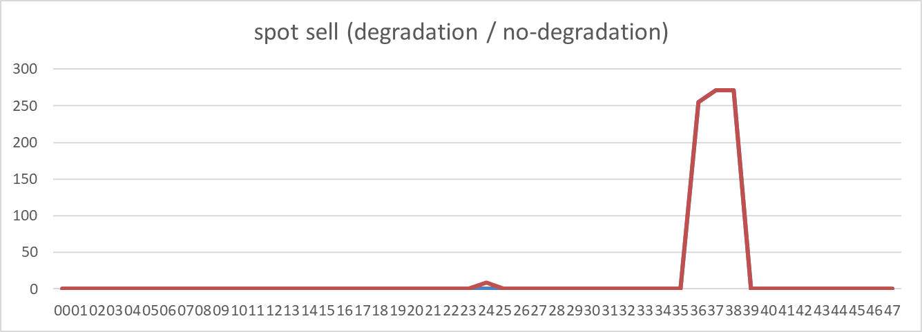
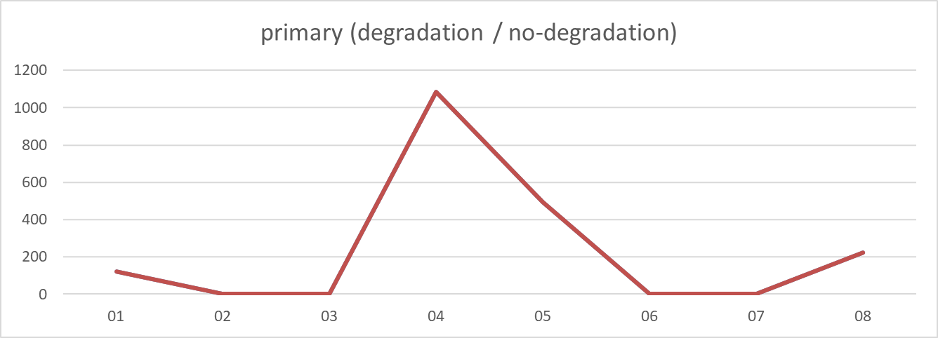
2024-06-05
2024-06-05
SOC: non-degraded case is higher (avg diff -0.015, sum diff -0.73) | Spot buy: non-degraded case is higher (avg diff -0.206, sum diff -9.87) | Spot sell: non-degraded case is higher (avg diff -0.176, sum diff -8.46) | Primary: almost same (avg diff 0.000, sum diff 0.00)

Slide 6
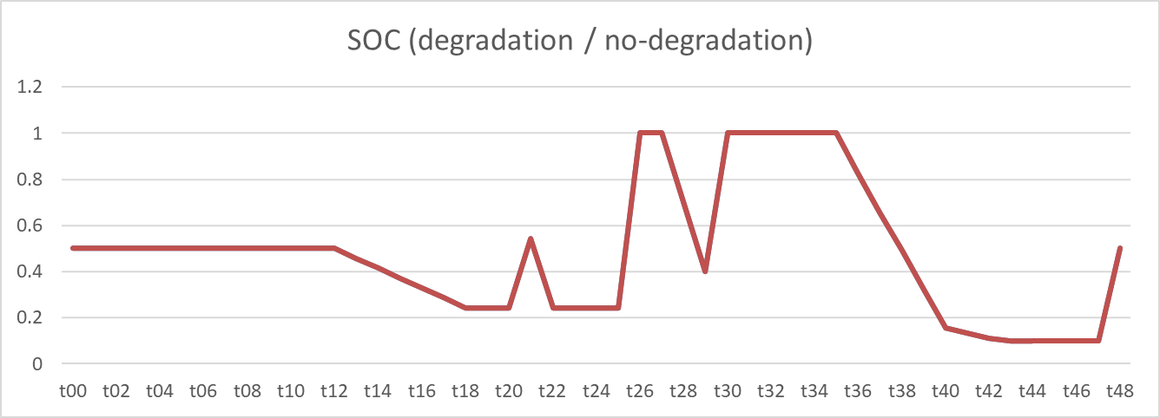
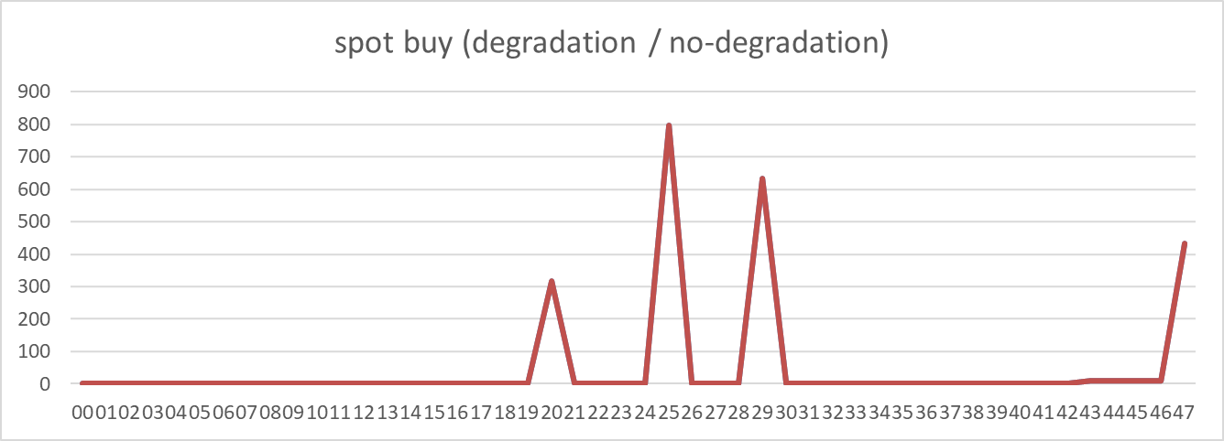
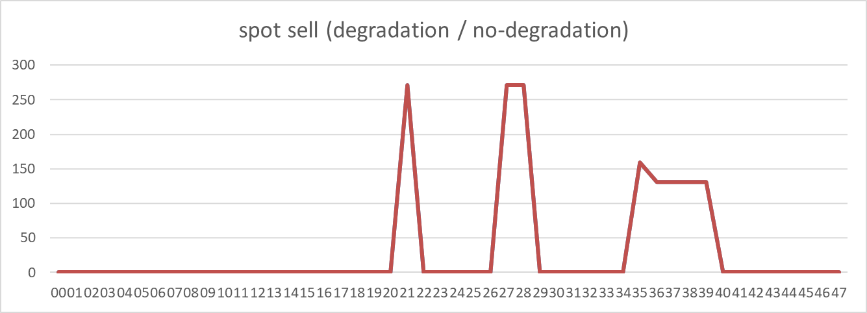
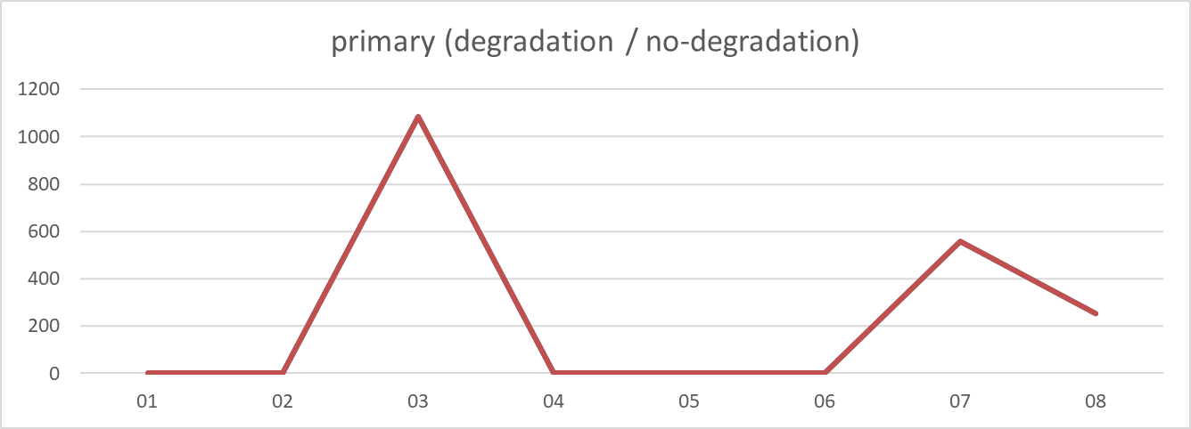
2024-06-11
2024-06-11
SOC: almost same (avg diff 0.000, sum diff 0.00) | Spot buy: almost same (avg diff 0.000, sum diff 0.00) | Spot sell: almost same (avg diff 0.000, sum diff 0.00) | Primary: almost same (avg diff 0.000, sum diff 0.00)

Slide 7
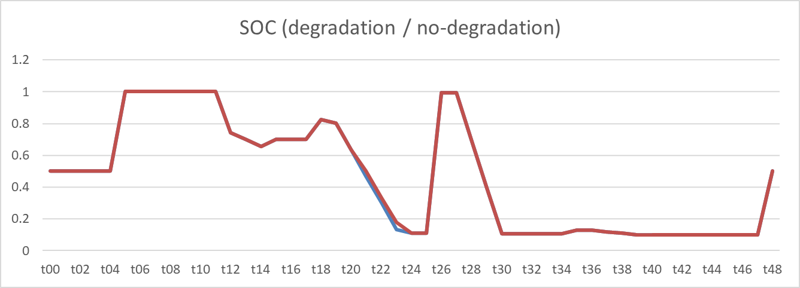
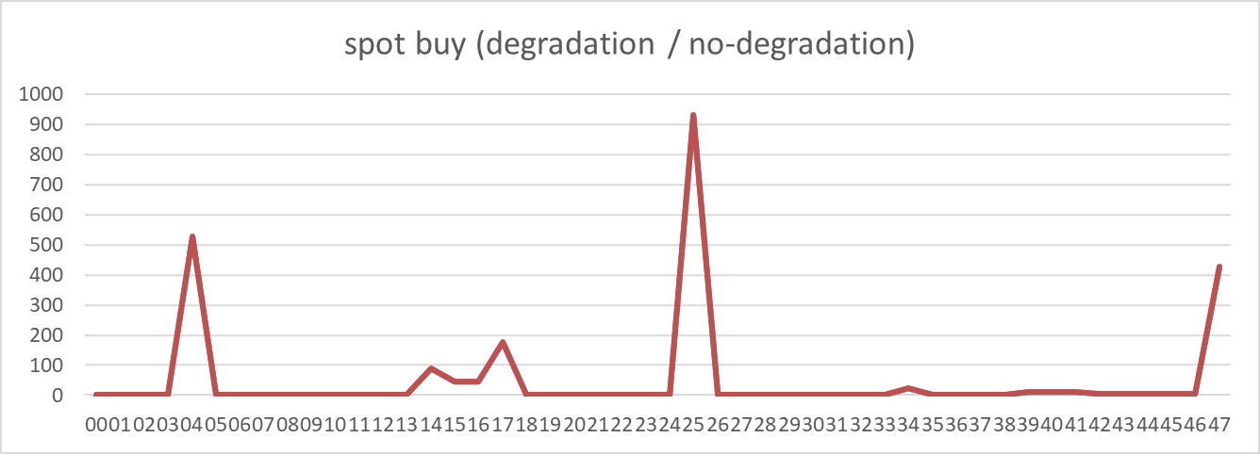
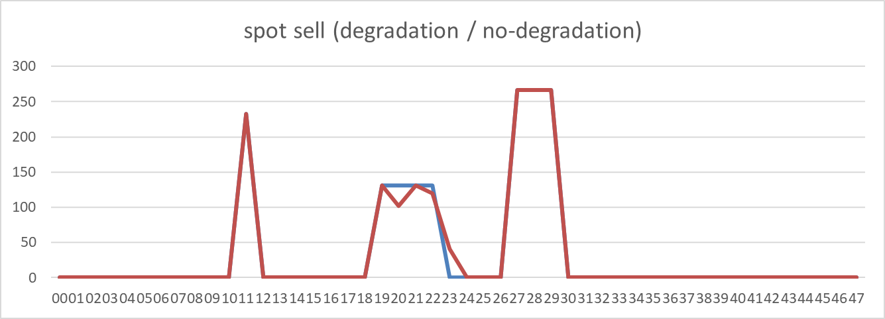
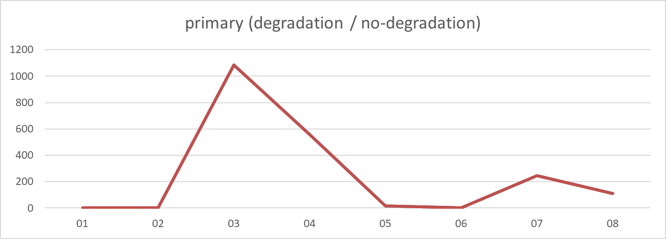
2024-07-01
2024-07-01
SOC: non-degraded case is higher (avg diff -0.002, sum diff -0.11) | Spot buy: almost same (avg diff 0.000, sum diff 0.00) | Spot sell: almost same (avg diff 0.000, sum diff 0.00) | Primary: almost same (avg diff 0.000, sum diff 0.00)

Slide 8
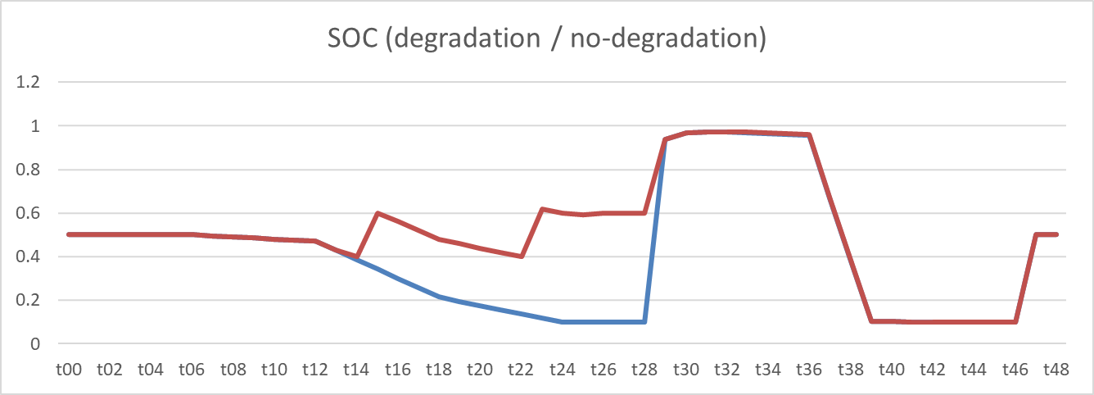
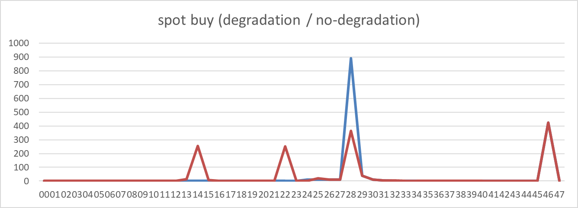

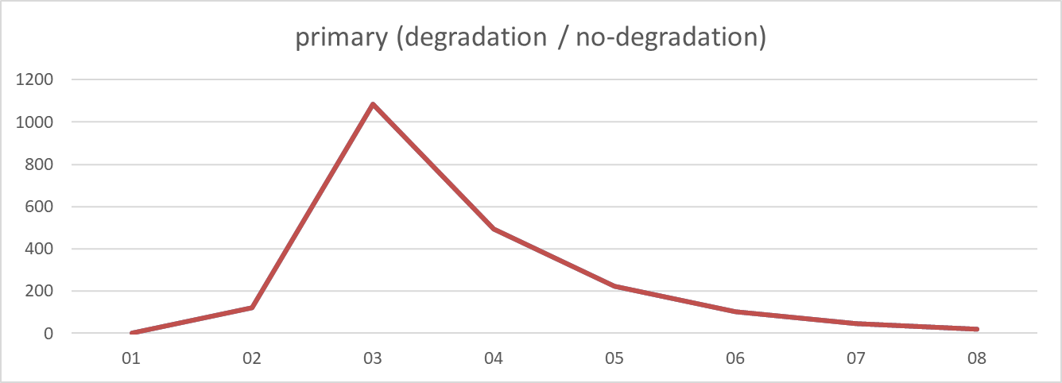
2024-08-06
2024-08-06
SOC: non-degraded case is higher (avg diff -0.105, sum diff -5.13) | Spot buy: non-degraded case is higher (avg diff -0.088, sum diff -4.25) | Spot sell: non-degraded case is higher (avg diff -0.076, sum diff -3.64) | Primary: almost same (avg diff 0.000, sum diff 0.00)

Slide 9
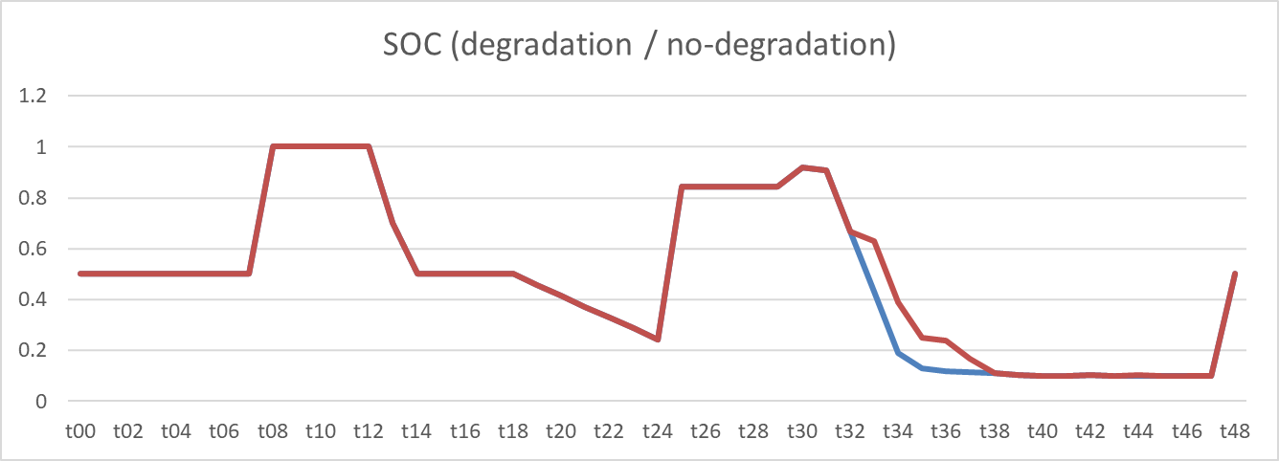
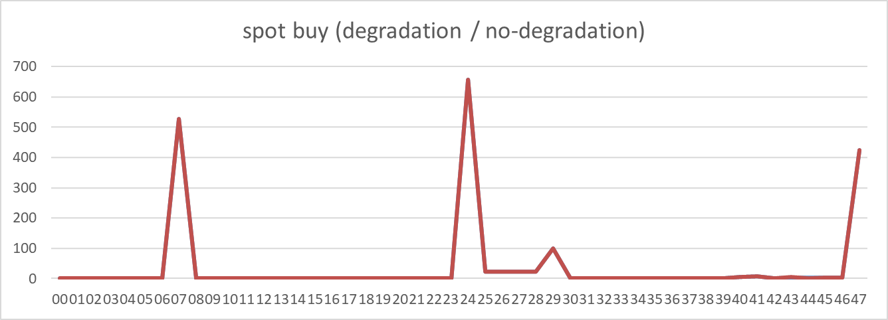
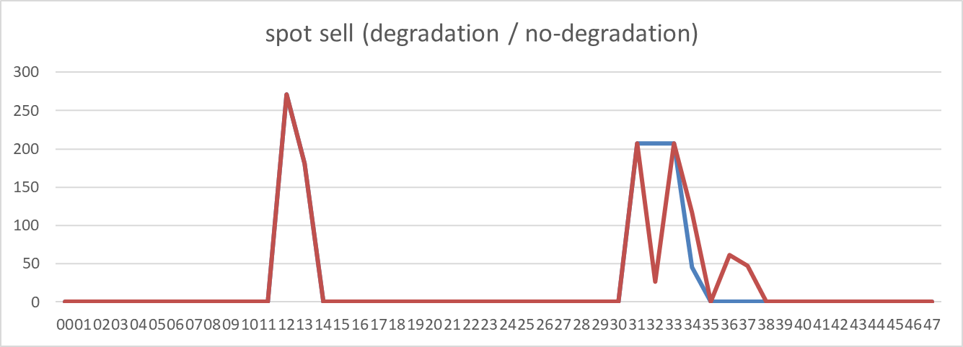
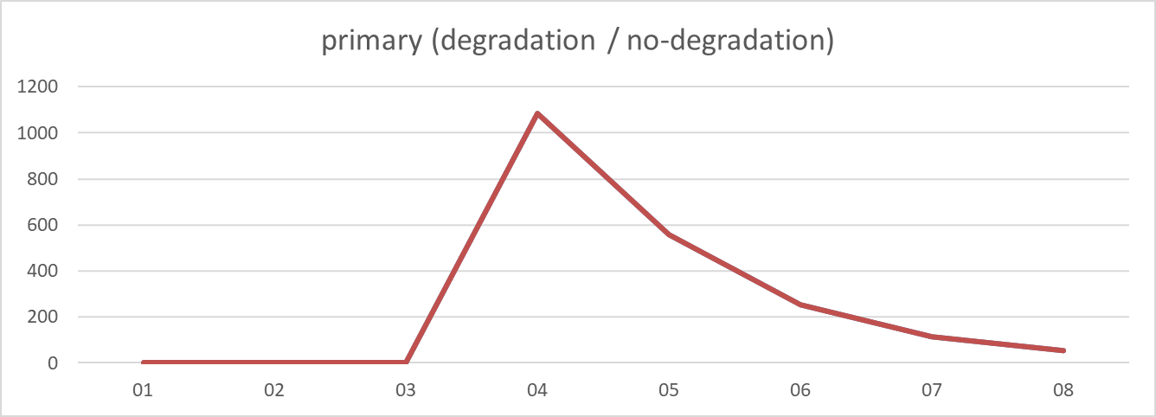
2024-10-22
2024-10-22
SOC: non-degraded case is higher (avg diff -0.014, sum diff -0.70) | Spot buy: almost same (avg diff 0.000, sum diff 0.00) | Spot sell: almost same (avg diff 0.000, sum diff 0.00) | Primary: almost same (avg diff 0.000, sum diff 0.00)

Slide 10
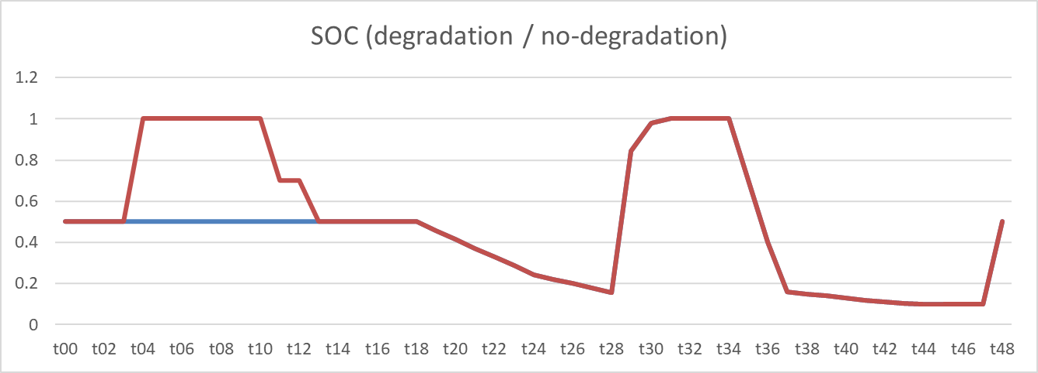
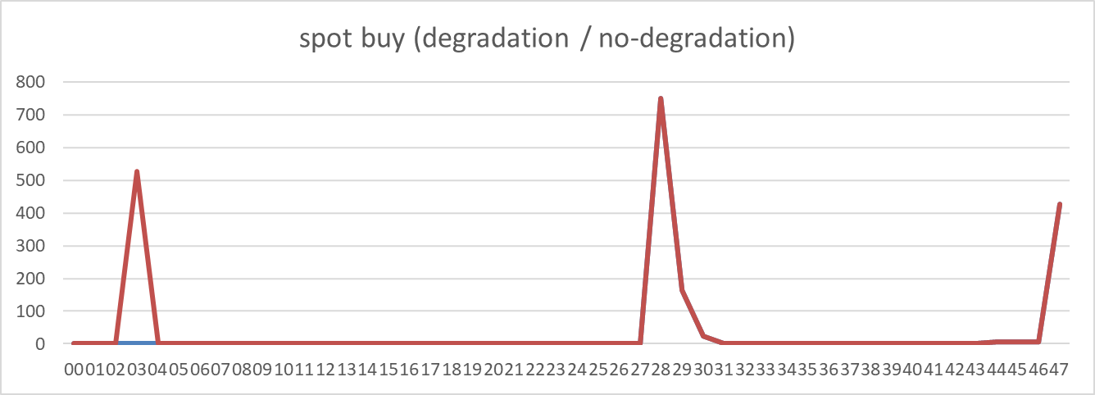
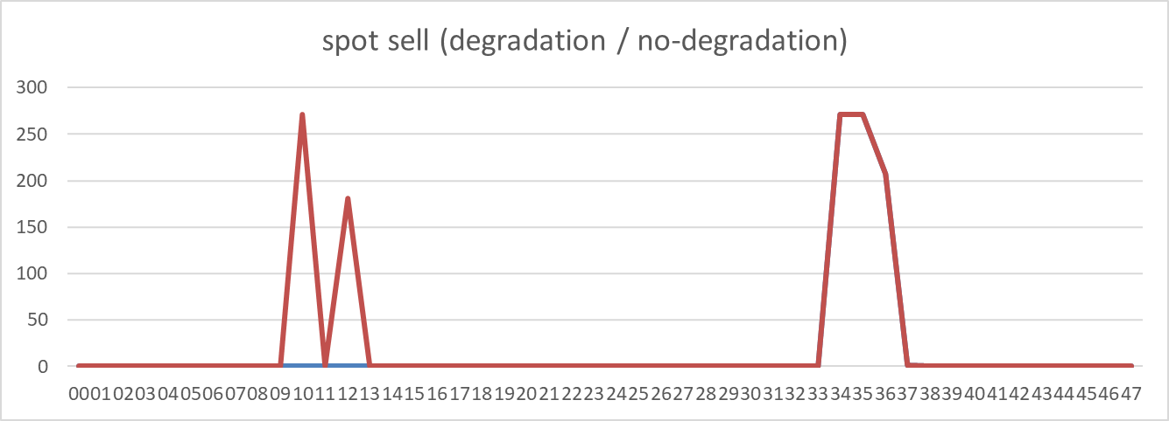
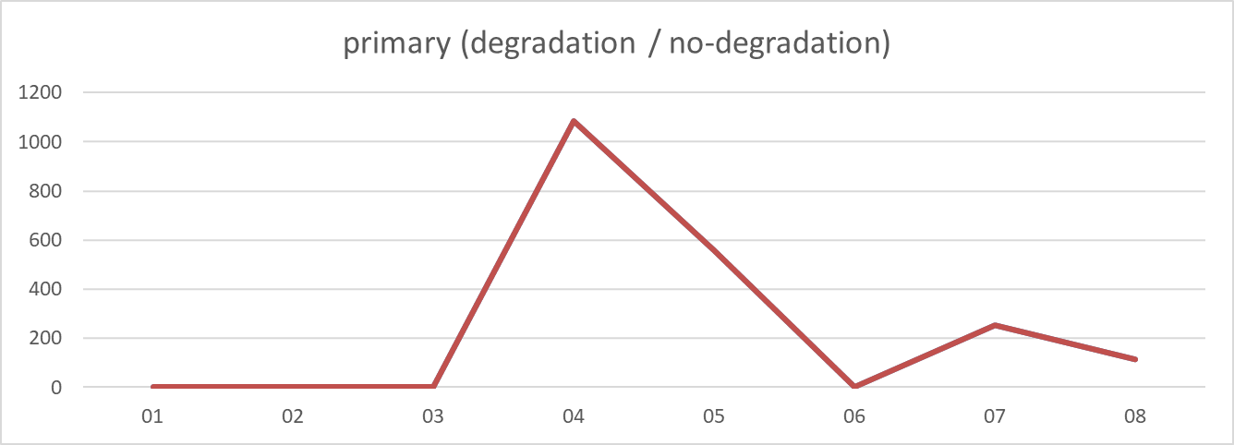
2024-12-04
2024-12-04
SOC: non-degraded case is higher (avg diff -0.080, sum diff -3.90) | Spot buy: non-degraded case is higher (avg diff -10.965, sum diff -526.32) | Spot sell: non-degraded case is higher (avg diff -9.401, sum diff -451.25) | Primary: almost same (avg diff 0.000, sum diff 0.00)

Slide 11
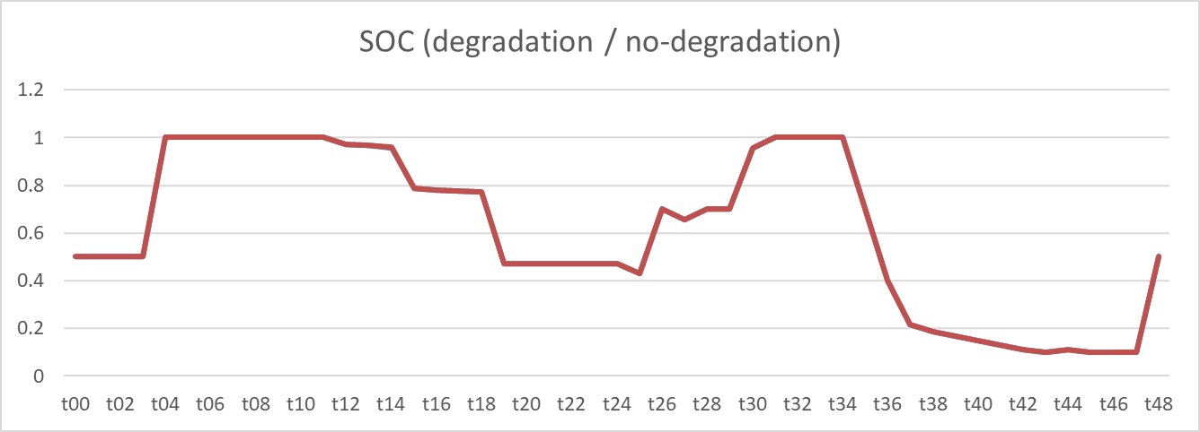
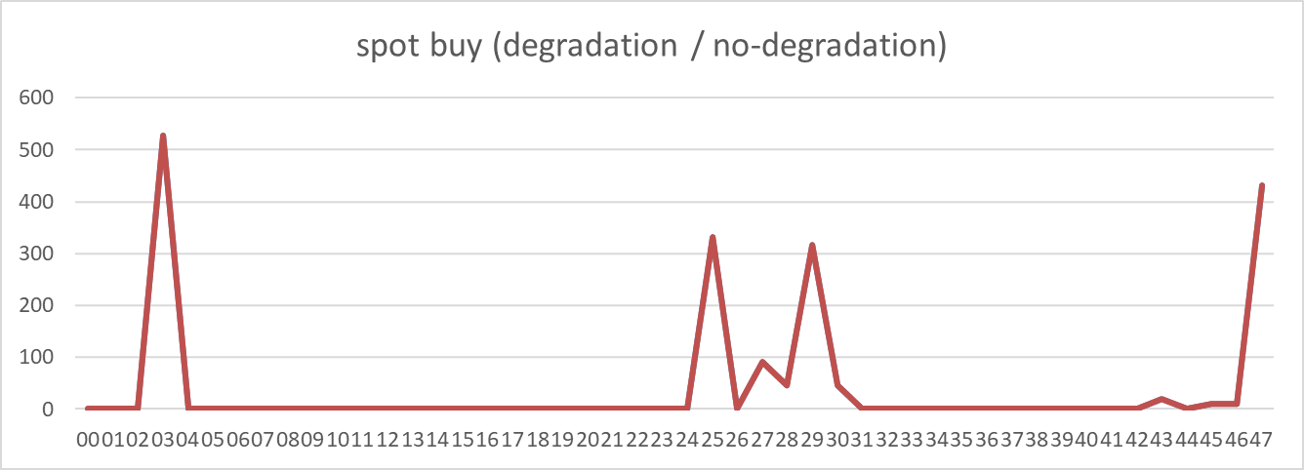
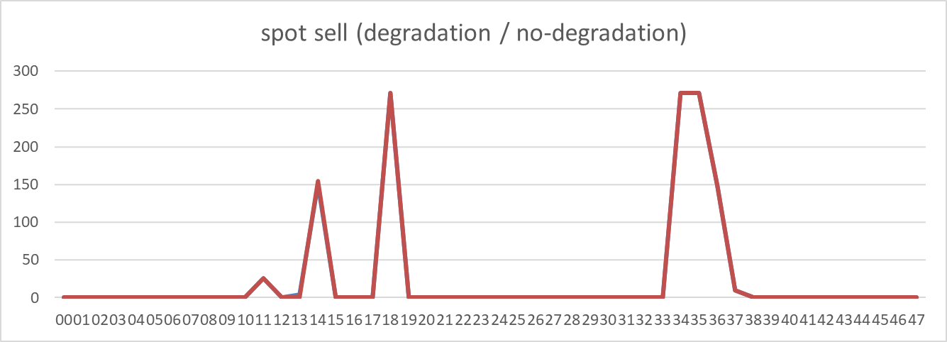
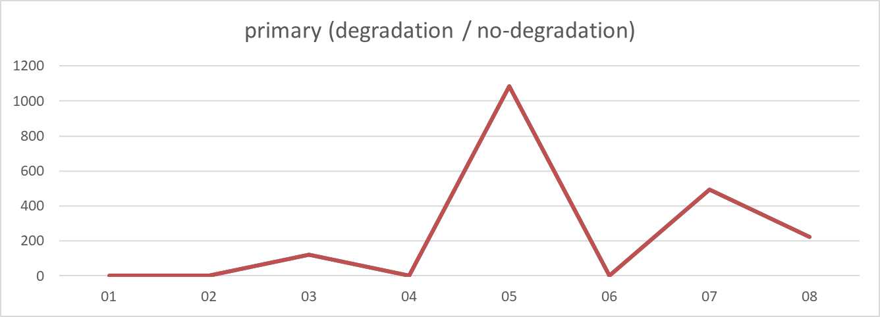
2025-01-30
2025-01-30
SOC: non-degraded case is higher (avg diff 0.000, sum diff 0.00) | Spot buy: almost same (avg diff 0.000, sum diff 0.00) | Spot sell: almost same (avg diff 0.000, sum diff 0.00) | Primary: almost same (avg diff 0.000, sum diff 0.00)

Slide 12
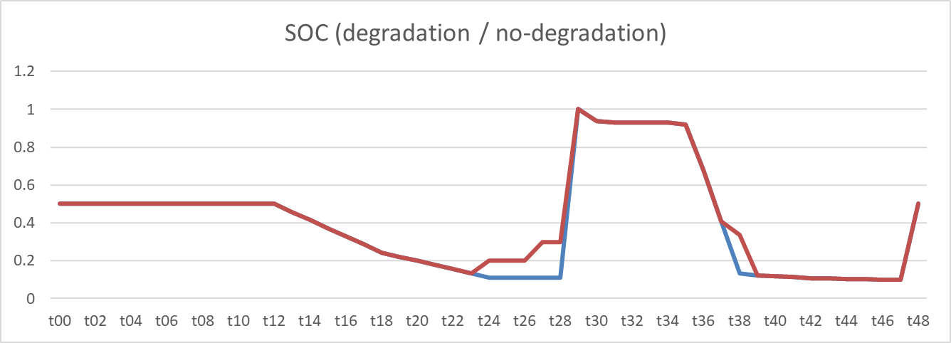
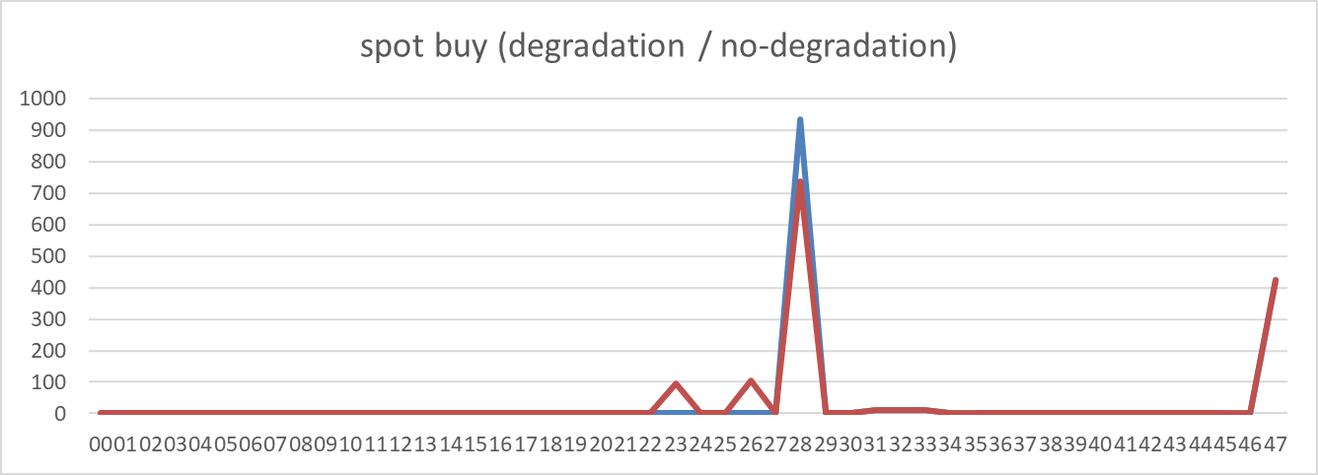
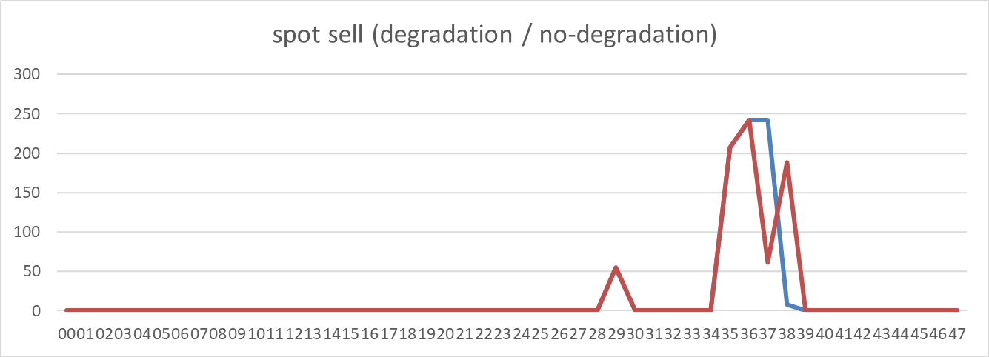
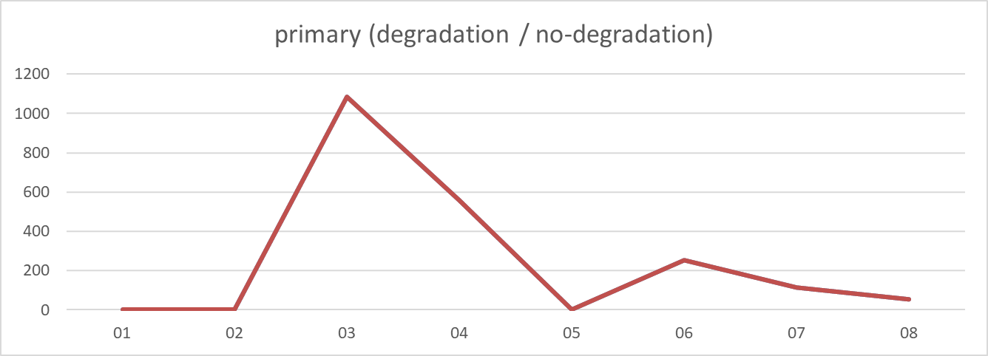
2025-02-11
2025-02-11
SOC: non-degraded case is higher (avg diff -0.017, sum diff -0.85) | Spot buy: almost same (avg diff 0.000, sum diff 0.00) | Spot sell: almost same (avg diff 0.000, sum diff 0.00) | Primary: almost same (avg diff 0.000, sum diff 0.00)

Slide 13
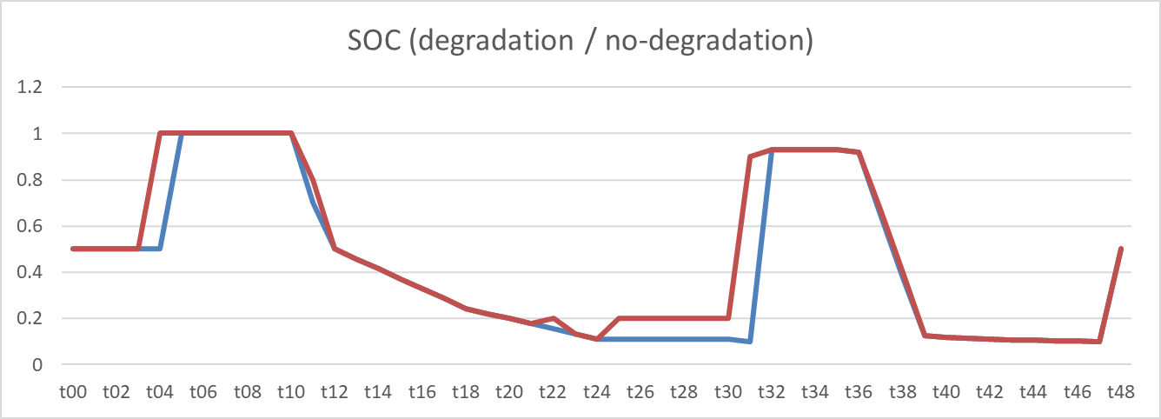


2025-03-25
2025-03-25
SOC: non-degraded case is higher (avg diff -0.041, sum diff -2.02) | Spot buy: non-degraded case is higher (avg diff -0.989, sum diff -47.47) | Spot sell: non-degraded case is higher (avg diff -0.848, sum diff -40.70) | Primary: almost same (avg diff 0.000, sum diff 0.00)

Slide 14

spot_summary_2024 (1)_soc
spot_summary_2024 (1) Cluster 0
SOC: almost same (avg diff 0.000, sum diff 0.00)

Slide 15
spot_summary_2024 (1)_soc
spot_summary_2024 (1) Cluster 0
SOC: almost same (avg diff 0.000, sum diff 0.00)

Slide 16

spot_summary_2024 (1)_soc
spot_summary_2024 (1) Cluster 1
SOC: almost same (avg diff 0.000, sum diff 0.00)

Slide 17

spot_summary_2024 (1)_soc
spot_summary_2024 (1) Cluster 2
SOC: almost same (avg diff 0.000, sum diff 0.00)

Slide 18

spot_summary_2024 (1)_soc
spot_summary_2024 (1) Cluster 3
SOC: almost same (avg diff 0.000, sum diff 0.00)

Slide 19

spot_summary_2024 (1)_soc
spot_summary_2024 (1) Cluster 4
SOC: almost same (avg diff 0.000, sum diff 0.00)

Slide 20

spot_summary_2024 (1)_soc
spot_summary_2024 (1) Cluster 5
SOC: almost same (avg diff 0.000, sum diff 0.00)

Slide 21

spot_summary_2024 (1)_soc
spot_summary_2024 (1) Cluster 6
SOC: almost same (avg diff 0.000, sum diff 0.00)

Slide 22

spot_summary_2024 (1)_soc
spot_summary_2024 (1) Cluster 7
SOC: almost same (avg diff 0.000, sum diff 0.00)

Slide 23

spot_summary_2024 (1)_soc
spot_summary_2024 (1) Cluster 8
SOC: almost same (avg diff 0.000, sum diff 0.00)

Slide 24

spot_summary_2024 (1)_soc
spot_summary_2024 (1) Cluster 9
SOC: almost same (avg diff 0.000, sum diff 0.00)

Slide 25

spot_summary_2024 (1)_soc
spot_summary_2024 (1) Cluster 10
SOC: almost same (avg diff 0.000, sum diff 0.00)

Slide 26

spot_summary_2024 (1)_soc
spot_summary_2024 (1) Cluster 11
SOC: almost same (avg diff 0.000, sum diff 0.00)

Slide 27

spot_summary_2024 (1)_soc
spot_summary_2024 (1) Cluster 12
SOC: almost same (avg diff 0.000, sum diff 0.00)

Slide 28
spot_summary_2024 (1)_soc (dates: 2024-04-03 - 2025-03-04 (n=11))
dates: 2024-04-03 - 2025-03-04 (n=11)
spot_summary_2024 (1) Cluster 0
SOC: almost same (avg diff 0.000, sum diff 0.00)

Slide 29
spot_summary_2024 (1)_soc (dates: 2024-04-08 - 2025-03-03 (n=40))
dates: 2024-04-08 - 2025-03-03 (n=40)
spot_summary_2024 (1) Cluster 1
SOC: almost same (avg diff 0.000, sum diff 0.00)

Slide 30
spot_summary_2024 (1)_soc (dates: 2024-04-04 - 2025-03-24 (n=69))
dates: 2024-04-04 - 2025-03-24 (n=69)
spot_summary_2024 (1) Cluster 2
SOC: almost same (avg diff 0.000, sum diff 0.00)

Slide 31
spot_summary_2024 (1)_soc (dates: 2024-07-03 - 2024-11-18 (n=45))
dates: 2024-07-03 - 2024-11-18 (n=45)
spot_summary_2024 (1) Cluster 3
SOC: almost same (avg diff 0.000, sum diff 0.00)

Slide 32
spot_summary_2024 (1)_soc (dates: 2024-04-21 - 2025-03-28 (n=40))
dates: 2024-04-21 - 2025-03-28 (n=40)
spot_summary_2024 (1) Cluster 4
SOC: almost same (avg diff 0.000, sum diff 0.00)

Slide 33
spot_summary_2024 (1)_soc (dates: 2024-04-11 - 2025-03-19 (n=43))
dates: 2024-04-11 - 2025-03-19 (n=43)
spot_summary_2024 (1) Cluster 5
SOC: almost same (avg diff 0.000, sum diff 0.00)

Slide 34
spot_summary_2024 (1)_soc (dates: 2024-04-02 - 2024-12-22 (n=20))
dates: 2024-04-02 - 2024-12-22 (n=20)
spot_summary_2024 (1) Cluster 6
SOC: almost same (avg diff 0.000, sum diff 0.00)

Slide 35
spot_summary_2024 (1)_soc (dates: 2024-10-27 - 2025-03-31 (n=28))
dates: 2024-10-27 - 2025-03-31 (n=28)
spot_summary_2024 (1) Cluster 7
SOC: almost same (avg diff 0.000, sum diff 0.00)

Slide 36
spot_summary_2024 (1)_soc (dates: 2024-04-06 - 2024-12-01 (n=17))
dates: 2024-04-06 - 2024-12-01 (n=17)
spot_summary_2024 (1) Cluster 8
SOC: almost same (avg diff 0.000, sum diff 0.00)

Slide 37
spot_summary_2024 (1)_soc (dates: 2024-04-01 - 2025-03-26 (n=17))
dates: 2024-04-01 - 2025-03-26 (n=17)
spot_summary_2024 (1) Cluster 9
SOC: almost same (avg diff 0.000, sum diff 0.00)

Slide 38
spot_summary_2024 (1)_soc (dates: 2024-04-18 - 2025-03-30 (n=10))
dates: 2024-04-18 - 2025-03-30 (n=10)
spot_summary_2024 (1) Cluster 10
SOC: almost same (avg diff 0.000, sum diff 0.00)

Slide 39
spot_summary_2024 (1)_soc (dates: 2024-04-07 - 2024-06-02 (n=17))
dates: 2024-04-07 - 2024-06-02 (n=17)
spot_summary_2024 (1) Cluster 11
SOC: almost same (avg diff 0.000, sum diff 0.00)

Slide 40
spot_summary_2024 (1)_soc (dates: 2024-04-14 - 2025-03-23 (n=8))
dates: 2024-04-14 - 2025-03-23 (n=8)
spot_summary_2024 (1) Cluster 12
SOC: almost same (avg diff 0.000, sum diff 0.00)

