Slide 1

Mil-OSS Ignite
Hackin' Excel with Ruby
Kit Plummer
kitplummer@gmail.com

Slide 2
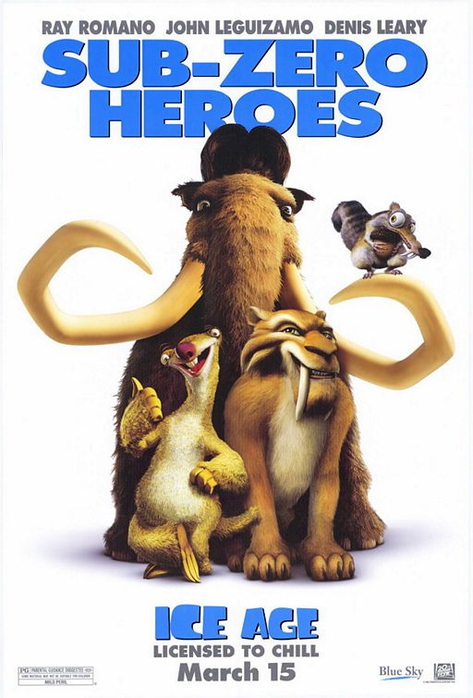
History of Excel
Mac
  1985 Excel 1.0
  1988 Excel 1.5
  1989 Excel 2.2
  1990 Excel 3.0
  1992 Excel 4.0
  1993 Excel 5.0
    (Office 4.X—Motorola 68000 version and first PowerPC version)
Winders
  1987 Excel 2.0
  1990 Excel 3.0
  1992 Excel 4.0
  1993 Excel 5.0
    (Office 4.2 & 4.3, also a 32-bit version for Windows NT only on the PowerPC, Alpha, and MIPS architectures)

Slide 3
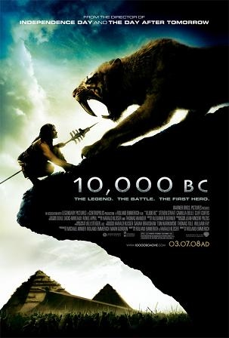
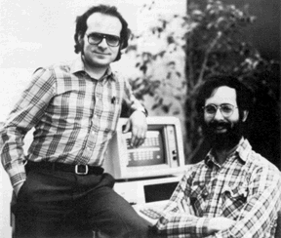

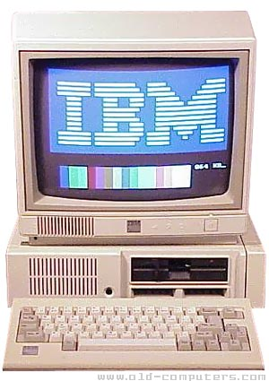
Pre-Excel
VisiCalc
SuperCalc
Lotus 1-2-3
Microsoft's MultiPlan

Slide 4
Why Excel?
When Microsoft was able to train dogs to drink from the toilet (Access)
Amazing, anyone outside of IT with a couple of books could write an app

Slide 5
Um...
Because MS had trained cats to drink from the toilet (Excel)
Excel is the personal Database de jour

Slide 6

Which leads to...
http://www.army.mil/-images/2009/04/20/35660/army.mil-35660-2009-04-21-070443.jpg

Slide 8
Why Ruby?
Eh...because I like Ruby
  Roo: http://roo.rubyforge.org/
Python
  http://www.python-excel.org/
Java
  Poi: http://poi.apache.org/spreadsheet/index.html

