Slide 1
Subliminal Forethoughts
Innovation
Perception
Your tax dollars

Slide 2
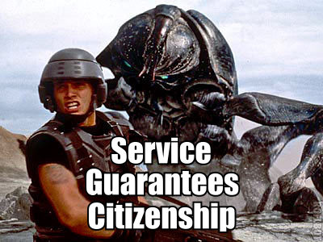
Meritocracy
Place at table is dependent on input
Community potential is dependent on input
We're in consume only mode still
Notes:
Open source communities are structured hierarchies (just like corporate departments)
Most are self-managed
Some are commercially aspirated
Some are a mix of commercial and volunteer members
All function based on a valued level of input
http://img137.imageshack.us/img137/4303/roflbotcypzfy3.jpg

Slide 3
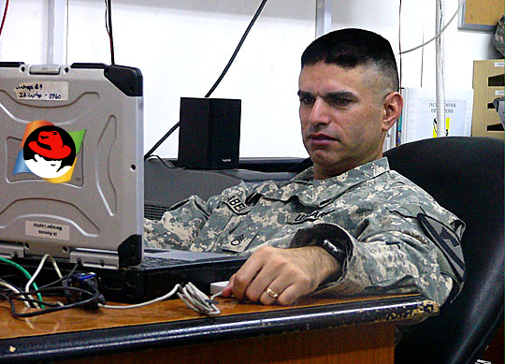
Consumption
“It may come as a surprise to many of you, but the U.S. Army is “the” single largest install base for Red Hat Linux. I’m their largest customer.”
- General Nick Justice
Perspectives:
1. Great! Feed Red Hat with resources while saving $ on license fees.
or
2. Cool. But, big deal.
Notes:
“When we rolled into Baghdad, we did it using open source,” General Justice continued. “It may come as a surprise to many of you, but the U.S. Army is “the” single largest install base for Red Hat Linux. I’m their largest customer.”
http://www.directionsmag.com/press.releases/index.php?duty=Show&id=17056&trv=1

Slide 4
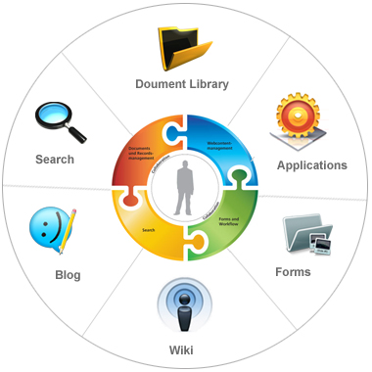
Alt. Consumption
The Army is likely to be (one of) the largest Microsoft Sharepoint install bases.
A Sharepoint engineer costs $108,000 (avg)
How many Sharepoint ”parts” are open?
Notes:
http://www.simplyhired.com/a/salary/search/q-Senior+SharePoint+SME/l-Andrews+Air+Force+Base,+MD
http://www.flickr.com/photos/chrys/401789811

Slide 5
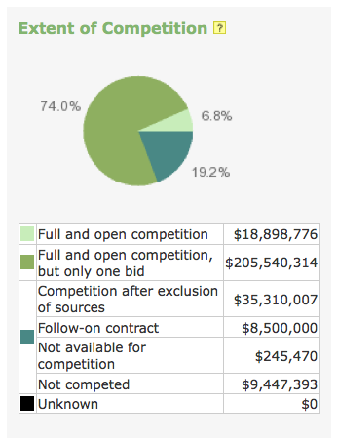
Strange Numbers
DoD R&D Software Engineering Projects from 2008
  74% Won with a Single Bid?
  Vendor Lock Anyone
  That's not citizenship
Thanks to: http://www.fedspending.org

Slide 6
Production
Open Source Software should be recognized for how it gets produced, not consumed!
  Production model
  Then, income model

Slide 7
Contributions
Test writers/Requirements generator
Code commiters
Bug/Issue submitters
  All stakeholders
Mailing list/chat communicators
  All stakeholders
Blog writers?

Slide 8
Complicated?
Why is it so difficult?
  Contractual constraints (color of money)
  Contractor IP
  ITAR
  Community governance
  Certification & Accreditation
  Maintenance
  Developer motivation

Slide 9
Software Development
2008 (fiscal)
  $277,941,960
  R&D only
  71% at Boeing
Nabble hits on ”boeing.com” → 12
CIGI
  Software and open source provided as is with no guarantee of usability
Notes:
A search of the Nabble archives for ”boeing.com” reveals a total of 12 hits.

Slide 10

System Integration
Open Standards promote
  Open Source integration
  Reusability
  System decoupling
  Vendor neutrality

Slide 11
Citizenship
We want the DoD to be a good citizen right?
What about DoD contractors' citizenship?
What about U.S. citizens, in general?

Slide 12
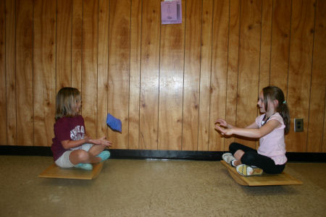
Good Citizenship is Simple
Balance
Between
Contributions and Consumption

Slide 13
How to Contribute
Well, that's why we're here.
Smart software architecture
Integrate OSS, where possible
  Communicate with communities
Communicate with your end customers
  They are starting to understand the benefits

Slide 14
Social Coding
As aligned to Social Networking?
Think about, who develops code?
  Developers communicate
    Developers
    Team(s)
    Customers
  Have their own languages

Slide 15
Distributed Version Control
Geekiest part of this presentation :)
Linus Torvalds created Git to serve his project's globally distributed software engineering effort
  The premier example of how to manage code
Not just Open Source
  Forking is encouraged
  Potential for emergent innovation...

Slide 16
The End Result
Social collaboration breeds citizenship
Improved citizenship breeds higher quality
Higher quality reduces costs
Reduced costs fields more functionality
More functionality improves performance
We need a truly Open [no gate] environment

