Slide 1
Hackin' Devices with Ruby
A Sensors to API to Feeds to Apps
“Show and Tell”
Kit Plummer
dozersoftware

Slide 2
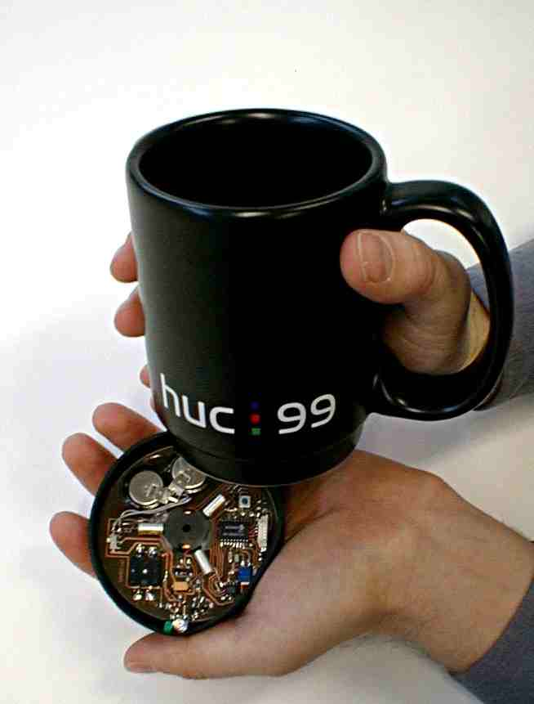
Ubiquitous Computing
Pervasive Computing
  Everything has a processor
  Everything is connected
Ambient Intelligence
  Sensitive to people
  Context aware
  Passive
Embedded

Slide 3
Devices → Producers/Consumers
Internet of Things
Producers Push
  To Where?
Consumers Pull
  From Where?
Consumers get pushed to is probably more right
Sound Familiar? Service-Oriented Architecture? ESB?

Slide 4
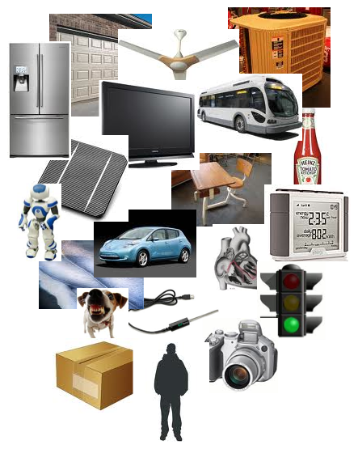
Devices → Sensors/Actuators
Sensors Push
Actuators Pull?
  In a Web world, Yes.
  In a Web world, No.
  Full-duplex is possible
    Chat protocols (XMPP)
    Webhooks
    Devices ARE servers

Slide 5
What if...
There was a SaaS that could receive data updates and make them available to the public through a standardize API, producing XML, JSON, or graphic visualizations (or PLI)
There was a SaaS that could provide a standard interface to publicly available sensors and actuators (from all over the world), via a standardized format and open API

Slide 6
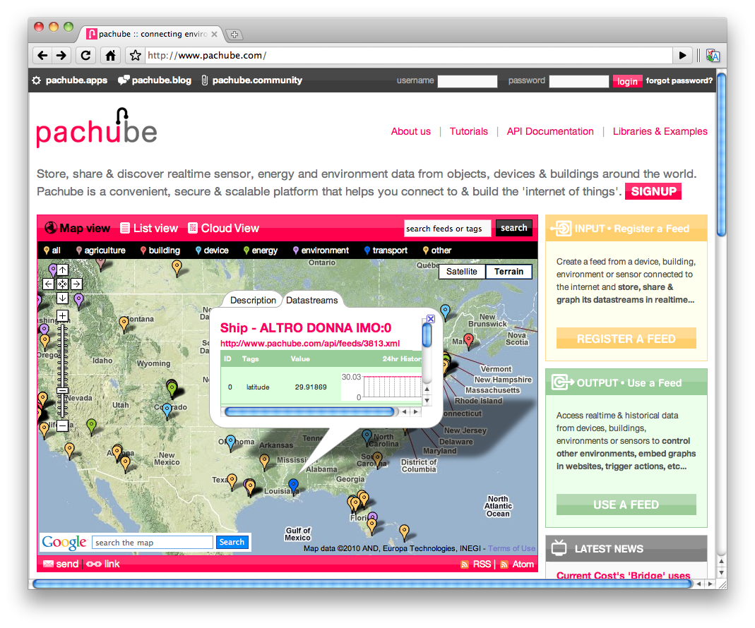
http://www.pachube.com

Slide 7
Need Hardware!
<?xml version="1.0" encoding="iso-8859-1"?>
<xsd:schema xmlns="http://www.eeml.org/xsd/005"
elementFormDefault="qualified"
targetNamespace="http://www.eeml.org/xsd/005"
xmlns:xsd="http://www.w3.org/2001/XMLSchema">
<xsd:element name="eeml">
...
Sensor
  Check: Vernier Go!Temp USB Temp Sensor
Embedded Platform
  Check: Gumstix Verdex

Slide 8
Need Software!
I <3 Ruby!
  Got Ruby 1.8.6 running on Gumstix
    ruby 1.8.6 (2008-08-11 patchlevel 287) [arm-linux-eabi]
Pachube speaks EEML* over HTTP
  Wrote pachuber gem for Ruby access to API
Access temp from Go!Temp via Ruby in Linux
  Thanks to Linux's USB “device bus”:
f = File.new("/dev/ldusb0")
packet = f.read(8)
f.close
parsed_packet = packet.unpack('ccsss')
temp = parsed_packet[2]/128
(*Extended Environments Markup Language)

Slide 9
Posting to Pachube
pachube_api_key = 'blahdyblahblah'
LAT = 32.358098
LON = -110.980960
NAME = "Dozer Software"
ELEVATION = 2545
temp = Temperature.temp()
# Build the EEML XML
env = EEML::Environment.new
env.location = EEML::Location.new(:physical, :disposition => :fixed, :exposure => :outdoor,
:ele => ELEVATION,
:lat => LAT,
:lon => LON,
:name => NAME)
data = EEML::Data.new(temp)
data.tags << "temperature"
data.unit = EEML::Unit.new("Celsius", :symbol => 'C', :type => :derivedSI)
env << data
# Create a connection to Pachube and update the feed
pach = Pachube.new(pachube_api_key)
resp = pach.update("/4077.xml", env.to_eeml)

Slide 10
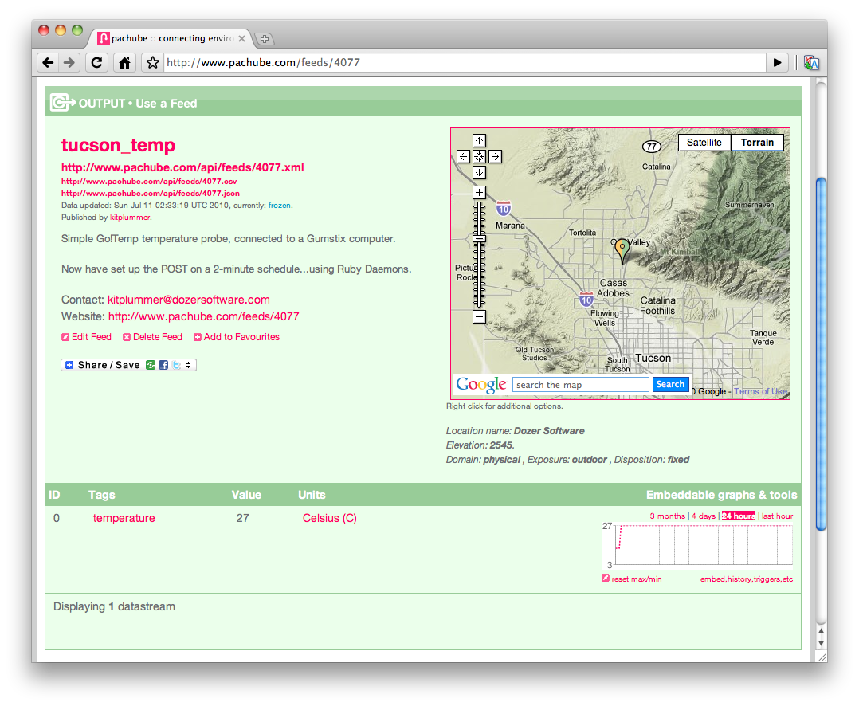

Slide 11
Got GPS?
GPSBabel (http://www.gpsbabel.org/)
  Can pull GPS info from USB-device
$ gpsbabel -i garmin,get_posn -f usb: -o garmin_poi -F -
class Location
attr_accessor :lat, :lng
def initialize()
get_coordinates
end
def get_coordinates
begin
coordinates = {}
# gpsbabel will return CSV coordinates "lng, lat, string, string"
data = `gpsbabel -i garmin,get_posn -f usb: -o garmin_poi -F -`
data = data.chop.split(',')
self.lng = data[0].to_s
self.lat = data[1].to_s
rescue
self.lat = "0"
self.lng = "0"
end
end # get_coordinates
end

Slide 12
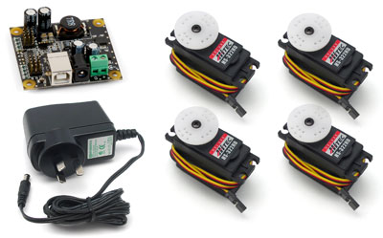
Phidgets!!!
www.phidgets.com
USB-based Widgets
  Sensors
  Servos
  Controls
phidgets4r
  Ruby wrapper for C lib
  Need help with more devices!

Slide 13
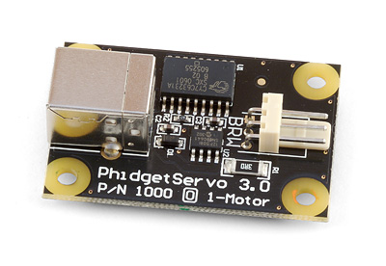
Driving a Servo...
assert_nothing_raised {
servo = Phidgets::Servo.new(-1, 2000)
puts "device_id: #{servo.getDeviceID}"
puts "device_name: #{servo.getDeviceName}"
puts "status: #{servo.getDeviceStatus}"
max = servo.getPositionMax(0)
min = servo.getPositionMin(0)
puts "min: #{min} - max: #{max}"
servo.setPosition(0, 10.0)
sleep 3
position = servo.getPosition(0)
servo.close
servo.delete
}

Slide 14
Serve it Up!
Sinatra: DSL for simple webapps
Live coding disaster to commence now...

Slide 15
Bug Labs BUG
Modular Blocks for Base Processor Brick
  Hardware and software modularity
Demo
And Ruby?
Why Yes Please.

