Slide 1
Mutiur Rahman
2207097
Welcome
Alok Baul (Turjo)
2207098
Inside Google Maps: how a global mapping platform is designed
Aavas Roy
2207099
Plabon Barua
2207101
Md. Sabbir Hossain
2207102

Slide 2

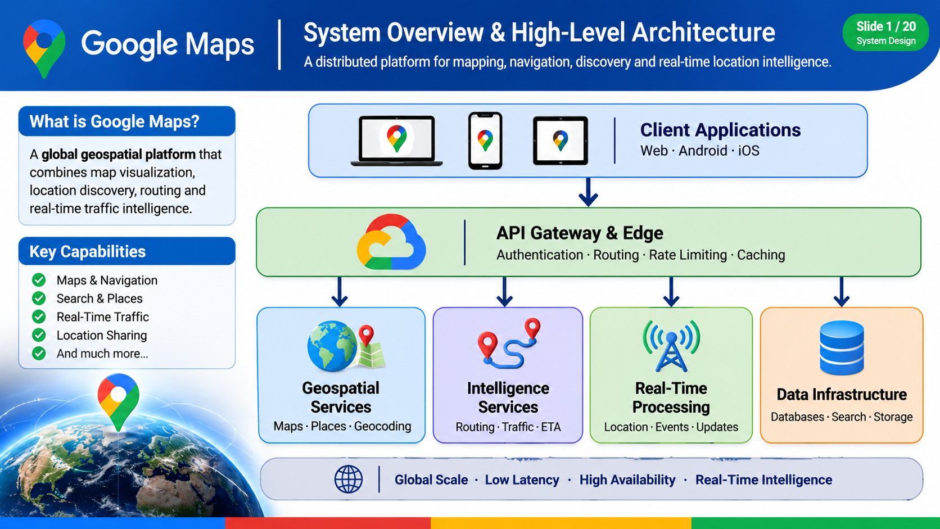
Google Maps
System Overview & High-Level Architecture
A distributed platform for mapping, navigation, discovery and real-time location intelligence.
Client Applications
Web · Android · iOS
What is Google Maps?
A global geospatial platform that combines map visualization, location discovery, routing and real-time traffic intelligence.
API Gateway & Edge
Authentication · Routing · Rate Limiting · Caching
Key Capabilities
Maps & Navigation
Search & Places
Real-Time Traffic
Location Sharing
Geospatial Services
Intelligence Services
Real-Time Processing
Data Infrastructure
And much more…
Maps · Places · Geocoding
Routing · Traffic · ETA
Location · Events · Updates
Databases · Search · Storage
Notes:
Google Maps is much more than a map application. It is a large-scale distributed system that processes geographic data and delivers location-based services to millions of users.
At the top, we have client applications, including web and mobile apps, through which users interact with the platform.
Requests first pass through the API Gateway and Edge layer, which handles authentication, request routing, rate limiting, and caching.
Behind this layer, the system is divided into several major service domains.
Geospatial Services manage map data, roads, places, and geographic queries.
Intelligence Services handle route calculation, traffic analysis, ETA estimation, and recommendations.
Real-Time Processing processes location updates, traffic signals, and incident information.
Data Infrastructure provides the databases, caches, streams, and storage required by all these services.
Together, these components allow the platform to deliver accurate geographic information with low latency, high availability, and global scalability.
This is a conceptual reference architecture rather than a representation of Google's proprietary internal infrastructure.
Now that we understand the overall architecture, let's look more closely at one of its most important foundations: how geographic data is stored, indexed, and retrieved efficiently.

Slide 3
Problem & Functional Requirements
What the system must do, and for whom
The problem
Functional requirements
Users and clients
Billions of people need to find places, get directions and see live traffic on any device.
The world changes constantly: roads close, businesses move, traffic shifts by the minute.
Answers must feel instant, everywhere.
Display, pan and zoom the map
Search places and addresses
Route with turn-by-turn navigation
Show live traffic and accurate ETA
Work offline with saved maps
Share live location
Drivers and commuters
Pedestrians and cyclists
Businesses and developers using APIs
Android, iOS and web clients
Notes:
Finally, this slide brings together all the major components of the Google Maps system architecture that we have explored throughout this presentation.
The process starts with users accessing Google Maps through web and mobile applications. Their requests pass through the API Gateway, which manages authentication, security, and request routing.
The system then distributes these requests across specialized microservices, including Map Services, Places Services, Routing Services, and Geocoding Services.
Behind these services, the data and intelligence layer manages geographic information, satellite imagery, GPS signals, traffic data, and AI-powered analysis.
A continuous data pipeline collects, processes, validates, and updates geographic information to keep the map accurate.
All these components operate on distributed cloud infrastructure supported by caching, CDNs, monitoring, and fault-tolerant systems.
Together, these technologies provide real-time navigation, location discovery, traffic intelligence, and reliable map services at global scale.
The most important takeaway is that Google Maps is not simply a mapping application. It is a massive, intelligent, distributed system that combines geospatial engineering, artificial intelligence, real-time data processing, and cloud computing.

Slide 4
Non-Functional Requirements
Scale, latency, availability, durability and security
Scale
Latency
Availability
Durability
Security
Billions
<100 ms
99.99%
No loss
Encrypted
of users, with millions of requests per second at peak
for map tiles at p95; routes in about 1 second
uptime, about 52 minutes of downtime a year
of map or user data, with multi-region replication
traffic, OAuth sign-in and user privacy controls
Notes:
Finally, this slide brings together all the major components of the Google Maps system architecture that we have explored throughout this presentation.
The process starts with users accessing Google Maps through web and mobile applications. Their requests pass through the API Gateway, which manages authentication, security, and request routing.
The system then distributes these requests across specialized microservices, including Map Services, Places Services, Routing Services, and Geocoding Services.
Behind these services, the data and intelligence layer manages geographic information, satellite imagery, GPS signals, traffic data, and AI-powered analysis.
A continuous data pipeline collects, processes, validates, and updates geographic information to keep the map accurate.
All these components operate on distributed cloud infrastructure supported by caching, CDNs, monitoring, and fault-tolerant systems.
Together, these technologies provide real-time navigation, location discovery, traffic intelligence, and reliable map services at global scale.
The most important takeaway is that Google Maps is not simply a mapping application. It is a massive, intelligent, distributed system that combines geospatial engineering, artificial intelligence, real-time data processing, and cloud computing.

Slide 5
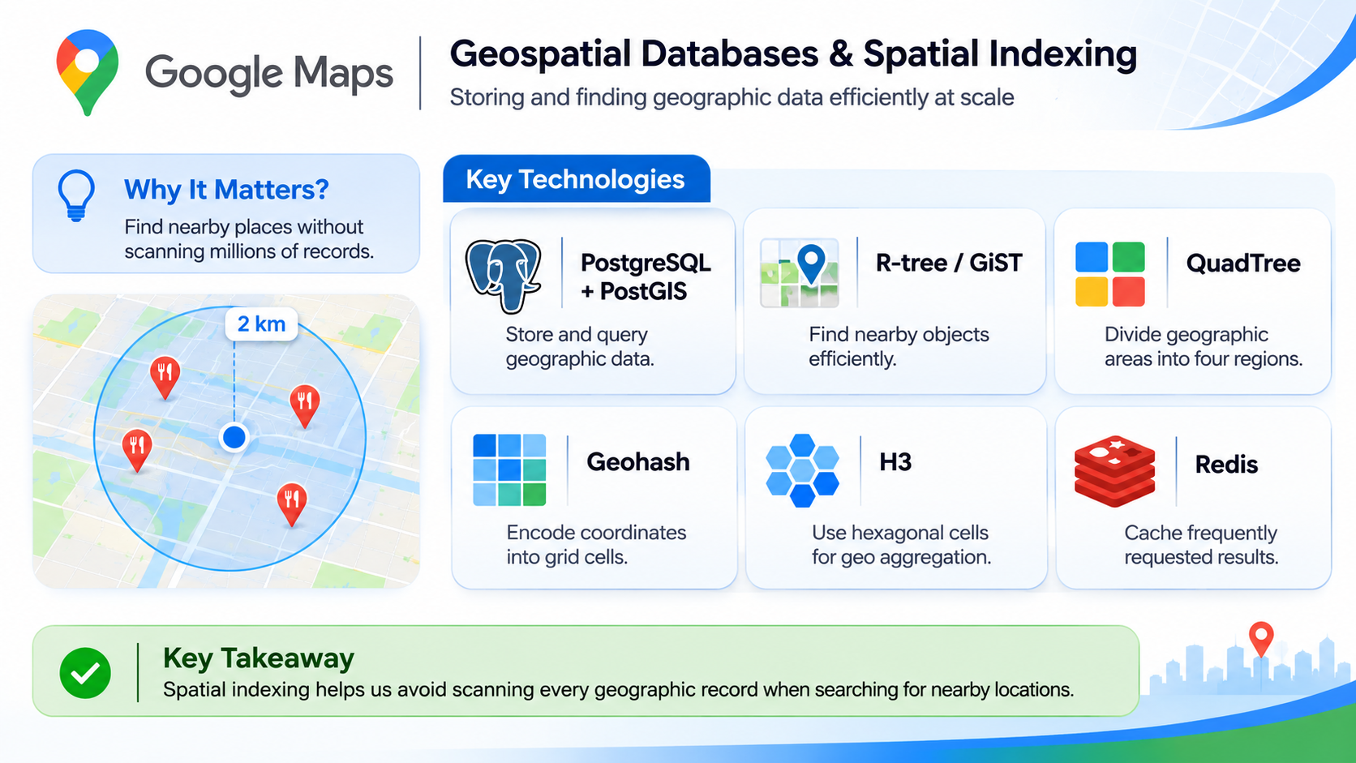
Geospatial Databases & Spatial Indexing
Storing and finding geographic data efficiently at scale
Key Technologies
Why It Matters
Find nearby places without scanning millions of records.
PostgreSQL
+ PostGIS
R-tree / GiST
QuadTree
Store and query geographic data.
Find nearby objects efficiently.
Divide geographic areas into four regions.
Geohash
H3
Redis
Encode coordinates into grid cells.
Use hexagonal cells for geo aggregation.
Cache nearby results for fast lookups.
Notes:
In a mapping platform, geographic data can include millions of restaurants, roads, buildings, and other points of interest. Searching through all these records for every request would be extremely inefficient.
To solve this problem, we use geospatial databases and spatial indexing techniques.
PostgreSQL with PostGIS provides the ability to store and query geographic objects such as points, roads, and geographic boundaries.
R-tree indexing, commonly implemented through GiST in PostGIS, helps locate nearby geographic objects efficiently by organizing them into spatial bounding boxes.
Other techniques serve different purposes:
QuadTree recursively divides geographic areas into four smaller regions.
Geohash converts geographic coordinates into hierarchical grid-based strings.
H3 divides the Earth's surface into hierarchical hexagonal cells, which are useful for geographic aggregation and traffic analysis.
Redis can cache frequently requested geographic results to reduce database load and improve response times.
These technologies can work together rather than replacing one another.
The key idea is that spatial indexing reduces the number of records we need to examine, allowing geographic queries to run efficiently even when the dataset is extremely large.

Slide 6
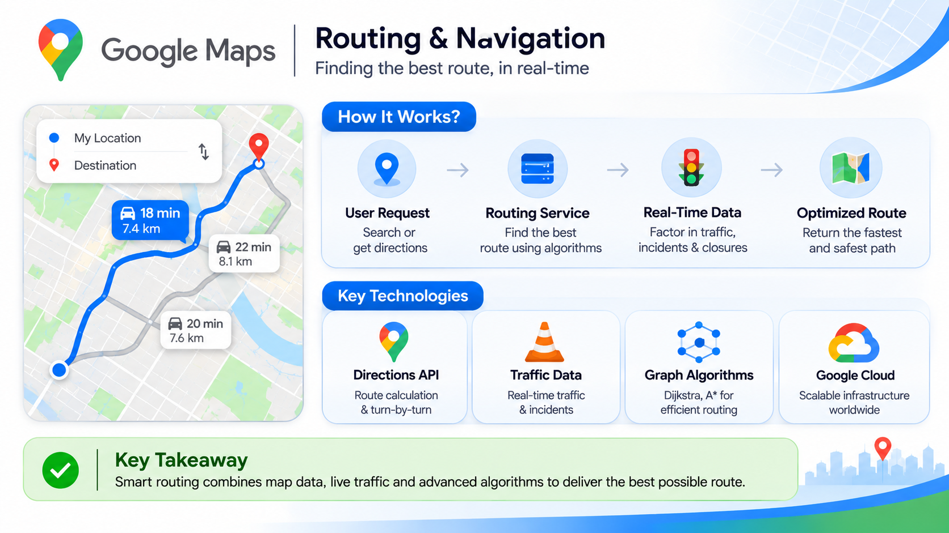
Routing & Navigation
Finding the best route, in real-time
How it works
User Request
Routing Service
Real-Time Data
Optimized Route
Search or get directions
Find the best route using algorithms
Factor in traffic, incidents & closures
Return the fastest and safest path
Key Technologies
Directions API
Traffic Data
Graph Algorithms
Google Cloud
Route calculation & turn-by-turn
Real-time traffic & incidents
Dijkstra, A* for efficient routing
Scalable infrastructure worldwide
Notes:
After understanding how geographic data is stored and indexed, let's look at how Google Maps uses that data to provide navigation.
When a user enters a destination, the request is sent to the routing service. The routing service analyzes the available road network and calculates possible routes.
This process relies on graph algorithms. Roads are represented as edges, while intersections and locations are represented as nodes. Algorithms such as Dijkstra's and A* help find efficient paths through this network.
However, the shortest route is not always the fastest route. That's why real-time information is important.
The system considers traffic congestion, road closures, and incidents to adjust route costs and estimate travel times.
Finally, it returns an optimized route with estimated arrival time, distance, and turn-by-turn directions.
The key idea is that modern navigation combines geographic data, graph algorithms, and real-time traffic intelligence to provide efficient routes.

Slide 7
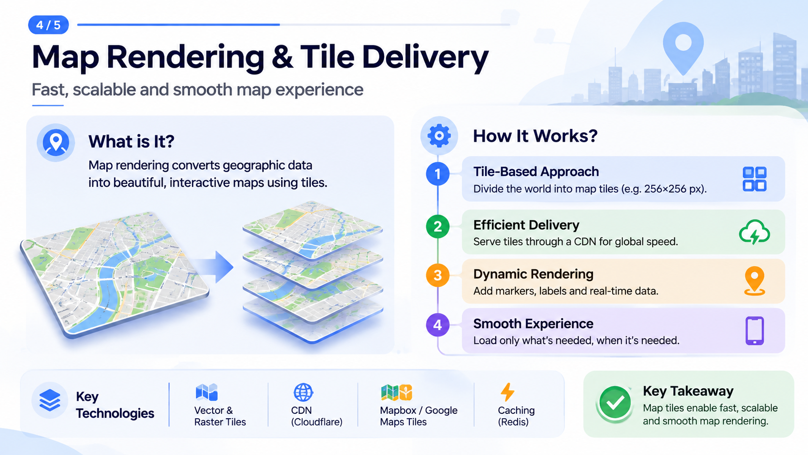
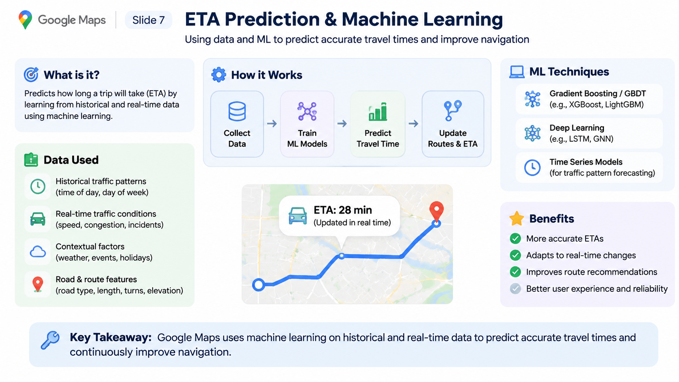
Map Rendering & Tile Delivery
Fast, scalable and smooth map experience
What Is It?
How It Works
Map rendering converts geographic data into beautiful, interactive maps using tiles.
Tile-Based Approach
Divide the world into map tiles (e.g. 256×256 px).
Efficient Delivery
Serve tiles through a CDN for global speed.
Dynamic Rendering
Add markers, labels and real-time data.
Smooth Experience
Load only what’s needed, when it’s needed.
Key
Technologies
Vector &
Raster Tiles
CDN
(Cloudflare)
Mapbox / Google
Maps Tiles
Caching
(Redis)
Notes:
Now let's understand how Google Maps displays such a massive geographic area smoothly and efficiently.
Instead of downloading the entire world map at once, the system divides the map into smaller square sections called map tiles.
Each tile represents a specific geographic area at a particular zoom level. When a user zooms in or moves the map, the application requests only the tiles needed for the visible screen.
These tiles are generated from geographic data and delivered through distributed storage and Content Delivery Networks, or CDNs. Caching allows frequently requested tiles to be served quickly from servers closer to users.
There are two major types of map tiles: raster tiles, which are pre-rendered images, and vector tiles, which contain geographic features that can be styled and rendered on the client device.
The client combines these individual tiles to create one continuous map experience.
The key idea is that tile-based delivery reduces unnecessary data transfer, improves loading speed, and makes global map rendering scalable.

Slide 8
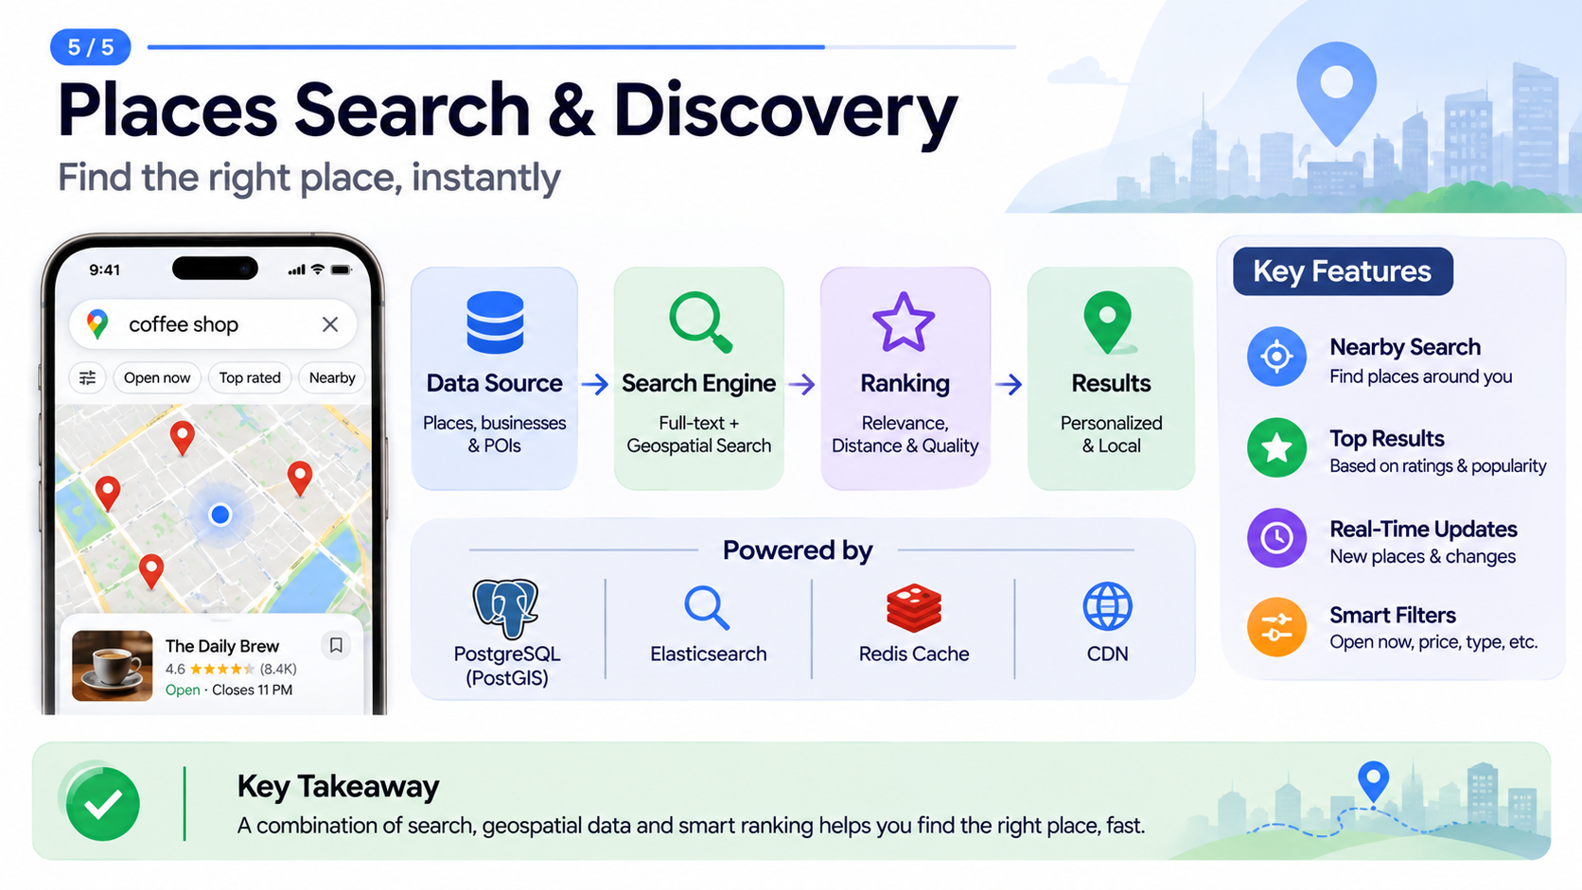
Places Search & Discovery
Find the right place, instantly
Key Features
Nearby Search
Find places around you
Top Results
Data Source
Search Engine
Ranking
Results
Based on ratings & popularity
Places, businesses & POIs
Full-text + Geospatial Search
Relevance, Distance & Quality
Personalized & Local
Real-Time Updates
New places & changes
Smart Filters
Open now, price, type, etc.
Notes:
Google Maps uses a combination of geospatial data and search technology to help users find places. First, place information is collected and stored in databases. Then, a search engine processes the user's query and finds relevant locations. A ranking system sorts the results based on distance, relevance, ratings, and popularity. Finally, users receive personalized local results with filters such as open now, price, and top rated.
The main idea is that combining search, location data, and intelligent ranking makes place discovery fast and useful.

Slide 9
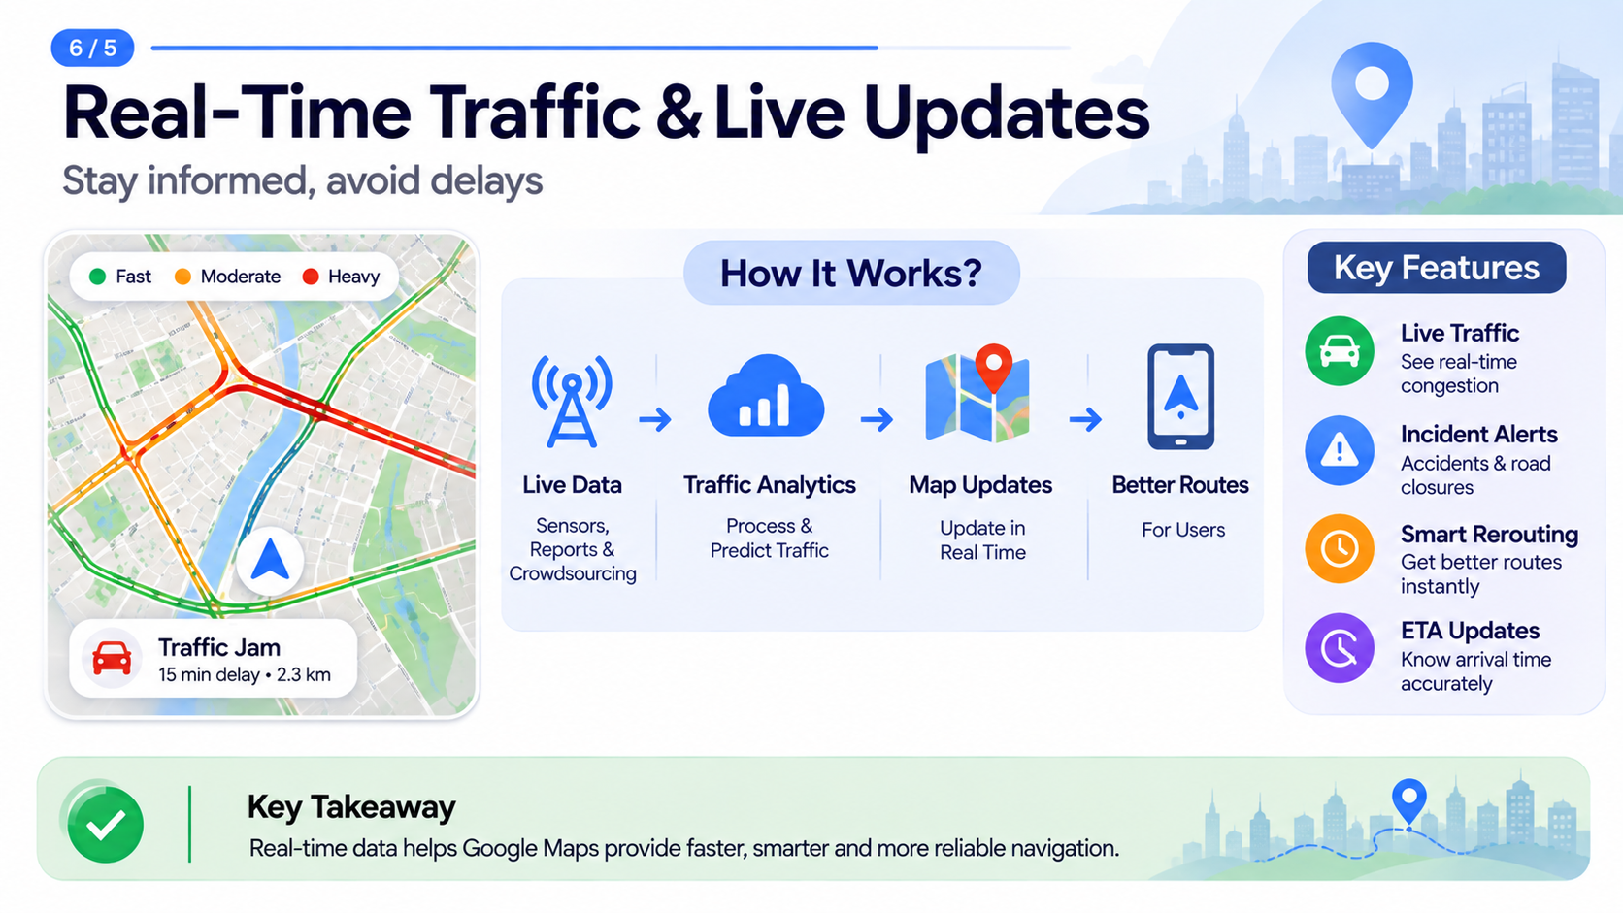
Real-Time Traffic & Live Updates
Stay informed, avoid delays
How It Works
Key Features
Live Traffic
See real-time
congestion
Incident Alerts
Live Data
Traffic Analytics
Map Updates
Better Routes
Accidents & road
closures
Sensors,
Reports &
Crowdsourcing
Process &
Predict Traffic
Update in
Real Time
For Users
Smart Rerouting
Get better routes
instantly
ETA Updates
Know arrival time
accurately
Notes:
Google Maps continuously collects traffic information from multiple sources, including GPS signals, road sensors, and user reports. This data is processed to identify congestion, accidents, and road closures. The system then updates traffic conditions and recalculates routes when better alternatives are available. It also adjusts estimated arrival times based on current road conditions.
The key idea is that real-time data helps Google Maps provide faster and more reliable navigation.

Slide 10
ETA Prediction & Machine Learning
Using data and ML to predict accurate travel times and improve navigation
How It Works
Collect
Data
Train
ML Models
Predict
Travel Time
Update
Routes & ETA
ML Techniques
Gradient Boosting / GBDT
(e.g., XGBoost, LightGBM)
Data Used
Deep Learning
(e.g., LSTM, GNN)
Historical traffic patterns
(time of day, day of week)
Time Series Models
(for traffic pattern forecasting)
Real-time traffic conditions
(speed, congestion, incidents)
Contextual factors
(weather, events, holidays)
Road & route features
(road type, length, turns, elevation)
Notes:
Google Maps uses machine learning to predict how long a journey will take. It analyzes historical traffic patterns, current road conditions, weather, special events, and road characteristics.
This information is processed by machine learning models to estimate travel time. Techniques such as Gradient Boosting and Deep Learning can help identify complex traffic patterns.
As traffic conditions change, the system updates estimated arrival times and can recommend alternative routes.
The main objective is to provide accurate ETAs and make navigation more reliable.

Slide 11
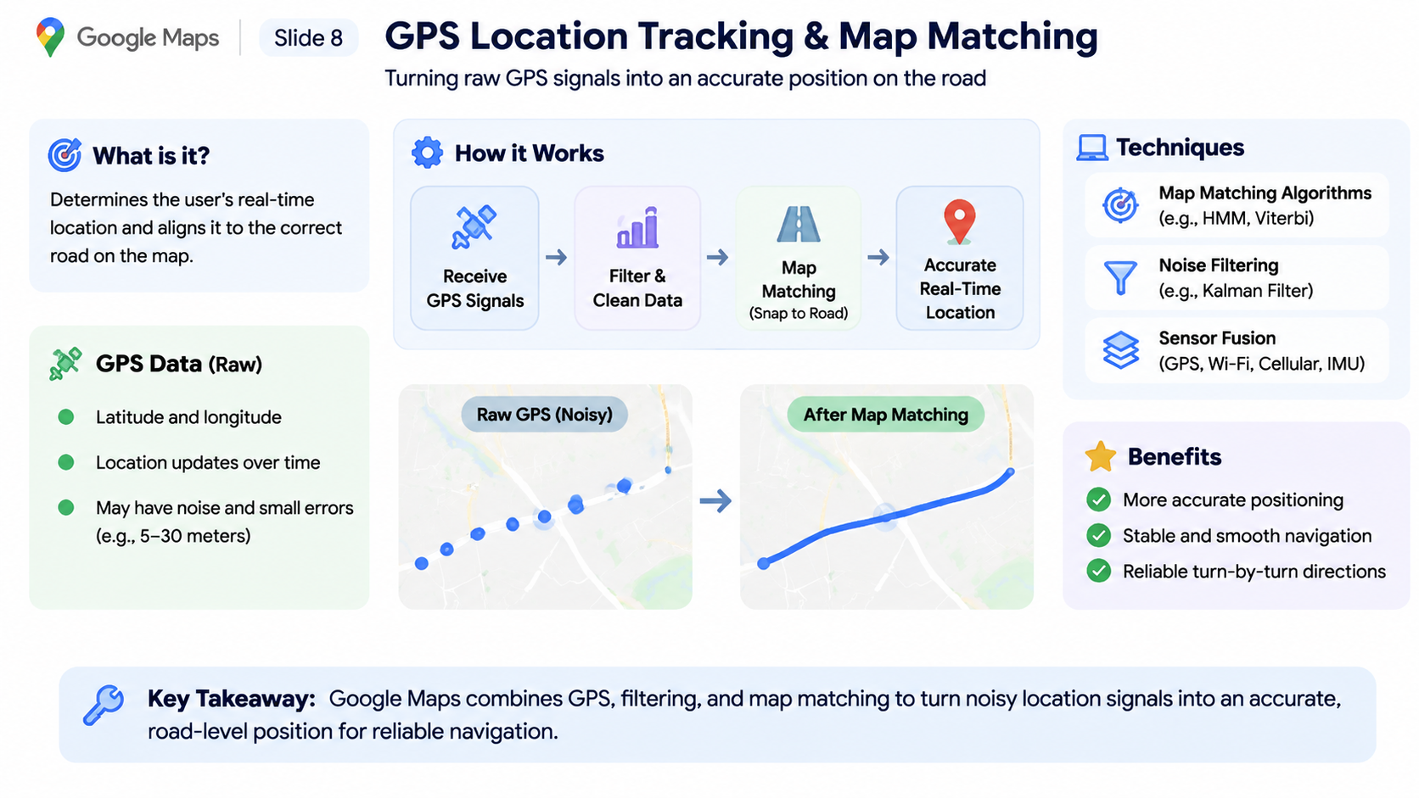
GPS Location Tracking & Map Matching
Turning raw GPS signals into an accurate position on the road
How It Works
Receive
GPS Signals
Filter &
Clean Data
Map
Matching
(Snap to Road)
Accurate
Real-Time
Location
Techniques
Map Matching Algorithms
(e.g., HMM, Viterbi)
GPS Data (Raw)
Noise Filtering
(e.g., Kalman Filter)
Latitude and longitude
Sensor Fusion
(GPS, Wi-Fi, Cellular, IMU)
Location updates over time
May have noise and small errors
(e.g., 5–30 meters)
Notes:
Google Maps needs to know the user's exact position while they are moving. However, GPS signals are not always perfectly accurate and may contain errors due to buildings, tunnels, or weak signals.
To improve accuracy, the system collects GPS coordinates and applies filtering techniques to reduce noise. It then uses map matching algorithms to align the user's estimated position with the most likely road on the digital map.
Techniques such as Hidden Markov Models, Viterbi algorithms, and sensor fusion help improve location accuracy.
The result is smoother navigation, more reliable positioning, and accurate turn-by-turn directions.

Slide 12
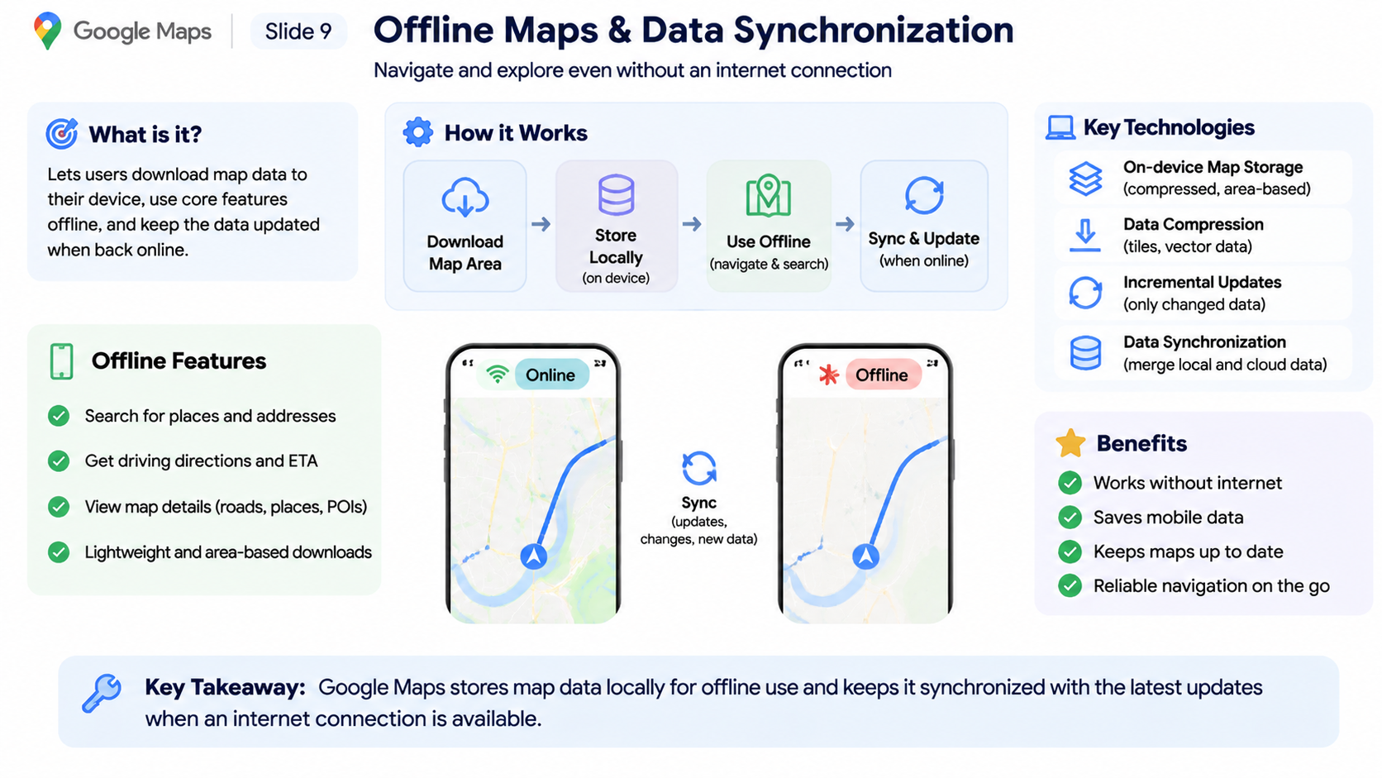
Offline Maps & Data Synchronization
Navigate and explore even without an internet connection
How It Works
Download
Map Area
Store
Locally
(on device)
Use Offline
(navigate & search)
Sync & Update
(when online)
Key Technologies
On-device Map Storage
(compressed, area-based)
Data Compression
(tiles, vector data)
Offline Features
Incremental Updates
(only changed data)
Search for places and addresses
Data Synchronization
(merge local and cloud data)
Get driving directions and ETA
Sync
(updates, changes, new data)
View map details (roads, places, POIs)
Lightweight and area-based downloads
Notes:
Google Maps supports offline functionality by allowing users to download geographic map data directly to their devices.
The downloaded data is stored locally, allowing users to access supported map features even without an internet connection.
When the device reconnects to the internet, the application can synchronize available updates and refresh its stored map information.
This approach reduces mobile data consumption and makes navigation more reliable in areas with poor network connectivity.
The key idea is to combine local storage with cloud synchronization to provide a continuous mapping experience.

Slide 13
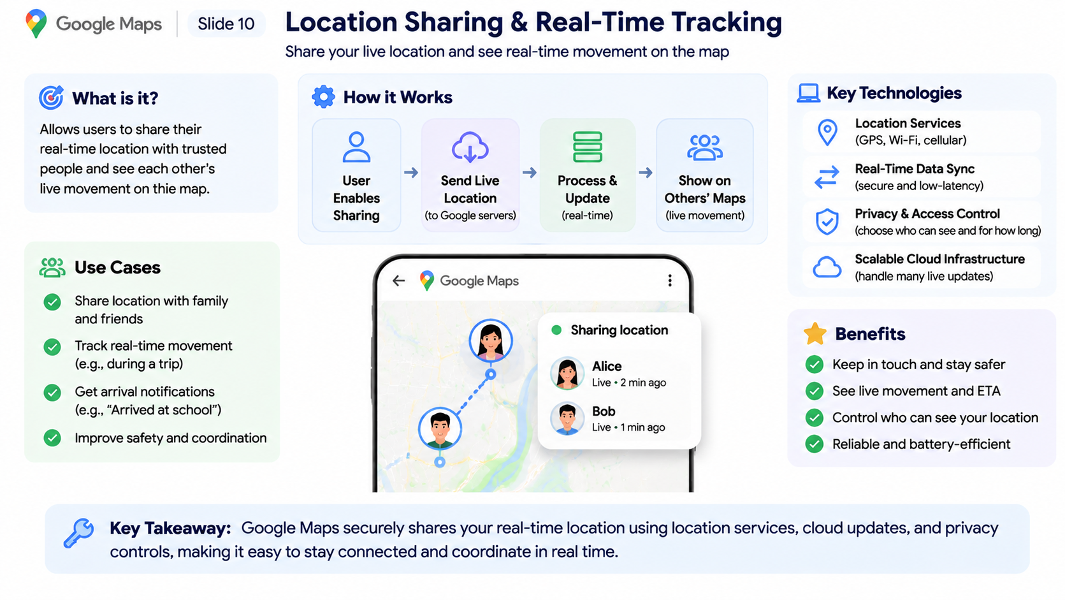
Location Sharing & Real-Time Tracking
Share your live location and see real-time movement on the map
Key Technologies
How It Works
Location Services
(GPS, Wi-Fi, cellular)
Real-Time Data Sync
(secure and low-latency)
User Enables Sharing
Send Live Location
(to Google servers)
Process & Update
(real-time)
Show on Others’ Maps
(live movement)
Privacy & Access Control
(choose who can see and for how long)
Scalable Cloud Infrastructure
(handle many live updates)
Notes:
Google Maps allows users to share their real-time location with selected people. Once location sharing is enabled, the device collects location information using GPS and other positioning technologies.
These updates are securely transmitted to backend services, processed, and made available to authorized users on their maps.
The system continuously updates shared positions so people can see movement and estimated arrival times. Users can also control who sees their location and how long sharing remains active.
This feature is useful for coordinating meetings, tracking journeys, and improving personal safety.
The key idea is to combine real-time location services, cloud synchronization, and privacy controls to enable reliable location sharing.

Slide 14
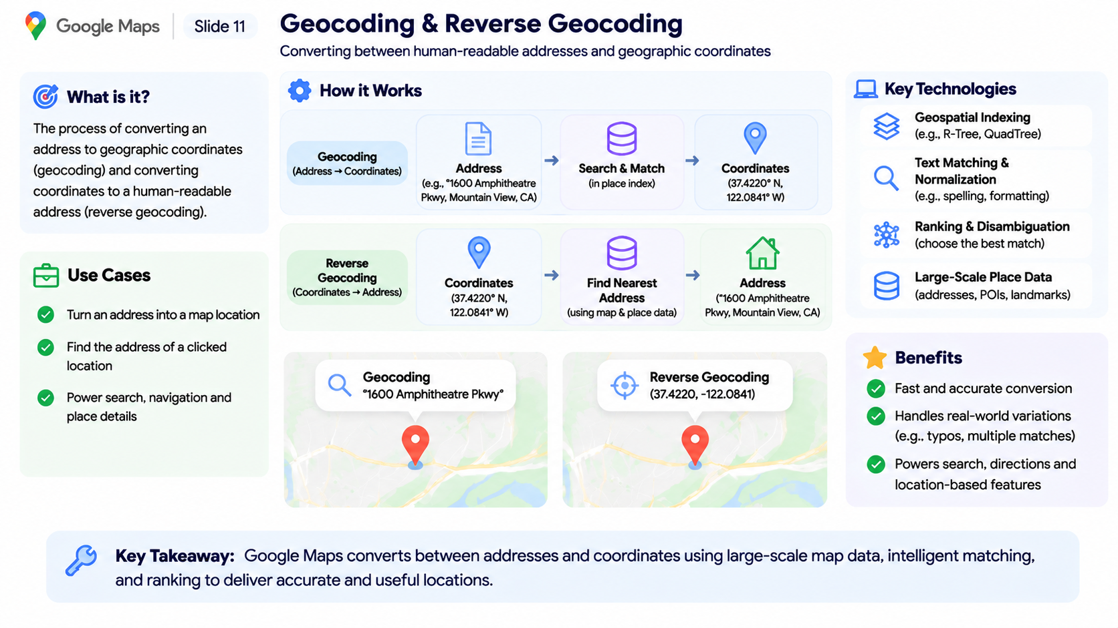
Geocoding & Reverse Geocoding
Converting between human-readable addresses and geographic coordinates
How It Works
Key Technologies
Geospatial Indexing
(e.g., R-Tree, QuadTree)
Geocoding
Address
Search & Match
Coordinates
Text Matching & Normalization
(e.g., spelling, formatting)
Ranking & Disambiguation
(choose the best match)
Reverse Geocoding
Coordinates
Find Nearest Address
Address
Large-Scale Place Data
(addresses, POIs, landmarks)
Notes:
Geocoding and reverse geocoding are two important services in Google Maps that connect human-readable addresses with geographic coordinates.
Geocoding converts a physical address into latitude and longitude. For example, when a user searches for a particular street address, the system identifies its geographic coordinates and displays the corresponding location on the map.
Reverse geocoding performs the opposite operation. When a user clicks on a location on the map, the system uses its coordinates to identify the corresponding readable address.
To perform these operations efficiently, the system uses large-scale geographic databases, spatial indexing, text matching, and ranking algorithms.
These services are essential for location search, navigation, address lookup, and many other location-based applications.
The key takeaway is that geocoding connects textual addresses with geographic locations, making location-based services possible.
Now that we understand how Google Maps identifies and converts locations, let's explore the cloud infrastructure that connects all these services and allows the platform to operate at a global scale.

Slide 15
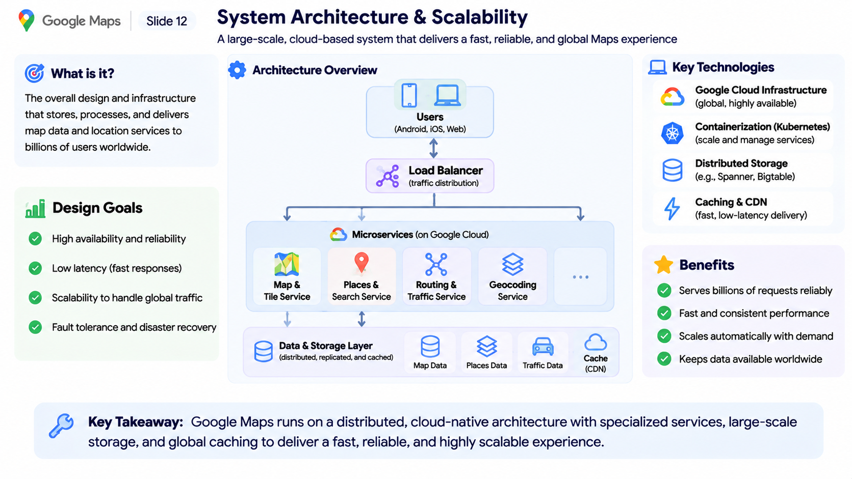

System Architecture & Scalability
A cloud-based system that delivers a fast, reliable, global Maps experience
Architecture Overview
Users
(Android, iOS, Web)
Key Technologies
Google Cloud Infrastructure
(global, highly available)
Load Balancer
(traffic distribution)
Containerization (Kubernetes)
(scale and manage services)
Microservices (on Google Cloud)
Distributed Storage
(e.g., Spanner, Bigtable)
•••
Caching & CDN
(fast, low-latency delivery)
Map &
Tile Service
Places &
Search Service
Routing &
Traffic Service
Geocoding
Service
Data & Storage Layer
(distributed, replicated, and cached)
Map Data
Places Data
Traffic Data
Cache
(CDN)
Notes:
Google Maps operates on a large-scale distributed cloud architecture designed to serve millions of users simultaneously across the world.
Users access the platform through web and mobile applications. Their requests pass through load balancers, which distribute incoming traffic across multiple backend services.
The system uses a microservices architecture, where different services handle specific responsibilities, such as map rendering, place search, routing, and geocoding.
These services communicate with distributed storage systems that maintain geographic, place, and traffic information.
To improve performance, caching and Content Delivery Networks reduce response times by serving frequently requested data closer to users.
The architecture also focuses on high availability, fault tolerance, and automatic scalability to handle changing workloads.
The key idea is that distributed cloud infrastructure allows a mapping platform to deliver reliable performance at global scale.

Slide 16
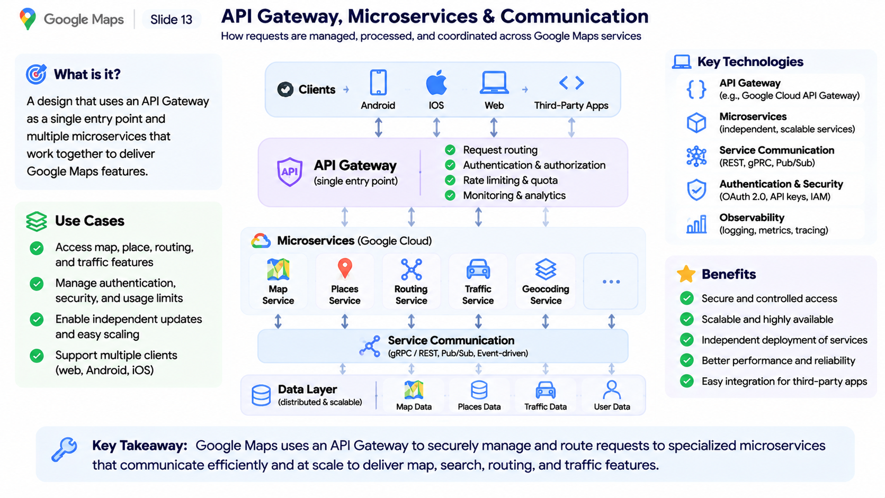
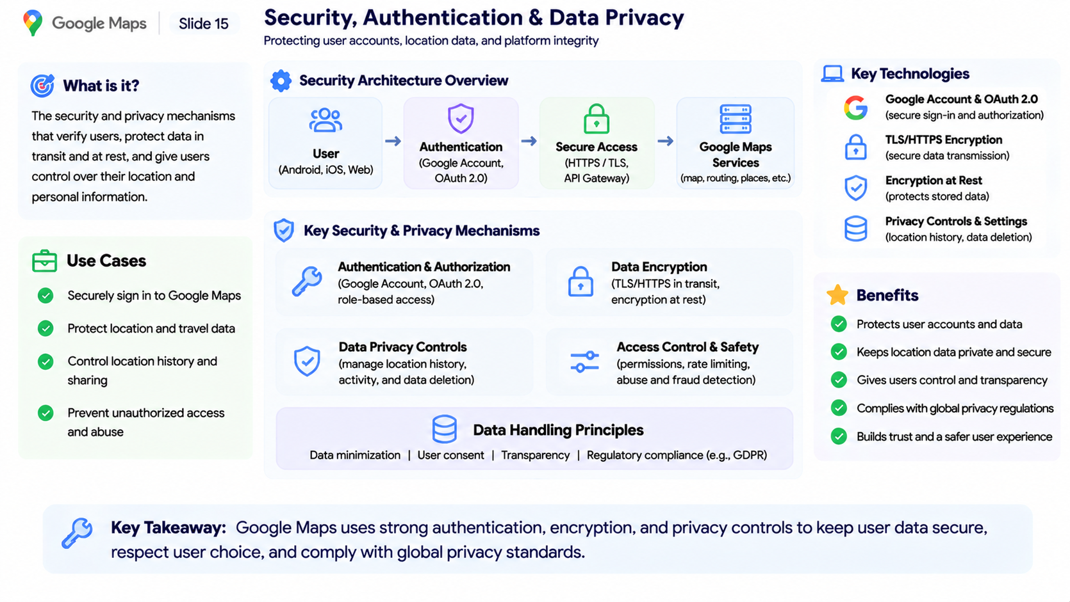
API Gateway, Microservices & Communication
How requests are managed, processed, and coordinated across Google Maps services
Clients
Android
iOS
Web
Third-Party Apps
Request routing
Key Technologies
API Gateway
(single entry point)
Authentication & authorization
API Gateway
(e.g., Google Cloud API Gateway)
Rate limiting & quota
Monitoring & analytics
Microservices
(independent, scalable services)
Microservices (Google Cloud)
Service Communication
(REST, gRPC, Pub/Sub)
•••
Authentication & Security
(OAuth 2.0, API keys, IAM)
Map
Service
Places
Service
Routing
Service
Traffic
Service
Geocoding
Service
Observability
(logging, metrics, tracing)
Service Communication
(gRPC / REST, Pub/Sub, Event-driven)
Data Layer
(distributed & scalable)
Map Data
Places Data
Traffic Data
User Data
Notes:
Google Maps uses an API Gateway and microservices architecture to manage communication between its client applications and backend systems.
When a user makes a request, such as searching for a location or requesting directions, the request first passes through the API Gateway.
The gateway handles authentication, authorization, rate limiting, and request routing. It then forwards the request to the appropriate backend microservice.
For example, map rendering requests go to the Map Service, location searches go to the Places Service, and navigation requests go to the Routing Service.
These services communicate through different mechanisms, including REST APIs, gRPC, and asynchronous messaging.
The biggest advantage of this architecture is that each service can be developed, deployed, and scaled independently without requiring changes to the entire system.
The key idea is that API Gateways and microservices make complex distributed applications easier to manage, secure, and scale.

Slide 17
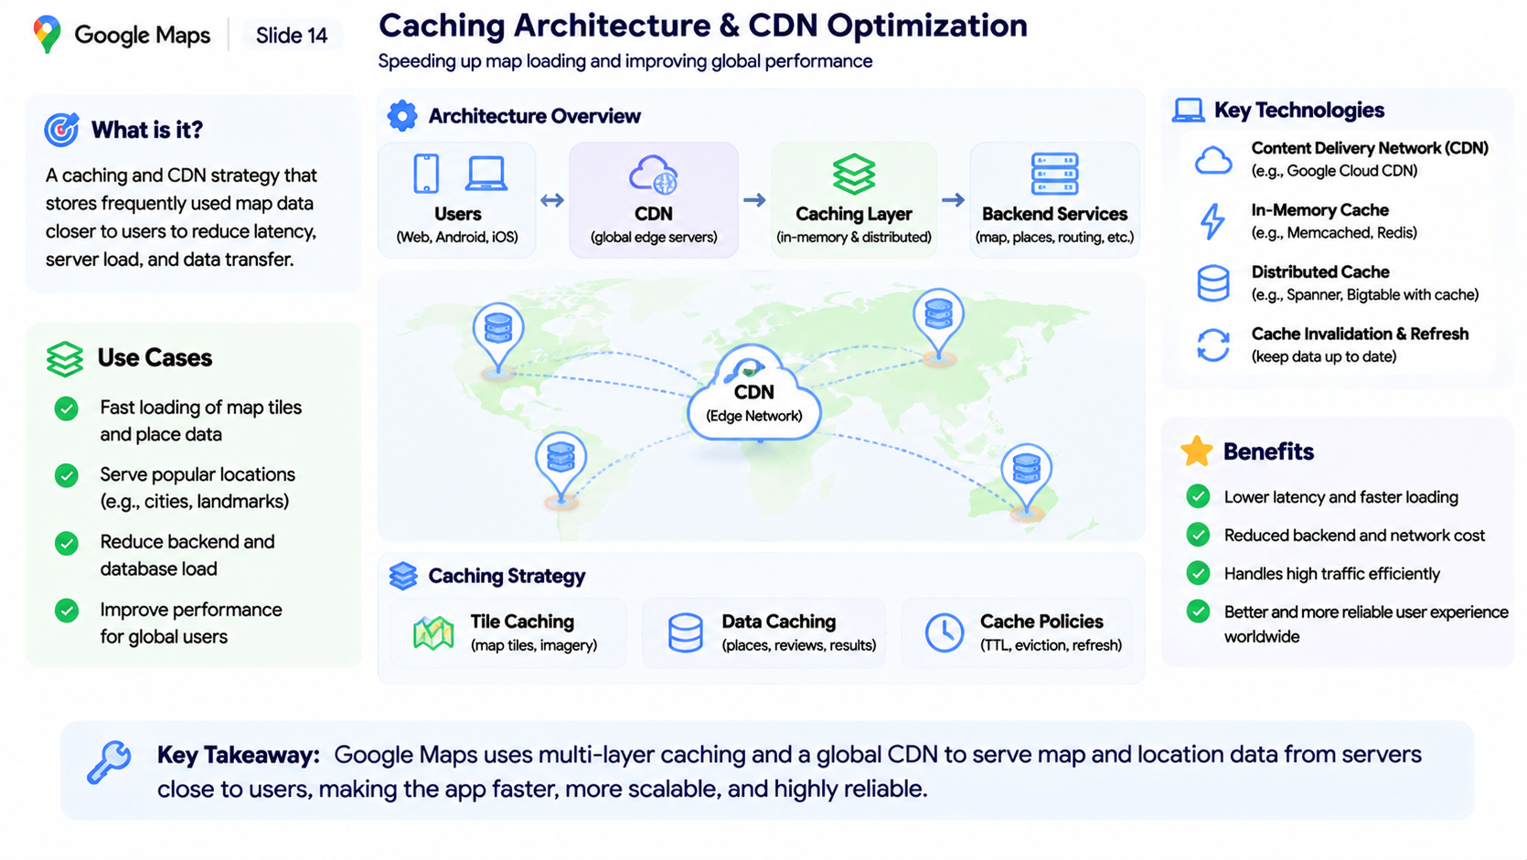
Caching Architecture & CDN Optimization
Speeding up map loading and improving global performance
Architecture Overview
Users
(Web, Android, iOS)
CDN
(global edge servers)
Caching Layer
(in-memory & distributed)
Backend Services
(map, places, routing, etc.)
Key Technologies
Content Delivery Network (CDN)
(e.g., Google Cloud CDN)
CDN
(Edge Network)
In-Memory Cache
(e.g., Memcached, Redis)
Distributed Cache
(e.g., Spanner, Bigtable with cache)
Cache Invalidation & Refresh
(keep data up to date)
Caching Strategy
Tile Caching
(map tiles, imagery)
Data Caching
(places, reviews, results)
Cache Policies
(TTL, eviction, refresh)
Notes:
Google Maps needs to deliver map data quickly to users around the world. To achieve this, it uses caching techniques and Content Delivery Networks.
A CDN distributes cached content across geographically distributed edge servers. When a user requests map tiles or other frequently accessed data, the system can serve that content from a nearby server instead of repeatedly accessing the central backend.
The architecture also uses different caching layers, including in-memory caches and distributed caches, to store frequently requested information such as map tiles, place details, and search results.
Cache policies such as expiration time and invalidation ensure that outdated information can be refreshed.
This reduces network latency, database load, and infrastructure costs while improving the user experience.
The key idea is that caching and CDNs make global map services faster, more efficient, and more scalable.

Slide 18
Security, Authentication & Data Privacy
Protecting user accounts, location data, and platform integrity
Security Architecture Overview
User
(Android, iOS, Web)
Authentication
(Google Account, OAuth 2.0)
Secure Access
(HTTPS / TLS, API Gateway)
Google Maps Services
(map, routing, places, etc.)
Key Technologies
Google Account & OAuth 2.0
(secure sign-in and authorization)
Key Security & Privacy Mechanisms
TLS/HTTPS Encryption
(secure data transmission)
Authentication & Authorization
(Google Account, OAuth 2.0, role-based access)
Data Encryption
(TLS/HTTPS in transit, encryption at rest)
Encryption at Rest
(protects stored data)
Privacy Controls & Settings
(location history, data deletion)
Data Privacy Controls
(manage location history, activity, and data deletion)
Access Control & Safety
(permissions, rate limiting, abuse and fraud detection)
Data Handling Principles
Data minimization | User consent | Transparency | Regulatory compliance (e.g., GDPR)
Notes:
Security and data privacy are essential parts of Google Maps because the platform handles sensitive information, including user accounts, location history, and travel activities.
When users access Google Maps, authentication mechanisms verify their identity and authorization determines which resources they can access.
Data transmitted between applications and backend services is protected using HTTPS and TLS encryption. Sensitive stored information also requires appropriate protection.
Google Maps provides privacy controls that allow users to manage location history, location sharing, and personal data settings.
The system also uses access controls and security monitoring to reduce unauthorized access and potential abuse.
The key idea is that strong authentication, encryption, and privacy controls help protect users and maintain trust in the platform.

Slide 19
Bottlenecks, Failures & Trade-offs
Where the system strains and what we give up
Bottlenecks
Failures and responses
Trade-offs
Hot tiles in busy cities at rush hour
Route search over very large road graphs
Fan-out of live location updates
Region outage: fail over to another region
Slow service: timeouts, retries, circuit breakers
Bad data release: staged rollout and rollback
Freshness vs cost: cache longer, show older data
Accuracy vs speed: approximate routes for instant answers
Consistency vs availability: favor availability for map reads
Notes:
Finally, this slide brings together all the major components of the Google Maps system architecture that we have explored throughout this presentation.
The process starts with users accessing Google Maps through web and mobile applications. Their requests pass through the API Gateway, which manages authentication, security, and request routing.
The system then distributes these requests across specialized microservices, including Map Services, Places Services, Routing Services, and Geocoding Services.
Behind these services, the data and intelligence layer manages geographic information, satellite imagery, GPS signals, traffic data, and AI-powered analysis.
A continuous data pipeline collects, processes, validates, and updates geographic information to keep the map accurate.
All these components operate on distributed cloud infrastructure supported by caching, CDNs, monitoring, and fault-tolerant systems.
Together, these technologies provide real-time navigation, location discovery, traffic intelligence, and reliable map services at global scale.
The most important takeaway is that Google Maps is not simply a mapping application. It is a massive, intelligent, distributed system that combines geospatial engineering, artificial intelligence, real-time data processing, and cloud computing.

Slide 20
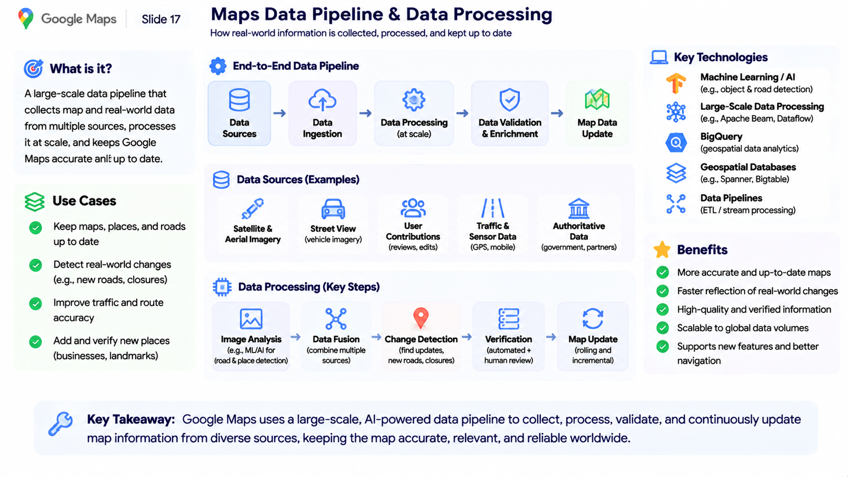
Maps Data Pipeline & Data Processing
How real-world information is collected, processed, and kept up to date
End-to-End Data Pipeline
Data
Sources
Data
Ingestion
Data Processing
(at scale)
Data Validation
& Enrichment
Map Data
Update
Key Technologies
Machine Learning / AI
(e.g., object & road detection)
Data Sources (Examples)
Large-Scale Data Processing
(e.g., Apache Beam, Dataflow)
BigQuery
(geospatial data analytics)
Satellite &
Aerial Imagery
Street View
(vehicle imagery)
User
Contributions
(reviews, edits)
Traffic &
Sensor Data
(GPS, mobile)
Authoritative
Data
(government, partners)
Geospatial Databases
(e.g., Spanner, Bigtable)
Data Pipelines
(ETL / stream processing)
Data Processing (Key Steps)
Image Analysis
(e.g., ML/AI for
road & place detection)
Data Fusion
(combine multiple
sources)
Change Detection
(find updates,
new roads, closures)
Verification
(automated +
human review)
Map Update
(rolling and
incremental)
Notes:
Google Maps relies on a massive data pipeline to keep its geographic information accurate and up to date.
The system collects data from multiple sources, including satellite imagery, Street View, GPS signals, user contributions, and official geographic records.
This information enters the data ingestion layer, where it is collected and prepared for processing.
Large-scale processing systems then analyze the data using machine learning and image recognition techniques to identify roads, buildings, businesses, and changes in the real world.
After processing, the information goes through validation and enrichment to improve accuracy and consistency.
Finally, verified changes are integrated into the map database through continuous updates.
The key idea is that Google Maps is not a static map. It is a continuously updated geographic information system powered by large-scale data processing and AI.

Slide 21
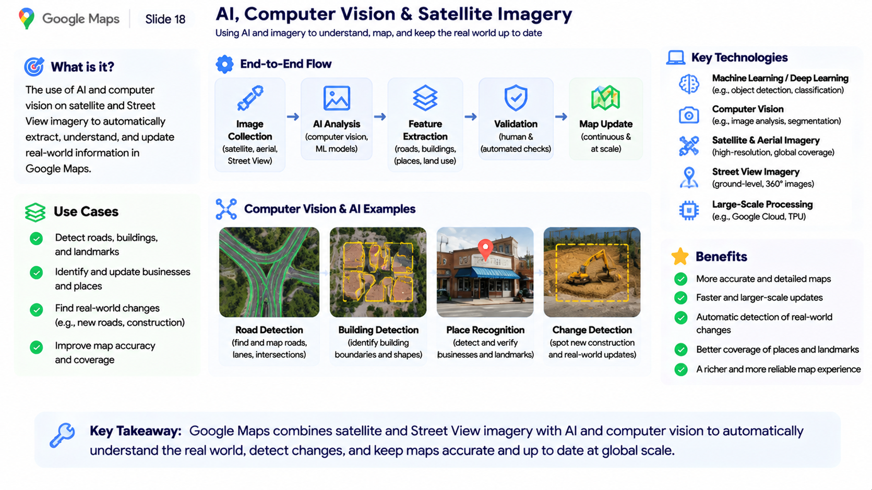
AI, Computer Vision & Satellite Imagery
Using AI and imagery to understand, map, and keep the real world up to date
End-to-End Flow
Image
Collection
(satellite, aerial,
Street View)
AI Analysis
(computer vision,
ML models)
Feature
Extraction
(roads, buildings,
places, land use)
Validation
(human &
automated checks)
Map Update
(continuous &
at scale)
Key Technologies
Machine Learning / Deep Learning
(e.g., object detection, classification)
Computer Vision
(e.g., image analysis, segmentation)
Computer Vision & AI Examples
Satellite & Aerial Imagery
(high-resolution, global coverage)
Street View Imagery
(ground-level, 360° images)
Large-Scale Processing
(e.g., Google Cloud, TPU)
Road Detection
(find and map roads,
lanes, intersections)
Building Detection
(identify building
boundaries and shapes)
Place Recognition
(detect and verify
businesses and landmarks)
Change Detection
(spot new construction
and real-world updates)
Notes:
Google Maps uses artificial intelligence and computer vision to understand the physical world and keep its maps updated.
The system collects images from satellite imagery, aerial photography, and Street View.
These images are processed using machine learning and computer vision models to identify important geographic features.
For example, AI can detect roads, buildings, intersections, businesses, and landmarks. It can also identify changes in the real world, such as new roads, construction, or modified buildings.
The extracted information goes through validation before being integrated into the geographic database.
This allows Google Maps to improve map accuracy, expand geographic coverage, and reflect real-world changes more efficiently.
The key idea is that AI transforms massive amounts of visual information into structured geographic data.

Slide 22
Key Lessons & Sources
What to take away, and where to read more
References
[1] Derrow-Pinion et al. (2021). ETA Prediction with Graph Neural Networks in Google Maps. CIKM. arxiv.org/abs/2108.11482
[2] Newson & Krumm (2009). Hidden Markov Map Matching Through Noise and Sparseness. ACM SIGSPATIAL. microsoft.com/en-us/research/publication/hidden-markov-map-matching-noise-sparseness
[3] Geisberger et al. (2012). Exact Routing in Large Road Networks Using Contraction Hierarchies. Transportation Science. doi.org/10.1287/trsc.1110.0401
[4] Hart, Nilsson & Raphael (1968). A Formal Basis for the Heuristic Determination of Minimum Cost Paths. IEEE. doi.org/10.1109/TSSC.1968.300136
[5] Bast et al. (2016). Route Planning in Transportation Networks. Algorithm Engineering, Springer. arxiv.org/abs/1504.05140
[6] Chang et al. (2008). Bigtable: A Distributed Storage System for Structured Data. ACM TOCS. doi.org/10.1145/1365815.1365816
[7] Corbett et al. (2013). Spanner: Google's Globally Distributed Database. ACM TOCS. doi.org/10.1145/2491245
[8] Dean & Barroso (2013). The Tail at Scale. Communications of the ACM. doi.org/10.1145/2408776.2408794
Notes:
Finally, this slide brings together all the major components of the Google Maps system architecture that we have explored throughout this presentation.
The process starts with users accessing Google Maps through web and mobile applications. Their requests pass through the API Gateway, which manages authentication, security, and request routing.
The system then distributes these requests across specialized microservices, including Map Services, Places Services, Routing Services, and Geocoding Services.
Behind these services, the data and intelligence layer manages geographic information, satellite imagery, GPS signals, traffic data, and AI-powered analysis.
A continuous data pipeline collects, processes, validates, and updates geographic information to keep the map accurate.
All these components operate on distributed cloud infrastructure supported by caching, CDNs, monitoring, and fault-tolerant systems.
Together, these technologies provide real-time navigation, location discovery, traffic intelligence, and reliable map services at global scale.
The most important takeaway is that Google Maps is not simply a mapping application. It is a massive, intelligent, distributed system that combines geospatial engineering, artificial intelligence, real-time data processing, and cloud computing.

Slide 23
Key lessons
Thank You
1
Cache first: most requests should never reach a service.
Questions and discussion
2
Split into small services that scale independently.
3
Design for failure in every region.
Google Maps system design
4
Treat data freshness as a product choice with a cost.

