Slide 1
PISA 2018: Interactive Visualizations
Dynamic Exploration with Plotly

Slide 2
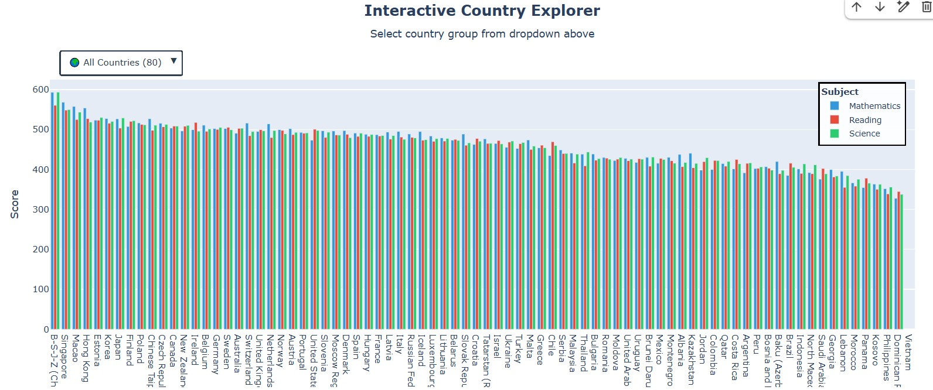
Interactive Plot 1: Country Performance Explorer
Dropdown menu allows filtering: All Countries (80), Top 10, Top 20, or Greece vs Top 5. Compare Math (blue),
Reading (red), and Science (green) scores interactively.

Slide 3
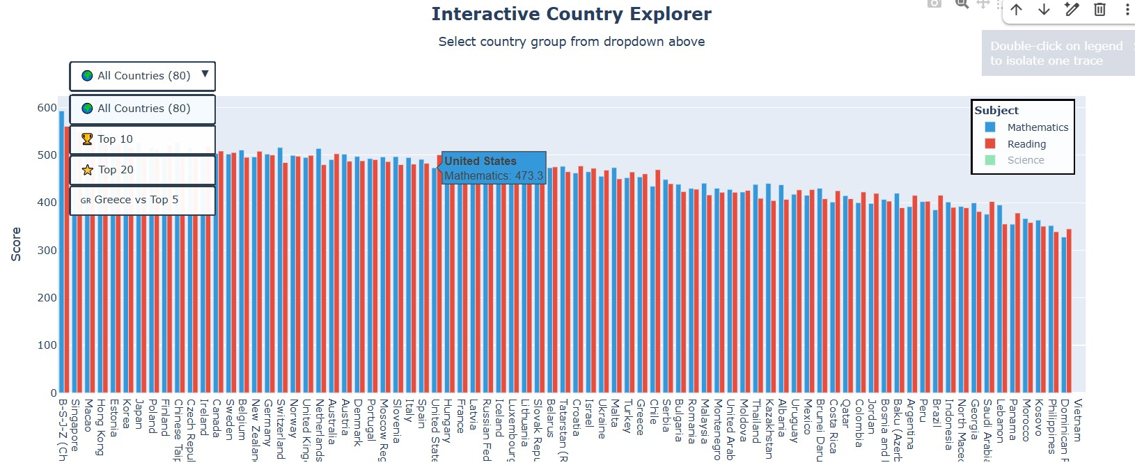
Interactive Plot 1: Filtered View Example
Example showing filtered country groups. Interactive hover displays exact scores. Toggle subjects on/off by
clicking legend items.

Slide 4
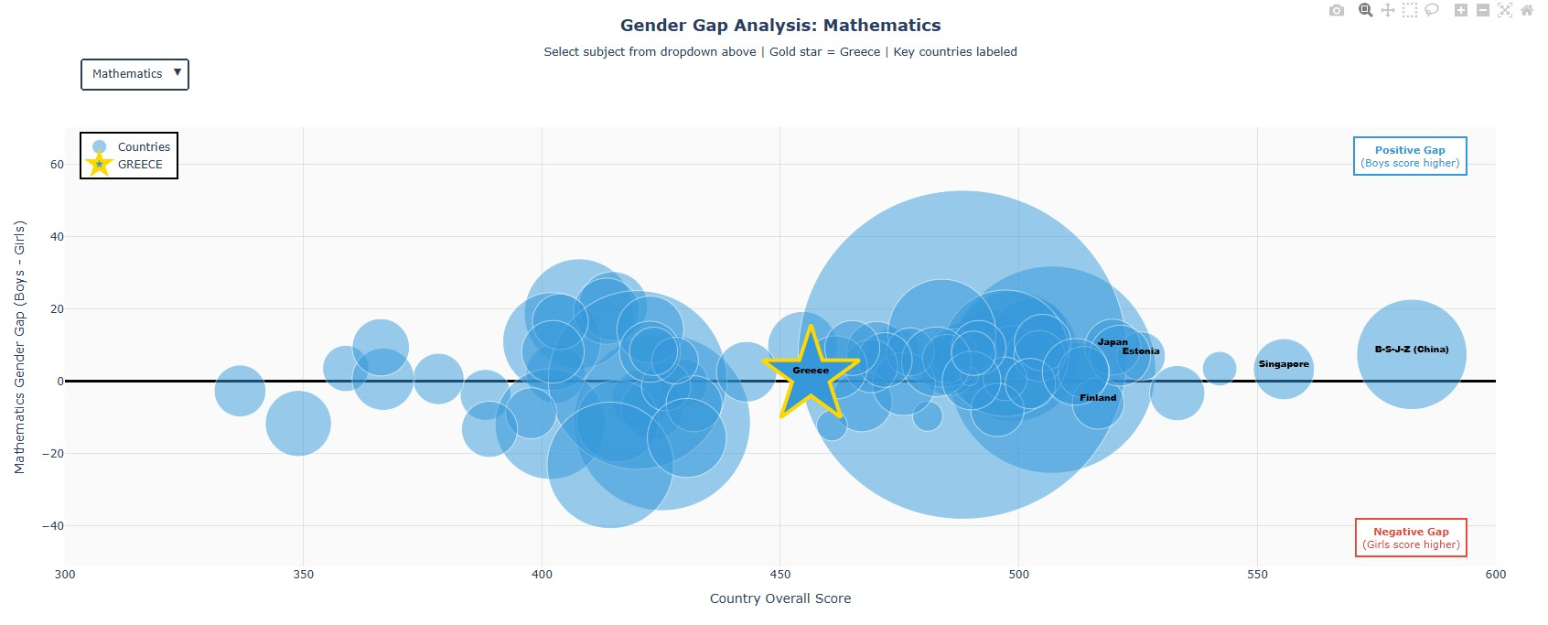
Interactive Plot 2: Gender Gap - Mathematics
Bubble scatter plot showing relationship between country performance and gender gaps. Greece highlighted as
gold star. Bubble size = number of students tested.

Slide 5
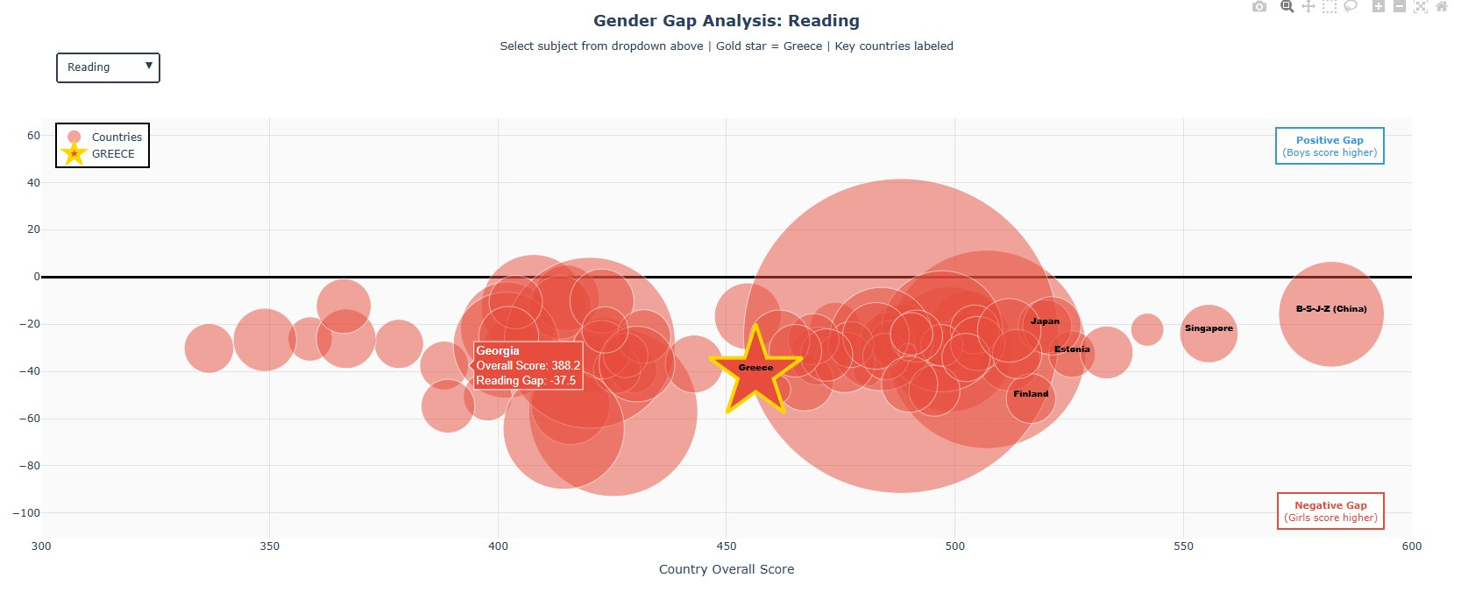
Interactive Plot 2: Gender Gap - Reading
Reading shows largest gender gaps globally. Girls consistently outperform boys across most countries.
Dropdown allows switching between subjects dynamically.

Slide 6
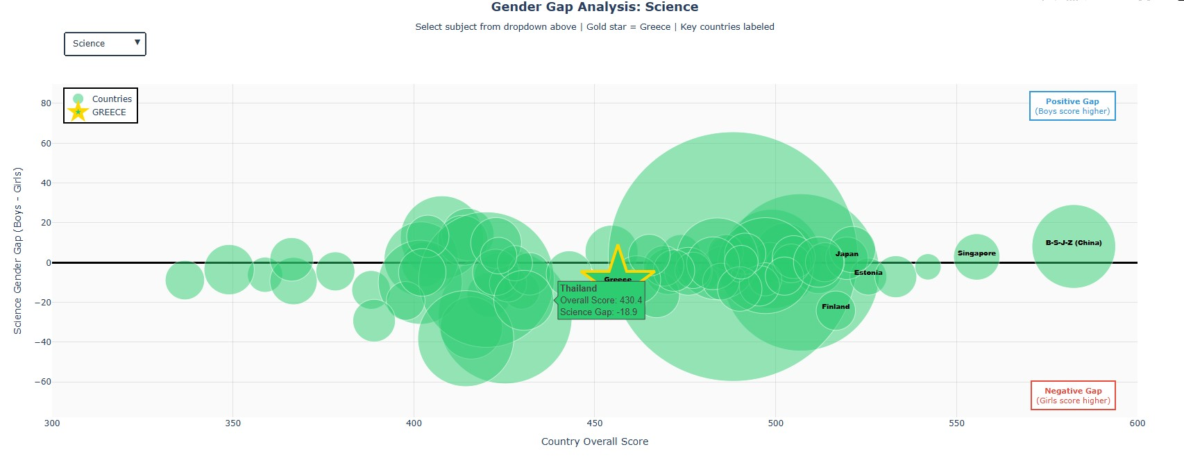
Interactive Plot 2: Gender Gap - Science
Science shows mixed patterns - some countries favor boys, others favor girls. Zero line (black) indicates equal
performance. Above = boys ahead, below = girls ahead.

Slide 7
Interactive Features
Plot 1: Country Performance Explorer
- Dropdown filters: All Countries / Top 10 / Top 20 / Greece vs Top 5
- Compare all three subjects simultaneously
- Hover for exact scores
- Toggle subjects on/off via legend
Plot 2: Gender Gap Scatter Plot
- Subject selector: Switch between Math / Reading / Science
- Bubble size represents sample size (number of students)
- Greece always highlighted as gold star
- Key countries labeled automatically
- Interactive hover shows country details
Benefits of Interactive Visualizations:
- Explore data dynamically without creating multiple static plots
- Compare countries and subjects on-demand
- Identify patterns and outliers interactively

