Slide 1

Data Challenge 2025 «Product Classification Challenge»
Date
3 June 2025
Presentation by
Theofanopoulos Michail - P3352401
Kitsakis Georgios - P3352406

Slide 2
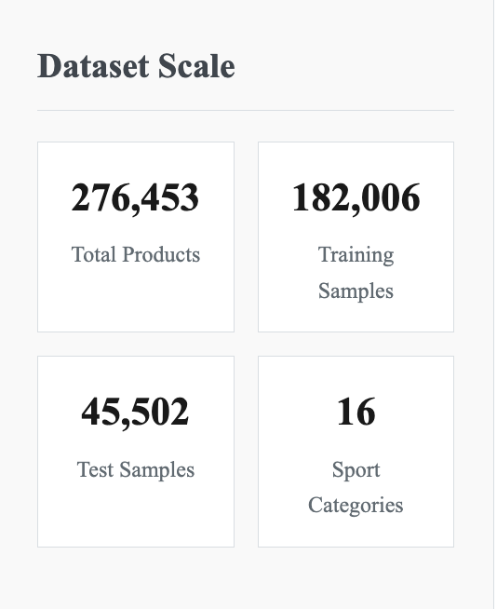
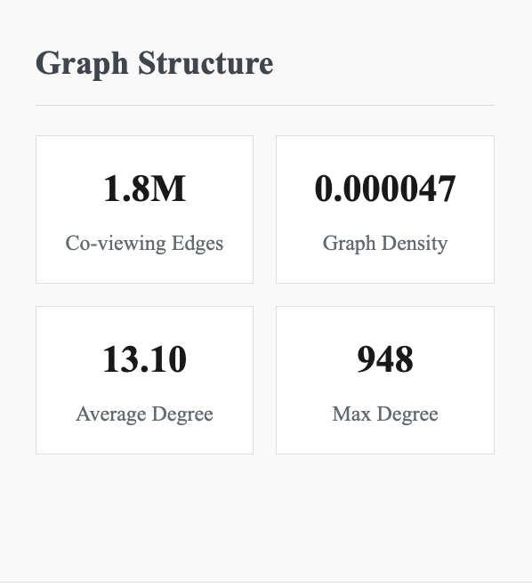
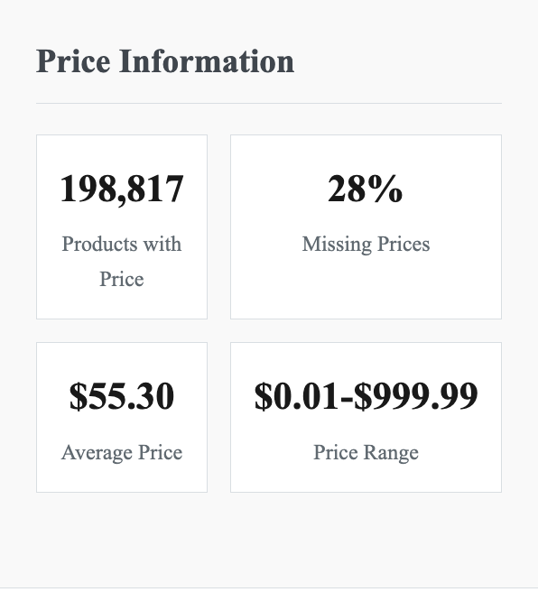
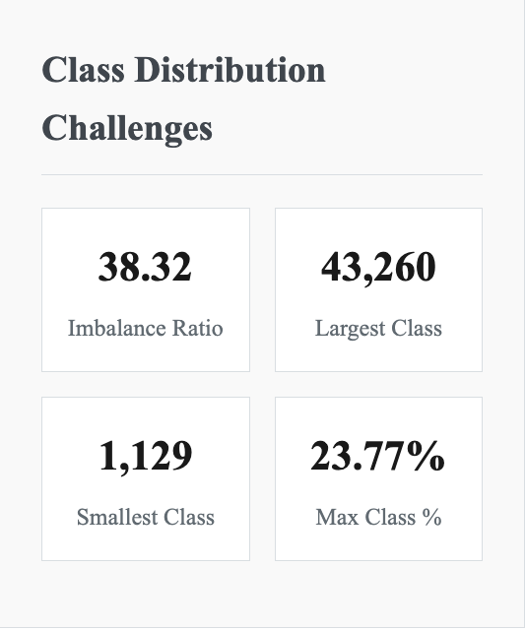
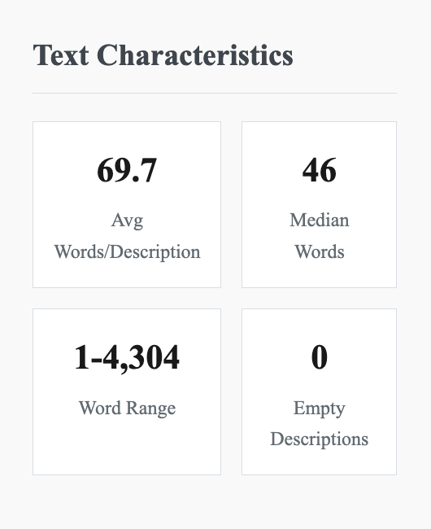
Dataset Brief Overview

Slide 3
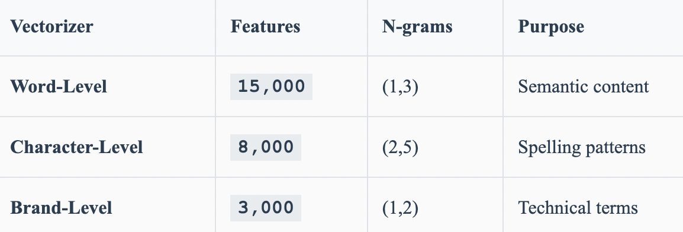
TF – IDF Feature Engineering
Product Text
Tokenization
3 Vectorizers
Feature Selection
Three-Vectorizer Strategy:
Final Output: 26.000 features -> Chi-squared selection -> 15.000 features

Slide 4
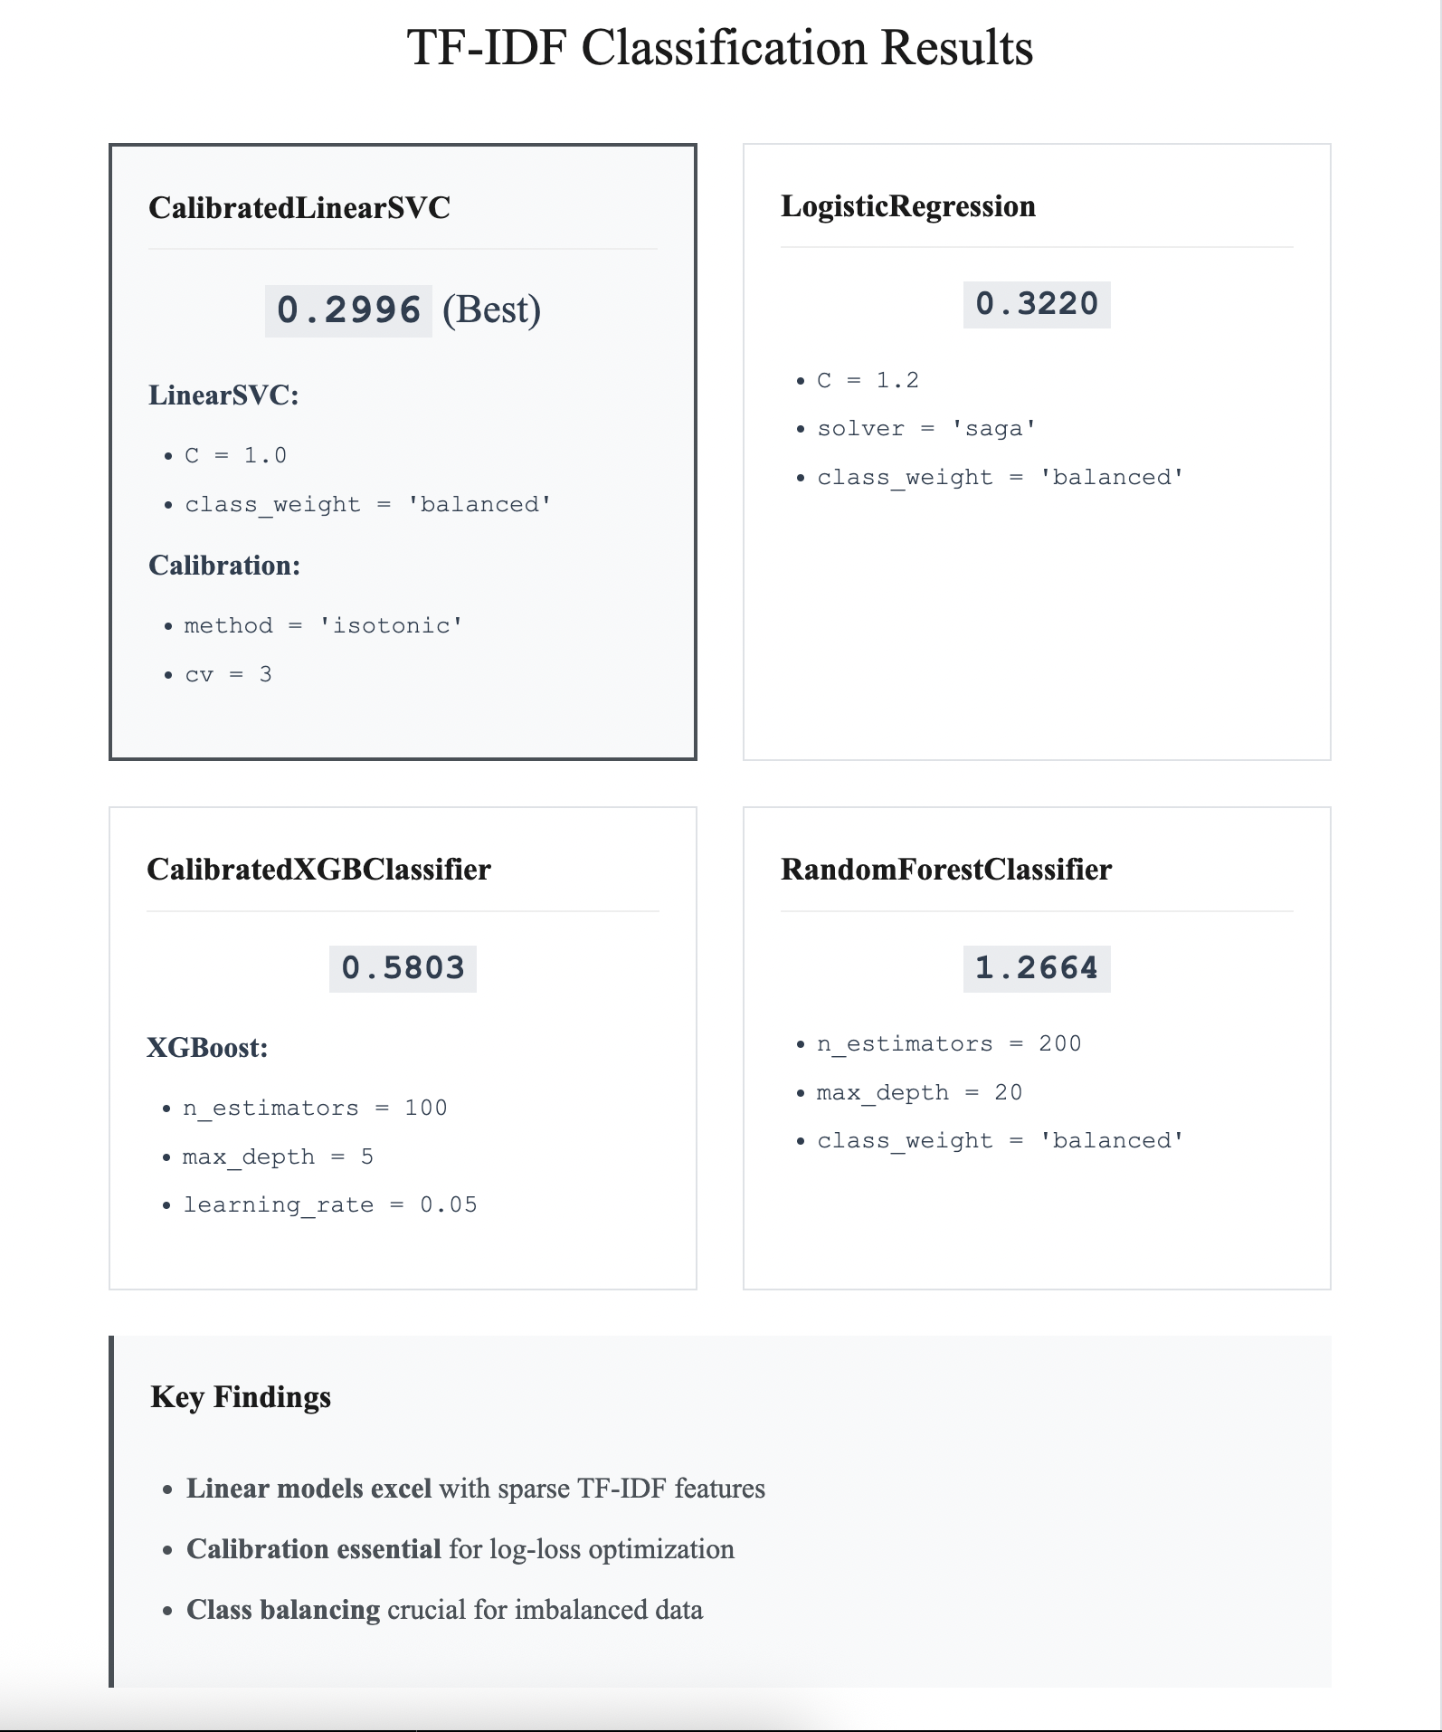
TF – IDF Classification Results
Key Findings:
Linear models excel with space TF-IDF features
Calibration essential for log-loss optimization
Class balancing for imbalanced data

Slide 5

Word2Vec Feature Engineering
All Descriptions
3 Word2Vec Training
Document Embeddings
Tokenization
Processing Steps:
Tokenization: Lemmatization+ Stemming + Stop word removal
Training: Skip-gram on 276.453 product descriptions
Embedding: Average word vectors per document
Output: 100-dimensional dense vectors
Word2Vec vs TF-IDF:
Semantic similarity: Captures word relationships
Dense representations: 100D vs 15.000 sparse
Complementary signal: Different from frequency-based

Slide 6
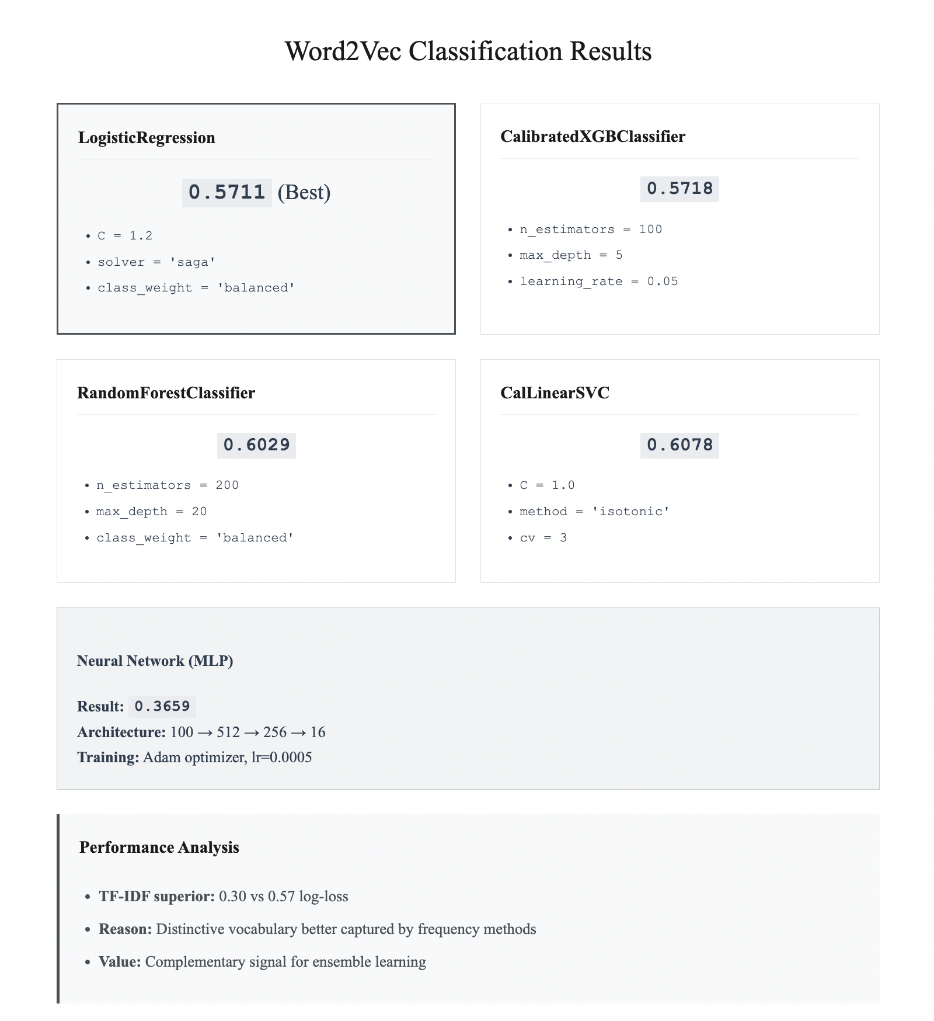
Word2Vec Classification Results
Performance Analysis:
TF-IDF superior: 0,30 vs 0,57 log-loss
Reason: Distinctive vocabulary better captured by frequency methods
Value: Complementary signal for ensemble learning
Neural Network(MLP):
Result: 0,3659
Architecture: 100 -> 512 -> 256 -> 16
Training: Adam optimizer, lt=0,0005

Slide 7

Graph Feature Engineering
Co-viewing Data
NetworkX Graph
Feature Extraction
Standardization
Two Approaches:
Graph Statistics:

Slide 8

Node2Vec Feature Engineering
Random Walks
Skip-gram Training
Node Embeddings
64D Vectors
Node2Vec Parameters:
How Node2Vec Works:
Random walks: Simulate user browsing through co-viewing relationships
Word2Vec training: Treat walks as sentences, products as words
Embedding learning: 64-dimensional vectors capture product relationships
Search bias: p=0,5, q=2,0 favors exploration over local clustering
Advantages:
Automatic pattern discovery: Learns latest latent relationships vs manual engineering
Dense representation: Compact 64D vectors capture complex patterns
User behavior modeling: Random walks simulate browsing patterns

Slide 9
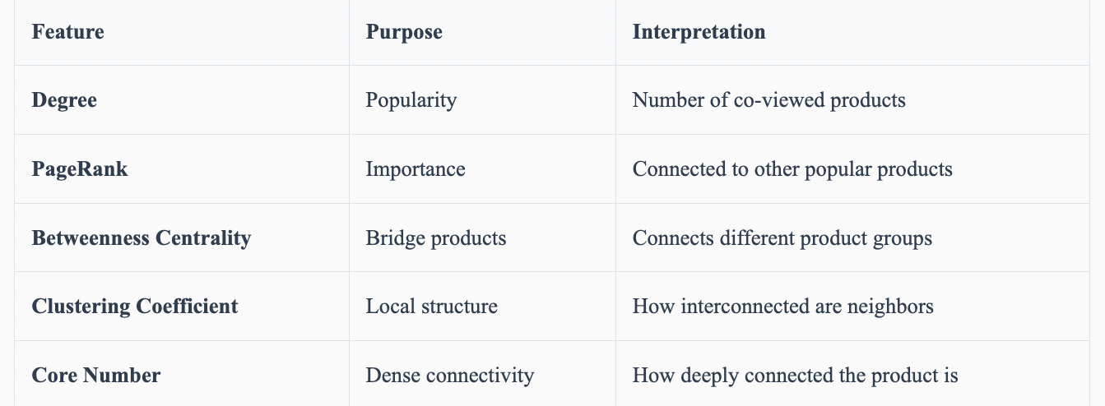
Custom Graph Feature Engineering
Limitations:
Computational cost: ~35 minutes for feature extraction
Manual engineering: Requires domain knowledge vs learned representations
Performance gap: 5x worse that Node2Vec (1,35 vs 0,28)
10 Hand-crafted Features:
Additional Features:
Eigenvector centrality, Triangle count, Average neighbor degree, Logi(degree), Sqrt(degree)

Slide 10
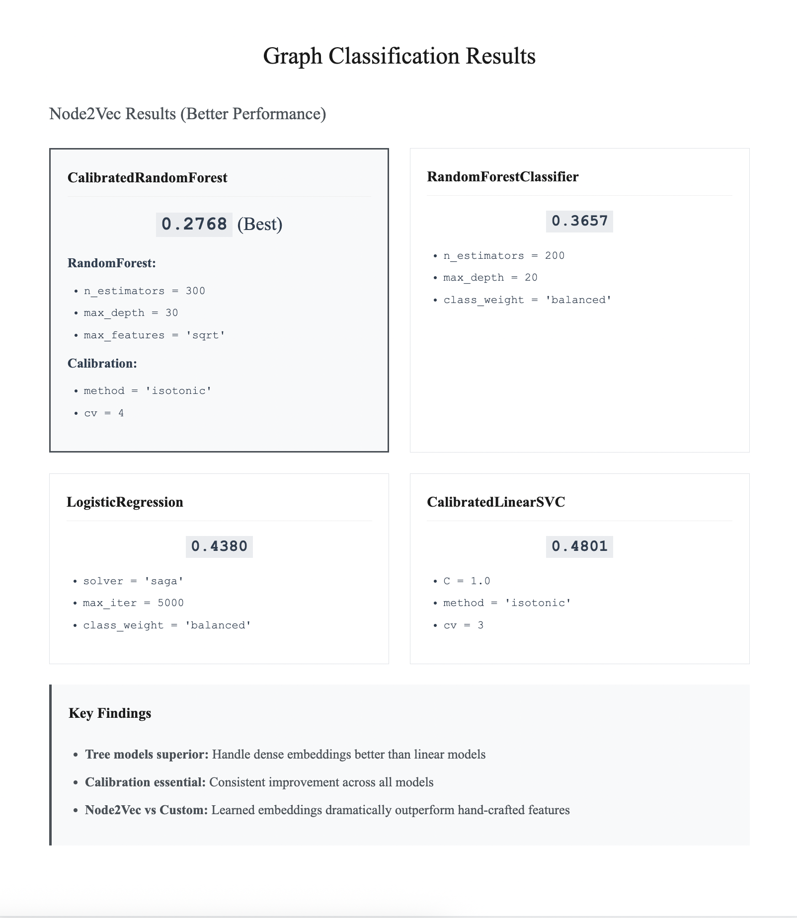
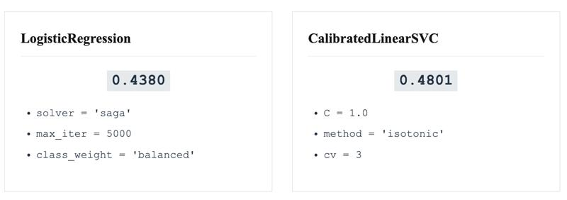
Graph Classification Results
Node2Vec Results (Better Performance):
Key Findings:
Three models superior cost: Handle dense embeddings better than linear models
Calibration essential: Consistent improvement across all models
Node2Vec vs Custom: Learned embeddings dramatically outperform hand-crafted features

Slide 11

Price Feature Engineering
Price Data
Missing Value Imputation
Feature Engineering
Standardization
Engineering Strategy:
Multiple transformations: Capture non-linear price-category relationships
Text Integration: Price-description interactions reveal product positioning
Selective standardization: Scale continuous features, preserve binary indicators

Slide 12
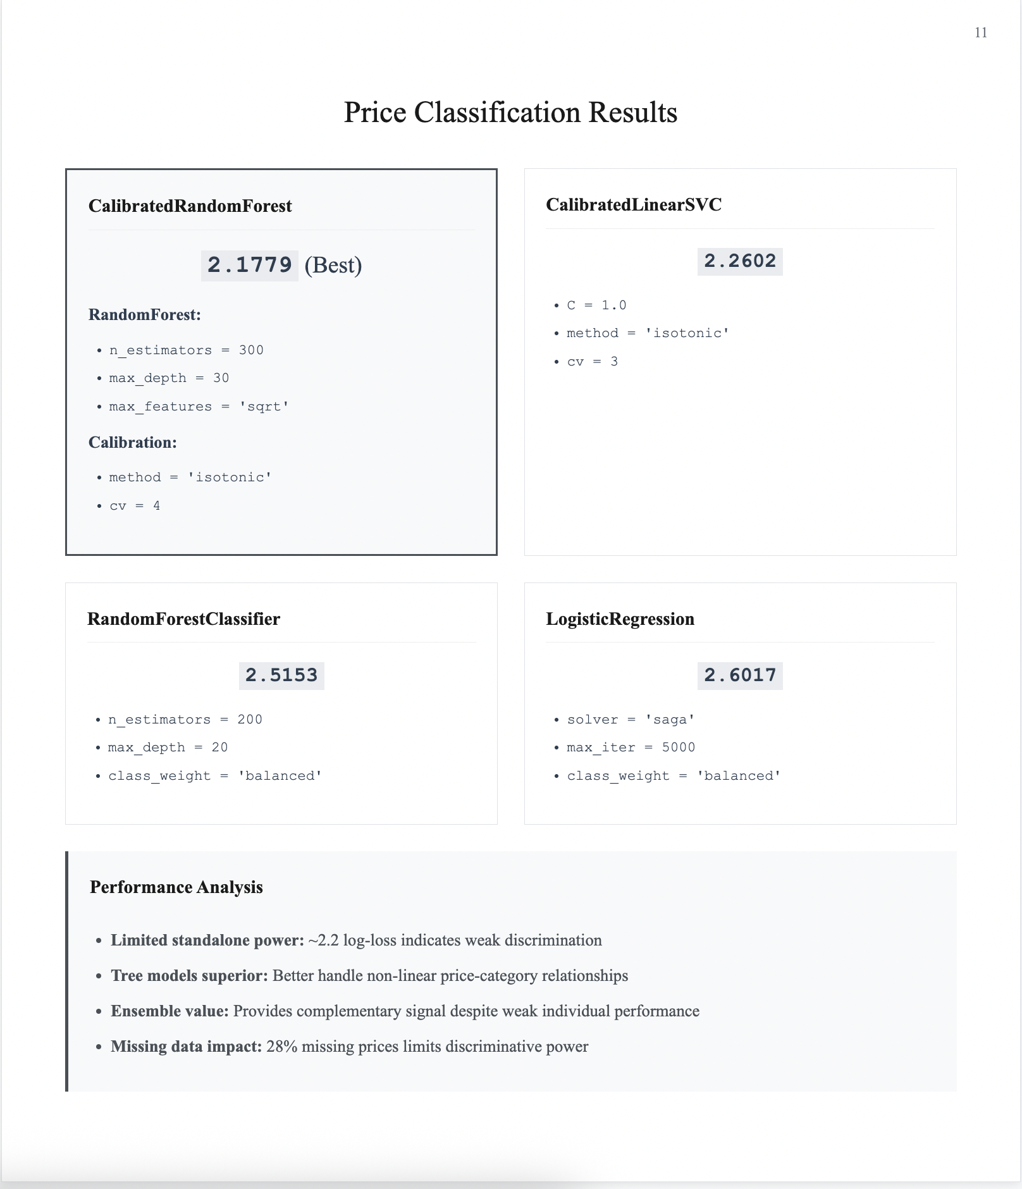
Price Classifications Results
Performance Analysis:
Limited standalone power: ~2.2 log-loss indicates weak discrimination
Tree models superior: Better handle non-linear price-category relationships
Ensemble value: Provides complementary signal despite weak individual performance
Missing data impact: 28% missing prices limits discriminative power

Slide 13
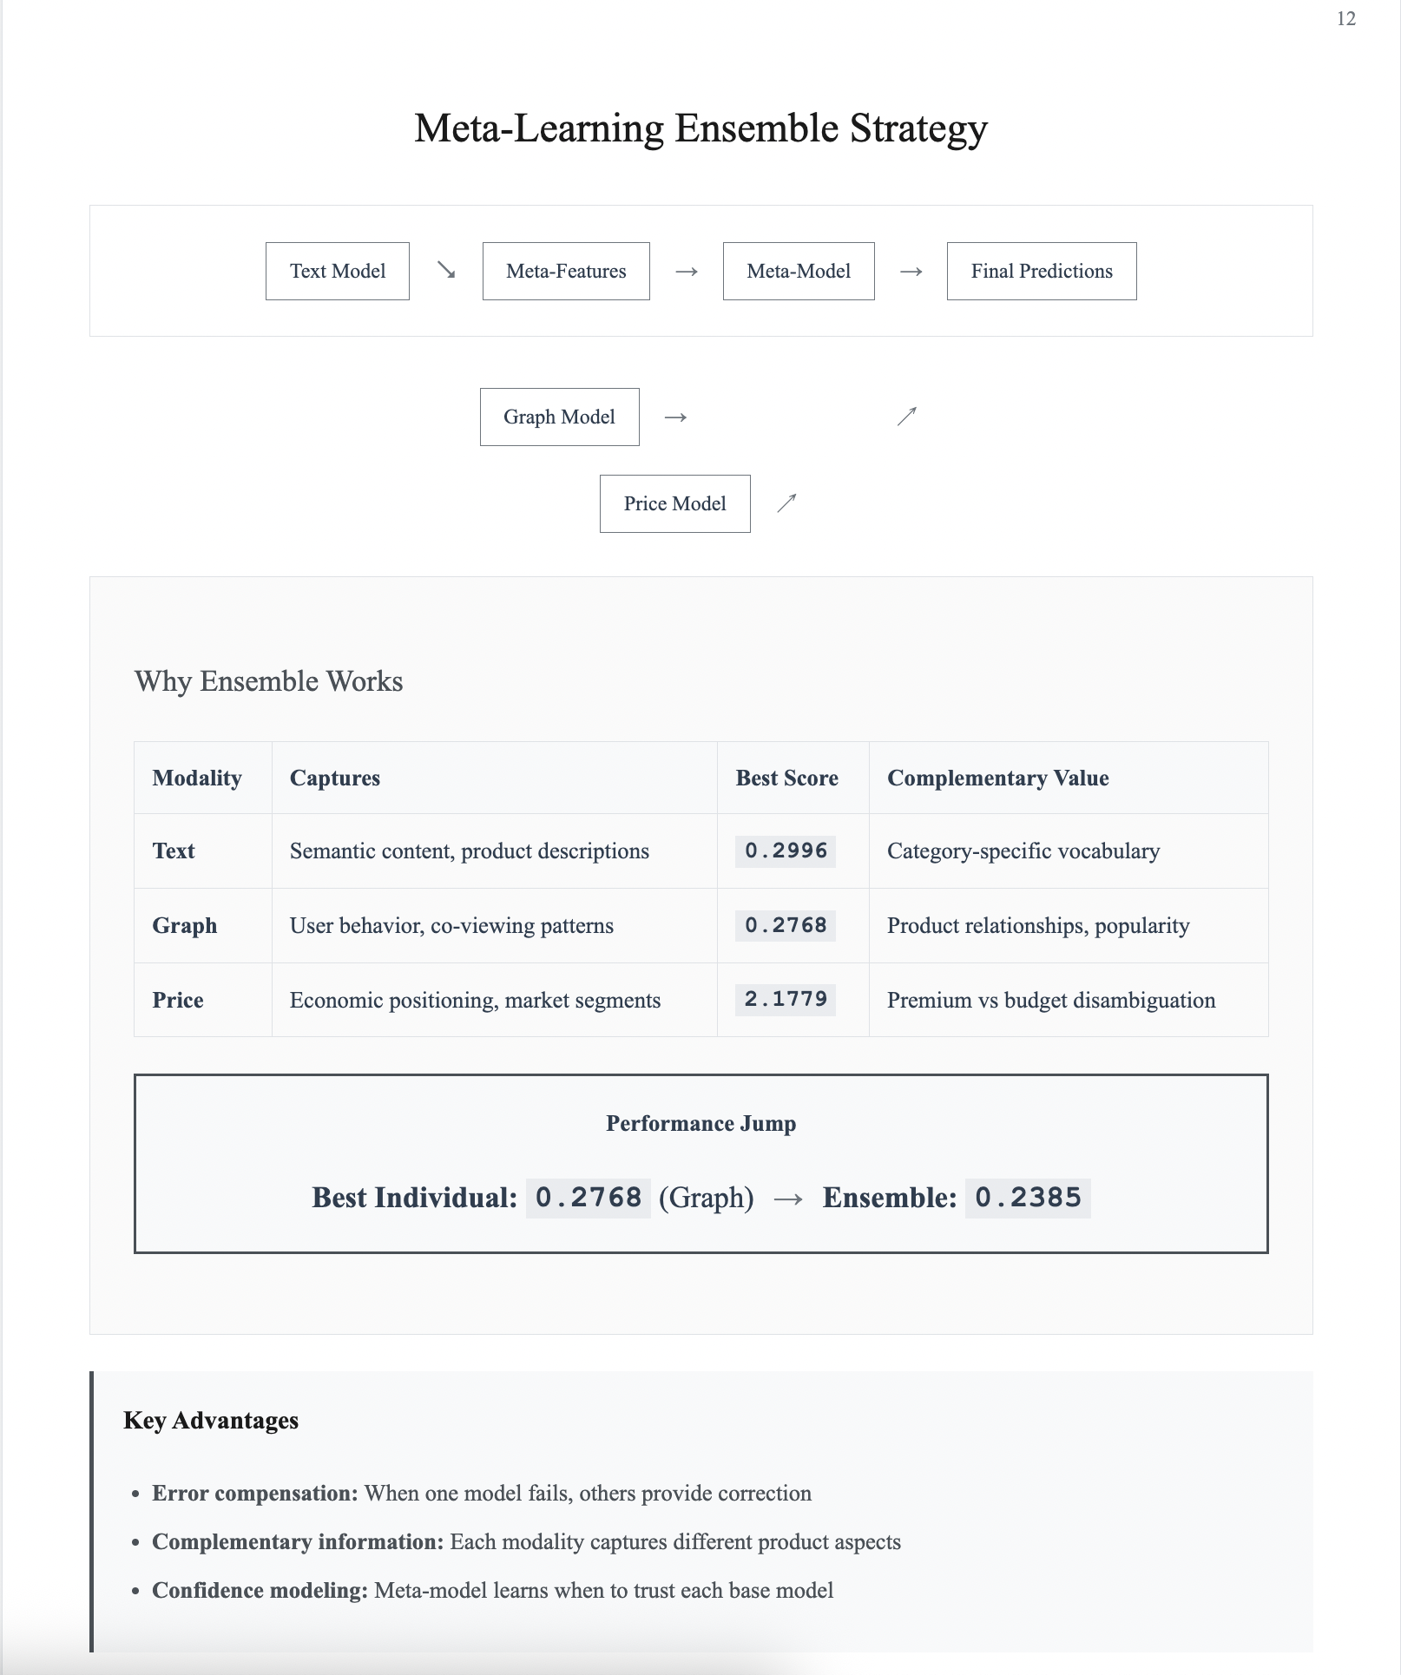
Meta-Learning Ensemble Strategy
Best Text Model
Best Graph Model
Missing Value Imputation
Feature Engineering
Standardization
Best Price Model
Key Advantages:
Error compensation: When one model fails, others provide corrections
Complementary information: Each modality captures different product aspects
Confidence modeling: Meta-model learns when to trust each base model
Why Ensemble Works:

Slide 14

Stacking Methodology
Training Data
80/20 Split
Base Training
Meta-Features(48D)
Meta-Model
Training Process:
Why this approach works:
Learned combination: Meta-model automatically discovers optimal weighting
Proper validation: Meta-features generated on unseen data prevent overfitting
Rich representation: 48D Space captures model confidence and interactions

Slide 15
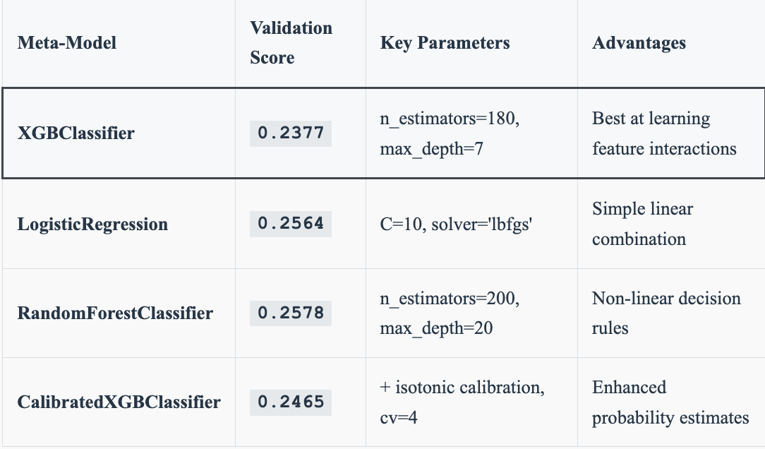
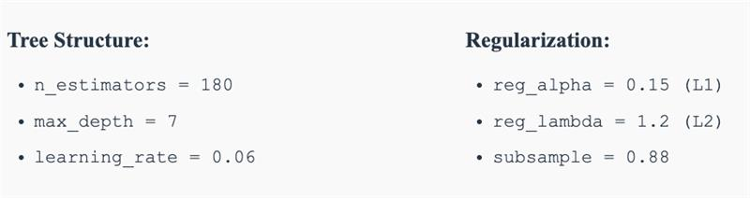
Meta-Model Results
Meta-Model Comparison:
Optimized XGBoost Configuration:
Why XGBoost Excels:
Complex interactions: Learns when to trust each base model
Sequential learning: Iteratively improves combination strategy
Regulation: Prevents overfitting 48D meta-feature page

Slide 16
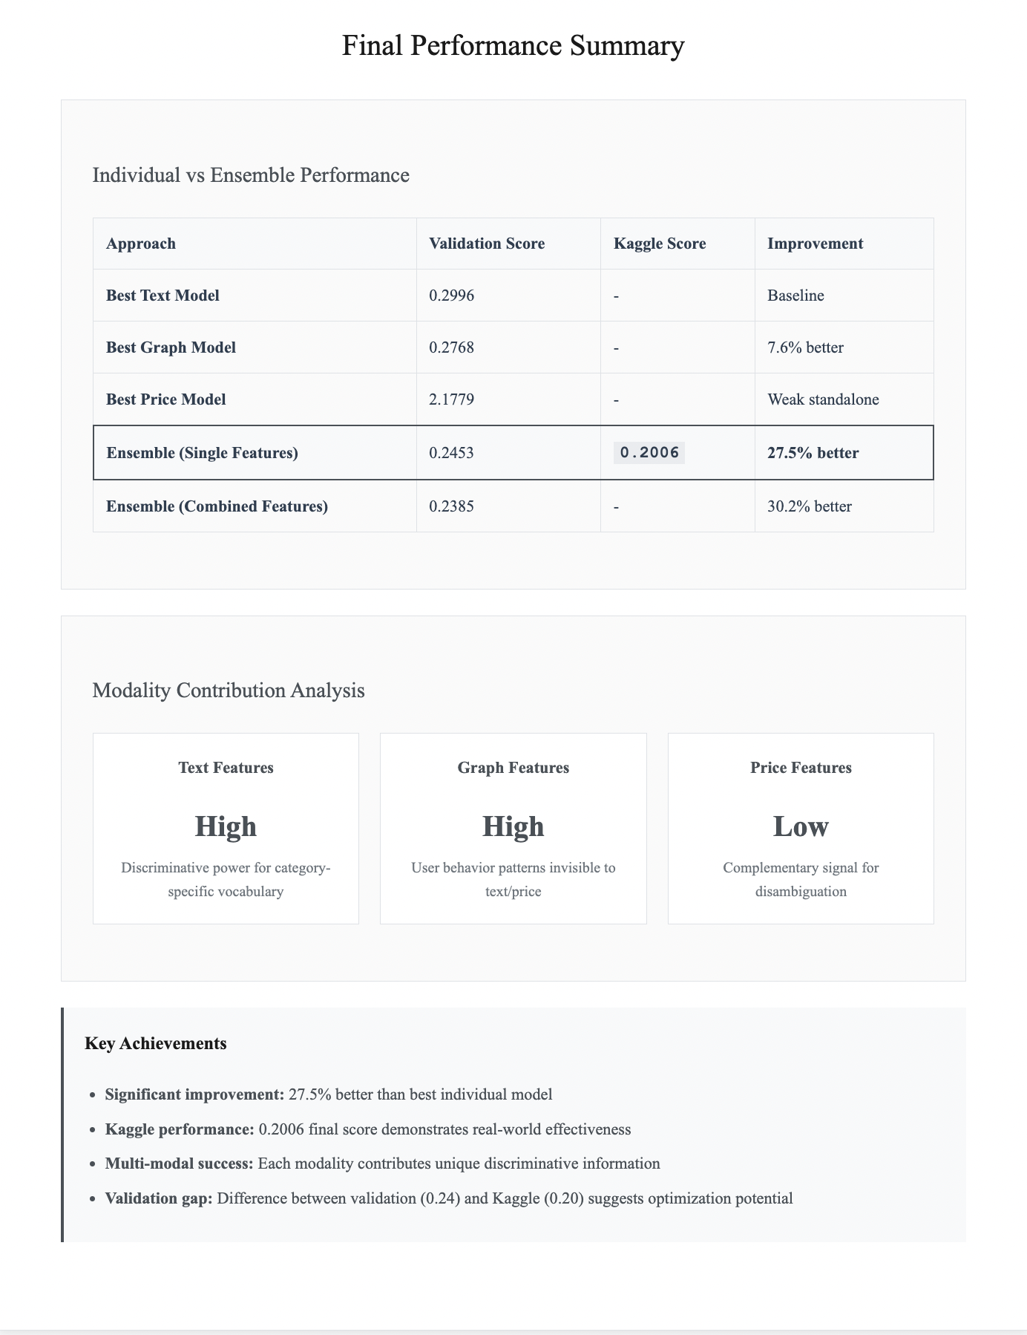
Final Performance Summary
Individual vs Ensemble Performance:
Key Achievements:
Significant improvement: 27,5% better than best individual model
Kaggle performance: 0.2006 final score demonstrates real-world effectiveness
Multi-modal success: Each modality contributes unique discriminative information
Validation gap: Difference between validation (0,24) and Kaggle (0,20) suggests optimization potential

