Slide 1
Real-Time Price Tracking
Interactive Power BI Visualizations 6 Retailers, 600+ Products

Slide 2
Contents
Visualization | Visualization Content
Average Brand Price per Kilo | Displays the average price trend analysis per kilo for various brands across categories such as yoghurts, puddings, evaporated milk, and more.
Average Brand Price per Litre | Displays the average price trend analysis per litre for various brands across categories such as juices, milk, plant-based beverages, etc.
Average Product Price per Kilo | Displays the average price trend analysis per kilo for various products across categories.
Average Product Price per Litre | Displays the average price trend analysis per kilo for various products across categories.
Current Price by Category and Retailer | Displays the current prices of products, with items on sale highlighted in red for easy identification. Hovering over a product provides detailed information including the final price, any applicable promotional discounts, and a dynamic line plot illustrating the price trend over time.
Latest Week Prices | Displays product prices from all retailers, including final and non-promotional prices. Users can export data to Excel for further analysis.
These slides help analyze market dynamics. Detect price increases, track competitor responses to our discounts, and assess brand presence in each category.

Slide 3
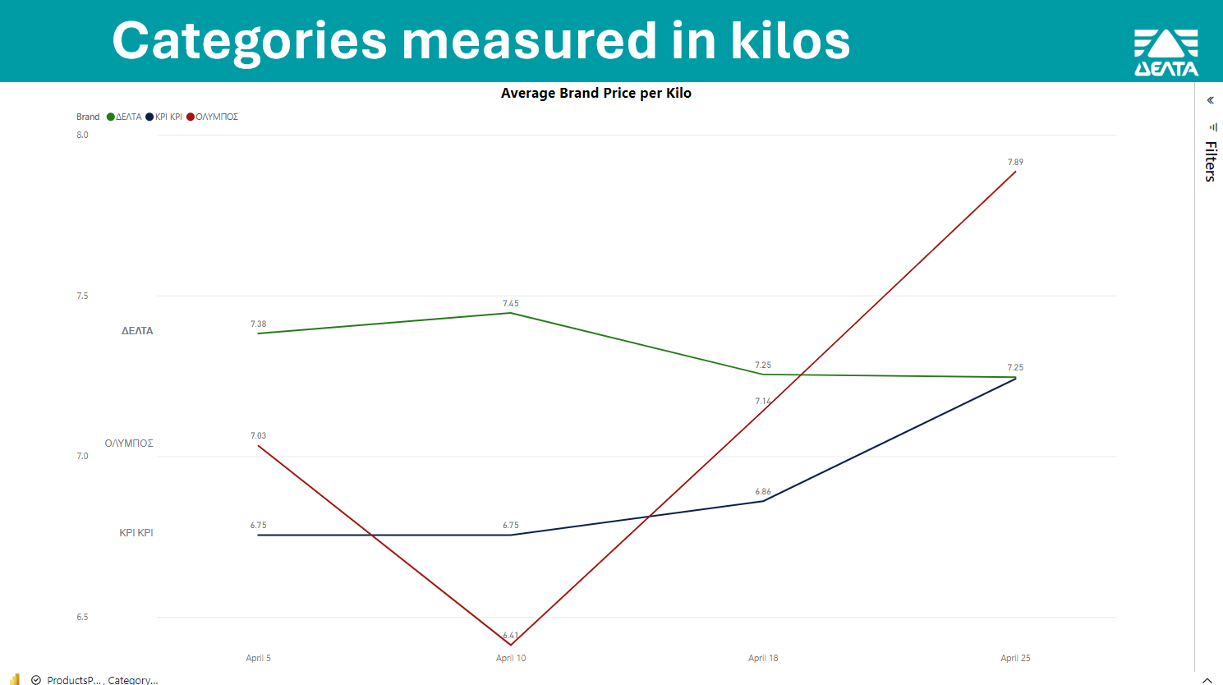
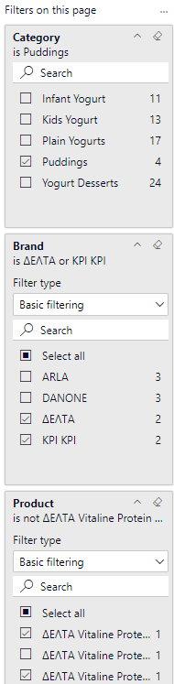
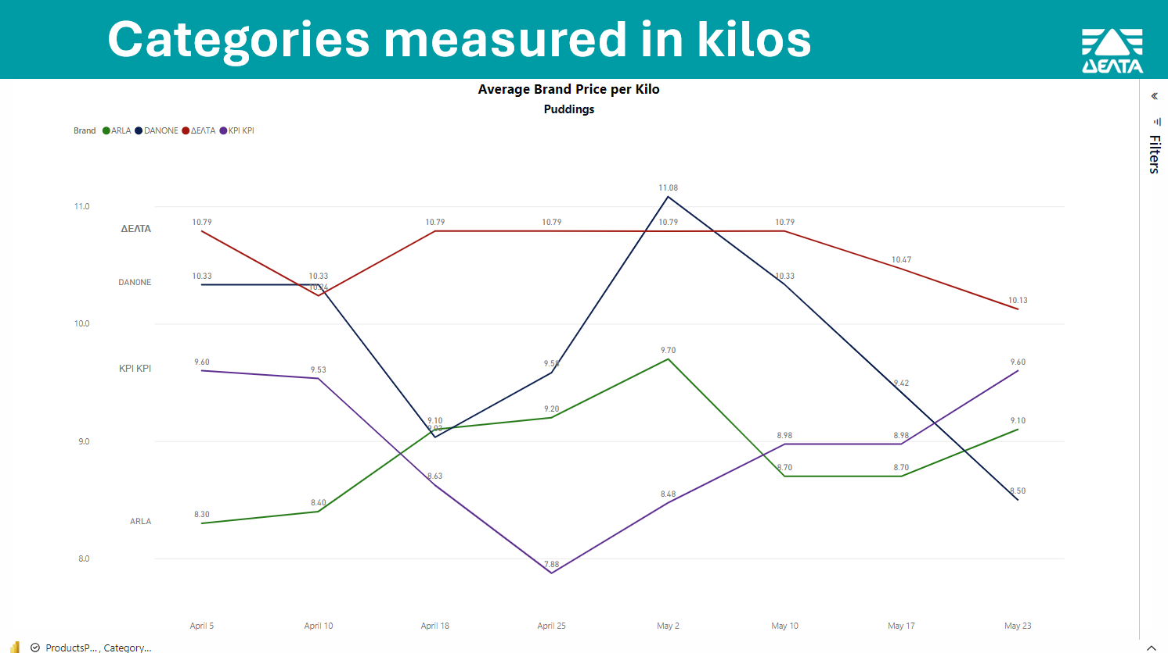


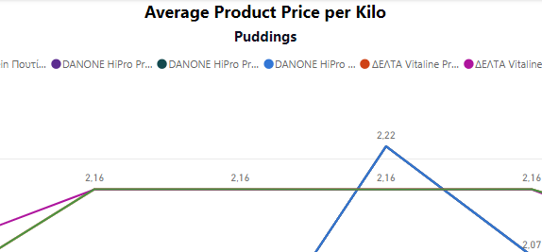
Power BI Filters Overview
Arrow Indicator: Located at the top right corner, the arrow signifies the presence of filters.
By clicking on it, you can unveil various filter option, which help you customize your view.
Category Filter:
Functionality: Allows selection of a specific category (e.g., Puddings).
Usage: Click on the dropdown to choose a category.
Brand Filter:
Functionality: Enables selection of multiple or single brands.
Usage: Use the checkboxes to select one or more brands (e.g., ΔΕΛΤΑ, KPI KPI).
Selecting a category automatically updates the subtitle of the visual to reflect your chosen category
Product Filter:
Functionality: Provides options to select specific products or all products.
Usage: Use the checkboxes to select the desired products.

Slide 4

Trend Analysis of Brands (kg)

Slide 5
Trend Analysis of Brands (lt)

Slide 6
Trend Analysis of Products (kg)

Slide 7
Trend Analysis of Products (lt)

Slide 8
Active Promotions

Slide 9
Table of Market Prices

Slide 10

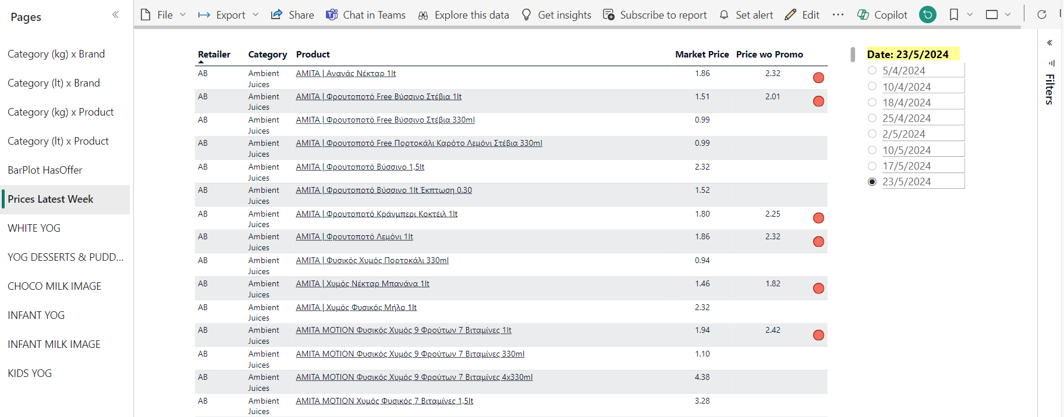

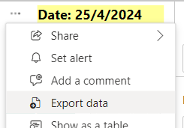
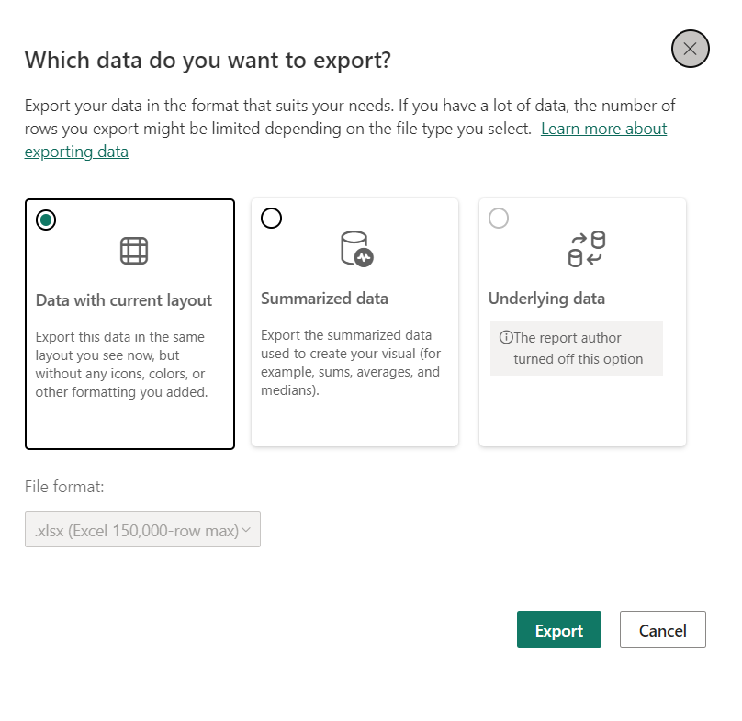
Export Table Data
If you want to download the table as an Excel file, choose the date you want, then click here (“ProductsPrice, Prices Latest Week” at the bottom left corner) which will lead you to Power BI.
Make sure “Prices Latest Week” page is selected.
Click on the ellipsis (...) (to the left of the “Date” slicer) and then click on 'Export data'. Choose 'Data with current layout', and this will download an Excel file to your PC."

Slide 11
Focusing on each brand
Our products vs. Competitors

Slide 12
White Yoghurts

Slide 13
Yoghurt Desserts & Puddings

Slide 14
Chocolate Milk & Protein Drinks

Slide 15
Infant Yoghurts

Slide 16
Infant Milk

Slide 17
Kids Yoghurt

