Slide 1
Smart Driver for Power Reduction in Next Generation Bistable Electrophoretic Display Technology
Michael A. Baker
Aviral Shrivastava
Karam S. Chatha
Arizona State University
Tempe, Arizona, USA
November 8, 2026
Notes:
Good afternoon, my name is Mike Baker, Arizona State University.
I’m presenting the paper “Smart Driver for Power Reduction in Next Generation Bistable Electrophoretic Display Technology”

Slide 2
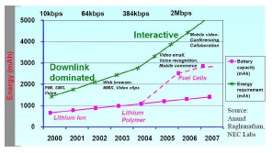
Power: A Critical Constraint in ES
Impact of energy consumption of embedded systems
  Most important factor in usability of electronic devices
Device | Battery life | Charge time | Battery weight/ Device weight
Apple iPOD | 2-3 hrs | 4 hrs | 3.2/4.8 oz
Panasonic DVD-LX9 | 1.5-2.5 hrs | 2 hrs | 0.72/2.6 pounds
Nokia N80 | 20 mins | 1-2 hrs | 1.6/4.73 oz
  Performance/Power requirements of handhelds
    Increase by 30X in a decade
  Battery capacity
    Increase by 3X in a decade
    Considering technological breakthroughs, e.g. fuel cells
Notes:
Let me start by motivating my problem.
This talk and my work is about Embedded Systems.
Why should we care about embedded systems at all?
First is that embedded system market has been estimated to be about 45 billion dollars in 2004, and is expected to rise to 90 billion dollars before 2010.
We want to ensure this and enable possibly higher growth.
Now one trend that is common in the embedded systems is the increasing complexity of systems.
This increase in complexity is not only because of increasing demands from the same systems, but also because of convergence of functionality.
Not only the plam-top of today is much more faster than that of 2 years back, but it performs much more functions.
It is a cell phone, digital organizer, mp3 player, video player, speech recognition, etc…
With the increasing complexity of embedded systems, and shrinking time-to-market pressures, designer productivity becomes the key to successs.
Therefore programmable embedded systems are becoming increasing popular.
By programmable embedded systems, I mean an embedded system, which have a processor.
The program running on the processor can be changed fairly easily e.g. by downloading a new application.
Programmable embedded systems provide faster development, easier re-usability and upgradability of the system.
In such programmable embedded systems, the processor is the main controller, and as a result has major impact on the system power, performance etc.
Therefore the programmable processor, which is also called “embedded processor” is becoming the main focus of research.
My research theme is the embedded processor, both the hardware and software aspects.

Slide 3
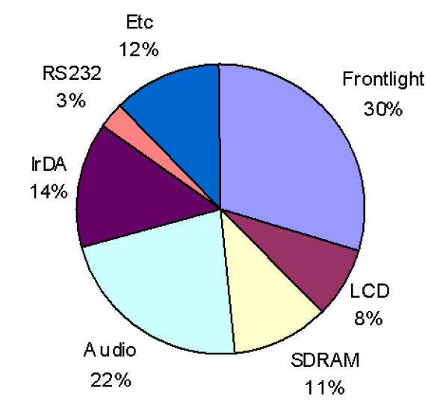
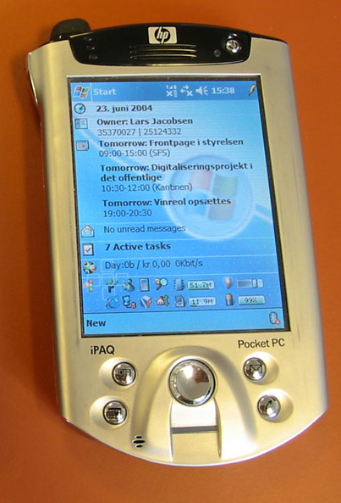
Displays: Major power consumer
LCDs consume 30-60% of power in handhelds
  Up to 90% is due to backlight
HP iPAQ
  320 x 240 QVGA LCD consumes 220 mW
Notes:
Bistable displays have the property that images drawn on the display remain stable without additional overhead. In effect a bistable display can be written, and then the device turned off when the image is static. This is ideal for applications such as e-paper and signs where these devices are termed “no-power” displays, but it also has advantages in typical user interface and video applications where usually some portion of the screen is updated at any given time.

Slide 4
Electrophoretic Displays (EPDs)
320 x 240 QVGA display
  < 15 mW (Compare to 220 mW for LCD)
  14X less power consumption
Much Higher reflectivity
  Similar to newspaper
  Usable in bright sunlight
Extremely thin
  ~1.7 mm (Compare to 3mm of LCDs)
Wider viewing angle
  ~170º (Compare with 120º for LCDs)
Extremely durable and flexible
  Wearable computers
Displaying static images with almost zero power

Slide 5
Agenda
Electrophoretic Displays
Contribution
Previous Work
EPD Power Model
Display Driver
  Naive Driver
  Smart/Lazy Driver
Results
Conclusion
Notes:
I’m going to present some background on bistable displays and their properties.
Our contribution and previous work on EPD.
I will give some additional background on Electrophoretic Displays, our power model, our display driver concept, and results.

Slide 6
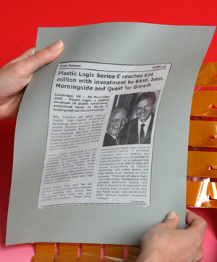
EPD: A Bistable Display Technology
Information remains for hours or weeks without power
Tremendous energy savings in static image applications
  Electronic paper / Books
  Slide Show
  Signs / Advertising
Future displays to provide color and motion, where bistable memory has advantages
Image: Plastic Logic Limited, UK
Notes:
Bistable displays have the property that images drawn on the display remain stable without additional overhead. In effect a bistable display can be written, and then the device turned off when the image is static. This is ideal for applications such as e-paper and signs where these devices are termed “no-power” displays, but it also has advantages in typical user interface and video applications where usually some portion of the screen is updated at any given time.

Slide 7
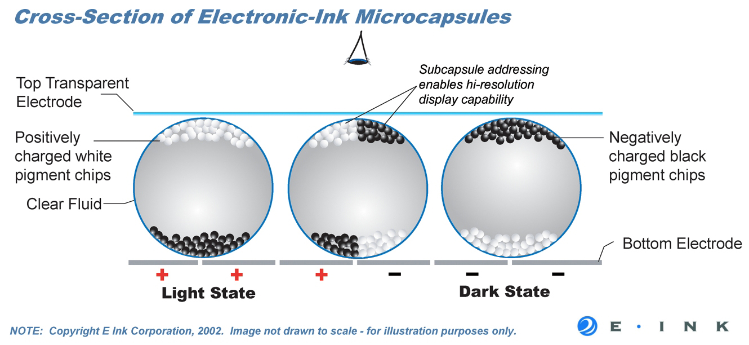
EPD Technology
Electrically charged particles physically displaced by electric field
Resolution independent of capsule size
Notes:
Electrophoretic Displays use the physical force of an electrical field on charged particles suspended in solution to control and change their appearance. An EPD is made up of arrays of microcapsules about 50micrometers in diameter.
Each microcapsule is filled with the colloidal solution made up of the suspension fluid and the charged pigment particles. An electric field applied to the capsule causes the particles in the capsule to migrate toward the front-plane or the back-plane of the display resulting in a change of appearance. In the diagram, two different colored particles are used with a transparent fluid. Another example is a single particle capsule with a colored fluid. These single particle displays have slightly degraded contrast performance due to interference from the colored solution.
The diagram at the top illustrates the arrangement of the capsule, particles, and electrodes used to drive the display. The image at the bottom illustrates the array of capsules in the display and the independence of resolution and capsule size.
Unlike LCDs, which are current driven, EPDs are voltage driven, consequently voltage is independent of pixel value.
Because the displays use the physical displacement of particles in solution, they respond more slowly than other displays such as LCD, 10ms is a very fast switching time for an EPD, but not fast for LCDs

Slide 8
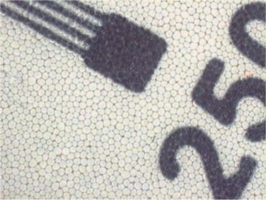
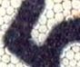
EPD Technology
Capsule diameter about 50μm
~ 6 capsules/subpixel
~ 17 capsules/pixel
pixel array (greyscale)
capsule
+
-
+
-
Negatively charged pigment particle
Positively charged pigment particle
E-Ink Corp.
Notes:
Electrophoretic Displays use the physical force of an electrical field on charged particles suspended in solution to control and change their appearance. An EPD is made up of arrays of microcapsules about 50micrometers in diameter.
Each microcapsule is filled with the colloidal solution made up of the suspension fluid and the charged pigment particles. An electric field applied to the capsule causes the particles in the capsule to migrate toward the front-plane or the back-plane of the display resulting in a change of appearance. In the diagram, two different colored particles are used with a transparent fluid. Another example is a single particle capsule with a colored fluid. These single particle displays have slightly degraded contrast performance due to interference from the colored solution.
The diagram at the top illustrates the arrangement of the capsule, particles, and electrodes used to drive the display. The image at the bottom illustrates the array of capsules in the display and the independence of resolution and capsule size.
Unlike LCDs, which are current driven, EPDs are voltage driven, consequently voltage is independent of pixel value.
Because the displays use the physical displacement of particles in solution, they respond more slowly than other displays such as LCD, 10ms is a very fast switching time for an EPD, but not fast for LCDs

Slide 9
Agenda
Electrophoretic Displays
Contributions
EPD Power Model
Display Driver
  Naive Driver
  Smart/Lazy Driver
Results
Conclusion
Notes:
I’m going to present some background on bistable displays and their properties.
Our contribution and previous work on EPD.
I will give some additional background on Electrophoretic Displays, our power model, our display driver concept, and results.

Slide 10
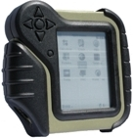
Contributions
Power characterization and modeling of EPDs
Device drivers to use them in video applications
  Exploit EPD properties to further optimize performance and save power?
Notes:
Our motivation is low power design, probably the most important parameter for designers when looking at mobile computing devices.
A mobile device recently demonstrated by InHand Electronics for the US Army uses a bistable electrophoretic display as a user interface, and consumes less than one watt of power even with bluetooth wireless capability. This device has a battery life of about 6 hours which could be improved. Even mW power savings will result in extended battery life in a device with less than a Watt in overall power consumption.
We developed a forward looking driver concept for a bistable electrophoretic disply with full frame rate video capability for improved performance in future ultra low power mobile devices.

Slide 11
Agenda
Electrophoretic Displays
Contributions
Related Work
EPD Power Model
Display Driver
  Naive Driver
  Smart/Lazy Driver
Results
Conclusion
Notes:
I’m going to present some background on bistable displays and their properties.
Our contribution and previous work on EPD.
I will give some additional background on Electrophoretic Displays, our power model, our display driver concept, and results.

Slide 12
Previous Work
EPD technology studied for over 30 years
  Fundamental Properties
    [1] EPD Characterization of colloidal suspension (Phillips Laboratories, 1977 )
    [2] Model for driving EPDs (Xerox Research Center of Canada, 1979)
    [3] EPD ink and capsule characterization (MIT Media Laboratory, 1998)
  Simulation
    [4] EPD properties and simulation (Ghent University, 2005)
Applicable LCD driver power reduction efforts
  [5] Reducing driver cost in active matrix displays (Texas Instruments, 1982)
[1] A. L. Dalisa, “Electrophoretic Display Technology”, IEEE Transactions on Electron Devices, Vol. ED-24, No. 7, July 1977
[2] M. A. Hopper, V. Novotny, “An Electrophoretic Display, Its Properties, Model, and Addressing”, IEEE Transactions on Electron Devices, Vol. ED-26, No. 8, August 1979 (Model for driving EPDs)
[3] B. Comiskey, J. D. Albert, H. Yoshizawa, J. Jacobson, “An electrophoretic ink for all-printed reflective electronic displays”, Nature 394, 253-255, 16 July 1998
[4] T. Bert, H. De Smet, F. Beunis, K. Neyts, Complete electrical and optical simulation of electronic paper, Science Direct, 13 October 2005
[5] W. Marks, “Power Reduction in Liquid-Crystal Display Modules”, IEEE Transactions on Electron Devices, Vol. ED-29, No. 12, December 1982
Notes:
Electrophoretic displays have been studied for over 30 years. Important paper characterizing the colloidal suspension used in EPDs the EPD capsule and driving requirements have been published since 1977.
There has been a tremendous amount of work aimed at optimizing backplanes and techniques for power reduction in LCD which have been dominant in small form and low power applications for decades.
Ongoing efforts in industry are aimed at improving the response time of EPDs, improving color and greyscale performance, and enabling video quality performance.
Phillips Laboratories: A. L. Dalisa, “Electrophoretic Display Technology”, IEEE Transactions on Electron Devices, Vol. ED-24, No. 7, July 1977
(EPD Characterization of colloidal suspension)
Xerox Research Center of Canada: M. A. Hopper, V. Novotny, “An Electrophoretic Display, Its Properties, Model, and Addressing”, IEEE Transactions on Electron Devices, Vol. ED-26, No. 8, August 1979 (Model for driving EPDs)
MIT Media Laboratory: B. Comiskey, J. D. Albert, H. Yoshizawa, J. Jacobson, “An electrophoretic ink for all-printed reflective electronic displays”, Nature 394, 253-255, 16 July 1998 (EPD capsule characterization)
Texas Instruments: B. W. Marks, “Power Reduction in Liquid-Crystal Display Modules”, IEEE Transactions on Electron Devices, Vol. ED-29, No. 12, December 1982 (Reducing driver cost in active matrix)

Slide 13
Agenda
Electrophoretic Displays
Contributions
Related Work
EPD Power Model
Display Driver
  Naive Driver
  Smart/Lazy Driver
Results
Conclusion
Notes:
I’m going to present some background on bistable displays and their properties.
Our contribution and previous work on EPD.
I will give some additional background on Electrophoretic Displays, our power model, our display driver concept, and results.

Slide 14

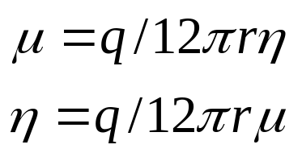
Physically Modeling EPD Capsule
Particle velocity requirement derived from capsule diameter and frame write period
Particle velocity drives mobility requirement determining suspension fluid viscosity
capsule
diameter
Particle mobility:
Physical Capsule Characteristics | Value | Unit
pigment particle radius (r) [12] | 0.5 | μm
pigment particle charge (q) [12] | 4.8E-16 | Coulomb
microcapsule diameter [6] | 50 | μm
supply voltage [11] | 15 | Volts
suspension resistivity [5] | 1.0E12 | Ωm
particle concentration [11] | 2E16 | part./m³
microcapsules/subpixel [6] | 6 | capsules
Suspension fluid viscosity:
Notes:
In order to characterize the energy needed to drive the EPD, we look at the distance the particles must travel within a given amount of time. We use the capsule diameter as the required distance, and the video refresh rate determines the available time. We use particle mobility which Is a function of the pigment particle’s velocity and the electric field applied to determine the fluid viscosity eta needed to achieve full frame rate video. The value used in our simulation was 2cP (centi Poise)
The chart shows the capsule properties used in our model. These values are based on properties used in current EPD displays and limitations needed for correct operation of EPDs described in references.

Slide 15
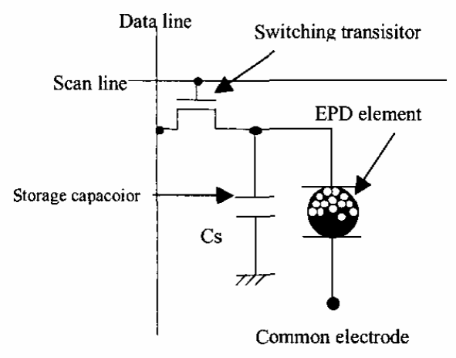
EPD Capsule Power Model
Particle motion analogous to current in a resistor
Storage capacitor
  Large capacitor per RGB sub-pixel (8.6 pF)
  Capsule capacitance is small (<1 pF)
  Charge capacitor during row scan then discharged after frame period
  Required due to relatively slow electrophoretic response
Notes:
The EPD capsule is modeled as a capacitor and resistor in parallel. The capsule itself has a small capacitance, and the motion of charged particles in the suspension fluid is analogous with current in a resistor.
Each

Slide 16
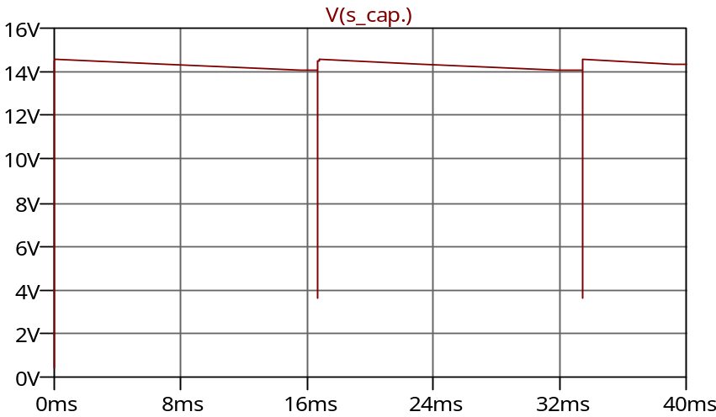
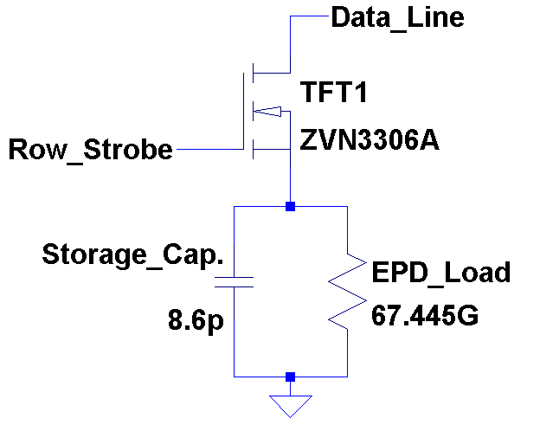
EPD Capsule Power Model
Model uses storage capacitor energy stored during row-write to calculate power
Sequential row-write power equivalent to instantaneous display power
V(s_cap.)
Capacitor Energy Dissipation
Notes:
The EPD capsule is modeled as a capacitor and resistor in parallel. The capsule itself has a small capacitance, and the motion of charged particles in the suspension fluid is analogous with current in a resistor.
Each

Slide 17
Agenda
Electrophoretic Displays
Contributions
Previous Work
EPD Power Model
Display Driver
  Naive Driver
  Smart/Lazy Driver
Results
Conclusion
Notes:
I’m going to present some background on bistable displays and their properties.
Our contribution and previous work on EPD.
I will give some additional background on Electrophoretic Displays, our power model, our display driver concept, and results.

Slide 18
Smart Bistable Display Driver
How can we exploit EPD properties to increase power performance?
Notes:
For our improved driver concept, we take advantage of the memory effect of the bistable display to reduce the the amount of effort needed when to update the display.
The Naïve driver updates every pixel in the display each time the image is refreshed, or each frame.
The Smart Driver only updates pixels which have changed bit for bit from the previous image, retaining the remaining pixel values from the previous image.
The Lazy Driver chooses not to update pixels which have not changed enough depending on the amount of change in the new pixel value compared to the previous value. The comparison is done bit by bit just as in the Smart Driver case, but between 1 and 6 of the Least Significant Bits are ignored during the comparison. Ignoring more bits results in fewer pixel updates which reduces power requirements as well as image quality.

Slide 19
Smart Bistable Display Driver
Naive Driver
  100% of image redrawn during refresh or update
  Even if portions of the image remain unchanged in the new image
  Wastes energy since display retains unchanged portions anyway
Notes:
For our improved driver concept, we take advantage of the memory effect of the bistable display to reduce the the amount of effort needed when to update the display.
The Naïve driver updates every pixel in the display each time the image is refreshed, or each frame.
The Smart Driver only updates pixels which have changed bit for bit from the previous image, retaining the remaining pixel values from the previous image.
The Lazy Driver chooses not to update pixels which have not changed enough depending on the amount of change in the new pixel value compared to the previous value. The comparison is done bit by bit just as in the Smart Driver case, but between 1 and 6 of the Least Significant Bits are ignored during the comparison. Ignoring more bits results in fewer pixel updates which reduces power requirements as well as image quality.

Slide 20
Smart Bistable Display Driver
Smart Driver
  Unchanged pixels not addressed when new image is drawn--no image degradation
  If the 8 bit data value of any subpixel changes, the pixel is updated
1 pixel:
RGB sub-pixels
Pixel data values: R:11111111 B:11111111 G:11111111
(R:255) (B:255) (G:255)
Notes:
For our improved driver concept, we take advantage of the memory effect of the bistable display to reduce the the amount of effort needed when to update the display.
The Naïve driver updates every pixel in the display each time the image is refreshed, or each frame.
The Smart Driver only updates pixels which have changed bit for bit from the previous image, retaining the remaining pixel values from the previous image.
The Lazy Driver chooses not to update pixels which have not changed enough depending on the amount of change in the new pixel value compared to the previous value. The comparison is done bit by bit just as in the Smart Driver case, but between 1 and 6 of the Least Significant Bits are ignored during the comparison. Ignoring more bits results in fewer pixel updates which reduces power requirements as well as image quality.

Slide 21
Smart Bistable Display Driver
Lazy Drivers (Modified Smart Driver)
  Similar pixels not addressed when new image is drawn--image degradation
  Some number (1-6 / 8) of LSB from Pixel component values ignored during decision comparison
Max pixel color impact due to ignoring bits during comparison:
Bits ignored:
0
1
2
3
4
5
6
7
8 bit value
(x3 subpixels):
Binary Value:
255
11111111
254
11111110
252
11111100
248
11111000
240
11110000
224
11100000
192
11000000
128
10000000
Notes:
For our improved driver concept, we take advantage of the memory effect of the bistable display to reduce the the amount of effort needed when to update the display.
The Naïve driver updates every pixel in the display each time the image is refreshed, or each frame.
The Smart Driver only updates pixels which have changed bit for bit from the previous image, retaining the remaining pixel values from the previous image.
The Lazy Driver chooses not to update pixels which have not changed enough depending on the amount of change in the new pixel value compared to the previous value. The comparison is done bit by bit just as in the Smart Driver case, but between 1 and 6 of the Least Significant Bits are ignored during the comparison. Ignoring more bits results in fewer pixel updates which reduces power requirements as well as image quality.

Slide 22
Lazy Driver Example
Lazy driver configured to ignore specific number of LSBs.
Example: Lazy Driver ignoring 5 bits:
R
G
B
011
01100011
111
11101110
001
01100011
00100011
011
11101110
111
00100011
Current value:
001
011
110
001
01101100
11111010
00110100
01111010
011
11001100
111
00111111
Next value:
001
Change, pixel is updated
No change, pixel is not updated
Notes:
In this example, two pixel values are given, and their apparent color is demonstrated. If these are subsequent values for the same pixel in two consecutive video frames, then we can see which driver configuration will choose to leave the pixel unchanged, and how different the displayed pixel is from the originally intended pixel value for the next frame.
The smart driver compares each 8 bit RGB sub-pixel value in each to find differences. In the case of the smart driver, if any of the three sub-pixels values have changed from one frame to the next, then the pixel is updated. In the lazy driver, the same comparison is made, but a number of Least Significant Bits are ignored.
In the example, we can find a difference between the old pixel value and the new pixel value in at least one sub-pixel unless we choose to ignore at least 7 bits. A Lazy(7) driver would refuse to update this pixel, and the difference in the image is clear. Due to low quality of the output, the 7 bit Lazy driver was not considered in our results.
The array at the bottom demonstrates the maximum difference between the displayed pixel and the intended pixel value in the data depending on how many bits are ignored during the comparison. The colored boxes show the color of the red sub-pixel if the data value is all ones, if the last bit is changed to zero, if the last two bits are changed to zero etc.
Note that this is the maximal difference between two consecutive sub-pixels with different values as the difference will actually be distributed between a 1 bit difference and the maximum difference of n bits ignored in the Lazy Driver.

Slide 23
Agenda
Electrophoretic Displays
Contributions
Previous Work
EPD Power Model
Display Driver
  Naive Driver
  Smart/Lazy Driver
Results
Conclusion
Notes:
I’m going to present some background on bistable displays and their properties.
Our contribution and previous work on EPD.
I will give some additional background on Electrophoretic Displays, our power model, our display driver concept, and results.

Slide 24
Driver Simulation
Simulator takes series of bitmaps extracted from video stream as input
Outputs series of bitmaps altered in accordance with each driver scheme
Power is calculated based on the number of pixels written in each row
Capacitor energy stored in the drive capacitors energy expended per row write

Slide 25

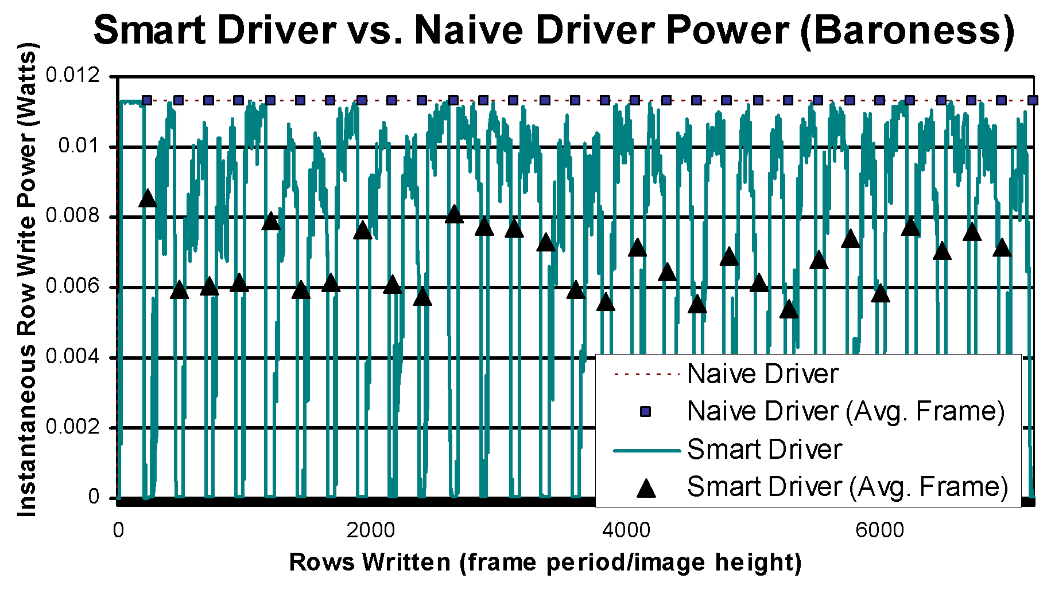
Video 1: Display Power
Notes:
This chart shows the instantaneous power consumption over 29 frames of the video “Baroness”. The x axis is measured in rows because the image is written a row at a time so that the instantaneous power is the row-write power.
The Markers across the top of the chart represent the average power consumed by the Naïve Driver over one frame at the end of each frame.
The triangle markers indicate the average power consumed by the Smart Driver over one frame at the end of each frame.
The power consumption drops to zero at the beginning and end of each frame as a result of the letter-box black stripes at the top and bottom of the video which is almost constant.

Slide 26
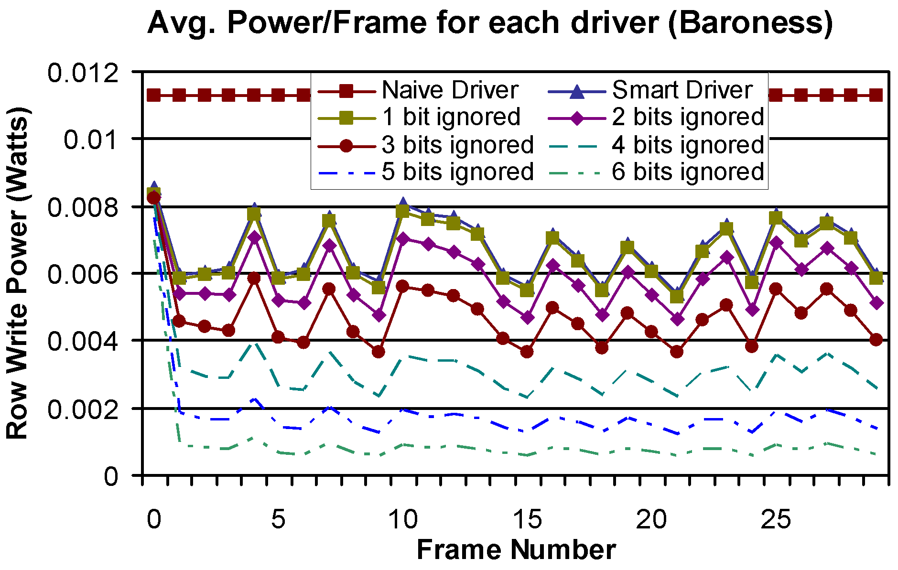
Video 1: Display Power
Notes:
This chart shows the same average power consumed per frame-write from the previous slide plus average frame power consumption for each of the lazy drivers. Each line represents a different driver writing the same video stream. The power is shown to decrease as the number of bits ignored increases with each driver configuration.

Slide 27



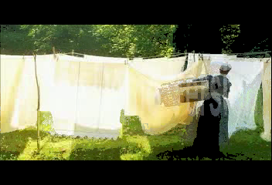
Video 1: Image Degradation
no degradation
4 bits
Baroness frame 29
5 bits
6 bits
Elecard Ltd.
Notes:
Here we see the resulting image after 29 frames from “Baroness” have been drawn. Here we have an video with a relatively static background, and a figure moving from left to right. The original quality of the 29th frame is shown on the upper left. The remaining images demonstrate the frame quality for a Lazy(4), Lazy(5), and Lazy(6) driver. In the Lazy(6) frame, the trail left by the figure’s motion is apparent on the relatively static background.

Slide 28
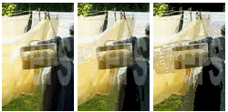
Video 1: Image Degradation
4 bits
Original
5 bits
6 bits
Baroness frame 29
5 bits
6 bits
Notes:
These images highlight the difference in degradation for the Lazy(5) and Lazy(6) drivers.

Slide 29
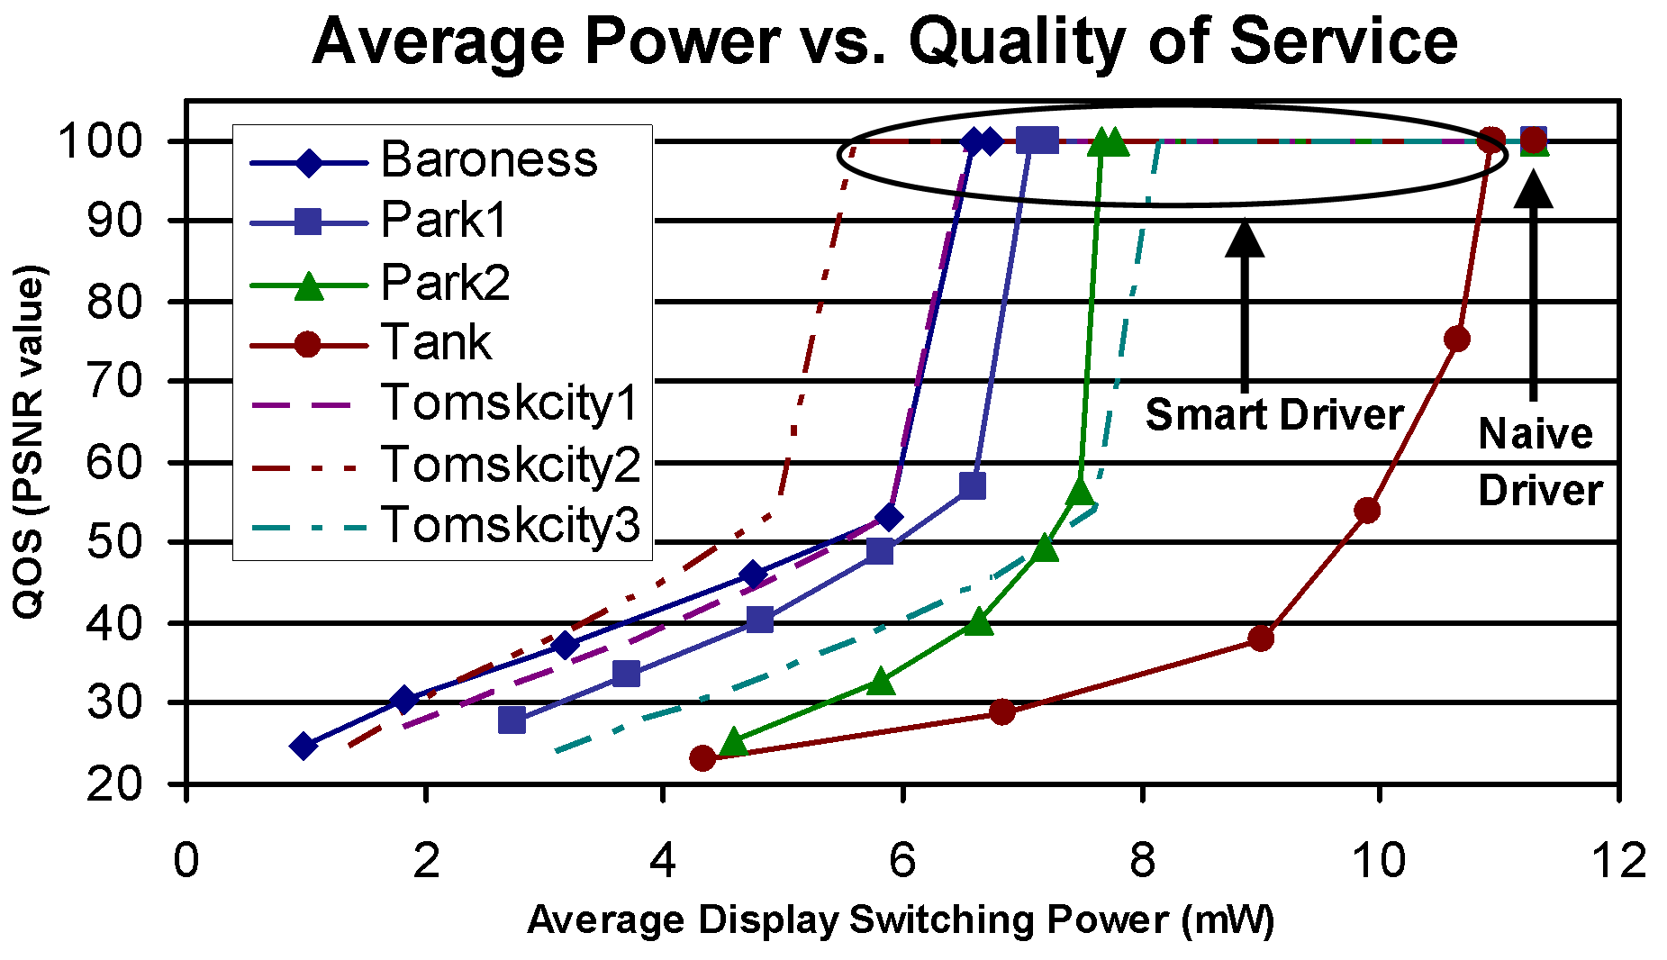
Energy Savings vs. QOS
Notes:
Here we can see the relationship between Quality of Service and Power consumption for each video and each driver scheme.
Each line on the chart represents a single video. The points along the line represent the Power/QOS performance of each driver scheme on that video.
The first point (lower left) of each line is the most aggressive driver used Lazy(6) which provides the best power performance for the greatest quality degredation.
The points inside the circle remaining on the 100dB QOS line represent the Smart Driver. It’s also interesting to note that the Lazy(1) driver performs at a slight power advantage with no measurable loss of quality.

Slide 30
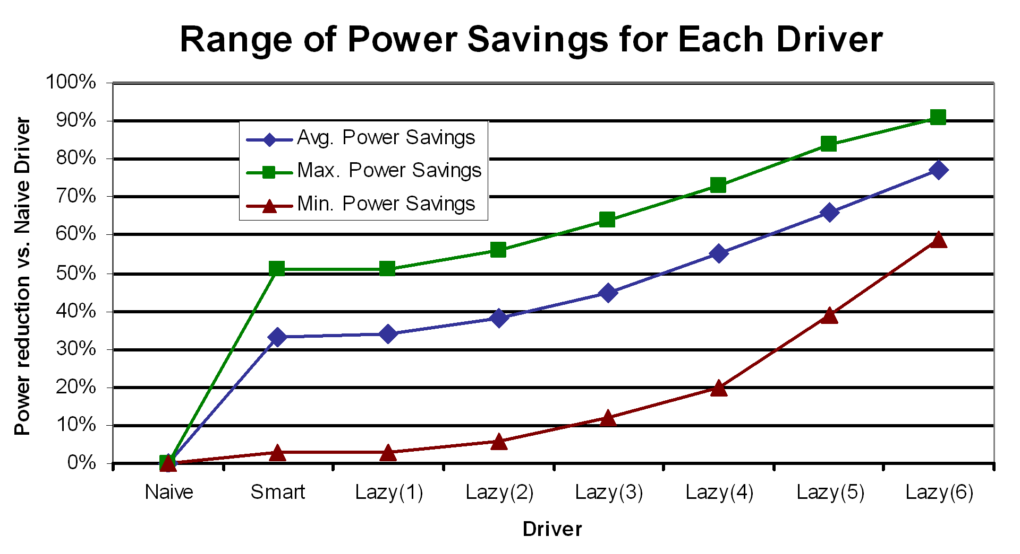
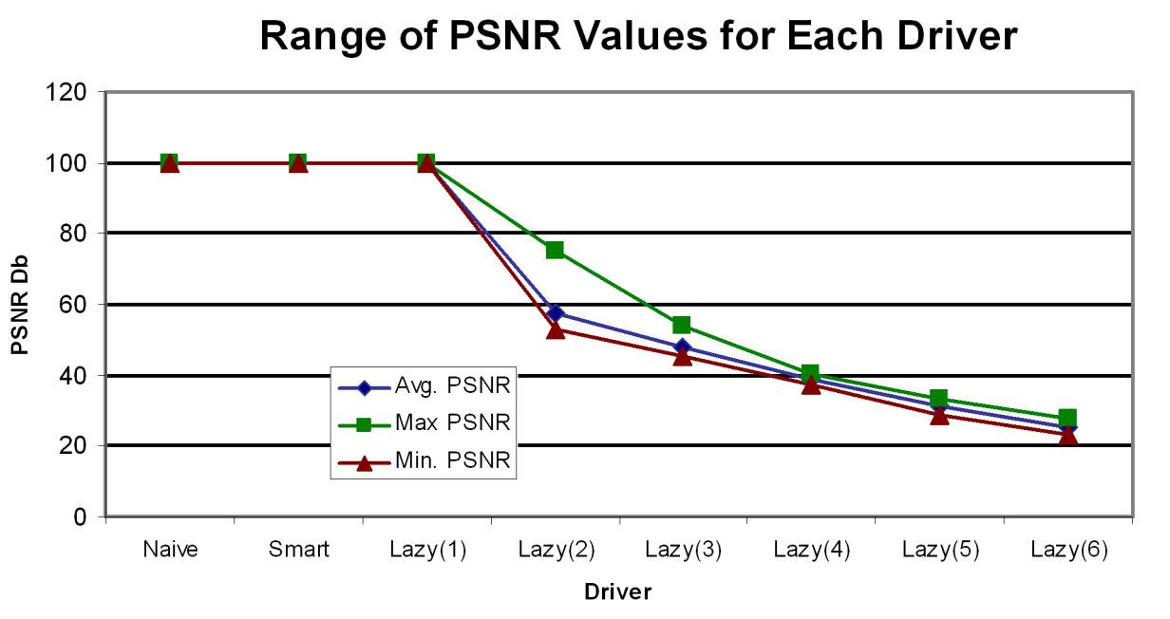
QOS and Power Savings Results
Notes:
This chart shows the power advantage of each driver over the naïve driver as the number of bits left out of smart driver pixel comparisons grows from 1 to 7.
The average power consumption per frame among the 7 videos evaluated is indicated along with the maximum and minimum per frame power savings.
On the right side of the chart are the average, maximum and minimum calculated PSNR values of all videos for each driver scheme.
Notice that the Smart driver and the Lazy(1) driver both achieved appreciable power savings with a computationally insignificant decrease in PSNR values.

Slide 31
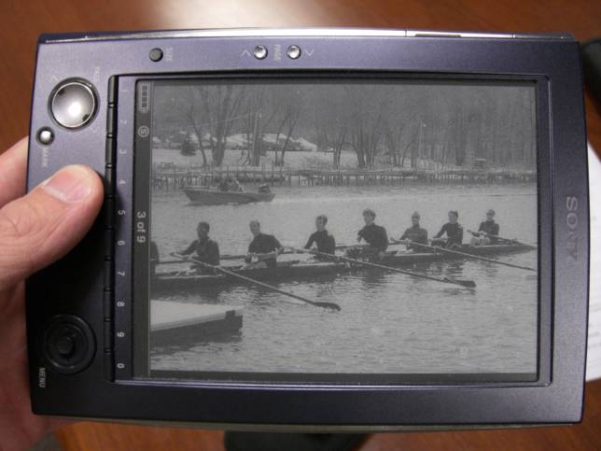
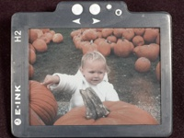
Ongoing work in EPD
Generating Greyscale
  Complex driving waveforms used to generate grayscale
  Area Ratio Grayscale also used to achieve gray levels
Producing Color EPDs
  Different color pigment particles
  Frontplane filters
Improving Response time
  Particle mobility
Sony E-Book with E-Ink 4 bit waveform driven grayscale
9 gray level ARG element
E-Ink Color EPD Prototype
Notes:
These displays exhibit contrast comparable to paper. The pigment particle solution is often referred to as electronic ink.
Complex driving waveforms are typically used to generate grayscale in EPDs. Usually different levels of greyscale are generated by modulating the amount of time the voltage is applied to the pixel.
Area ratio grayscale is an alternative using subpixels to achieve gray levels. Area ratio grayscale is limited by the number of subpixels avaialble.
Various colors can be achieved by introducing color filters in the front-plane, or by using different colored pigment particles. Some current prototypes use filterning to generate color images.
EPDs require 2-5 times higher driving voltages than LCD.

Slide 32
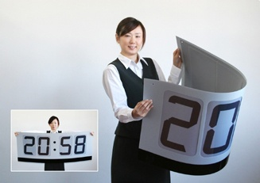
Conclusion
Bistability of electrophoretic displays enables power savings via smart drivers
Smart driver might take advantage of context or user preferences to expand power reduction in exchange for picture quality
E-Ink Bendable Clock

Slide 33
Questions?
+
-

Slide 34
References
1. W. Cheng, Y. Hou, M. Pedram, Power Minimization in a Backlit TFT-LCD Display by Concurrent Brightness and Contrast Scaling, Design, Automation and Test in Europe Conference and Exhibition, Vol.: 1, pp. 252 - 257, 2004
2. I. Choi, H. Shim, N. Chang, Low-Power Color TFT LCD Display for Hand-Held Embedded Systems, International Symposium on Low Power Electronics and Design, August 12-14, 2002
3. NEC NL2432HC17-01B QVGA LCD for mobile applications with touch panel specification
4. F. Gatti, A. Acquaviva, L. Benini, B. Ricco’, Low Power Control Techniques For TFT LCD Displays, CASES, October 2002
5. A. L. Dalisa, Electrophoretic Display Technology, IEEE Transactions on Electron Devices, Vol. ED-24, No. 7, July 1977
6. S. Inoue, H. Kawai, S. Kanbe, T. Saeki, T. Shimoda, High-Resolution Microencapsulated Electrophoretic Display (EPD) Driven by Poly-Si TFTs With Four-Level Grayscale, IEEE Transactions on Electron Devices, Vol. 49, No. 8, August 2002
7. LTSpice manual
8. L. Blackwell, LCD Specs: Not So Swift, PC World, Friday, July 22, 2005
9. Ghent University Liquid Crystals & Photonics Group, http://www.elis.ugent.be/elisgroups/lcd/research/elektink.php
10. B. Comiskey, J. D. Albert, H. Yoshizawa, J. Jacobson, An electrophoretic ink for all-printed reflective electronic displays, Nature 394, 253-255 (16 July 1998)
11. S. Vermael, K. Neyts, G. Stojmenovik, F. Beunis, L. Schlangen, A 1-Dimensional Simulation Tool for Electophoretic Displays, Fourth FTW PhD Symposium, Ghent University, 2003
12. T. Bert, H. De Smet, F. Beunis, K. Neyts, Complete electrical and optical simulation of electronic paper, Science Direct, 13 October 2005
13. M. A. Hopper, V. Novotny, An Electrophoretic Display, Its Properties, Model, and Addressing, IEEE Transactions on Electron Devices, Vol. ED-26, No. 8, August 1979
14. H. Takao, M. Miyasaka, H. Kawai, H. Hara, A. Miyazaki, T. Kodaira, S. W. B. Tam, S. Inoue, T. Shimoda, Flexible Semiconductor Devices: Fingerprint Sensor and Electrophoretic Display on Plastic, ESSDERC Proceeding of the 34th European, pp. 309-312, September 2004
15. B. W. Marks, Power Consumption in Multiplexed Liquid-Crystal Displays, IEEE Transactions on Electron Devices, Vol. ED-29, No. 8, August 1982
16. B. W. Marks, Power Reduction in Liquid-Crystal Display Modules, IEEE Transactions on Electron Devices, Vol. ED-29, No. 12, December 1982
17. Elecard Ltd., http://www.elecard.com/download/clips.php, videos used with permission
18. Semiconductor Gobal LCD Driver IC S6B0723A Specification
19. F. Strubbe, (K. Neyts), Determination of the valency of pigment particles in electrophoretic ink, Ghent Univ., November 2005

Slide 35
QOS and Power Savings Results
Driver (bits) | Power Savings (Improvement over Naive Driver) |  |  | PSNR (Db)
 | Avg | Max | Min | Avg | Max | Min
Naive | 0% | 0% | 0% | 100.00 | 100.00 | 100.00
Smart | 33% | 51% | 3% | 100.00 | 100.00 | 100.00
Lazy(1) | 34% | 51% | 3% | 100.00 | 100.00 | 100.00
Lazy(2) | 38% | 56% | 6% | 57.69 | 75.35 | 53.15
Lazy(3) | 45% | 64% | 12% | 47.85 | 53.98 | 45.19
Lazy(4) | 55% | 73% | 20% | 38.59 | 40.45 | 37.40
Lazy(5) | 66% | 84% | 39% | 31.45 | 33.44 | 28.86
Lazy(6) | 77% | 91% | 59% | 24.97 | 27.84 | 22.97
Notes:
This chart shows the power advantage of each driver over the naïve driver as the number of bits left out of smart driver pixel comparisons grows from 1 to 7.
The average power consumption per frame among the 7 videos evaluated is indicated along with the maximum and minimum per frame power savings.
On the right side of the chart are the average, maximum and minimum calculated PSNR values of all videos for each driver scheme.
Notice that the Smart driver and the Lazy(1) driver both achieved appreciable power savings with a computationally insignificant decrease in PSNR values.

