Slide 1
spice

Slide 2
元件
轉向鏡射 : ctrl r ,e
移動刪除選取 : 右鍵edit
節點 : net node
回到原位 : 空白鍵
網表 : view-spice list
元件細部參數 : view-spice output log

Slide 3
註解
Nmos註解:.model name nmos(level,kp,vto,gamma,phi)
語法 : t.
註解 : t

Slide 4
模擬
掃描: .ac-dc sweep
放大鏡 : 電流 , 筆:電壓(再按一次取消)
直橫共享視窗 : window-tile vertically
加入電流電壓圖層 : 圖上右鍵-add plot pane above
工作點 : .ac-dc op pnt

Slide 5
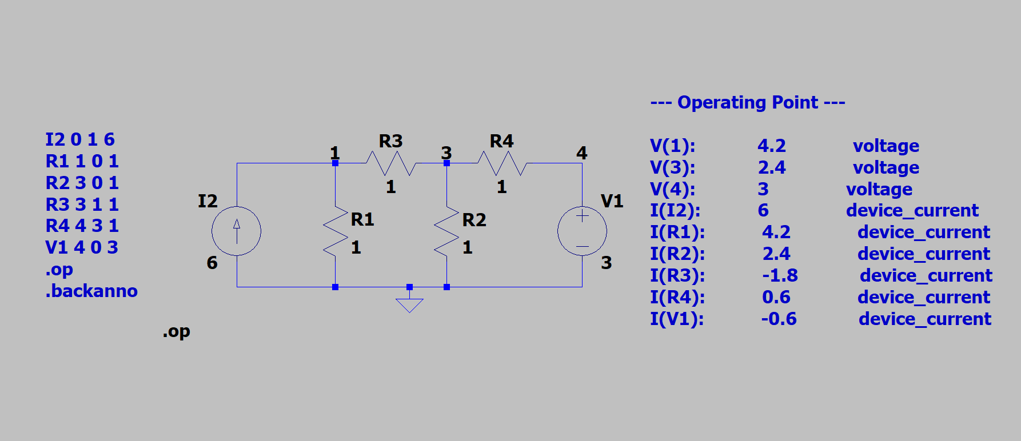
netlist
Operation point analysis

Slide 6
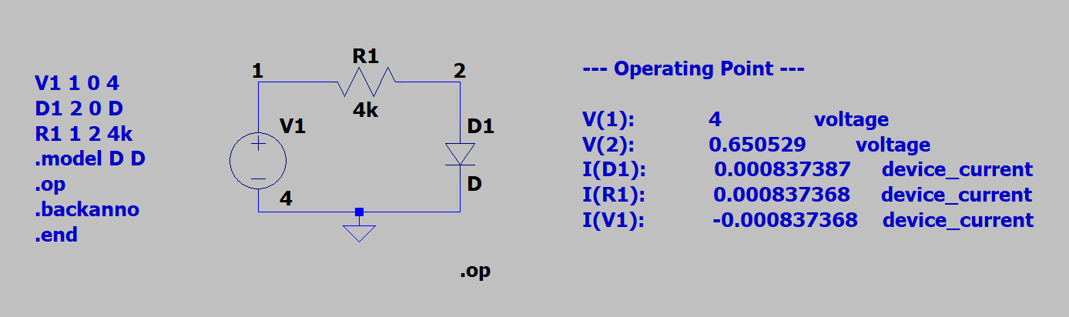
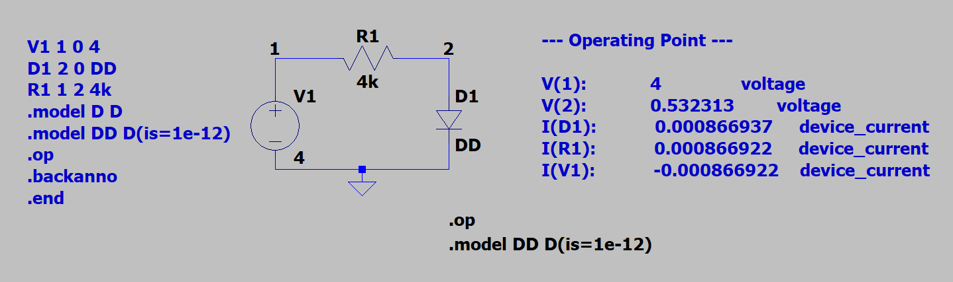
(Default value)
Diode parameter
(none)
Diode type name

Slide 7
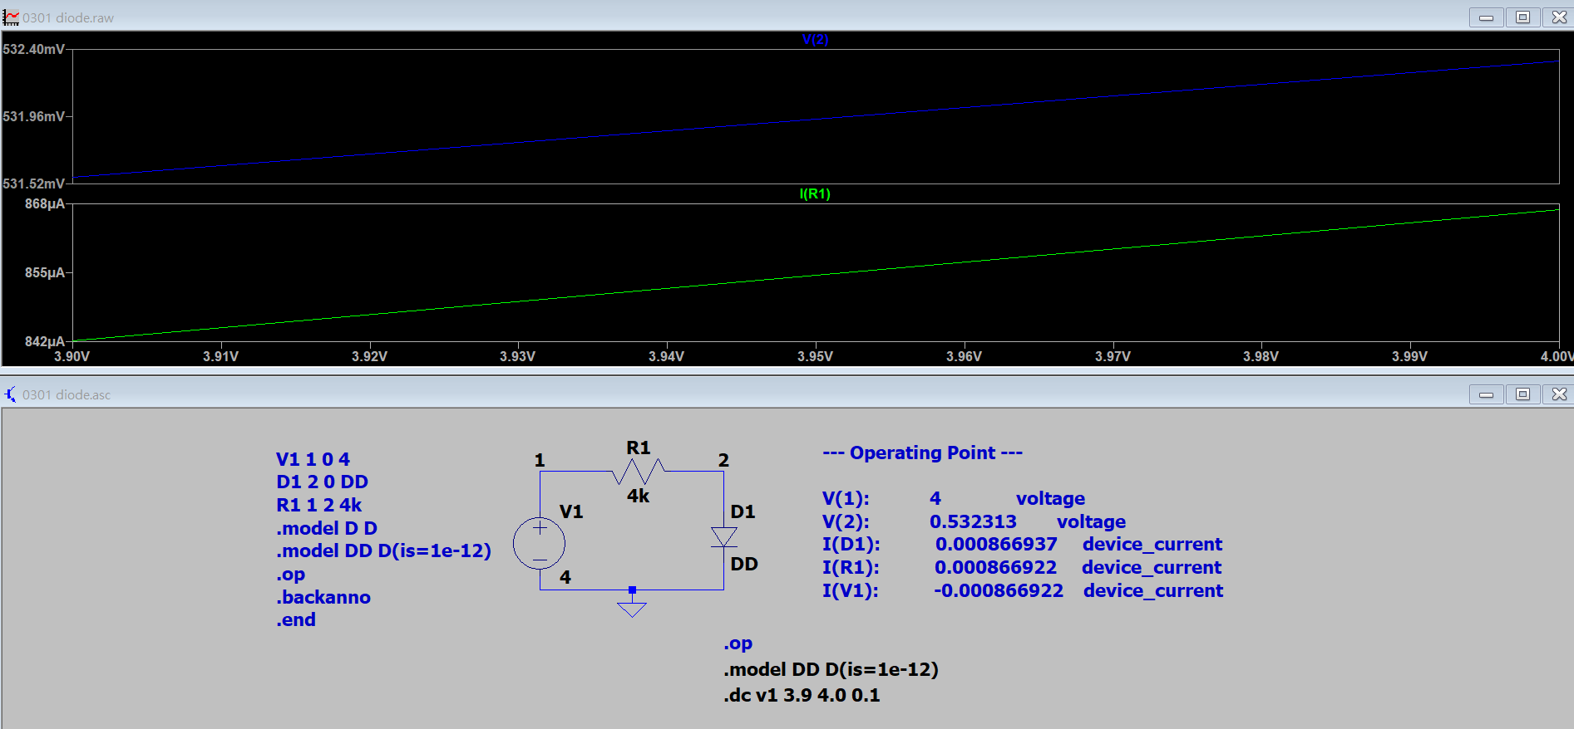
Dc sweep value with V/I seperately
(.op&.dc one at a time)

Slide 8
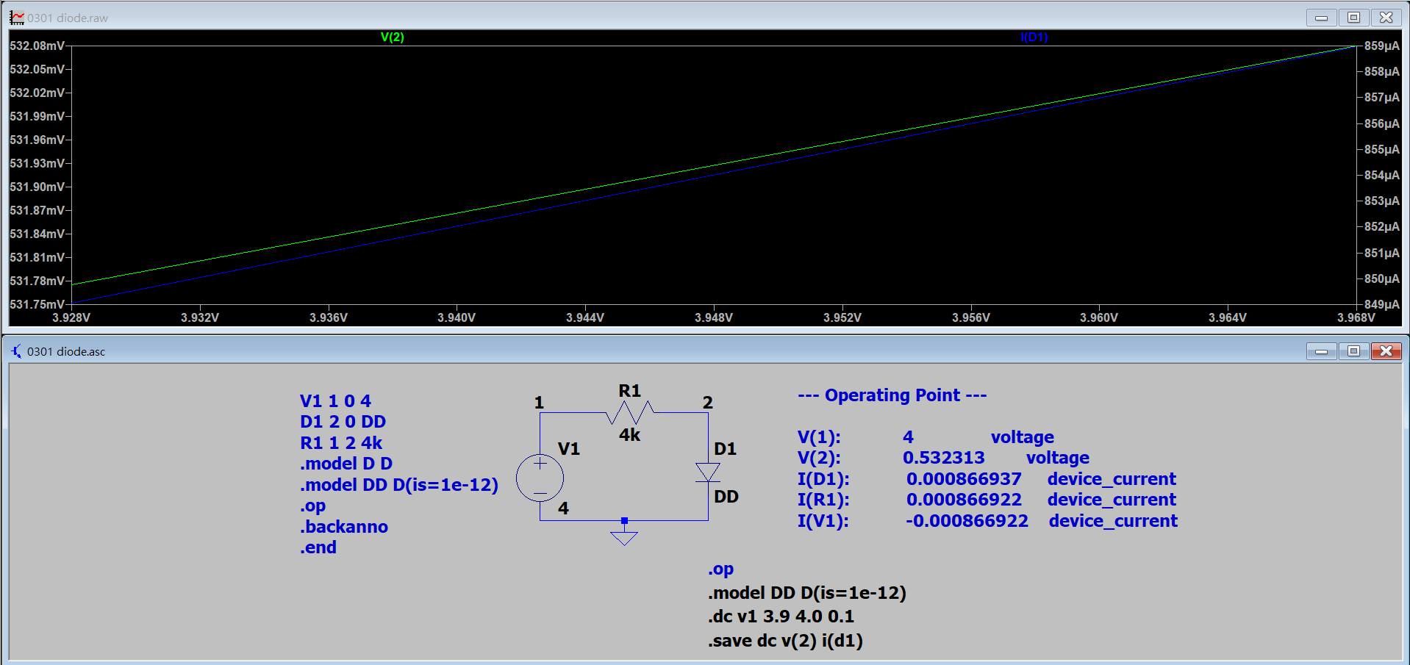
Dc sweep value with V/I on the same plot
.save only saves certain node (save space)

Slide 9
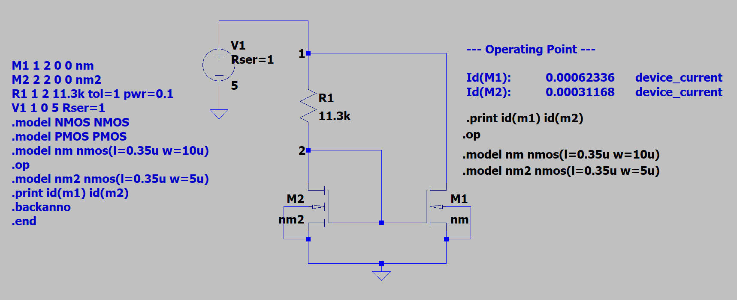
Series resistor
NMOS D G S B type
W1 is twice W2, thus Id1 is twice Id2
Resistor tolerance,power rating(maximum power)

Slide 10
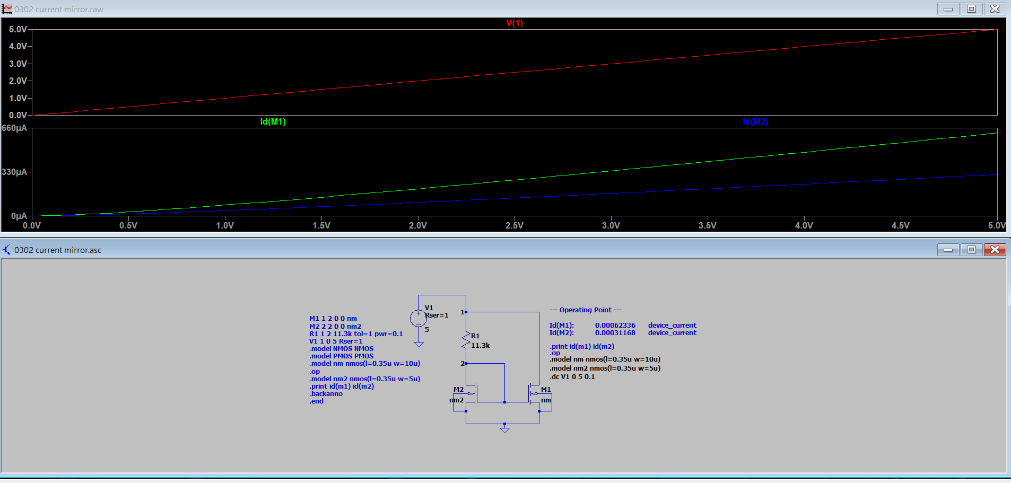
Dc sweep value with V/I shown seperately

Slide 11
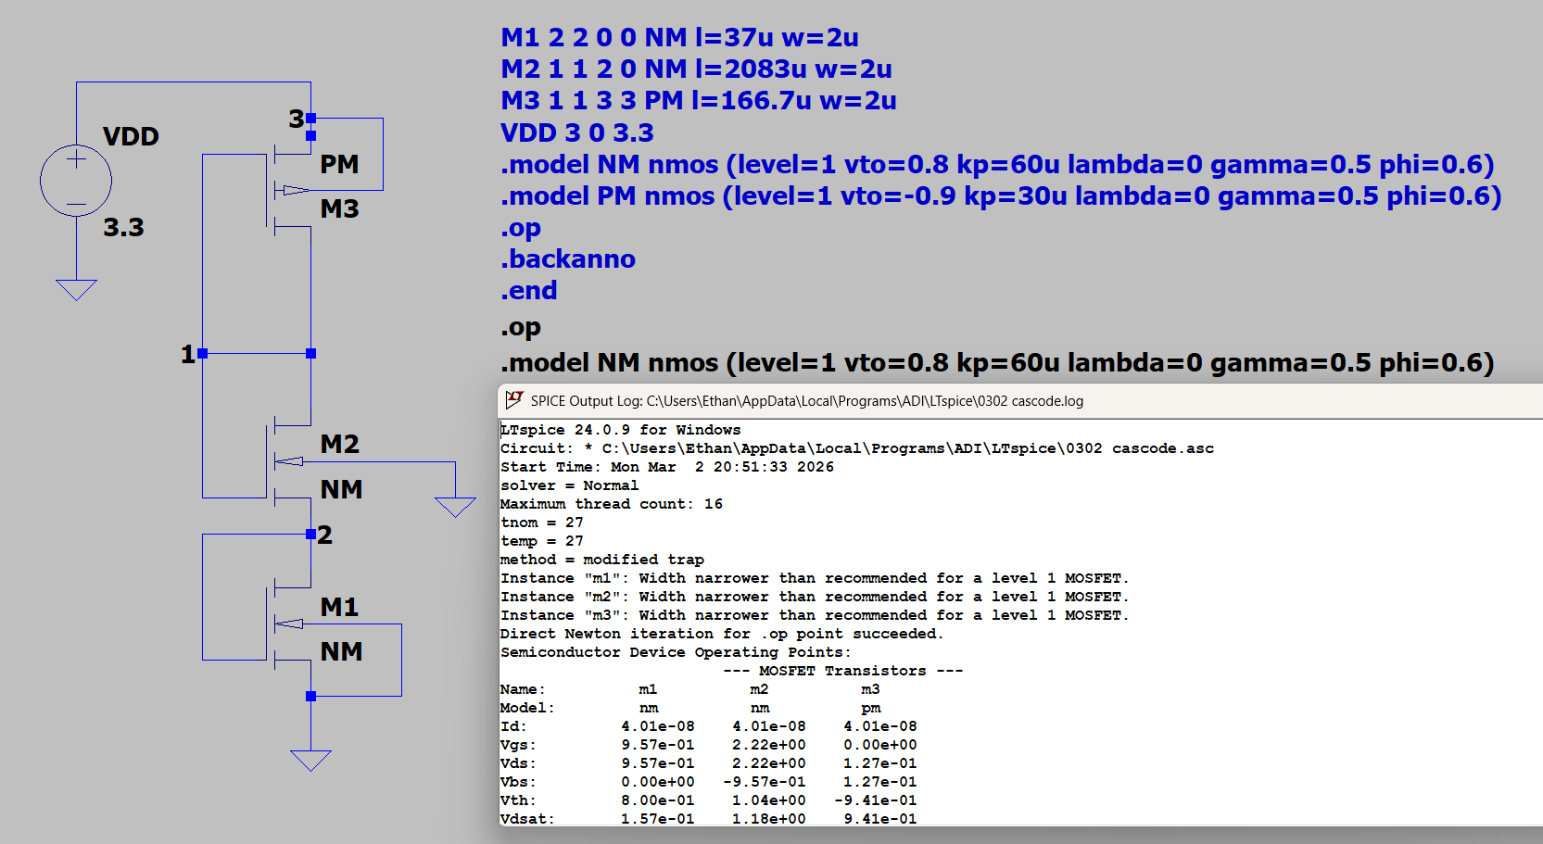
NMOS D G S B type
PMOS D G S B type
S is the one
closer to G
M2 with body effect, Vt2 > 0.8V

Slide 12
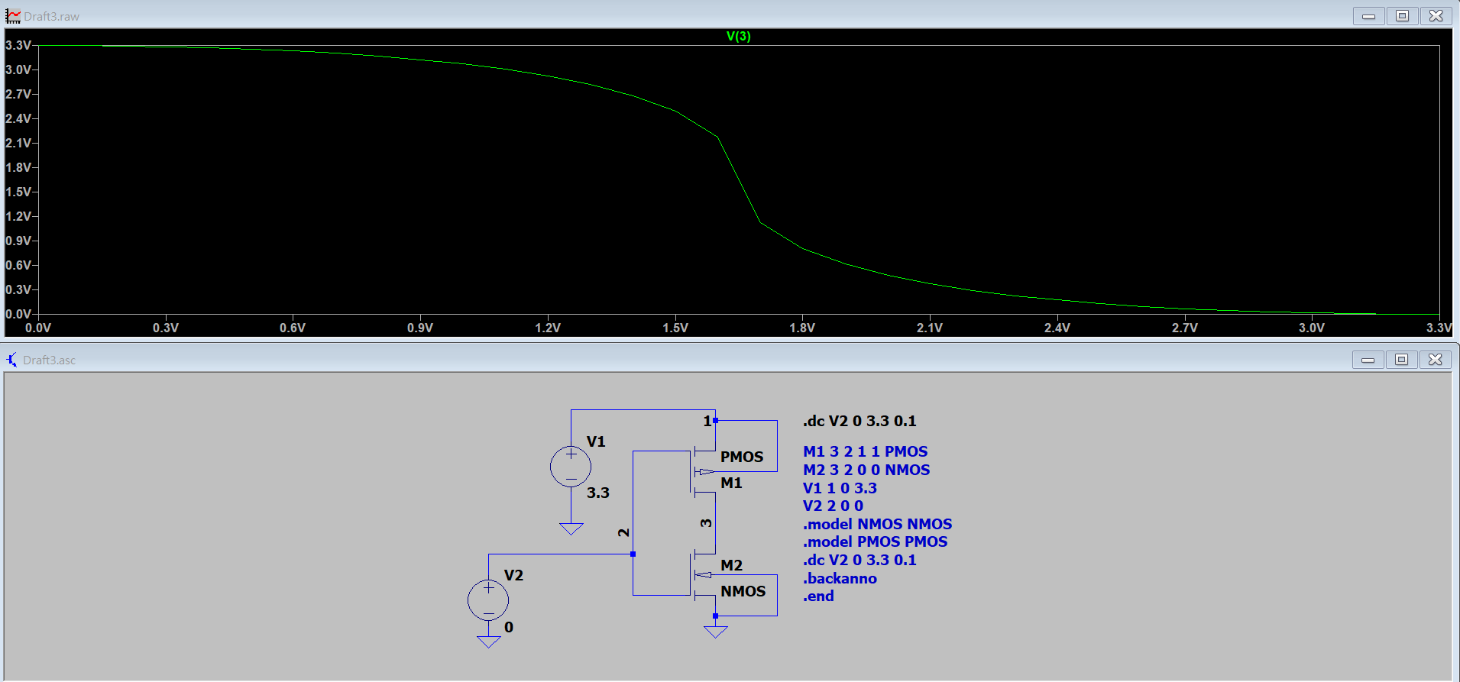
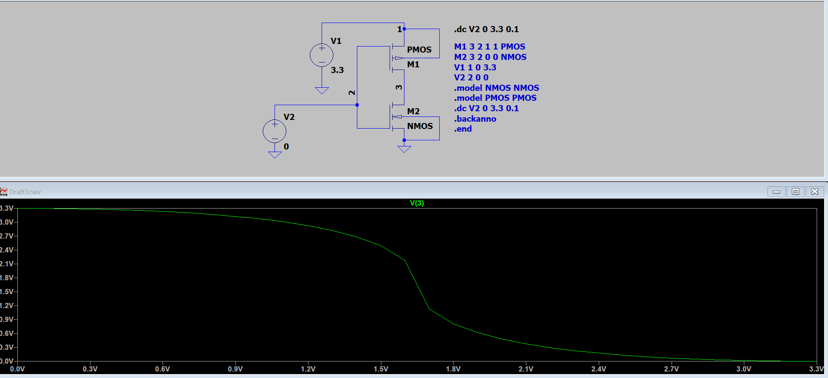
CMOS Inverter

