Slide 1
First Sprint Presentation
Team 34
Jiyang Tao Yumeng Xie

Slide 2
Agenda
Introduction
First Sprint Goals
Progress
Reflection & Problems
Second Sprint Goals

Slide 3
Introduction
A Travel Website “Go Travel”
Major Functionalities:
Create own plan
Add time and route manually or using map
Find companions
Search by your own plan or key words
Share travel notes
Go through other user’s travel notes
Comment & Evaluate & Add To Favorite
Provide recommendations about the hotels and restaurants about the travel place

Slide 4
First Sprint Goals
Test how to use Google Map API and Yelp API
How to use API get required data
Display on the corresponding webpage
Implement login and registration functions
Homepage, Travel Notes, Travel Plans can be accessed with anonymous users
Other functionalities only can be accessed with authentication users
Implement homepage and relative functions

Slide 5
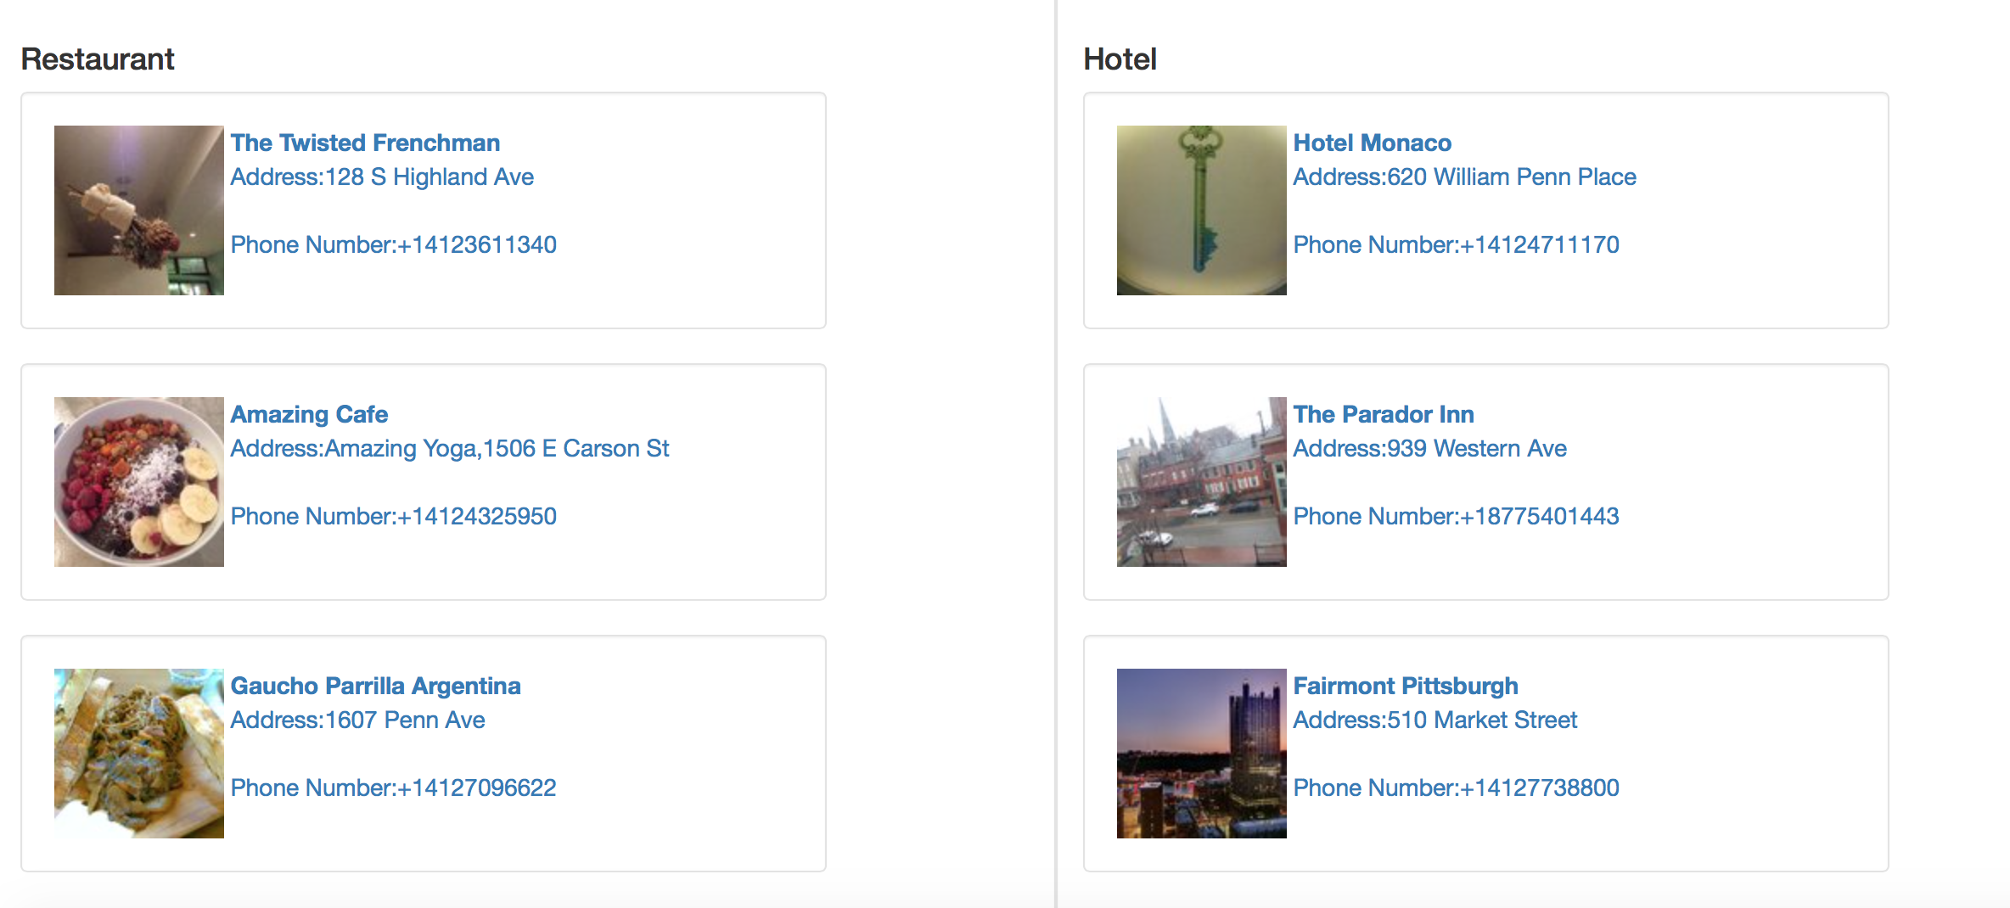
Our Progress
Test how to use Google Map API and Yelp API

Slide 6
Our Progress
Test how to use Google Map API and Yelp API

Slide 7


Our Progress
Implement login and registration functions
Code is just like what we did in the homework
Anonymous User
Authenticate User

Slide 8
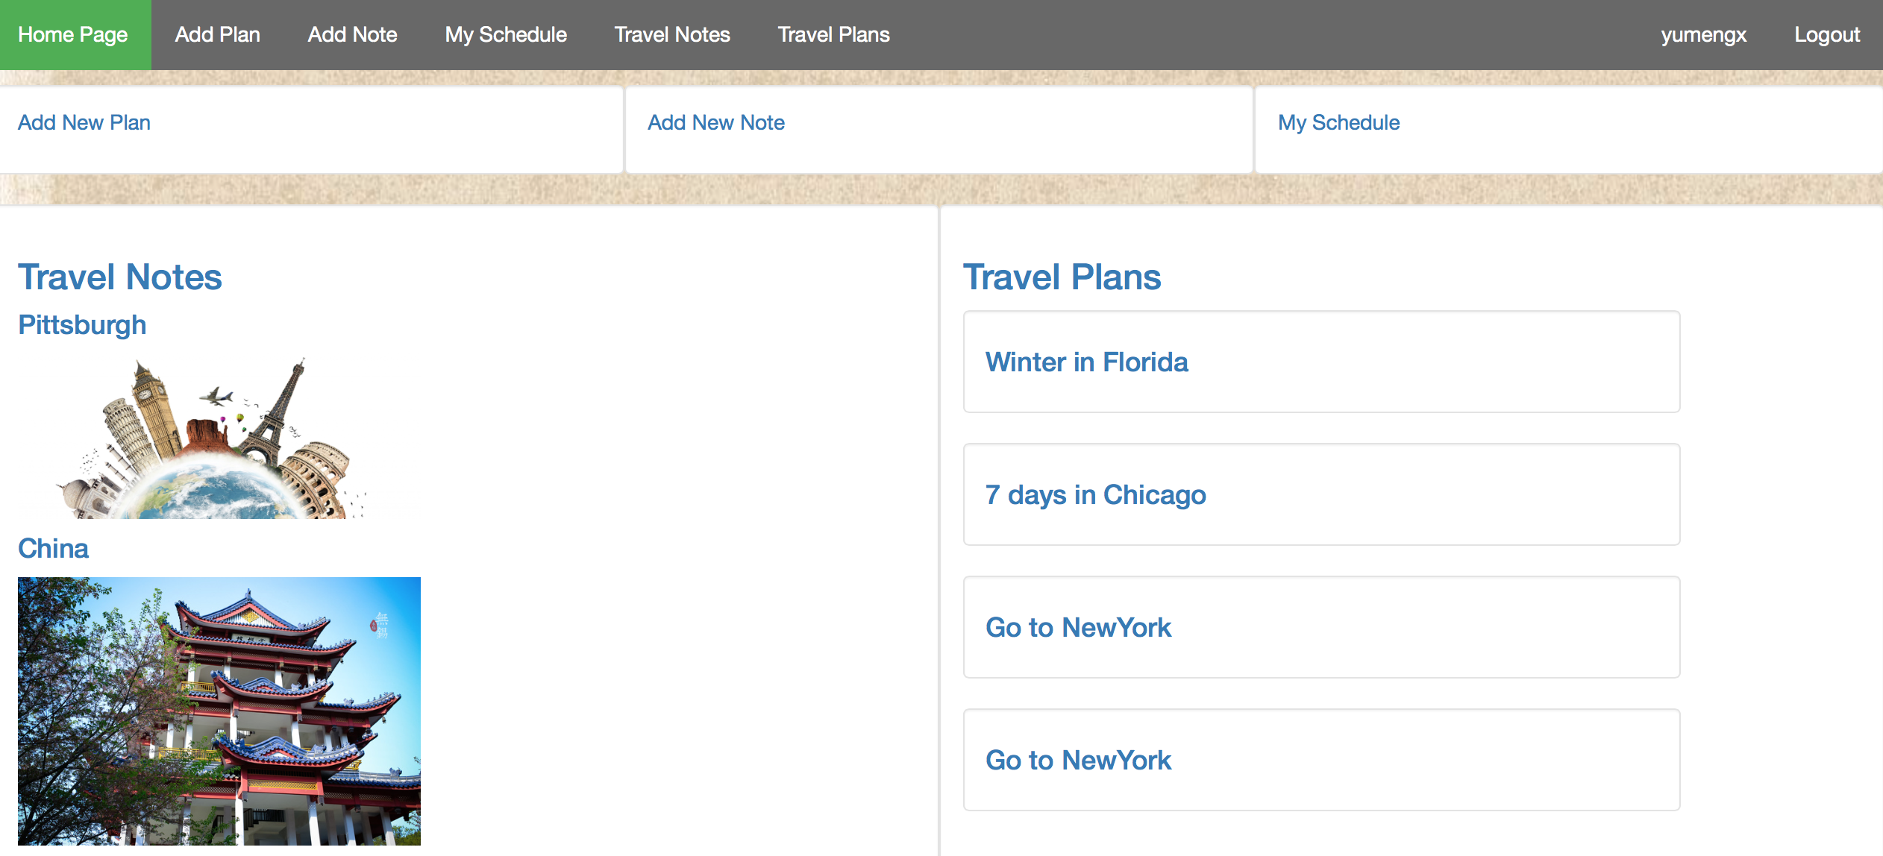
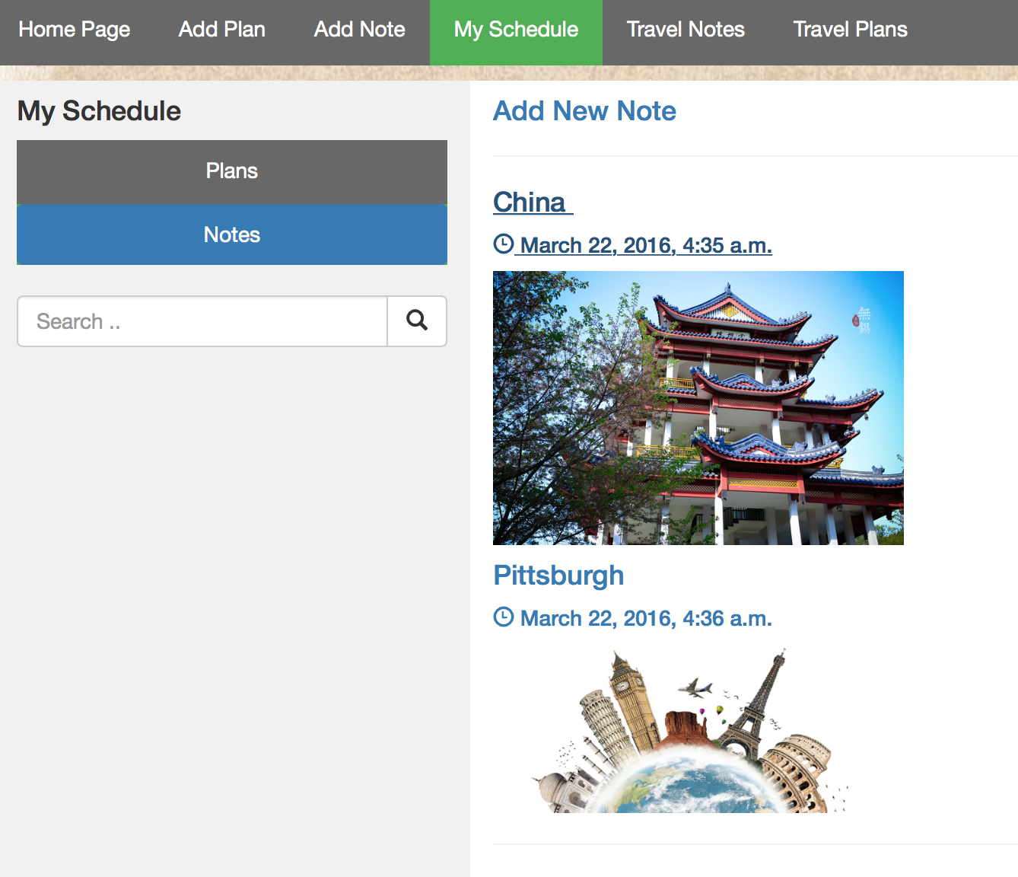
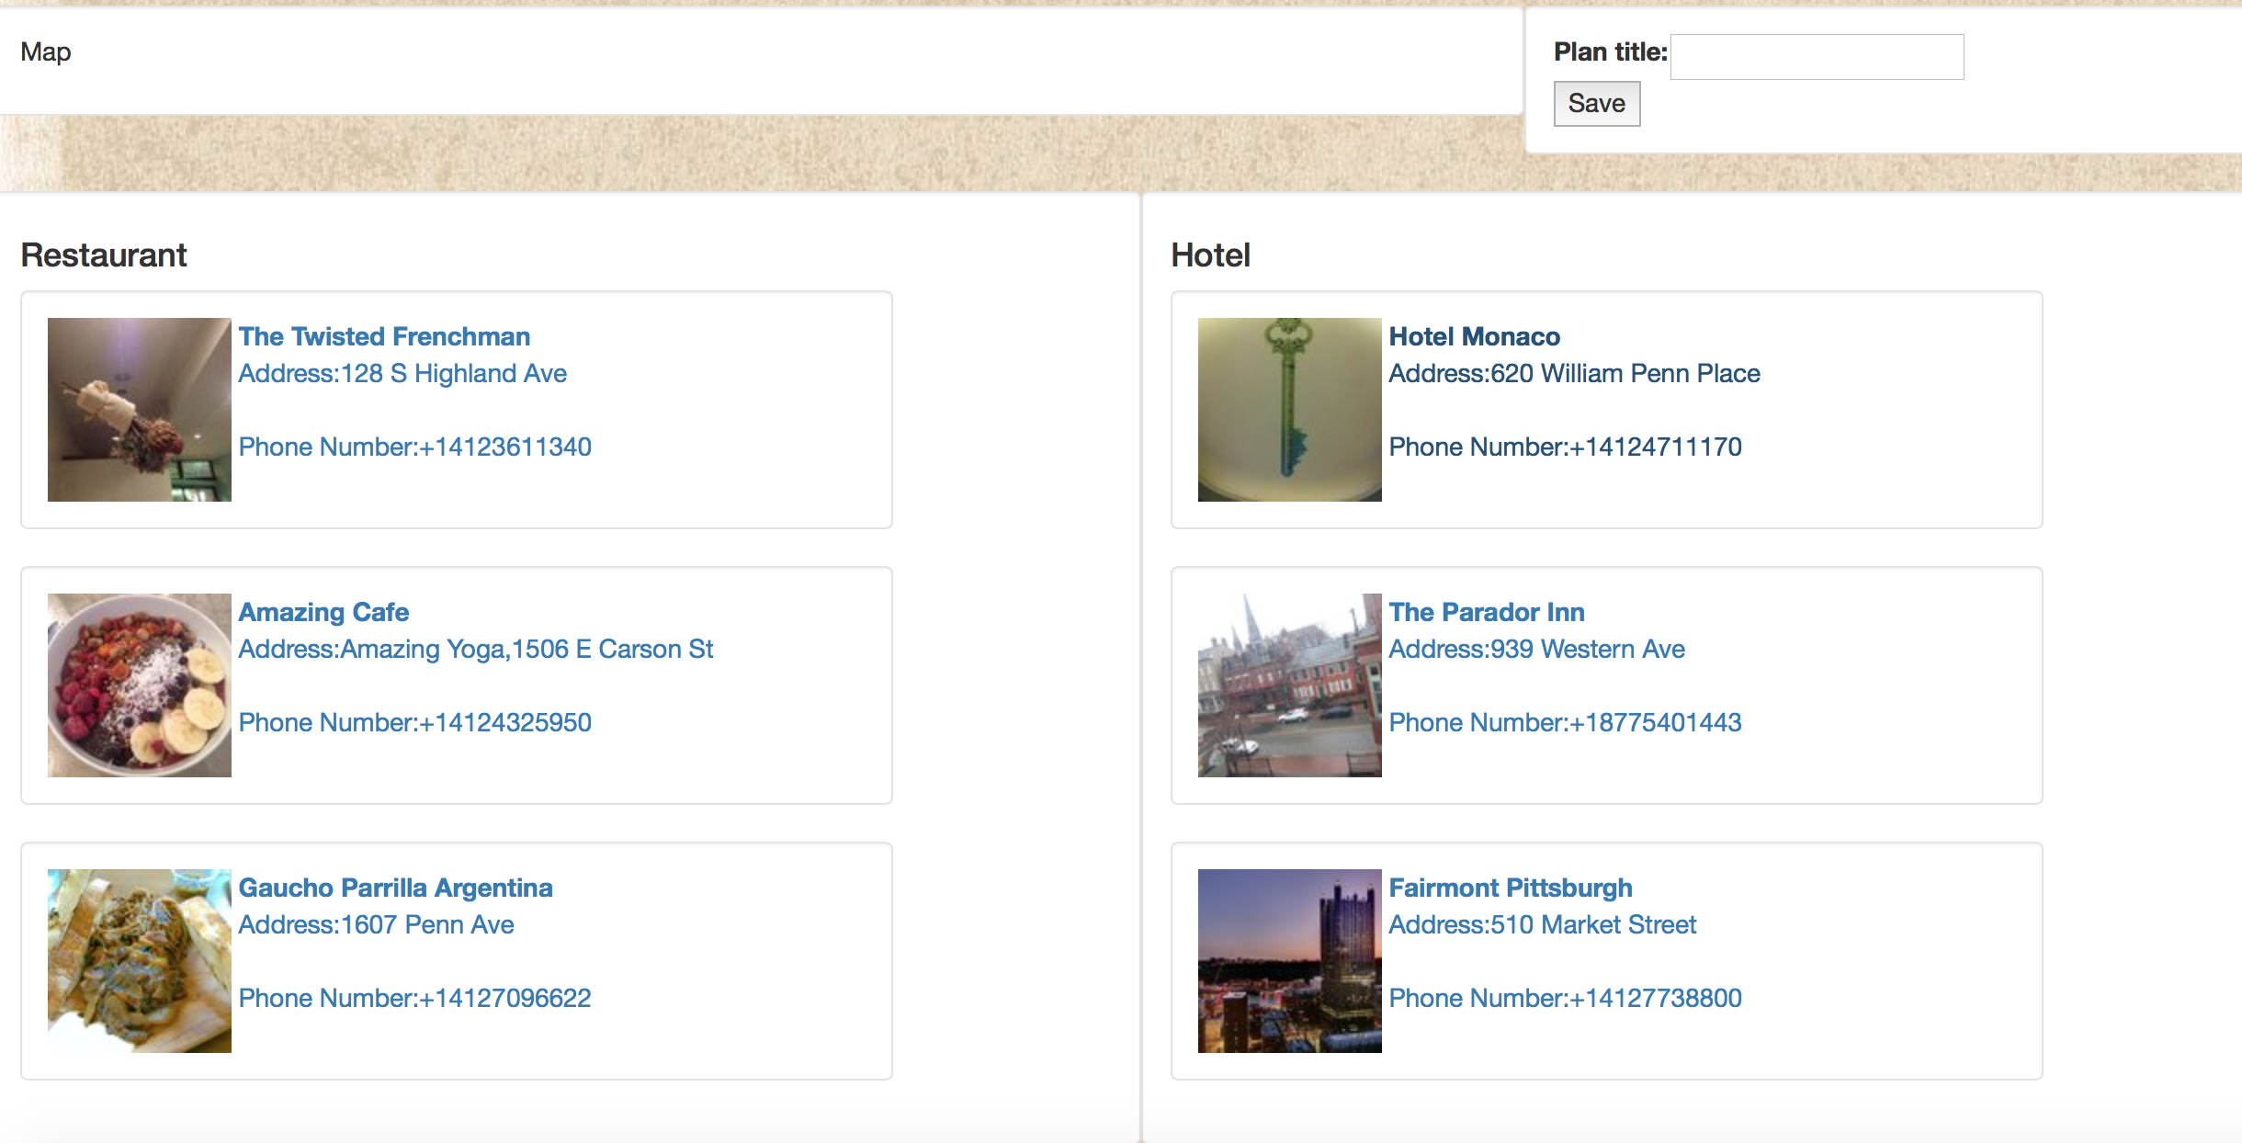
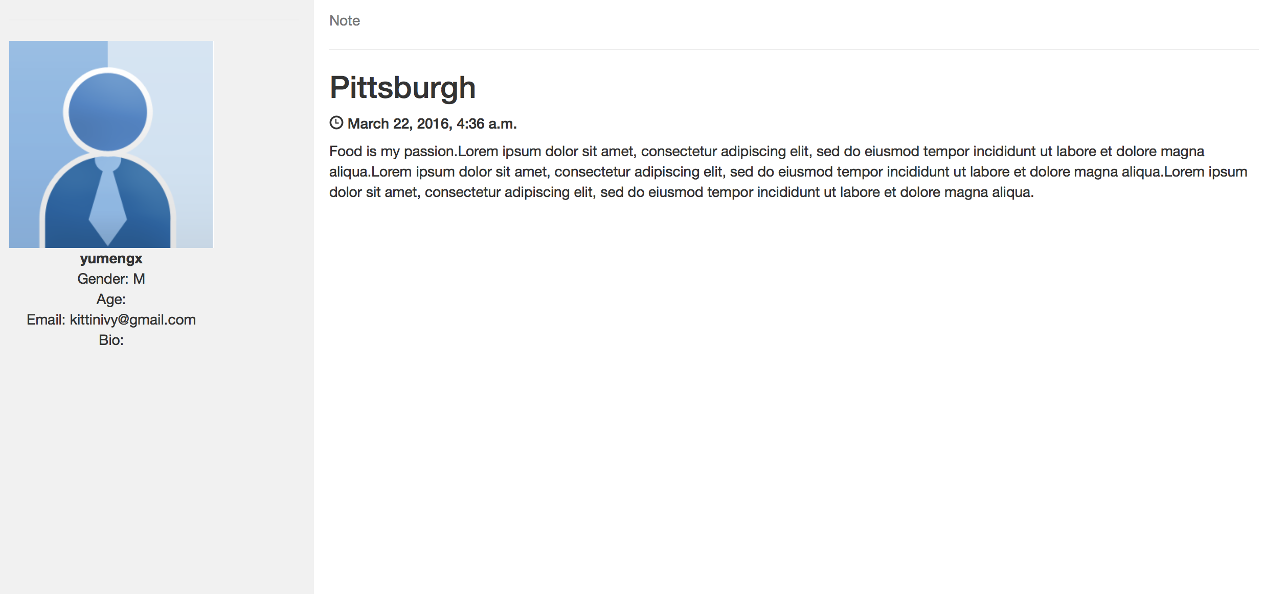
Our Progress
Implement homepage and relative functions

Slide 9
Reflection
Spend time on deciding the topic & Start late
Scrum is useful

Slide 10
Problems
How to construct the database?
Each note or plan has multiple time & place pairs. But the number is uncertain.
Scrape the data and store in the database?
Get yelp’s data when calling the function. The latency is high.

Slide 11
Second Sprint Goals
How to construct the database?
Each note or plan has multiple time & place pairs. But the number is uncertain.
Scrape the data and store in the database?
Get yelp’s data when calling the function. The latency is high.

Slide 12
Thank YOU!

