Slide 1
Xicro & NETPI Instruction

Slide 2
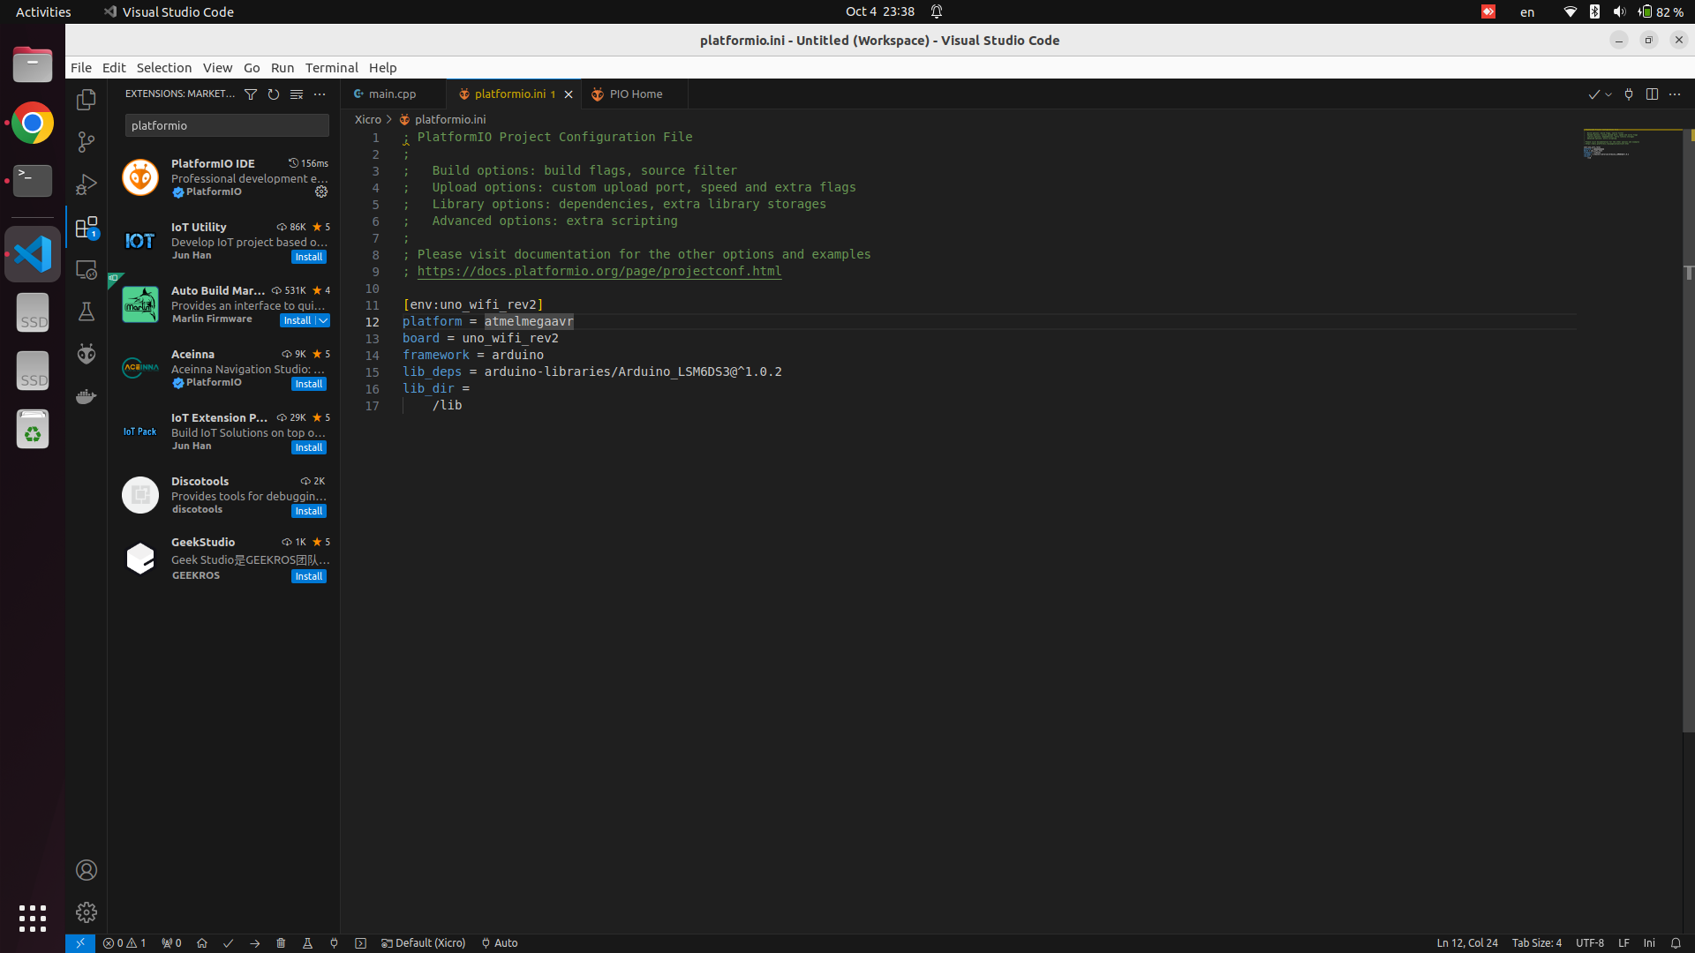
1. Setup VSCode
2. Setup PlatformIO (Extension)
3. Reset VSCode

Slide 3
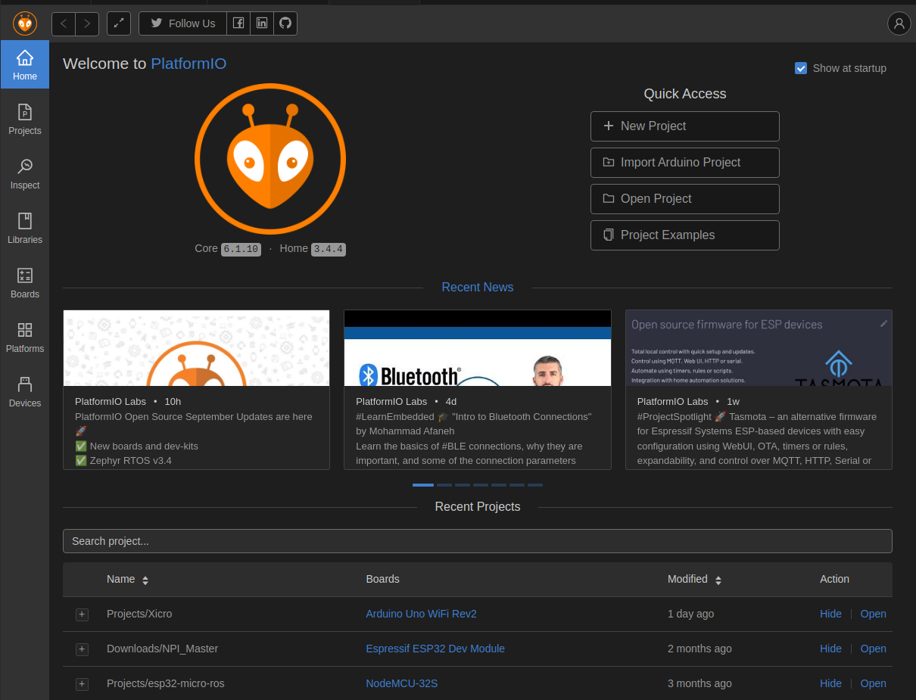
1. Download File → software_integration.zip
2. Open Project → software_integration_[...]/xicro_example

Slide 4
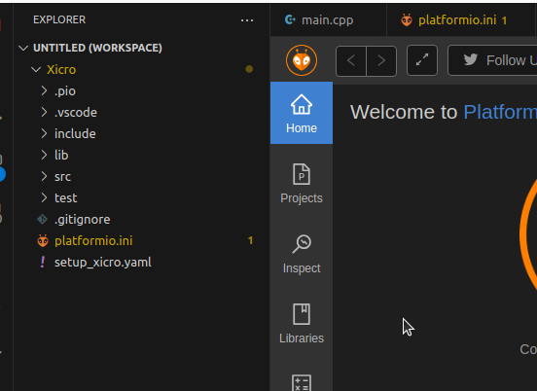
1. Lib > Right Click > Copy Path
Output → lib path : /home/kittinook/fra501_ws/src/software_integration_solution/XicroExample/lib

Slide 5
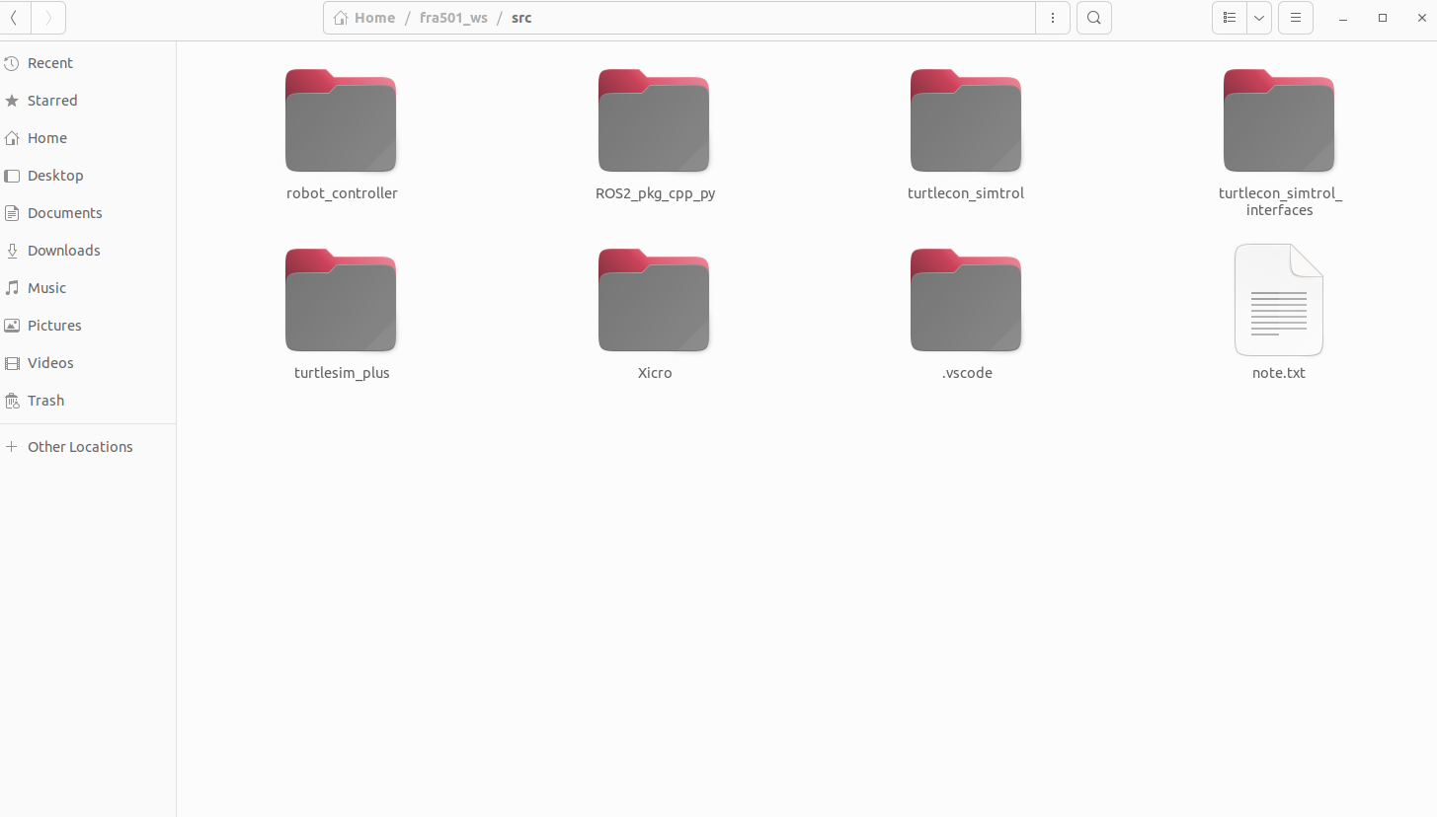
1. clone Lib Xicro → [workspace]/src
https://github.com/coxsys-robotics/XICRO
2. [workspace] → colcon build

Slide 6
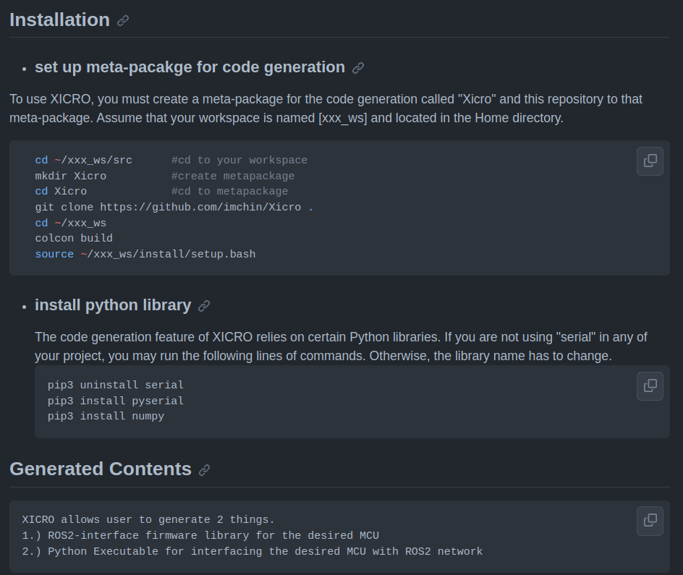
https://github.com/coxsys-robotics/XICRO
Follow Instruction
- Installation
- set up meta-package for ….
- install python library
- Generated Contents
- Setup Parameters in the Configuration File

Slide 7
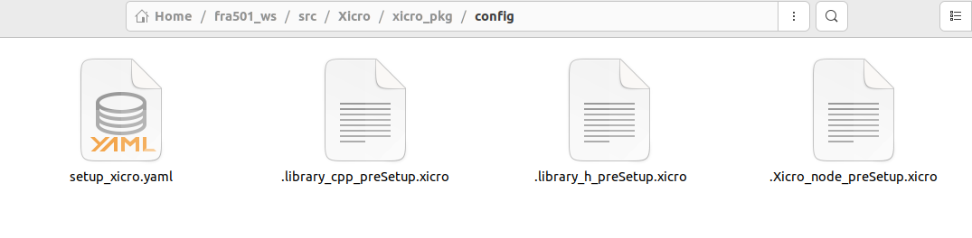
Setup Parameters in the Configuration File
1. Copy file setup_xicro.yaml from software_integration_package to
~/[workspace]/src/Xicro/xicro_pkg/config
2. cd ~/[workspace]/src/Xicro/xicro_pkg/config
3. code setup_xicro.yaml
4. edit → generate_library_Path: "arduino-1.8.19/libraries" # path for generate library
To → generate_library_Path: "/home/kittinook/Documents/PlatformIO/Projects/[ProjectName]/lib”
# your lib path
1. Lib > Right Click > Copy Path
Output → lib path : /home/kittinook/fra501_ws/src/software_integration_solution/XicroExample/lib

Slide 8
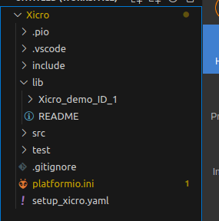
Generating File
1. Run : ros2 run xicro_pkg generate_library.py -mcu_type arduino
2. Run : ros2 run xicro_pkg generate_xicro_node.py -mcu_type arduino
3. Run : ros2 run xicro_pkg xicro_node_demo_ID_1_arduino.py

Slide 9

NETPI
https://netpie.io/

Slide 10
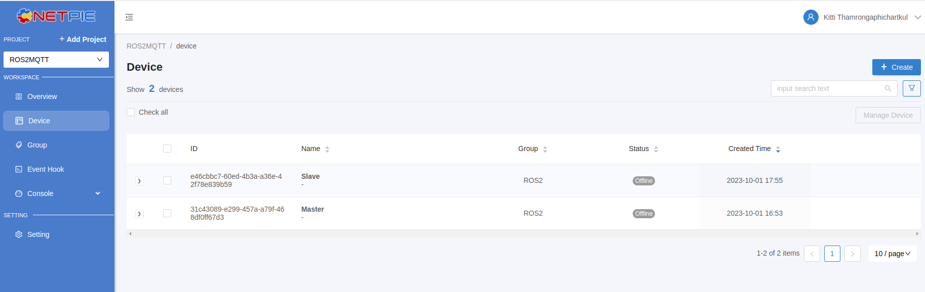
NETPI
Sign Up
Log In
Create Project > ROS2MQTT
Create Device > Master and Slave
Create Group > Add Master and Slave to Group

Slide 11
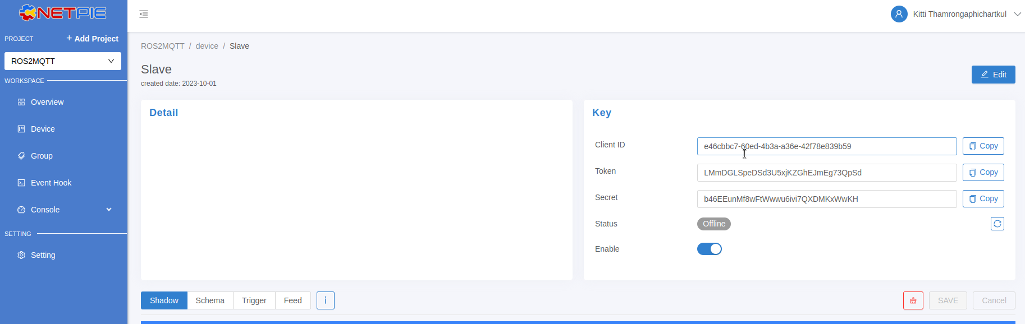
NETPI
Copy Key [Master, Slave]
- Client ID, Token, Secret to Code

