Slide 1

Bikini Showcase for Summer
(A Must See for the Daring!)

Slide 2
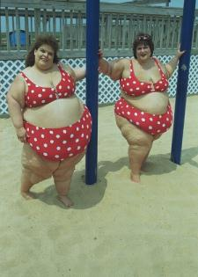
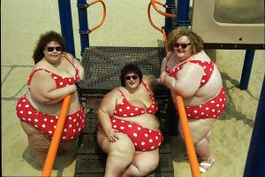
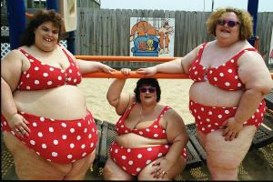
Model: Romantic Dreams
Red polka-dot bikinis on the playground.

Slide 3
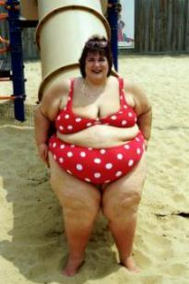
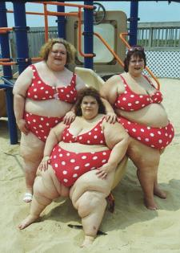
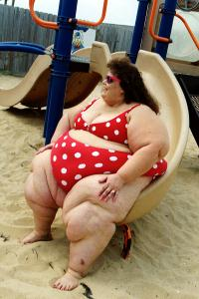
Model: Romantic Dreams
Red polka-dot bikinis on the playground.

Slide 4
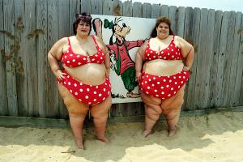
Model: Romantic Dreams
We love you Goofy! If he would like us?

Slide 5
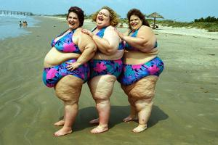
Model: Flower Power
Let‘s dance a Sunshine-Reggea
Shiny & flowery bikinis on the wet sand.

Slide 6
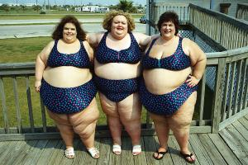
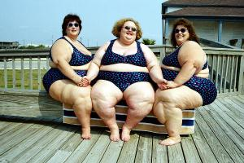
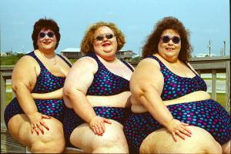
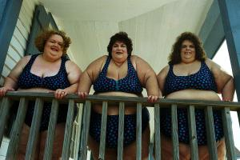
Model: Ocean-Dream
Colorful polka-dot bikinis by the resthouse’s balcony.

Slide 7
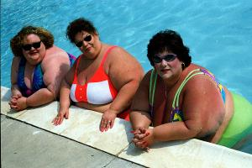
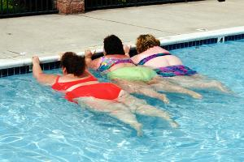
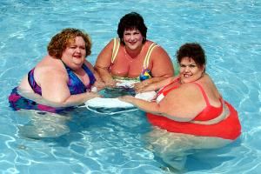
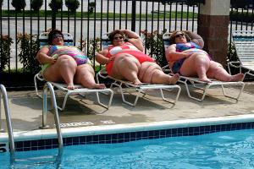
Model: Crazy-Colors
Bright neon-colored bikinis in the pool.

Slide 8
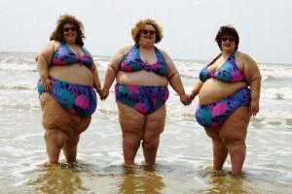
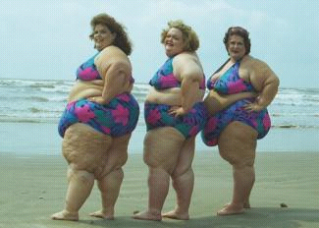
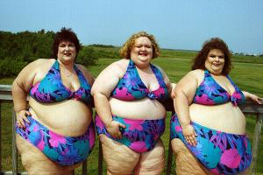
Model: Baywatch
Flowery prints for SOS-calls.

Slide 9
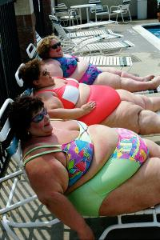
Model: Relax
Bright bikinis for special pool moments.

Slide 10
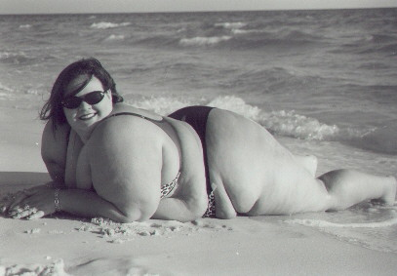
Model: Black & White
Two-toned bikini against the burning sun.

Slide 11
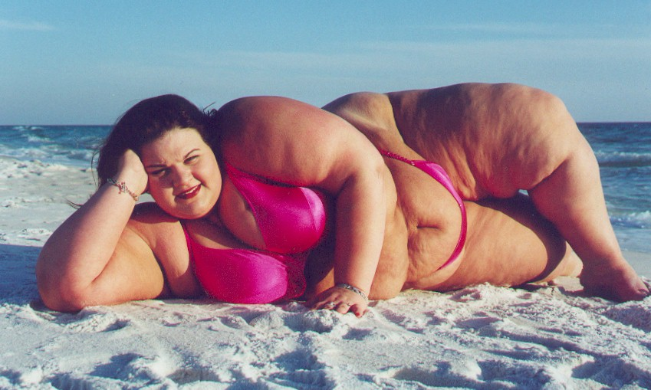
Model: Pinky-Minky
Sweet-colored bikini perfect for a swim date.

Slide 12
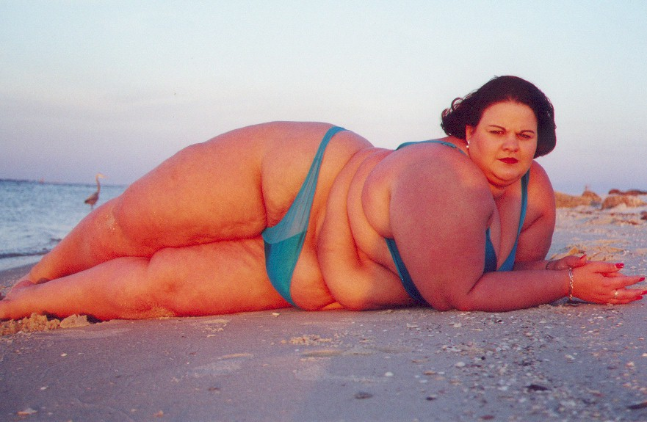
Model: Blue Sunset
Aqua-cool colored bikini on the beach.

Slide 13
End of
Bikini-Show

