Slide 1



Office Safety
31 July 2000, ITC Staff Meeting

Slide 2
Office Safety
Office Related Injuries & Illness
Workstation Ergonomics
Indoor Air Quality & Ventilation
Noise
Office Electrical Safety

Slide 3

Office Related Illness Injuries
Falls:
tripping over desks, open drawers, elec cords, bending from an unstable chair, etc.
Prevention:
walk on a clear pathway
close drawers after use
avoid excessive bending, twisting or leaning back around while seated
secure elec cords & wires away from walkways
use step ladder & not chairs for overhead reaching
Clean up mess & spills immediately
Report loose carpeting/damaged flooring
When falling- roll don’t reach!

Slide 4

Office Related Illness Injuries
Strains & Overexertion:
improper way of carrying reaching/lifting materials
Prevention:
balance self when lifting items
never carry loads that block your vision
try arranging tables/items to avoid twisting
store materials at knee level to avoid too much bending
when carrying materials/loads some distance, try getting support or hand truck or cart to transport it.

Slide 5

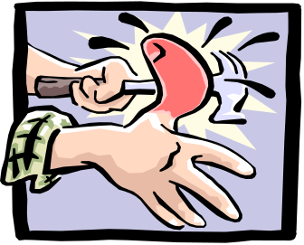

Office Related Illness Injuries
Struck By or Striking Objects:
bumping or striking against office machines,
hit by dropped items/equipments
Caught In-Between Objects:
fingers or articles of clothing caught in or
in-between objects, windows, doors,
office machines, etc
Material Storage:
improper piling of stocks leading to
falling objects, poor visibility/obstruction, etc

Slide 6
Workstation Ergonomics
Common Complains:
neck pains, also in shoulders, back eyes, arms due to positioning & design of workstation
Prevention:
Arrange workstation to fit you by adjusting chair height. Be comfortable with arm & back rest
Apply good work practice by adjusting drapers/blinds, moving the monitor away from light to minimize glare. Proper handling of telephone. Moving from different position regularly. Keep regularly used items within reach. Take mini-breaks to rest eyes & muscles. Maintain a comfortable workplace

Slide 7
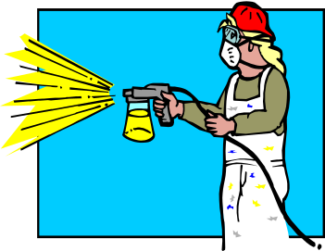
Indoor Air Quality & Ventilation
These are associated w/ chemical contaminants from inside or outside the office, which may come from paints, sealants and the likes
Other sources: dusts, smokes, office re-modeling & maintenance, emissions of some equipments,
Prevention:
Adequate ventilation of office, including design & maintenance
Periodic cleaning of air-conditioning system
Special attention (isolation) of operation that may generate contaminants (painting, spraying & heavy cleaning)

Slide 8

Noise
Unwanted sound from materials that may include printers, telephones, machines & human voices. These can lead to interference w/ speech & communication, annoyance and distraction from mental activities.
Prevention:
Selection of quietest equipment possible.
Proper maintenance of equipment (lubrication & tightening)
Relocation of loud equipment in areas where its effect is less disturbing.
Use barrier/walls/dividers to isolate noise sources
Schedule noisy tasks at time when it will have less effect on the other tasks in the office.

Slide 9

Office Electrical Safety
Ungrounded equipment, overloaded outlets, unsafe/un-approved equipment, defective and improper installation of cords, working on “live” equipment, pulling of plugs to shut off power, etc.
Prevention:
Inspection of outlets, cables, wirings & electrical connections of equipment
Practice safety first in working with electrical connections.

Slide 10

One last thing…
Practice Safety First

Slide 11
And you don’t have to applaud….
I provided the sound effect!

