Slide 1
Composite Sketch
This program creates a sketch of your face according to the information entered by you regarding your facial features.

Slide 2
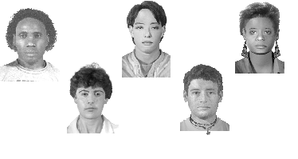
Examples
The results can be decent, but will be close enough to your features. It all depends on the characteristics you enter. Here are some examples :

Slide 3
Questionnaire
In a few seconds a questionnaire will appear, asking you about your features in order to be able to do a sketch of yourself.

Slide 4
Hair Color
Brown
Blonde
Black
Red/Auburn

Slide 5
Hair Style
Curly
Straight
Baldy

Slide 6
Hair Color
Brown
Black
Blue
Green/Hazel

Slide 7
Nose Shape
Pointy
Round
Flat

Slide 8
Mouth
Large
Small
Medium

Slide 9
Lips
Full
Thin
Medium thickness

Slide 10
Ears
Pointy
Sticking out
Small
Medium

Slide 11
Forma de la cara
Oval
Narrow
Chubby
Bony

Slide 12
Complexion
Pale
Tan
Dark

Slide 13
Ethnicity
European
African
Oriental

Slide 14
Facial Hair
Beard
Handlebar
Moustache
Goatee
None

Slide 15
Gender
Male
Female

Slide 16
Age
0-5
5-9
10-13
14-16
17-24
25-35
36-45
46-55
56-65
+65

Slide 17
Processing
The information will now be processed. In a few seconds, you will be able to see the results. Hopefully,it will be realistic.

Slide 18
Analyzing
.....................................................
....................................................
.....................................................
Data analyzed, press to see your composite sketch

Slide 19
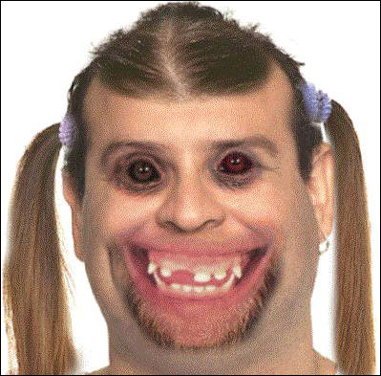
Did you come out ok?

Slide 20
The End

