Slide 1
ITC @ DLSU

Slide 2

Where are we going?

Slide 3

IT Center’s Vision:
To be a reliable service unit.

Slide 4
Questions to ask yourselves
Are these problems or challenges? Why?
Who wants all these? Why?
For whom are these for? Why?
When are these needed? Why?
What are you going to do now? Why?

Slide 5
IT Center’s Mission-Vision:
The DLSU-PSI Information Systems & Technology Center sees itself to be a highly effective proactive team of committed and motivated Christian Achievers. It is guided by the values of Religio, Mores, et Cultura.
It spearheads the pervasive application of information technology with excellent service, innovative leadership, holistic human resource development, continual reengineering, effective change management, and quality assurance.
It envisions itself to be involved with cross-functional and cross-organizational teams in Lasallian and world-class communities.

Slide 6

Vision
To be a highly effective proactive team of committed and motivated Christian Achievers.

Slide 7



Vision
For IT to be pervasive
…not just computers.

Slide 8

Vision
To be a provider of excellent service

Slide 9
Vision
To have
  innovative leadership
  holistic human resource development
  continual reengineering
  effective change management
  quality assurance

Slide 10


Vision
To be involved with cross-functional and cross-organizational teams in Lasallian and world-class communities

Slide 11
IT Center’s Vision:
The DLSU-PSI Information Systems & Technology Center sees itself to be a highly effective proactive team of committed and motivated Christian Achievers. It is guided by the values of Religio, Mores, et Cultura.
It spearheads the pervasive application of information technology with excellent service, innovative leadership, holistic human resource development, continual reengineering, effective change management, and quality assurance.
It envisions itself to be involved with cross-functional and cross-organizational teams in Lasallian and world-class communities.

Slide 12
Quality Framework
University
Processes
⬅match➔
Quality

Slide 13
IT Framework
With focus on
efficiency,
productivity,
& quality,
⬅ match ➔
University
Processes
Information
Technology

Slide 14
IT in DLSU
Knowledge
Customers
University
Information Systems
Information Technology

Slide 15
Information Technology
Computers
Computer peripherals
(e.g., printers, scanners)
Computer network
Telecommunications (e.g., phone/PABX, fax)
Internet
Other office devices

Slide 16
Information Systems
People
Policies and procedures
Operating systems (e.g., MS Windows)
Application programs (e.g., My.LaSalle Portal, Student Records Management, Decision Support Systems)

Slide 17
Strategic Enterprise Management
Enterprise Resource Planning
Human Resources Management
Customer Relations Management
Campus Management
Enterprise Systems Management
Decision Support Systems

Slide 18
Enterprise Resource Planning
(“backroom operations”)
Accounting (on-line payment)
Inventory
Purchasing (on-line purchase)
Supply chain execution

Slide 19
Human Resources
Payroll
Attendance
Staffing
Competencies
Employee development / training
Evaluation
Succession
201 file and accountability

Slide 20
Customer Relations Management
Recruitment
  Faculty / Administrators
  Students
Alumni Relations
Industry-academe linkages, consortia
On-line application
On-line “PR/marketing materials”
  Course catalogs, newsletters, et al

Slide 21
Customer Relations Management
Faculty training
  Information technology
  Education technology
  Intellectual property
  On-line learning and collaboration
  Courseware authoring
  Research
Faculty services / HR

Slide 22
Customer Relations Management
Student training
  Information technology
  Education technology
  Intellectual property
  On-line learning and collaboration
  Research
Student Services

Slide 23
Customer Relations Management
Distance learning / on-line learning
  Computer-based courseware
  Internet- or web-based courseware
  Video conferencing
  Computer-assisted learning and collaboration

Slide 24
Customer Relations Management
Help Desk
Library Information System
Intranet, groupware / collaboration
Web sites
Active desktop
On-line services (e.g., on-line payment, events)

Slide 25
Customer Relations Management
My.LaSalle portal
  One-stop shop of information services
  Information at a click of a button
  “Personalized” or with a personal touch
  Accessible, secured, reliable

Slide 26
Customer Relations Management
Alumni
  Job placement
  Alumni Association
  Communication (e.g., newsletter)
  Alumni tracking

Slide 27
Campus Management
Telecommunications (e.g., e-mail, fax, voice, teleconference)
Security
Electricity and electrical devices
Water, tanks
Elevators, noise control, others

Slide 28
Enterprise Systems Management
(IT Center)
Network and server management
Software deployment & configuration
Anti-virus and security management
Hardware and software inventory
Data / database administration
Storage management
Back-up and recovery

Slide 29
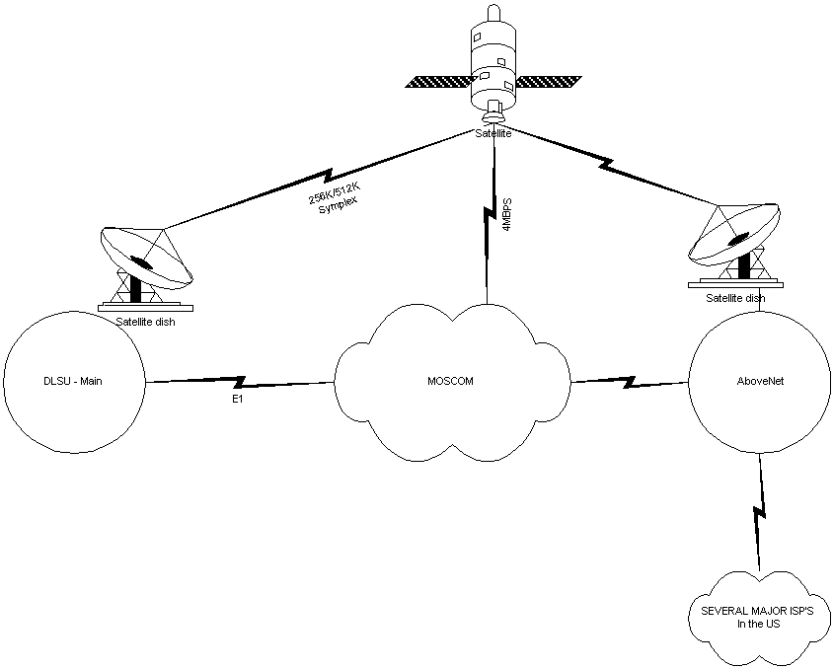
5 to 9 Mbps
(receive-only)
DLSU
4 Mbps
(two-way)
Internet Infrastructure

Slide 30
Student Records Management
Admissions
Enrollment, Grades, Transcript
Discipline, health
Guidance, counseling, formation
Student activities
Outputs: Transcript, Diploma, Résumé

Slide 31
Decision Support Systems
Data warehouse
Report generation tools
Activity-based costing and management
Balance Scorecard
Others

Slide 32
Questions to ask yourselves
Are these problems or challenges? Why?
Who wants all these? Why?
For whom are these for? Why?
When are these needed? Why?
What are you going to do now? Why?

Slide 33

Where are we going?

Slide 34
Thank you!
Questions?

