Slide 1
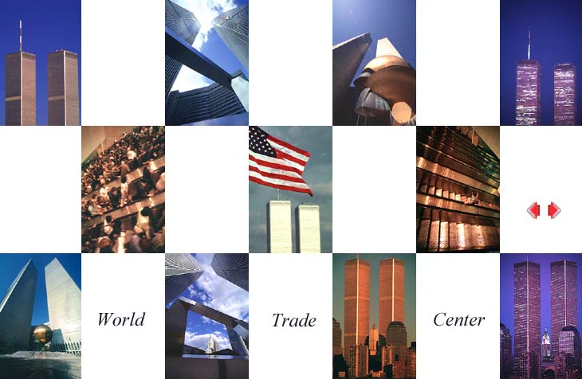
Constructed 1966 to 1975
Destroyed by terrorists September 11, 2001

Slide 2
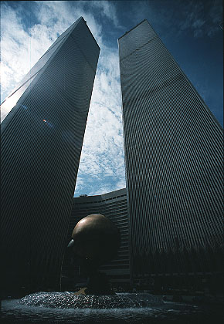
Designed by Minoru Yamasaki and constructed by the Port Authority of New York and New Jersey in the early 1970s, the World Trade Center was a complex of seven office buildings, most impressive of which were the twin towers, with nine million square feet of office space.
The 110-story towers were 1,353 feet high, for a time the highest skyscrapers in the world, now surpassed only by the Sears Tower in Chicago and the Petronas Towers in Kuala Lumpur.
Address Church St
City New York City
State New York
Country U.S.A.

Slide 3
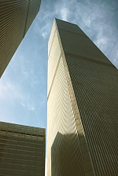
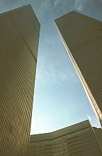
Height (tip of flag): 415.14 m (1,362.00 ft)
Height (top floor): 411.00 m (1,348.41 ft)
Year (construction start): 1966
Year (construction end): 1973
Year (opening): 1975
Each tower had 104 elevators, 21,800 windows, and roughly an acre of rentable space on each floor.
Total size of the complex was 1,114,800 sqm.
50,000 people worked in the complex.
It attracted 90,000 visitors daily.

Slide 4
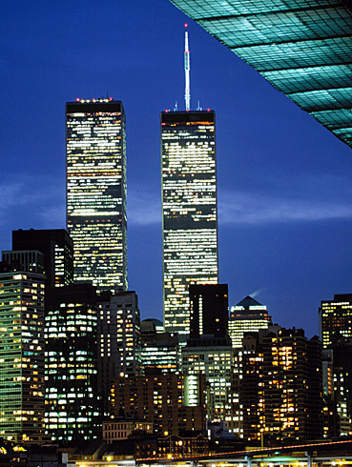
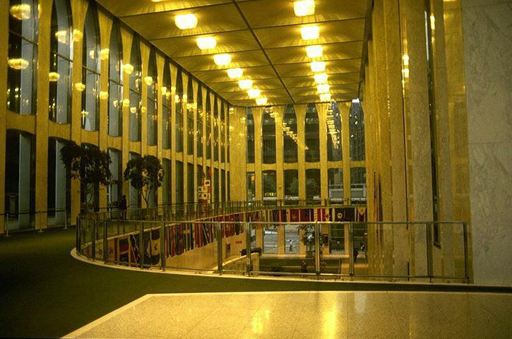
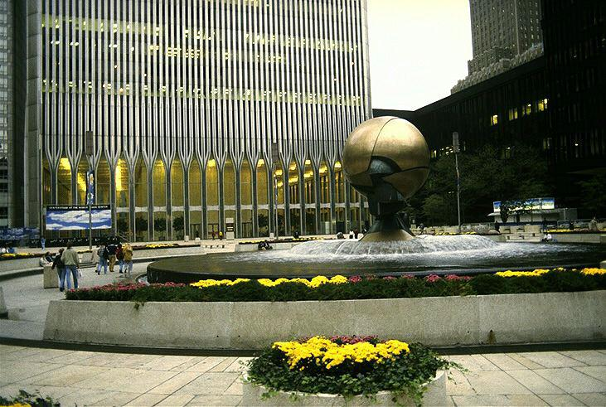
(Photo, lobby interior at mezzanine)
Both towers had something to offer up top.
One World Trade Center (the one with the antenna) was home to the elegant restaurant Windows on the World while Two World Trade Center contained the indoor and outdoor observation decks.
(Photo, exterior, across open space and fountain)

Slide 5
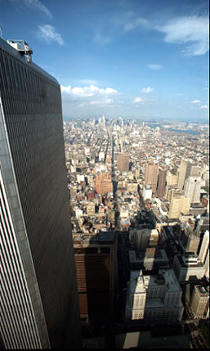
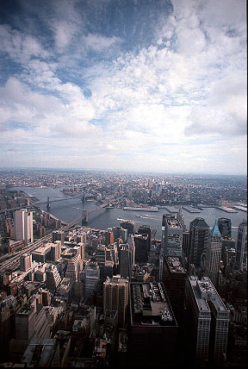
From the observation deck on Two World Trade Center, it was possible to see 45 miles in every direction.

Slide 6
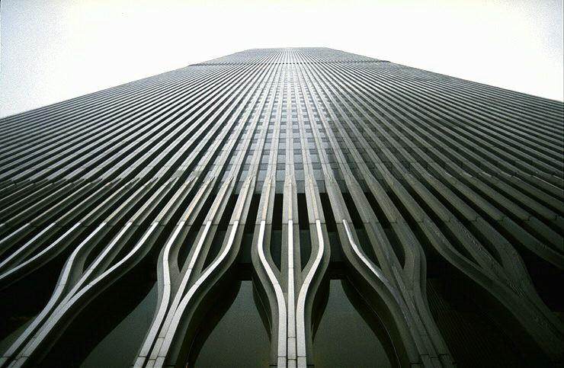
In one of the most horrific attacks ever against the United States, terrorists hijacked two airliners and crashed them into the World Trade Center in a coordinated series of blows that brought down the twin towers on Tuesday, September 11, 2001.
Another hijacked plane slammed into the Pentagon. A fourth hijacked plane crashed in Pennsylvania. Metro areas have been evacuated; the nation is in shock.

Slide 7
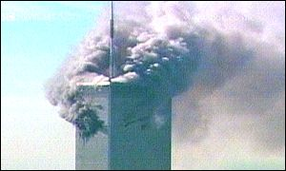
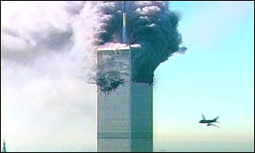
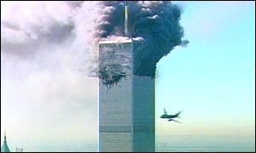
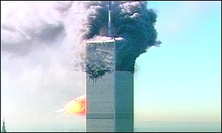
Smoke billowed out of One World Trade Center after the first plane hit it.
Less than 18 minutes later, another plane closed in on Two World Trade Center.
The plane seemed to swerve to hit the second tower.
The second plane caused a massive explosion and fire on the second tower.

Slide 8
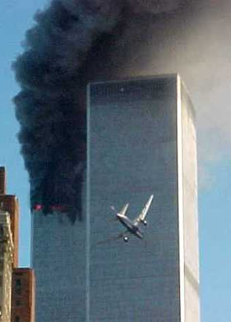
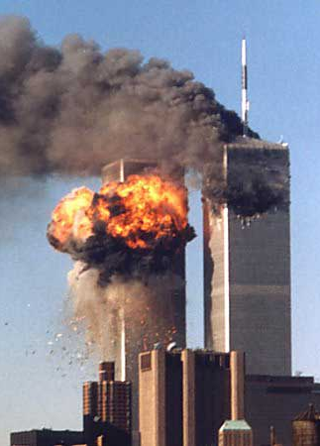
The approaching plane taken from another angle.
A fireball erupts from the other tower as it was struck by the second airplane.

Slide 9
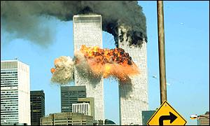
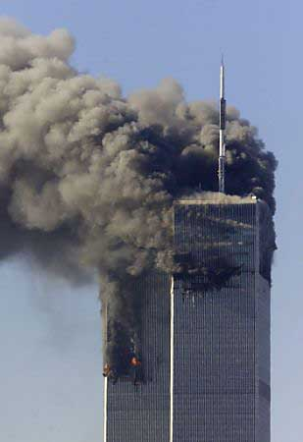
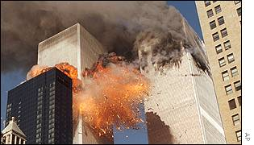
The fireball generated by the second collision spread out across both towers

Slide 10
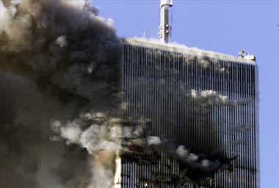
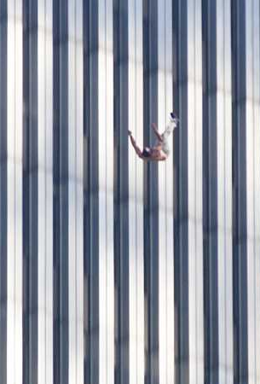
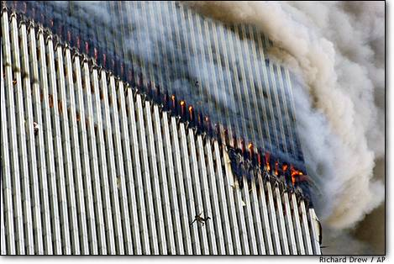
A close view of the crash site show some people jumping off the towers while smoke and fire billowed from the buildings.

Slide 11
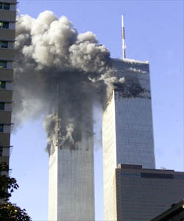
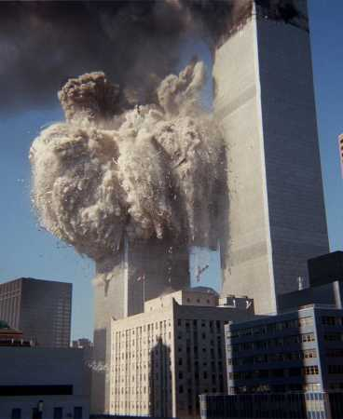
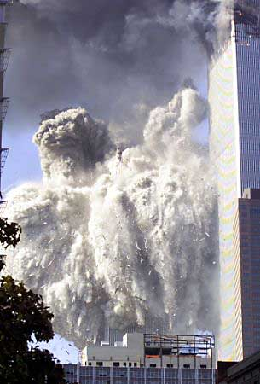
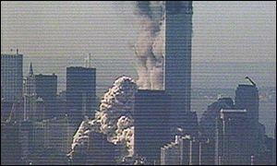
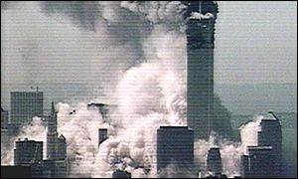
Two World Trade Center collapsed in a cloud of debris and smoke...
… obscuring much of downtown Manhattan.

Slide 12
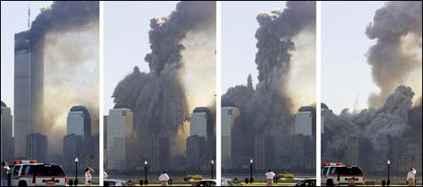
One World Trade Center likewise dissolved in a cloud of dust and debris about half an hour after the collapse of Two World Trade Center.

Slide 13
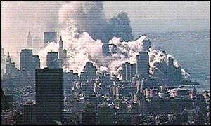
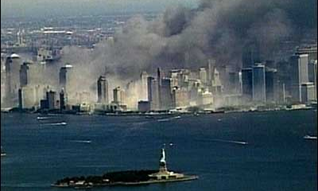
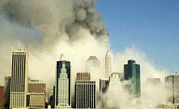
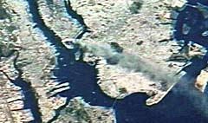
New York shrouded in smoke
With the Statue of Liberty in the foreground
A view of the Manhattan skyline from Brooklyn after the towers collapsed
Image taken from the International Space Station showing a smoke plume rising from the Manhattan area (Photo taken by Commander Frank Culbertson)

Slide 14
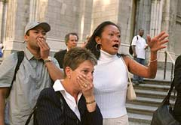
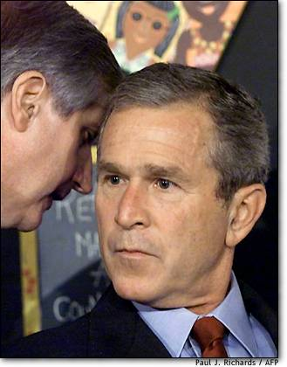
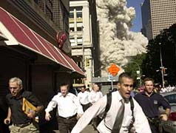
Shocked people in front of St Patrick's Cathedral watched in horror as the first tower collapsed.
US President George W. Bush was told the news at an early morning event with children in a Florida school.
New York City pedestrians run as the second tower collapsed.

Slide 15
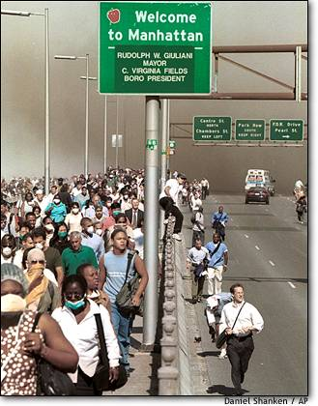
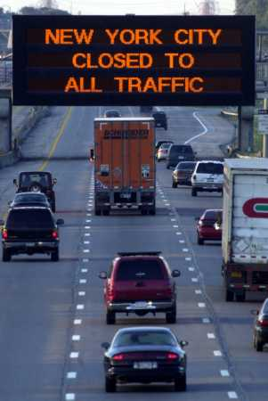
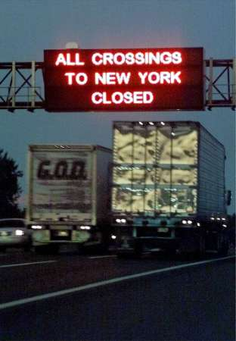
Frantic exodus on Brooklyn Bridge as people flee lower Manhattan across the Brooklyn Bridge after the towers collapsed. Later, New York City was closed to traffic while airports nationwide cancelled all flights.

Slide 16
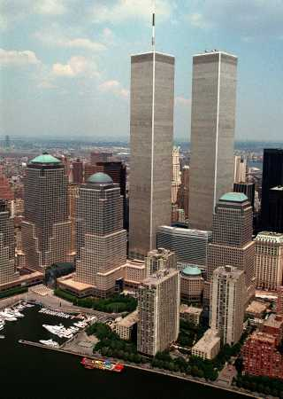
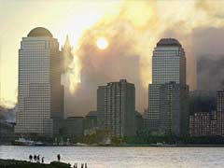
The Manhattan skyline before and
after the terrorist attack

Slide 17
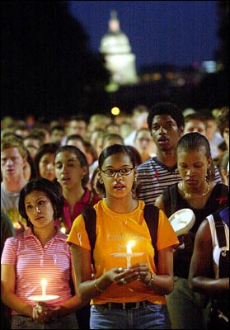
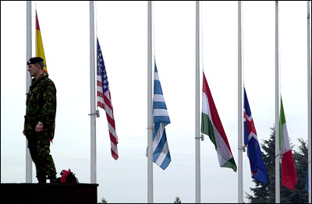
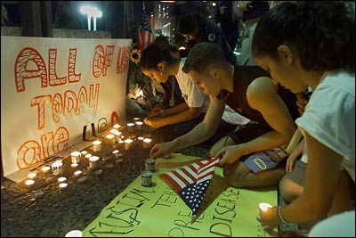
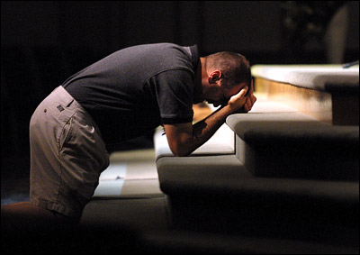
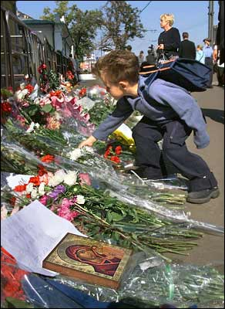
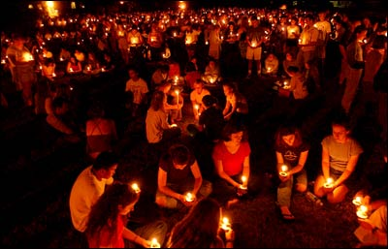
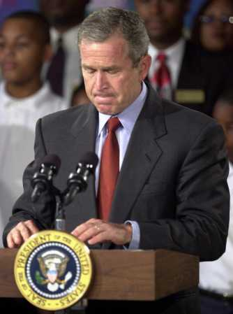
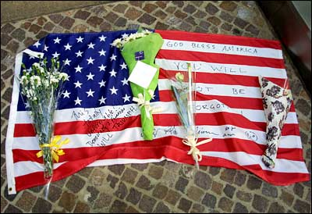
Condolences
We join all citizens around the world offering condolences
to those directly touched by the September 11 attacks.
We all share in the pain of those cast in harm's way
and the grief of those who mourn the loss of loved ones.
God bless America

