Slide 1

Tip of the Tongue
When you can't quite remember the song in your head
Notes:
Booth does intro

Slide 2

Tip of the Tongue - Our Team
Chris Crawford
back end coding, Firebase, API Musixmatch
Booth Kittson
API Spotify, presentation styling
Josh Carroll
front end, design, back end coding, code integration, project management
Notes:
Booth introduces Chris and Josh and explains the roles

Slide 3
Tip of the Tongue – The Project
What does it do?
We wanted a way to find that elusive song that you cannot quite remember by using a snippet of a lyric.
It was important to provide a clean, intuitive interface without a lot of clutter.
And make it easy for the user to search in a couple of ways
And be able to find other track information about the artist(s)
And remember a few things about the user.
Notes:
One or all of us explain on a high level

Slide 4
Tip of the Tongue – The Code
We used two main API’s
Musixmatch
Spotify
CSS Framework
Bootstrap 3
Jquery-ui, jquery, javascript
Firebase for users and user data
Notes:
One of us just reads this part, code explanation comes later

Slide 5
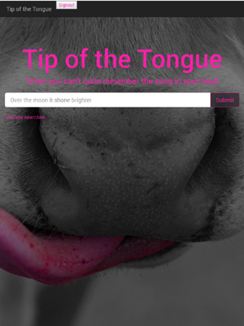
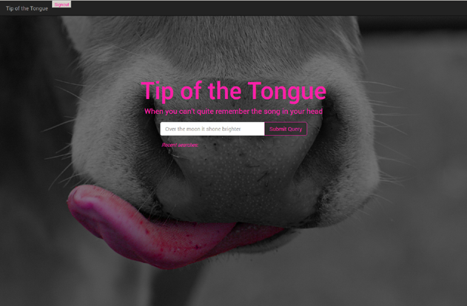
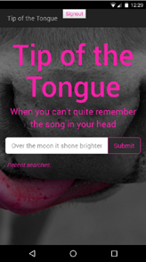
Notes:
just say these are screen shots, desktop, ipad, phone

Slide 6
Tip of the Tongue – The Details…
Notes:
Code should be up on screen use this slide if transition needed
Chris talking points:
MusixMatch API, Ajax call area: around lines 163 - 240
Firebase database:
Users and user data
- Each user has an associated key
- The searches are logged in the database
- They are also tied with their respective user
Firebase authentication:
Email authentication
- Users will enter their email so they can access all the lyrics they have searched for in the past
- Checks if certain conditions are met upon password creation
- Does not validate the email
Booth talking points
Spotify API: around line 6
We needed to use Spotify to actually capture the short playback and bring up the Artist data and artist’s top tracks
Josh talking points:
explain reasoning and generally rest of the code

Slide 7
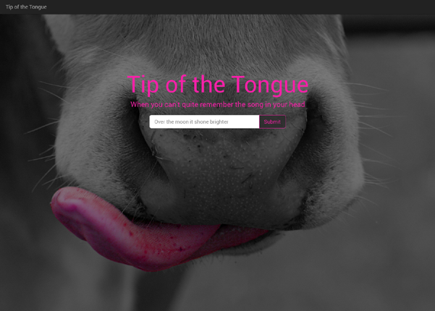
Tip of the Tongue – Demo
Notes:
Demo of app
should move from this slide to laptop demo
“Love me Do” gets simple, decent results
“Cheap Thrills” gets simple, decent results
NOTE NEED LIVE SPOTIFY LOG IN FOR SONG SNIP TO PLAY

Slide 8
Tip of the Tongue – The Future
What else could we do?
Access multiple music lyrics sources for a more complete return.
Store other user data like preferences, playlists.
Make recommendations to user based on their previous choices.
Design a platform for sharing playlists, likes.
Notes:
In case we do the demo and still have time to fill..

