Slide 1
This Presentation Template has been designed using the following fonts and colors:
FONTS
Times New Roman
Playfair Display - https://fonts.google.com/specimen/Playfair+Display
COLORS
#DFEECD
#7DB351
#4E712E
#B4D888
#7B9933
#364E22

Slide 2
SwasthyaAI
Smart Ayurveda for Women’s Wellness

Slide 3

PARTICIPANT DETAILS
01
Kirti Rane
College: Datta Meghe College of Engineering, Navi Mumbai
Stream: AI&DS

Slide 4
TABLE OF CONTENTS
01
Introduction
06
Technology Stack
02
Objectives
07
System Architecture
03
Problem Statement
08
Results
04
Proposed Solution
09
Market Comparison & Uniqueness
05
How Technology Powers Change?
10
Conclusion and Future Scope

Slide 5
INTRODUCTION
SwasthyaAI is an AI-driven healthcare assistant that empowers women with personalized health insights. It integrates Machine Learning, Ayurveda, and AI chatbot support for tailored recommendations. By enabling early diagnostics and holistic wellness solutions, it accelerates proactive healthcare. SwasthyaAI bridges the gap between traditional and modern medicine for accessible women’s healthcare.

Slide 6
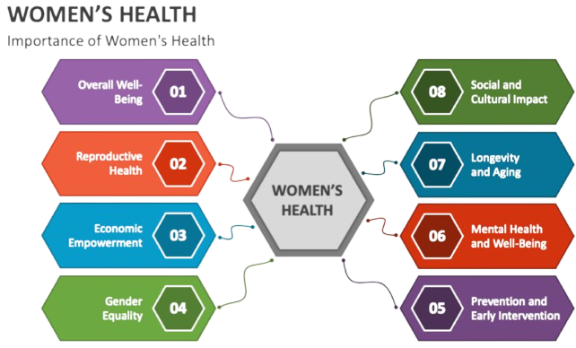

Slide 7
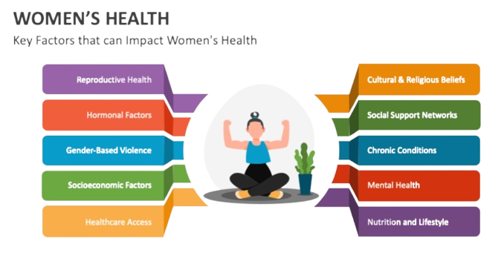

Slide 8
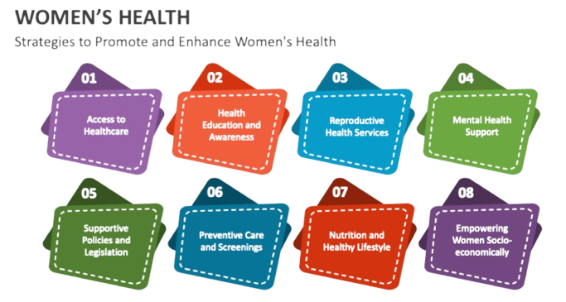

Slide 9
PRINCIPLES OF AYURVEDA
Aahar (Dietary Guidelines)
Yoga & Meditation
Personalized nutrition recommendations
Mental and physical wellness
Dinacharya (Daily Routine)
Oushadhi (Herbal Medicines)
Importance of structured lifestyle
Role of Ayurvedic treatments
Dosha Balance (Vata, Pitta, Kapha)
Understanding body constitution

Slide 10
AYURVEDA IN MODERN HEALTHCARE
Herbal Medicine & Natural Remedies
Gut Health & Digestive Balance
Ayurveda uses natural herbs like Turmeric, Ashwagandha, and Tulsi to treat diseases.
Ayurveda emphasizes Agni (digestive fire) for maintaining overall health.
Holistic Healing & Lifestyle Integration
Stress Management & Mental Well-being
Ayurveda promotes a balanced lifestyle (Dinacharya) based on body types (Vata, Pitta, Kapha).
Techniques like meditation, yoga, and breathing exercises (Pranayama) are part of Ayurveda.

Slide 11
OBJECTIVE
Promote personalized healthcare using Ayurveda & AI
Improve women’s health through holistic & data-driven solutions
Integrate ancient wisdom with modern technology (AI + Ayurveda)
Provide real-time health guidance for individuals

Slide 12
PROBLEM STATEMENT
Women’s health issues like PCOS, thyroid disorders, and menstrual irregularities are often misdiagnosed due to a lack of personalized and holistic healthcare. Conventional medicine follows a generic approach, ignoring individual body types (Prakriti), lifestyle, and environmental factors. There is a need for an AI-powered Ayurveda Health Assistant that provides tailored diagnostics, predictive insights, and Ayurvedic recommendations for women’s well-being.
Challenges in Women’s Health
🚨 Lack of Personalized Care – Generic treatments overlook Prakriti & lifestyle. 🚨 Hormonal Imbalances – PCOS, menopause, and thyroid disorders on the rise. 🚨 Limited Awareness – Preventive healthcare & Ayurveda insights are inaccessible. 🚨 Fragmented Solutions – No AI-integrated Ayurveda-based diagnostic system.
Need for an AI-Powered Ayurveda Health Assistant
🔹 Bridges Ayurveda & AI for holistic, accessible, and personalized healthcare. 🔹 Predicts health risks and provides tailored Ayurvedic recommendations. 🔹 Empowers women with proactive, data-driven wellness solutions. 🌿🤖

Slide 13
PROPOSED SOLUTION
To address the challenges in women’s healthcare, SwasthyaAI integrates Artificial Intelligence and Ayurveda to offer a personalized, predictive, and holistic healthcare approach.
🔹 Key Features of SwasthyaAI
✅ AI-Powered Personalized Diagnostics → Analyzes Prakriti (body type), lifestyle, and environmental factors to provide tailored insights.
✅ Predictive Health Monitoring → Detects early warning signs for hormonal imbalances such as PCOS, thyroid disorders, and menopause.
✅ Ayurvedic Health Recommendations → Offers customized herbal, dietary, and lifestyle solutions based on an individual’s health profile.
✅ Integrated Health Ecosystem → Combines AI-driven predictive analysis with traditional Ayurvedic wisdom to enhance preventive and therapeutic care.
🌱 Impact & Benefits
🚀 Empowers women with data-driven, proactive healthcare 💡 Bridges technology and Ayurveda for accessible and effective health solutions ⚕️ Encourages preventive care rather than reactive treatments

Slide 14

HOW TECHNOLOGY POWERS CHANGE?
SwasthyaAI is an AI-powered Ayurveda healthcare system that:
1. Uses Machine Learning to analyze symptoms and predict possible conditions.
2. Provides personalized Ayurveda-based health recommendations (Doshas, Prakriti).
3. Offers lifestyle modifications through yoga, diet, and herbal treatments.
4. Integrates a chatbot (Gemini AI) for real-time medical guidance.
💡 How AI & Ayurveda Provide Personalized Healthcare 1. AI-driven health assessments based on symptoms & Dosha type 2. Ayurveda-backed remedy suggestions for diet, herbs, and yoga 3. Smart lifestyle recommendations based on daily routine & habits
✨ Key Features & Benefits Early detection of women-specific diseases Personalized diet & lifestyle recommendations Ayurveda-based remedies & holistic wellness plans AI-based chatbot for quick medical responses

Slide 15
TECHNOLOGY STACK
Category | Technology/Tool | Purpose
Programming Language | Python | Core language for AI & web app development
Framework | Streamlit | Frontend framework for interactive UI
Libraries Used | Pandas, NumPy, Seaborn | Data handling, processing, and visualization
Machine Learning/Clustering Algorithms | Scikit-Learn (GMM,Hierarchial Clustering) | AI-based clustering and segmentation
Chatbot Integration | Google Gemini API | NLP & AI-powered chatbot
Frontend | Streamlit | Python-based UI framework
Model Deployment | Joblib | Saving and loading ML models
Data Sources | Manually Curated from Government Health Databases, Ayurveda Texts and Ancient Ayurveda Books | Training AI models & knowledge base
Deployment | Local/Cloud (Streamlit Sharing, AWS, GCP) | Hosting & accessibility

Slide 16
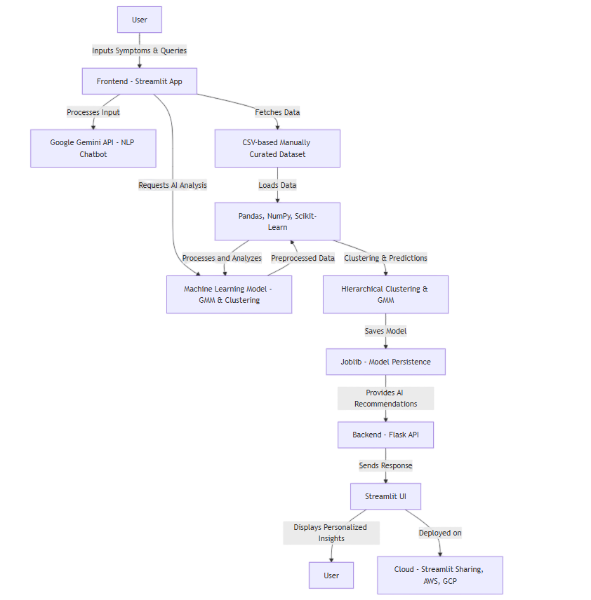
SYSTEM ARCHITECTURE

Slide 17
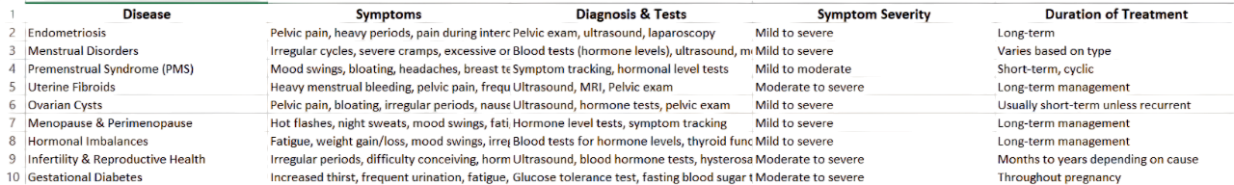
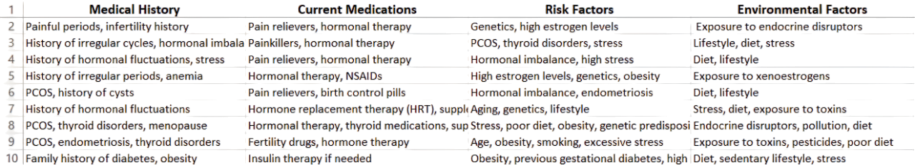
Common Women's Health Conditions
RESULTS
Medical History and Risk Factors

Slide 18
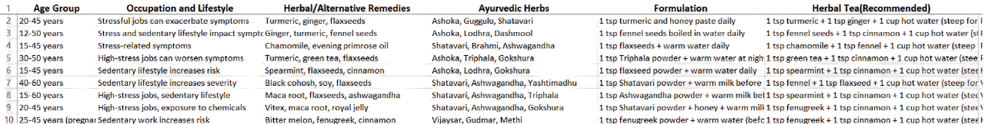
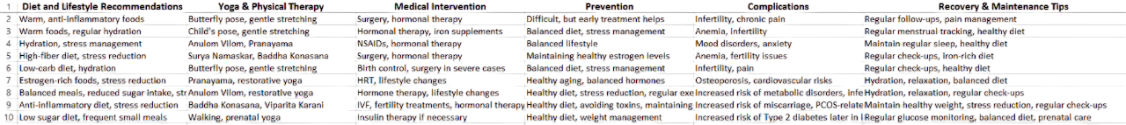
Lifestyle, Remedies, and Herbal Interventions
RESULTS
Holistic Treatment and Prevention Strategies

Slide 19
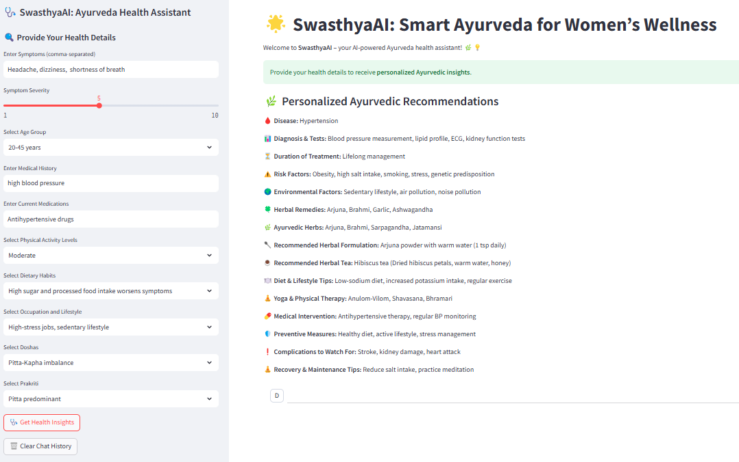
Prototype
RESULTS

Slide 20
MARKET COMPARISON AND UNIQUENESS
💡 Why is SwasthyaAI Solution Better? ✔ Bridges AI & Ayurveda for holistic women's health care. ✔ AI-driven clustering for personalized health analysis. ✔ Integrated Chatbot for real-time assistance. ✔ Empowers women to take control of their health with preventive solutions.
Feature | Smart Women’s Health Assistant | Other Market Solutions
AI-Based Women’s Health Analysis | ✅ Yes | ⚠️ Limited
Ayurveda + AI Integration | ✅ Yes | ❌ No
Personalized Dosha-based Advice | ✅ Yes | ❌ No
Chatbot for Health Queries | ✅ Yes (Gemini AI) | ❌ No
Diet & Yoga-Based Recommendations | ✅ Yes | ❌ No

Slide 21
CONCLUSION AND FUTURE SCOPE
CONCLUSION
SwasthyaAI leverages AI and Ayurveda to provide a personalized and holistic approach to women's healthcare. By integrating Hierarchical Clustering, Gaussian Mixture Models (GMM), and NLP-powered chatbots, it offers data-driven health insights tailored to individual body types (Vata, Pitta, Kapha). The system enhances early detection, preventive care, and lifestyle recommendations, addressing challenges in women’s health diagnosis and awareness. With a user-friendly Streamlit interface and Google Gemini API integration, SwasthyaAI ensures accessibility and intelligent health guidance for women.
FUTURE SCOPE
🚀 Enhancing AI Models: Implementing Deep Learning & Reinforcement Learning for more accurate Ayurvedic health predictions. 📊 Expanding Datasets: Integrating real-time health data from wearables (smartwatches, fitness trackers) for more precise analysis. 🤖 Advanced Chatbot Features: Improving NLP capabilities with multilingual support for better accessibility across diverse populations. 🩺 Integration with Healthcare Systems: Collaborating with Ayurvedic practitioners & medical professionals for validation and improved AI recommendations. ☁️ Cloud-Based Expansion: Deploying on AWS/GCP for real-time health monitoring & remote access.
This future vision ensures SwasthyaAI continues evolving as a cutting-edge AI-powered Ayurvedic health assistant, bridging the gap between technology and holistic wellness. 🌿💡

Slide 22
THANK
YOU!

