Slide 1
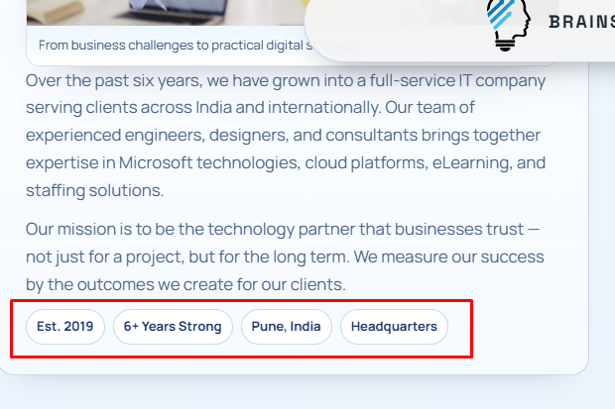
DONE.
About Us page
Remove the marked area. We are mentioning it too many times and at too many places.

Slide 2
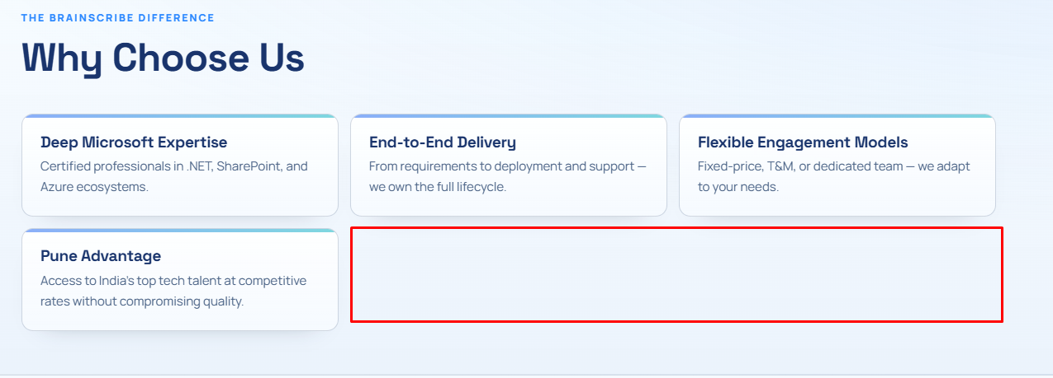
DONE.
About Us page
Either add two more boxes with write up from ChatGPT. Or make it 4, 2 on single row

Slide 3
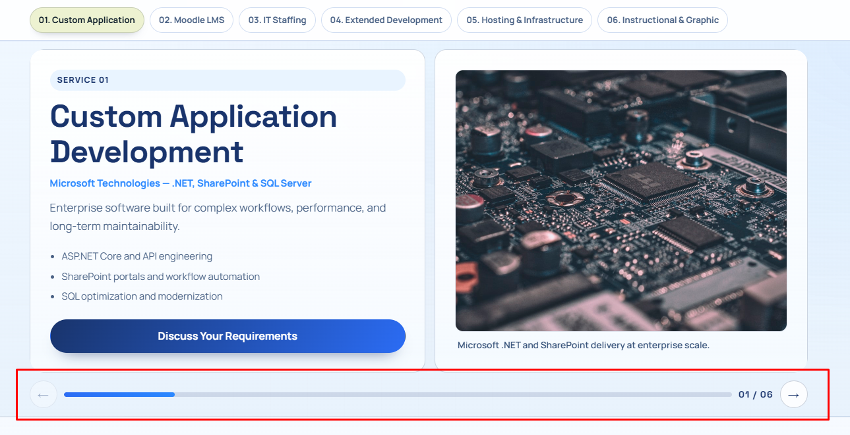
DONE.
Note: I have retained the same layout on desktop. On mobile devices the cards will stack up one after the other.
Note: This layout is not applicable currently as the feedback on slide 7 requests to take more writeup from https://www.brainscribe.co.in/services.html. Please see slide 7 for more details.
Services page
We would prefer all sections appearing in one go, one below the other.
Though this looks fantastic on desktop, it looks odd on Mobile.
The pictures used are not very relevant. E.g. the attached does not represent the coding. Rather the pic used for “Hosting” is about coding

Slide 4
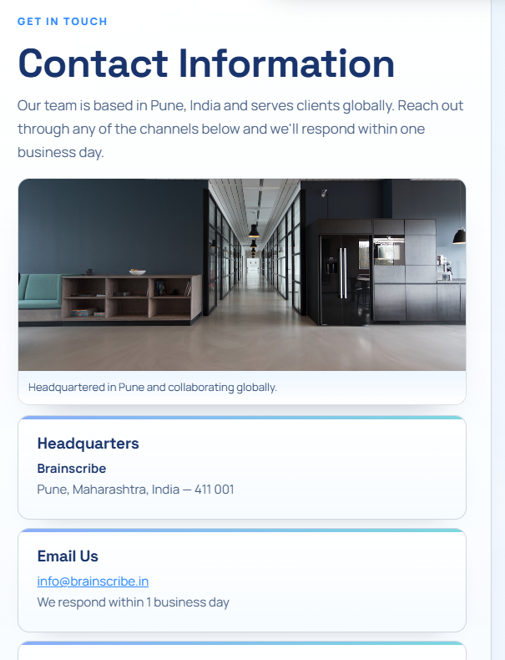
DONE.
Contact Us page
Please remove this card completely.

Slide 5


DONE.
Footer
Please remove these
Added the Privacy Policy and Terms and Conditions pages and linked.
By EOD today, I would provide you the Privacy Policy and TnC which we need to add to here.

Slide 6
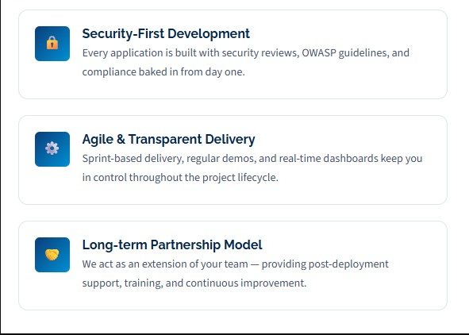
DONE.
On About Us page, under "Why Choose Us" Remove Pune and Add the 3 below. You can copy and paste from https://www.brainscribe.co.in Home Page

Slide 7
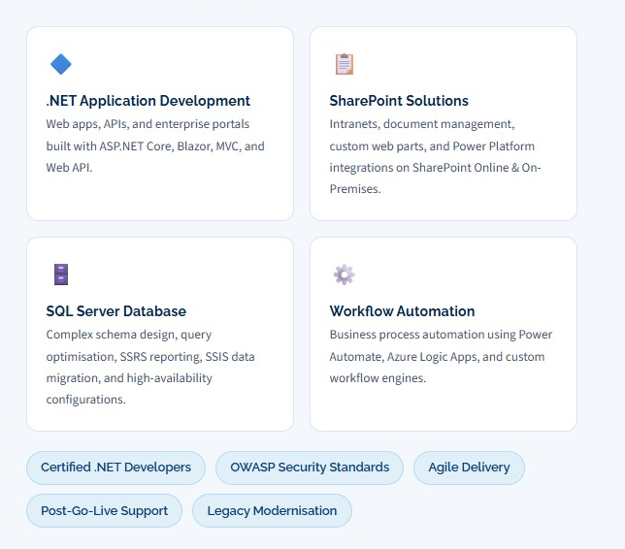

DONE.
Note: Designed a Services Overview page with all six offerings at a glance. Designed dedicated pages for each service for full scope, delivery model, and engagement details. This is accounts for better UX, SEO, and reduced information overload.
For "Services" page I would strongly prefer the writeups from https://www.brainscribe.co.in/services.html as an example. This is really important and it explains in detail

