Slide 1


STUDENT SERVICE -CHATBOT
GROUP-5

Slide 2

PROBLEM STATEMENT
THE GAP IN STUDENT SUPPORT
Students often feel overwhelmed navigating For services like tuition, OSAP, housing, and academic services. Existing systems are slow, fragmented, and emotionally disconnected.
Core issues
Delays in getting simple answers
Lack of personalized or empathetic support
Repetitive questions burdening advisors
Confusing navigation of college policies

Slide 3

PROPOSED SOLUTION
A multi-layered chatbot that understands emotions, answers accurately, and connects students to real help when needed
Features
Human-like, natural interactions
Emotion-aware, supportive replies
Accurate FAQ matching
LLM fallback for complex queries
Direct advisor escalation

Slide 4
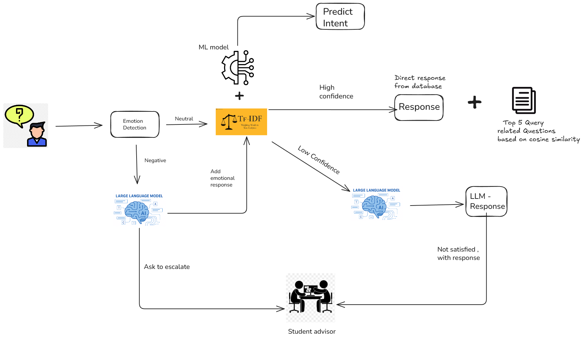
HIGH LEVEL FLOW
Query

Slide 5
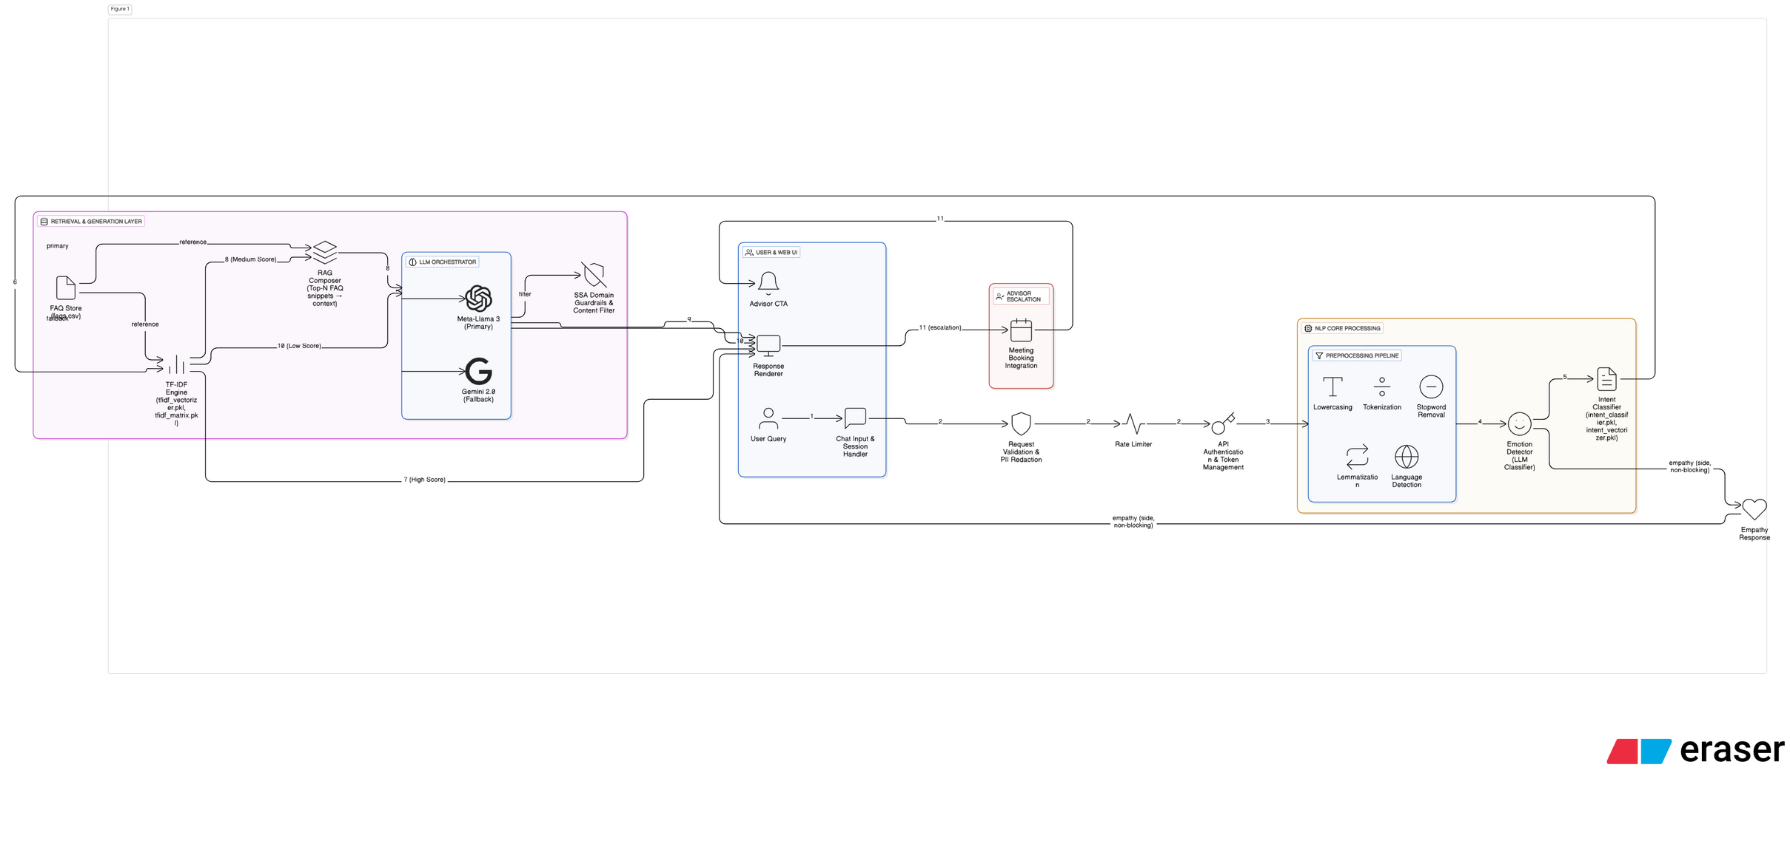
SYSTEM ARCHITECTURE

Slide 6

WHY EMOTION DETECTION FIRST?
EMPATHY FIRST — THEN INFORMATION
Emotion detection is prioritized to prevent ignoring student frustration or distress.
Responds with empathy when tone is negative
Redirects to escalation logic when needed
Ensures supportive, human-like interaction
Avoids robotic or tone-deaf replies

Slide 7


NATURAL LANGUAGE PROCESSING
IN THE SSA CHATBOT
Our SSA Chatbot leverages Natural Language Processing (NLP) to understand, classify, and respond to student queries with high accuracy and contextual awareness.
Key Highlights:
Text Preprocessing to clean and normalize input.
TF-IDF Vectorization to represent text numerically.
Cosine Similarity to rank relevant answers.
This foundation enables precise retrieval and supports advanced response generation.

Slide 8

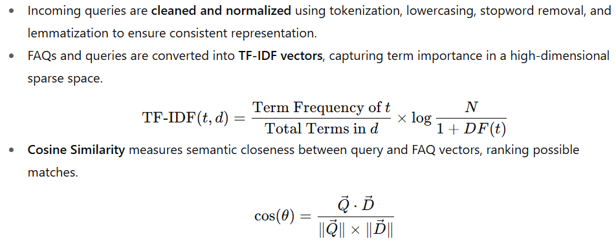
HOW NLP WORKS IN OUR SSA CHATBOT

Slide 9
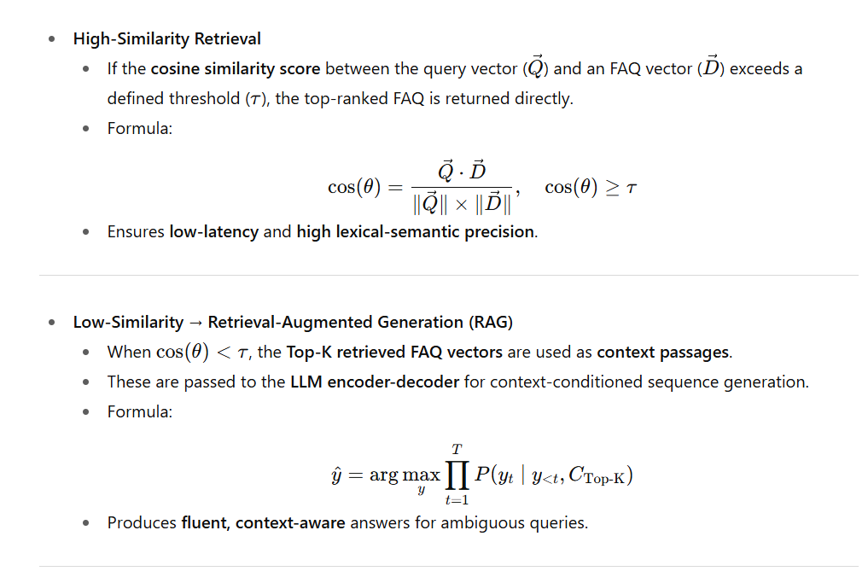
SIMILARITY RETRIEVAL & RAG MECHANISM

Slide 10
PREDICTION MODEL – LOGISTIC REGRESSION
Our chatbot’s prediction engine is powered by Logistic Regression, a supervised machine learning algorithm for classification tasks.
Purpose: Classify queries into predefined categories such as Financial Aid, Academic Policy, and Campus Services.
Function:
Logistic Regression applies learned weights (β)to each feature
Softmax function converts raw scores into probabilities across all categories
Output: The category with the highest probability is selected, guiding the chatbot to provide the correct response

Slide 11
PREDICTION ENGINE- PROCESS
Model: Multi-class Logistic Regression
Goal: Classify queries into categories such as Financial Aid, Academic Policy, and Housing.
Process:
Input: Preprocessed query text → TF-IDF vector
Weights: Model applies learned β values to each feature
Softmax: Converts class scores into probabilities that sum to 1
Output: Class with the highest probability is selected as the predicted intent
Why Softmax?
Handles multiple classes at once
Ensures probabilities are comparable across all categories

Slide 12
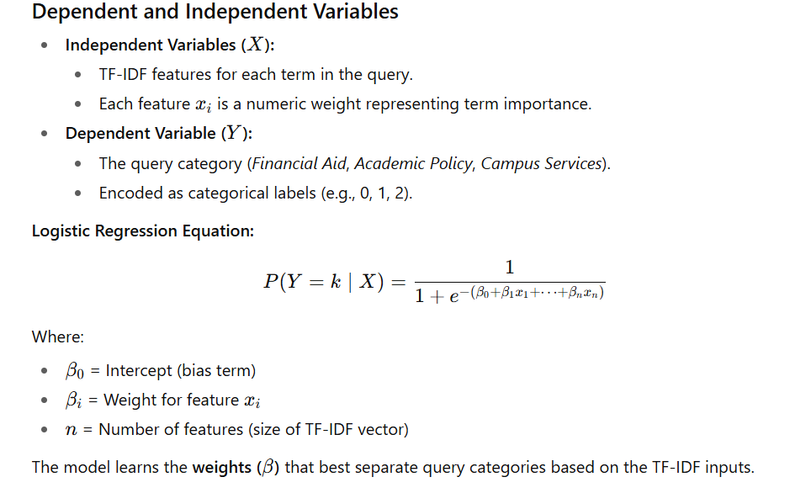
CLASSIFYING CHATBOT QUERIES

Slide 13
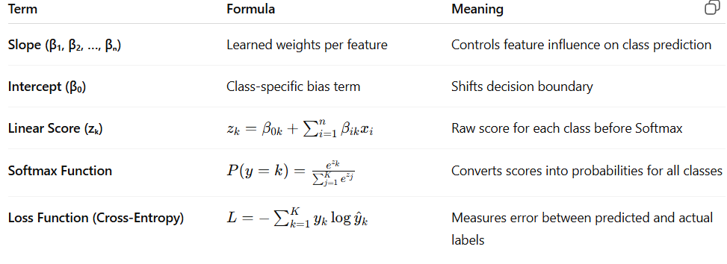
TECHNICAL OVERVIEW

Slide 14
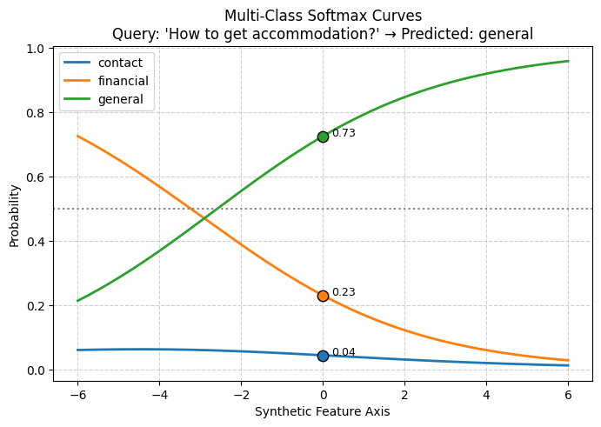


QUERY CLASSIFICATION PROBABILITY
The graph shows how the model assigns probabilities to each category for the query
"How to get accommodation?".
Housing → highest probability 0.73 → predicted
Financial → ~0.23
Contact → ~0.04
Query Received
Logistic Regression
Softmax Function
Highest Probability
Convert to TF-IDF Vectors
Apply Learned Weights (β)
Calculate Class Probabilities
Final Predicted Category

Slide 15


DEMO

Slide 16
Thank
you!

