Slide 1
Adversarial Attack

Slide 2
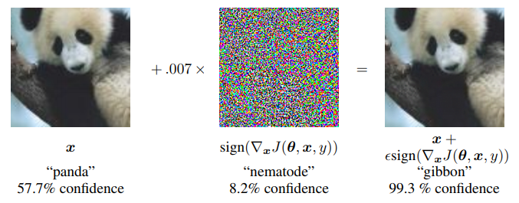
Adversarial Attack ?
Adversarial Attack
Change the result of the model by adding imperceptible noise to input to deceive image classification model
To deceive image classification model

Slide 3
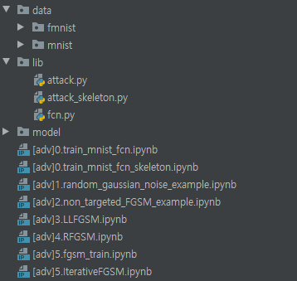
Preparation
Directory structure setting
Make ‘data’, ‘lib’, ‘model’ directory
Place given files in appropriate place

Slide 4
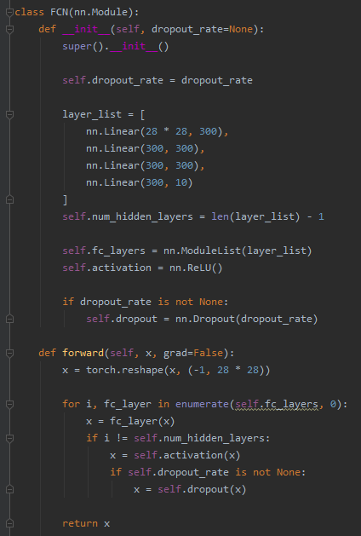
Preparation
Practice 0. Train image classifier
Refer to lib/fcn.py
MNIST image classifier
3 hidden layers
300 hidden nodes per layer
Dropout for next practice

Slide 5
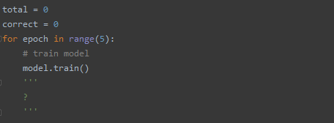
Preparation
Practice 0. Train image classifier
Fill the blanks in given “0.train_mnist_fcn.ipynb”
Goal is
Train MNIST image classifier
Save trained model!
Check whether model file is created in ‘model’ directory

Slide 6
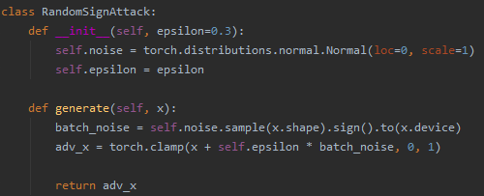
Random Noise
Random Gaussian Noise
Most simple way to test model’s robustness
Refer to lib/attack.py
torch.clamp: clipping!

Slide 7
Random Noise
Test model’s robustness against random noise - 1
First, load trained model
Construct new model
load trained parameter, etc
Should specify “map_location” to avoid error in multi-gpu env
gpu_name = "cuda:0" device = torch.device("cuda:0" if torch.cuda.is_available() else "cpu") path = "model/FCN_MNIST" model = FCN() model.load_state_dict(torch.load(path, map_location=gpu_name)) model = model.to(device)

Slide 8
Random Noise
Test model’s robustness against random noise - 2
Second, setup data
transform = torchvision.transforms.Compose([ torchvision.transforms.ToTensor() ]) _test = torchvision.datasets.MNIST(root='data/mnist', train=False, download=True, transform=transform) test = torch.utils.data.DataLoader(_test, batch_size=32, shuffle=False, num_workers=2)

Slide 9
Random Noise
Test model’s robustness against random noise - 3
Third, check robustness
noise = RandomSignAttack(epsilon=0.3) for data in test: inputs, labels = data inputs, labels = inputs.to(device), labels.to(device) adv_inputs = noise.generate(inputs) prediction = model(inputs).max(1)[1] adv_prediction = model(adv_inputs).max(1)[1] total += labels.size(0) correct += prediction.eq(labels).sum().item() adv_correct += adv_prediction.eq(labels).sum().item()

Slide 10
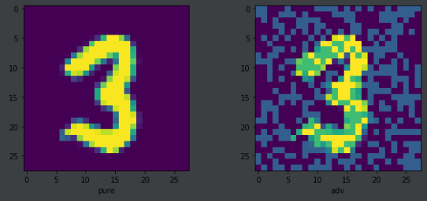
Random Noise
Test model’s robustness against random noise - 4
Third, check robustness
Accuracy for pure test data: 97.90%
Accuracy for data with random noise: 68.91%

Slide 11
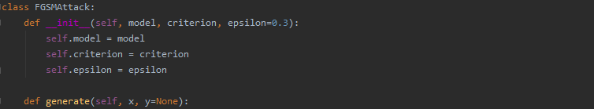

Non-Targeted FGSM
Fast Gradient Sign Method (FGSM)
One-Step Gradient Method
$$x^{∗}=x+εsign\left(∇_{x}L\left(x,y_{true}\right)\right)$$

Slide 12
Non-Targeted FGSM
Generate adversarial example using FGSM – v0
Requires_grad?
Detach()?
What is the problem of this code?
x.requires_grad = True output = self.model(x) loss = self.criterion(output, output.max(1)[1] if y is None else y) loss.backward() adv_x = torch.clamp(
x.detach() + self.epsilon * torch.sign(x.grad.detach()), 0, 1)
.detach() return adv_x

Slide 13
Non-Targeted FGSM
Generate adversarial example using FGSM – v1
x.requires_grad = True output = self.model(x) loss = self.criterion(output, output.max(1)[1] if y is None else y) x_grad = torch.autograd.grad(loss, x, only_inputs=True)[0] adv_x = torch.clamp(
x.detach() + self.epsilon * torch.sign(x_grad.detach()), 0, 1)
.detach() return adv_x

Slide 14
Non-Targeted FGSM
Test Non-Targeted FGSM (Refer to Slide#8)
total = 0 correct = 0 adv_correct = 0 fgsm = FGSMAttack(model, criterion=torch.nn.CrossEntropyLoss(), epsilon=0.3) for data in test: inputs, labels = data inputs, labels = inputs.to(device), labels.to(device) adv_inputs = fgsm.generate(inputs) outputs = model(inputs) adv_outputs = model(adv_inputs) prediction = outputs.max(1)[1] adv_prediction = adv_outputs.max(1)[1] total += labels.size(0) correct += prediction.eq(labels).sum().item() adv_correct += adv_prediction.eq(labels).sum().item()

Slide 15
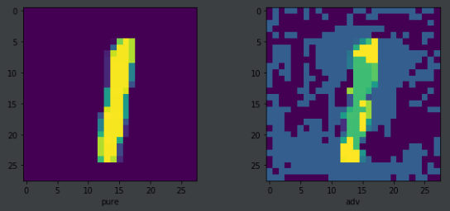
Non-Targeted FGSM
Test model’s robustness against Non-Targeted FGSM
Accuracy (pure test data): 97.90%
Accuracy (adv data from FGSM): 2.63%

Slide 16
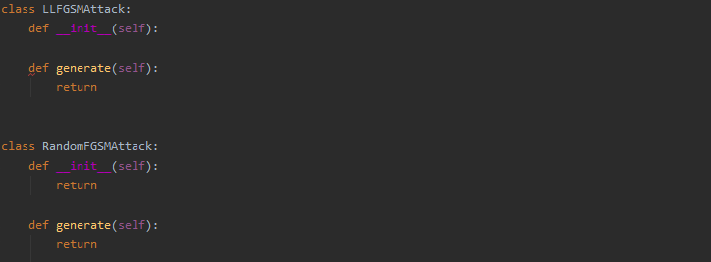
Practice
Practice 1. Implement Least-Likely FGSM
Practice 2. Implement R-FGSM
Refer to RandomSignAttack & FGSMAttack
Implement & Test Attack Success Rate!

Slide 17
FGSM Training
How can we improve model’s robustness
Data augmentation!
Adversarial training
Train model using adversarial examples as well as natural data
$$L\left(θ, x, y\right)=αL\left(θ,x,y\right)+\left(1−α\right)L(θ,x+εsign(∇_{x}L\left(θ,x,y\right))$$

Slide 18
FGSM Training
Train model with adversarial example – 1
Same as vanilla training
transform = torchvision.transforms.Compose([ torchvision.transforms.ToTensor() ]) _train = torchvision.datasets.MNIST(root='data/mnist', train=True, download=True, transform=transform) train = torch.utils.data.DataLoader(_train, batch_size=32, shuffle=True, num_workers=2) _test = torchvision.datasets.MNIST(root='data/mnist', train=True, download=True, transform=transform) test = torch.utils.data.DataLoader(_test, batch_size=32, shuffle=False, num_workers=2) model = FCN() model = model.to(device) criterion = torch.nn.CrossEntropyLoss() optimizer = torch.optim.Adam(model.parameters())

Slide 19
FGSM Training
Train model with adversarial example – 2
Adversarial Logit Pairing?
fgsm = FGSMAttack(model, criterion=criterion, epsilon=0.3) for epoch in range(5): # train model model.train() for data in train: inputs, labels = data inputs, labels = inputs.to(device), labels.to(device) adv_inputs = fgsm.generate(inputs) outputs = model(inputs) adv_outputs = model(adv_inputs) loss = criterion(outputs, labels)
+ criterion(adv_outputs, labels) optimizer.zero_grad() loss.backward() optimizer.step()

Slide 20
FGSM Training
Train model with adversarial example - 3
# eval model
model.eval() total = 0 correct = 0 adv_correct = 0 for data in test: inputs, labels = data inputs, labels = inputs.to(device), labels.to(device) adv_inputs = fgsm.generate(inputs) prediction = model(inputs).max(1)[1] adv_prediction = model(adv_inputs).max(1)[1] total += labels.size(0) correct += prediction.eq(labels).sum().item() adv_correct += adv_prediction.eq(labels).sum().item()
test_acc = 100*correct/total adv_test_acc = 100*adv_correct/total

Slide 21
FGSM Training
Train model with adversarial example – 4
Accuracy (pure test data): 98.33%
Accuracy (adv data from RandomSign): 82.08%
Accuracy (adv data from FGSM): 82.70%
Accuracy (adv data from LLFGSM): 85.16%
Accuracy (adv data from RFGSM): 29.63%
Next step?

Slide 22
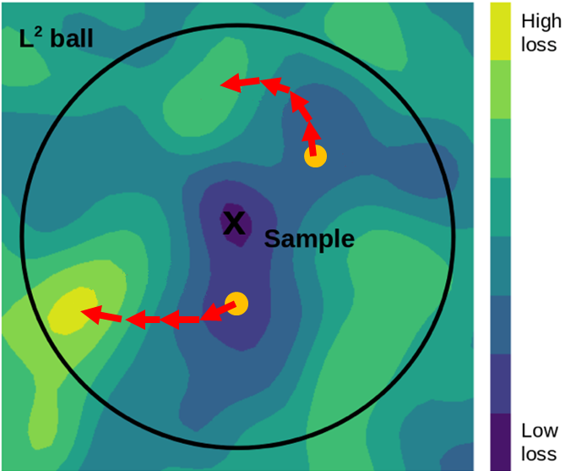
PGD
Projected Gradient Descent (PGD)
Known as strongest attack(?)
Iterative + Restart + Random Start

Slide 23

PGD
Projected Gradient Descent (PGD)
Iterative FGSM
$$x^{t+1}=\prod_{x+S}{x^{t}+αsgn(∇_{x}L(θ,x,y))}$$
Size of $α$
FGSM => 0.3 (1 step)
Iterative FGSM => 0.01 (< 30 steps)
x.requires_grad = True output = self.model(x) loss = self.criterion(output, output.max(1)[1] if y is None else y) x_grad = torch.autograd.grad(loss, x, only_inputs=True)[0] adv_x = torch.clamp(
x.detach() + self.epsilon * torch.sign(x_grad.detach()), 0, 1)
.detach() return adv_x

Slide 24
Practice
Practice 3. Implement Iterative FGSM
Point1) use ‘for loop’
Point2) don’t forget to limit size of perturbation
Test Attack Success Rate!

Slide 25
PGD Training
Train model with PGD adversarial example
Computation Bottleneck?
pgd = PGDAttack(model, criterion=criterion, epsilon=0.3, ...) for epoch in range(5): # train model model.train() for data in train: inputs, labels = data inputs, labels = inputs.to(device), labels.to(device) adv_inputs = pgd.generate(inputs) outputs = model(inputs) adv_outputs = model(adv_inputs) loss = criterion(outputs, labels)
+ criterion(adv_outputs, labels) optimizer.zero_grad() loss.backward() optimizer.step()

Slide 26
PGD Training
PGD requires lots of computation resource!
Default setting of PGD on MNIST
Number of steps: 40, Step size: 0.01
One step -> forward + backward propagation
40x slow!
Computation Bottleneck?
pgd = PGDAttack(model, criterion=criterion, epsilon=0.3, ...) for epoch in range(5): # train model model.train() for data in train: inputs, labels = data inputs, labels = inputs.to(device), labels.to(device) adv_inputs = pgd.generate(inputs)

Slide 27
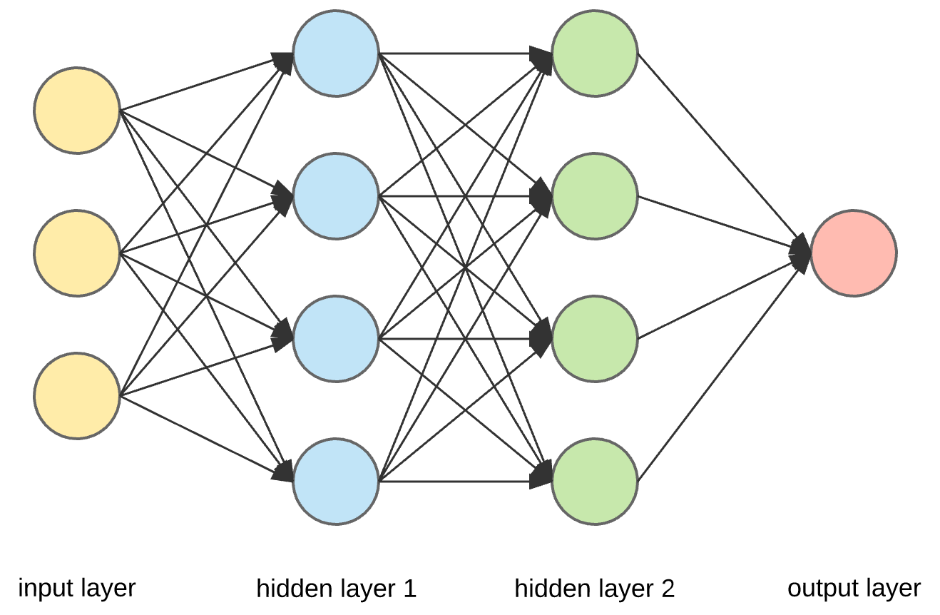
Adversarial Training for Free
How can we reduce PGD computation resource? – 1
To get input gradient,
Need activation’s gradient

Slide 28
Adversarial Training for Free
How can we reduce PGD computation resource? – 1
To get input gradient,
Can get weight’s gradient with few additional cost!

Slide 29
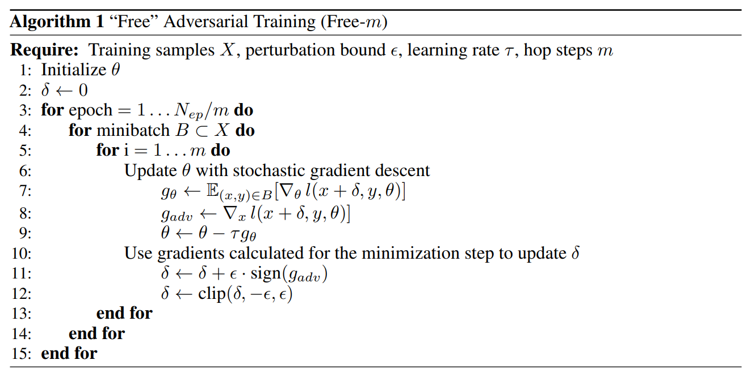
Adversarial Training for Free
How can we reduce PGD computation resource? – 3
Adversarial training for Free (NeurIPS2019, Shafahi et al.)

Slide 30
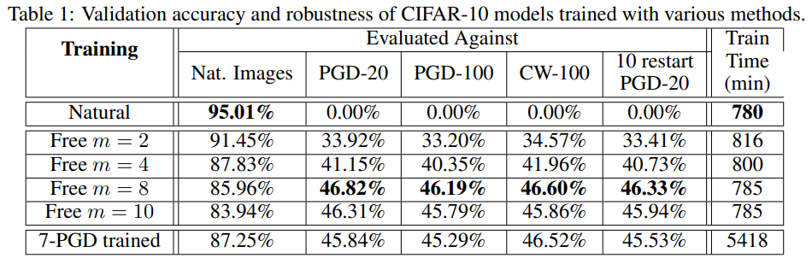
Adversarial Training for Free
How can we reduce PGD computation resource? – 4
Adversarial training for Free (NeurIPS2019, Shafahi et al.)

Slide 31
Practice
Additional Practice. Implement ‘Free’ Adversarial Training!

