Slide 1
深度學習 之 Keras 高級技巧
林澤佑
政治大學應用數學系 博士候選人

Slide 2
Outline
Sequential Review
Model (Functional API)
Final Challenge

Slide 3
Sequential Review

Slide 4
Syntax to Neural Network
When enter a Keras syntax and execute it, what would you think?

Slide 5
Syntax to Neural Network
When enter a Keras syntax and execute it, what would you think?
In [2]: model = Sequential()

Slide 6
Syntax to Neural Network
When enter a Keras syntax and execute it, what would you think?
model
In [2]: model = Sequential()
In [3]:

Slide 7
Syntax to Neural Network
When enter a Keras syntax and execute it, what would you think?
model
In [2]: model = Sequential()
In [3]: model.add(Dense(3, input_shape=(2, )))

Slide 8
Syntax to Neural Network
When enter a Keras syntax and execute it, what would you think?
model
In [2]: model = Sequential()
In [3]: model.add(Dense(3, input_shape=(2, )))
In [4]: model.summary()
9
= 2*3+3
=(2+1)*3

Slide 9
Syntax to Neural Network
When enter a Keras syntax and execute it, what would you think?
model
In [2]: model = Sequential()
In [3]: model.add(Dense(3, input_shape=(2, )))
In [4]: model.summary()
In [5]: model.add(Dense(2))

Slide 10
Syntax to Neural Network
When enter a Keras syntax and execute it, what would you think?
model
In [2]: model = Sequential()
In [3]: model.add(Dense(3, input_shape=(2, )))
In [4]: model.summary()
In [5]: model.add(Dense(2))
In [6]: model.add(Dense(3))

Slide 11
Syntax to Neural Network
When enter a Keras syntax and execute it, what would you think?
model
In [2]: model = Sequential()
In [3]: model.add(Dense(3, input_shape=(2, )))
In [4]: model.summary()
In [5]: model.add(Dense(2))
In [6]: model.add(Dense(３))
In [7]: model.summary()
9
8
9

Slide 12
Parameter Counting
How many parameters we have when a layer is added?
e.g., Dense, Conv1D, Conv2D, SimpleRNN, LSTM
To simplify your observation, use simple model w/o hidden layer and set unit = 1, 2 or 3 to see how the # of parameters changed?

Slide 13
Parameter Counting
How many parameters we have when a layer is added?
e.g., Dense, Conv1D, Conv2D, SimpleRNN, LSTM
To simplify your observation, use simple model w/o hidden layer and set unit = 1, 2 or 3 to see how the # of parameters changed?
In [ ]: model_1 = Sequential()
In [ ]: model_1.add(Dense(2, input_shape=(2, )))
In [ ]: model_1.summary()
In [ ]: model_2 = Sequential()
In [ ]: model_2.add(Dense(3, input_shape=(2, )))
In [ ]: model_2.summary()

Slide 14
Parameter Counting
How many parameters we have when a layer is added?
e.g., Dense, Conv1D, Conv2D, SimpleRNN, LSTM
To simplify your observation, use simple model w/o hidden layer and set unit = 1, 2 or 3 to see how the # of parameters changed?
In [ ]: model_3 = Sequential()
In [ ]: model_3.add(Dense(3, input_shape=(2, )))
In [ ]: model_3.summary()
In [ ]: model_4 = Sequential()
In [ ]: model_4.add(Dense(2, input_shape=(3, )))
In [ ]: model_4.summary()

Slide 15
Parameter Counting
You must try conv1D and Conv2D to see how they work in your model.
SimpelRNN and LSTM is relative easy to understand.
However, I suggest you to go through it by yourself.

Slide 16
Parameter Counting
Activation unction doesn’t affect the # of parameters.
model
In [ ]: model = Sequential()
In [ ]: model.add(Dense(3, input_shape=(2, )))
In [ ]: model.add(Dense(2))
In [ ]: model.add(Dense(3))
In [ ]: model.add(Activation('sigmoid'))
In [ ]: model.summary()
9
8
9

Slide 17
Conclusion
The Sequential model is a linear stack of layers.
Pros: You can define your network layer-by-layer, you don’t need to take care those layers we have already defined.
Cons: When you want to modified some layers, you need to
re-defined EVERYTHING in your model from the very beginning！

Slide 18
Some Black Magic – Shared Layer
If we want first 9 weights and last 9 weights to be the same.
We have no idea how to formulate using Sequential API.
model
9
8
9

Slide 19
Some Black Magic – Branch or Merge
If we want our model has branch in some place and merge together in other place.
We have no idea how to formulate using Sequential API.

Slide 20
Some Black Magic – Branch or Merge
model

Slide 21
Model
(Functional API)

Slide 22
Sequential v.s. Model
Sequential: create a “sandbox”, then build your NN model layer-by-layer.
Model: create the connection between layers (and I/O on each layer), then “model” them as a NN model.
Some Pros: only need to define the relation of I/O on each layer, easy to create sub-models.

Slide 23
What does Functional means?
We can use Keras syntax as well as function composition!
If you like mathematical notations (especial, functions) more than Keras syntax.
You’re welcome！

Slide 24

Syntax to Neural Network Revisit
When enter a Keras syntax and execute it, what would you think?
$$ℝ^{2}$$

Slide 25



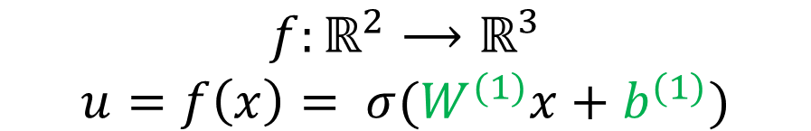
Syntax to Neural Network Revisit
When enter a Keras syntax and execute it, what would you think?
$$f$$
$$ℝ^{2}$$
$$⟶$$
$$ℝ^{3}$$
$$f:ℝ^{2}⟶ℝ^{3}$$
$$u=f\left(x\right)= σ(W^{(1)}x+b^{(1)})$$

Slide 26



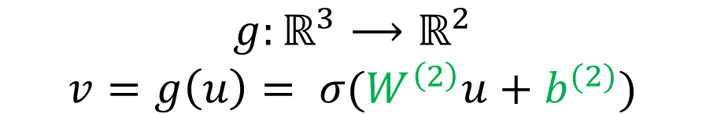
Syntax to Neural Network Revisit
When enter a Keras syntax and execute it, what would you think?
$$f$$
$$g$$
$$ℝ^{2}$$
$$⟶$$
$$ℝ^{3}$$
$$⟶$$
$$ℝ^{2}$$
$$g:ℝ^{3}⟶ℝ^{2}$$
$$v=g\left(u\right)= σ(W^{\left(2\right)}u+b^{(2)})$$

Slide 27

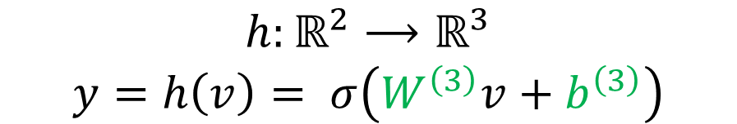


Syntax to Neural Network Revisit
When enter a Keras syntax and execute it, what would you think?
$$f$$
$$g$$
$$h$$
$$ℝ^{2}$$
$$⟶$$
$$ℝ^{3}$$
$$⟶$$
$$ℝ^{2}$$
$$⟶$$
$$ℝ^{3}$$
$$h:ℝ^{2}⟶ℝ^{3}$$
$$y=h\left(v\right)= σ\left(W^{\left(3\right)}v+b^{\left(3\right)}\right)$$

Slide 28
Let’s see how it works!

Slide 29


Syntax to Neural Network Revisit
$$ℝ^{2}$$
$$x$$
In [ ]: x = Input(shape=(2,))

Slide 30





Syntax to Neural Network Revisit
$$f$$
$$ℝ^{2}$$
$$⟶$$
$$ℝ^{3}$$
$$x$$
$$↦$$
$$u$$
$$f:ℝ^{2}⟶ℝ^{3}$$
$$u=f\left(x\right)= σ(W^{(1)}x+b^{(1)})$$
In [ ]: f = Dense(3, activation='relu')
In [ ]: u = f(x)
or
In [ ]: u = Dense(3, activation='relu')(x)

Slide 31





Syntax to Neural Network Revisit
$$f$$
$$g$$
$$ℝ^{2}$$
$$⟶$$
$$ℝ^{3}$$
$$⟶$$
$$ℝ^{2}$$
$$x$$
$$↦$$
$$u$$
$$↦$$
$$v$$
$$g:ℝ^{3}⟶ℝ^{2}$$
$$v=g\left(u\right)= σ(W^{\left(2\right)}u+b^{(2)})$$
In [ ]: g = Dense(2, activation='relu')
In [ ]: v = g(u)
or
In [ ]: v = Dense(2, activation='relu')(u)

Slide 32





Syntax to Neural Network: Revisit
$$f$$
$$g$$
$$h$$
$$ℝ^{2}$$
$$⟶$$
$$ℝ^{3}$$
$$⟶$$
$$ℝ^{2}$$
$$⟶$$
$$ℝ^{3}$$
$$x$$
$$↦$$
$$u$$
$$↦$$
$$v$$
$$↦$$
$$y$$
$$h:ℝ^{2}⟶ℝ^{3}$$
$$y=h\left(v\right)= σ\left(W^{\left(3\right)}v+b^{\left(3\right)}\right)$$
In [ ]: h = Dense(3, activation='sigmoid')
In [ ]: y = h(v)
or
In [ ]: y = Dense(3, activation='sigmoid')(v)

Slide 33
Syntax to Neural Network Revisit
model
$$f$$
$$g$$
$$h$$
$$ℝ^{2}$$
$$⟶$$
$$ℝ^{3}$$
$$⟶$$
$$ℝ^{2}$$
$$⟶$$
$$ℝ^{3}$$
$$x$$
$$↦$$
$$u$$
$$↦$$
$$v$$
$$↦$$
$$y$$
$$h:ℝ^{2}⟶ℝ^{3}$$
$$y=h\left(v\right)= σ\left(W^{\left(3\right)}v+b^{\left(3\right)}\right)$$
In [ ]: model = Model(x, y)

Slide 34
Syntax to Neural Network Revisit
model
$$f$$
$$g$$
$$h$$
$$ℝ^{2}$$
$$⟶$$
$$ℝ^{3}$$
$$⟶$$
$$ℝ^{2}$$
$$⟶$$
$$ℝ^{3}$$
$$x$$
$$↦$$
$$u$$
$$↦$$
$$v$$
$$↦$$
$$y$$
In [ ]: x = Input(shape=(2,))
In [ ]: f = Dense(3, activation='relu')
In [ ]: u = f(x)
In [ ]: g = Dense(2, activation='relu')
In [ ]: v = g(u)
In [ ]: h = Dense(3, activation='sigmoid')
In [ ]: y = h(v)
In [ ]: model = Model(x, y)

Slide 35
Syntax to Neural Network Revisit
model
$$f$$
$$g$$
$$h$$
$$ℝ^{2}$$
$$⟶$$
$$ℝ^{3}$$
$$⟶$$
$$ℝ^{2}$$
$$⟶$$
$$ℝ^{3}$$
$$x$$
$$↦$$
$$u$$
$$↦$$
$$v$$
$$↦$$
$$y$$
In [ ]: x = Input(shape=(2,))
In [ ]: u = Dense(3, activation='relu')(x)
In [ ]: v = Dense(2, activation='relu')(u)
In [ ]: y = Dense(3, activation='sigmoid')(v)
In [ ]: model = Model(x, y)
This is the same as what you did when using Sequential API

Slide 36
Syntax to Neural Network Revisit
model
$$f$$
$$g$$
$$h$$
$$ℝ^{2}$$
$$⟶$$
$$ℝ^{3}$$
$$⟶$$
$$ℝ^{2}$$
$$⟶$$
$$ℝ^{3}$$
$$x$$
$$↦$$
$$u$$
$$↦$$
$$v$$
$$↦$$
$$y$$
In [ ]: x = Input(shape=(2,))
In [ ]: u = Dense(3, activation='relu')(x)
In [ ]: v = Dense(2, activation='relu')(u)
In [ ]: y = Dense(3, activation='sigmoid')(v)
In [ ]: model = Model(x, y)
This is the same as what you did when using Sequential API

Slide 37
Conclusion
Model Functional API defines the relation of I/O of each layer as well as a function.
Variables from each layer are all available in Model case other than only I/O in Sequential case.
Latent variables can be manipulated by user.

Slide 38


Black Magic Revisit – Shared Layer
If we want first 9 weights and last 9 weights to be the same.
How to formulate using Model API?
model
$$f$$
$$g$$
$$f$$
$$ℝ^{2}$$
$$⟶$$
$$ℝ^{3}$$
$$⟶$$
$$ℝ^{2}$$
$$⟶$$
$$ℝ^{3}$$

Slide 39

Black Magic Revisit – Shared Layer
If we want first 9 weights and last 9 weights to be the same.
How to formulate using Model API?
model
$$f$$
$$g$$
$$f$$
$$ℝ^{2}$$
$$⟶$$
$$ℝ^{3}$$
$$⟶$$
$$ℝ^{2}$$
$$⟶$$
$$ℝ^{3}$$
$$f:ℝ^{2}⟶ℝ^{3}$$
$$u=f\left(x\right)= σ(W^{(1)}x+b^{(1)})$$
$$g:ℝ^{3}⟶ℝ^{2}$$
$$v=g\left(u\right)= σ\left(W^{\left(2\right)}u+b^{\left(2\right)}\right)$$
$$y=f\left(v\right)= σ\left(W^{\left(3\right)}v+b^{\left(3\right)}\right)$$

Slide 40
Black Magic Revisit – Shared Layer
If we want first 9 weights and last 9 weights to be the same.
How to formulate using Model API?
model
$$f$$
$$g$$
$$f$$
$$⟶$$
$$ℝ^{3}$$
$$⟶$$
$$ℝ^{2}$$
$$⟶$$
$$ℝ^{3}$$
In [ ]: x = Input(shape=(2,))
In [ ]: f = Dense(3, activation='relu')
In [ ]: u = f(x)
In [ ]: g = Dense(2, activation='relu')
In [ ]: v = g(u)
In [ ]: h = Dense(3, activation='sigmoid')
In [ ]: y = h(v)
In [ ]: y = f(v)
In [ ]: model = Model(x, y)
$$ℝ^{2}$$

Slide 41















Black Magic Revisit – Branch or Merge
$$f$$
$$g^{r}$$
$$ℝ^{2}$$
$$⟶$$
$$ℝ^{3}$$
$$⟶$$
$$ℝ^{2}$$
$$ℝ^{3}$$
$$g_{1}^{b}$$
$$g_{2}^{b}$$
$$ℝ^{3}$$
$$⟶$$
$$ℝ$$
$$⟶$$
$$ℝ^{2}$$

Slide 42
Black Magic Revisit – Branch or Merge
$$f$$
$$g^{r}$$
$$ℝ^{2}$$
$$⟶$$
$$ℝ^{3}$$
$$⟶$$
$$ℝ^{2}$$
$$ℝ^{3}$$
$$g_{1}^{b}$$
$$g_{2}^{b}$$
$$ℝ^{3}$$
$$⟶$$
$$ℝ$$
$$⟶$$
$$ℝ^{2}$$

Slide 43




Black Magic Revisit – Branch or Merge
$$h$$
$$ℝ^{4}$$
$$⟶$$
$$ℝ^{3}$$
$$f$$
$$g^{r}$$
$$ℝ^{2}$$
$$⟶$$
$$ℝ^{3}$$
$$⟶$$
$$ℝ^{2}$$
$$g_{1}^{b}$$
$$g_{2}^{b}$$
$$ℝ^{3}$$
$$⟶$$
$$ℝ$$
$$⟶$$
$$ℝ^{2}$$

Slide 44










Black Magic Revisit – Branch or Merge
model
$$f$$
$$ℝ^{2}$$
$$⟶$$
$$ℝ$$
$$h$$
$$⟶$$
$$⟶$$
$$ℝ$$
$$g$$
$$ℝ^{2}$$

Slide 45


Black Magic Revisit – Branch or Merge
model
$$f$$
$$ℝ^{2}$$
$$⟶$$
In [ ]: x = Input(shape=(2,))
In [ ]: f = Dense(3, activation='relu')
In [ ]: u_1 = f(x)
In [ ]: g = Dense(2, activation='relu')
In [ ]: u_2= g(u)
$$ℝ$$
$$h$$
$$⟶$$
$$⟶$$
$$ℝ$$
$$=$$
$$ℝ^{3}$$
$$g$$
$$ℝ^{2}$$

Slide 46
Black Magic Revisit – Branch or Merge
model
$$f$$
$$ℝ^{2}$$
$$⟶$$
In [ ]: x = Input(shape=(2,))
In [ ]: f = Dense(3, activation='relu')
In [ ]: u_1 = f(x)
In [ ]: g = Dense(2, activation='relu')
In [ ]: u_2= g(u)
In [ ]: merged_u = concatenate([u_1, u_2])
$$ℝ$$
$$h$$
$$⟶$$
$$⟶$$
$$ℝ$$
$$=$$
$$ℝ^{3}$$
$$g$$
$$ℝ^{2}$$

Slide 47
Black Magic Revisit – Branch or Merge
model
$$f$$
$$ℝ^{2}$$
$$⟶$$
In [ ]: x = Input(shape=(2,))
In [ ]: f = Dense(1, activation='relu')
In [ ]: u_1 = f(x)
In [ ]: g = Dense(2, activation='relu')
In [ ]: u_2= g(u)
In [ ]: merged_u = concatenate([u_1, u_2])
In [ ]: h = Dense(1, activation='softmax')
In [ ]: y = h(merged_u)
In [ ]: model = Model(x, y)
$$ℝ$$
$$h$$
$$⟶$$
$$⟶$$
$$ℝ$$
$$=$$
$$ℝ^{3}$$
$$g$$
$$ℝ^{2}$$

Slide 48









Black Magic Revisit – Challenge
$$h$$
$$g^{r}$$
$$ℝ^{4}$$
$$⟶$$
$$ℝ^{3}$$
$$f$$
$$ℝ^{2}$$
$$⟶$$
$$ℝ^{3}$$
$$⟶$$
$$ℝ^{2}$$
$$g_{1}^{b}$$
$$g_{2}^{b}$$
$$ℝ^{3}$$
$$⟶$$
$$ℝ$$
$$⟶$$
$$ℝ^{2}$$

Slide 49


















Hint:
$$g^{r}$$
$$⟶$$
$$ℝ^{2}$$
$$f$$
$$h$$
$$ℝ^{2}$$
$$⟶$$
$$ℝ^{3}$$
$$=$$
$$ℝ^{4}$$
$$⟶$$
$$ℝ^{3}$$
$$g_{1}^{b}$$
$$g_{2}^{b}$$
$$⟶$$
$$ℝ$$
$$⟶$$
$$ℝ^{2}$$

Slide 50
Black Magic Revisit – Conclusion
A common application of Brach-and-Merge is to build Multi-input and multi-output models.
Ref: https://keras.io/getting-started/functional-api-guide/#multi-input-and-multi-output-models

Slide 51
Customized Layer
For example, we want a layer which output the average of the input neurons
Average

Slide 52
Customized Layer
Lambda layer transfers customized function as a layer.
This could be also used when using Sequential API.
Average
def my_avergae(args):
return K.mean(args)
x = Input(shape=(3,), name='x_is_input')
f = Lambda(my_avergae, output_shape=(1,))
y = f(x)
model = Model(x, y)

Slide 53
Customized Layer
Lambda layer is used for customized function as layer behavior.
This could be also used when using Sequential API.
Black
Magic
def my_spell(args):
xxx
return black_magic
x = Input(shape=(3,), name='x_is_input')
f = Lambda(my_spell, output_shape=(1,))
y = f(x)
model = Model(x, y)

Slide 54
Customized Loss Function
Can we use user-defined loss function?
model
In [ ]: x = Input(shape=(2,))
In [ ]: f = Dense(3, activation='relu')
In [ ]: u = f(x)
In [ ]: g = Dense(2, activation='relu')
In [ ]: v = g(u)
In [ ]: h = Dense(3, activation='sigmoid')
In [ ]: y = h(v)
In [ ]: model = Model(x, y)
In [ ]: model.compile(loss=‘mse’)

Slide 55
Customized Loss Function
Can we use user-defined loss function?
Yes, as shown below. Another example is VAE.
model
In [ ]: x = Input(shape=(2,))
In [ ]: f = Dense(3, activation='relu')
In [ ]: u = f(x)
In [ ]: g = Dense(2, activation='relu')
In [ ]: v = g(u)
In [ ]: h = Dense(3, activation='sigmoid')
In [ ]: y = h(v)
In [ ]: model = Model(x, y)
In [ ]: def my_loss(y_true, y_pred):
return K.mean(y_true - y_pred)
In [ ]: model.compile(loss=my_loss)

Slide 56
Customized Loss Function
In most case, the order of y_true and y_pred is not important
However, for cross-entropy-like loss function, it’s IMPORTANT
model
In [ ]: x = Input(shape=(2,))
In [ ]: f = Dense(3, activation='relu')
In [ ]: u = f(x)
In [ ]: g = Dense(2, activation='relu')
In [ ]: v = g(u)
In [ ]: h = Dense(3, activation='sigmoid')
In [ ]: y = h(v)
In [ ]: model = Model(x, y)
In [ ]: def my_loss(y_true, y_pred):
return K.mean(y_true - y_pred)
In [ ]: model.compile(loss=my_loss)

Slide 57
Customized Loss Function
Now, try to define some loss function using functions provided from backend.
model
In [ ]: x = Input(shape=(2,))
In [ ]: f = Dense(3, activation='relu')
In [ ]: u = f(x)
In [ ]: g = Dense(2, activation='relu')
In [ ]: v = g(u)
In [ ]: h = Dense(3, activation='sigmoid')
In [ ]: y = h(v)
In [ ]: model = Model(x, y)
In [ ]: def my_loss(y_true, y_pred):
xxx
return ooo
In [ ]: model.compile(loss=my_loss)

Slide 58
Submodels
When we define a NN model, sometimes, we don’t care about output value or class.
Usually, neurons in the hidden layers are of interesting.

Slide 59
Submodels – Autoencoder as Example

Slide 60
Submodels – Autoencoder as Example

Slide 61
Assignment Revisit – VAE
Variational Autoencoder (VAE) is a variant of AE which randomize latent vector from deterministic one. (Don’t worry, I will explain what it means)
VAE can be constructed using all tips we learned above: Model, Branch-and-Merge, Customized Layers, Customized Loss Function.

Slide 62
Assignment Revisit – VAE

Slide 63

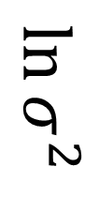
MSE loss
圖
片
圖
片
(重建)
$$μ$$
常
態
抽
樣
Encoder
nx1
Decoder
$$\ln{σ^{2}}$$
nx1
nx1
KL loss
total loss = MSE loss + KL loss
N(0_{nx1}, I_{n})

Slide 64

Assignment Revisit – VAE
So, we need to define two things:
Sampling from Normal distribution where mean and covariance are given by previous two layers.
Loss function defined by sum of MSE between I/O and KL-divergence between N($μ, σ^{2}$) and N(0,I_{n}).

Slide 65
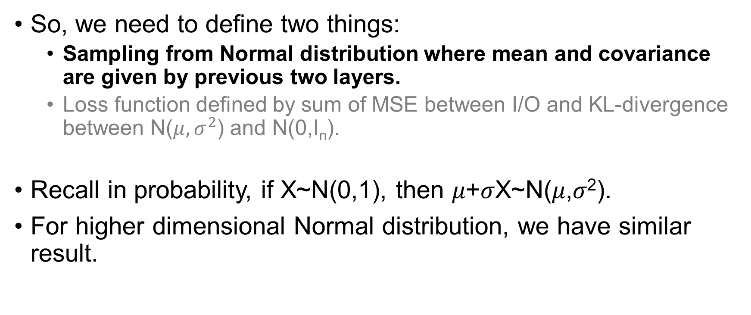
Assignment Revisit – VAE
So, we need to define two things:
Sampling from Normal distribution where mean and covariance are given by previous two layers.
Loss function defined by sum of MSE between I/O and KL-divergence between N($μ, σ^{2}$) and N(0,I_{n}).
Recall in probability, if X~N(0,1), then 𝜇+𝜎X~N(𝜇,𝜎²).
For higher dimensional Normal distribution, we have similar result.

Slide 66

Assignment Revisit – VAE
So, we need to define two things:
Sampling from Normal distribution where mean and covariance are given by previous two layers.
Loss function defined by sum of MSE between I/O and KL-divergence between N($μ, σ^{2}$) and N(0,I_{n}).
def sampling(args):
z_mean, z_log_var = args
epsilon = K.random_normal(shape=(batch_size, latent_dim), mean=0., stddev=epsilon_std)
return z_mean + K.exp(z_log_var / 2) * epsilon

Slide 67

Assignment Revisit – VAE
So, we need to define two things:
Sampling from Normal distribution where mean and covariance are given by previous two layers.
Loss function defined by sum of MSE between I/O and KL-divergence between N($μ, σ^{2}$) and N(0,I_{n}).
def vae_loss(y_true, y_pred):
mse_loss = K.square(y_true - y_pred)
kl_loss = - 0.5 * K.sum(1 + z_log_var - K.square(z_mean) - K.exp(z_log_var), axis=-1)
return K.mean(xent_loss + kl_loss)

Slide 68
Assignment Revisit – VAE
Review the code of VAE!

Slide 69
Final Challenge
For the remaining time, I want you all to build up a model which is a combination of what we learned today.
You might use Model, Branch-and-Merge, Customized Loss Function in this model.

Slide 70



Final Challenge - Structure
MSE loss
X
autoencoder
$$\hat{\text{X}}$$
MSE loss
X
X
autoencoder
$$\hat{\text{X}}$$
X
MSE loss
X
autoencoder
$$\hat{\text{X}}$$

Slide 71
autoencoder
autoencoder
‧ ‧ ‧
‧ ‧ ‧
‧ ‧ ‧
‧ ‧ ‧
‧ ‧ ‧

Slide 72
Congratulations!
If you can finish this final challenge, then you are one step closer to …

Slide 73
Congratulations!
If you can finish this final challenge, then you are one step closer to …
Berkeley AI Research (BAIR) Laboratory！

Slide 74
Real World Implementation
Ref: R. Zhang, P. Isola, and A. A. Efros. Split-brain autoencoders: Unsupervised learning by cross-channel prediction. CoRR, abs/1611.09842, 2016.

Slide 75
Real World Implementation

Slide 76
Acknowledgement
Special thanks to Yen Jan who provides me some suggestion about this talk.

Slide 77
всё

