Slide 1
Using a compiler based approach, FLAT, to accelerate Finite Volume kernels within ExaHyPE
Jack Slingsby
Supervisor: Professor Tobias Weinzierl

Slide 2

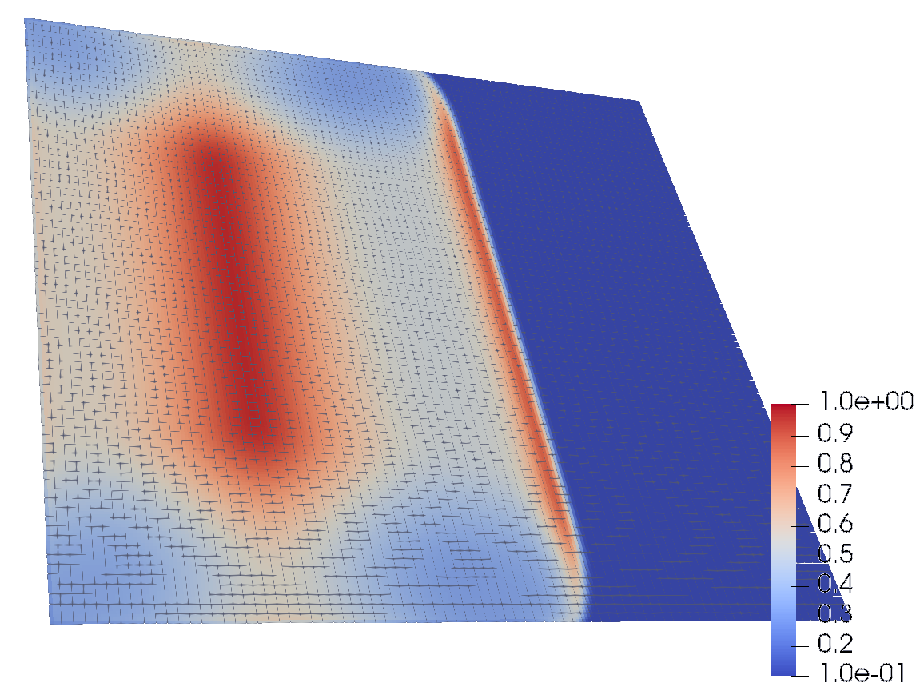
Background
High Performance Comping (HPC)
Solving Partial Differential Equations
ExaHyPE

Slide 3
Finite Volume Method
Space is divided into cells
Cells subject to different influences
ExaHyPE
Cells grouped into patches
Patches are updated (single core)

Slide 4
Problem
Boundary of user and engine code
Engine is unaware of user code
Missed optimisations

Slide 5
Related
“Role-Oriented Code Generation in an Engine for Solving Hyperbolic PDE Systems” [1]
ExaHyPE
3 team roles
Use of jinja2 templating library
Architecture aware optimisations
[1] Jean-Matthieu Gallard et al. “Role-Oriented Code Generation in an Engine for Solving Hyperbolic PDE Systems”. In: CoRR abs/1911.06817 (2019).

Slide 6
Related
YATeTo – Yet Another Tensor Toolbox [2]
SeiSol
Linear Problem
GEMM libraries
1.1x to 6.5x speedup
[2] Carsten Uphoff and Michael Bader. “Yet Another Tensor Toolbox for Discontinuous Galerkin Methods and Other Applications”. In: ACM Trans. Math. Softw. 46.4 (Oct. 2020). ISSN: 0098-3500. DOI: 10.1145/3406835.

Slide 7
Related
“Automatic Code Generation for High-Performance Discontinuous Galerkin Methods on Modern Architectures” [3]
Manual SIMD optimisations
Argue developers know best
50% peak floating point performance
[2] Dominic Kempf et al. Automatic Code Generation for High-Performance Discontinuous Galerkin Methods on Modern Architectures. 2018. DOI: 10.48550/ARXIV.1812. 08075. URL: https://arxiv.org/abs/1812.08075.

Slide 8
Solution
Domain specific compiler: FLAT
Flat Long And potentially Transformed code
Goals:
Supporting a large range of problems
Generating code that is faster than the current default code
User friendly
Practical to use

Slide 9
Domain
All functions are pure functions
All functions have a fixed number of inputs and outputs
All functions contain a fixed number of operations
Functions can be nested
Machine precision effects can be ignored
No function contains control flow

Slide 10
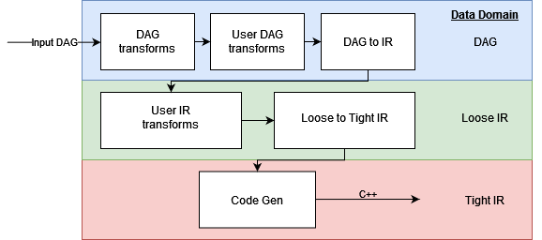
Architecture Overview

Slide 11
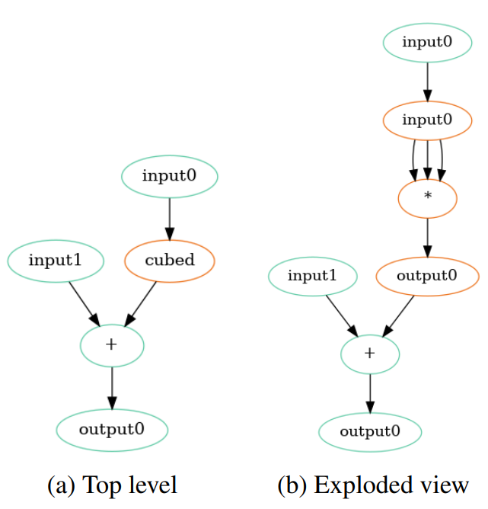

Directed Acyclic Graph (DAG)
$$out_{0}={\left(in_{0}\right)}^{3}+in_{1}$$

Slide 12
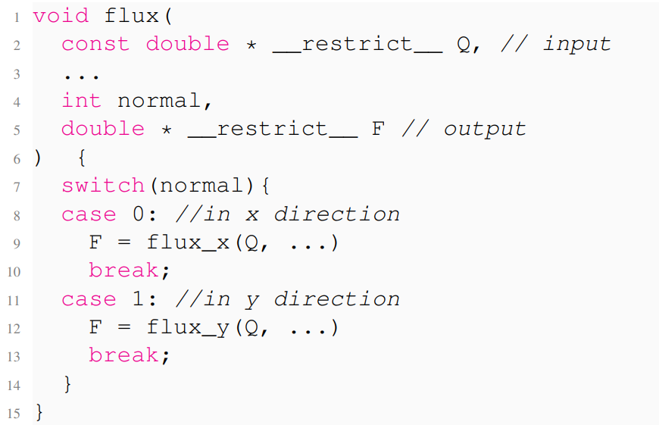
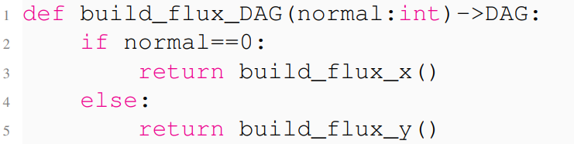
Control Flow Hoisting

Slide 13
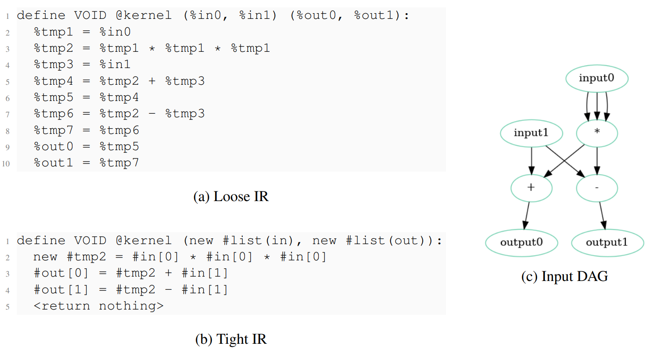
Internal Representation (IR)

Slide 14
Creating a Kernel
User makes DAG builders
User DAGs used in prebuilt engine DAG builders
DAG passed through FLAT

Slide 15
Example

Slide 16
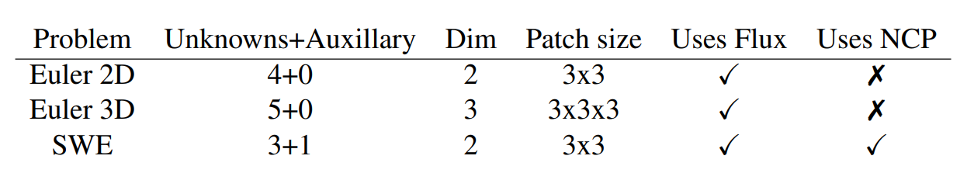
Test Problems
Intel System
CPU: Intel Xeon E5-2680
Compiler: ipcx v2021.1
Flags: -Ofast
AMD System
CPU: EPYC 7702
Compiler: aocc v12.0.0
Flags: -Ofast

Slide 17
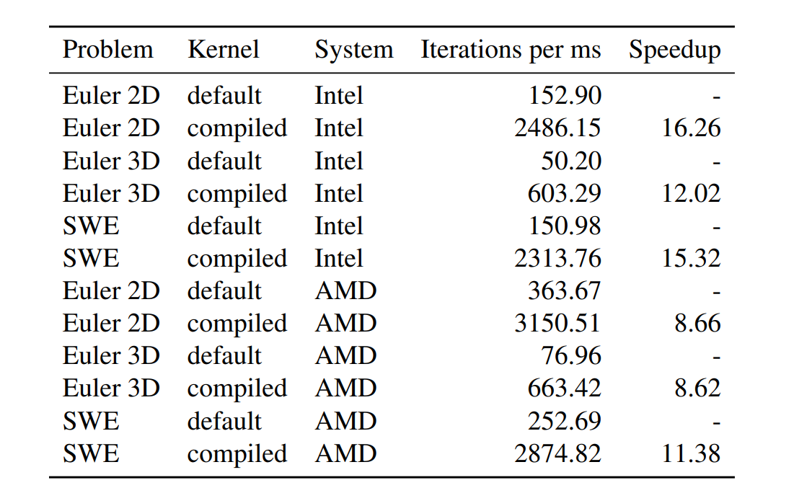
Results – Synthetic Benchmark

Slide 18
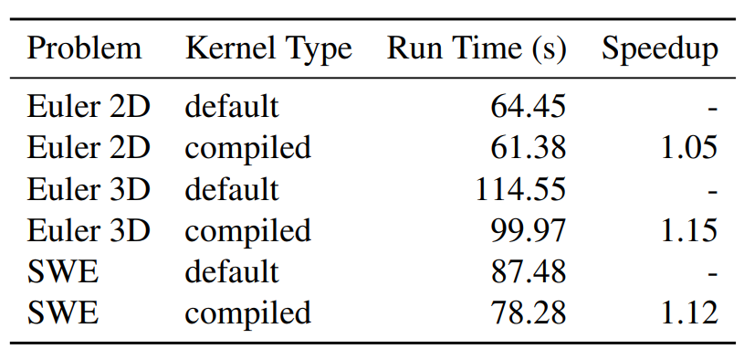
Results – ExaHyPE

Slide 19
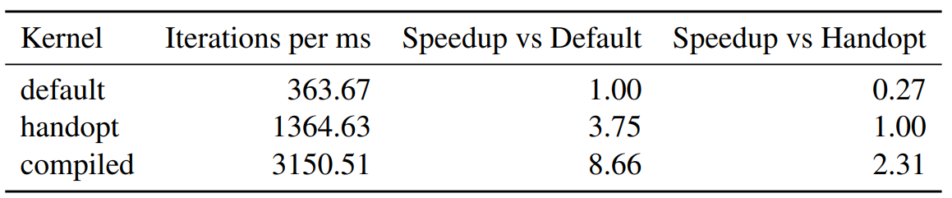
Results – vs Hand Optimised Kernel

Slide 20
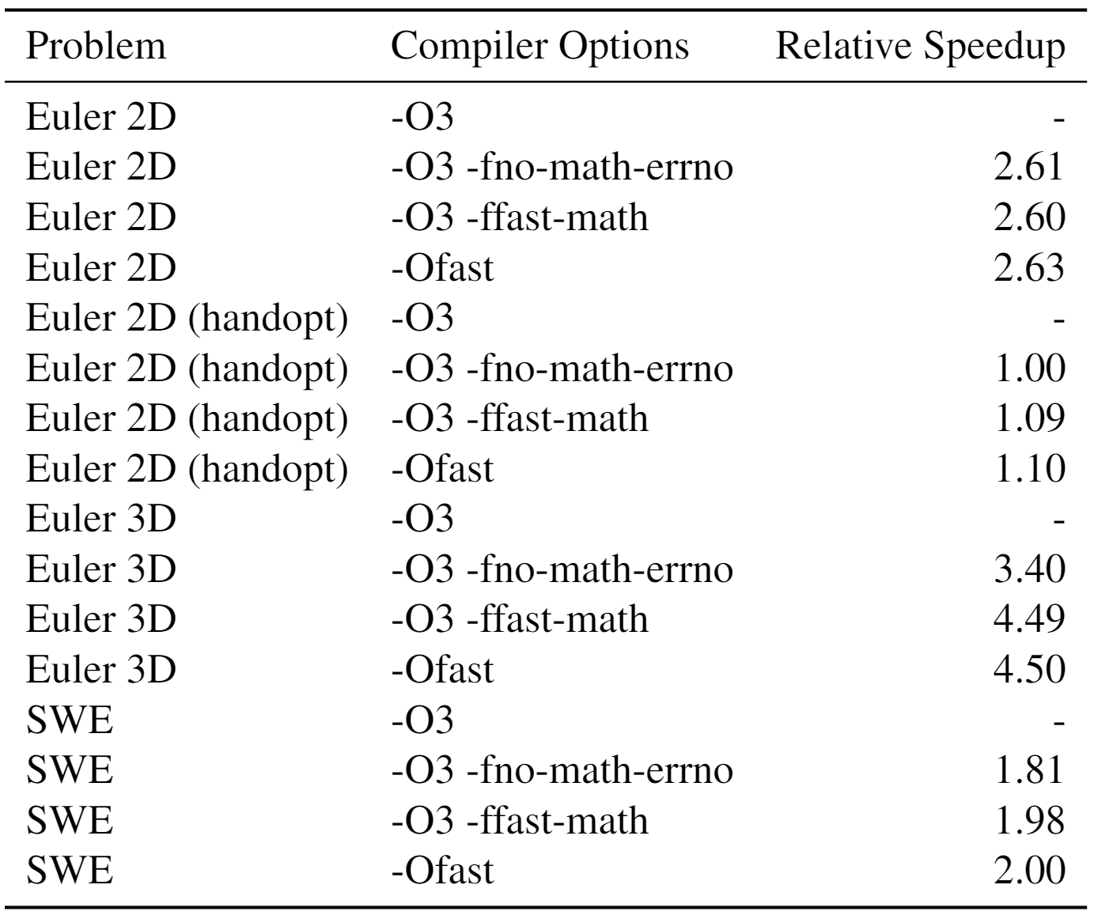
Results – Compiler Flags

Slide 21
Results - SIMD
Compiler Flags: -O3 –fno-math-errorno
x86 Instructions: 1371
FP vectorization ratio: 60%
Compiler Flags: -O3
x86 Instructions: 4855
FP vectorization ratio: 36%
Results gathered using the MAQAO static analysis tool:
Lamia Djoudi et al. “MAQAO : Modular Assembler Quality Analyzer and Optimizer for Itanium 2”. In: 2005.

Slide 22
Evaluation and Conclusion
Promising Results
Difficult to use
What is the performance on big problems?
Is flat the right way to go?
How does it compare to other results?

Slide 24

This is an example of a text slide
Oluptate mpossitius et ratur quiam fuga. Porem fugiati scietur accum volum laccae minvent ex et aut a quibusdam cam quam est.
Sint, sumet modit pe que nus rerumenis eaturitis sedicidebis aut atati. Beribusae cus re odis magnis sitaturesed modi debit simusam accusor assint.

Slide 25

This is an example of a text slide
Oluptate mpossitius et ratur quiam fuga. Porem fugiati scietur accum volum laccae minvent ex et aut a quibusdam cam quam est.
Sint, sumet modit pe que nus rerumenis eaturitis sedicidebis aut atati. Beribusae cus re odis magnis sitaturesed modi debit simusam accusor assint.

Slide 26


This is an example of a text slide
Oluptate mpossitius et ratur quiam fuga. Porem fugiati scietur accum volum laccae minvent ex et aut a quibusdam cam quam est.
Sint, sumet modit pe que nus rerumenis eaturitis sedicidebis aut atati. Beribusae cus re odis magnis sitaturesed modi debit simusam accusor assint.

Slide 27
This is an example of a bullet slide
Oluptate mpossitius et ratur quiam fuga porem fugiati scietur accum volum
Laccae minvent exet aut a quibusdam
Quam est ut dolore dist sint sumet modit pe que nus rerumenis eaturitis sedicidebis aut atati
Beribusae cus re odis magnis sitaturesed modi debit simusam accusor assint

