Slide 1
Group L
Weibo Data flow
Visualization
韩冬奇
李依霖
李玥珮
王海璐
刘庆庆

Slide 2
Group L
zzplovezzp

Slide 3
Group L
Scenarios
There are BILLIONS of weibo users.
Vast amount of data contains rich information.
We can find sensitive events, emotional changes or user activities at different times in different locations.

Slide 4
Group L
How to excavate potential & valuable
information?

Slide 5
Group
L
Data Sets
300 thousand pieces for each day

Slide 6
Group
L
Data Processing
1.Segment sentences to entries with IkAnalyzer;
2.Interests mining with sensitive dictionary;
3.Emotional analysis with emotional dictionary;

Slide 7
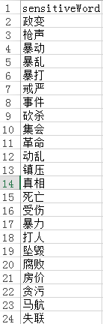




Group
L

Slide 8
Group
L
Features
Text Flow Display
Interests Mining
Real-time status
Emotional Analysis
Statistical Analysis

Slide 9
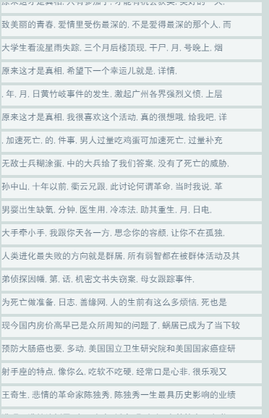
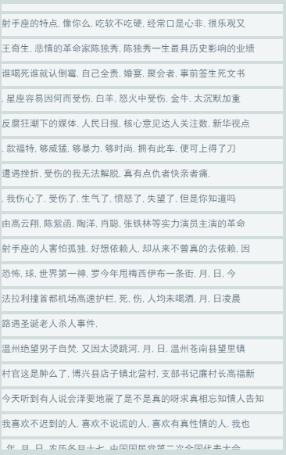
Group
L
Text Flow

Slide 10
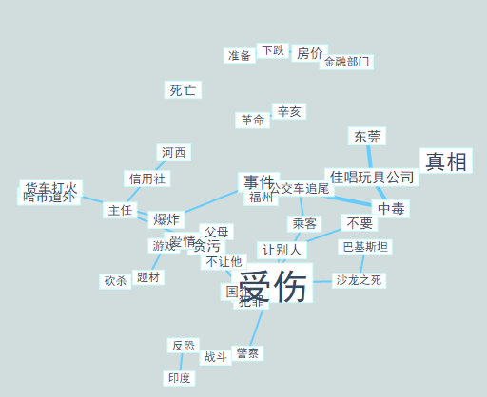
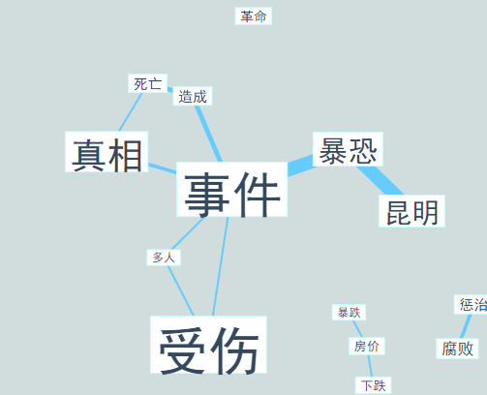
Group
L
Interests Mining

Slide 11
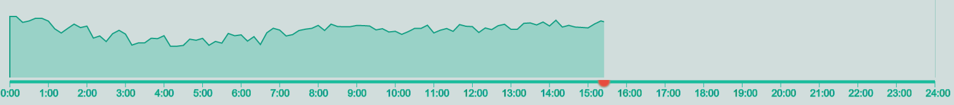
Group
L
Real-Time Status

Slide 12
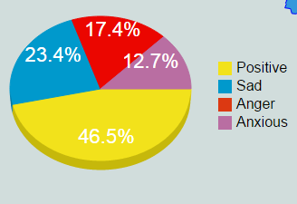
Group
L
Emotional Analysis

Slide 13
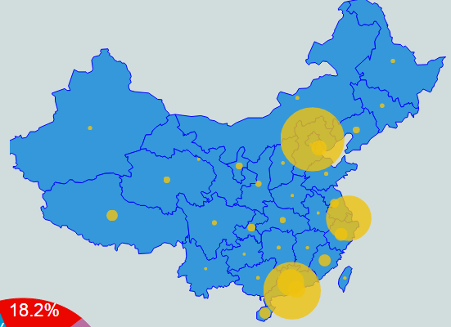
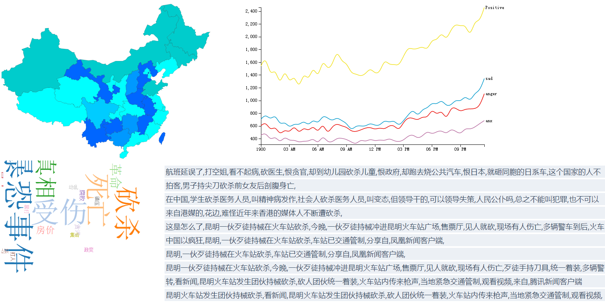
Group
L
Statistical Analysis

Slide 14
Group L
TEXT
Demo

Slide 15
Group L
zzplovezzp

Slide 16
Group
L
Summary
Innovation
Challenge
Improvement
Multi dimensions
Real-time display
Data processing
Status updates
Interaction
Page layout

Slide 17
Thanks

