Slide 1
Fundamentals of deep learning part 4: Data augmentation And Deployment

Slide 2
Agenda
Part 1: An Introduction to Deep Learning
Part 2: How a Neural Network Trains
Part 3: Convolutional Neural Networks
Part 4: Data Augmentation and Deployment
Part 5: Pre-trained Models
Part 6: Advanced Architectures

Slide 3
Agenda – Part 4
Data Augmentation
Model Deployment

Slide 4
Recap of the exercise
Analysis
CNN increased validation accuracy
Still seeing training accuracy higher than validation
Notes:
Looks like our models are getting better. When we used a Convolutional Neural Network, our validation accuracy improved, which is great, but it still looks like our training accuracy is higher than our training accuracy. It looks like we’re still overfitting a bit.

Slide 5



Recap of the exercise
Analysis
Solution
CNN increased validation accuracy
Still seeing training accuracy higher than validation
Clean data provides better examples
Dataset variety helps the model generalize
Notes:
Sometimes it’s not the model, but the data. There are lots of sayings around this: “Garbage in, garbage out”, “You can’t make a silk purse out of a sow’s ear”. Just like us humans, neural networks learn from example, and if the examples aren’t that great, the model won’t learn either.
The other thing to consider is to have enough varied examples. For example, let’s consider what it takes to teach a kid what a dog is. There a many different kinds of dogs, not just different breeds, but even within a breed there are many variations. Size, coloring, hair length, the size of the snout, the length of a tail…
If I was an alien that came from a different planet, I might be surprised to learn that a chihuahua and a great dane were from the same species!
At the same time, we should also be providing many different examples of what a dog isn’t. Coyotes, foxes and jackals are all closely related, but are technically not domesticated dogs. If we only proved one or two examples of what a dog is and what a dog isn’t, our model won’t be able to generalize its definition of a dog.

Slide 6
Data Augmentation

Slide 7

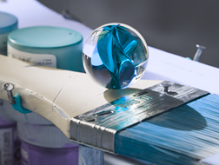
Data augmentation
Notes:
One neat property about working with a computer vision machine learning model is that if we’re careful, we can augment out data to provide more examples. If you’ve ever spent time altering photos digitally, we’re going to be using a lot of the same tools found in Photoshop or Gimp to expand our datasets.
For instance, even though I’ve changed the hue (color representation) in our marble photo, we can still tell that it’s a marble. Many machine learning frameworks already have tools in them to alter photos. We’re going to go over a few the tricks available to us.
As always, these aren’t tricks that will work in every situation. Depending on what we’re training our model to do, we might end up confusing it instead. Let’s say we’re making a model to identify flowers. Color would likely be critical information, so changing the color like I did above would end up being unhelpful.

Slide 8

Image Flipping
Horizontal Flip
Vertical Flip
Notes:
Let’s start with image flipping. In this case, we can imagine our photo is printed on a sheet of paper, and we’re just flipping that sheet of paper over.
Fair warning though flipping an image dataset might not always be appropriate. Fun fact: with a few exceptions, most words in American Sign Language can be mirrored depending on whether you’re right handed or left handed. https://www.handspeak.com/learn/index.php?id=98, so horizontal flipping is appropriate for our dataset. One the other hand, vertical flipping probably is not effective since people aren’t usually upside down when signing.
We can also think of our mnist dataset. If we both vertically and horizontally flip our sixes, they’ll look like nines, unnecessarily confusing our model.

Slide 9

Rotation
90⁰
45⁰
135⁰
0⁰
180⁰
315⁰
225⁰
270⁰
Notes:
A related one is rotation. We can still imagine our piece of paper, but now we’re rotating it. Is this one appropriate for American Sign Language?
Within reason. Just checking with my own posture, it’ pretty difficult to get into the exact same position 100% of the time, but we also might expect that signing at a 90 degree angle would be pretty out of place.

Slide 10





Zooming
Notes:
In fact, with many of these tools, it’s easy to go too far. Let’s take a look at zooming. If we think of our sheet of paper analogy, we can imagine we’re bringing the sheet closer to our faces.
Here we have our marble, and we’re zooming in on it more and more from left to right, top to bottom. For the first two or three, yeah, we can still tell that it’s a marble, but especially at the fourth one, we’re starting to lose too much information to be able to properly recognize it.
We usually only zoom into our pictures, because if we zoom out, we’ll need some sort of padding around the edges to keep our picture the same number of pixels.

Slide 11
Width And Height Shifting
Notes:
When we zoon in however, we can keep track of the pixels outside our field of view in order to do some shifting. Another word for this is translate. We’re just going to move our image left or right (horizontal) and up or down (vertical).
In the center here, we’ve zoomed in on our marble. Each of the surrounding pictures has the same zoom, but has been shifted either up, right, down, or left.

Slide 12

HomogRaphy
Notes:
All of these ways where we can warp an image in a physical dimension has an underlying concept called a homography. I’ve linked to an OpenCV article that explains the math behind it more, but here’s the quick version. We can imagine we have a camera and an image, and depending on our camera’s position and our image’s position, we can project our image in three dimensional space. We can do all this with some matrix multiplication, pretty neat!
https://docs.opencv.org/master/d9/dab/tutorial_homography.html

Slide 13





Brightness
Notes:
There are other things besides physically moving our image. We can adjust the pixel values as well. Here we have some examples of brightness. This is a great one to consider for real world images because unless the photos are professionally shot, it’s unlikely that lighting will stay consistent.
Just don’t go too crazy with the brightness adjuster. If it’s too dark or too bright, we won’t be able to see the image!

Slide 14
Channel Shifting
Notes:
Up until now, we’ve been working with greyscale images, but soon, we’ll be working with color. Colored images are 3d objects, the 3rd dimension now representing different color channels like Red, Green, and Blue (RGB). Each of these different channels has their own independent value, so for instance, if the red channel is 255, green is 0 and blue is 0, then the pixel will be red. Red 125, green 0, and blue 255 results in a purplish color. There are non-color channels too like alpha in RGBA, which represents transparency.
Channel shifting takes the pixels in each of these channels and adds or subtracts a random amount.

Slide 15
Model Deployment
Notes:
So a closing thought before we move on to the next section. How many pictures did we get out of our original marble image? (By my count, it’s 39, including the cropped ones). This is an extremely powerful way to get more data. Pro tip: randomly sample the images coming out of our random image generator. If the images can’t be interpreted by human eyes, chances are the computer will have a tough time too.
Ok, one last thought before moving to the lab, and that’s model deployment.

Slide 16
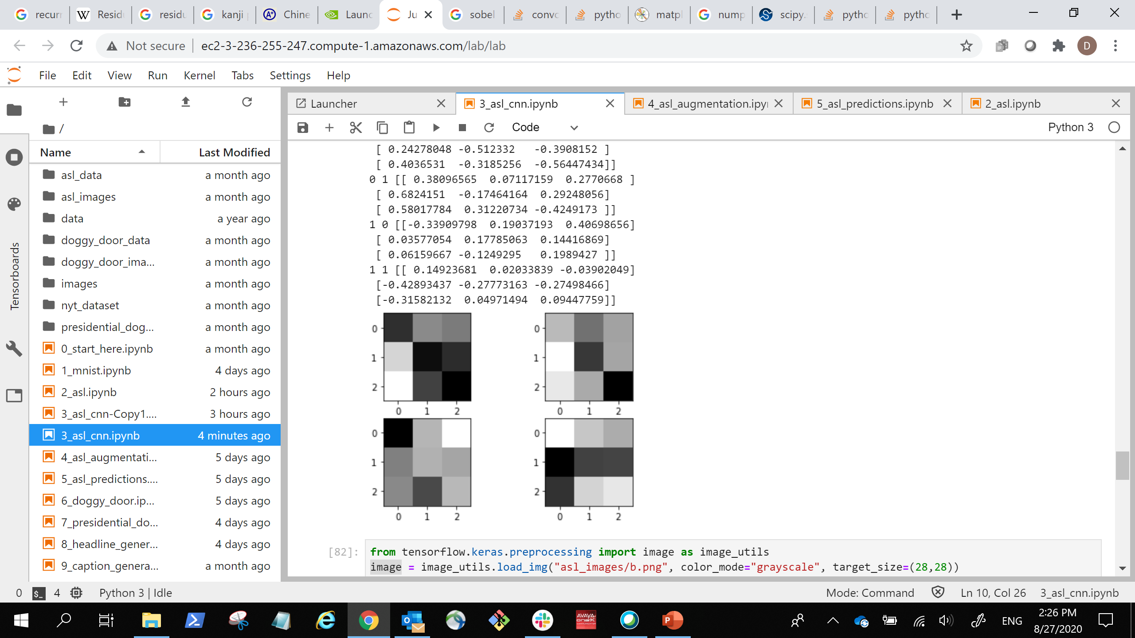
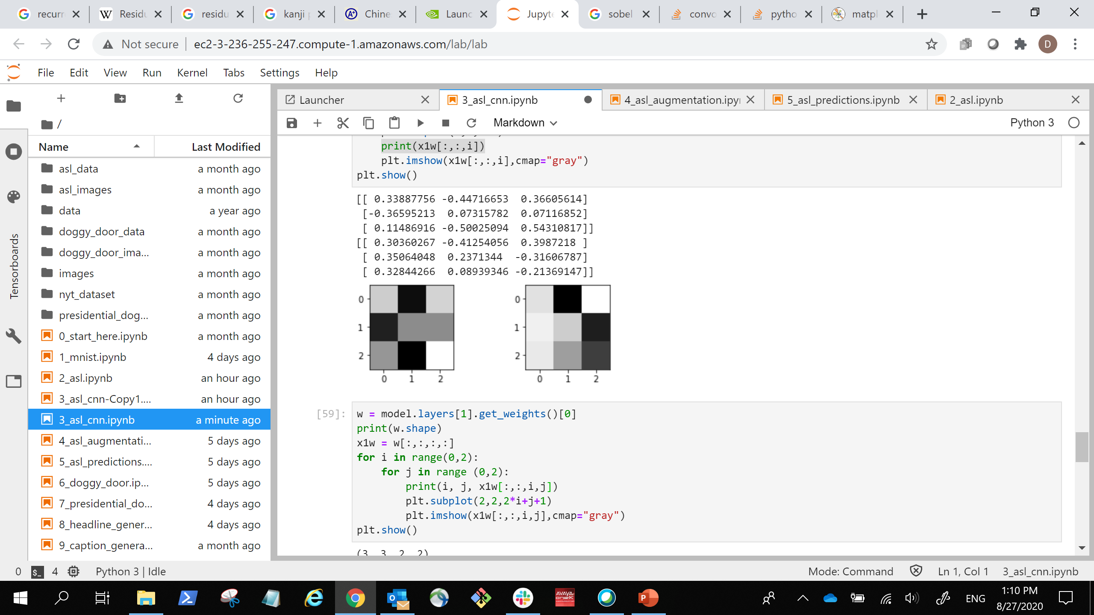
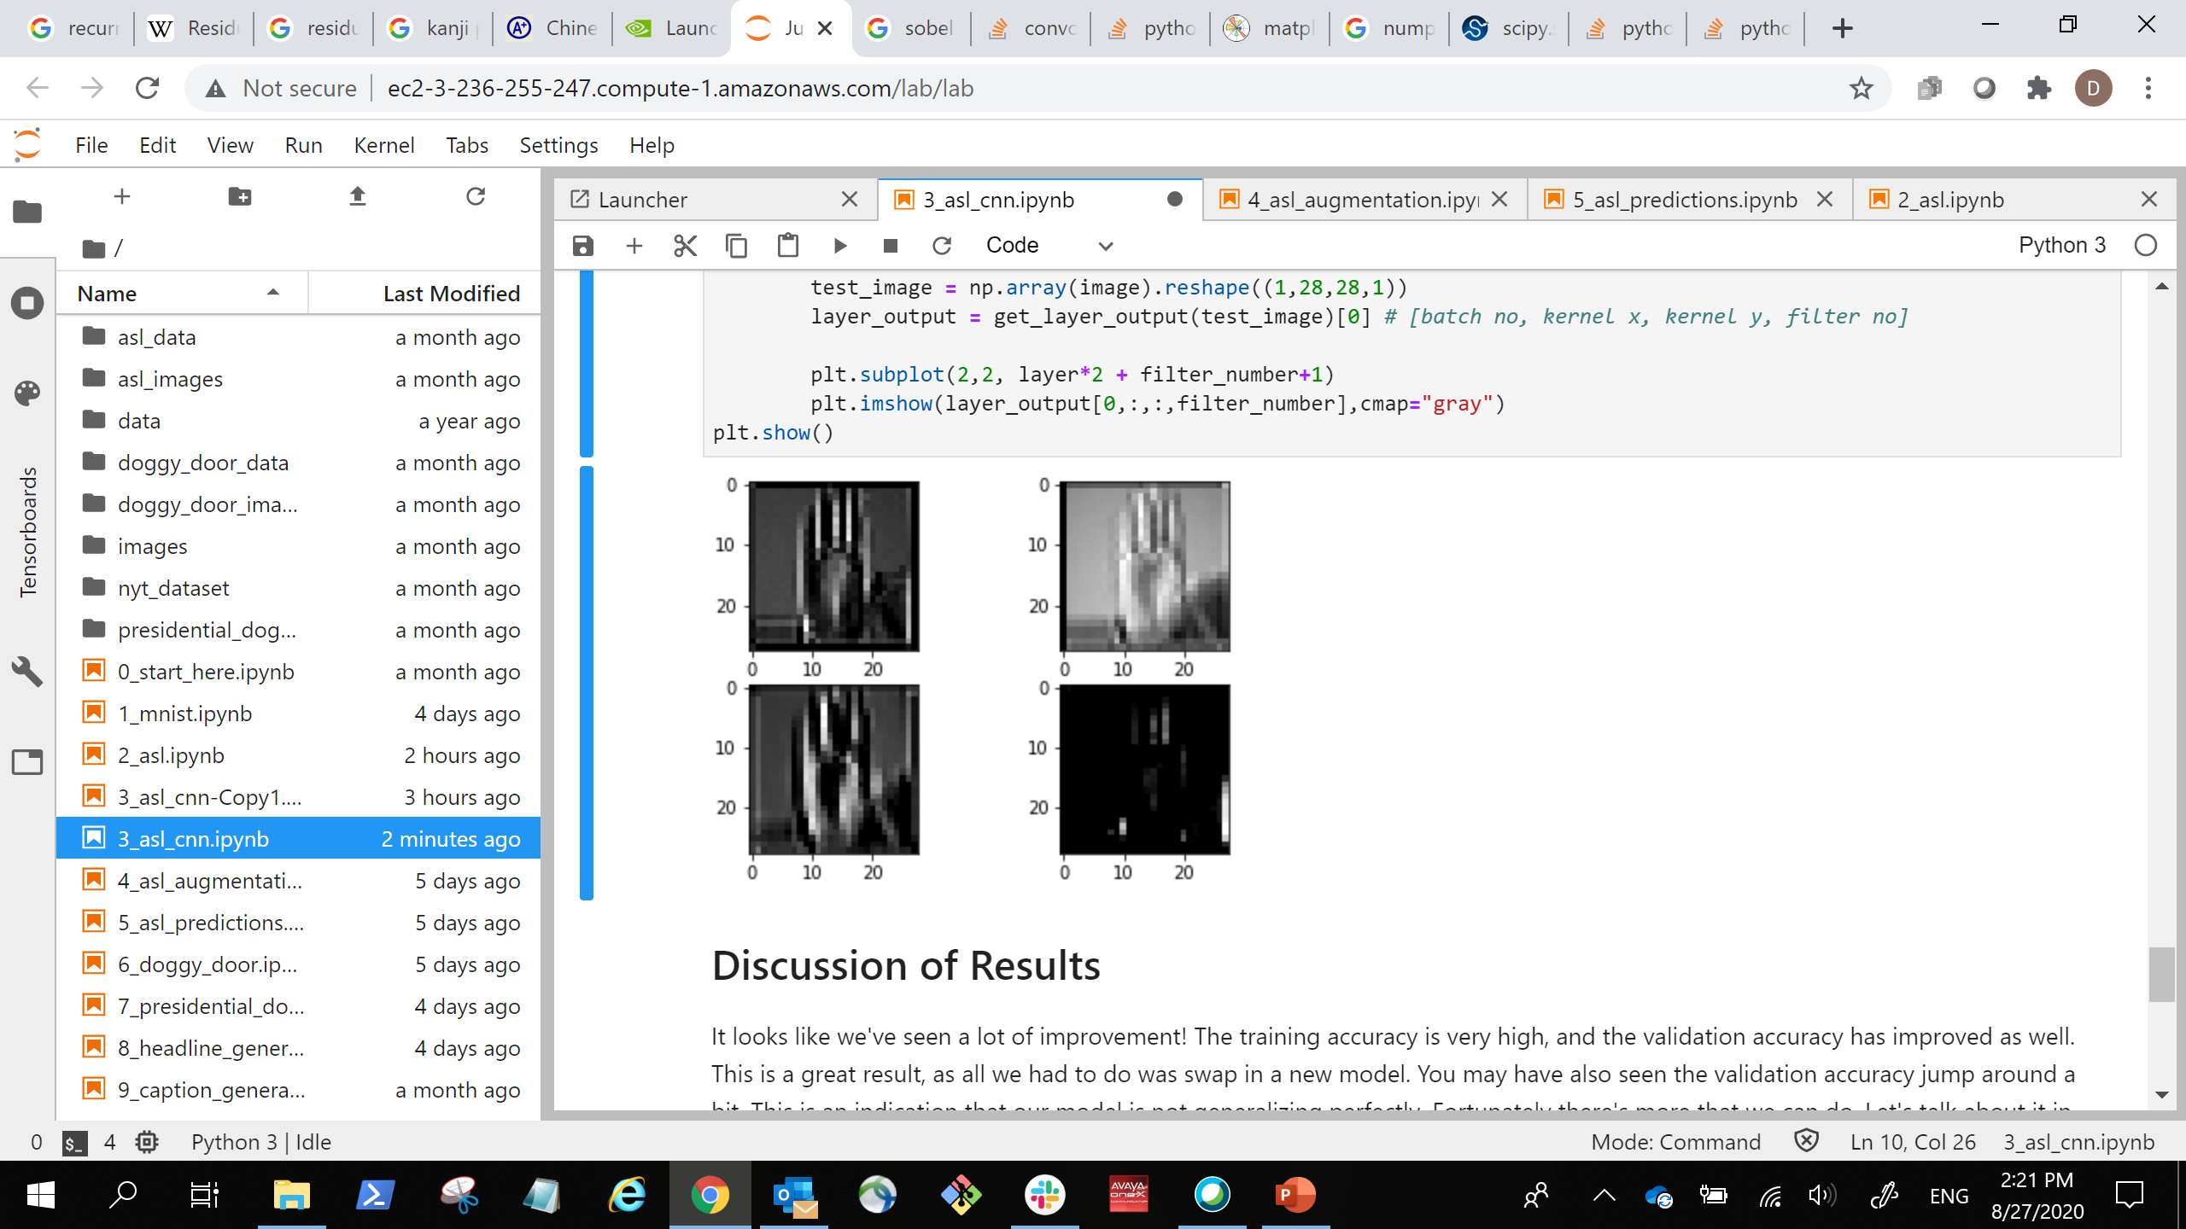
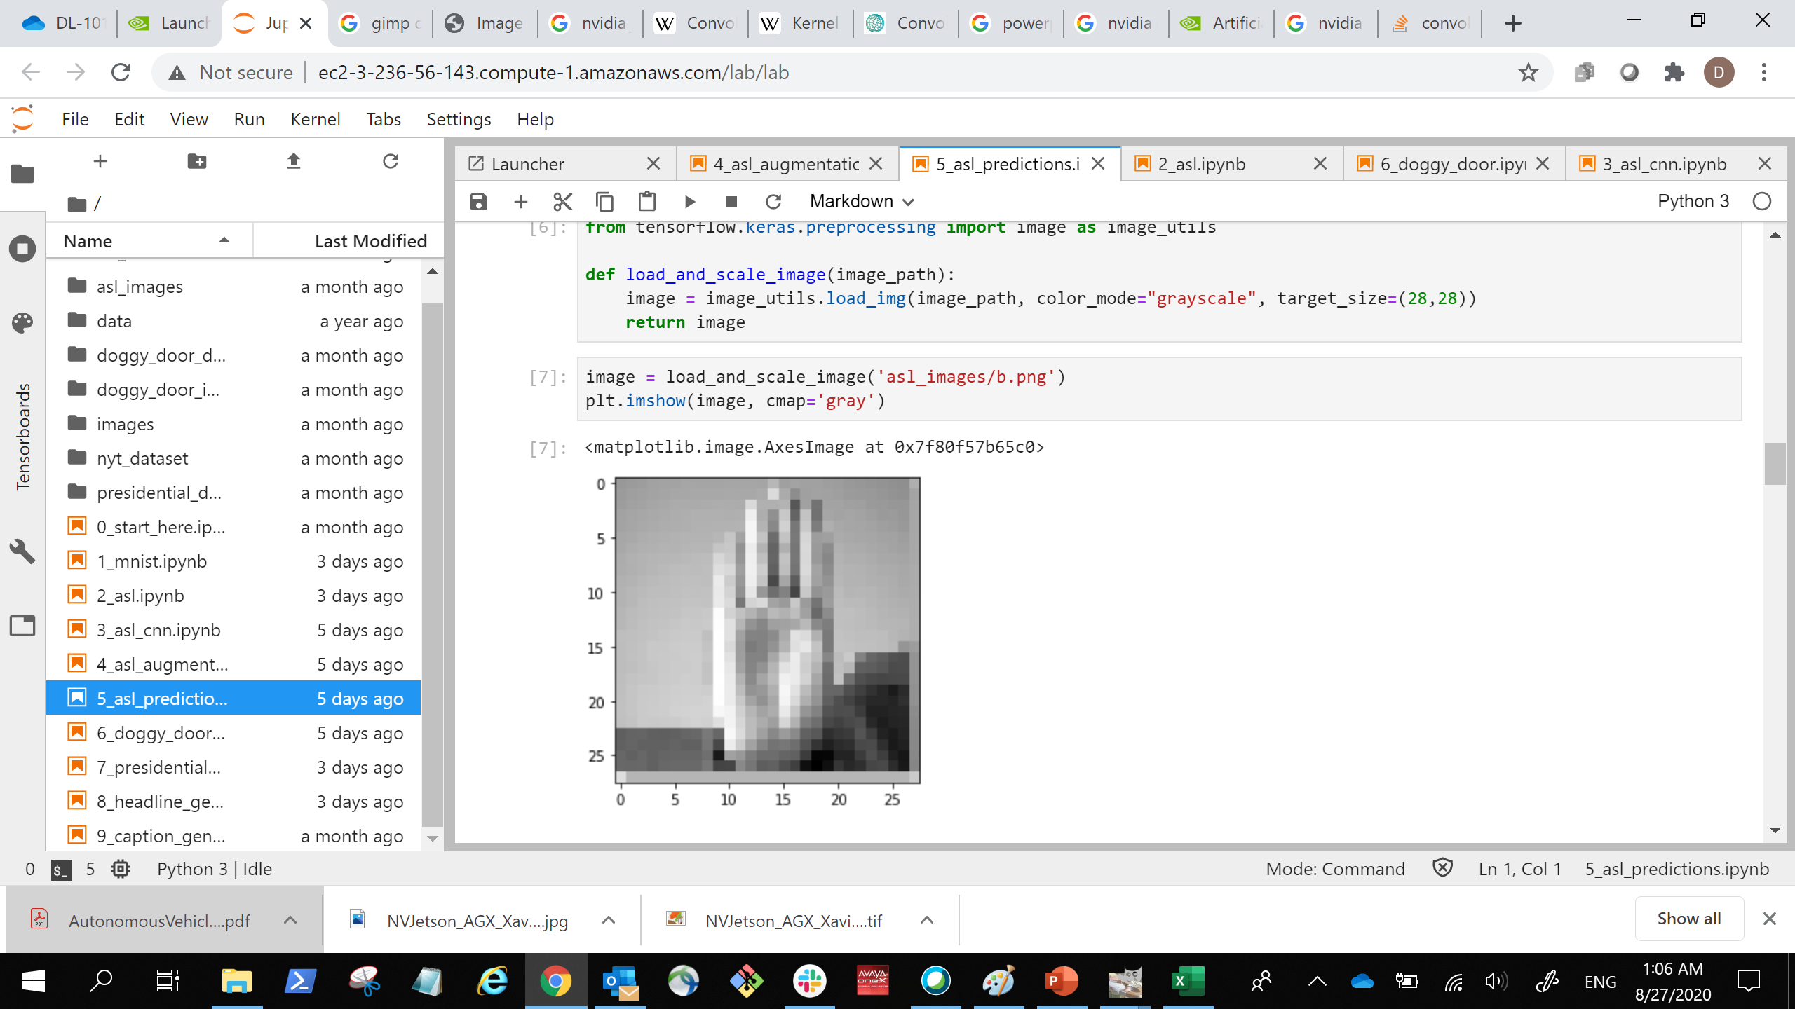
Model Deployment
… …
… …
(28, 28, 2)
Stacked Images
(28, 28, 2)
Stacked Images
(3, 3, 1, 2)
Kernels
(3, 3, 2, 2)
Kernels
(512)
Dense
(512)
Dense
(28, 28,1)
Image Input
(1568)
Flattened Image
Vector
(10)
Output Prediction
Notes:
Our model expects a particular input dimension, but it’s very possible that when we deploy our model for use in production (the real world), the format of the data we get from users is different then the format we trained on.

Slide 17
Model Deployment
Training Batch Input
Convolution
Max Pooling
…
Notes:
Also, Keras models typically assume training batches, meaning it learns on more than one image at a time.

Slide 18
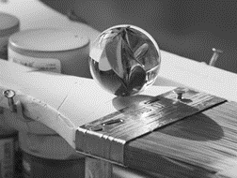
Model Deployment
(220, 155, 3)
(220, 155, 1)
(1, 220, 155, 1)
(287, 433, 3)
Resize
Greyscale
“Batch”
Notes:
If the data we want to predict on a single image that has a different shape than our model expects, no problem. We can resize the image, to get the correct width and height. If our image is in color, and our model was trained on grey-scale, there are tools to do the conversion. Another way is to take the average between the red, green and blue channels. Finally, to turn it from a single image into a batch, we can add a new axis along the first dimension. That’s just a fancy way of saying we’re going to put a new pair of brackets on the outside of our image.

Slide 19
Let’s try it out!

