Slide 1
Fundamentals of deep learning Part 6: Advanced Architectures

Slide 2
Agenda
Part 1: An Introduction to Deep Learning
Part 2: How a Neural Network Trains
Part 3: Convolutional Neural Networks
Part 4: Data Augmentation and Deployment
Part 5: Pre-trained Models
Part 6: Advanced Architectures

Slide 3
Agenda – Part 6
Moving Forward
Natural Language Processing
Recurrent Neural Networks
Other Architectures
Closing Thoughts

Slide 4
Moving Forward
Notes:
Now that we’ve mastered the basics of neural networks, we’re going to do a brief survey of some more advanced neural network architectures.

Slide 5
Fields of AI
Natural Language Processing
Linguistics
Reinforcement Learning
Game Theory
Psychology
Anomaly Detection
Security
Medicine
Computer Vision
Optometry
Notes:
Ultimately, the goal of artificial intelligence is to solve problems, as well as or better than humans. The more we try to find practical uses of artificial intelligence, the better we should understand how humans think and operate.

Slide 6
Fields of AI
Natural Language Processing
Linguistics
Reinforcement Learning
Game Theory
Psychology
Anomaly Detection
Security
Medicine
Computer Vision
Optometry
Notes:
For example, for most of today, we talked about how AI is used in the field of Computer Vision. But we’ve only scratched the surface of the research in that field. Many of the breakthroughs in computer vision have to do with a better understanding of our own human hardware.
Ever wonder why computers have three color channels for red, green and blue? It’s not a coincidence that those colors are chosen. In human eyes, we have specialized cells called photoreceptors, and there are photoreceptors with the function of picking up red, green, and blue light. So when the RGB data structure for computers was proposed, it was very much done with humans in mind.

Slide 7
Fields of AI
Natural Language Processing
Linguistics
Reinforcement Learning
Game Theory
Psychology
Anomaly Detection
Security
Medicine
Computer Vision
Optometry
Notes:
Let’s switch gears a little bit and try our hand at Natural Language Processing, where the goal is to make an intelligence that can perceive and generate language in the way that humans do. There are a lot of interesting mechanisms in place here. To start, for a computer to perceive anything at all, it must be represented as a number. How are we going to do that? And the order in which we choose our words is also important. How are we going to capture sentence structure?
With that in mind, it’s incredible to think that humans have the ability to communicate with each other through language. Turing test time! Are these instructor notes written by a human or by a machine? We look forward to seeing your response in the course feedback : )

Slide 8
Natural Language Processing
Notes:
Just like with Computer Vision, we’re only going to be able to scratch the surface of Natural Language Processing. Even so, we’re going to learn a few interesting tricks to help us get started.

Slide 9
From Words to Numbers
Dictionary
“A dog barked at a cat.”
A
An
And
At
Ate
Bark
Barked
Cat
Cats
Dog
Dogs
Eat
[1, 10, 7, 4, 1, 8]
Notes:
Let’s say we’re going to make a tool to help with writer’s block. Given the first few words of a sentence, we want our model to fill in the rest of the sentence.
The first thing we need to figure out is how are we going to represent our words as numbers? When people were first approaching this problem, one solution they came up with was to make their own dictionary. We’ll take every unique word and assign it a number, and we’ll call this list of words our dictionary. We can then run our sentence through our dictionary to get the number assigned to each word. A function that does this is called a tokenizer.

Slide 10
From Words to Numbers
Inputs
Outputs
Dictionary
A
A
An
An
And
And
At
At
A
An
And
At
Ate
Bark
Barked
Cat
Cats
Dog
Dogs
Eat
Ate
Ate
Bark
Bark
Barked
Barked
Cat
Cat
Cats
Cats
Dog
Dog
Dogs
Dogs
Eat
Eat
Notes:
We’ll start simple and create a model that takes one word as an input and tries to predict the next word as an output. Given our dictionary, we might predict the word to come after “dog” would be “ate” or “barked”. How would we set up our model to do this?
Even though we’ve assigned each word a number, it’s still a categorical variable. To treat it as such, we’ll assign each word to an input neuron.

Slide 11
From Words to Numbers
Inputs
Outputs
Dictionary
0
0%
0
0%
0
10%
0
5%
A
An
And
At
Ate
Bark
Barked
Cat
Cats
Dog
Dogs
Eat
0
35%
0
0%
0
50%
0
0%
0
0%
1
0%
0
0%
0
0%
Notes:
From the computer’s perspective, it will assign the input word a 1 and all other inputs a 0. This is called one-hot encoding because we’re giving one value a one (the hot) and everything else is cold (the zeros). For the outputs, it will assign a percentage chance that the output word will follow the input word.

Slide 12
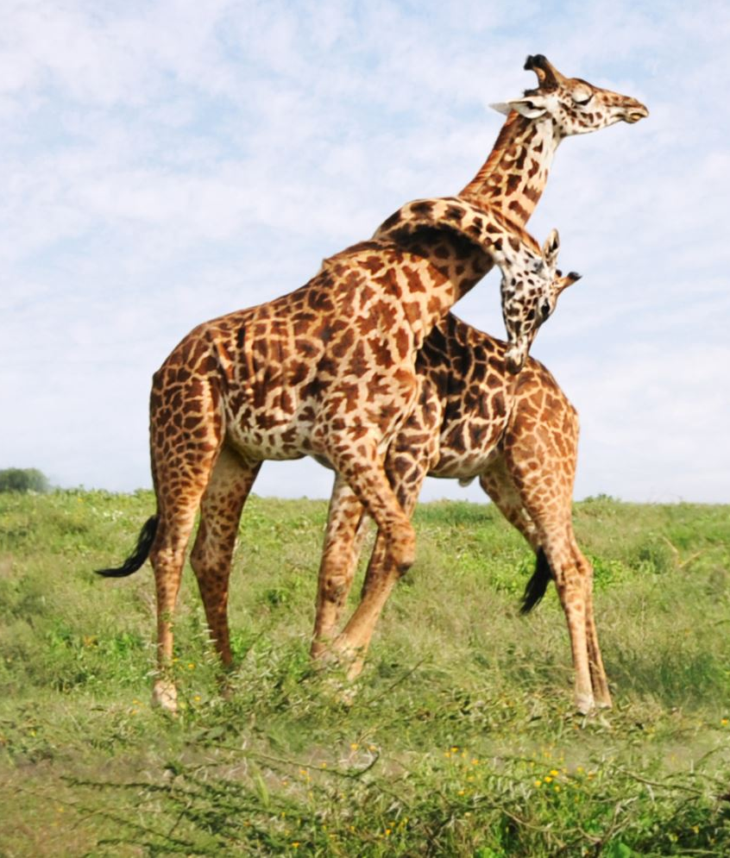
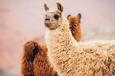
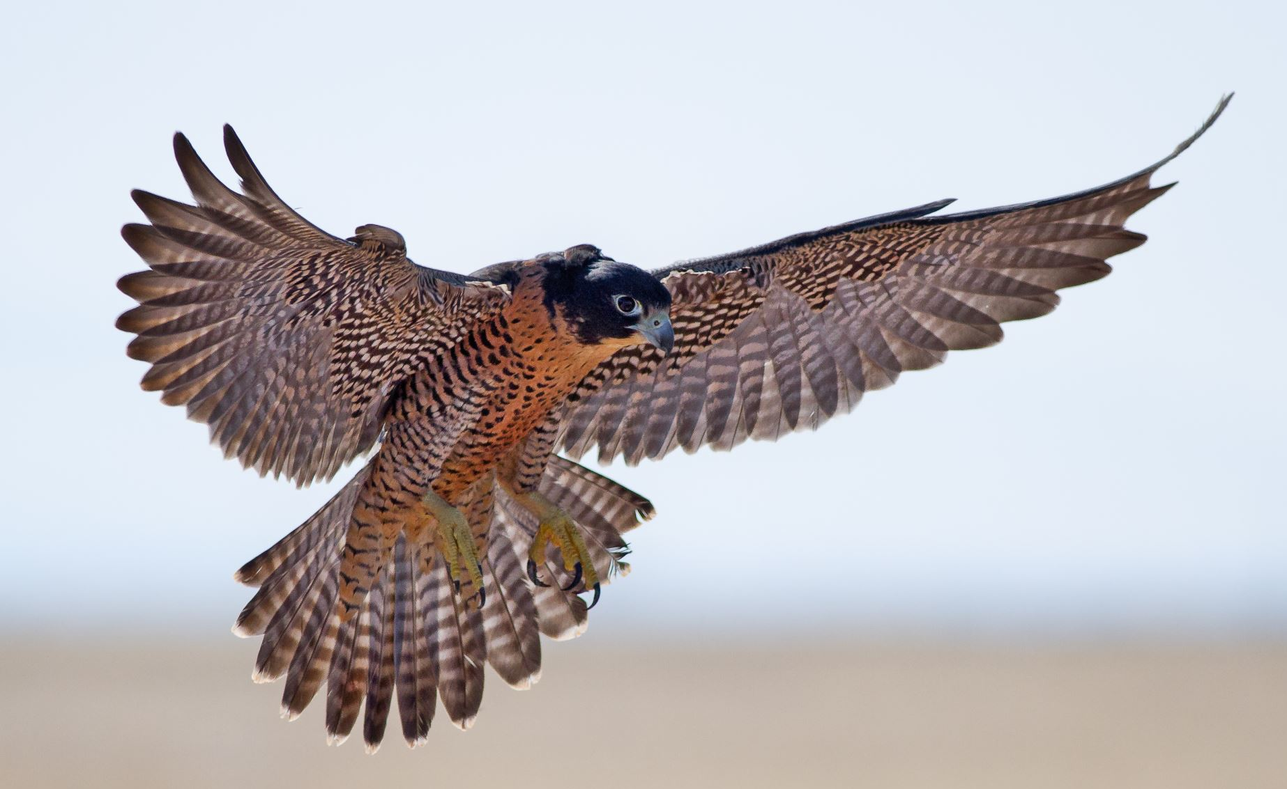
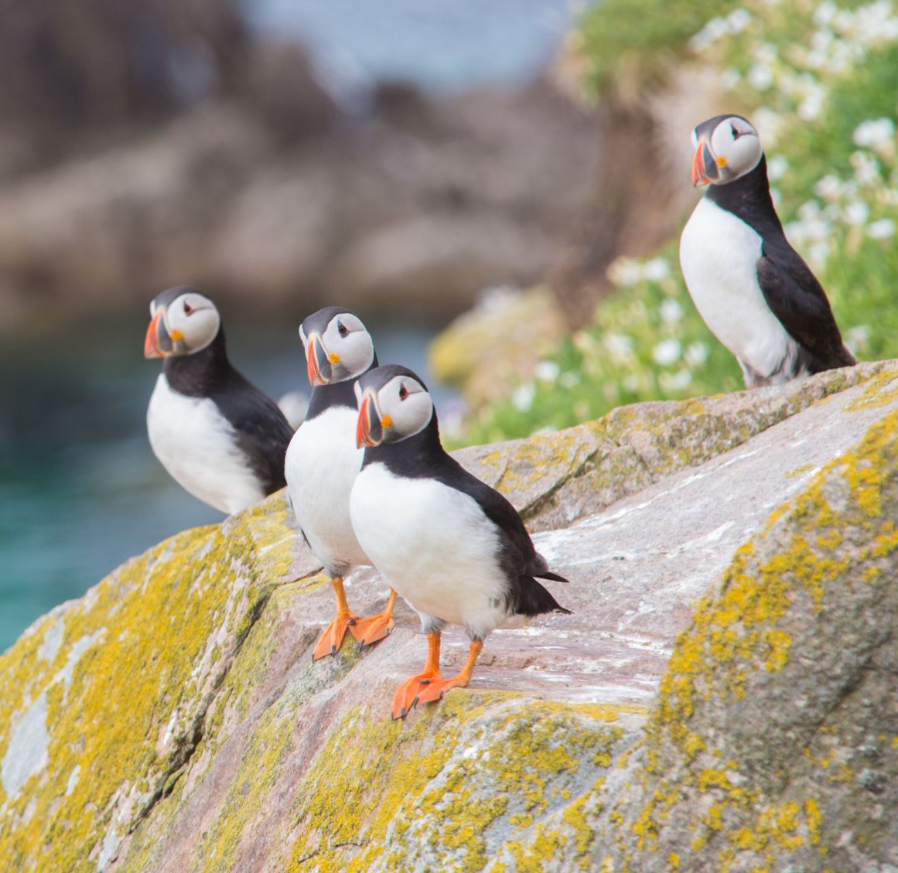

From Words to Numbers
Big
Bigger Dictionary
Giraffe
(.9, .9)
Llama
(-.9, .1)
A
An
And
At
Ate
Bark
Barked
Cat
Cats
Dog
Dogs
Eat
Eaten
A
An
And
At
Ate
Bark
Barked
Cat
Cats
Dog
Dogs
Eat
Eaten
A
An
And
At
Ate
Bark
Barked
Cat
Cats
Dog
Dogs
Eat
Eaten
A
An
And
At
Ate
Bark
Barked
Cat
Cats
Dog
Dogs
Eat
Eaten
A
An
And
At
Ate
Bark
Barked
Cat
Cats
Dog
Dogs
Eat
Eaten
A
An
And
At
Ate
Bark
Barked
Cat
Cats
Dog
Dogs
Eat
Eaten
…
…
…
…
Domestic
Wild
Falcon
(.15, -.4)
Kitty
(-.75, -.8)
Penguin
(.85, -.65)
Small
Notes:
That works well if we have a small dictionary size, but what if we have millions of words? That would result in us having millions of weights! One trick to handle this situation is to make something called an embedding. Let’s say we have a dictionary of animals and we want to represent them with two numbers. We might take two ways we can describe these animals like how domestic/wild they are and how big/small they are. We’ll assign an animal that’s totally domestic a -1 on the domestic/wild scale and assign an animal that’s totally wild a +1 on the domestic/wild scale.
This is called an embedding because we’re taking something that’s higher dimensional (all of our animals as categories) and mapping them in a smaller dimensional space. We’re using two descriptors here, so it’s a 2-dimensional embedding. If we used three descriptors like domestic/wild, big/small, and prey/predator, that would be a 3-dimensional embedding.
A long time ago, a group of linguists tried to do this exercise where they assigned values to word descriptors. Today, we can use neural networks.

Slide 13
From Words to Numbers
Inputs
Technically an Embedding
Outputs
Dictionary
A
A
An
An
And
And
At
At
A
An
And
At
Ate
Bark
Barked
Cat
Cats
Dog
Dogs
Eat
Ate
Ate
Bark
Bark
Barked
Barked
Cat
Cat
Cats
Cats
Dog
Dog
Dogs
Dogs
Eat
Eat
Notes:
Whenever we go from higher dimensional space down to lower dimensional space in our neural network, that’s technically an embedding. In other words, whenever we go from more neurons to less neurons, we’re creating an embedding. The number of neurons in the lower dimension is the embedding size.
These days, people often use transfer learning for word embeddings. This follows the results of recent research. In the lab today, we’ll be creating our own to see how it’s done.

Slide 14
Recurrent Neural Networks
Notes:
Cool, so we now know how to map our words to numbers. However, if we’re going to predict the next word of a sentence, we’ll need a way to capture the previous words used in a sentence.

Slide 15
Recurrent Neural Networks
“Cats say ___.”
Dictionary
“Dogs say ___.”
Cats
Dogs
Meow
Say
Woof
Notes:
Here, we’re trying to predict the third word of these sentences, but the first word of these sentences has a significant impact on those predictions.

Slide 16
Recurrent Neural Networks
“Cats say ___.”
Dictionary
Cats
“Dogs say ___.”
Dogs
Cats
Meow
Cats
Dogs
Meow
Say
Woof
Dogs
Say
RNN
Woof
Meow
Say
Outputs
Embedding
Woof
Inputs
Notes:
In order to keep this first word in memory, we’re going to create something called a Recurrent Neural Network, or RNN. It will make more sense when we see it in action, so let’s step through it with our cats example.

Slide 17
Recurrent Neural Networks
0
“Cats say ___.”
Dictionary
0
0%
“Dogs say ___.”
0
0%
50%
Cats
Dogs
Meow
Say
Woof
1
50%
0
RNN
0%
0
0
Outputs
Embedding
0
Inputs
Notes:
Let’s start off with our cat prediction. We’ll feed a 1 into the neuron that corresponds with cat, and like before, we’ll get a prediction on what the next word will be.

Slide 18
Recurrent Neural Networks
0
“Cats say ___.”
Dictionary
0
0%
“Dogs say ___.”
0
.1
-.5
.6
0%
50%
Cats
Dogs
Meow
Say
Woof
1
50%
0
RNN
0%
0
0
Outputs
Embedding
0
Inputs
Notes:
When we do this, the neurons in our RNN layer are going to have a numerical output just like a normal neuron does.

Slide 19
Recurrent Neural Networks
0
“Cats say ___.”
Dictionary
0
“Dogs say ___.”
0
.1
-.5
.6
1
Cats
Dogs
Meow
Say
Woof
0
RNN
0
0
Outputs
Embedding
0
Inputs
Notes:
We’re going to use this same output again when we feed in the next word for our sentence. In general terms, our networks learns that “Cats” at the beginning of the sentence has a specific meaning as opposed to during a different part of the sentence.

Slide 20
Recurrent Neural Networks
.1
“Cats say ___.”
Dictionary
-.5
“Dogs say ___.”
.6
0
Cats
Dogs
Meow
Say
Woof
0
RNN
0
1
Outputs
Embedding
0
Inputs
Notes:
We’ll reuse our network again for the next word, “say”. When we combine this with the encoding we have from “cats” …

Slide 21
Recurrent Neural Networks
.1
“Cats say ___.”
Dictionary
-.5
0%
“Dogs say ___.”
.6
-.3
.2
.5
0%
0
100%
Cats
Dogs
Meow
Say
Woof
0%
0
RNN
0%
0
1
Outputs
Embedding
0
Inputs
Notes:
We’ll get a new encoding in our RNN, and a new prediction for the next word in our sentence.

Slide 22
Recurrent Neural Networks
Input
Input
RNN
LSTM
Output
Output
Notes:
In the lab, we’ll be using an evolution of the RNN called the Long-Short Term Memory unit or LSTM. The difference is that the LSTM has its own set neurons that act as its own memory. The goal is to capture attention. If the LSTM is fed long paragraphs of text, it does a better job of remembering the key elements of that text.
If you’re curious to learn more about the math, check out this excellent animation breaking it down: https://www.youtube.com/watch?v=8HyCNIVRbSU

Slide 23
Other Architectures
Notes:
We’re getting close to the end of the class, so before we go, let’s go over how we can take our new skills further.

Slide 24
Autoencoders
Inputs
Outputs
Notes:
Autoencoders are a great next step after mastering embeddings as they’re closely related. Like embeddings, one of the goals is to take higher dimensional data and be able to represent it in a lower dimensional space. Here’s our strategy: we’re going to make a model that’s a mirror image of itself with a low number of neurons in the center. Then, we’re going to take our input and also use it as our output when training.
As an example, in the above, we’ve taken a flattened image, and we’ll train this model to output the same flattened image as what was inputted.

Slide 25

Autoencoders
Inputs
Outputs
Notes:
Why would we go through this complicated process if we’re just going to get the same thing as what we entered? Check out this magic. After we train the model, we’re going to cut it right after the middle…

Slide 26
Autoencoders
-.3
-.3
.6
.6
Encoder
Decoder
Notes:
And we’ll get an encoder and decoder. There are a couple of great uses for this. If our model is accurate, we can store large amounts of data with only a few numbers, and we can restore the original data if and when we ever need the raw data format.
The other use for this is for something called anomaly detection, which is useful in security, fault detection, and medicine. If we train an accurate autoencoder on lots of data, but there are some datapoints for which the output is significantly different than the input, then we might consider that an anomaly that we need to pay more attention to.

Slide 27
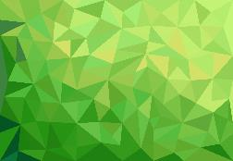

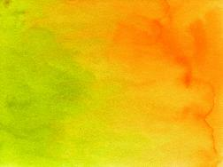



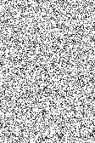





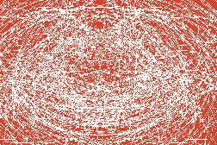
Generative Adversarial Networks (GANs)
Prediction
Real Images
Discriminator
Real
Fake
Generator
Noise
Fake Images
Notes:
Next up is Generative Adversarial Networks, or GANs for short.
This one’s interesting, we’re going to have two models. One is called the generator and one is called the discriminator. In a way, they’re fighting against each other, hence why they’re called "Adversarial" networks.
Let’s start with the discriminator. The goal of the of the discriminator is to determine if the input is real or not. Let’s say we want to make a model that can determine if a piece of art was a forgery or not. We’ve gone to our local art museum and they’ve given us many images of genuine paintings. The discriminator works just like the models we made earlier today: we’ll feed in an image, and it will return a prediction on whether the image is genuine or not.
However, we don’t have a lot of art forgeries. We’re the good guys, we don’t go to the black market very often, so we need a way to make forgeries so our discriminator has something to compare the real pieces of art against. This is where our other network, our generator, is going to come in. The generator is going to learn how to take random pixels, or “noise”, and it’s going to transform that noise into an art forgery. The way it learns is by how well it’s able to fool the discriminator. With enough data and training time, these fakes can get pretty good, fooling human eyes!

Slide 28
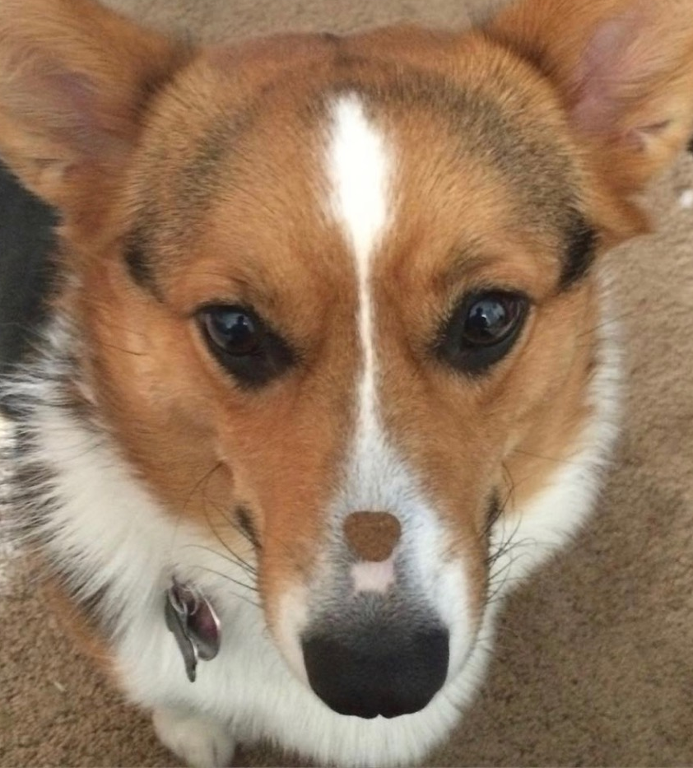


Reinforcement Learning
Agent
Environment
Notes:
The last architecture we’re going to talk about is Reinforcement Learning. Well, it’s less of an architecture and more of a clever way to use the machine learning models we learned how to make today. Reinforcement Learning comes from an idea from Psychology called delayed rewards: the idea that we can put off a reward now for a better reward later.
On the left here, I have a picture of my sister’s corgi trying very hard not to eat the treat on her nose. If you have a pet at home, you might recognize that it’s especially hard to teach them concepts that require a bit of time delay. This is something that humans are surprisingly good at. There’s a theory that we’ve given up our short-term reaction time to better be able to plan in advance.
In Reinforcement Learning, there are two systems at play: there’s the agent, or the intelligence that is trying to learn a skill, and there’s the environment that the agent needs to react to. People who work with Reinforcement Learning are both Data Scientists and Game Designers. Our neural network lives in the agent, where it will predict the best action to take given information about the environment. The environment can change given what the agent does, and that’s where being a Game Designer comes in. It’s quite tricky designing an environment that’s reflective of real-world conditions.
The neural networks in the agent are only a part of what we need to build the agent. We also need to give it memory so it can learn from past actions and a sense of curiosity so that it’s willing to try new things for the sake of learning.
Remember way way back to the beginning of this course when we talked about how humans learn versus how artificial intelligence learns? Much of that insight comes from Reinforcement Learning. The field is known for having applications in robotics and finance, but it’s also a great topic just to have a better appreciation for how humans learn. It takes time and patience to be able to learn a new skill, and those who are a little fearless and are willing to make mistakes in order to learn will have an easier time mastering a subject. Reinforcement Learning shows that our failures are as much a powerful teaching tool as our successes. So genuinely, congrats on making it through the class today. If it was easy for you, that’s great! But if it was hard, that’s fine too. By taking on the challenge, there is a bigger opportunity to learn.

Slide 29
Closing Thoughts
Notes:
Before we end lecture, let’s do a quick thought experiment in order to appreciate computer intelligence a little more.

Slide 30
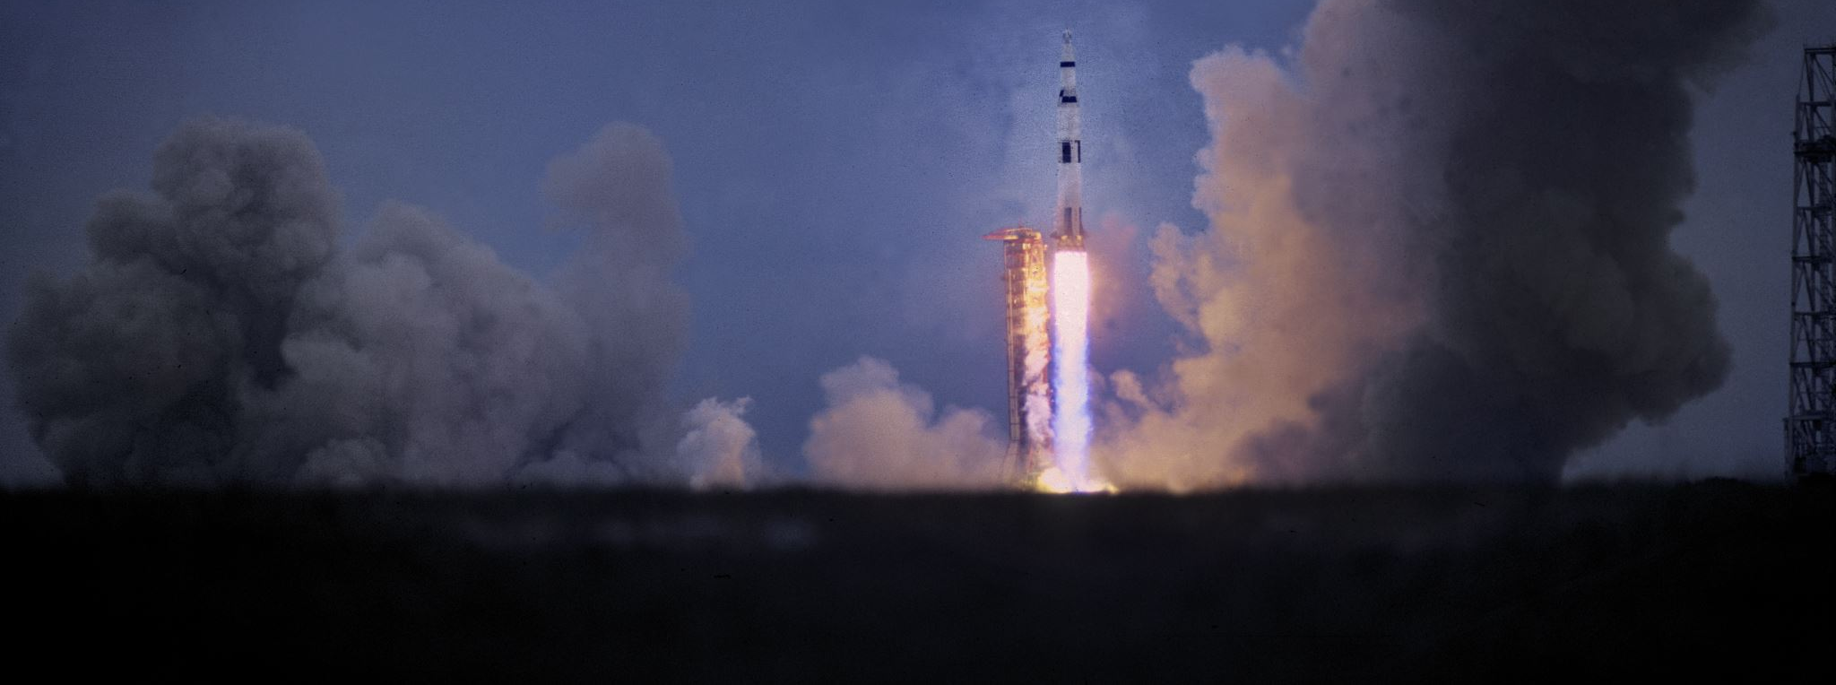
Copying Rocket Science
Notes:
Let’s say there’s a person locked away in a room where people slip equations related to Rocket Science under the door. The person in the room doesn’t know anything about Rocket Science, but they have a list of instructions to follow depending on the symbols on the paper slipped to them. The locked person follows the instructions and returns the solutions on a piece of paper back under the door. The locked person acts like a computer, following a list of instructions with an output, and the people outside the room, none the wiser, believe that the locked person is a Rocket Scientist.
My question to you is, where does mimicry end and understanding begin? When humans first learn how to do math, it’s done by copying, such as memorizing our times tables. We can debate all day on where that line is drawn but the point is this:
The greatest breakthroughs in AI are from people who not only understand computers, but can mathematically express how humans think. See if you can define “understanding” in a way that a computer can interpret, and you will help it grow from mimicry to understanding.
https://plato.stanford.edu/entries/chinese-room/

Slide 31
Let’s get Started!
Notes:
That’s all for now. Thank you for joining us.
Alright, last lab! Best of luck!

